Slide 1
Team no -11
.

Slide 2


Slide 3
Team SAARF

Slide 4
What is HealthTech Care?
Progressively utilized in the medical care sector
Upgrade the service and reduce costs
Emergency services with full potentiality
e-Pharmacy
Equal Gender opportunities
Elderly Health Care
Nurse Service
Decentralization of medical Heath Care

Slide 5
Less is more

Slide 6
Key Features -
Emergency services
Rural health care
Pharmacy services
Elderly heath care

Slide 7
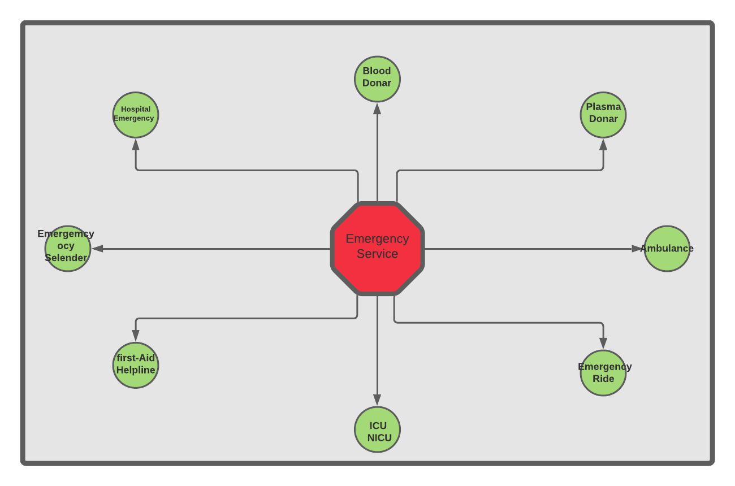

Slide 8
Elderly Health Care
Health checker Board
Nurse Service
Diet Chart
Offline Services

Slide 9
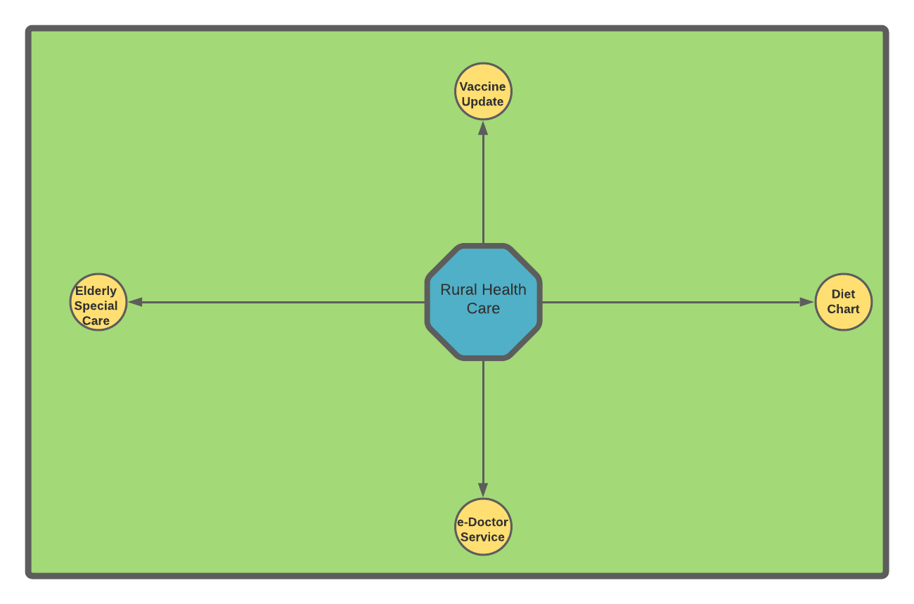

Slide 10
E-Pharmacy Service
Order medicine
Buy-sell
Home delivery

Slide 11
Revenue
Token Money
Private company Collaboration with govt
Cost mitigate proposal
Exchange Service
Long Term Impact
Stake holders
Govt /Non-Govt Fund
Website

Slide 12
Marketing Plan
01
02
03
Offline Cmpaing
Health Insurance
Service exchange of hair / plastic
04
05
06
Rural Hospitals
Volnteers
Online Marketing
Rural Areas
Futuer plan
Alternative of money
Targated marketing place
(student ,men ,women ,transgender )
You can describe the topic of the section here

Slide 13
Long term revenue calculation
-→1 village
→50 family
→70 elderly
50 taka token money
1 month -------------------------50*70 = 3500 taka
12 month ------------------------3500*12= 42000tk
5 years ---------------------------42000*5= 210,00 tk

Slide 14
Our target
Piloting in 3 rural areas
Estimated – 210,00*3 = 630,00 bdt

Slide 15
Costing during offline campaing
cost Offline Volunteerc cost Doctor Cost Rural Campaing
Cost online
Marketing

Slide 16
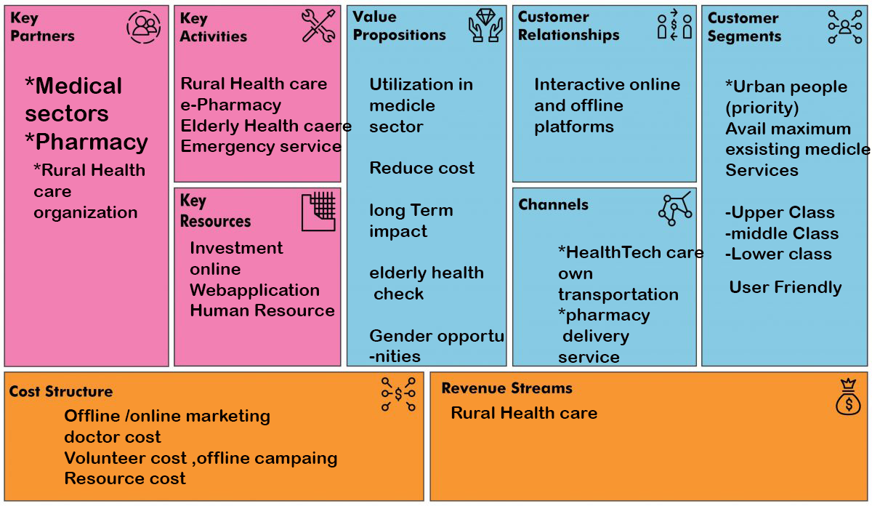

Slide 17
Thank you
.
.
.
.

