Slide 1
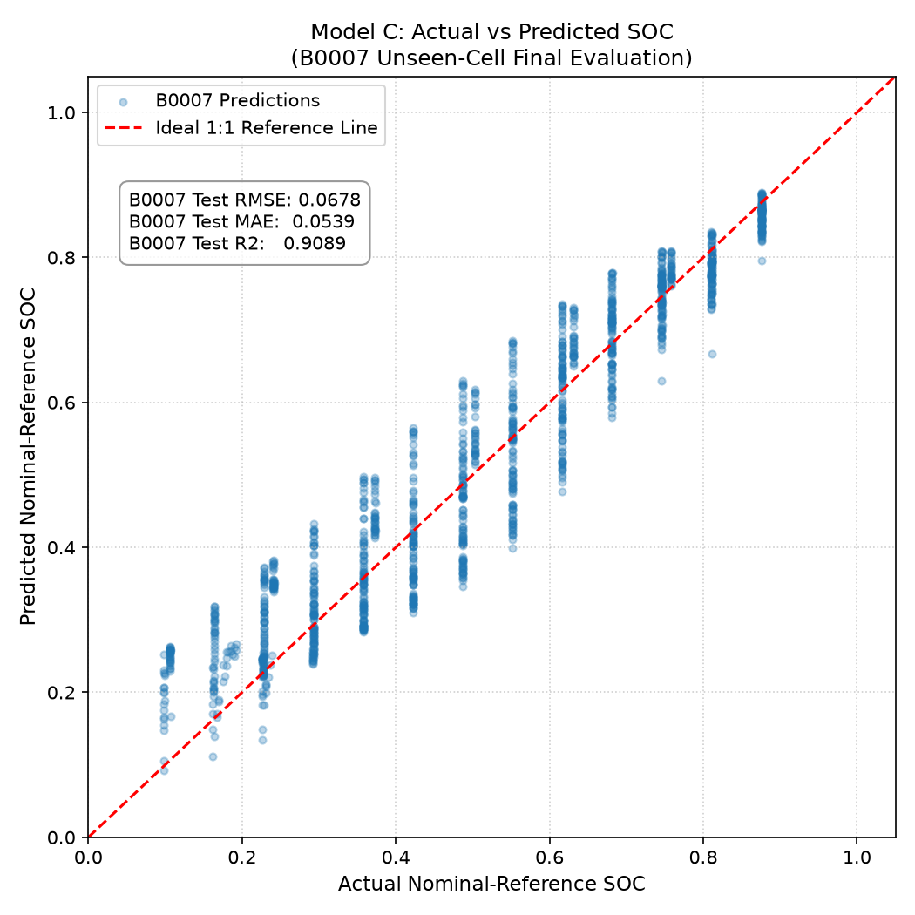
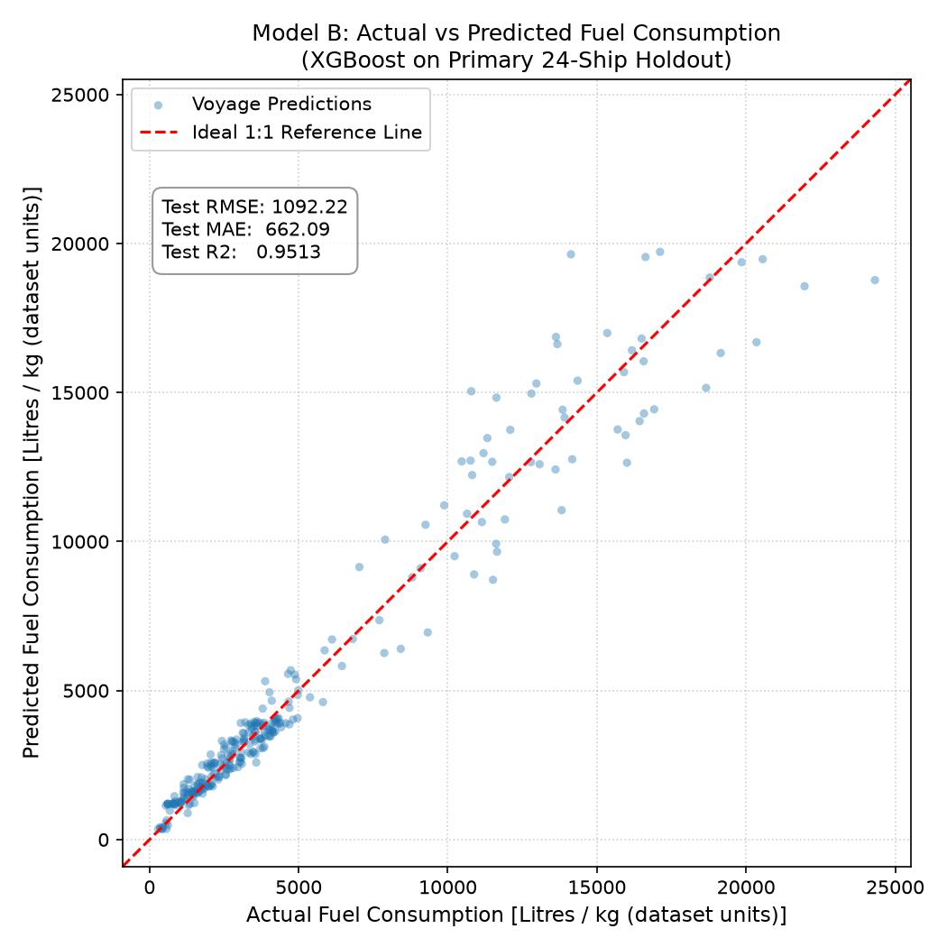
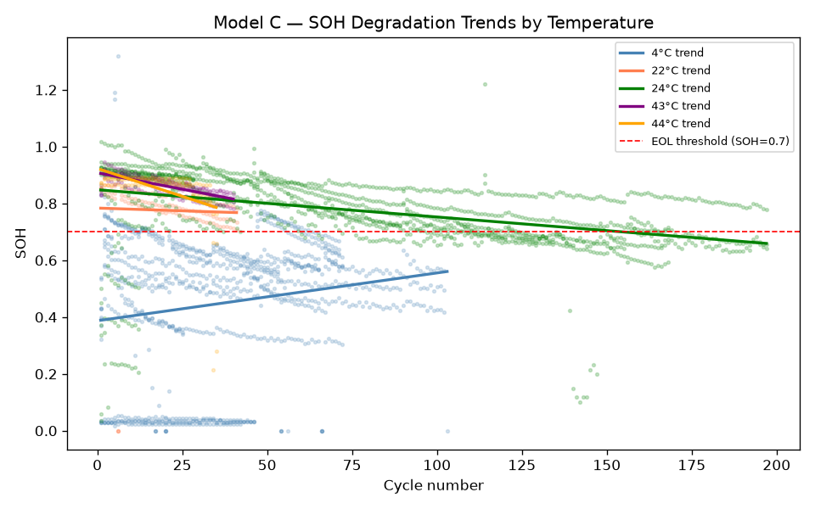
St. Vincent
Pallotti
College
of Engineering
& Technology
Nagpur
St. Vincent Pallotti College of Engineering & Technology, Nagpur
Department of Computer Science and Engineering (Data Science)
Academic Session 2025–26
MARITIME GRIDS
Integrated Maritime Voyage Simulation, Energy Modeling, Optimization and Decision Support
ARISE
&
SHINE
Guide: Dr. Manish Gudadhe Team: Chinmayakumar Shegokar | Prajakta Timande | Tanushri Tonde | Vuha Modala
ABSTRACT
COMPLETE SYSTEM ARCHITECTURE
PROJECT OUTCOMES
Maritime voyage operations require simultaneous management of vessel dynamics, route geometry, environmental conditions (wind, waves, current), fuel and energy consumption, battery behavior, and regulatory compliance. These are typically handled in isolation, creating fragmented decision-making.
Maritime Grids provides an integrated engineering platform combining physics-based voyage simulation, environmental forecast processing, fuel and hybrid energy modeling, multi-objective optimization, IMO/CII emissions analysis, and human-in-the-loop decision support via the Signal Agent.
A Native Virtual Maritime Simulator demonstrates the pipeline end-to-end on the Escravos Terminal → Lagos Port route (250 NM), verified through 975 automated tests.
MARITIME & ENVIRONMENTAL DATA
PO1 — Integrated Maritime Data
Environmental, route & vessel data unified.
PO2 — Physics-Based Voyage Simulation
Virtual vessel coupled with environmental
conditions, dynamics & energy models.
PO3 — Engineering Intelligence
Sizing, speed, sensitivity, break-even,
grid & fleet-level analyses.
PO4 — Regulatory & Emissions Analysis
Voyage → CII trajectory via MEPC.353/354(78).
PO5 — Operational Decision Support
Signal Agent: weather, fuel, battery, CII
advisories — human review required.
PO6 — Verified Integrated Platform
975 automated tests + browser acceptance.
• Weather / Wind / Waves / Ocean Current
• Temp · Humidity · Pressure · Solar/GHI
• Route Data · Vessel Parameters
▼
DATA ENGINEERING
• Ingestion · QC · Validation
• Spatial Processing
• Temporal / Route Alignment
▼
ENVIRONMENTAL INTELLIGENCE
• Weather Forecast · Route Lookahead
• Adverse Weather Detection
• Open-Meteo API + Mock Provider
▼
MARITIME PHYSICS
PROBLEM STATEMENT
• Vessel Dynamics · Resistance
• Environmental Forces
• Propulsion Power · Speed
VERIFICATION & RESULTS
Maritime voyage planning requires simultaneous
consideration of:
• Vessel characteristics & route geometry
• Wind, waves & ocean current forces
• Fuel consumption & hybrid energy behavior
• Battery SOC / SOH evolution
• Voyage duration, ETA & progress
• CO₂ emissions & CII/regulatory obligations
• Economic & engineering trade-offs
These aspects are often handled separately.
Maritime Grids integrates them into one
unified engineering decision platform.
▼
ENERGY & FUEL MODEL
975 TESTS PASSED
• Fuel Consumption — XGBoost (Model B)
• Battery SOC — LSTM (Model C-SOC)
• Battery SOH — HGB · Solar / GHI
▼
Frontend 65 / 65
Backend 910 / 910
VOYAGE SIMULATOR
• Position · SOG / STW · Heading
• Distance · Progress · ETA
• Native Virtual Maritime Simulator
✓ Native simulator movement verified
✓ Route progress & distance accumulation
✓ ETA calculation verified
✓ Weather synchronization verified
✓ Signal Agent advisory chain verified
✓ Engine provenance integrity verified
✓ Map & telemetry synchronization
✓ Fuel / battery evolution verified
✓ Pause / reset cycle verified
✓ Engineering Workbench preserved
✓ 6,228 raw data files validated
✓ 0 actuator commands confirmed
ENGINEERING
WORKBENCH
▼
SIGNAL AGENT
DECISION SUPPORT
OBJECTIVES
• Voyage Simulation
• Sizing Evaluation
• Sizing Optimization
• Speed Co-Optimization
• Sensitivity Analysis
• Break-Even Analysis
• 2D Grid Analysis
• Fleet Portfolio
• CII Trajectory
• Scenario Dossier
• Weather Alerts
• Fuel Alerts
• Battery Alerts
• CII / Regulatory
• Decision Not Ready
• Human Review
• human_review
required = True
O1 Integrate maritime, environmental, vessel & route
data into a common engineering platform.
O2 Model vessel movement using physics-based
maritime simulation.
O3 Estimate fuel, propulsion power & hybrid energy
(battery + solar) behavior.
O4 Evaluate vessel sizing, speed & energy trade-offs.
O5 Perform optimization, sensitivity, break-even &
fleet-level engineering analysis.
O6 Analyze emissions & CII/regulatory implications
of voyage scenarios.
O7 Provide human-in-the-loop operational decision
support via Signal Agent & Driver Dashboard.
ENGINEERING WORKBENCH
▼
Voyage Simulation
DRIVER DASHBOARD + ENGINEERING WORKBENCH
Sizing Evaluation
▼ HUMAN DECISION ▼
Sizing Optimization
Speed Co-Optimization
Sensitivity Analysis
Break-Even Analysis
2D Grid Analysis
Fleet Portfolio
CII Trajectory
ENVIRONMENTAL INTELLIGENCE
Scenario Dossier / Export
Environmental inputs processed by Maritime Grids:
• Wind Speed & Direction (m/s, degrees)
• Significant Wave Height & Period
• Wave Direction
• Ocean Current Speed & Direction
• Air Temperature & Relative Humidity
• Atmospheric Pressure
• Solar Irradiance / GHI (Climatological Est.)
Provider: Open-Meteo Forecast API + Mock Provider
Route Lookahead: Future waypoints evaluated
ahead of vessel position for adverse conditions.
Threshold logic:
Wind > 25 kn → MET_WIND_HIGH_001
Waves > 2.5 m → MET_SEA_ROUGH_002
Ahead adverse → MET_AHEAD_ADVERSE_001
Simulation → Analysis → Optimization → Decision
SIGNAL AGENT — HUMAN-IN-THE-LOOP
Vessel State + Weather + Fuel + Battery
+ Route Lookahead + Regulatory State
▼ SIGNAL AGENT ▼
NORMAL
WEATHER ALERT
FUEL ALERT
ENVIRONMENTAL INPUT
FORECAST / MODEL DATA
Weather · Waves · Current
SIMULATOR OUTPUT
SIMULATED / DERIVED
Position · SOG · Fuel · SOC
BATTERY ALERT
REGULATORY / CII ALERT
▼ HUMAN REVIEW ▼
MARITIME PHYSICS MODEL
Signal Agent does NOT control the vessel.
All advisories require human review.
Wind + Waves + Current
↓ Environmental Forces Applied
Hydrodynamic Resistance Calculated
↓
Required Propulsion Power Derived
↓
Ship Speed / SOG Determined
↓
Fuel Rate & Energy Consumption
The simulator applies physics to calculate vessel
behavior — not a simple icon-moving simulator.
Each step: Resistance → Power → Fuel → SOC.
IMO / CII / EMISSIONS ANALYSIS
Voyage + Speed + Fuel Consumption
↓ CO₂ Emissions Derived
CII = CO₂ × 1000 / (DWT × distance NM)
↓ Rating: A / B / C / D / E
MARPOL Annex VI Regulation 28:
Statutory Z% Schedule 2023–2026:
5% → 7% → 9% → 11%
Reference Line: MEPC.353(78)
Rating Bands: MEPC.354(78)
Multi-year CII trajectory simulation.
Clean-energy assisted compliance extension.
No official regulatory certification claimed.
ML / ENGINEERING MODELS — VERIFIED METRICS
Model B — Fuel Consumption (XGBoost, ship-holdout):
R² = 0.9513 RMSE = 1092 L MAE = 662 L
CO₂ RMSE = 3310 kg, R² = 0.9423
Model C-SOC — Battery State of Charge (2-layer LSTM):
B0007 Unseen-Cell Test: R² = 0.9089 RMSE = 0.0678
Model C-SOH — Battery State of Health (HistGradBoost):
Val R² = 0.9028 Test RMSE = 0.0397 (B0007)
Model A — Weather Classifier:
Honest result: No ML model exceeded majority-class
baseline (34.72%). Majority class selected.
FUEL · BATTERY · SOLAR
TELEMETRY & BRIDGE COMMAND
FUEL (Physics / Model-Derived):
Shaft/propulsion power → fuel rate
Fuel consumed & remaining tracked
Speed-dependent & resistance-adjusted
XGBoost fuel model (R² = 0.9513)
BATTERY (Simulated / Model-Derived):
SOC — 2-layer LSTM (R² = 0.9089 on B0007)
SOH — HistGradientBoosting (Test R² = 0.6308)
Usable energy = Capacity × SOH
Pack topology: 96S×nP per vessel profile
SOLAR (Climatological / Scenario Estimate):
NASA POWER monthly GHI data
Solar area × panel efficiency × GHI
Auxiliary hotel-load coverage modeled
Labeled as scenario estimate, not live data
Bridge Command 5.11.0 (Read-Only Standby)
NMEA 0183 UDP → Port 10110
$GPRMC · $GPGGA · $GPHDT · $GPVTG
NMEA Adapter → CanonicalTelemetryPayload
Telemetry Gateway → SSE/REST → Dashboard
Live evidence: SOG=5.0 kn · COG=90° confirmed
Native Simulator = Primary Demonstration
Bridge Command = Optional / Read-Only Standby
Port 10111: 0 connections (read-only verified)
⚠ SAFETY BOUNDARY
✗ 0 External Actuators
✗ 0 External Control Commands
✓ Read-Only Operational Integration
✓ Human Review Required for All Advisories
✗ No Autonomous Steering
✗ No Autonomous Throttle
✗ No Autonomous Engine Control
APPLICATIONS
• Voyage planning & vessel performance analysis
• Fuel optimization
• Hybrid energy planning (battery + solar)
• Weather-aware voyage analysis
• Vessel sizing engineering
• Speed & fleet optimization
• Emissions / CII scenario analysis
• Operational decision support
Maritime Grids | Integrated Maritime Simulation & Engineering Intelligence Platform | St. Vincent Pallotti College of Engineering & Technology, Nagpur | 2025–26
FUTURE SCOPE
• Larger route library
• Additional vessel profiles
• More real-world telemetry sources
• Advanced ML weather forecasting
• Expanded environmental datasets
• Additional optimization objectives
• Larger fleet-scale simulations
• Additional regulatory scenarios
• Real-time AIS integration (read-only)

