Slide 1
DSC 465
Team 47:
Monisha Arunachalam
Jorge Fernandez
Sanjana Gowda Hetthur Chandrashekar
Saiyed Irfanullah
Alejandra Rodriguez

Slide 2
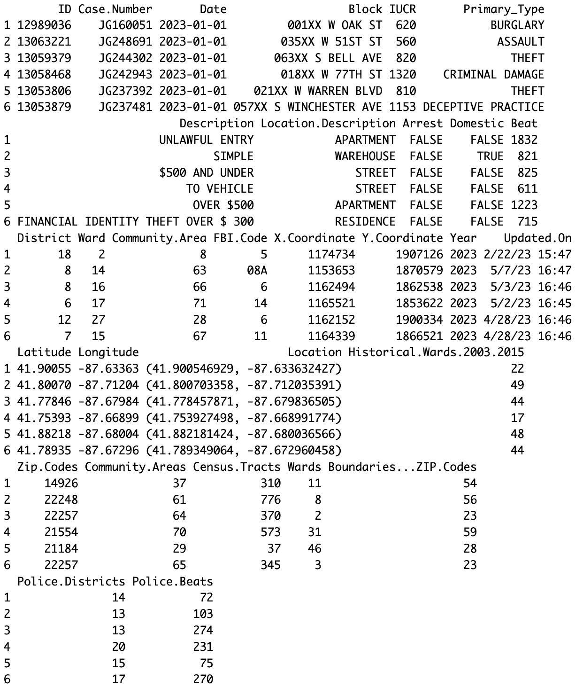
Introduction
Chicago Crime Data
Source: https://data.cityofchicago.org/Public-Safety/Crimes-2001-to-Present/ijzp-q8t2
This dataset containing 1,048,575 observation with 30 variables provides comprehensive information on criminal incidents reported in Chicago, Illinois.
It offers valuable insights for analyzing crime patterns and facilitating evidence-based decision-making.
It encompasses a wide range of attributes including incident details, location, time, and classification.

Slide 3
Exploratory Analysis
Created multiple kinds of exploratory visualizations for the Chicago Crimes dataset based on given variables (Crime Type, Arrest, Location, Building Type/Street)
Counts of Crimes by type
Crimes and the arrest rates
Variation between types of crime
Hotspots of crime based on location

Slide 4
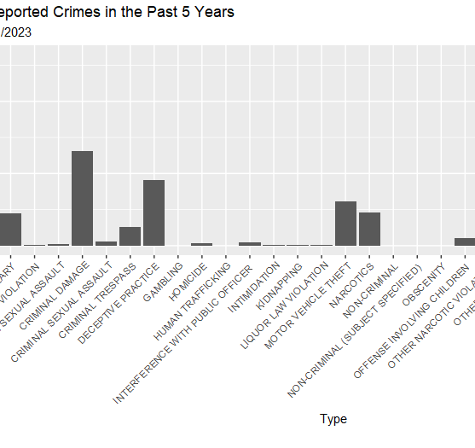
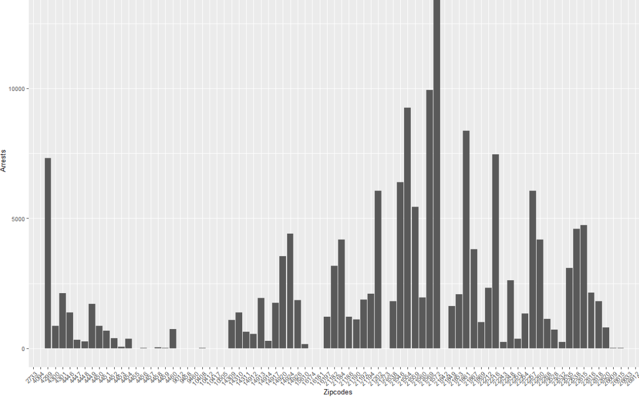
Exploratory Visualizations
Counts of the types of crime like Theft, Battery, Assault, and Damage/Trespass
Attempting to use location information to find trends for crime

Slide 5
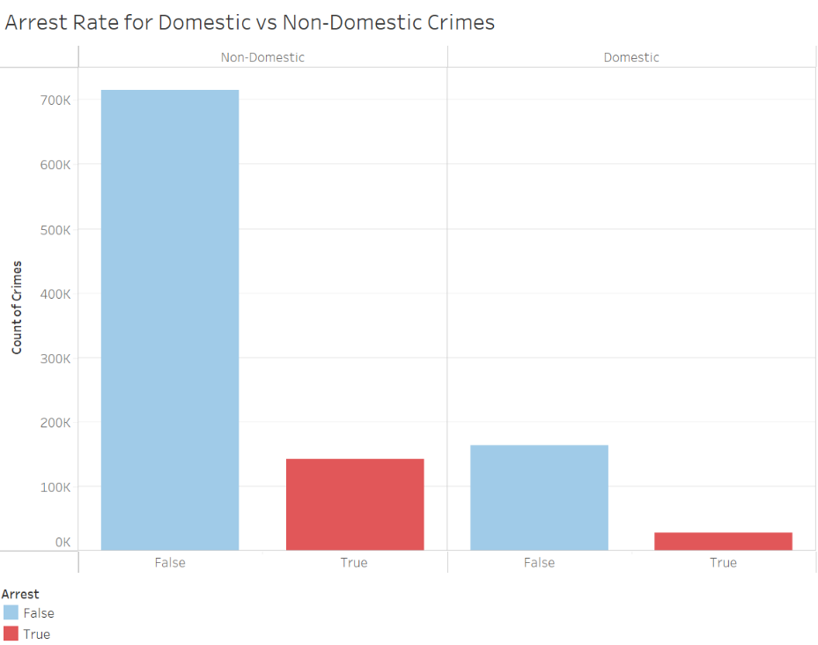
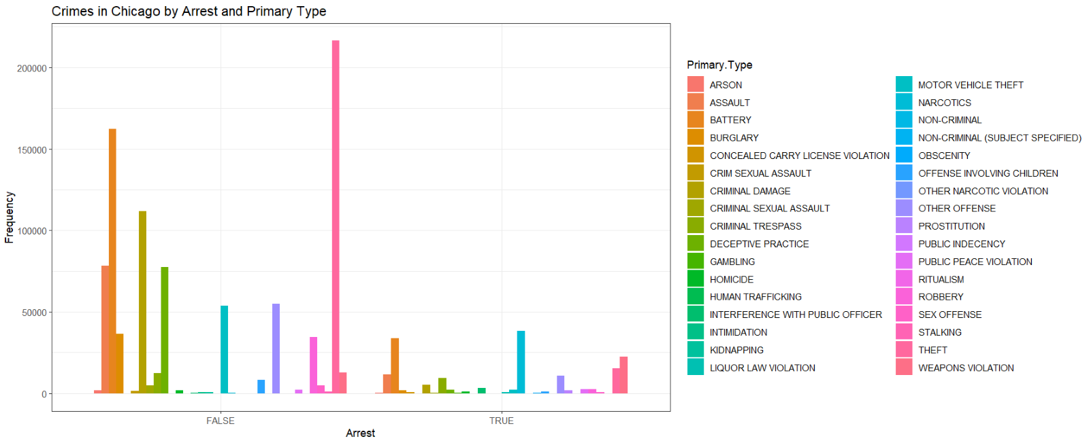
Exploratory Visualizations
Viewing the count of Crimes and the arrest rates associated with them
Does a particular type of crime come with a higher arrest rate

Slide 6
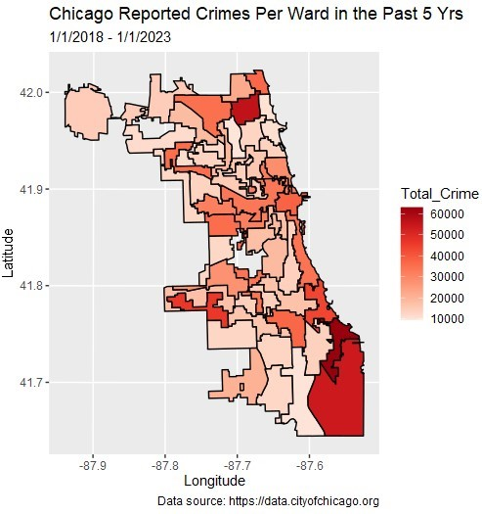
Better Exploratory Visualizations
Viewing the total crime by ward in Chicago
Using a shape file to create the base of the cartogram
Highlights the wards of the city where crime is higher and can be attributed

Slide 7
Visualizations

Slide 8
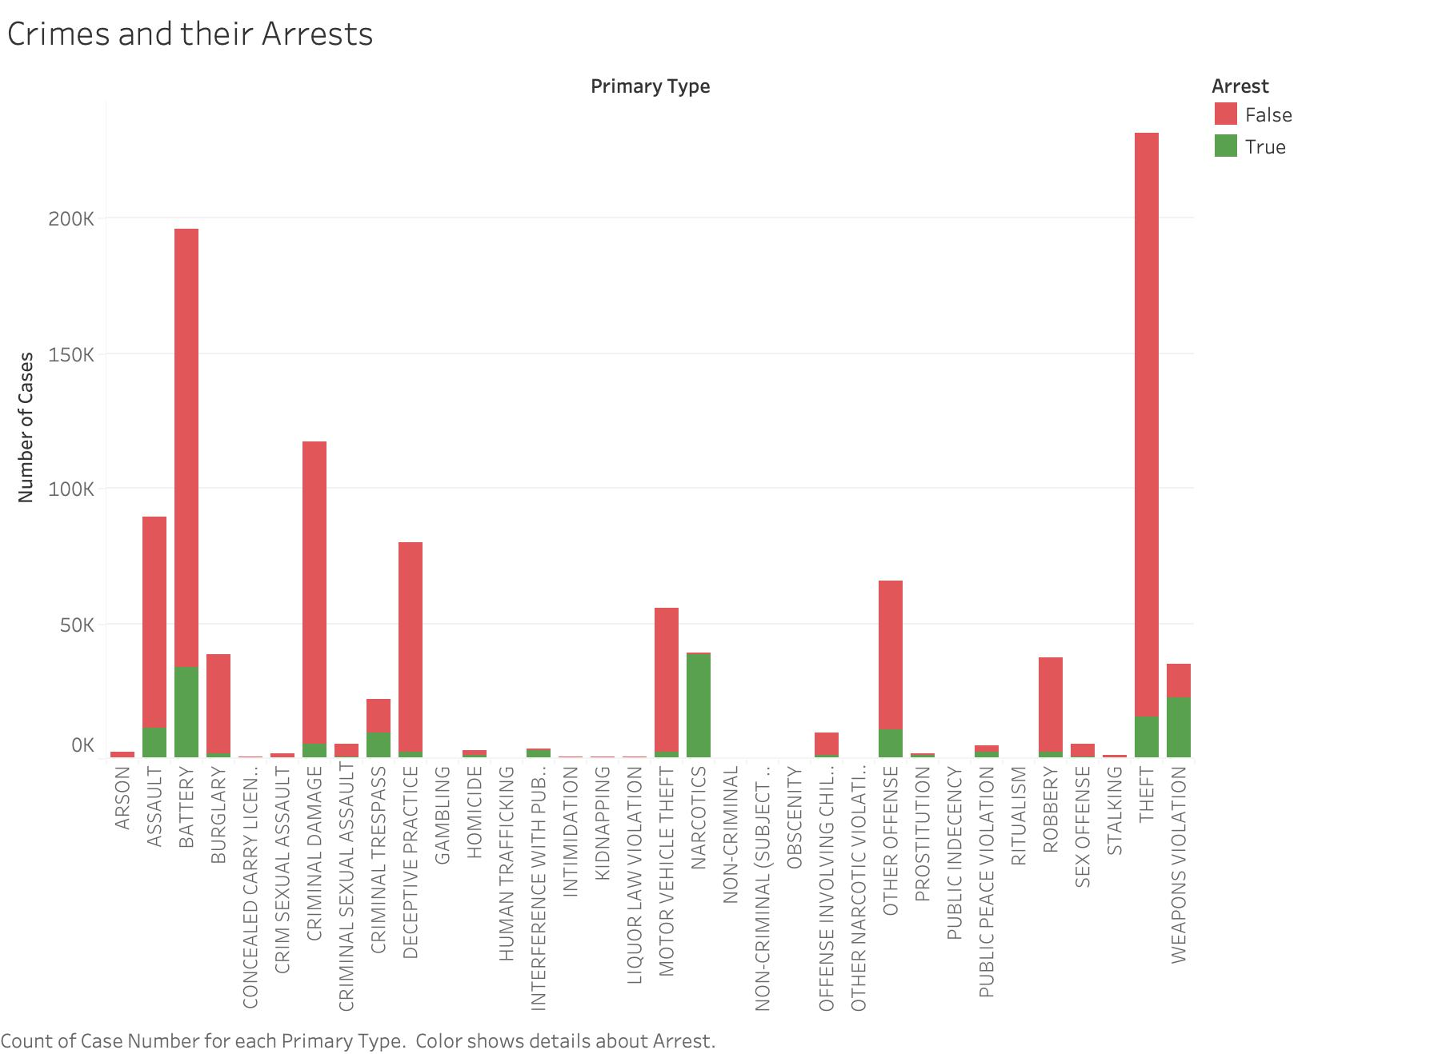
The stacked bar graph represents the number of cases of different types of crimes, with the y-axis representing the count of cases and the x-axis displaying the types of crimes.
The bars are stacked to show the total count of cases for each crime type.
This visualization provides an overview of the distribution of crime types and allows for a comparison of arrest rates across different types of crimes.

Slide 9
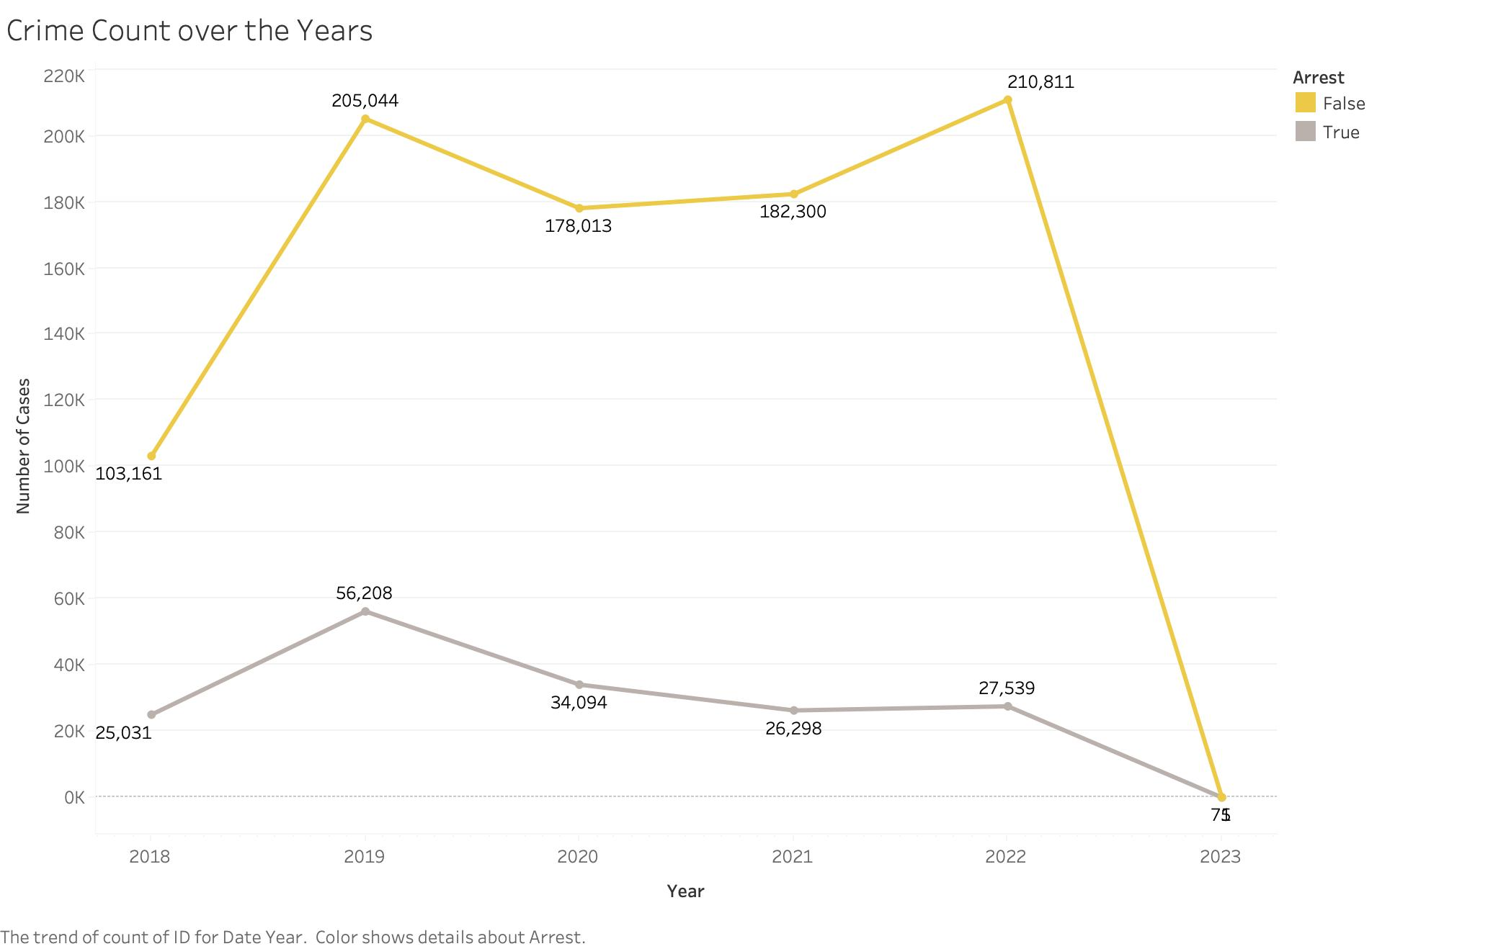
The crime count from 2018 through 2023 is depicted in the time-series line graph.
A visual depiction of the variation in crime events over time is provided by the graph, allowing for an analysis of the overall trend.
By looking at the line graph, one can spot any patterns, peaks, or falls in crime activity through time, which helps one comprehend the overall state of crime within the given time period.
*Note that 2023 only includes January 1st, 2023

Slide 10
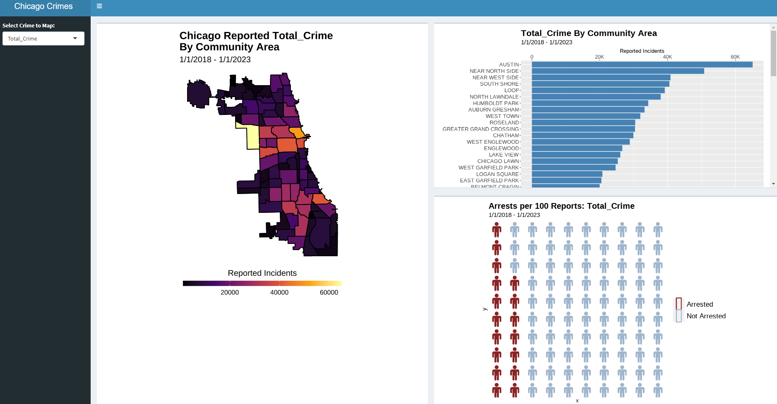
Interactive Dashboard:​
Crime by Community Area Choropleth & Bar Chart​
Arrest Rate Waffle Chart

Slide 11
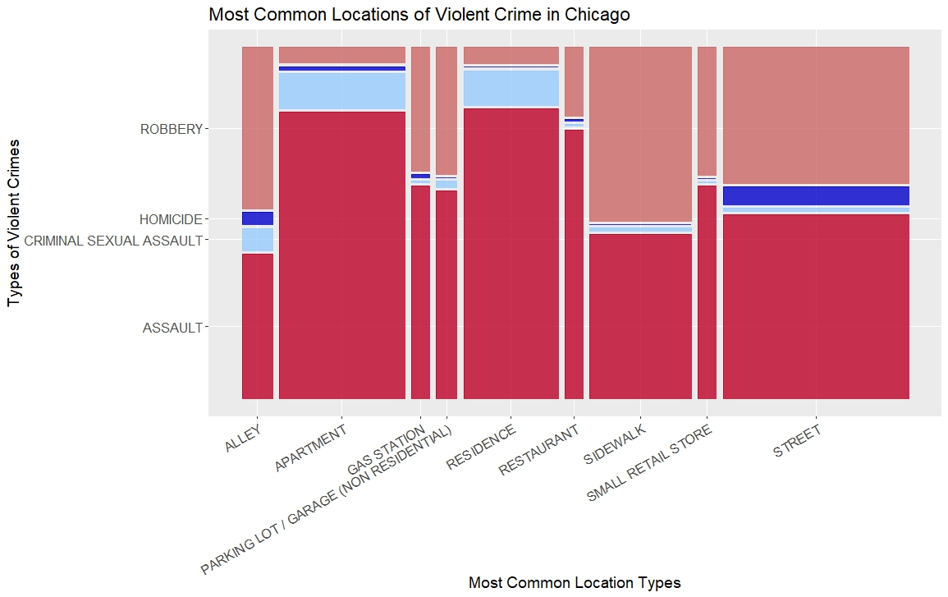
Mosaic Plot
Quick overview of the distribution of violent crimes across the most commonly reported locations
Assault and robbery make up the largest portion
Highest density of reported crimes takes place in street settings
Notes:
Street, Apartment, Sidewalk, Residence

Slide 12
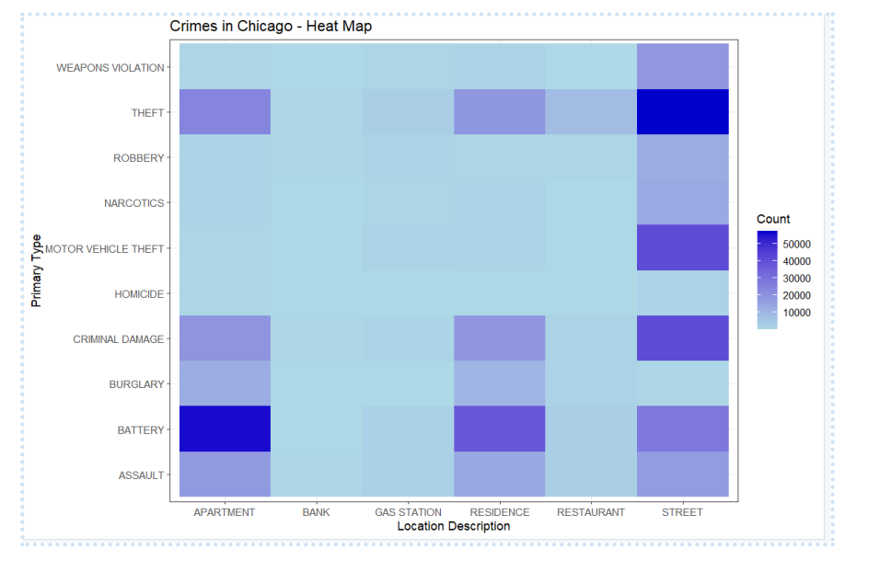
This heat map demonstrates the severity of crimes in specific areas. This helps us understand which categories of crimes are most common there to be treated. This information is crucial for wisely allocating police resources, identifying areas that need closer observation, putting in place focused crime prevention measures, and developing specific intervention strategies.

Slide 13
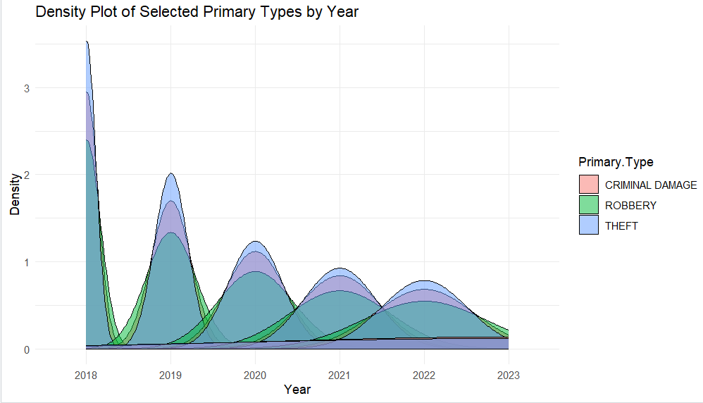
The density plot is a visual depiction that demonstrates how the number of crimes is spread out throughout several years. It helps us understand the pattern or trend in the frequency of crimes over time. The density of crimes for each year is represented by the shaded region on the plot. The higher the number of crimes for that specific year, the darker or thicker the darkened area. Less dense areas are those that are lighter or thinner.

Slide 14
Analysis
LOCATION
The most common location of reported crimes is on the street
Areas with the most reported crimes: Austin, Near North Side, Near West Side
CRIME TYPES
Assault and robbery are the two most common violent crimes
Battery is most common in apartments
Theft is most common in street settings
TIME TRENDS
Between 2019 and 2022 crime counts stayed within 15 percentage points of the previous year
Overall arrest counts have been exhibiting slight decreases and the current arrest to reported crime ratio is low

