Slide 1
Setting Up GEE

Slide 2
Step 1:
GEE Registration
1) Visit https://signup.earthengine.google.com/
2) Sign-up with your Google account
3) After signing up, you should obtain the approval instantaneously or within minutes

Slide 3
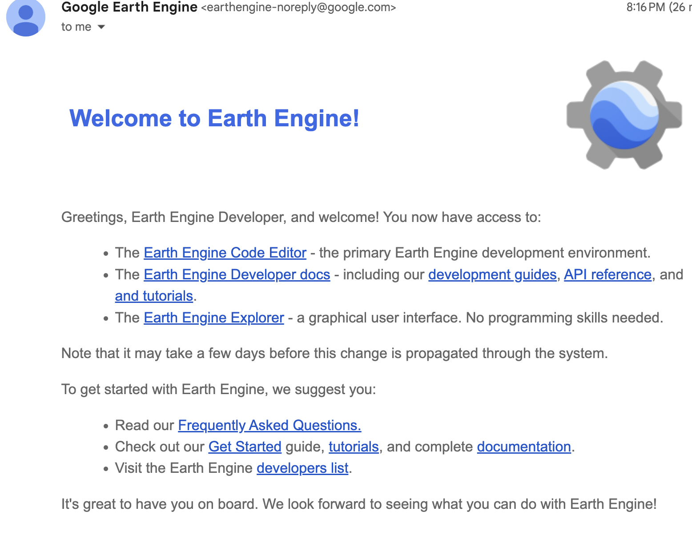
Step 1
GEE Registration

Slide 4
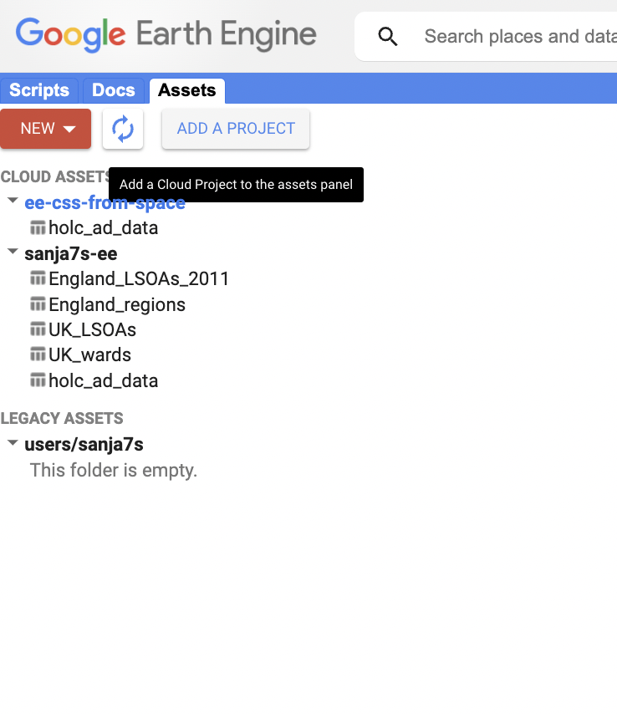
Step 2
Creating an EE project
Go To:
https://code.earthengine.google.com
Select Tab “Assets”
Click:
ADD A PROJECT

Slide 5
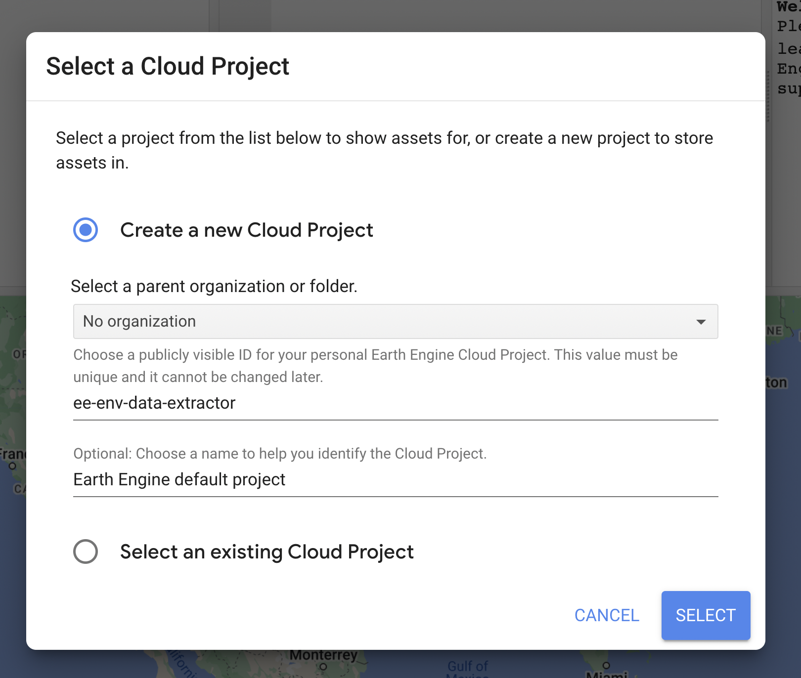
Step 2
Creating an EE project
Click Create a new Cloud Project
*This project name you will later use
in Colab Notebooks.

Slide 6

Step 3:
Place this folder, i.e.,
code/collate_data/environmental_data_extractor
to Your Drive
e.g., drive/MyDrive/your_project_folder

Slide 7
Step 4: GEE Assets
Upload LSOA/Region Data from
data/auxiliary_data to
To your GEE Assets on
https://code.earthengine.google.com/

Slide 8
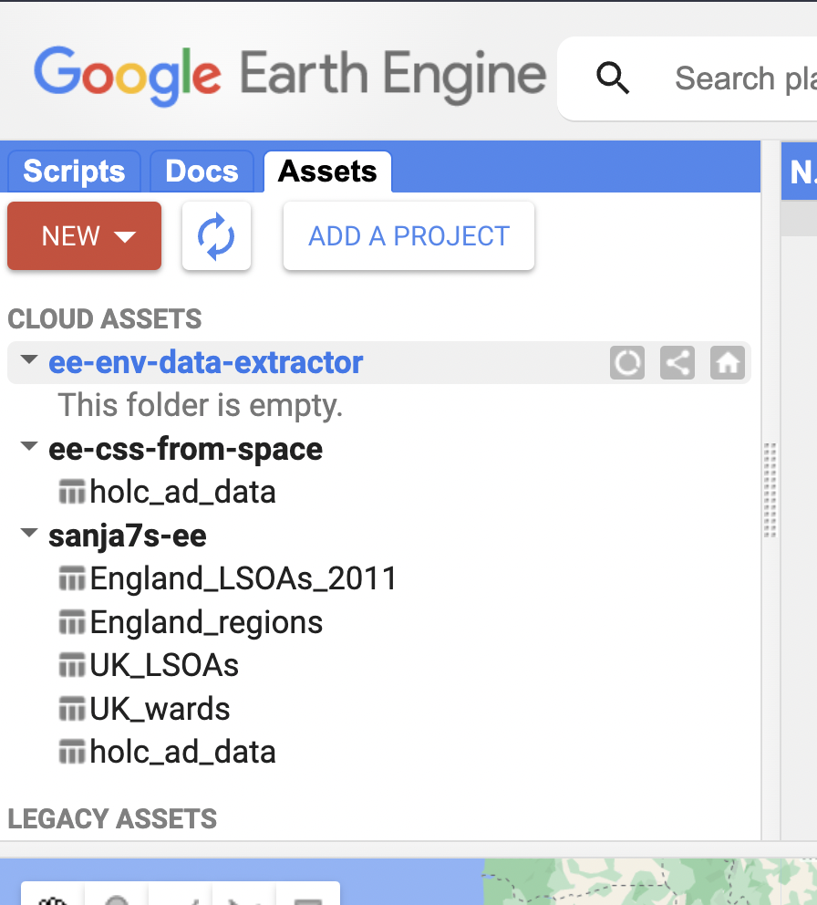
Step 4: GEE Assets
https://code.earthengine.google.com/
Select your newly created project
and then choose NEW

Slide 9
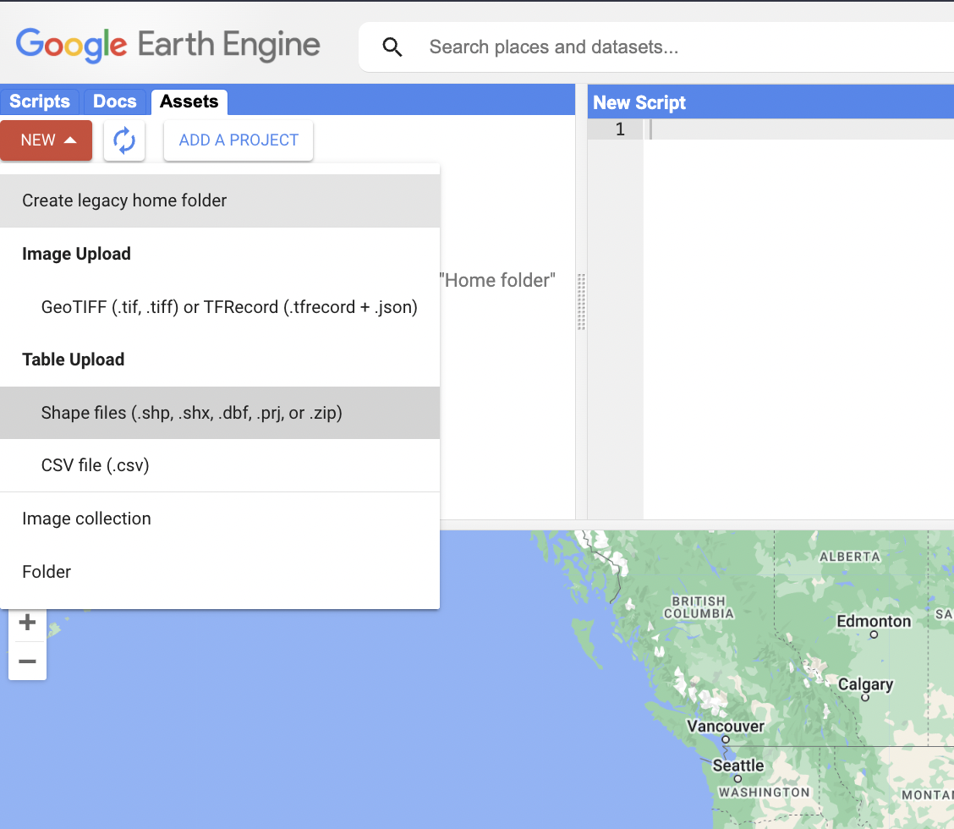
Step 4: GEE Assets
https://code.earthengine.google.com/
choose Shape files

Slide 10
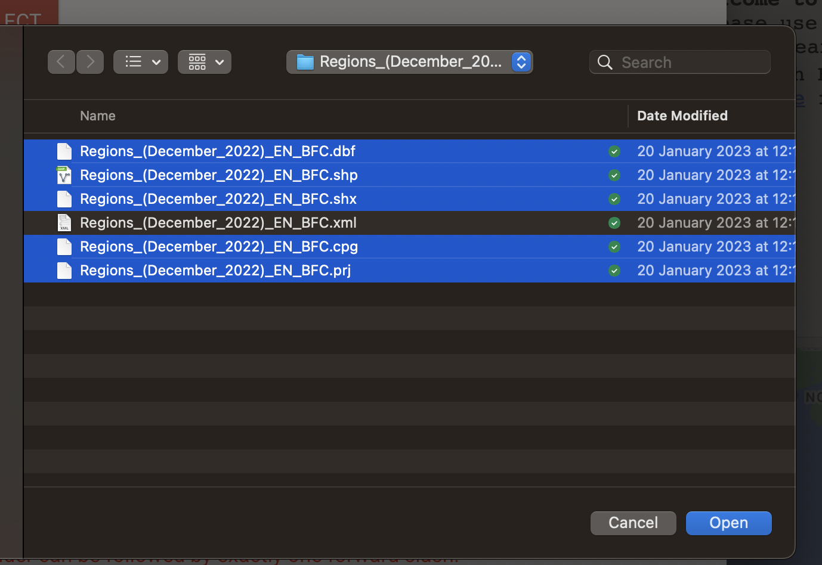
Step 4: GEE Assets
https://code.earthengine.google.com/
For Regions, choose all the files from Regions_(December_2022)_EN_BFC
except the .xml file.
Set asset name as regions
and then press UPLOAD.

Slide 11
Step 4: GEE Assets
https://code.earthengine.google.com/
Repeat the same for LSOA
shape files

Slide 12
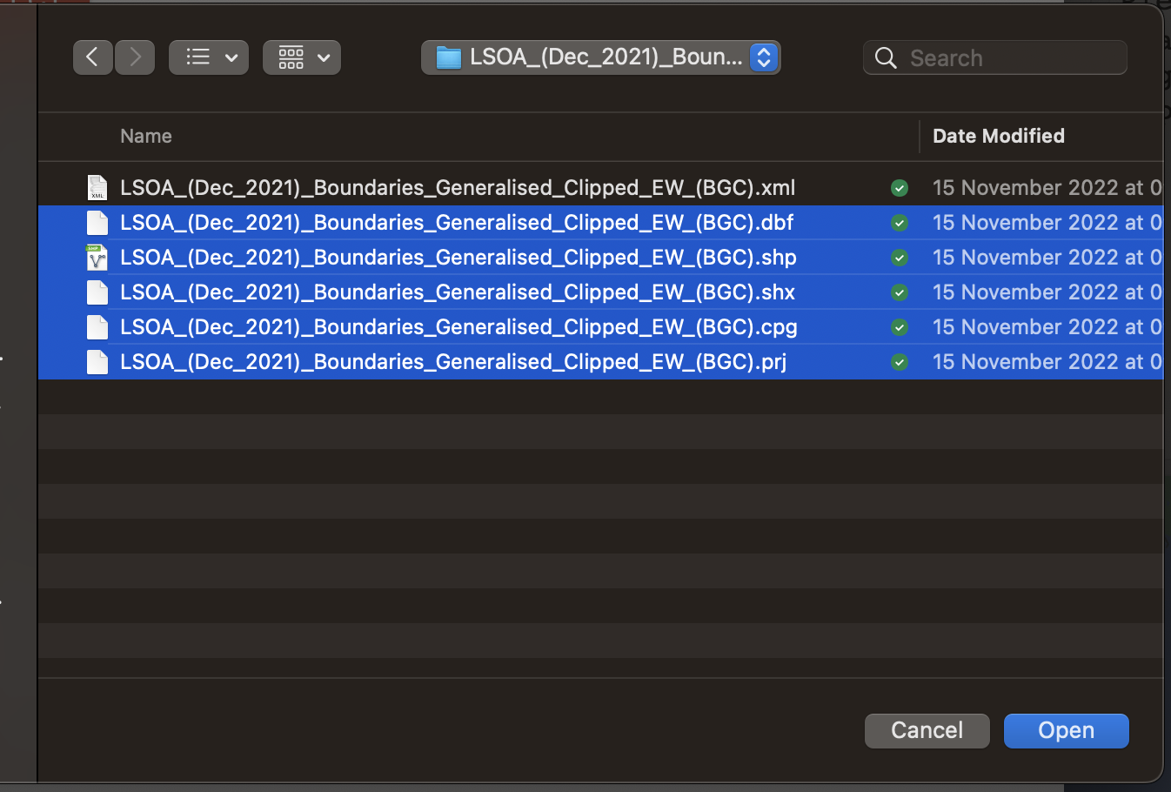
Step 4: GEE Assets
https://code.earthengine.google.com/
For LSOAs, choose all the files from LSOA_(Dec_2021)_Boundaries_Generalised_Clipped_EW_(BGC)
Except the .xml file.
Set asset name as LSOAs
and then press UPLOAD.

Slide 13
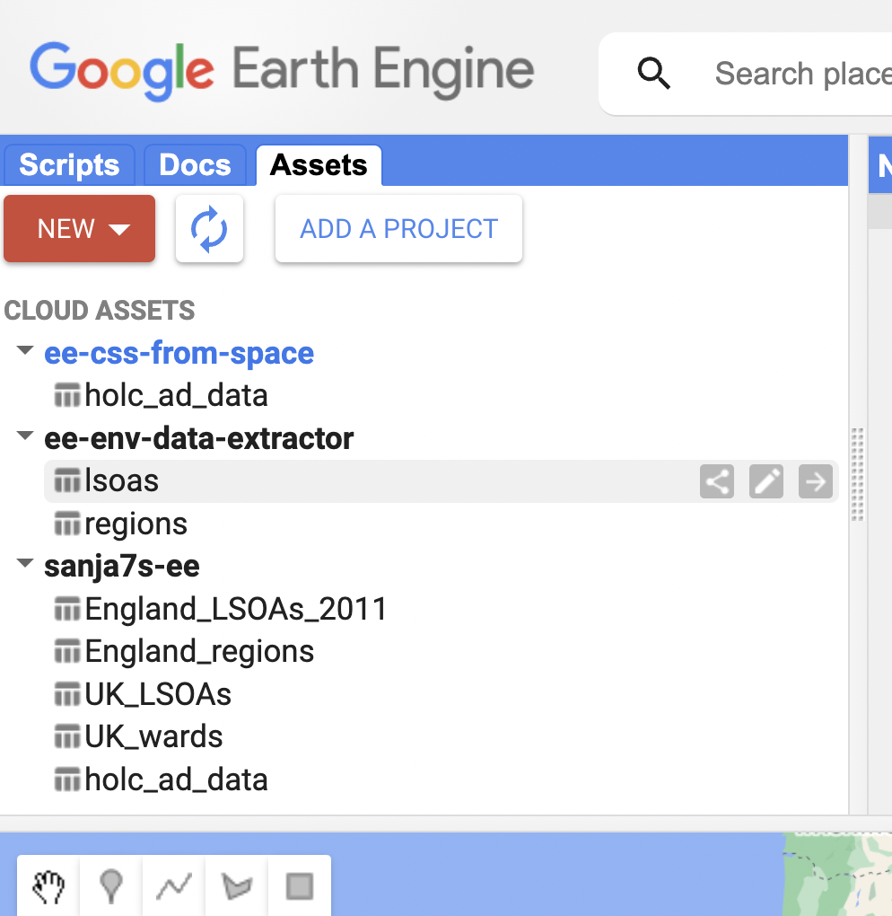
Step 4: GEE Assets
https://code.earthengine.google.com/
Please do wait a bit, as these are large files, and it will take a couple of minutes that they are uploaded to your assets.
Once they are, you should be able to see them as so to the right.

Slide 14
NOW THE EXTRACTOR SHOULD WORK FOR YOU!

Slide 15

Why we need a tool such as Google Earth Engine (GEE)?
Satellite and EO data are huge, and it takes time to download, preprocess and analyze them.

Slide 16
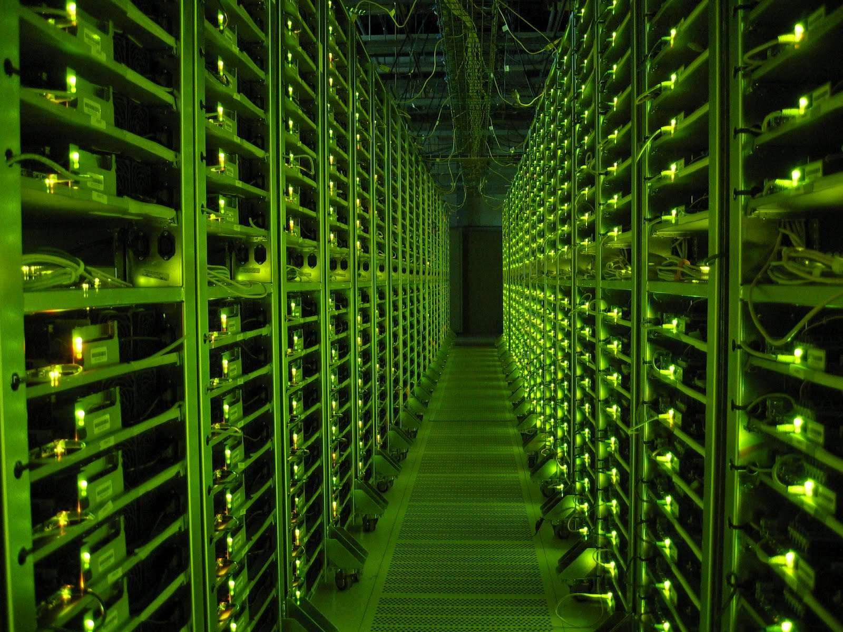



What is Google Earth Engine (GEE)?
A cloud-based tool that consists of:
A large repository of analysis-ready EO data (Earth Engine Data Catalog)
Computational Infrastructure with a pool of servers co-located with data
Powerful API (JavaScript, Python, Julia, etc.)
Notes:
https://developers.google.com/earth-engine/datasets

Slide 17








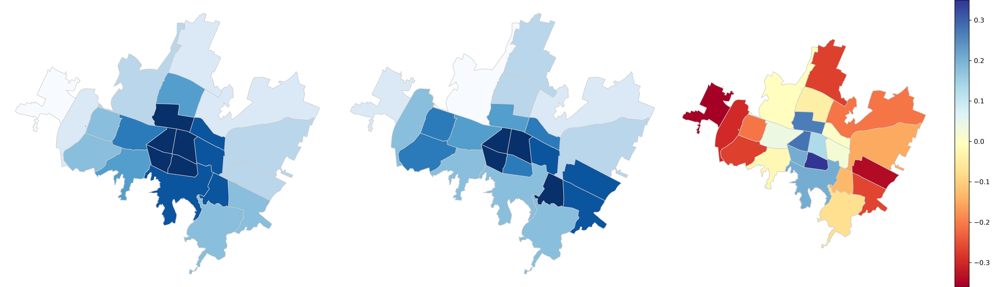
How GEE works?
Main data data structures
Image – raster
Feature -- vector
Image Collection
Feature Collection
Other fundamental data structures in Earth Engine include Dictionary, List, Array, Date, Number and String.
Notes:
he two most fundamental geographic data structures in Earth Engine are Image and Feature corresponding to raster and vector data types, respectively. Images are composed of bands and a dictionary of properties. Features are composed of a Geometry and a dictionary of properties. A stack of images (e.g. an image time series) is handled by an ImageCollection. A collection of features is handled by a FeatureCollection. Other fundamental data structures in Earth Engine include Dictionary, List, Array, Date, Number and String (learn more about basic data types from this tutorial. It is important to remember that these are all server-side objects and are not manipulated the same way as client-side JavaScript objects are (learn more).

Slide 18



How GEE works?
Main methods and functions
FILTER
MAP
REDUCE
Notes:
he two most fundamental geographic data structures in Earth Engine are Image and Feature corresponding to raster and vector data types, respectively. Images are composed of bands and a dictionary of properties. Features are composed of a Geometry and a dictionary of properties. A stack of images (e.g. an image time series) is handled by an ImageCollection. A collection of features is handled by a FeatureCollection. Other fundamental data structures in Earth Engine include Dictionary, List, Array, Date, Number and String (learn more about basic data types from this tutorial. It is important to remember that these are all server-side objects and are not manipulated the same way as client-side JavaScript objects are (learn more).
https://developers.google.com/earth-engine/guides/getstarted

