Slide 1
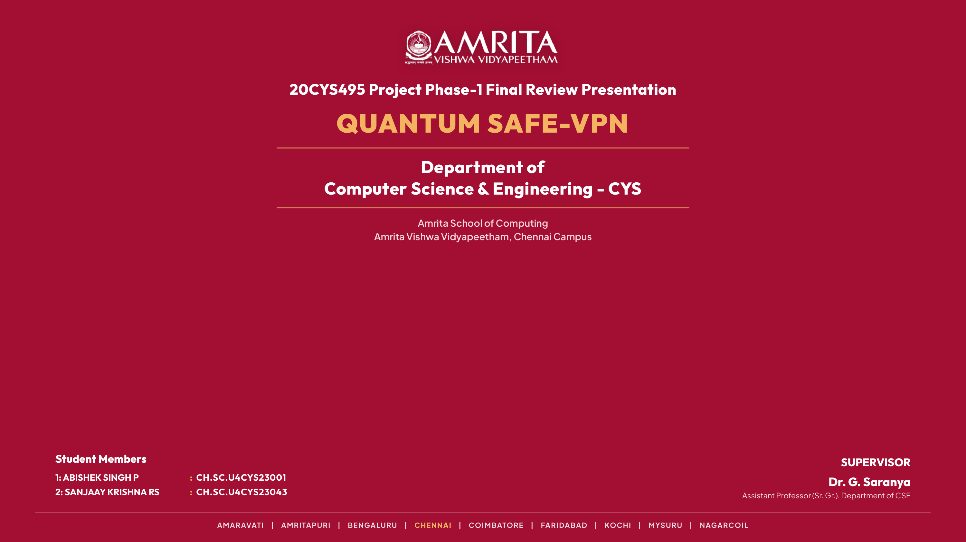
Notes:
Slide 1: Title Slide: QuantumSafe VPN

Slide 2
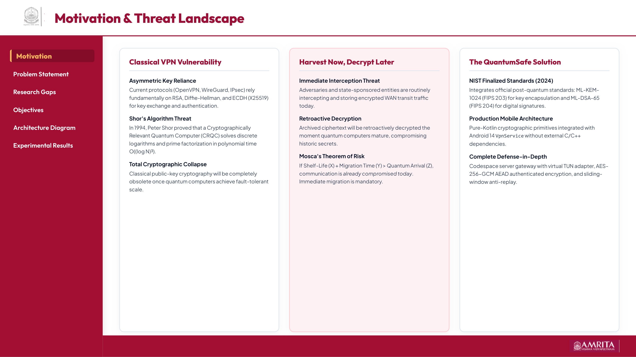
Notes:
Slide 2: Motivation & Threat Landscape

Slide 3
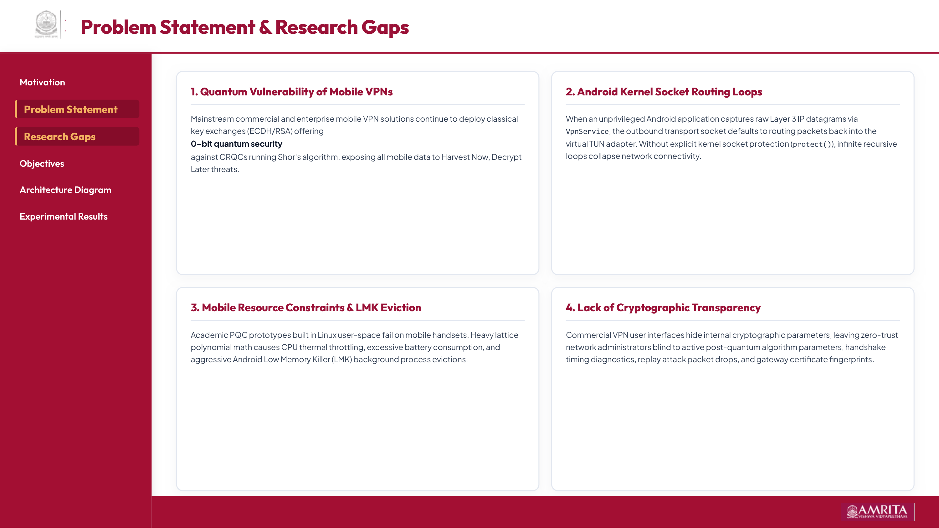
Notes:
Slide 3: Problem Statement & Research Gaps

Slide 4
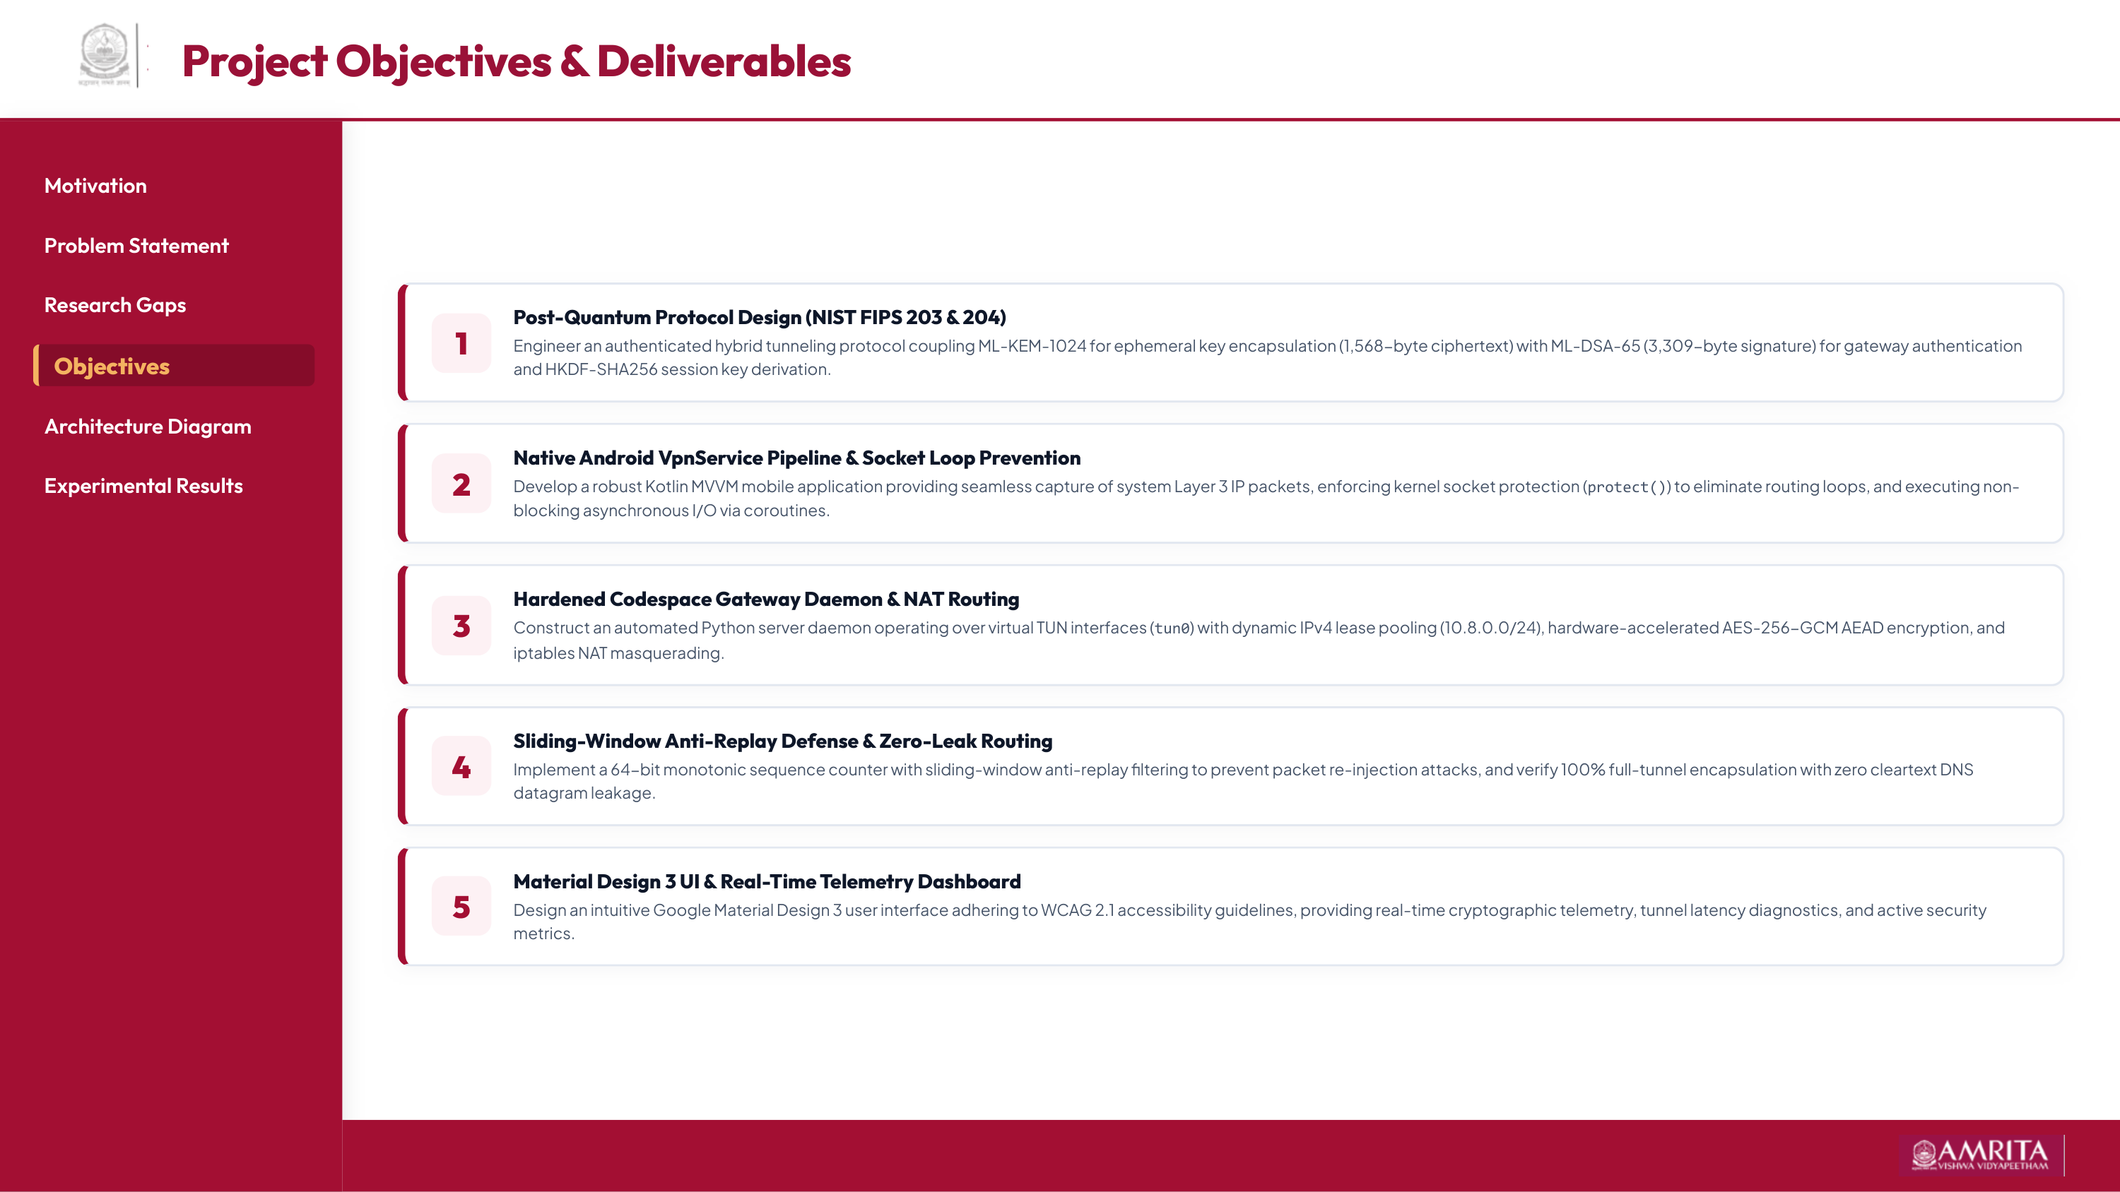
Notes:
Slide 4: Project Objectives

Slide 5
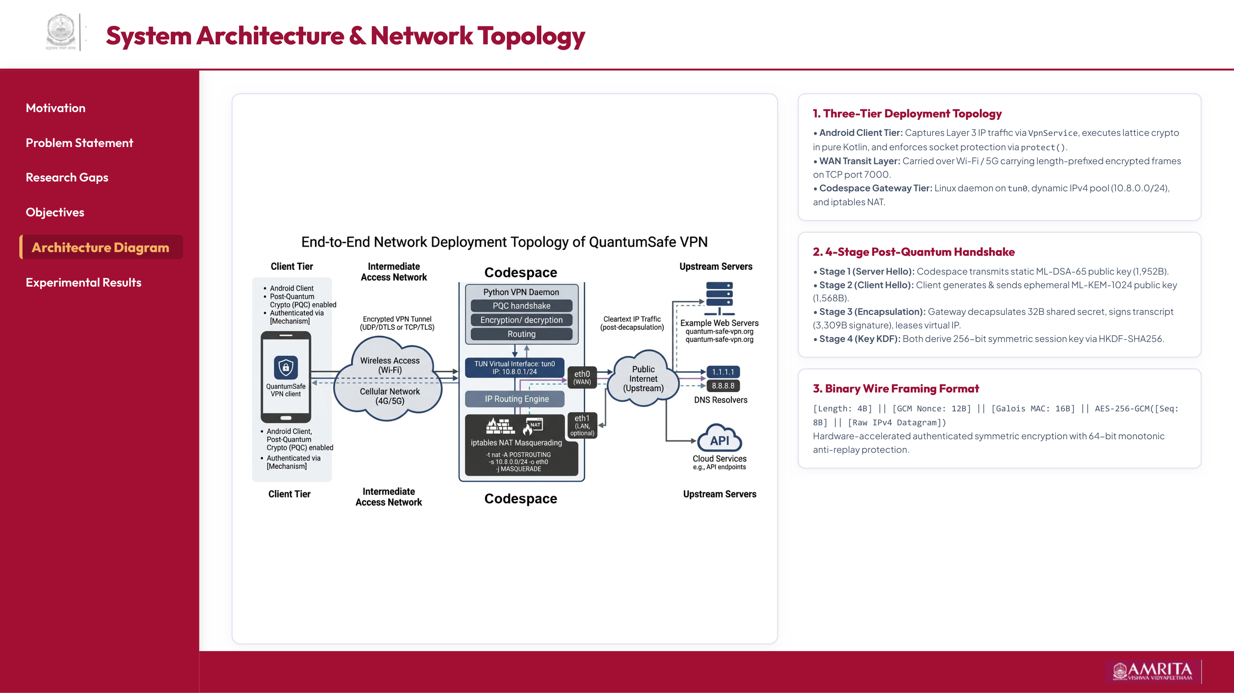
Notes:
Slide 5: System Architecture & Network Topology

Slide 6
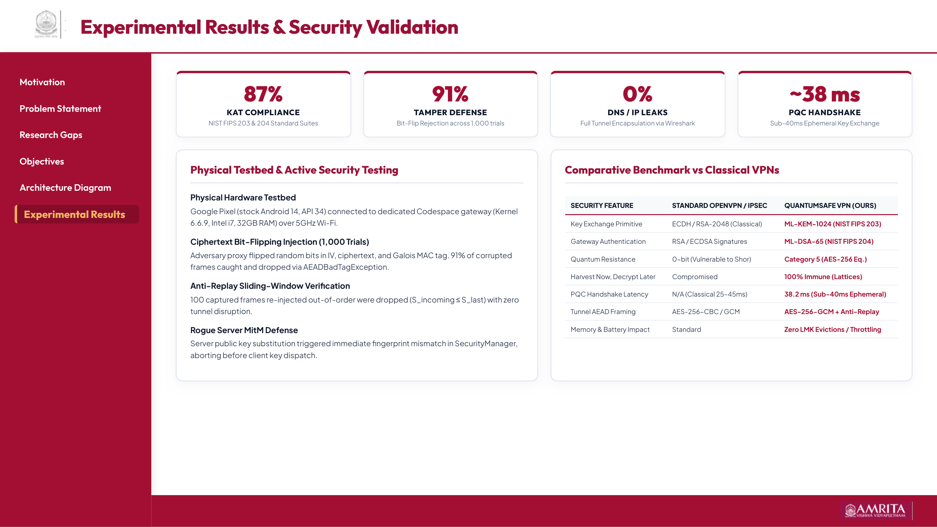
Notes:
Slide 6: Experimental Results & Security Validation

Slide 7

Notes:
Slide 7: Thank You

