Slide 1
Avalanche Insight Hub
Data-Driven Decision Support for Himalayan Avalanche Risk
Hosted prototype for scientist review and validation partnership
June 24, 2026 | Scientist Demo Session
Experimental decision-support prototype — not an official warning service

Slide 2
Why Himalayan Avalanche Forecasting Is Hard
11 systemic challenges from 20+ years of research
Data Environment
Algorithmic Limits
System Constraints
Sparse AWS network
Dangerous manual data collection
Incomplete occurrence records
Difficult data integration
Severe class imbalance
Feature redundancy & overfitting
Complex physical processes
Subjective calibration
Spatial-temporal disconnect
Computational bottlenecks
Multiple optima in calibration
Climate non-stationarity
Traditional approaches treat space and time independently, use compensatory risk models, and rely on sparse local stations that fail during storms.
Avalanche Insight Hub | Experimental Decision-Support Prototype
2 / 15

Slide 3
Research Lineage & Respect for Prior Work
Building on decades of Himalayan avalanche science
2008-2015
SASE/DGRE k-NN models, eNN10 calibration, ABC optimization
2016-2020
HIM-STRAT neural snowpack, SNOWPACK limitations in Himalayas
2021-2023
SAR detection with Sentinel-1, class imbalance research
2024-2025
RAvaFcast (Swiss 3-stage), Mission Mausam, DRDO AI pilot
2026
Avalanche Insight Hub: integrated decision-support platform
"We build on your team's work; we do not replace it."
Avalanche Insight Hub | Experimental Decision-Support Prototype
3 / 15

Slide 4
Platform Architecture — Batch-First, Zero-Cost
Heavy compute offline, published artifacts online
Open-Meteo
Global Weather API
→
Python Batch
Inference Pipeline
→
Supabase
Storage & Database
→
React Frontend
Hosted on Netlify
GitHub Actions:
Daily scheduled inference + manual dispatch (zero-cost CI/CD)
Modal.com:
Off-path GPU for candidate MTS-LSTM and SAR training (not production)
Supabase:
Postgres + Storage + Edge Functions + RLS policies
Netlify:
Static frontend hosting with instant deploys
No GPU required for production inference. No runtime synthesis. Every forecast has provenance and timestamp.
Avalanche Insight Hub | Experimental Decision-Support Prototype
4 / 15

Slide 5
ML Pipeline — From Weather to Risk
20x20 grid, 72-hour horizon, 400 cells per region
Open-Meteo
weather fetch
→
DEM terrain
extraction
→
Snowpack
proxy
→
RF inference
+ calibration
→
Chebyshev IPA
risk fusion
→
Bulletin
generation
→
Supabase
publication
72
400
8
5
forecast hours
grid cells per region
regions worldwide
risk fusion criteria
Each cell gets: weather features, terrain features (slope/aspect/elevation/roughness), snowpack proxy, calibrated probability, Chebyshev IPA risk level, SHAP explainability, and uncertainty bounds.
Avalanche Insight Hub | Experimental Decision-Support Prototype
5 / 15

Slide 6
Solving Class Imbalance & Feature Selection
Rare events require specialized ML techniques
Class Imbalance Solutions
SVM-RFE Feature Selection
KMeansSMOTE
Synthetic minority oversampling (k=5, cluster_balance=0.1)
Cost-Sensitive RF
Class weights {0:1, 1:4} — 4x false-negative penalty
PSS as Primary Metric
Peirce Skill Score — not accuracy
Time-Series CV
5 chronological folds, no temporal leakage
MTS-LSTM Governance
No SMOTE in sequence space — weighted sampling + focal loss
40+ raw features
Temperature, snowfall, wind, radiation, terrain...
SVM-RFE reduces to ~15
Iterative cross-validation-based elimination
Critical selected features:
Fresh snowfall (24h/72h), cumulative seasonal snow, min/max temp, wind speed/loading, sunshine duration, slope, aspect
Key insight:
Avalanche conditions ripen over 2-3 days, not instantaneously
Avalanche Insight Hub | Experimental Decision-Support Prototype
6 / 15

Slide 7
Non-Compensatory Risk Fusion — The Key Innovation
Chebyshev Ideal Point Analysis prevents false safety scores
The Problem: Weighted Linear Additive
The Solution: Chebyshev IPA
Flat slope (10 deg) + heavy snowfall = "Moderate" risk
But a 10 deg slope will NEVER avalanche.
Safe terrain masks critical weather triggers.
This is physically wrong and dangerous.
Non-compensatory: dominant criterion drives risk.
Safe terrain CANNOT mask critical weather.
Max weighted deviation from ideal hazard point.
First application in avalanche forecasting.
5-Criteria Hazard Vector
Criterion | Weight | What it captures
Probability | 1.0 | Model-predicted avalanche probability
Slope deviation from 38 deg | 1.0 | Avalanche-prone slope angle (peak at 38 deg)
Aspect risk | 0.8 | Wind loading / solar radiation by aspect
Snowpack weakness | 0.9 | Inverse of shear strength (weak layer proxy)
Exposure | 0.7 | Infrastructure / road proximity
Avalanche Insight Hub | Experimental Decision-Support Prototype
7 / 15

Slide 8
Explainability — TreeSHAP in the UI
Solving the black-box trust problem
Per-cell risk-driver breakdown shows exactly WHY the model assigned a risk score
Sample SHAP contributions for a Considerable-risk cell:
Key Points
snowfall_24h
+0.15
Exact TreeSHAP
Mathematically exact for tree ensembles (not approximation)
Per-cell bar chart
Shows top contributing features in the UI dashboard
Honest fallback
Heuristic explanation with FALLBACK badge when SHAP artifact unavailable
Surrogate model only
TreeSHAP on RF surrogate, not MTS-LSTM internals
wind_loading
+0.11
slope_angle
+0.08
cumulative_snow
+0.06
aspect_loading
+0.04
temp_gradient
-0.03
Avalanche Insight Hub | Experimental Decision-Support Prototype
8 / 15

Slide 9
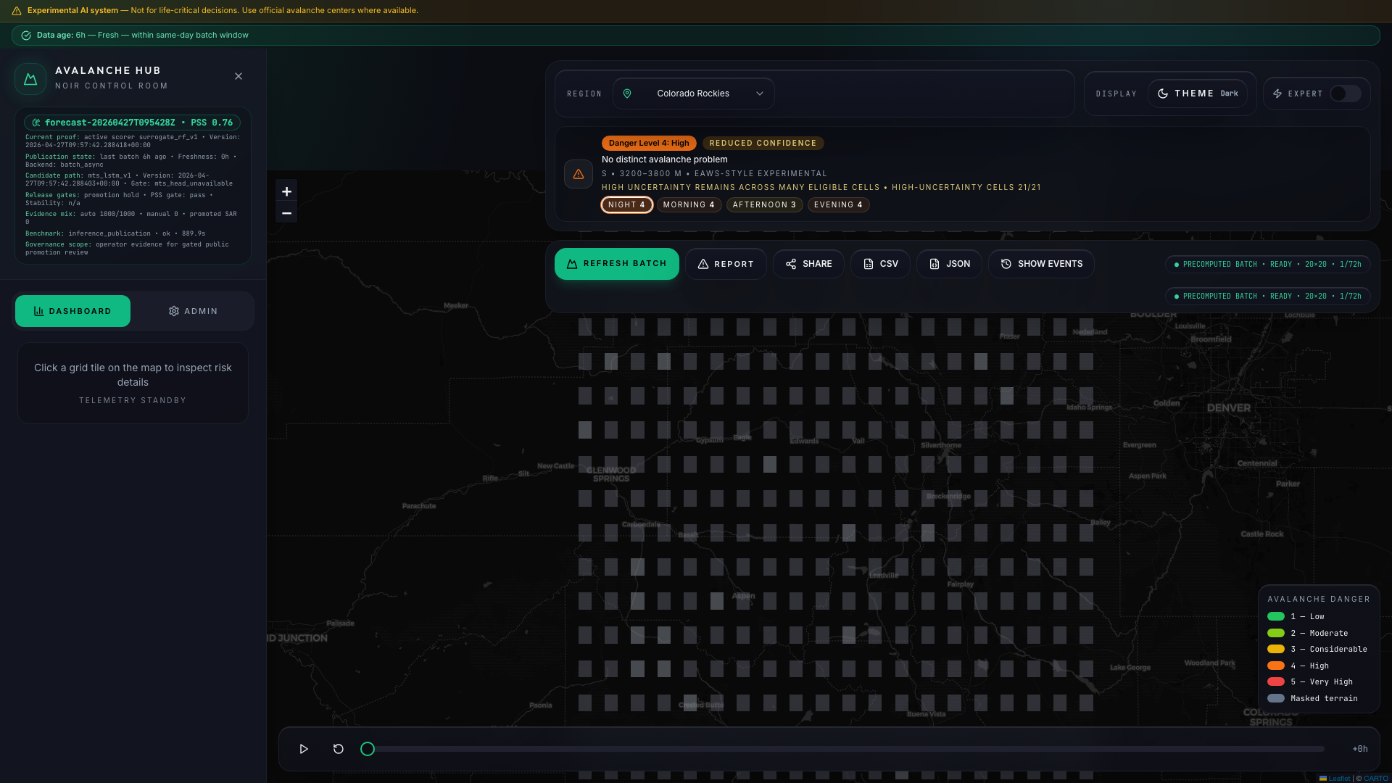
Live Demo — Colorado Rockies
Fresh published 72-hour forecast artifact
What to Show
20x20 grid with 72h horizon
EAWS-style experimental bulletin
Danger level + avalanche problem
Time slider navigation (hour 0-71)
Cell inspection with SHAP
Uncertainty cues + confidence state
Share / export / report workflows
PRECOMPUTED BATCH - READY (72h)
URL: https://avalanche-insight-hub.netlify.app/?region=Colorado%20Rockies
Avalanche Insight Hub | Experimental Decision-Support Prototype
9 / 15

Slide 10
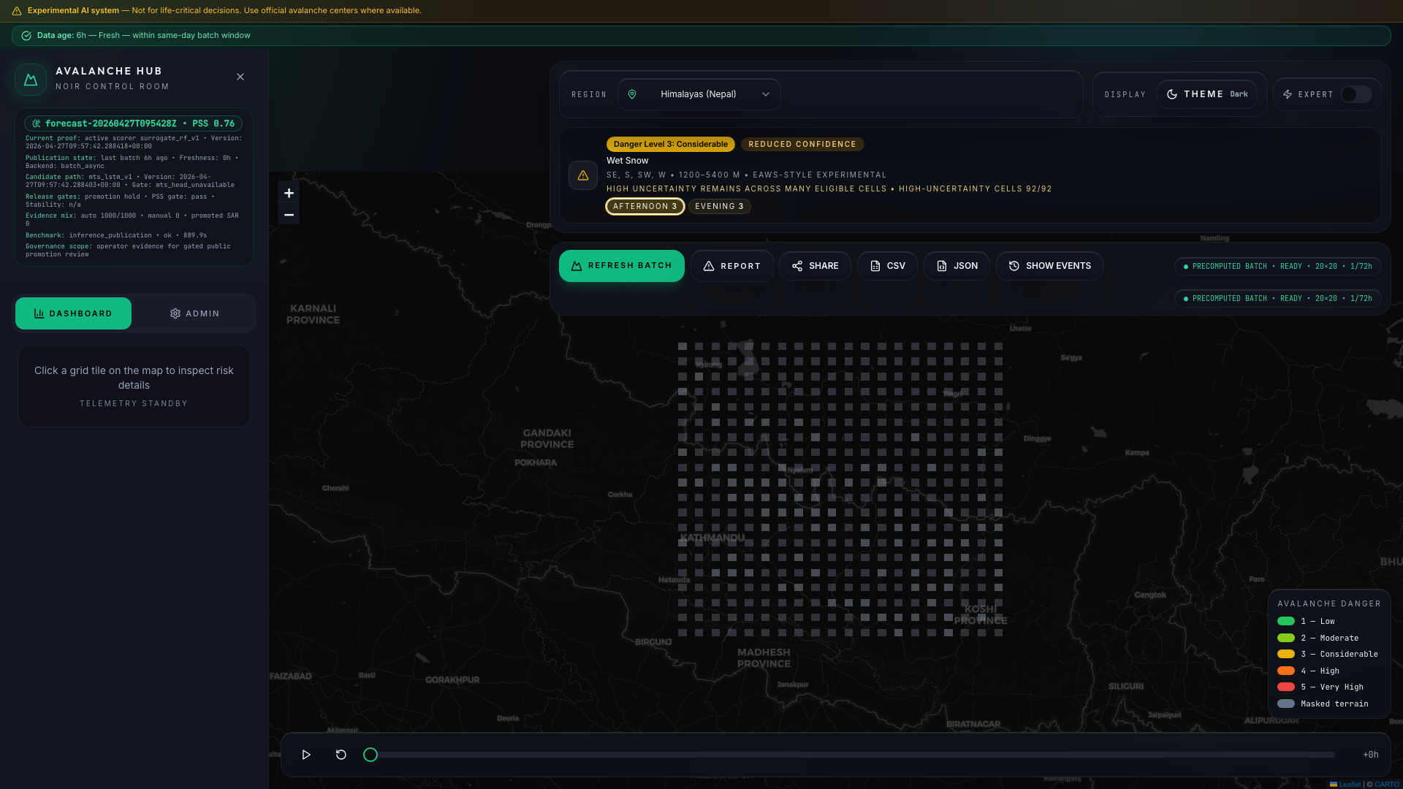
Live Demo — Himalayas (Nepal)
Pipeline capability demonstration — not validated Himalayan accuracy
Himalayan Demo
Danger level 3 (Considerable)
Wet snow avalanche problem
400/400 cells ready
3D voxel terrain view
Global weather API (no AWS needed)
DEM: himalayas_nepal.tif
Snowpack proxy: seasonal_cumulative_v1
SAR: UNAVAILABLE (shadow-gated)
Claim boundary: himalayan_accuracy_claim_allowed = false. This demonstrates pipeline capability, not validated operational accuracy.
Avalanche Insight Hub | Experimental Decision-Support Prototype
10 / 15

Slide 11
Candidate Deep Learning Paths
Gated behind promotion gates — not in production scoring
Branched MTS-LSTM
SAR U-Net Segmentation
Multi-timescale sequence model
Hourly branch: 32-hidden LSTM (weather dynamics)
Daily branch: 24-hidden LSTM (snowpack evolution)
Static branch: 16-unit encoder (terrain)
Why gated:
Insufficient Himalayan training data
Promotion gates not yet passed (PSS, Brier, stability)
Shadow mode alongside RF surrogate
Governance:
No SMOTE in sequence space — focal loss instead
Sentinel-1 C-band SAR
Cloud-penetrating, all-weather avalanche detection
Model architectures:
Swin Transformer V2 Tiny U-Net (cold-start)
ResNet34-UNet (CNN baseline)
Why gated:
SAR_UNET_PROMOTED = false
Shadow-gated for label mining only
Needs F1/IoU validation + region qualification
Physics gate: 25-65 deg slope for training eligibility
Avalanche Insight Hub | Experimental Decision-Support Prototype
11 / 15

Slide 12
Uncertainty, Honesty & Claim Boundaries
Hardcoded locks prevent premature operational claims
Uncertainty Communication
What We Cannot Claim
Confidence state: normal / reduced (with reasons)
Uncertainty class: low / medium / high
95% confidence interval per cell
Stale / unavailable / masked states
Data freshness badge: READY / STALE
Himalayan operational accuracy (blocked)
Official warning service
Promoted SAR detection
Production MTS-LSTM
Field-validated against Himalayan data
Approved Language
Instead of | Use
"Fresh operational forecast" | "Latest published batch with freshness state"
"Official warning service" | "Experimental decision-support workspace"
"Production MTS-LSTM" | "Candidate MTS-LSTM with release gates"
"Validated Himalayan accuracy" | "Pipeline capability demonstration"
Avalanche Insight Hub | Experimental Decision-Support Prototype
12 / 15

Slide 13
Scientist Co-Working & Validation Workflow
Not a replacement for experts — a structured review tool
/scientist
Structured case validation, evidence attachments, verdicts, notes, exportable review artifacts
/scientist/daily-verification
Paired model-vs-scientist daily comparison with analytics and disagreement metrics
/admin
Operator controls, model status, source health, evaluation metrics, publication traces
Key principle: Scientist review informs decisions; it does not automatically retrain or promote models.
Validation outputs: feature ratings, scientific objections, data commitments, validation actions, next meeting scope.
Avalanche Insight Hub | Experimental Decision-Support Prototype
13 / 15

Slide 14
What We Need From You
A respectful, scoped ask — only after team agrees to explore
Reviewed station data
Critical
Pilot region selection
High
Ground truth for weather and snowpack validation
Focus the validation geographically
Snowpack profiles
Critical
Warning-region definitions
High
Weak-layer identification and proxy validation
Align bulletins with local policy
Avalanche occurrence records
Critical
Holdout evidence
High
Training labels with accurate timing
Independent validation gate
Weak-layer taxonomy
High
Field report cases
Medium
Local definitions of critical weak layers
Scientist-reviewed observations
3-Month Exploratory Co-Development: Month 1: Evidence review | Month 2: Limited validation | Month 3: Results & decision
Avalanche Insight Hub | Experimental Decision-Support Prototype
14 / 15

Slide 15
Decision Options & Next Steps
A
Benchmark-Design Workshop
One session to define validation metrics, holdout slices, and scientist-approved cases
B
Scoped 3-Month Validation Pilot
Limited research validation using agreed data and scientist review. Decision: continue, narrow, or stop.
C
Deeper Co-Development Track
Full partnership: data sharing, weak-layer program, SAR qualification, MTS-LSTM promotion
"The prototype is strong enough to show a credible direction. Himalayan operational claims wait for your reviewed evidence and scientist validation."
We remain fully open to modifying the approach based on your team's guidance.

