Slide 1
KEYLOGGER USING PYTHON
Presented By: SANJAI J
Student Name : SANJAI J
College Name & Department : BHARATH INSTITUTE OF HIGHER EDUCATION AND REASEARCH (BTech/CSE)

Slide 2
OUTLINE
Problem Statement
Technology used
Wow factor
End users
Result
Conclusion
Git-hub Link
Future scope

Slide 3
Problem Statement
With the increasing need for monitoring and security in digital environments, keylogging technology can be used for both ethical and unethical purposes. This project aims to develop a basic keylogger using Python and Tkinter, capable of capturing and logging keystrokes in real-time. The keylogger records pressed, held, and released keys, storing the data in text and JSON files for further analysis. While such tools are often used for parental control, employee monitoring, or cybersecurity research, they also raise ethical and privacy concerns, highlighting the importance of responsible usage.

Slide 4
Technology used
Python & Tkinter – Used for developing the keylogger and creating the GUI interface.
pynput Library – Captures keystrokes by listening to keyboard events.
JSON & File Handling – Stores keystroke data in structured JSON and text files.
Threading – Ensures the keylogger runs in the background while keeping the GUI responsive.

Slide 5
Wow factors
Real-Time Keystroke Logging – Captures and logs every key press, hold, and release in real-time, storing the data in both text and JSON formats for structured analysis.
Interactive GUI with Controls – Unlike traditional command-line keyloggers, this project includes a user-friendly Tkinter-based interface to start and stop logging with a single click.
Multi-Event Tracking – Differentiates between pressed, held, and released keys, offering deeper insights into user typing behavior rather than just raw key inputs.
Extensibility for Ethical Use – Can be adapted for cybersecurity research, parental monitoring, or AI-based typing pattern analysis, making it more than just a basic keylogger.

Slide 6
End users
Cybersecurity Professionals – Used for ethical hacking, penetration testing, and analyzing keylogging threats to improve security defenses.
Parental Control & Monitoring – Parents can track children's keyboard activity to ensure safe and responsible computer usage.
IT Administrators & Employers – Can be adapted for workplace monitoring to detect unauthorized access or potential insider threats (with legal and ethical compliance).
Forensic Investigators – Helps in digital forensics to analyze user activity and detect suspicious behavior in cybercrime investigations

Slide 7
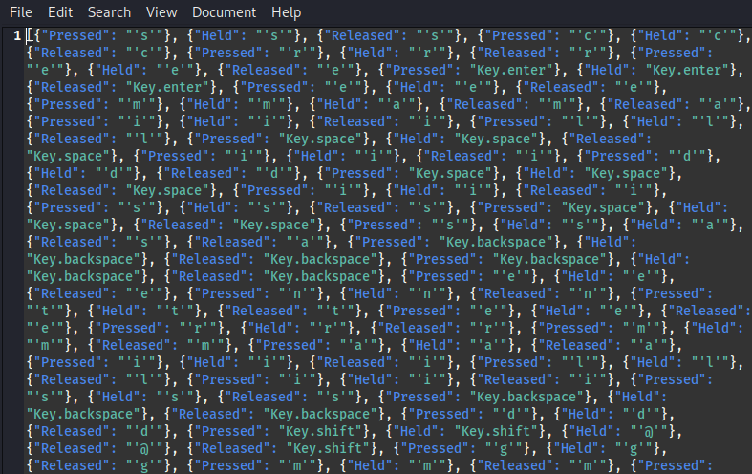
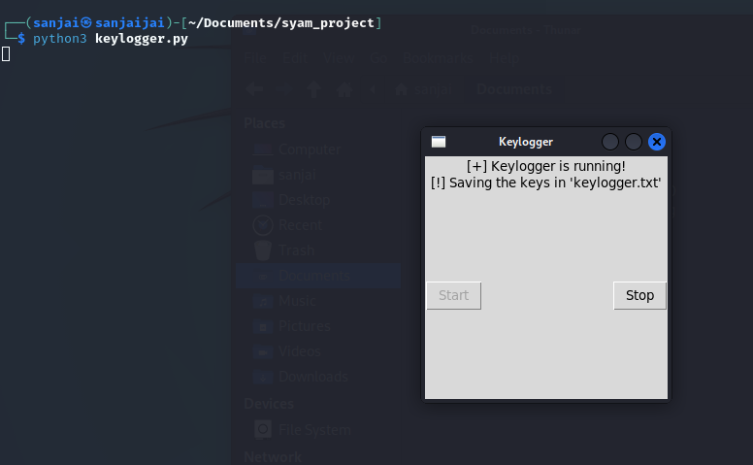
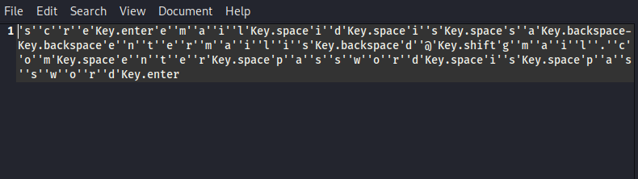
Results
fig 1-run the program
fig2-json format
fig 3-captures the keystrokes

Slide 8
Conclusion
This keylogger project successfully addresses the need for keystroke monitoring by capturing and recording keyboard activity in real-time. By integrating Python, Tkinter, and the pynput library, it provides an interactive and user-friendly interface for starting and stopping keylogging. The project effectively logs pressed, held, and released keys, storing them in both text and JSON formats for further analysis. While keylogging technology has ethical concerns, this project highlights its responsible use for cybersecurity research, parental control, and forensic investigations. Future enhancements can include encryption, remote logging, and AI-based anomaly detection to make it more secure and insightful.

Slide 9
GitHub Link
https://github.com/sanjai-566/keylogger-python

Slide 10
Future scope(optional)
Enhanced Security & Encryption – Encrypting stored keystroke data to prevent unauthorized access and misuse.
AI-Based Behavior Analysis – Using machine learning to analyze typing patterns for user authentication and fraud detection.
Remote Monitoring & Cloud Storage – Enabling secure remote logging and cloud storage for real-time monitoring.
Cross-Platform & Stealth Mode – Expanding compatibility to macOS/Linux and running discreetly in the background for better usability.

Slide 11
THANK YOU

