Slide 1



WPS
Swagger UI
2
0
2
5
CAMPUS
API
Education
API for Managing Courses & Faculty using FastAPI
Name :Sanjai B
Date: 19.07.2025
CAMPUS API EDUCTION

Slide 2




Table Of Contents
01 part
02 part
03 part
04 part
Overview & Features
Project Structure
Data Models
Core API Endpoints (Courses & Faculty)
05 part
06 part
07 part
08 part
Advanced Analytics
Setup Instructions
Live Demo Use Cases
Key Takeaways & Future Scope
CAMPUS API EDUCTION

Slide 3

01
Thesis Defense
What is the Campus API?
CAMPUS API EDUCATION

Slide 4

What is Campus API
1
A RESTful API built with FastAPI and Pydantic
2
Manages data for:
-Courses
-Faculty
3
CRUD operations, advanced queries, fuzzy search
4
Stores data in JSON files for testing/mock storage and Auto-generated Swagger docs at /docs

Slide 5
02
Thesis Defense
Project Files & Structure
CAMPUS API EDUCATION

Slide 6
main.py:
Initializes the FastAPI app and registers all route modules (courses, faculty, advanced). It also serves a simple homepage with links to Swagger/docs.
database.py:
Handles loading and saving of mock JSON data (courses.json, faculty.json) and provides utility functions to fetch individual records from memory.
models.py:
Defines the Pydantic data models (Course, Faculty) used for request validation and response serialization across the entire API.
routers/courses.py:
Implements all course-related API operations including CRUD, search, filtering, recommendations, specialization matching, and advanced analytics (e.g. most prerequisites).
routers/faculty.py:
Implements faculty-related API operations including CRUD, fuzzy search, availability, contact directory, section-wise filtering, and advanced faculty analytics.
routers/advanced.py:
Contains cross-domain analytic features and advanced filters such as department course counts, global search, and credit-based filtering.
mock_data/courses.json:
Stores mock course records including course details, prerequisites, and lead faculty IDs; used to simulate a working database.
mock_data/faculty.json:
Stores mock faculty information including departments, specialization, availability, and linked courses; used for testing and response data.
mock_data_generator.py:
Automatically generates realistic mock data for both courses.json and faculty.json using the faker package; saves time when testing the full API.

Slide 7
03
Thesis Defense
Data Models
Course & Faculty Models
CAMPUS API EDUCATION

Slide 8
COURSE AND FACULTY MODELS
class Course(BaseModel):
id: int
name: str
code: str
description: str
credits: int
department: str
prerequisites: List[int]
faculty_id: int
class Faculty(BaseModel):
id: int
first_name: str
last_name: str
email: str
department: str
specialization: List[str]
office_location: str
office_hours: str

Slide 9


04
Thesis Defense
Core API Endpoints (Courses & Faculty)
CAMPUS API EDUCATION

Slide 10
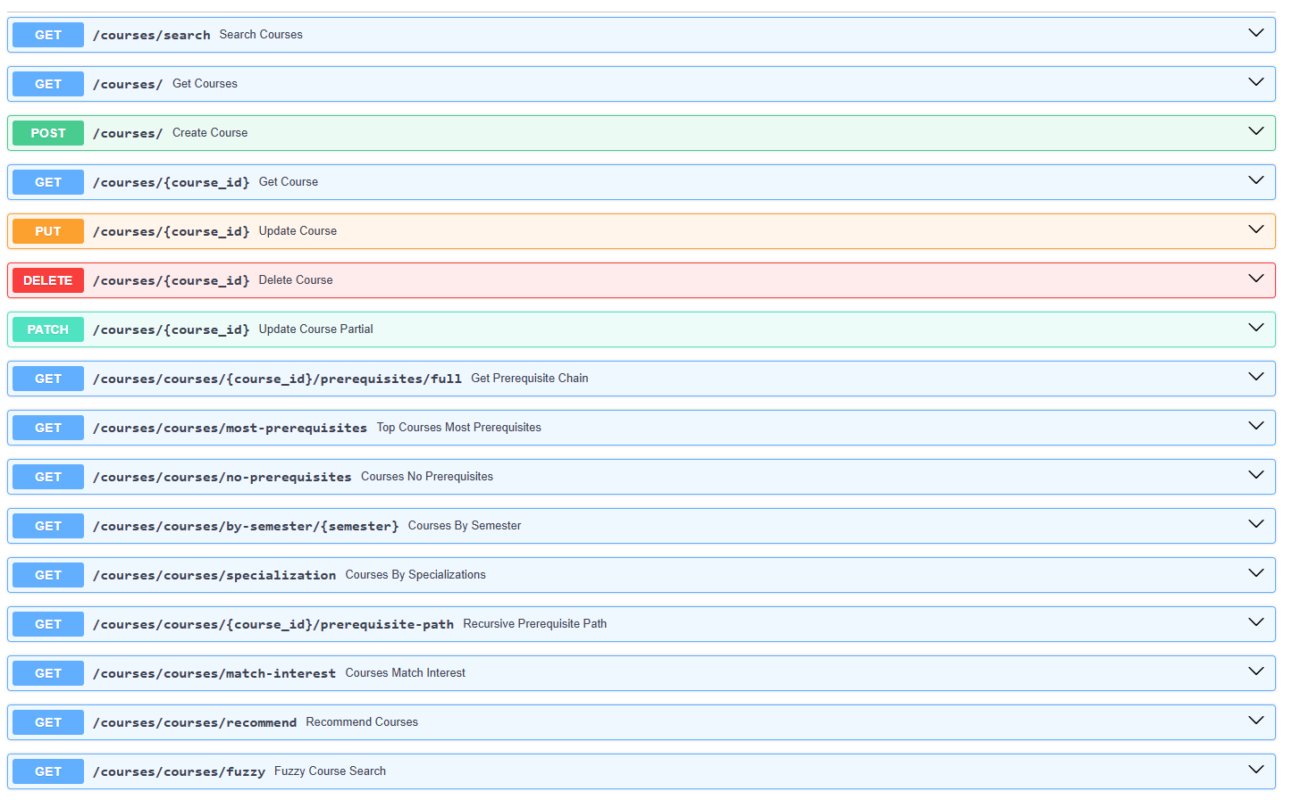
COURSES

Slide 11
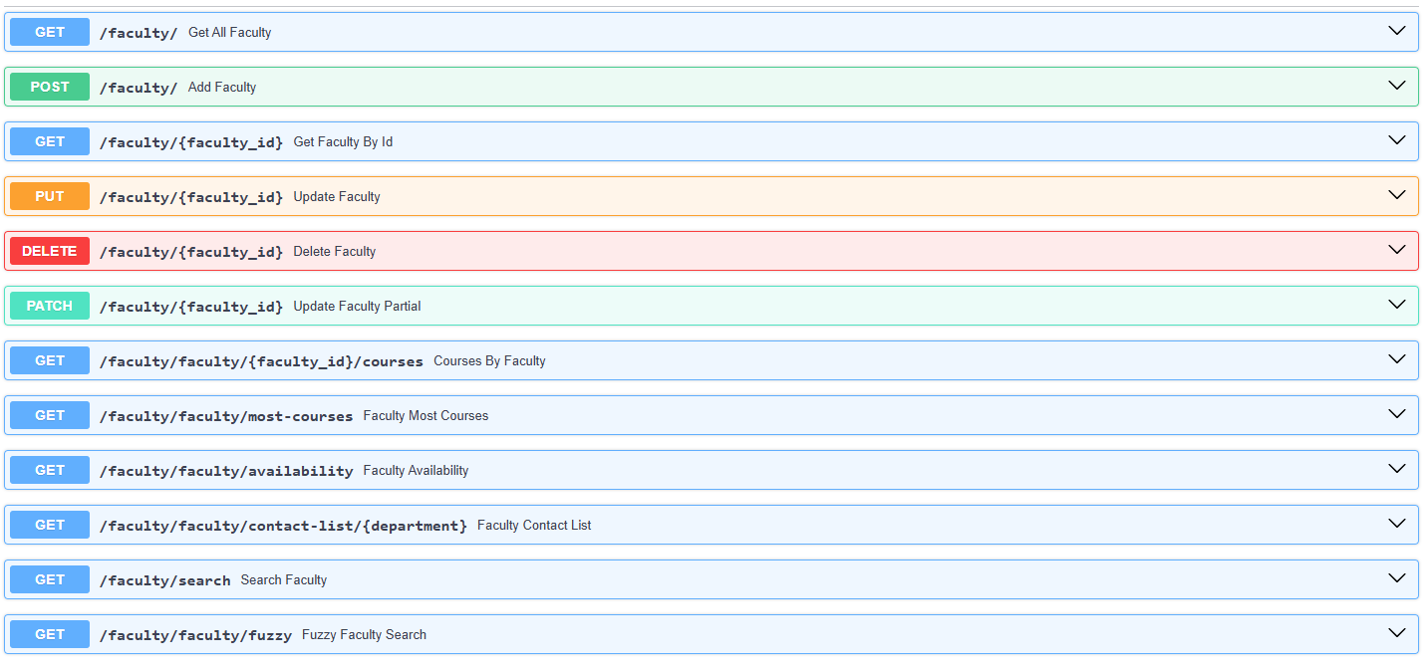
FACULTY

Slide 12
05
Thesis Defense
Advanced Analytics Endpoints
CAMPUS API EDUCATION

Slide 13
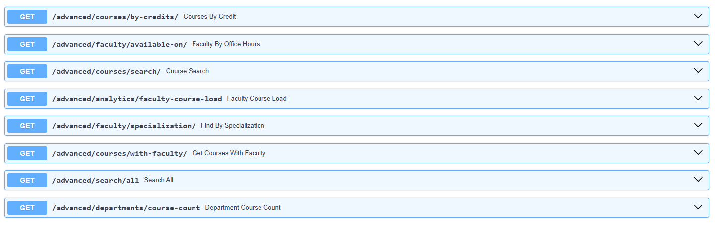
ADVANCED STATISTICS & FILTERS

Slide 14
06
Thesis Defense
Setup instructions
CAMPUS API EDUCATION

Slide 15

Steps
Install dependencies:
Go to folder with main.py
pip install -r requirements.txt
01
cd app
04
02
Explore Docs or Redoc:
Run Server
03
http://localhost:8000/docs
or
http://localhost:8000/redoc
uvicorn main:app --reload

Slide 16

07
Thesis Defense
Use Cases
CAMPUS API EDUCATION

Slide 17

Use Cases
Course recommendation system for students
Student/Faculty portal connector
Real-time search assistant for courses & faculty
Integrated into a College Content Management System

Slide 18
08
Thesis Defense
Key Takeaways and Future scope
CAMPUS API EDUCATION

Slide 19

Validation & 422 Errors
Type Enforcement:
FastAPI automatically checks if inputs match the expected data types using Pydantic and Python type hints.
1
422 Error Response:
Invalid or missing input returns a 422 Unprocessable Entity with details explaining the validation error.
2
Applies to All Inputs:
Validation applies to query parameters, path variables, and request bodies to ensure clean and correct data.
3

Slide 20

Key Takeaways
01
FastAPI enables rapid development of robust, type-safe REST APIs with built-in documentation.
02
The College Campus API supports full CRUD operations with advanced search and analytics.
03
Title here
REST APIs provide a standardized way for different applications to communicate and exchange data reliably over the web, enabling integration between diverse systems and technologies.

Slide 21


WPS
Thesis Defense
2
0
2
5
THANK YOU
Research
Education
It serves a variety of purposes, making presentations powerful tools for convincing and teaching.
Speaker name :Sanjai B
19.07.25
CAMPUS API EDUCATION

