Slide 1

AUTONAS
A NEURAL ARCHITECTURE SEARCH–BASED MODEL SELECTION SYSTEM
FOR HEART DISEASE PREDICTION
Guided by:
Dr. Smitha E S
Prof. Janisha A
Submitted by :
Nanditha S
LBT25CSCE03
M2 CSE

Slide 2

TABLE OF CONTENTS
INTRODUCTION
MOTIVATION
LITERATURE REVIEW
RESEARCH GAPS
OBJECTIVE
SYSTEM ARCHITECTURE
METHODOLOGY
TECHNOLOGY USED
IMPLEMENTATION
INTERIM RESULTS
PROJECT PLAN
CONCLUSION
REFERENCES

Slide 3
INTRODUCTION
Heart disease is a leading cause of death; early detection saves lives.
Coronary Artery Disease (CAD) is caused by blocked or narrowed heart vessels.
Traditional tests (ECG, blood test, angiography) require expert analysis.
These methods may miss complex patterns in data.
Machine learning helps analyze large medical datasets efficiently.
Common models need manual design and tuning.
Deep learning captures complex patterns but is hard to design.
Neural Architecture Search (NAS) automatically builds optimized models with better accuracy.

Slide 4
MOTIVATION
Heart disease prediction helps doctors make faster and reliable decisions.
Traditional methods depend on doctor experience and manual analysis.
These methods may not always give accurate or consistent results.
Machine learning improves prediction but needs manual feature selection and tuning.
Different models give different results and may not be optimal.
Deep learning performs better but is complex and time-consuming to design.
Neural Architecture Search (NAS) automatically finds the best model.
NAS provides higher accuracy, less effort, and better performance for medical data

Slide 5
LITERATURE REVIEW
International Application of a New Probability Algorithm for the Diagnosis of Coronary Artery Disease AUTHOR: R. Detrano et al. Date: 1989 SOURCE: American Journal of Cardiology | ABSTRACT • Early computer-based diagnostic system for CAD • Probability-based algorithm using clinical parameters • Parameters: age, sex, chest pain, BP, cholesterol, ECG, heart rate • Introduced the Cleveland Heart Disease Dataset | ADVANTAGES • Simple and interpretable statistical model • Introduced the standard Cleveland benchmark dataset • Widely reproducible across clinical sites
 | Datasets Used • Cleveland Heart Disease Dataset | DISADVANTAGES • Uses statistical probability only • Cannot learn complex nonlinear feature relationships • Limited predictive accuracy
 | Final Result / Accuracy • Moderate accuracy (~77%) on Cleveland dataset

Slide 6
LITERATURE REVIEW
DARTS: Differentiable Architecture Search AUTHOR: H. Liu, K. Simonyan, Y. Yang YEAR: 2019 SOURCE: ICLR 2019 | ABSTRACT • Proposes differentiable architecture search (DARTS) by relaxing the search space to be continuous • Uses gradient descent instead of RL or evolution for architecture optimization • Achieves competitive results with orders of magnitude less computation than prior NAS methods • Search cost reduced to a few GPU-days instead of thousands | ADVANTAGES • Dramatically reduces NAS computational cost (1.5 GPU-days vs 2000+) • Elegant continuous relaxation of discrete search space • Gradient-based optimization is well-understood and efficient • Achieves 2.76% test error on CIFAR-10, competitive with state-of-the-art
 | Datasets Used • CIFAR-10 • ImageNet • Penn Treebank (language modeling) | DISADVANTAGES • Prone to collapse — may converge to skip connections • Continuous relaxation can introduce a discretization gap • Memory-intensive during search (full supernet in memory) • Architecture found may not transfer well across tasks
 | Final Result / Accuracy • CIFAR-10: 2.76% test error • ImageNet: 26.7% top-1 error • PTB: 55.7 perplexity • Search cost: 1.5 GPU-days on CIFAR-10

Slide 7
LITERATURE REVIEW
Heart Disease Prediction Using Machine Learning Techniques: A Survey AUTHOR: V. V. Ramalingam, A. Dandapath, M. K. Raja YEAR: 2018 SOURCE: Int. J. Eng. Technol., vol. 7, no. 2.8 | ABSTRACT • Comprehensive survey of ML techniques for heart disease prediction • Reviews SVM, KNN, Naïve Bayes, Decision Tree, Random Forest, and ANN approaches • Compares performance of different classifiers on Cleveland heart disease dataset • Identifies key challenges and future directions in cardiac diagnosis using ML | ADVANTAGES • Thorough comparison of multiple ML algorithms for heart disease • Provides performance benchmarks on standard datasets • Identifies that ensemble methods often outperform single classifiers • Useful survey for understanding the landscape of heart disease ML research
 | Datasets Used • Cleveland Heart Disease Dataset (UCI) • Statlog Heart Disease Dataset • Various published results surveyed | DISADVANTAGES • Survey only — no novel method proposed • Does not cover deep learning or NAS-based approaches • Limited to traditional ML algorithms • Some referenced studies use small datasets
 | Final Result / Accuracy • Reports best accuracies from surveyed papers: - Random Forest: up to 90% - SVM: up to 86% - Naïve Bayes: up to 87%

Slide 8
LITERATURE REVIEW
Neural Architecture Search with Reinforcement Learning AUTHOR: Barret Zoph, Quoc V. Le Date: 2017 SOURCE: ICLR 2017 | ABSTRACT • Introduced Neural Architecture Search (NAS) using RL • A controller RNN generates and evaluates architectures • Best architecture selected automatically by the system • NAS-designed models outperform manually designed networks | ADVANTAGES • Fully automatic neural network architecture generation • Demonstrated superior performance over manual design • Generalizes to language modeling and image tasks
 | Datasets Used • CIFAR-10 • Penn Treebank | DISADVANTAGES • Extremely high computational cost (thousands of GPU hours) • Not practical for small or resource-limited projects • Primarily validated on CIFAR-10 and language tasks
 | Final Result / Accuracy • ~97.1% accuracy on CIFAR-10

Slide 9
LITERATURE REVIEW
Neural Architecture Search: A Survey AUTHOR: Thomas Elsken, Jan Hendrik Metzen, Frank Hutter Date: 2019 SOURCE: Journal of Machine Learning Research | ABSTRACT • Comprehensive survey covering all major NAS components • Three key components: Search Space, Search Strategy, Performance Evaluation • NAS useful when optimal architecture is unknown • Reviews random, evolutionary, RL, and gradient-based NAS methods | ADVANTAGES • Comprehensive overview of all NAS methods • Identifies best strategies for different problem types • Directly applicable to medical prediction tasks
 | Datasets Used • Various benchmark datasets (CIFAR-10, ImageNet) | DISADVANTAGES • Survey paper only – no new algorithm proposed • NAS methods reviewed are still computationally expensive • Limited focus on healthcare applications
 | Final Result / Accuracy • N/A – Survey paper; summarizes state-of-the-art NAS results

Slide 10
LITERATURE REVIEW
TabNet: Attentive Interpretable Tabular Learning AUTHOR: S. Ö. Arık, T. Pfister YEAR: 2021 SOURCE: AAAI 2021 / arXiv:1908.07442 | ABSTRACT • Proposes TabNet, a deep learning architecture specifically designed for tabular data • Uses sequential attention to select relevant features at each decision step • Provides instance-wise feature selection, offering interpretability • Outperforms or matches tree-based methods on multiple tabular benchmarks | ADVANTAGES • Specifically designed for tabular data — directly relevant to clinical datasets • Built-in interpretability through attention-based feature selection • Supports self-supervised pre-training for limited labeled data • Outperforms XGBoost/LightGBM on several benchmarks without feature engineering
 | Datasets Used • Forest Cover Type • Poker Hand • Sarcos (regression) • Higgs Boson • Multiple UCI tabular datasets | DISADVANTAGES • Requires careful hyperparameter tuning (learning rate, sparsity coefficient) • Training is slower than gradient-boosted trees • Not specifically tested on medical/heart disease data in original paper • Architecture is manually designed, not automatically searched
 | Final Result / Accuracy • Forest Cover Type: 96.99% (vs 96.35% XGBoost) • Outperforms or matches GBDT on 6/6 datasets • Provides interpretable feature importance masks

Slide 11
LITERATURE REVIEW
AutoML: A Survey of the State-of-the-Art AUTHOR: X. He, K. Zhao, X. Chu YEAR: 2021 SOURCE: Knowl.-Based Syst., vol. 212 / arXiv:1908.00709 | ABSTRACT • Comprehensive survey covering the full AutoML pipeline • Covers data preparation, feature engineering, hyperparameter optimization, and NAS • Reviews one-shot NAS, differentiable NAS, and resource-aware NAS methods • Discusses open problems and future directions in automated machine learning | ADVANTAGES • Most complete survey of AutoML covering all pipeline stages • Detailed comparison of NAS algorithms on CIFAR-10 and ImageNet • Covers both architecture search and hyperparameter optimization jointly • Discusses practical resource-aware and hardware-aware NAS
 | Datasets Used • Survey paper reviewing results on: - CIFAR-10, CIFAR-100, ImageNet - Penn Treebank - Various tabular and medical datasets | DISADVANTAGES • Survey only — does not propose a new method • Primarily focused on image and NLP tasks • Limited coverage of AutoML for healthcare-specific applications • Published 2021; newer methods not included
 | Final Result / Accuracy • Summarizes NAS SOTA: - CIFAR-10 best: 2.13% error (NASNet) - ImageNet best: 23.0% top-1 error - Notes trend toward efficient search (<1 GPU-day)

Slide 12
LITERATURE REVIEW
Comprehensive Evaluation and Performance Analysis of Machine Learning in Heart Disease Prediction AUTHOR: H. A. Al-Alshaikh et al. YEAR: 2024 SOURCE: Scientific Reports (Nature), vol. 14 | ABSTRACT • Proposes a hybrid feature selection model combining genetic algorithm (GA) and recursive feature elimination (RFEM) • Addresses class imbalance using under-sampling clustering oversampling method (USCOM) • Evaluates multiple classifiers: RF, SVM, KNN, LR, DT, XGBoost, AdaBoost • Achieves state-of-the-art results on Cleveland heart disease dataset | ADVANTAGES • Published in Nature Scientific Reports — high-quality peer review • Novel hybrid feature selection (GA + RFEM) improves robustness • Addresses class imbalance — common issue in medical datasets • Comprehensive comparison of 7+ classifiers with statistical tests
 | Datasets Used • Cleveland Heart Disease Dataset (UCI) • 303 instances, 14 attributes • Applied USCOM for class balancing | DISADVANTAGES • Does not explore deep learning or NAS approaches • Feature selection adds computational overhead • Results limited to a single dataset (Cleveland) • Manually designed pipeline — no automation of model selection
 | Final Result / Accuracy • Random Forest with GA+RFEM: 97.57% accuracy • XGBoost: 96.52% • SVM: 95.65% • Significant improvement over baseline ML models

Slide 13
LITERATURE REVIEW
ProxylessNAS: Direct Neural Architecture Search on Target Task and Hardware AUTHOR: H. Cai, L. Zhu, S. Han YEAR: 2019 SOURCE: ICLR 2019 | ABSTRACT • Proposes ProxylessNAS — directly searching architectures on the target task without proxy • Reduces GPU memory by binarizing architecture parameters (path-level pruning) • Supports hardware-aware NAS by incorporating latency into the objective • Makes NAS practical for large-scale tasks like ImageNet | ADVANTAGES • Eliminates the need for proxy tasks — searches directly on target dataset • Memory-efficient through path-level binarization • Hardware-aware: can optimize for specific devices (GPU, CPU, mobile) • Search cost: only 200 GPU-hours on ImageNet (vs 48,000 for NASNet)
 | Datasets Used • CIFAR-10 • ImageNet • Evaluated on GPU, CPU, and mobile hardware | DISADVANTAGES • Binarization introduces noise in gradient estimation • Search space still manually defined • Not tested on tabular/medical datasets in original paper • Requires careful tuning of latency penalty weight
 | Final Result / Accuracy • ImageNet: 75.1% top-1 accuracy (3.1% better than MobileNetV2) • CIFAR-10: 2.08% test error • 200 GPU-hours search cost on ImageNet

Slide 14
LITERATURE REVIEW
Regularized Evolution for Image Classifier Architecture Search AUTHOR: Esteban Real, Alok Aggarwal, Yanping Huang Date: 2019 SOURCE: AAAI 2019 | ABSTRACT • Proposed evolutionary algorithm for neural architecture search • Automatically generates and evaluates multiple architectures • Tournament selection with regularization prevents premature convergence • Automatic search outperforms manually designed architectures | ADVANTAGES • Fully automated architecture generation using evolution • Outperforms manually designed networks consistently • Scalable evolutionary approach with regularization
 | Datasets Used • CIFAR-10 • ImageNet | DISADVANTAGES • Very high computation cost – requires many GPU hours • Primarily designed for image classification tasks • Difficult to directly apply to small tabular medical datasets
 | Final Result / Accuracy • ~97.6% accuracy on CIFAR-10

Slide 15
LITERATURE REVIEW
Efficient Neural Architecture Search via Parameter Sharing AUTHOR: H. Pham, M. Guan, B. Zoph Date: 2018 SOURCE: ICML 2018 | ABSTRACT • Proposed ENAS: faster NAS via shared parameters across child models • Reduces training cost by orders of magnitude over original NAS • Parameter sharing makes architecture search practical for real use • Controller learns to search using shared weights efficiently | ADVANTAGES • Dramatically faster than original RL-based NAS • Parameter sharing reduces computation significantly • Practical for real-world architecture search tasks
 | Datasets Used • Penn Treebank (NLP) • CIFAR-10 | DISADVANTAGES • Shared parameters may not reflect true individual model performance • Complex implementation of the weight-sharing scheme • Additional memory overhead for shared parameter storage
 | Final Result / Accuracy • ~97.11% accuracy on CIFAR-10 (2.89% error rate)

Slide 16
LITERATURE REVIEW
SNAS: Stochastic Neural Architecture Search AUTHOR: S. Xie, H. Zheng, C. Liu Date: 2019 SOURCE: ICLR 2019 | ABSTRACT • Introduced gradient-based differentiable NAS using stochastic sampling • Faster and more efficient than reinforcement learning NAS • Reduces computation cost significantly over RL-based methods • Architecture parameters optimized jointly with network weights | ADVANTAGES • Gradient-based search is much faster than RL or evolutionary NAS • Efficient use of computation through differentiable relaxation • End-to-end differentiable architecture optimization
 | Datasets Used • CIFAR-10 • ImageNet | DISADVANTAGES • May get stuck in local optima during optimization • Sensitive to hyperparameter settings and learning rates • Potential architecture collapse during training
 | Final Result / Accuracy • ~97.02% accuracy on CIFAR-10 (2.98% error)

Slide 17
LITERATURE REVIEW
NAS-Bench-201: Extending the Scope of Reproducible Neural Architecture Search AUTHOR: X. Dong, Y. Yang YEAR: 2020 SOURCE: ICLR 2020 | ABSTRACT • Proposes NAS-Bench-201, a unified benchmark for NAS algorithms • Provides a fixed cell-based search space with 15,625 architectures • Each architecture evaluated on CIFAR-10, CIFAR-100, and ImageNet-16-120 • Enables fair comparison of NAS algorithms by eliminating confounding factors | ADVANTAGES • Reproducible benchmark — all architectures pre-evaluated • Enables fair apple-to-apple comparison of NAS methods • Multiple datasets allow testing generalization of search algorithms • Open-source with full training logs and diagnostic information
 | Datasets Used • CIFAR-10 (15,625 architectures evaluated) • CIFAR-100 • ImageNet-16-120 (downsampled ImageNet) | DISADVANTAGES • Fixed search space limits exploration of novel operations • Only cell-based architectures — doesn't cover macro search • Not designed for tabular or medical data • Pre-computed results may not reflect real-world search dynamics
 | Final Result / Accuracy • Provides ground truth for all 15,625 architectures • Best architecture: 94.37% on CIFAR-10 • Reveals that many NAS algorithms find sub-optimal architectures • Random search is a surprisingly strong baseline

Slide 18
LITERATURE REVIEW
Prediction of Heart Disease Using Classification Algorithms AUTHOR: H. D. Masethe, M. A. Masethe Date: 2014 SOURCE: Proceedings of the World Congress on Engineering and Computer Science (WCECS) | ABSTRACT • Applied J48 Decision Tree and Bayes Net for heart disease prediction • Compared classification performance on Cleveland dataset • Evaluated accuracy, precision, recall, and F-measure • Demonstrated effectiveness of decision tree for medical diagnosis | ADVANTAGES • Clear comparison of two established classifiers • Detailed performance metrics beyond just accuracy • Reproducible methodology on public dataset • Interpretable decision tree model for clinical use
 | Datasets Used • Cleveland Heart Disease Dataset (UCI) • 303 instances, 14 attributes | DISADVANTAGES • Only two classifiers compared • No deep learning or ensemble methods • Single dataset evaluation • No automated model selection or architecture search
 | Final Result / Accuracy • J48 Decision Tree achieved 78.89% accuracy • Bayes Net achieved 81.11% accuracy

Slide 19
LITERATURE REVIEW
Association Rule Discovery with the Train and Test Approach for Heart Disease Prediction AUTHOR: C. Ordonez Date: 2006 SOURCE: IEEE Transactions on Information Technology in Biomedicine | ABSTRACT • Proposed association rule mining approach for heart disease prediction • Introduced train-and-test methodology for rule validation • Reduced number of rules while maintaining predictive accuracy • Applied on Cleveland and New York heart disease datasets | ADVANTAGES • Rules are highly interpretable for clinicians • Train-test approach prevents overfitting of rules • Effective rule pruning reduces complexity • Validated on two different hospital datasets
 | Datasets Used • Cleveland Heart Disease Dataset (303 instances) • New York Heart Disease Dataset (411 instances) | DISADVANTAGES • Association rules limited in capturing complex patterns • Cannot model nonlinear feature interactions • Manual threshold setting for support and confidence • No comparison with neural network or deep learning methods
 | Final Result / Accuracy • Reduced rules from 68,000 to ~30 with high accuracy • Achieved ~74% accuracy on Cleveland, ~77% on New York dataset

Slide 20
RESEARCH GAPS
From previous studies, the following problems are identified:
Statistical models have low accuracy
Machine learning requires manual tuning
Deep learning architecture design is manual
Different architectures give different results
No guarantee of best model
Limited use of NAS in heart disease prediction
Need for automatic model generation
Need for higher accuracy medical prediction
Therefore, NAS-based heart disease prediction is required.

Slide 21

OBJECTIVE
Study existing heart disease prediction methods
Use Cleveland dataset
Implement ML models
Implement deep learning model
Apply Neural Architecture Search
Generate automatic neural network
Compare ML / DL / NAS
Improve accuracy
Develop automated system
Provide reliable prediction

Slide 22
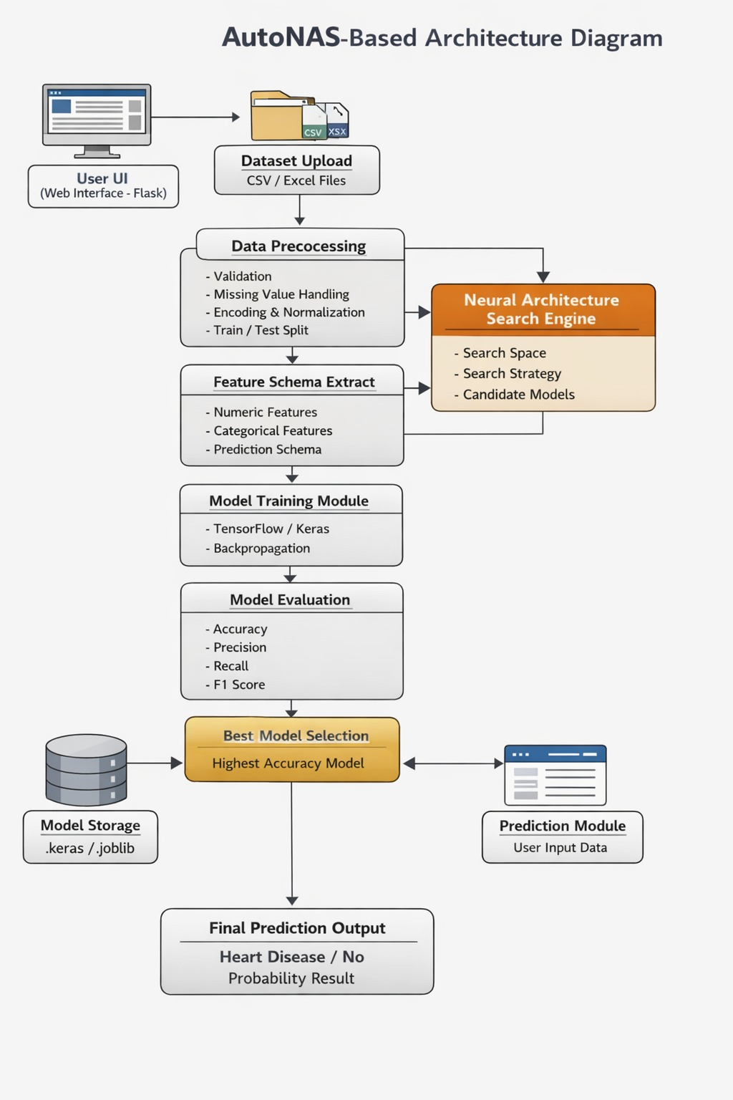
SYSTEM ARCHITECTURE

Slide 23
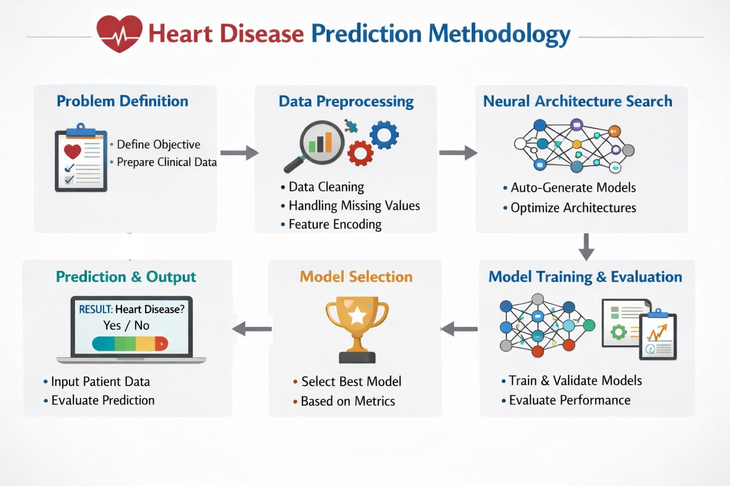
METHODOLOGY

Slide 24
METHODOLOGY
The proposed system focuses on developing an automated heart disease prediction model.
It uses Neural Architecture Search (NAS) to design the model.
The system automatically preprocesses medical data for better accuracy.
It generates multiple neural network architectures instead of using a single fixed model.
Each generated model is trained using the given dataset.
The performance of all models is evaluated and compared.
The best-performing model is selected for final prediction.
The complete process includes problem definition, data preprocessing, architecture search, model training, evaluation, and prediction.

Slide 25
METHODOLOGY
Problem Definition
The main goal of this project is to build a machine learning system to predict heart disease.
The system uses patient medical data to make predictions.
This is a supervised learning problem where the model learns from labeled data.
The model predicts whether a patient has heart disease or not.
Input features include:
Age of the patient
Sex
Type of chest pain
Resting blood pressure
Cholesterol level
Fasting blood sugar
ECG results
Maximum heart rate achieved
Exercise-induced angina
Oldpeak value
Slope of ST segment
Number of major Vessels
Thalassemia

Slide 26
METHODOLOGY
Output:
0 means no heart disease.
1 means heart disease is present.
Evaluation metrics used:
Accuracy checks overall correctness.
Precision measures correct positive predictions.
Recall measures how many actual positives are foundF1-score balances. precision and recall.
Confusion matrix shows prediction results clearly.

Slide 27
METHODOLOGY
2. Data Collection and Preprocessing
The dataset can be collected from hospitals or public sources like Cleveland dataset.
Before training, data must be cleaned and prepared properly.
Data Validation
The dataset is checked for errors and correctness.
Missing values are identified.
Incorrect data types are corrected.
Empty columns are removed.
Target labels are verified.
Invalid data is removed to improve accuracy.
Handling Missing Values
Missing numerical values are replaced with mean or median.
Missing categorical values are replaced with mode.
Rows with too many missing values are removed.
This step ensures complete and clean data.

Slide 28
METHODOLOGY
Feature Encoding
Some data values are categorical and need conversion.
Label encoding assigns numbers to categories.
One-hot encoding creates binary columns.
This helps the neural network understand the data.
Data Normalization
Features may have different ranges.
Large values can affect learning negatively.
Min–Max scaling brings values between 0 and 1.Standardization scales data around mean.
This improves model performance and training speed.
Train–Test Split
Data is divided into three parts.
Training set is used to train the model.
Validation set is used to compare models.
Testing set is used for final evaluation.

Slide 29
METHODOLOGY
3.Neural Architecture Search (NAS)
NAS automatically finds the best neural network design.
It removes the need for manual model design.
It has three main components.
Search Space
Search space includes all possible model designs.
It defines different combinations of parameters.
Parameters include:
Number of hidden layers
Number of neurons
Activation functions
Dropout layers
Optimizer type
Learning Rate

Slide 30
METHODOLOGY
Search Strategy
Search strategy decides how models are generated.
It explores different architectures.
Methods include:
Random search
Evolutionary algorithms
Reinforcement learning
Gradient-based methods
Candidate Model Generation
Multiple models are created automatically.
Each model has a different structure.
All models are trained using training data.
Models are evaluated using validation data.

Slide 31
METHODOLOGY
4. Model Training and Evaluation
Each generated model is trained on the dataset.
The model learns by adjusting weights using backpropagation.
Training settings include:
Loss function is binary cross-entropy
Optimizer can be Adam or SGD
Activation functions include ReLU, Sigmoid, and Tanh
Training runs for multiple epochs
After training, models are evaluated.
Performance is measured using accuracy, precision, recall, and F1-score.
Results are stored for comparison.

Slide 32
METHODOLOGY
5. Model Selection
The best model is selected after evaluation.
Selection is based on performance metrics.
Criteria include:
Highest validation accuracy
Lowest loss
Best F1-score
This model is considered the optimal architecture.
It is used for future predictions.

Slide 33
METHODOLOGY
6. System Interface
The system provides a simple user interface.
Users can upload datasets.
Users can start architecture search.
Models are trained automatically.
Results are displayed clearly.
Users can make predictions easily.
No deep technical knowledge is required.

Slide 34
METHODOLOGY
7. Prediction Process
The final model is used to predict new cases.
Steps include:
User enters patient data
Data is preprocessed
Trained model is applied
Prediction is generated
Output:
Shows whether disease is present or not
Provides probability value
This helps in early detection of heart disease

Slide 35
TECHNOLOGY USED
SOFTWARE REQUIREMENTS:
Programming & Development
Python – Core programming language
TensorFlow / Keras – Deep learning framework
Evolutionary Algorithm – Architecture optimization
2. Web Development
Flask – Backend web framework
HTML, CSS, JavaScript – Frontend interface
Server-Sent Events (SSE) – Real-time updates
3. Dataset & Processing
Heart Disease Dataset (CSV format)
NumPy, Pandas – Data handling
Scikit-learn – Preprocessing & train-test split
HARDWARE REQUIREMENTS:
Processor: i3 or higher
RAM: Minimum 8 GB
Storage: At least 512 MB free space
GPU: Optional (for faster training)
Display: 1366×768 resolution or higher

Slide 36
IMPLEMENTATION
1. Project Structure & Technology Stack
Developed using Python + Flask (backend)
Deep learning using TensorFlow / Keras
Data processing using Pandas & Scikit-learn
Web interface for training and prediction
System divided into:
Data pipeline
NAS engine
Web application

Slide 37
IMPLEMENTATION
2. Data Pipeline
Dataset uploaded by user (CSV/Excel)
Missing values handled (mean/mode)
Categorical data encoded
Data normalized for better training
Dataset split into:
Training
Validation
Testing

Slide 38
IMPLEMENTATION
3. Neural Architecture Search
Multiple neural networks generated automatically
Different configurations:
Layers
Neurons
Activation functions
Models trained on dataset
Performance evaluated using:
Accuracy
Precision / Recall
Best model selected automatically

Slide 39
IMPLEMENTATION
4. Prediction System
User inputs patient data
Data is preprocessed
Best trained model used for prediction
Output:
Disease present / not present
Probability score
Simple web interface for easy usage

Slide 40
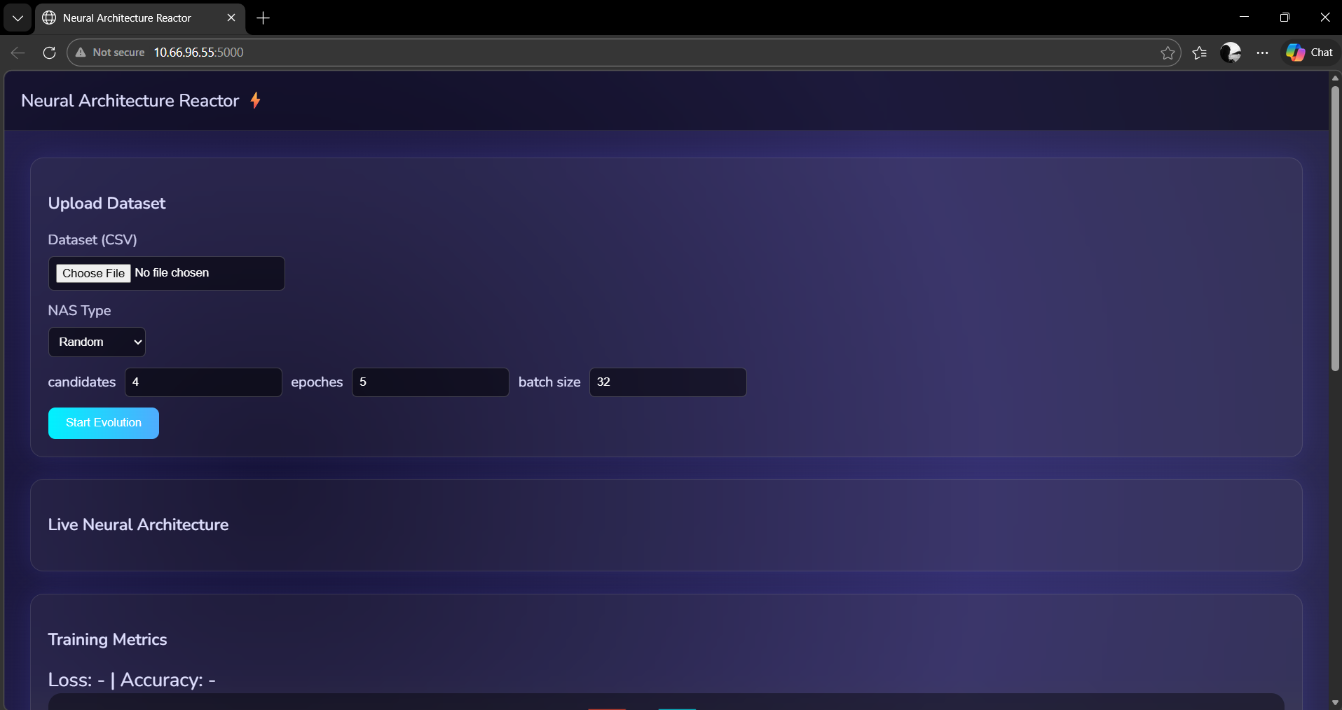
INTERIM RESULTS

Slide 41
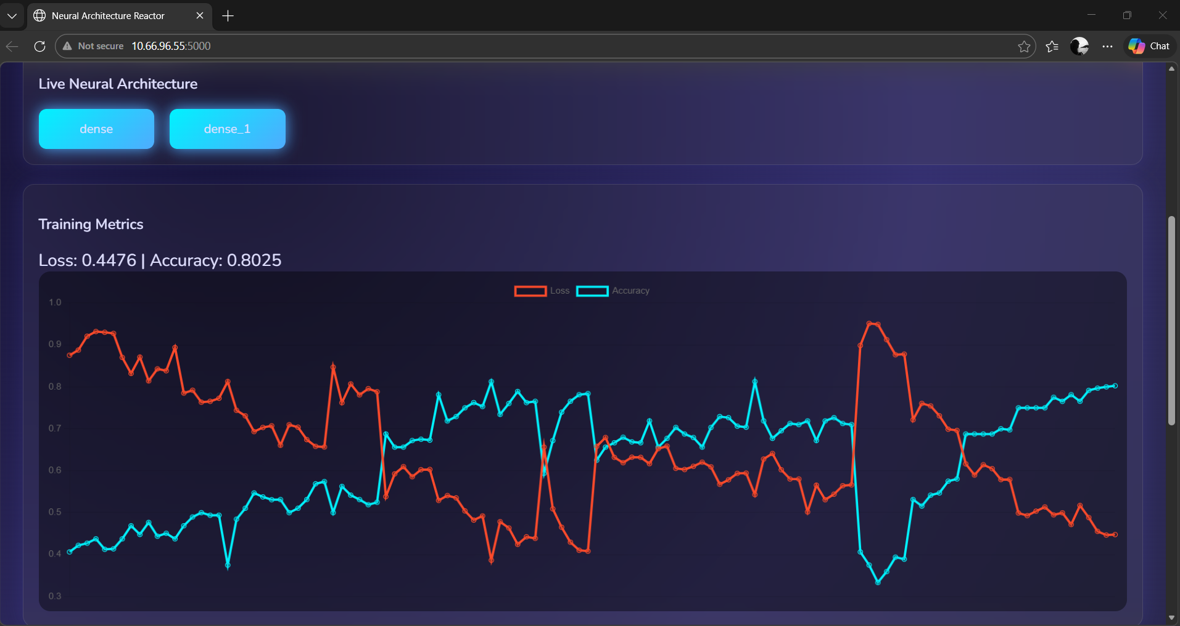
INTERIM RESULTS

Slide 42
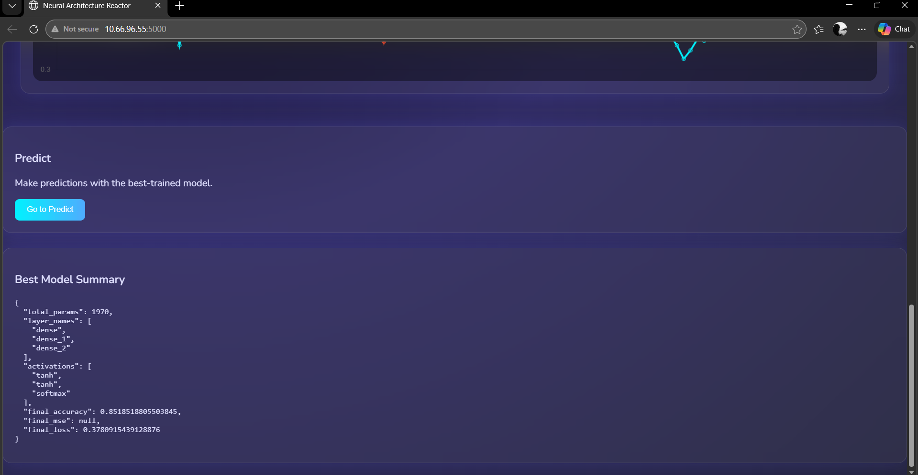
INTERIM RESULTS

Slide 43

PROJECT TIMELINE

Slide 44
CONCLUSION
Heart disease is a leading cause of death; early detection is important.
Manual diagnosis can be complex and time-consuming.
This project uses an AI-based system for heart disease prediction.
It uses Evolutionary Neural Architecture Search (NAS).NAS automatically finds the best neural network model.
The system improves prediction accuracy.
It is efficient, scalable, and easy to use.
It helps doctors and improves patient outcomes.

Slide 45
REFERENCES
[1] R. Detrano et al., "International application of a new probability algorithm for the diagnosis of coronary artery disease," Am. J. Cardiol., vol. 64, pp. 304–310, 1989.
[2] H. Liu, K. Simonyan, and Y. Yang, "DARTS: Differentiable Architecture Search," in Proc. ICLR, 2019.
[3] V. V. Ramalingam, A. Dandapath, and M. K. Raja, "Heart disease prediction using machine learning techniques: a survey," Int. J. Eng. Technol., vol. 7, no. 2.8, pp. 684–687, 2018.
[4] B. Zoph and Q. V. Le, "Neural Architecture Search with Reinforcement Learning," in Proc. ICLR, 2017.
[5] T. Elsken, J. H. Metzen, and F. Hutter, "Neural Architecture Search: A Survey," J. Mach. Learn. Res., vol. 20, pp. 1–21, 2019.
[6] S. Ö. Arık and T. Pfister, "TabNet: Attentive Interpretable Tabular Learning," in Proc. AAAI, vol. 35, pp. 6679–6687, 2021.
[7] X. He, K. Zhao, and X. Chu, "AutoML: A Survey of the State-of-the-Art," Knowl.-Based Syst., vol. 212, p. 106622, 2021.
[8] H. A. Al-Alshaikh et al., "Comprehensive evaluation and performance analysis of machine learning in heart disease prediction," Sci. Rep., vol. 14, p. 9819, 2024.

Slide 46
REFERENCES
[9] H. Cai, L. Zhu, and S. Han, "ProxylessNAS: Direct Neural Architecture Search on Target Task and Hardware," in Proc. ICLR, 2019.
[10] E. Real, A. Aggarwal, Y. Huang, and Q. V. Le, "Regularized Evolution for Image Classifier Architecture Search," in Proc. AAAI, vol. 33, pp. 4780–4789, 2019.
[11] H. Pham, M. Y. Guan, B. Zoph, Q. V. Le, and J. Dean, "Efficient Neural Architecture Search via Parameter Sharing," in Proc. ICML, pp. 4095–4104, 2018.
[12] S. Xie, H. Zheng, C. Liu, and L. Lin, "SNAS: Stochastic Neural Architecture Search," in Proc. ICLR, 2019.
[13] X. Dong and Y. Yang, "NAS-Bench-201: Extending the Scope of Reproducible Neural Architecture Search," in Proc. ICLR, 2020.
[14] H. D. Masethe and M. A. Masethe, "Prediction of heart disease using classification algorithms," in Proc. World Congr. Eng. Comput. Sci. (WCECS), vol. II, pp. 809–812, 2014.
[15] C. Ordonez, "Association rule discovery with the train and test approach for heart disease prediction," IEEE Trans. Inf. Technol. Biomed., vol. 10, no. 2, pp. 334–343, 2006.
[16] M. S. Ekambareesh and K. B. V. Prasad, "Heart Disease Prediction using Machine Learning Algorithms," IJMRSET, vol. 7, no. 9, 2024, doi: 10.15680/IJMRSET.2024.0709023.

Slide 47

THANK YOU

Slide 48
Additional Supporting Paper Connected to AutoNAS Project
Title: Heart Disease Prediction using Machine Learning Algorithms
Authors: Mandavalli Sathi Ekambareesh, Kantipudi Budda Vara Prasad (2024)
Source: International Journal of Multidisciplinary Research in Science, Engineering and Technology (IJMRSET), Vol. 7, Issue 9
DOI: 10.15680/IJMRSET.2024.0709023 | PDF: 16_Ekambareesh_2024_Heart_ML_Algorithms.pdf
Project Connection (AutoNAS):
• Directly supports AutoNAS baseline benchmarking on the same heart disease problem; provides classical-ML reference points that AutoNAS is designed to outperform with automated architecture search.
Key Result:
• Best reported model: Gradient Boosting with 88.5% accuracy.

