Slide 1



ADAPTIVE PLANT WATERING TECHNOLOGY

Slide 2
PROBLEM STATEMENT:
Designing an intelligent and adaptable irrigation system to optimize plant watering based on individual plant types, considering factors such as species-specific water requirements, soil conditions, and climate variations. The challenge is to develop a system that efficiently manages water distribution, ensuring adequate hydration for diverse plant species while minimizing water wastage.

Slide 3
OBJECTIVE:
Develop an intelligent plant irrigation system that customizes watering schedules and amounts based on the distinct water requirements of various plant species. This aims to enhance plant growth by providing optimal hydration while minimizing water wastage.
Implement an automated and user-friendly interface, incorporating real-time monitoring and control features. This includes the utilization of sensors and microcontrollers to ensure efficient water distribution, adaptability to environmental changes, and the collection of data-driven insights for continuous improvement.

Slide 4
ABSTRACT:
This project introduces an intelligent plant irrigation system leveraging real-time monitoring and automation to tailor watering schedules for diverse plant species. By utilizing soil moisture sensors and microcontrollers, the system optimizes hydration, fostering optimal plant growth while minimizing water usage.
The user-friendly interface allows remote control and monitoring, facilitating customization of settings. Adaptability to environmental changes, including weather conditions, ensures resource efficiency. The project aims to provide sustainable and data-driven precision irrigation for enhanced agricultural and horticultural practices.

Slide 5
EXISTING SYSTEM:
Traditional irrigation systems follow fixed schedules, often leading to inefficient water usage and potential harm to plants due to overwatering.
The proposed intelligent plant irrigation system utilizes soil moisture sensors and automation to tailor watering schedules, optimizing resource usage and promoting healthier plant growth through personalized hydration.

Slide 6
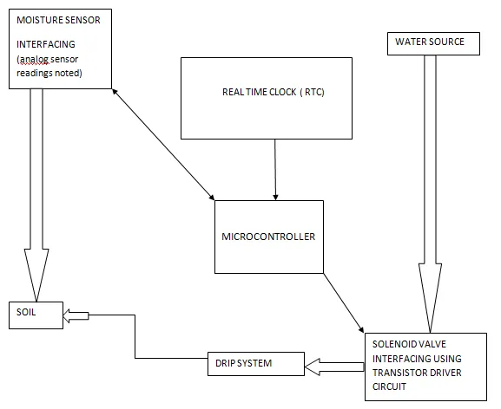
BLOCK DIAGRAM:

Slide 7
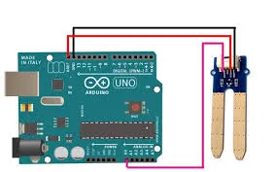
Moisture sensor Interface:
The moisture sensor interface enables communication between sensors and Arduino, converting analog signals to digital data for interpretation. It facilitates precise assessment soil moisture, leading to customized irrigation cycles for different plant species. Integration of multiple sensors ensures adaptable watering schedules, optimizing water usage. This interface is essential for promoting efficient plant growth in the smart irrigation system.

Slide 8
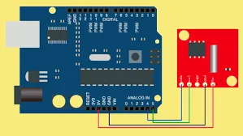
RTC Timer Interface:
The Real-Time Clock (RTC) timer interface serves a crucial role in the project by providing accurate timekeeping functionality. Its primary function is to synchronize irrigation cycles based on preset schedules, such as watering intervals during specific times of the day. The RTC timer ensures that irrigation occurs at the designated times, optimizing water usage and promoting plant health. Additionally, it enables the system to activate moisture sensors at scheduled intervals for soil moisture assessment. Overall, the RTC timer interface plays a vital role in coordinating irrigation operations and enhancing the efficiency of the smart irrigation system.

Slide 9
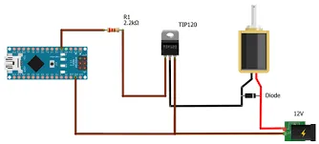
Solenoid Valve Interfacing:
The Solenoid Valve Interfacing component regulates water flow based on signals from the Arduino, allowing precise irrigation control. It opens to supply water when needed, based on soil moisture data, and closes to conserve water when irrigation is unnecessary. This interface optimizes watering, promoting healthy plant growth in the system.

Slide 10
WORKING:
1. Each plant species has its own unique water requirement, which is determined using moisture sensors that analyze soil resistance, reflecting the varying soil conditions.
2. Timers activate the moisture sensors during designated intervals, such as 7am to 8am and 5pm to 6pm, to assess soil moisture levels.
3. If the soil resistance surpasses a predetermined threshold, indicating dry soil, irrigation is initiated through current-controlled solenoid valves.
4. The irrigation continues until the soil moisture reaches the desired preset value, ensuring plants receive adequate hydration for optimal growth.
5. Additionally, the system introduces the concept of fertigation, combining irrigation with fertilizer supply to provide plants with essential nutrients, promoting healthier growth and maximizing yield.

Slide 11
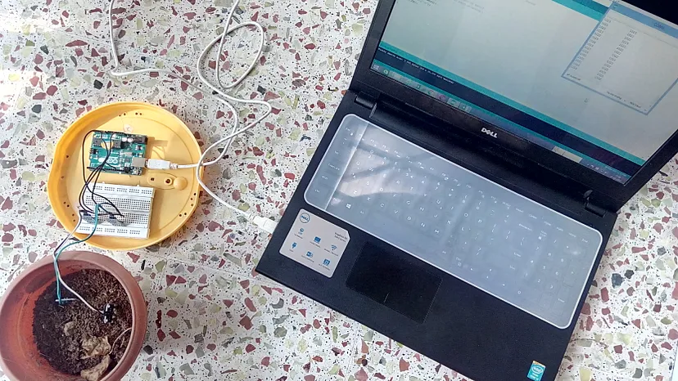
RESULT:

Slide 12
REFERENCES:
[1] S. V. Devika, SK. Khamuruddeen et aI., "Arduino based automated plant watering system" in International Journal of Advanced Research in Computer Science and Software Engineering, Volume 4, Issue 10, October 2014.
[2] Jonathan
Gana Kolo, "Design and Construction of an Automatic Power
Changeover Switch" in AU Journal of Technology,
[3] S. Darshna et aI., "Smart Irrigation System" in IOSR Journal of Electronics and
Communication Engineering (IOSR JECE), Volume 10, Issue 3, Ver. II (May - Jun.2015).
[4] Jesper Sandberg and Thomas Kockholm, ''iPlant: Inteligent Plant System", in SPCL-2012

Slide 13


