Slide 1
20cys202 user interface design assignment-3
D. Sanjai Prashad
Cb.en.u4cys21066

Slide 2
What is aums ?
Amrita University Management System(AUMS) is a comprehensive and innovative system for effective management of content, learning management services, assessment management services and learning administration services. Amrita UMS practically covers the entire area of operations of the university.
AUMS is a fully integrated, highly configurable, platform independent university wide Information System with scalability and performance at the same time ensuring to meet all the needs of an educational institution and much more.

Slide 3
Functionality of aums
Enter details for a new institution
Academic period and term period creation
Academic program definition
Course creation, offering and allocation
Class creation for a course
Assigning students and staff to a class
Attendance entry
Student graduation

Slide 4
Pros In aums
The amrita university management system completely belongs to the people of amrita university.
students and faculties can access this system. Here they can find all the information related to academics like tests, quizzes, assignment submissions, semester marks and grades, personal information.
The website is designed to keep all the information up-to-date with the latest information and resources.

Slide 5
troubles found in aums
In login page, right after we enter our login credentials when we click login, I can sometimes find the page get loaded in inappropriate way or sometimes I need to login twice or thrice to get logged in.
The consistency of back and forth between pages is slightly slow. Often the user get struck in that and faced issues during submissions, during tests, quizzes.
The alignment is different when you view the website on a smart phone because the course option won’t be visible when you view it on a phone screen.
The buttons for viewing marks, grades, and attendance is irrelevant to the above mentioned things.

Slide 6
Cons in aums
AUMS-UIE-001
This header part still can be a bit bigger in size so that the user doesn’t feel the stress by looking at that.
The icons can be bigger and eye-catchy.
The wordings in the header tag like welcome part of the user, date, day, time can find some space so that it looks good for the user.

Slide 7
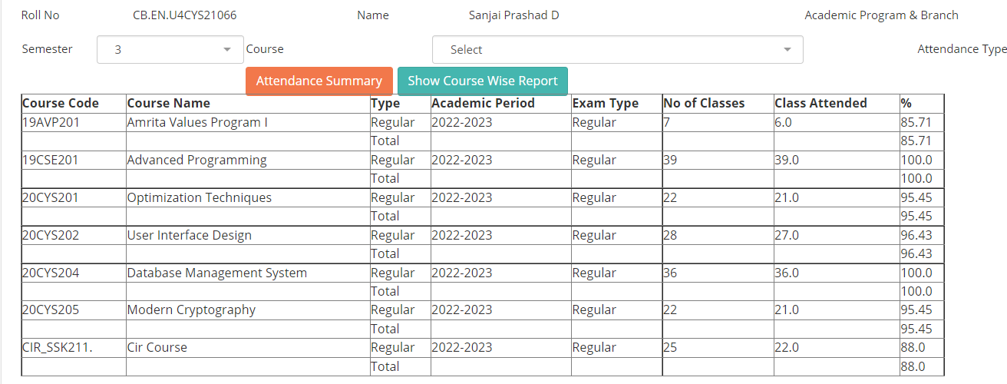
AUMS-UIE-002
This is the attendance section is not aligned properly in its original page size.
Its pages seems congested in its alignment even though it has large space.

Slide 8
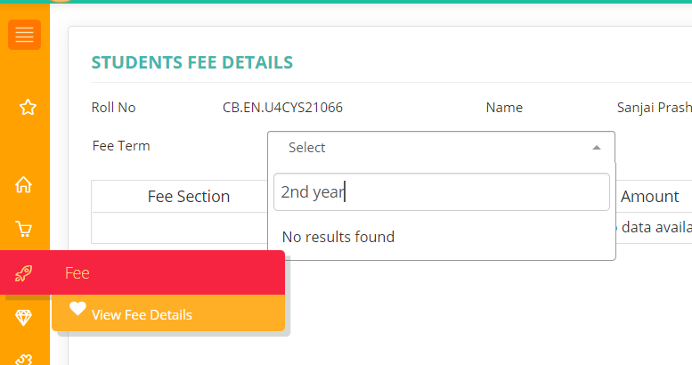
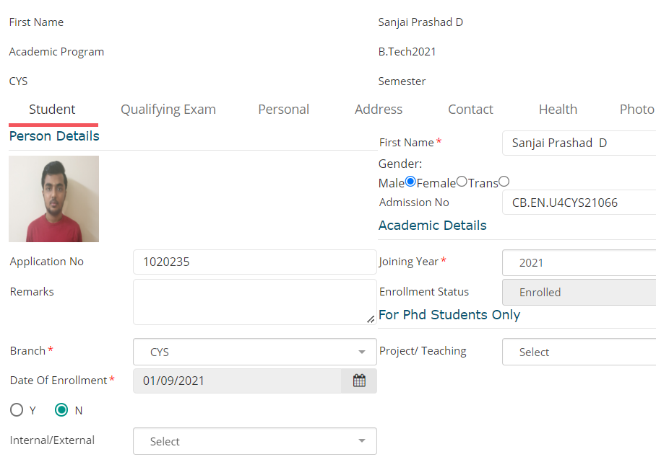
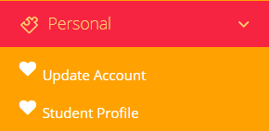
AUMS-UIE-003
This is fees section is a no use part of AUMS. Nothing displayed and nothing to check for the searched content.
AUMS-UIE-004
In the personal(student profile)region, the important credentials are editable. This may lead to some difficulties if the credentials are changed mistakenly by the user or by someone else
Also the alignment of the buttons in other tabs are improper like gender button, primary contact checking.

Slide 9

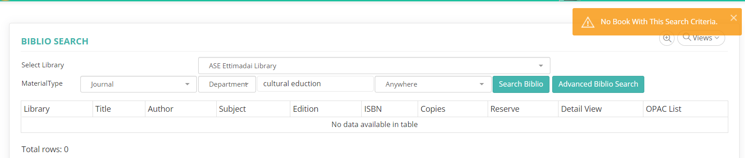
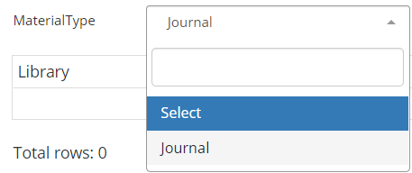
AUMS-UIE-005
The OPAC tab is to search for the books or journals present in the library.
But still it is use less because the user will not find any book or journal needed even after giving all the needed details about the book.
There is already an option called journal in OPAC tab and again u can find it in the books tab under material type.
This is one big drawback of the aums.

