Slide 1

Welcome to Doctor Appointments
A featured web app to Streamline booking Patient management Prescription handling
Developed By
Vijay kumar V, Sanjai J, Karuppiah C

Slide 2

End-to-End Flow
Patients:
Register and search for doctors based on their needs.
Book appointments by selecting the date, time, and adding a message.
Wait for admin approval.
Once approved, manage appointments and view medical history.
Doctors:
Review bookings after admin approval.
Access patient medical history to understand the case.
Provide a prescription, upload it, and mark the appointment as completed.
Admin:
Monitors and manages all bookings.
Has control over the status of appointments.
Provides insights via analytics.

Slide 3
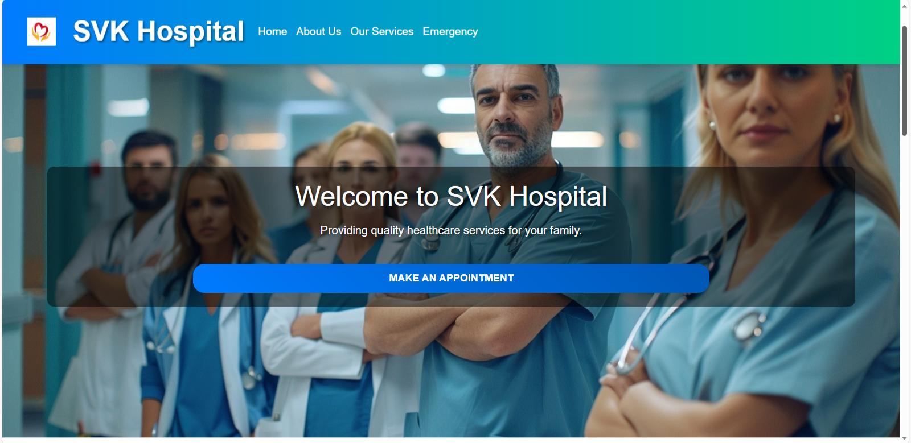
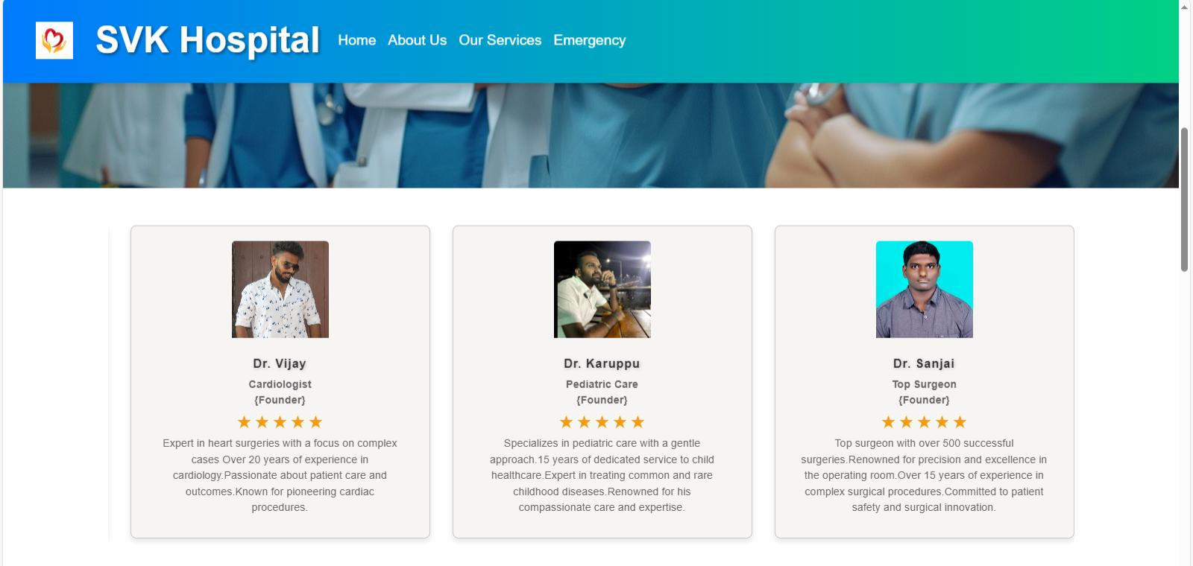
Introduction To Doctor Appointments
First let’s us provides an overview of the services and offers access to registration/login for Patients and Doctors.
Our expert doctors provide specialized care across 21 hospitals nationwide, covering 110+ specialties such as cardiac sciences, cancer care, orthopaedics, neurology, gastroenterology, liver and kidney transplants etc.

Slide 4

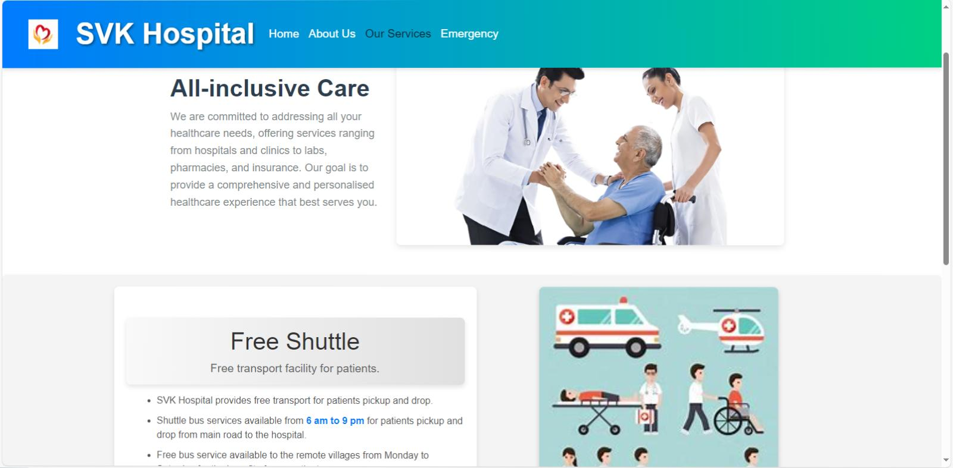
About Us & Services
* Mission Statement: SVK’s Health aims to make healthcare accessible for all, reflecting its core values of health and well-being.
* Key Milestones: Major achievements like setting a Guinness World Record and receiving global accreditations are showcased through a timeline.
* Pioneering Medical Innovations: SVK’s Health leads in breakthroughs like being Asia’s first heart hospital to implant an artificial heart.
* Honours and Recognition: Prestigious awards for patient safety and global healthcare excellence highlight its reputation
Comprehensive Healthcare: Offering a wide range of services, including hospitals, clinics, labs, pharmacies, and insurance for personalized care.
All-Inclusive Care Banner: Highlights commitment to addressing all healthcare needs with a personalized and comprehensive experience.
Free Shuttle Service: Provides free patient transportation with shuttle services running from 6 AM to 9 PM, including access to remote villages for the underprivileged.
Visuals: Banner image and shuttle service imagery effectively communicate services, enhancing engagement and understanding.

Slide 5
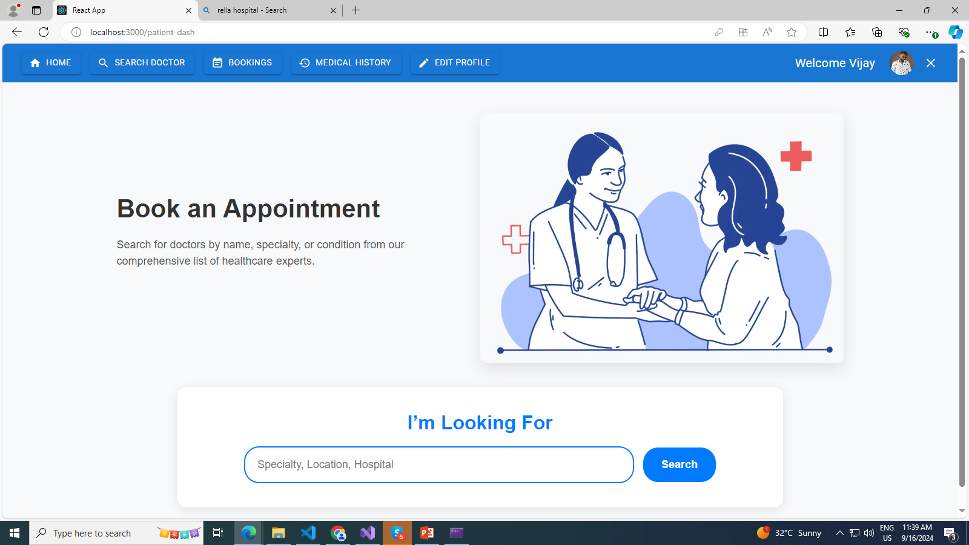
Patient Modules
Doctor Search:
Patients can search for doctors by location, specialization, or name.
Appointment Page:
Patients select doctors and schedule appointments by choosing the date, time, and sending a message to the doctor.
Notifications are sent to the admin for approval.
Bookings Page: Shows appointment status—pending, booked, completed, or cancelled.
Medical History Page:
Displays prescriptions provided by doctors.
Patients can download these prescriptions.
Profile Update: Patients can update their personal details via the profile update page.

Slide 6
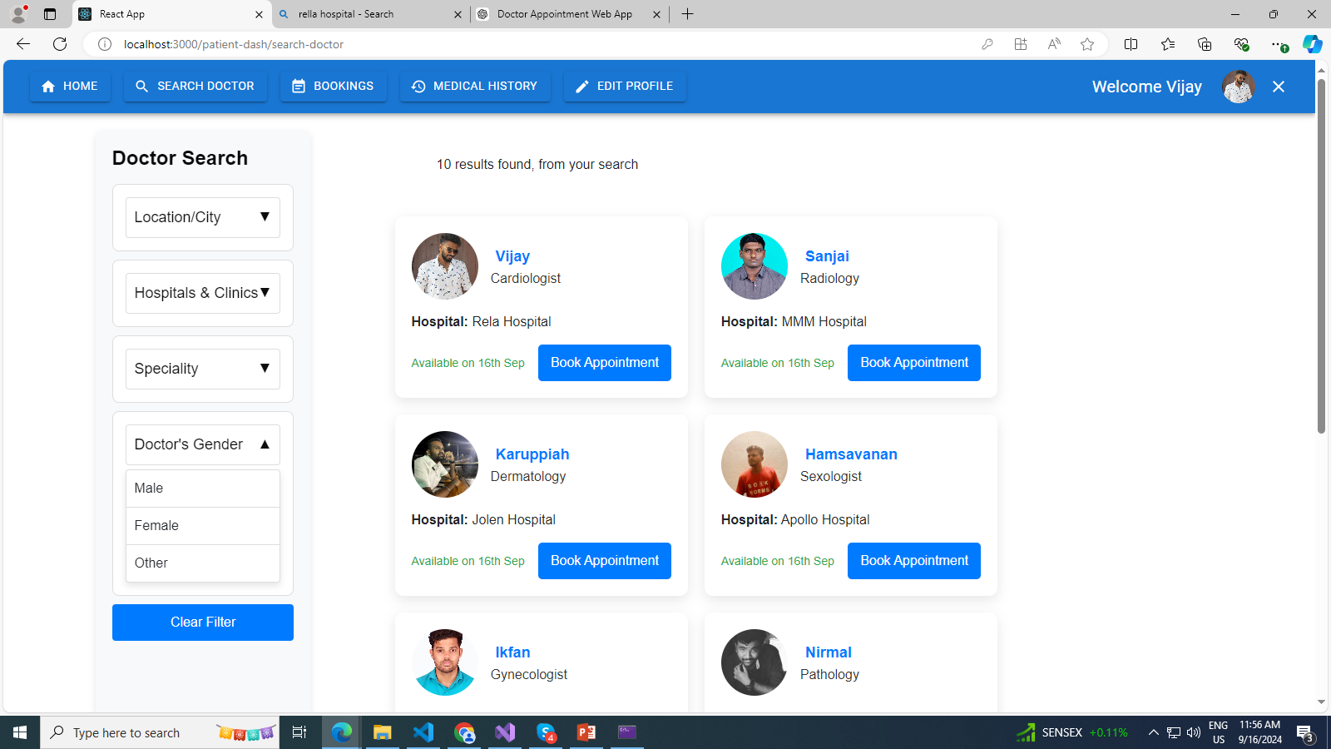
Doctor Search
Description: Patients can search for doctors using various criteria such as location, specialization, or name. This feature allows patients to easily find doctors who meet their specific needs or preferences.
Details:
Location: Patients can enter their city or ZIP code to find doctors within a certain geographical area.
Specialization: Allows patients to search based on the doctor's area of expertise (e.g., cardiology, dermatology).
Name: Patients can search for a specific doctor by their name.
Benefits: Facilitates easier and quicker access to appropriate healthcare providers, enhancing user experience and satisfaction.

Slide 7
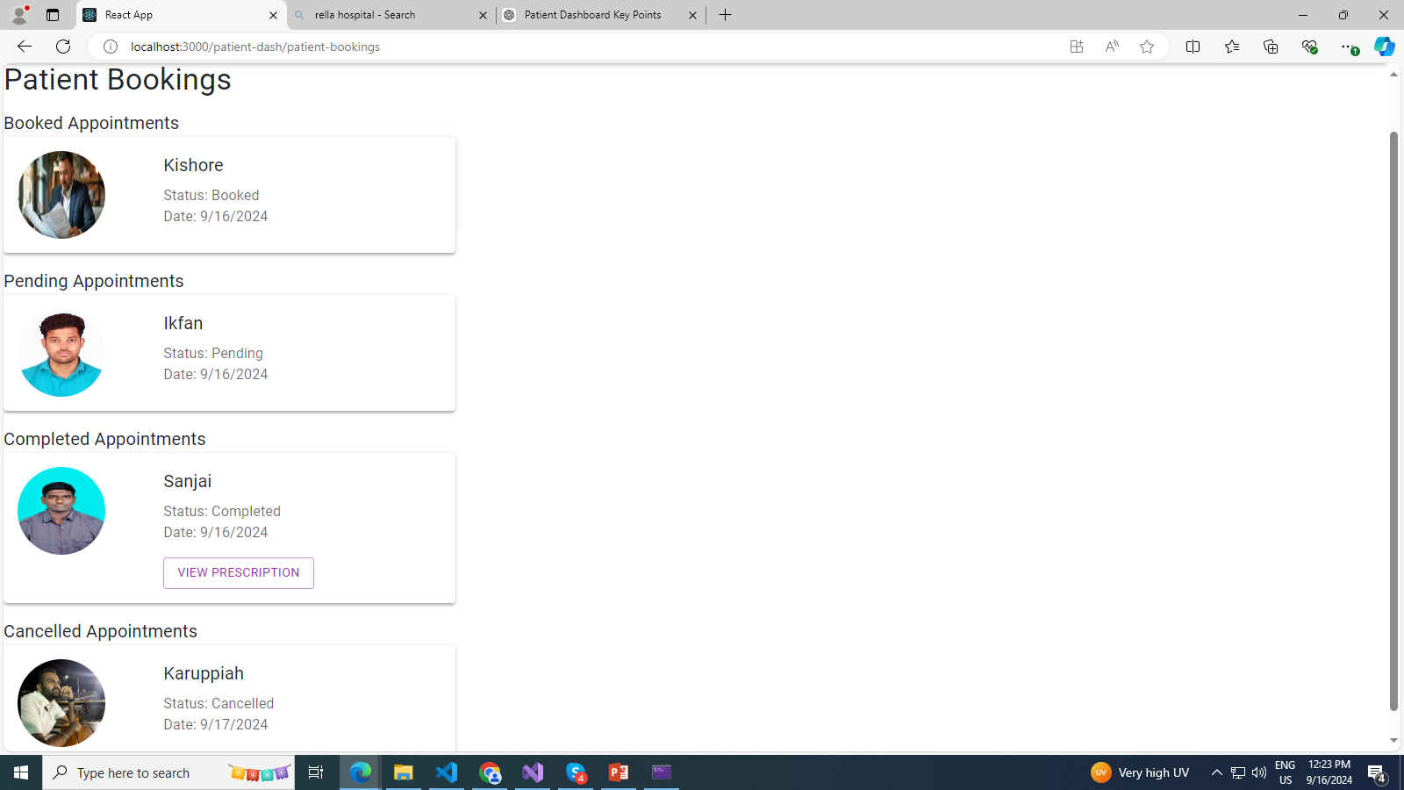
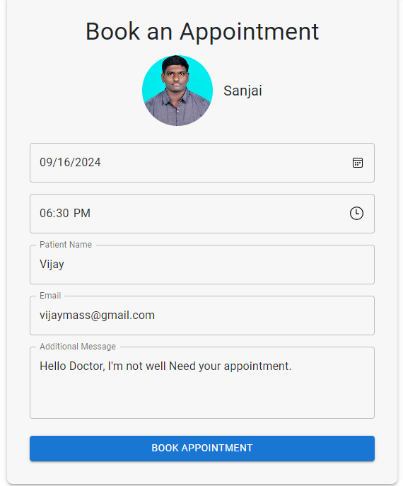
Bookings & Appointments
Doctor Selection: Patients can choose a doctor from the search results or a predefined list.
Date and Time: Allows patients to select a suitable date and time slot for the appointment.
Message: Patients can send a message to the doctor regarding their appointment or any specific concerns.
Benefits: Simplifies the booking process, provides clear communication channels, and ensures administrative oversight for appointment management.
Status Indicators: Shows appointment statuses such as "Pending," "Booked," "Completed," or "Cancelled.“
Booking History: Allows patients to view past and upcoming appointments.
Benefits: Helps patients keep track of their appointments, manage their schedule, and stay informed about their appointment status.

Slide 8
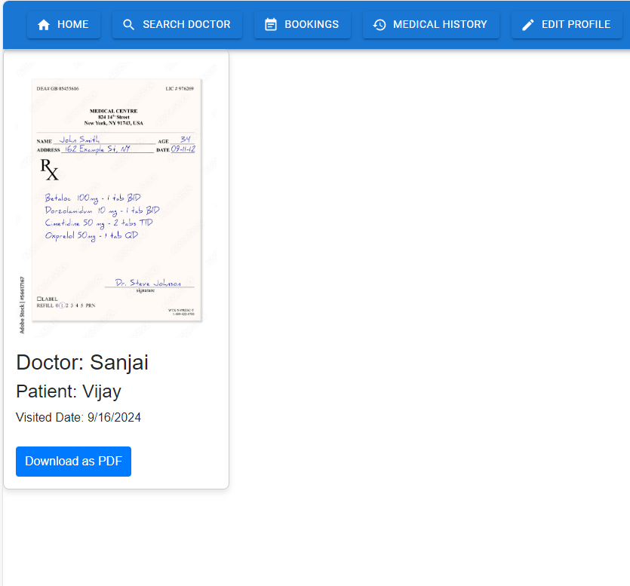
Medical History
Description: This page displays the patient's medical history, including prescriptions provided by doctors.
Details:
Prescriptions: Lists prescriptions with details such as medication name, dosage, and instructions.
Download Option: Patients can download their prescriptions for personal records or to share with other healthcare providers.
Benefits: Provides easy access to important medical records, facilitates better management of health information, and ensures patients have readily available documentation.

Slide 9
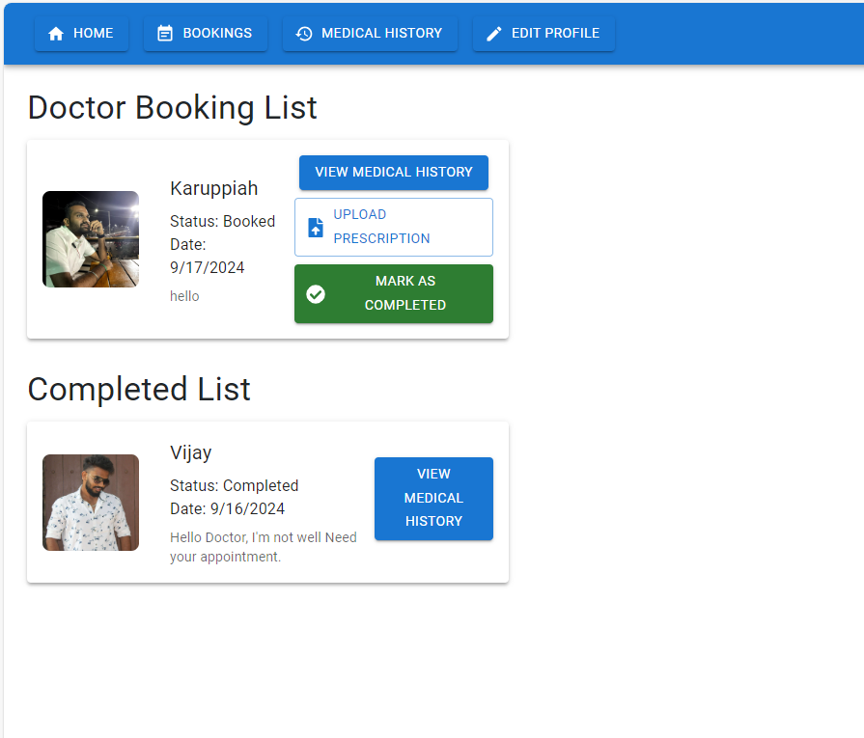
Doctor Module
Doctor Search: Doctors can search for other doctors and check their availability.
Bookings Page:
Displays appointments approved by the admin.
Shows booked patients and their medical history, including past prescriptions.
Prescription Upload: Doctors can upload prescriptions for patients and mark appointments as completed.
Profile Update: Doctors can update their availability, specialization, and contact details.

Slide 10
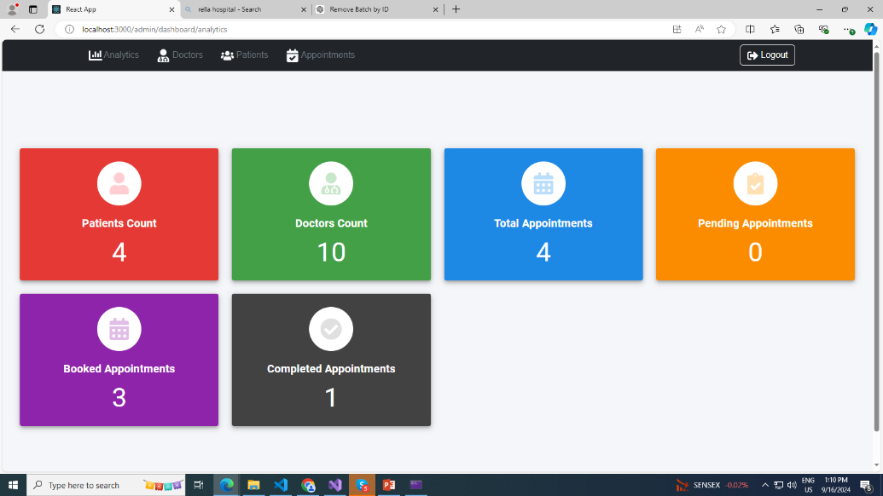
Admin Module
Analytics Dashboard
Description: This feature provides key insights into the system's data.
Details:
Number of doctor profiles: Displays the total count of doctor profiles in the system.
Number of patient profiles: Shows how many patient profiles are registered.
Total appointments booked, cancelled, and pending: Summarizes appointment status, helping in tracking and decision-making.

Slide 11
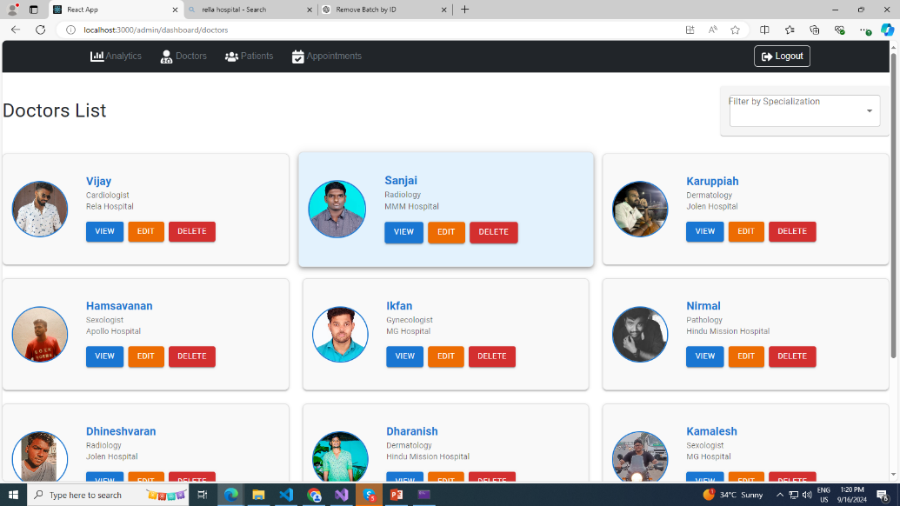
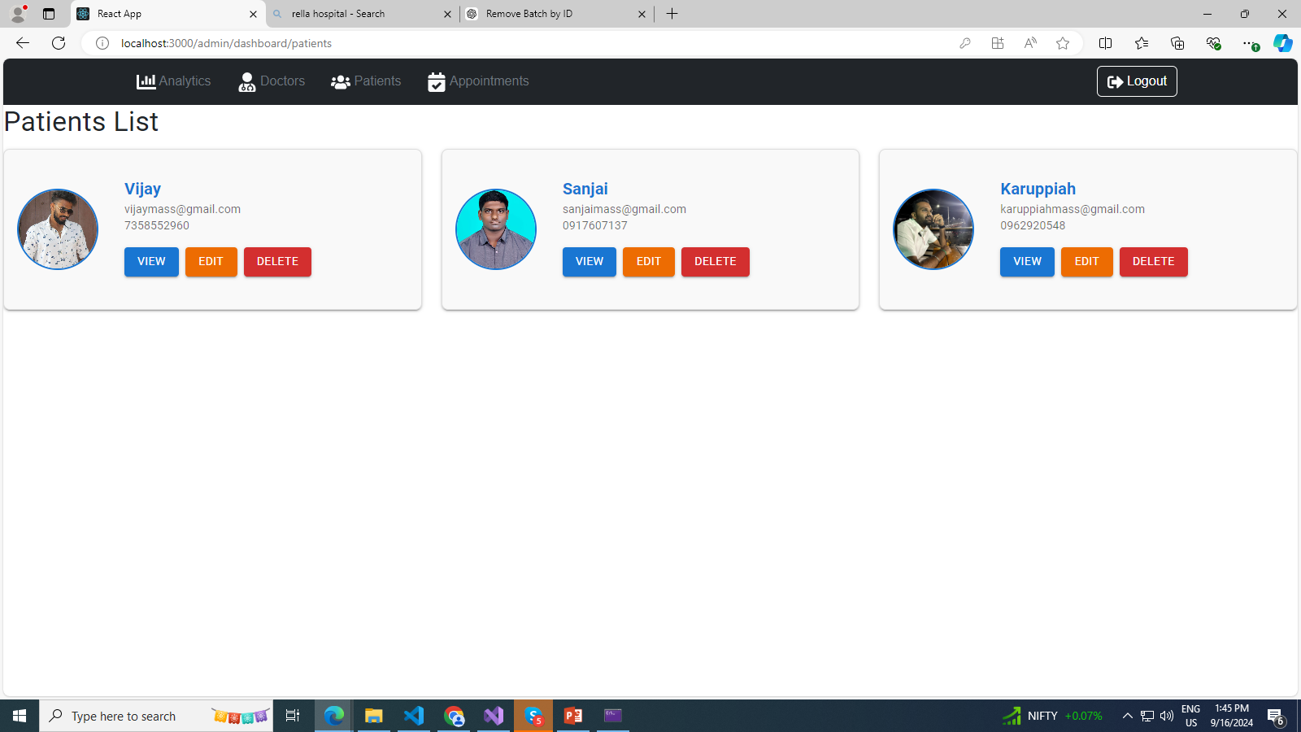
Doctor List – Patient List
1.Component Overview
Purpose: Provides an administrative interface to manage doctor profiles, including viewing, editing, and deleting doctors.
2. Filtering and Display
Functionality: Allows administrators to filter doctors by specialization and displays the results in a responsive card layout.
3. CRUD Operations
Create: Not explicitly mentioned but implied through edit functionality.
Read: View detailed information of each doctor.
Update: Edit doctor details.
Delete: Remove doctor profiles with confirmation.
4. User Interaction
Modal Dialog: Confirms delete actions to prevent accidental deletions.
Buttons: Provides options for viewing, editing, and deleting doctors directly from the card interface.
5. Data Management
Integration: Fetches and updates data from a database, ensuring that the displayed information is current and accurate.

Slide 12
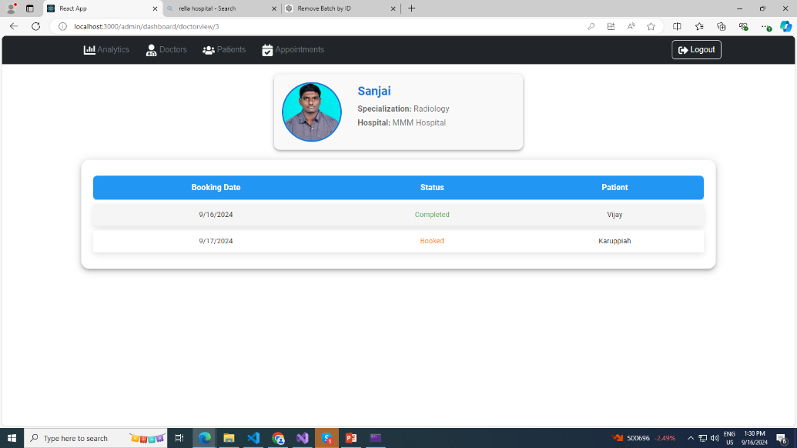
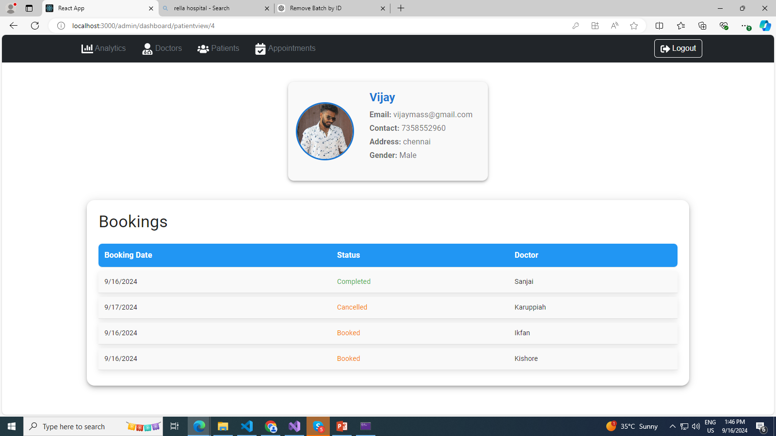
Doctor List , Patient List - View
Appointment History Table
Functionality: Shows a table of appointments related to the selected doctor, including booking date, status, and patient name.
Design: The table features styled headers and rows with responsive design and hover effects to improve user experience.
Data Retrieval
Integration: Fetches doctor details and appointment data from an API using DbService.
State Management: Utilizes React's useState and useEffect hooks to manage and display data dynamically.

Slide 13
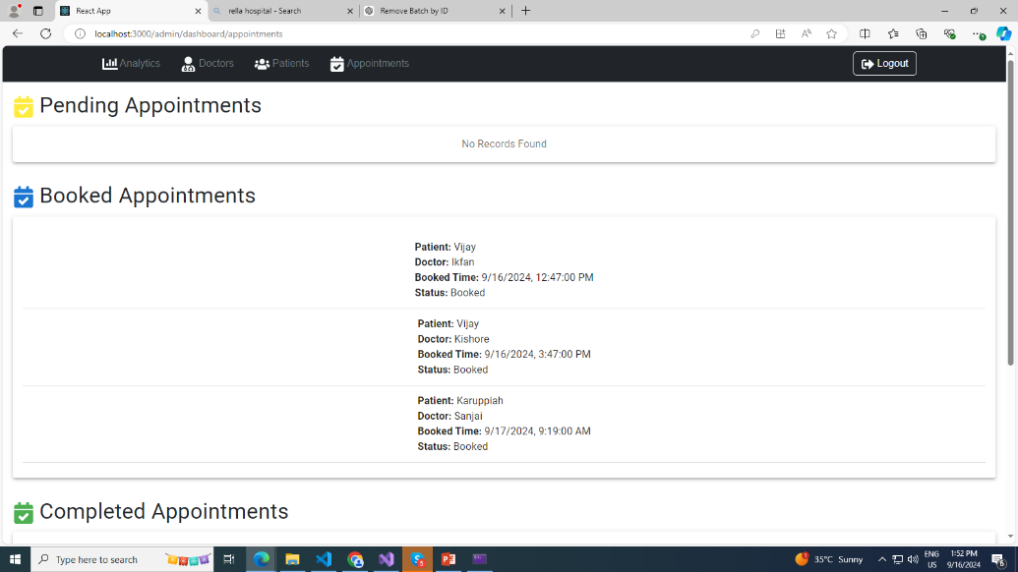
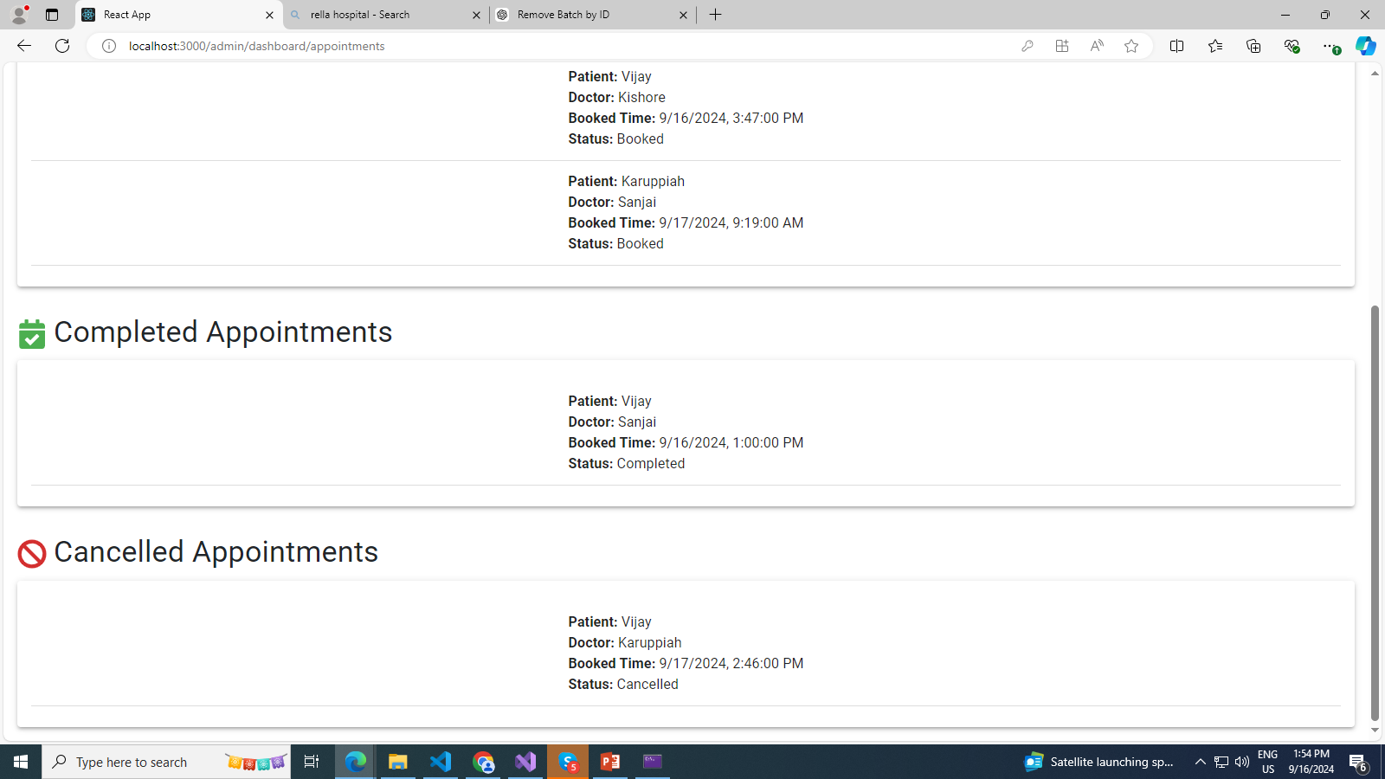
Manage Appointments
Component Overview
1.Purpose: Manages and displays different categories of appointments in a hospital setting, including Pending, Booked, Completed, and Cancelled appointments.
2. Features
Action Management: Allows for actions such as confirming or canceling appointments with a user-friendly interface.
3. User Interaction
Dialog Prompts: Offers clear confirmation dialogs to prevent accidental actions and ensure deliberate user choices.
4. User Interface
Loading and Empty States: Includes feedback mechanisms like loading spinners and "No Records Found" messages to handle various states effectively.
5. Benefits
Efficiency: Streamlines appointment management by categorizing and providing easy actions.
User Experience: Enhances user experience with clear visual cues, interactive elements, and straightforward confirmation dialogs.

Slide 14

Implementation Overview (Front-End)
Title: Key Packages Used in React
Content:
React: Core library for building user interfaces.
React-Router-Dom: Used for routing and navigation across pages.
Axios: Handles HTTP requests for data fetching from the backend.
Bootstrap & React-Bootstrap: For responsive, mobile-first UI components and layout.
MUI (Material UI): Pre-built components for creating a rich user interface.
Formik & Yup: Form handling and validation tools.
React Hook Form: Alternative for handling form state and validation.
React-Slick & Slick-Carousel: For implementing carousels and sliders.
React-Toastify: Display notifications (e.g., success, error) in the app.
JSPDF: Allows downloading data as PDFs, useful for medical prescriptions.
Emotion & Styled Components: For writing CSS in JavaScript and styling components dynamically.

Slide 15


Implementation Overview (Back-End)
Title: Key Features in .NET Backend
Content:
JWT Authentication: Secure user authentication using JSON Web Tokens
(JWT) for Admin, Doctor, and Patient roles.
Entity Framework Core: Used for data access and managing database interactions.
CORS Policy: Configured to allow cross-origin requests, enabling the React frontend
to communicate with the backend.
Role-Based Authorization: Defined policies for Admin, Doctor, and Patient roles to restrict access to certain endpoints.
Swagger Integration: Integrated Swagger for API documentation and testing.
Scoped Repositories: Dependency injection for DoctorRepository, BookingRepository, and PatientRepository to manage database operations.
JSON Serialization: Customized JSON options for preserving object references in responses.
SQL Server : Configured the HospitalContext to interact with the SQL Server database.

Slide 16
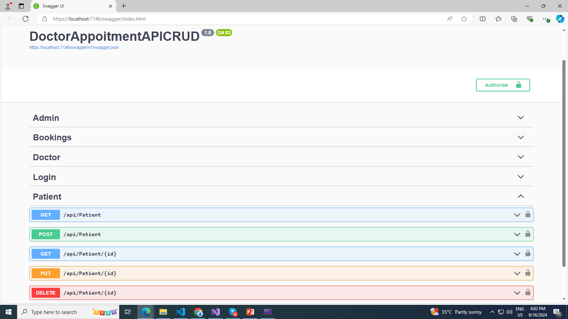
Back-End API
Request Name | Response
GetPatients (GET: api/patients) | 200 OK with the list of patients
GetPatient (GET: api/patients/{id}) | * 200 OK with the patient details . * 404 Not Found if the patient does not exist .
CreatePatient (POST: api/patients) | * 200 OK with the newly created patient . * 400 Bad Request if the provided data is invalid .
UpdatePatient (PUT: api/patients/{id}) | 200 OK with the updated patient details.
DeletePatient (DELETE: api/patients/{id}) | * 200 OK with a success message if the patient is deleted . *404 Not Found if the patient does not exist.

Slide 17

Project – Doctor Appointment
Link - Appuvj/DoctorAppoinment (github.com)

Slide 18
The End

