Slide 1
W4111 – Introduction to Databases Makeup/Continuation Lecture
© Donald F. Ferguson, 2025

Slide 2

Query Optimization
2 |W4111-2025F-Makeup-Module-II © Donald F. Ferguson, 2025

Slide 3

Reminder
3 |W4111-2025F-Makeup-Module-II © Donald F. Ferguson, 2025

Slide 4
Basic Steps in Query Processing
✓
1. Parsing and translation
2. Optimization
3. Evaluation

Slide 5
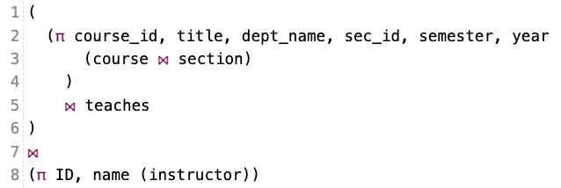
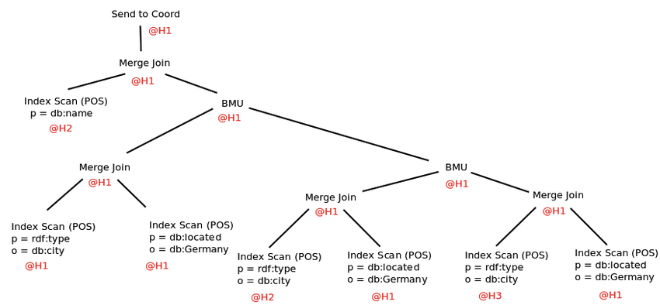
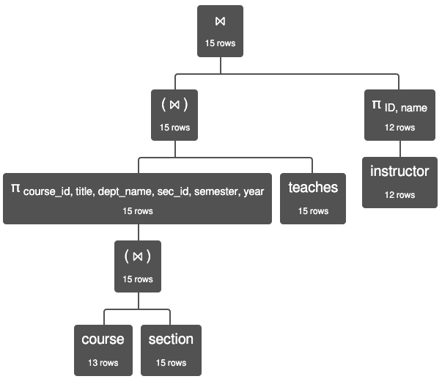
Query Processing
✓

Slide 6
✓

Slide 7
Basic Steps in Query Processing: Optimization
✓
A relational algebra expression may have many equivalent expressions
E.g., σ_{salary<75000}(∏_{salary}(instructor)) is equivalent to ∏_{salary}(σ_{salary<75000}(instructor))
Each relational algebra operation can be evaluated using one of several different algorithms
Correspondingly, a relational-algebra expression can be evaluated in many ways.
Annotated expression specifying detailed evaluation strategy is called an evaluation-plan. E.g.,:
Use an index on salary to find instructors with salary < 75000,
Or perform complete relation scan and discard instructors with salary ≥ 75000

Slide 8
Query Optimization (Continued)
8 |W4111-2025F-Makeup-Module-II © Donald F. Ferguson, 2025

Slide 9
Outline
Introduction
Transformation of Relational Expressions
Catalog Information for Cost Estimation
Statistical Information for Cost Estimation
Cost-based optimization
Dynamic Programming for Choosing Evaluation Plans
Materialized views

Slide 10
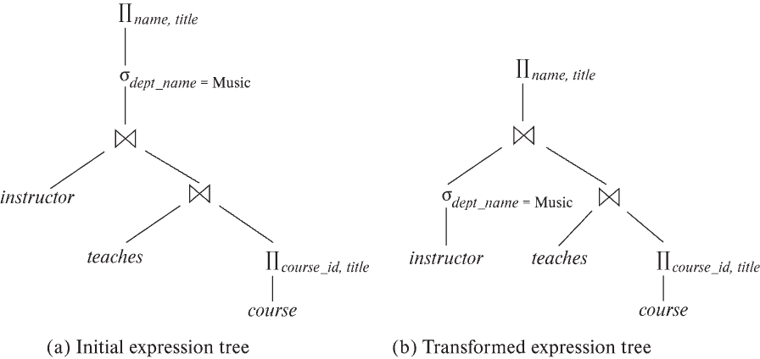
Introduction
✓
Alternative ways of evaluating a given query
Equivalent expressions
Different algorithms for each operation

Slide 11
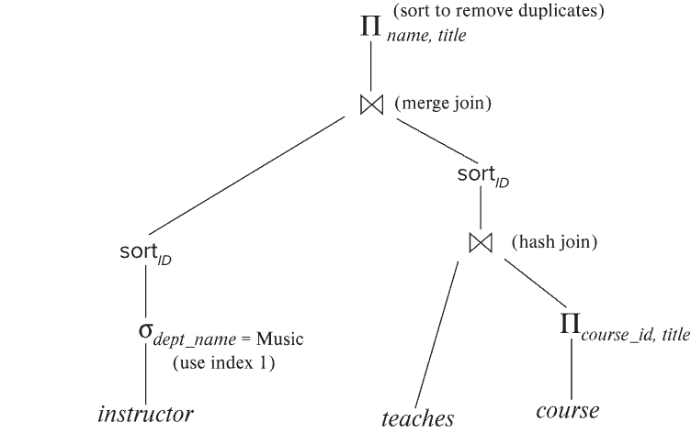
Introduction (Cont.)
✓
An evaluation plan defines exactly what algorithm is used for each operation, and how the execution of the operations is coordinated.
Find out how to view query execution plans on your favorite database

Slide 12
Introduction (Cont.)
✓
Cost difference between evaluation plans for a query can be enormous
E.g., seconds vs. days in some cases
Steps in cost-based query optimization
1. Generate logically equivalent expressions using equivalence rules
2. Annotate resultant expressions to get alternative query plans
3. Choose the cheapest plan based on estimated cost
Estimation of plan cost based on:
Statistical information about relations. Examples:
number of tuples, number of distinct values for an attribute
Statistics estimation for intermediate results
to compute cost of complex expressions
Cost formulae for algorithms, computed using statistics

Slide 13
Viewing Query Evaluation Plans
Most database support explain <query>
Displays plan chosen by query optimizer, along with cost estimates
Some syntax variations between databases
Oracle: explain plan for <query> followed by select * from table (dbms_xplan.display)
SQL Server: set showplan_text on
Some databases (e.g. PostgreSQL) support explain analyse <query>
Shows actual runtime statistics found by running the query, in addition to showing the plan
Some databases (e.g. PostgreSQL) show cost as f..l
f is the cost of delivering first tuple and l is cost of delivering all results
DFF Note: Show EXPLAIN in MySQLWorkbench

Slide 14
Generating Equivalent Expressions

Slide 15
Transformation of Relational Expressions
✓
Two relational algebra expressions are said to be equivalent if the two expressions generate the same set of tuples on every legal database instance
Note: order of tuples is irrelevant
we don’t care if they generate different results on databases that violate integrity constraints
In SQL, inputs and outputs are multisets of tuples
Two expressions in the multiset version of the relational algebra are said to be equivalent if the two expressions generate the same multiset of tuples on every legal database instance.
An equivalence rule says that expressions of two forms are equivalent
Can replace expression of first form by second, or vice versa

Slide 16
Equivalence Rules
✓
1. Conjunctive selection operations can be deconstructed into a sequence of individual selections. σ_{θ1 ∧ θ2} (E) ≡ σ_{θ1} (σ_{θ2} (E))
2. Selection operations are commutative. σ_{θ1}(σ_{θ2}(E)) ≡ σ_{θ2} (σ_{θ1}(E))
3. Only the last in a sequence of projection operations is needed, the others can be omitted. ∏ _{L1}(∏ _{L2}(…(∏ _{Ln}(E))…)) ≡ ∏ _{L1}(E) where L₁ ⊆ L₂ … ⊆ L_{n}
4. Selections can be combined with Cartesian products and theta joins.
σ_{θ} (E₁ x E₂) ≡ E₁ ⨝ _{θ} E₂
σ _{θ1} (E₁ ⨝_{θ2} E₂) ≡ E₁ ⨝ _{θ1∧θ2} E₂

Slide 17
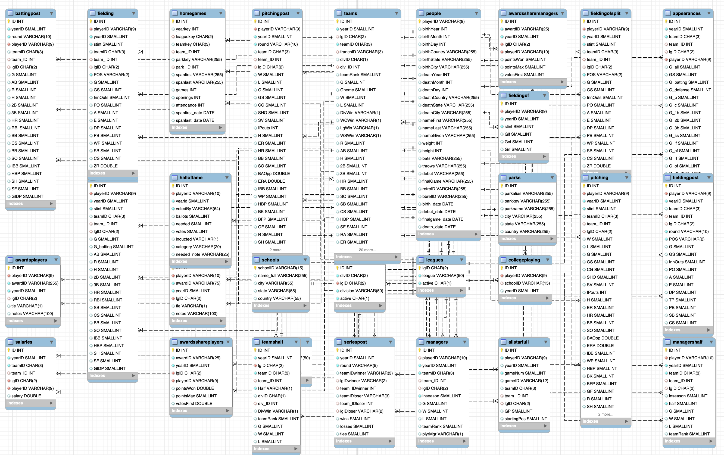
Lahman Baseball Database

Slide 18
Explanation
✓
σ_{θ1 ∧ θ2} (E) ≡ σ_{θ1} (σ_{θ2} (E)) –
What is going on here?
Why wouldn’t we just go through the table with one scan?
Consider Lahman’s Baseball Database
select * from people where throws="L" and nameLast="Williams";
people has about 20K rows ➔ a simple scan cost is O(20K)
Assume there is an index on throws and an index on nameLast.
The engine could first use the index to get matching rows producing a smaller table, and then scan the smaller result set. But which index?
Most Selective Index
select count(*) as no_of_rows, count(distinct nameLast) as nameLastValue, count(distinct throws) as throwsValues, count(*)/count(distinct nameLast) as nameLastSelectivity, count(*)/count(distinct throws) as throwsSelectivity from people;

Slide 19
Equivalence Rules (Cont.)
✓
5. Theta-join operations (and natural joins) are commutative. E₁ ⨝ E₂ ≡ E₂ ⨝ E₁
6. (a) Natural join operations are associative:
(E₁ ⨝ E₂) ⨝ E₃ ≡ E₁ ⨝ (E₂ ⨝ E₃) (b) Theta joins are associative in the following manner: (E₁ ⨝ _{θ1} E₂) ⨝ _{θ2 ∧ θ3} E₃ ≡ E₁ ⨝_{θ1 ∧ θ3} (E₂ ⨝ _{θ2} E₃) where θ₂ involves attributes from only E₂ and E₃.
These make sense when you realize having the smaller table on the right can improve performance.
This one only makes sense when you understand another rule covered in a couple of slides.

Slide 20
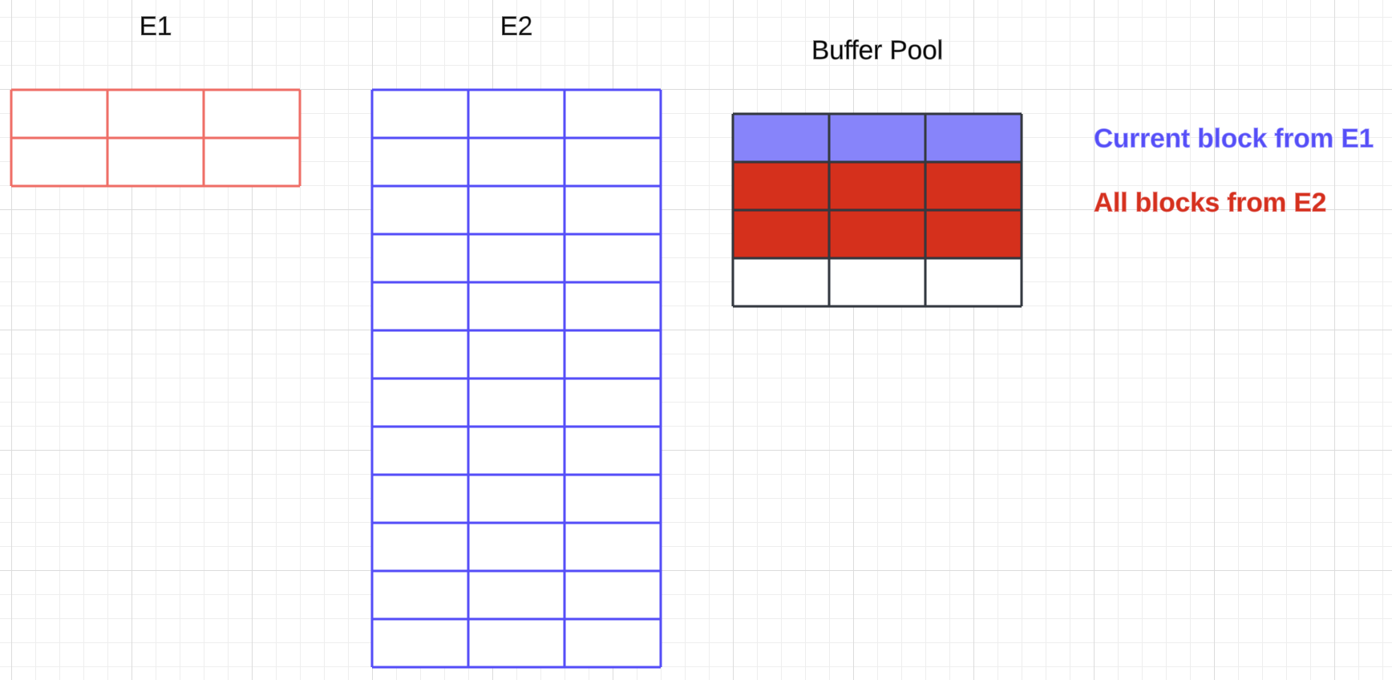
Explanation
✓
E₁ ⨝ E₂ ≡ E₂ ⨝ E₁
Assume there are no indexes ➔ Nested loop join ➔
The engine scans the left table one time.
The engine scans the right table once for each row in the left table.
If one of the tables is (much) smaller than the other, the engine prefers scanning the smaller table multiple times because it is more efficient WRT to buffer pool usage.
Extreme example
E₁ ⨝ E₂ reads 2 blocks from E₁ and access 2*12 blocks from E_{2 ,}
But the engine can only have 2 or 3 in the buffer pool ➔
Approximately 2 + 24/3 = 10 block Ios.
E₂ ⨝ E₁ accesses 12 blocks from E₂ and 12*2 blocks from E₁
But all of E₁ fits in the buffer pool ➔ 14 block I/Os

Slide 21
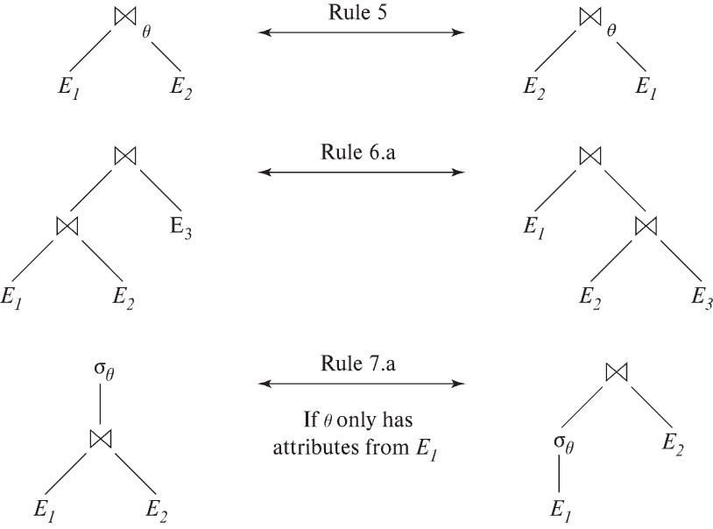
Pictorial Depiction of Equivalence Rules

Slide 22
Equivalence Rules (Cont.)
✓
7. The selection operation distributes over the theta join operation under the following two conditions: (a) When all the attributes in θ₀ involve only the attributes of one of the expressions (E₁) being joined. σ_{θ0} (E₁ ⨝_{θ} E₂) ≡ (σ_{θ0}(E₁)) ⨝_{θ} E₂
(b) When θ₁ involves only the attributes of E₁ and θ₂ involves only the attributes of E₂.
σ_{θ1 ∧ θ2} (E₁ ⨝_{θ} E₂) ≡ (σ_{θ1}(E₁)) ⨝_{θ} (σ_{θ2}(E₂))

Slide 23
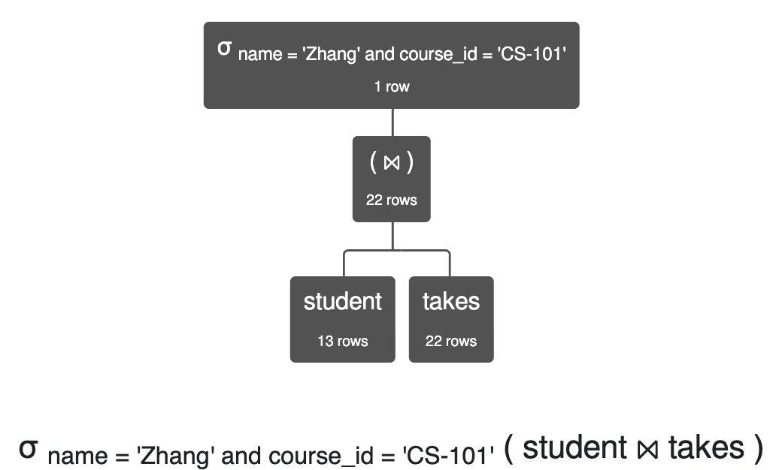
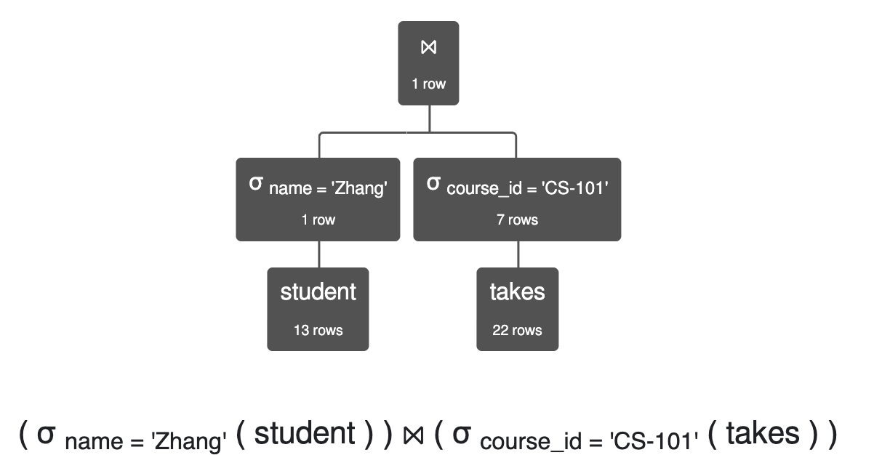
Explanation
✓
σ_{θ1 ∧ θ2} (E₁ ⨝_{θ} E₂) ≡ (σ_{θ1}(E₁)) ⨝_{θ} (σ_{θ2}(E₂))
σ name='Zhang' ∧ course_id='CS-101' (student ⨝ takes) is equivalent to (σ name='Zhang' (student)) ⨝ (σ course_id='CS-101' (takes))
Simplistically, the cost is:
(Join) 13 * 22 +
(Scan) 22
Simplistically, the cost is:
(Two scans) 13 + 22 +
(Join) 1 * 7

Slide 24
Equivalence Rules (Cont.)
8. The projection operation distributes over the theta join operation as follows:
(a) if θ involves only attributes from L₁ ∪ L₂: ∏ _{L1 ∪ L2}(E₁ ⨝_{θ} E₂) ≡ ∏ _{L1}(E₁) ⨝_{θ} ∏ _{L2}(E₂)
(b) In general, consider a join E₁ ⨝_{θ} E₂.
Let L₁ and L₂ be sets of attributes from E₁ and E₂, respectively.
Let L₃ be attributes of E₁ that are involved in join condition θ, but are not in L₁ ∪ L₂, and
let L₄ be attributes of E₂ that are involved in join condition θ, but are not in L₁ ∪ L₂. ∏ _{L1 ∪ L2}(E₁ ⨝_{θ} E₂) ≡ ∏ _{L1 ∪ L2}(∏ _{L1 ∪ L3}(E₁) ⨝_{θ} ∏ _{L2 ∪ L4}(E₂))
Similar equivalences hold for outerjoin operations: ⟕, ⟖, and ⟗
Think about this rule … …
The project makes the buffer pool consumption smaller, and
I can combine the rule with commutativity (from above).

Slide 25
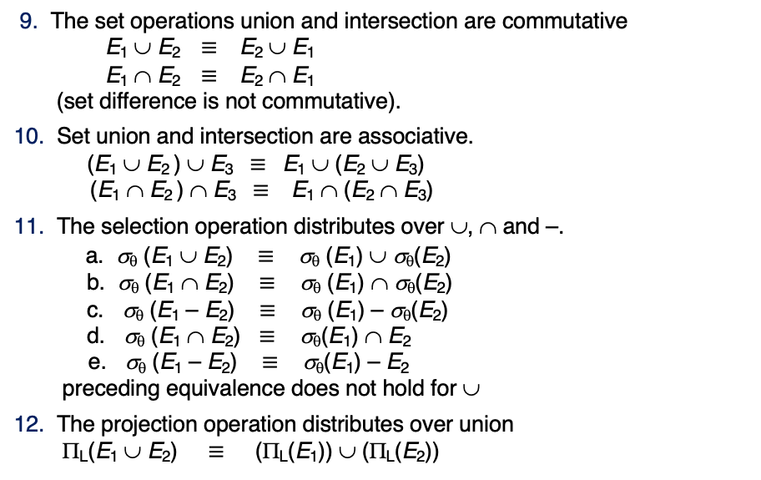
Equivalence Rules (Cont.)
9. The set operations union and intersection are commutative E₁ ∪ E₂ ≡ E₂ ∪ E₁ E₁ ∩ E₂ ≡ E₂ ∩ E₁ (set difference is not commutative).
10. Set union and intersection are associative. (E₁ ∪ E₂ ) ∪ E₃ ≡ E₁ ∪ (E₂ ∪ E₃) (E₁ ∩ E₂ ) ∩ E₃ ≡ E₁ ∩ (E₂ ∩ E₃)
11. The selection operation distributes over ∪, ∩ and –. a. σ_{θ} (E₁ ∪ E₂) ≡ σ_{θ} (E₁) ∪ σ_{θ}(E₂) b. σ_{θ} (E₁ ∩ E₂) ≡ σ_{θ} (E₁) ∩ σ_{θ}(E₂) c. σ_{θ} (E₁ – E₂) ≡ σ_{θ} (E₁) – σ_{θ}(E₂) d. σ_{θ} (E₁ ∩ E₂) ≡ σ_{θ}(E₁) ∩ E₂ e. σ_{θ} (E₁ – E₂) ≡ σ_{θ}(E₁) – E₂ preceding equivalence does not hold for ∪
12. The projection operation distributes over union Π_{L}(E₁ ∪ E₂) ≡ (Π_{L}(E₁)) ∪ (Π_{L}(E₂))
I will take their word for it.

Slide 26

Equivalence Rules (Cont.)
13. Selection distributes over aggregation as below σ_{θ}(_{G}𝛾_{A}(E)) ≡ _{G}𝛾_{A}(σ_{θ}(E)) provided θ only involves attributes in G
14. a. Full outerjoin is commutative: E₁ ⟗ E₂ ≡ E₂ ⟗ E₁ b. Left and right outerjoin are not commutative, but: E₁ ⟕ E₂ ≡ E₂ ⟖ E₁
15. Selection distributes over left and right outerjoins as below, provided θ₁
only involves attributes of E₁ a. σ_{θ1} (E₁ ⟕_{θ} E₂) ≡ (σ_{θ1} (E₁)) ⟕_{θ} E₂ b. σ_{θ1} (E₁ ⟖_{θ} E₂) ≡ E₂ ⟕_{θ} (σ_{θ1} (E₁))
16. Outerjoins can be replaced by inner joins under some conditions
a. σ_{θ1} (E₁ ⟕_{θ} E₂) ≡ σ_{θ1} (E₁ ⨝_{θ} E₂) b. σ_{θ1} (E₁ ⟖_{θ} E₁) ≡ σ_{θ1} (E₁ ⨝_{θ} E₂) provided θ₁ is null rejecting on E₂
Oh good. More rules.

Slide 27
Equivalence Rules (Cont.)
Note that several equivalences that hold for joins do not hold for outerjoins
σ_{year=2017}(instructor ⟕ teaches) ≢ σ_{year=2017}(instructor ⨝ teaches)
Outerjoins are not associative (r ⟕ s) ⟕ t ≢ r ⟕ (s ⟕ t)
e.g. with r(A,B) = {(1,1), s(B,C) = { (1,1)}, t(A,C) = { }
Notes:
How about (r ⟕ s) ⟕ t vs (r ⟕ t) ⟕ s assuming r has common attributes with s and t? Hint: consider 2 cases where s and t have common attributes and those where they have no common attribute

Slide 28
Transformation Example: Pushing Selections
✓
Query: Find the names of all instructors in the Music department, along with the titles of the courses that they teach
Π_{name, title}(σ_{dept_name= ‘Music’} (instructor ⨝ (teaches ⨝ Π_{course_id, title} (course))))
Transformation using rule 7a.
Π_{name, title}((σ_{dept_name= ‘Music’}(instructor)) ⨝ (teaches ⨝ Π_{course_id, title} (course)))
Performing the selection as early as possible reduces the size of the relation to be joined.

Slide 29
Join Ordering Example
✓
For all relations r_{1,} r_{2,} and r₃,
(r₁ ⨝ r₂) ⨝ r₃ = r₁ ⨝ (r₂ ⨝ r₃ )
(Join Associativity) ⨝
If r₂ ⨝ r₃ is quite large and r₁ ⨝ r₂ is small, we choose
(r₁ ⨝ r₂) ⨝ r₃
so that we compute and store a smaller temporary relation.

Slide 30
Join Ordering Example (Cont.)
✓
Consider the expression
Π_{name, title}(σ_{dept_name= “Music”} (instructor) ⨝ teaches) ⨝ Π_{course_id, title} (course))))
Could compute teaches ⨝ Π_{course_id, title} (course) first, and join result with σ_{dept_name= “Music”} (instructor) but the result of the first join is likely to be a large relation.
Only a small fraction of the university’s instructors are likely to be from the Music department
it is better to compute
σ_{dept_name= “Music”} (instructor) ⨝ teaches
first.

Slide 31
Enumeration of Equivalent Expressions
Query optimizers use equivalence rules to systematically generate expressions equivalent to the given expression
Can generate all equivalent expressions as follows:
Repeat
apply all applicable equivalence rules on every subexpression of every equivalent expression found so far
add newly generated expressions to the set of equivalent expressions
Until no new equivalent expressions are generated above
The above approach is very expensive in space and time
Two approaches
Optimized plan generation based on transformation rules
Special case approach for queries with only selections, projections and joins

Slide 32

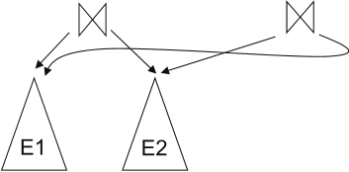
Implementing Transformation Based Optimization
Space requirements reduced by sharing common sub-expressions:
when E1 is generated from E2 by an equivalence rule, usually only the top level of the two are different, subtrees below are the same and can be shared using pointers
E.g., when applying join commutativity
Same sub-expression may get generated multiple times
Detect duplicate sub-expressions and share one copy
Time requirements are reduced by not generating all expressions
Dynamic programming
We will study only the special case of dynamic programming for join order optimization

Slide 33
Cost Estimation
✓
Cost of each operator computer as described in Chapter 15
Need statistics of input relations
E.g., number of tuples, sizes of tuples
Inputs can be results of sub-expressions
Need to estimate statistics of expression results
To do so, we require additional statistics
E.g., number of distinct values for an attribute
More on cost estimation later
Remember algorithm selection applies to the operators in each of the possible trees.

Slide 34
Choice of Evaluation Plans
✓
Must consider the interaction of evaluation techniques when choosing evaluation plans
choosing the cheapest algorithm for each operation independently may not yield best overall algorithm. E.g.
merge-join may be costlier than hash-join, but may provide a sorted output which reduces the cost for an outer level aggregation.
nested-loop join may provide opportunity for pipelining
Practical query optimizers incorporate elements of the following two broad approaches:
1. Search all the plans and choose the best plan in a cost-based fashion.
2. Uses heuristics to choose a plan.

Slide 35

Join Order Optimization Algorithm
procedure findbestplan(S) if (bestplan[S].cost ≠ ∞) return bestplan[S] // else bestplan[S] has not been computed earlier, compute it now if (S contains only 1 relation) set bestplan[S].plan and bestplan[S].cost based on the best way of accessing S using selections on S and indices (if any) on S else for each non-empty subset S1 of S such that S1 ≠ S P1= findbestplan(S1) P2= findbestplan(S - S1) for each algorithm A for joining results of P1 and P2 … compute plan and cost of using A (see next page) .. if cost < bestplan[S].cost bestplan[S].cost = cost bestplan[S].plan = plan; return bestplan[S]

Slide 36
Statistics for Cost Estimation

Slide 37
Statistical Information for Cost Estimation
n_{r}: number of tuples in a relation r.
b_{r}: number of blocks containing tuples of r.
l_{r}: size of a tuple of r.
f_{r}: blocking factor of r — i.e., the number of tuples of r that fit into one block.
V(A, r): number of distinct values that appear in r for attribute A; same as the size of ∏_{A}(r).
If tuples of r are stored together physically in a file, then:

Slide 38
Histograms
Histogram on attribute age of relation person
Equi-width histograms
Equi-depth histograms break up range such that each range has (approximately) the same number of tuples
E.g. (4, 8, 14, 19)
Many databases also store n most-frequent values and their counts
Histogram is built on remaining values only

Slide 39
Histograms (cont.)
Histograms and other statistics usually computed based on a random sample
Statistics may be out of date
Some database require a analyze command to be executed to update statistics
Others automatically recompute statistics
e.g., when number of tuples in a relation changes by some percentage

Slide 40
Selection Size Estimation
✓
σ_{A=v}(r)
n_{r} / V(A,r) : number of records that will satisfy the selection
Equality condition on a key attribute: size estimate = 1
σ_{A≤V}(r) (case of σ_{A ≥ V}(r) is symmetric)
Let c denote the estimated number of tuples satisfying the condition.
If min(A,r) and max(A,r) are available in catalog
c = 0 if v < min(A,r)
c =
If histograms available, can refine above estimate
In absence of statistical information c is assumed to be n_{r} / 2.

Slide 41
Size Estimation of Complex Selections
✓
The selectivity of a condition θ_{i} is the probability that a tuple in the relation r satisfies θ_{i} .
If s_{i} is the number of satisfying tuples in r, the selectivity of θ_{i} is given by s_{i} /n_{r}.
Conjunction: σ_{θ1∧ θ2∧. . . ∧ θn} (r). Assuming independence, estimate of tuples in the result is:
Disjunction:σ_{θ1∨} _{θ2 ∨. . . ∨} _{θn} (r). Estimated number of tuples:
Negation: σ_{¬θ}(r). Estimated number of tuples: n_{r} – size(σ_{θ}(r))
You do not need to know the material with the strikethrough.

