Slide 1

Appsbroker Tasks Discussion
By: Sanjai Kumar Dugasani
Date: 27 January 2022

Slide 2
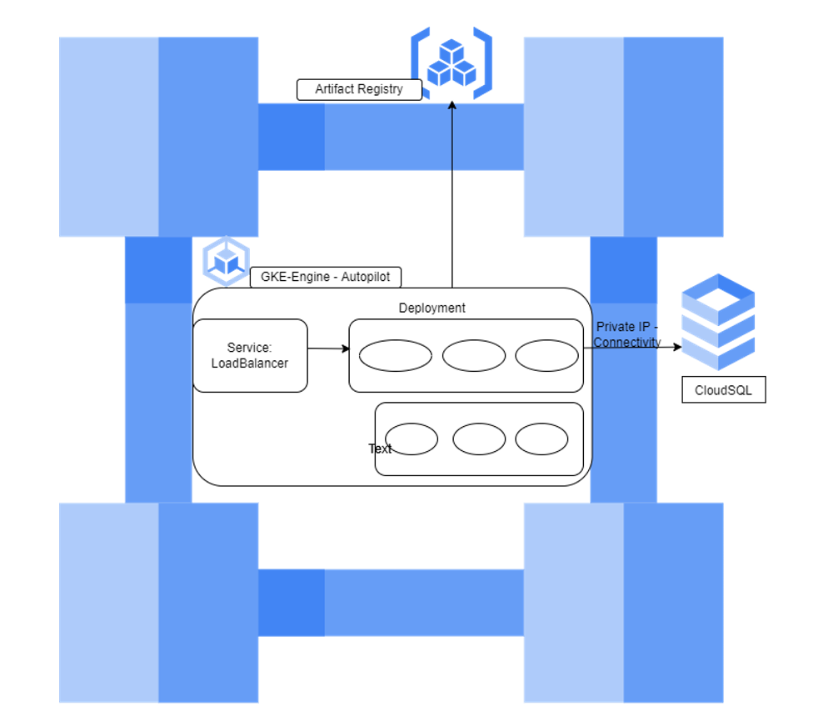
High Level Design:

Slide 3
Services Used In Google Cloud:
GKE – Autopilot
CloudSQL –PostgrSQL
Artifact Registry

