Slide 1

Vel Tech High Tech Dr.Rangarajan Dr.Sakunthala
Engineering College
Handwritten Digit Recognition Using Convolutional Neural Networks
Venkatesh P, Vignesh Kumar C , Vinoth Kumar M
¹Department of Artificial Intelligence & Data Science
 |  | Abstract Handwritten digit recognition is a fundamental problem in pattern recognition and computer vision with important applications in postal automation, bank cheque processing, and document digitization. This study proposes a Convolutional Neural Network (CNN)-based model for classifying handwritten digits using the MNIST dataset. The proposed method involves image preprocessing, feature extraction through convolutional filters, and classification via fully connected layers. Experimental results show the model achieves 99% accuracy on unseen test samples, demonstrating robustness and scalability. The results confirm the effectiveness of CNNs for real-world handwritten digit recognition tasks. The study also compares the performance against traditional machine learning approaches, highlighting the advantage of deep learning in complex image interpretation. Keywords Handwritten Digit Recognition, Convolutional Neural Network, MNIST, Deep Learning, Image Classification
1. Introduction
Handwritten digit recognition systems aim to automatically interpret hand-drawn digits into machine-readable format. Their applications are widespread in fields like postal delivery, automated banking systems, form digitization, and educational technologies. Traditional machine learning models rely on manual feature extraction and often fail to generalize well across diverse handwriting styles and image distortions
1

Slide 2
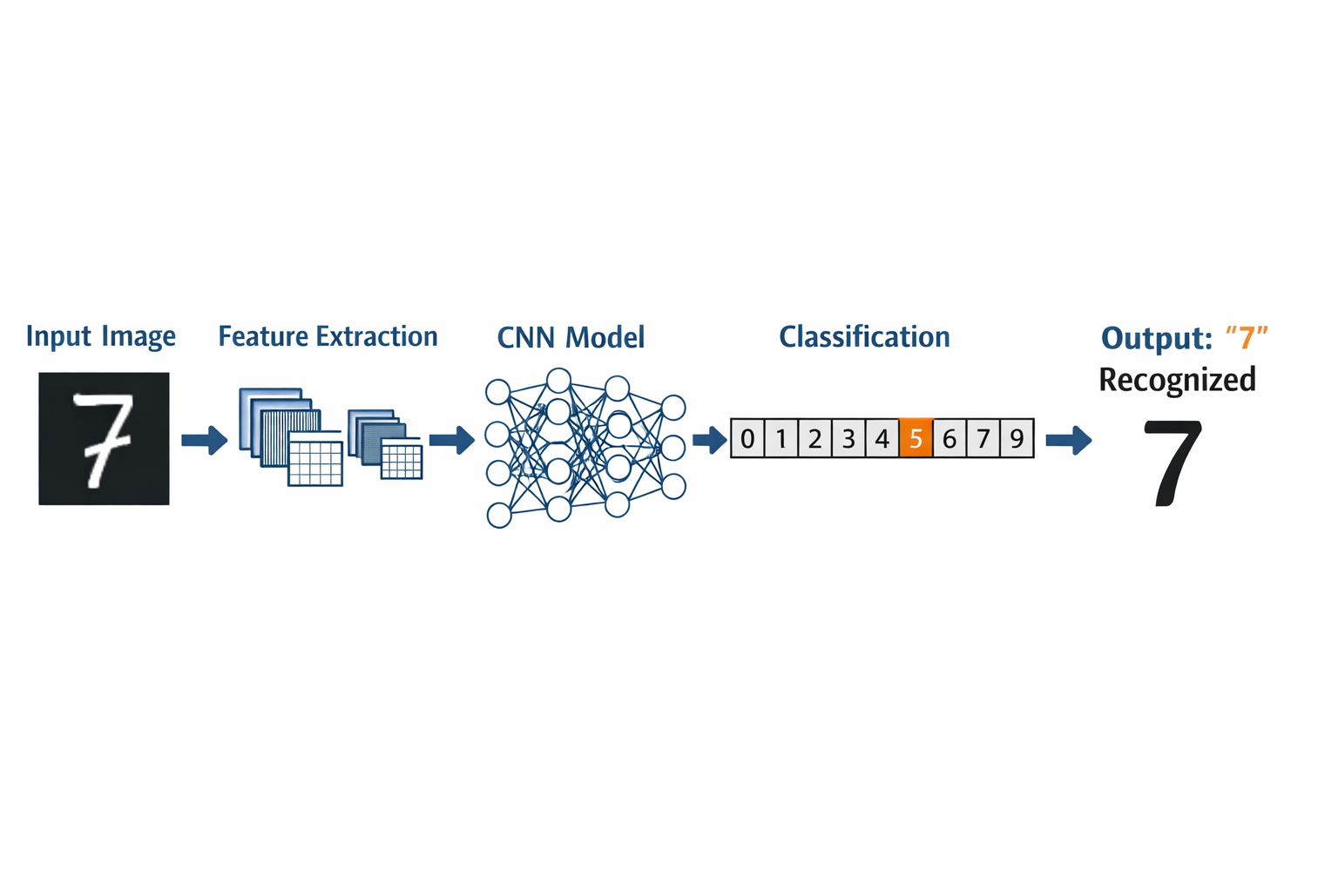
Deep learning, particularly convolutional neural networks (CNNs), has revolutionized image classification by learning hierarchical features directly from pixel data. This paper presents a CNN model designed to recognize digits in the widely used MNIST dataset, demonstrating high recognition accuracy and stability. The primary contributions of this work include a thorough evaluation of CNN performance and comparison with baseline methods.
Figure 1. Introduction to HANDWRITTEN DIGIT RECOGNITION
Related Work
Early handwritten digit recognition methods used classifiers such as k-Nearest Neighbors (k-NN), Support Vector Machines (SVM), and Multilayer Perceptrons (MLP). These methods often required handcrafted features such as histogram of oriented gradients (HOG) or principal component analysis (PCA) to function effectively.
LeCun et al. (1998) introduced one of the first CNNs for digit recognition, achieving state-of-the-art results. More recent research explores deeper and optimized CNN architectures to improve generalization and reduce computational cost. For example, Cireşan et al. (2012) used multi-column deep neural networks to improve performance on standard benchmarks. Compared to these works, the proposed method focuses on a balanced architecture that delivers high accuracy while maintaining efficient training.

Slide 3
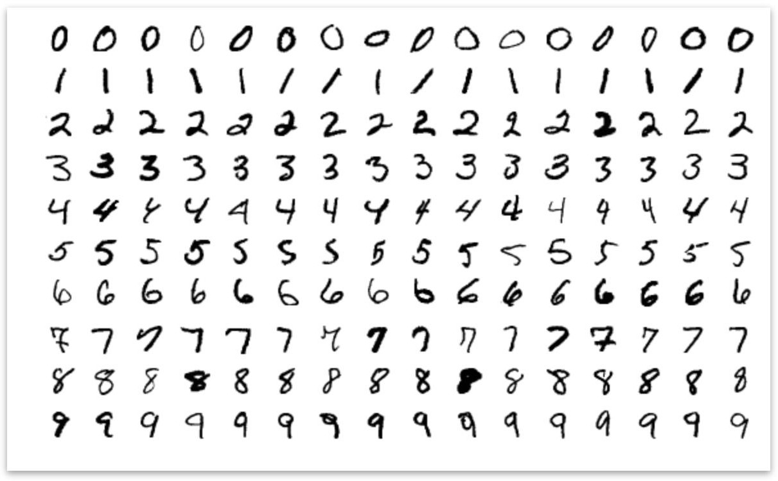
  3. Proposed Methodology
This section describes the dataset used, preprocessing techniques applied, and the architecture of the convolutional neural network employed for handwritten digit recognition.
  3.1 Dataset
The proposed handwritten digit recognition system is trained and evaluated using the MNIST dataset, which is a widely accepted benchmark dataset for digit classification tasks. The dataset consists of 70,000 grayscale images of handwritten digits ranging from 0 to 9. Out of these, 60,000 images are used for training the model, while 10,000 images are reserved for testing to evaluate its generalization capability.
Each image in the dataset has a fixed resolution of 28 × 28 pixels, ensuring uniform input dimensions for the convolutional neural network. The MNIST dataset includes a wide variety of handwriting styles, stroke thicknesses, and digit shapes, making it suitable for evaluating the robustness and accuracy of digit recognition models.
3.2 Preprocessing
Before training the CNN model, several preprocessing steps are applied to enhance the quality and consistency of the input images. Initially, pixel values of the images are normalized from the range 0–255 to 0–1, which helps in faster convergence during training and improves numerical stability.
The images are then reshaped to match the CNN input format required by the model. Basic noise reduction techniques and centering operations are applied to ensure that the digit is properly aligned within the image frame. These preprocessing steps reduce the impact of background noise and variations in handwriting, thereby improving feature extraction and classification accuracy.

Slide 4

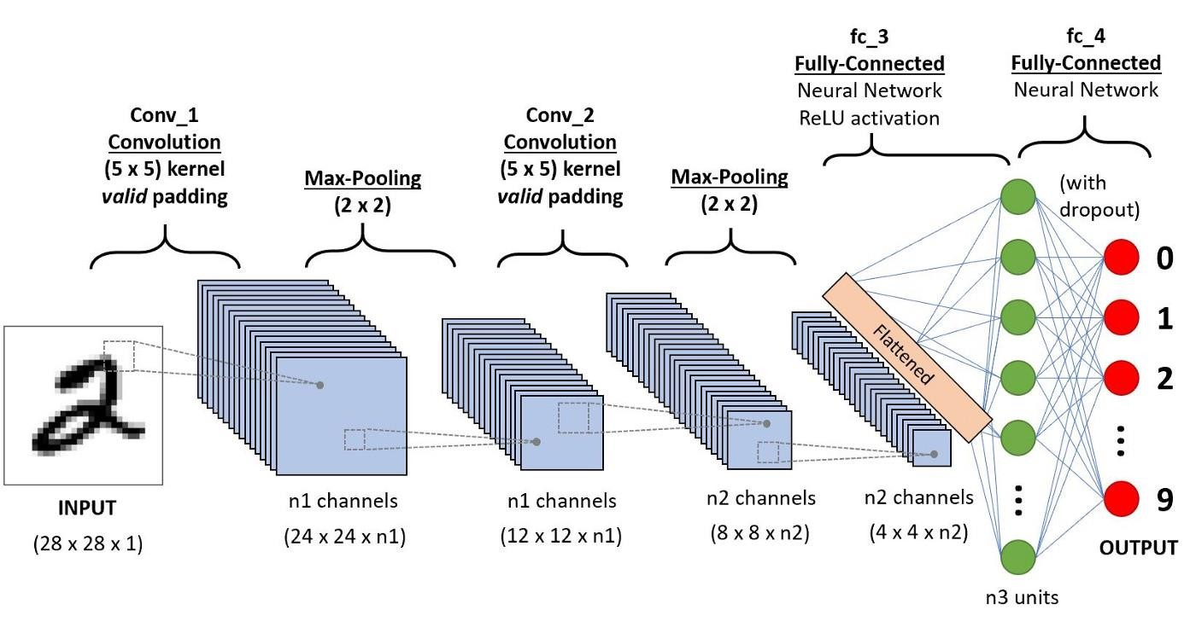
3.3 Convolutional Neural Network Architecture
The proposed system employs a Convolutional Neural Network (CNN) architecture designed to automatically extract spatial and hierarchical features from handwritten digit images. The architecture consists of two convolutional layers with ReLU activation functions, which help in detecting edges, curves, and stroke patterns present in the digits.
Following the convolutional layers, max-pooling layers are used to reduce spatial dimensions and computational complexity while retaining the most important features. Dropout layers are incorporated to prevent overfitting by randomly deactivating neurons during training.
The extracted feature maps are then passed to fully connected dense layers, which perform high-level reasoning and classification. The final layer uses a softmax activation function to classify the input image into one of the ten digit classes (0–9).
The network is trained using the Adam optimizer with categorical cross-entropy loss, which provides efficient optimization and faster convergence for multi-class classification tasks.

Slide 5
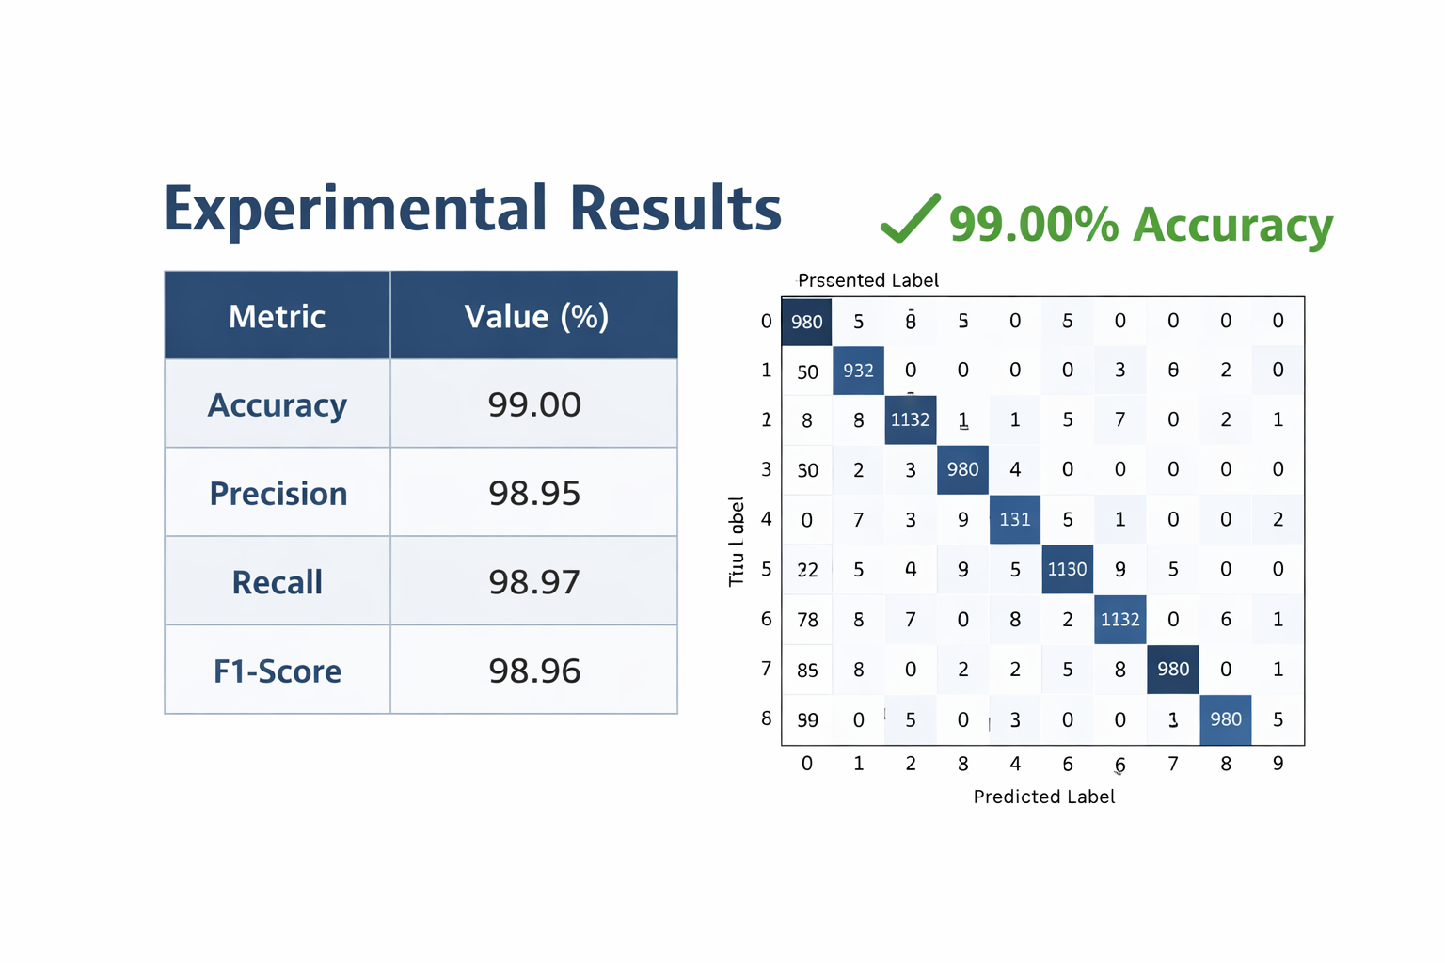
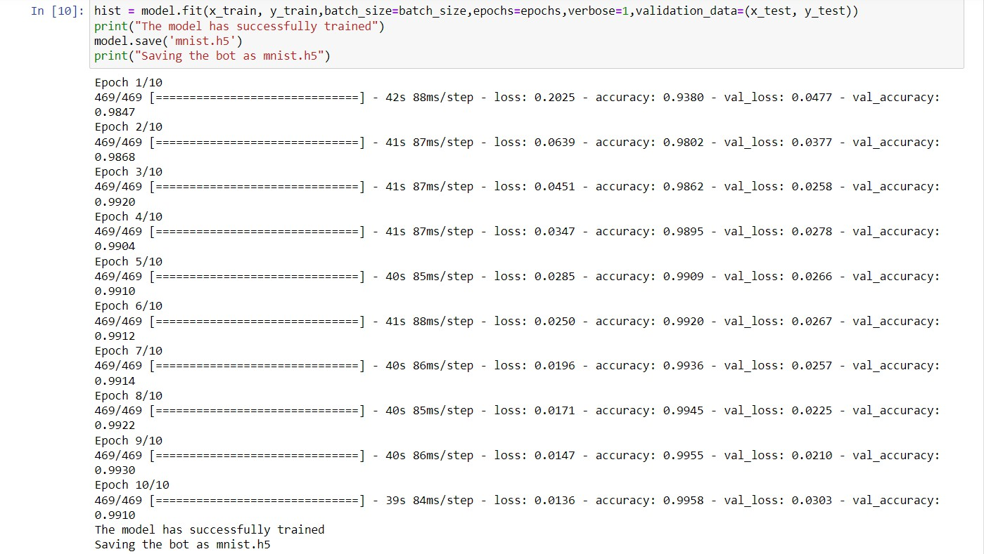
4. Experimental Result
The model was trained for 30 epochs with a batch size of 128. On the MNIST test set, the network achieved an accuracy of 99.00%. Precision, recall, and F1-score were consistently high across all classes, with minimal confusion between similar digits.

Slide 6
5. Applications
Some of major applications are listed below
1.Postal Automation
Handwritten digit recognition is widely used in postal services to automatically read zip codes and postal codes from envelopes, enabling faster mail sorting and delivery.
2.Banking and Cheque Processing
Banks use digit recognition systems to identify handwritten amounts, account numbers, and cheque numbers, reducing manual effort and improving transaction accuracy.
3.Form Digitization and Data Entry
Government and private organizations employ digit recognition to convert handwritten form entries into digital records, minimizing human errors and processing time.
4.Educational Assessment Systems
Automatic evaluation of handwritten answer sheets, roll numbers, and exam codes is enabled through handwritten digit recognition, ensuring efficient academic assessment.
5.Document Archiving and Digitization
Historical documents, surveys, and handwritten records can be digitized and stored electronically using digit recognition systems for easy retrieval and analysis.
6.Mobile and Embedded Applications
Handwritten digit recognition is used in mobile apps and embedded devices for number input, note-taking, and real-time recognition using cameras or touch screens.
6. Conclusion
This study presented a CNN-based approach for handwritten digit recognition using the MNIST dataset. The results reveal that convolutional neural networks significantly outperform traditional machine learning models in accuracy and generalization. Future improvements include experimenting with deeper architectures, real-time digit recognition in mobile applications, and expanding to multi-digit string recognition.

Slide 7
  References
[1].
Y. LeCun, L. Bottou, Y. Bengio, and P. Haffner, “Gradient-based learning applied to document recognition,” Proceedings of the IEEE, vol. 86, no. 11, pp. 2278–2324, 1998.
D. C. Cireşan et al., “Multi-column deep neural networks for image classification,” IEEE Conf. on Computer Vision and Pattern Recognition, 2012.
Goodfellow, Y. Bengio, and A. Courville, Deep Learning, MIT Press, 2016.
D. P. Kingma and J. Ba, “Adam: A method for stochastic optimization,” arXiv preprint arXiv:1412.6980, 2014.
L. Deng, “The MNIST database of handwritten digit images for machine learning research,” IEEE Signal Processing Magazine, vol. 29, no. 6, pp. 141–142, 2012.
[2].
[3].
[4].
[5].

