Slide 1
Introduction to Cricket

Slide 2
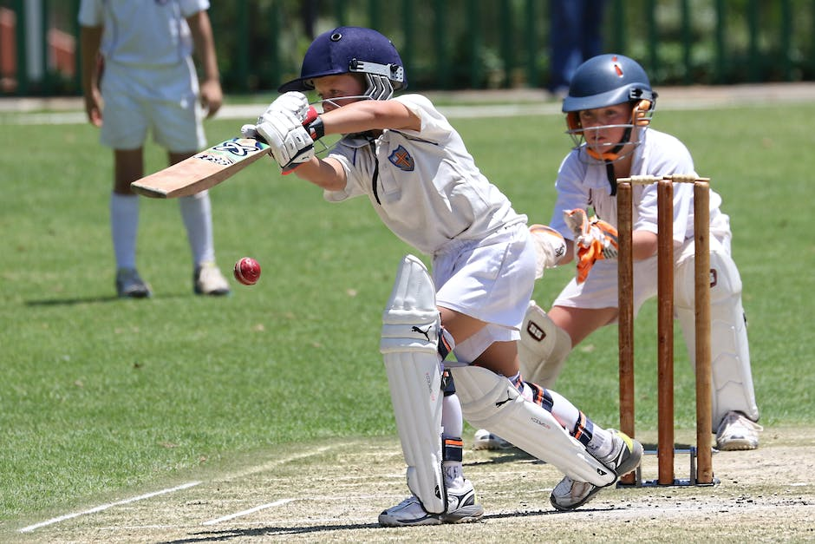
History of Cricket
This slide will talk about the origin and evolution of cricket. It will also highlight the significant milestones in the history of cricket.

Slide 3
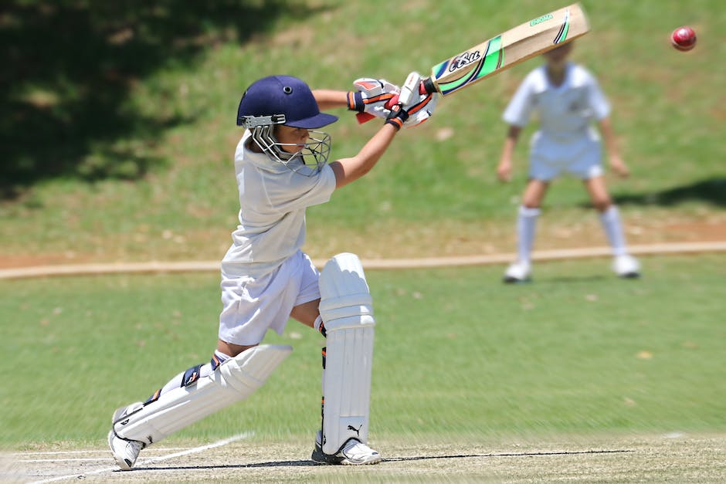
The rules and format of cricket
This slide will discuss the gameplay, format of the match, and the rules of cricket. It will include information on how a match is played and its duration.

Slide 4
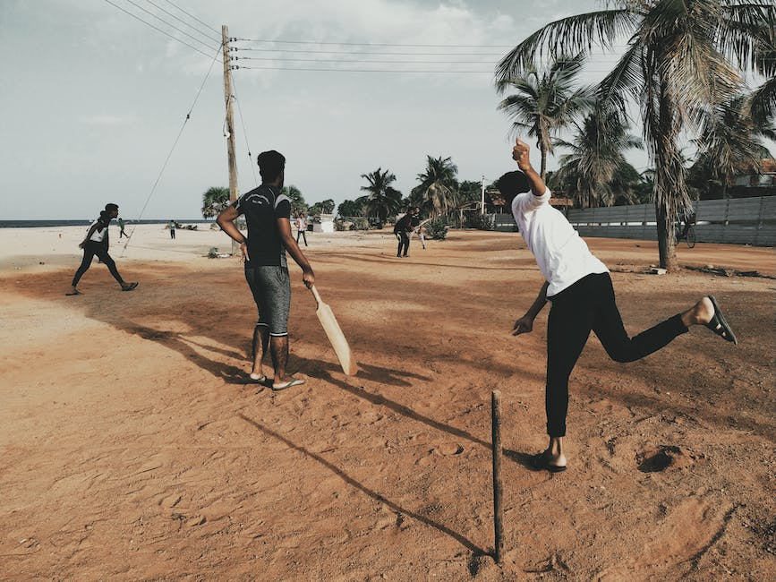
The role of the players in a cricket match
This slide will provide detailed information about the various roles of the players, such as batsmen, bowlers, and fielders, in a cricket match.

Slide 5
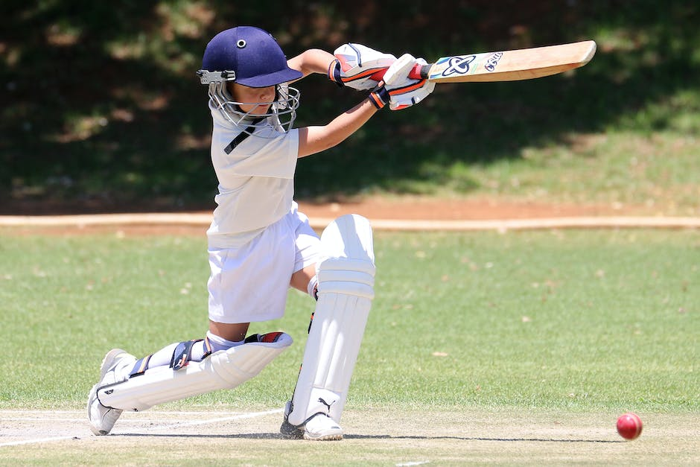
The different types of cricket matches
This slide will talk about the different types of cricket matches, such as Test, One Day international (ODI), Twenty20 (T20), and the latest innovation, The Hundred. It will also explain how these matches differ from each other.

Slide 6
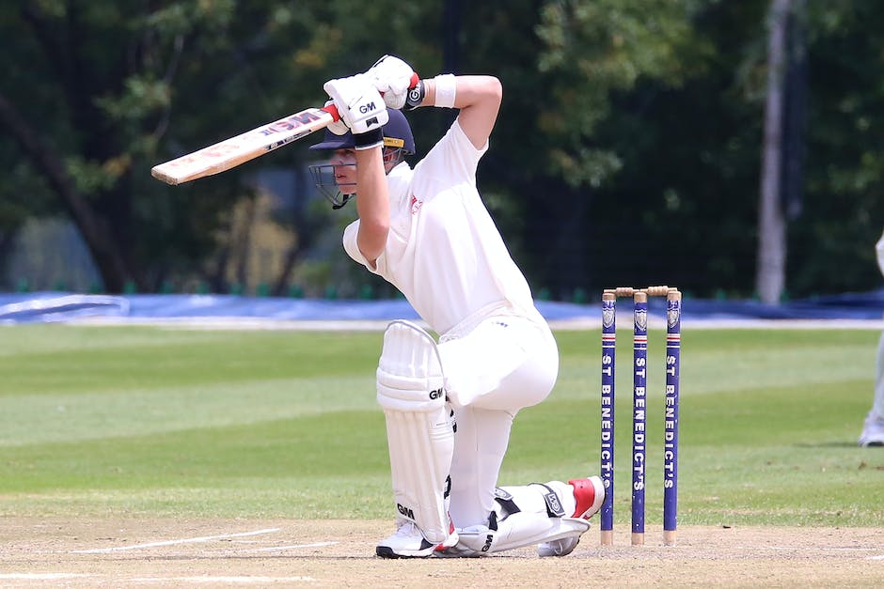
The governing bodies of cricket
This slide will explain the role of governing bodies such as the International Cricket Council (ICC), the national cricket boards, and other cricketing organizations in the management of cricket.

Slide 7
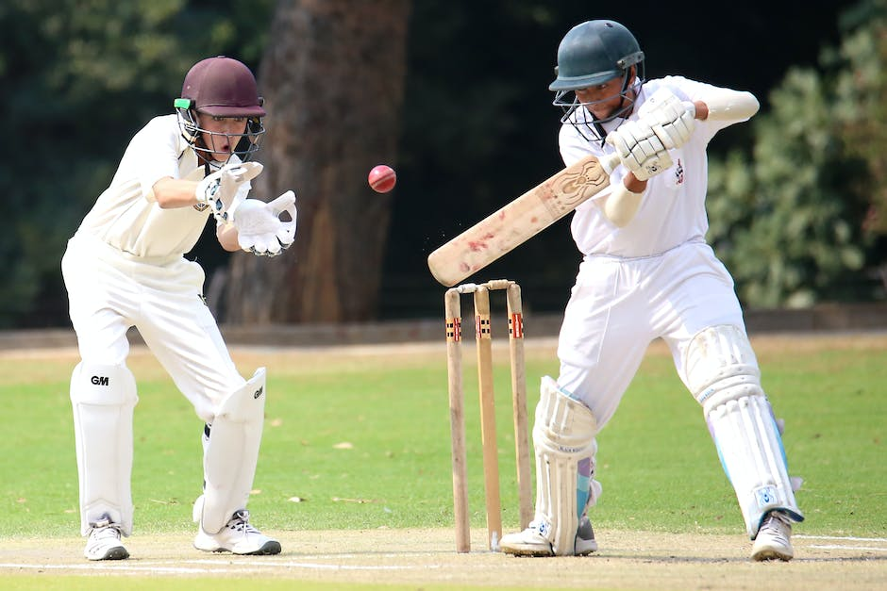
Famous cricket grounds around the world
This slide will provide information about famous cricket grounds around the world, such as Lord's Cricket Ground in London, Melbourne Cricket Ground in Australia, Eden Gardens in India, and many more.

Slide 8

The impact of cricket on society
This slide will discuss the significance of cricket and its impact on society. It will highlight inspiring stories and how cricket has helped in social, economic, and cultural development.

