Slide 1
The Mighty Lion

Slide 2
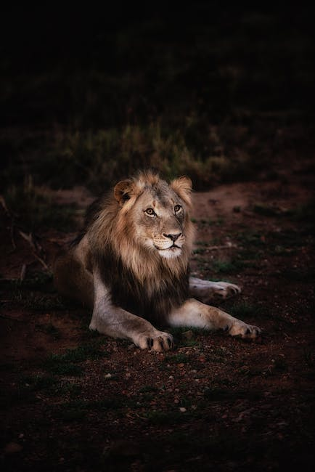
Introduction to Lions
- Overview of Lions
- Historical Significance of Lions
- Symbolic Representations of Lions in Different Cultures
- Famous Lions in Literature and Movies

Slide 3
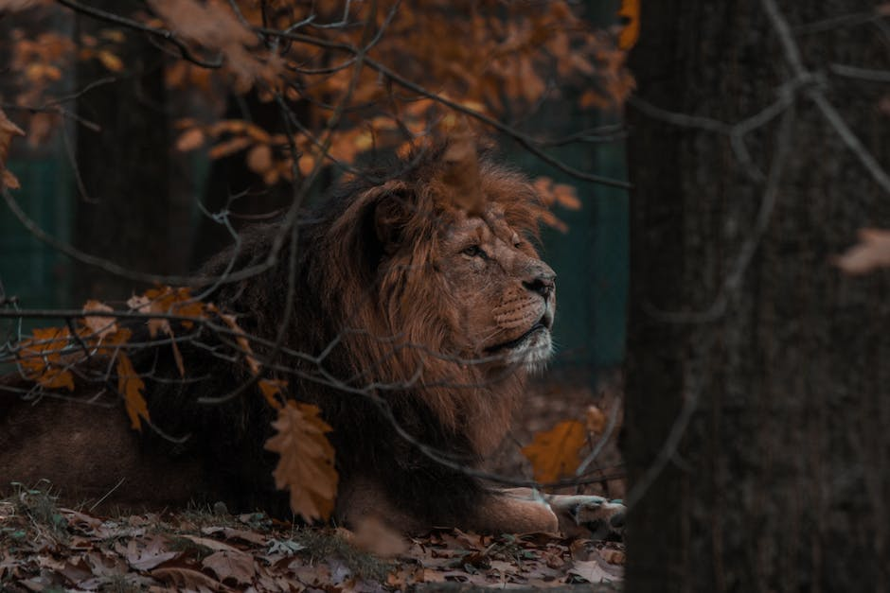
Physical Characteristics
- Anatomy and Physiology of Lions
- Differences between Male and Female Lions
- Color and Pattern of Lions' Fur
- Unique Features of Lions like Manes, Whiskers, and Paws

Slide 4
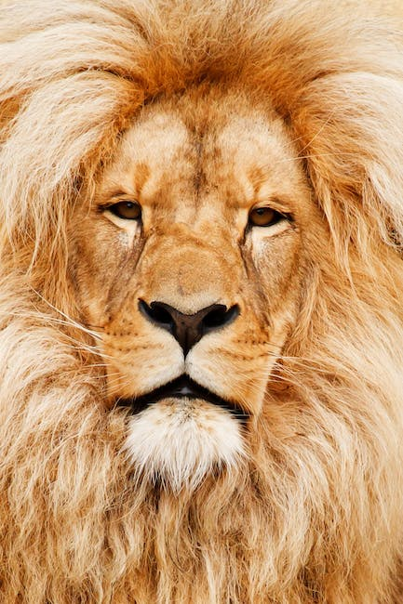
Habitat and Distribution
- Range of Lions
- Types of Ecosystems where Lions Thrive
- Challenges Encountered by Lions in their Habitat
- How Human Activity Affects Lion Populations

Slide 5
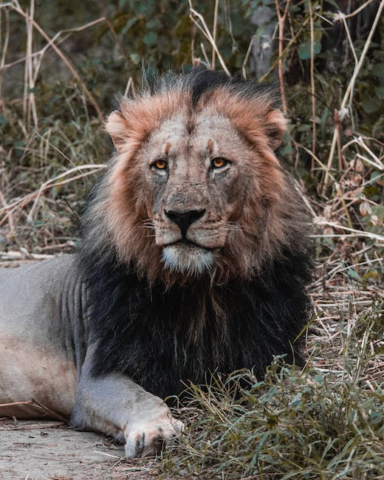
Behavior and Social Structure
- Organization of Lion Pride
- Role of Male and Female Lions in the Pride
- Communication and Vocalization of Lions
- Playful and Affectionate Behaviors of Lions

Slide 6
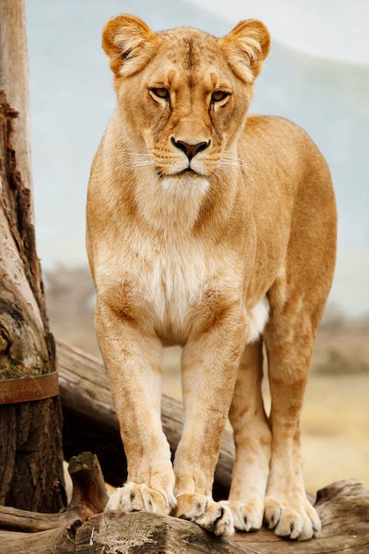
Hunting and Feeding Habits
- Hunting Techniques of Lions
- Diet of Lions
- Competition with Other Predatory Animals for Food
- Role of Hunting in Lion Social Structure

Slide 7
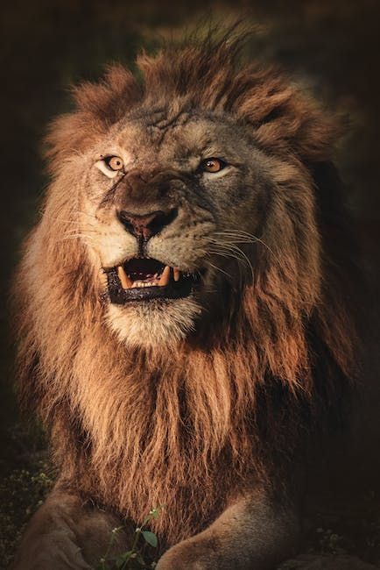
Conservation Status
- Threats to Lion Populations
- Conservation Efforts to Protect Lions
- Role of Zoos and Conservation Organizations in Lion Conservation
- Success Stories in Lion Conservation

Slide 8
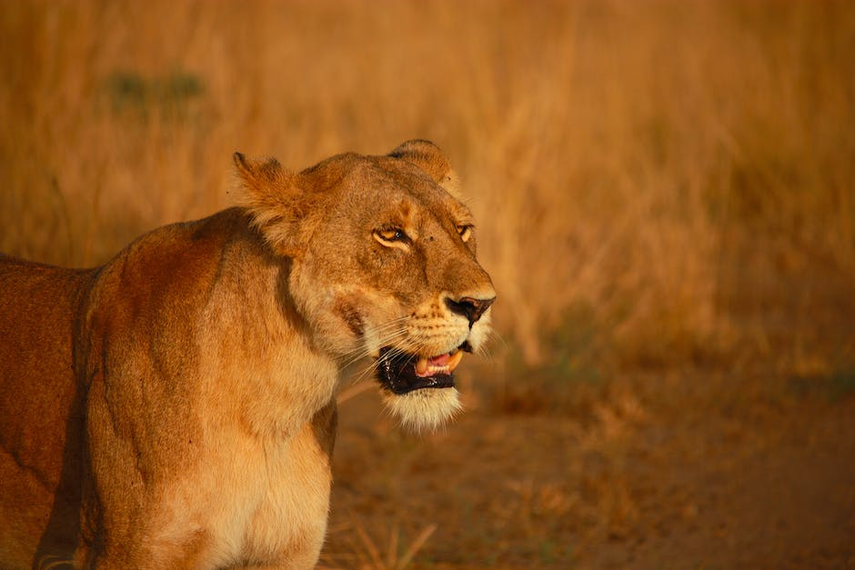
Interesting Facts about Lions
- Records and Statistics about Lions
- Mystical Beliefs Associated with Lions
- How Lions Inspire Art, Fashion, and Pop Culture
- Quirky and Surprising Facts about Lions

