Slide 1


HerWay
Chicago, through
her eyes.
A Data-Driven System for Chicago Neighborhood Awareness
Illinois Institute of Technology
Sanjana Waghray · Ananya Bhooplam Praveen · Sharanya Mishra
her-way-soremo.vercel.app

Slide 2

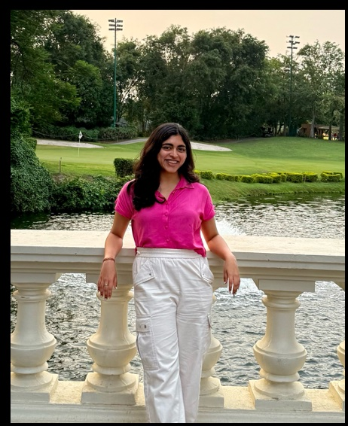
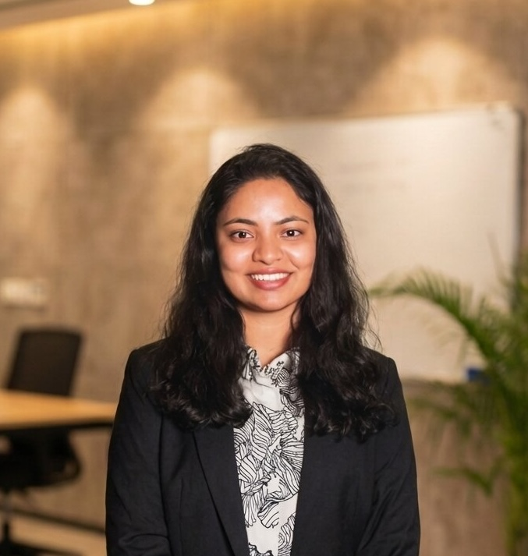
Meet the Team
SoReMo Research Fellowship · Illinois Institute of Technology · Spring 2026
Sanjana Waghray
Sharanya Mishra
Gayathri Ananya
Bhooplam Praveen
MAS in Data Science
MAS in Data Science
MAS in Data Science

Slide 3


Where HerWay began
Three international students. New to Chicago.
We moved in groups — not by choice, but out of uncertainty.
Crime maps showed numbers. Maps showed routes.
“Google Maps tells you
how to get there.
It doesn’t tell you
how it feels.”
Nothing told us how it actually felt to be there.
This gap is what HerWay was built to close.

Slide 4




An Information Equity Gap
Safety intelligence is unevenly distributed. These groups feel it most.
Women
International Students
Newcomers
Harassment, discomfort & fear of poorly lit streets — rarely reported, invisible in official records
New to the city. No local network. No accumulated knowledge of which areas feel safe
Lack the lived experience that longtime residents take for granted
Information is unevenly distributed.

Slide 5



What is HerWay?
One platform. Three data sources. A fuller picture of neighborhood safety.
Reddit Posts
1,218 posts — lived community experience & fear signals
Crime Data
Official reported incidents across all 77 neighborhoods
311 Service Requests
77
Neighborhoods
Infrastructure & livability stress from city records

Slide 6



How It Works
1
2
3
4
▶
▶
▶
Collect
Analyze
Map
Ask
Reddit, Crime & 311 Data from Chicago's open data sources
AI Sentiment Analysis + Weighted Neighborhood Scoring
Interactive Map of all 77 Chicago neighborhood profiles
Chatbot answers natural language questions about any area
Deployed at her-way-soremo.vercel.app — Interactive Map + Chatbot

Slide 7
Reddit — Community Voice
1,218 posts · 2010–2026 · 5 subreddits · 499 geotagged · 60 neighborhoods
Why Reddit?
1,218
posts collected, no API needed
Official data captures what gets reported. Reddit captures what people actually experience — the harassment, the dark streets, the gut feeling of being watched.
499
posts matched to a Chicago neighborhood
Where we looked
r/chicago · r/AskChicago · r/TwoXChromosomes · r/AskWomen · r/femalefashionadvice
Keywords: “unsafe”, “harassment”, “scared”, “alone at night” + 14 more
60
neighborhoods with usable safety signals

Slide 8
How we turned 1,218 posts into safety insights
1
2
3
4
Find the neighborhood
We scan each post for Chicago neighborhood names using an 80+ word dictionary
499 of 1,218 posts matched
Score safety relevance
A 40-word safety lexicon checks each post. “dark”, “alone”, “followed” — words general tools miss
Read the emotion
An AI model (pre-trained on 58M tweets) labels each post: Fearful, Neutral, or Reassuring
Build the fear score
% of fearful posts per neighborhood = the fear ratio
60 neighborhoods scored
->
->
->
This pipeline captures what official crime records cannot — the lived experience of fear.

Slide 9
Crime Data
200,000+ incidents · 2025 · All 77 Chicago community areas · Chicago Data Portal
Key Insights
11,056
Austin — highest incident count. Peaks 12am–1am Saturdays
50.5%
Riverdale — highest violent %. Only ~1,000 incidents: severity ≠ volume
48.7%
Crimes between 6pm–6am. Night patterns vary significantly by neighborhood
10–25%
Arrest rates citywide — structural reality, not an indicator of crime severity
Top Crime Types — Citywide 2025
Raw counts mislead — volume and violent concentration tell categorically different stories.

Slide 10
311 Service Requests
Non-emergency resident complaints · 2025 · Chicago Data Portal · Livability & infrastructure lens
Avg Resolution Time (days)
5.6×
South Chicago
53% + 36%
Request Type Breakdown
Longer to resolve vacant buildings (41d) vs street lights (7d)
Highest request volume — South & West sides carry disproportionate burden
Abandoned vehicles & broken lights — same conditions cited in fearful Reddit posts
Resolution time disparity is a measurable infrastructure equity gap — concentrated in the same areas with elevated crime and fear.

Slide 11
311 Service Requests
Non-emergency resident complaints · 2025 · Chicago Data Portal · Livability & infrastructure lens
Request Type Breakdown
Top 8 Neighbourhoods by Volume
Avg Resolution Time (days)
5.6×
South Chicago — 4,470
53% + 36%
Longer to resolve vacant buildings (41d) vs street lights (7d)
Highest 311 volume — South & West sides carry the burden disproportionately. Some don't call 311; they've stopped expecting a response.
Abandoned vehicles & broken lights — same conditions cited in fearful Reddit posts
Resolution time disparity is a measurable infrastructure equity gap — concentrated in the same areas with elevated crime and fear.

Slide 12
Three sources. One honest score.
Each source sees something the others miss. Together they tell a fuller story.
Reddit
How it feels
Crime Data
What was reported
311 Data
What’s broken
+
+
▼
40% Crime incidents — the most consistent, objective source we have
25% Reddit fear ratio — lived experience that never makes it into a report
20% Violent crime % — 5,000 assaults and 5,000 thefts are not the same thing
10% 311 service requests — infrastructure tells us what’s been neglected
5% Street lighting — the one thing women mention most when they feel unsafe
Every Chicago neighborhood lands in one of three groups:
3
High Risk
26
Medium Risk
48
Lower Risk

Slide 13
Merging Three Sources into One Score
Name harmonization → normalization → weighted formula → risk classification
1
Name Harmonization
2
Min-Max Normalization
3
Weighted Score
Reddit uses popular names.
Official data uses formal names.
Each source operates on
incompatible scales.
Sn = 0.40Cn + 0.25Rn
+ 0.20Vn + 0.10Tn + 0.05Ln
Wicker Park
→
West Town
›
x̃ = (x − x_min) / (x_max − x_min)
›
Cn 40%
Crime count — most objective
Pilsen
→
Lower West Side
Rn 25%
Reddit fear — lived experience
Maps every signal independently
to a [0, 1] scale so crime counts,
fear ratios, and 311 volumes
can be combined fairly.
Gold Coast
→
Near North Side
Vn 20%
Violent crime % — severity
South Loop
→
Near South Side
Tn 10%
311 complaints — infrastructure
Andersonville
→
Edgewater
Ln 5%
Street lights — women's safety
19 mappings total
Applied per source, independently
Risk bands:
● High Risk Sn ≥ 0.65 (3 neighborhoods)
● Medium Risk 0.40–0.65 (26 neighborhoods)
● Lower Risk Sn < 0.40 (48 neighborhoods)

Slide 14



The Source Agreement Signal
Our novel contribution — insights unavailable from any single source alone
The score tells you how a neighborhood ranks. The agreement signal tells you whether data and community agree — and that divergence is often the most important finding.
LOW
Reddit Fear (Rn)
HIGH
HIGH
Both sources signal concern
Community more worried than data shows
Data and community agree. Strongest actionable finding.
Possible unreported harassment, fear of infrastructure failure, or historical trauma.
Crime Count (Cn)
e.g. Austin · Englewood
e.g. High fear ratio, moderate crime count
Data elevated, community relatively calm
Consistent reassurance
Possible genuine improvement residents feel before statistics reflect it.
Both sources agree this area has lower concern levels.
LOW
e.g. Neighborhood in revitalization
e.g. Lincoln Park · Forest Glen
Surfaced in every neighborhood popup on the interactive map — and anchors the chatbot's perception-gap reasoning.

Slide 15

The Chatbot — How It Actually Works
GPT-4o powered by a hand-crafted knowledge base — no hallucination, no RAG needed
Knowledge Base Design
System Prompt Design
3-source synthesis
77 neighborhoods × 3 sources loaded into a Python dict at startup
Weave crime, Reddit & 311 into one coherent answer — never source-by-source
No RAG — entire KB fits in one GPT-4o context window (structured tabular data)
Perception gap first
Lead with where community fear diverges from reported data — the most valuable insight
Language constraints
Neighborhood detection: exact string match + difflib fuzzy fallback (60% threshold)
"safe", "dangerous", "bad area" banned. Use: "incident levels", "community concern"
Scenario reasoning
No match? Citywide summary of all 77 areas injected so comparative questions work
User says "I'm a grad student out late" → model weights night_crime_pct and female_fear_ratio
4-turn memory window
Rolling session history enables follow-up questions without re-stating context
✓ 18 of 19 tests passed across 6 question categories · Temperature 0.3 for factual grounding · Azure GPT-4o

Slide 16
Chatbot in Action
Real responses synthesizing all three data sources — grounded in our knowledge base, no hallucination
PERCEPTION GAP
SCENARIO REASONING
You: How is the Loop?
You: I'm traveling to Austin at 11am — what should I know?
[Searching: Loop]
[Searching: Austin]
HerWay:
HerWay:
Theft and battery dominate, but violent crime is under 25% of incidents — low for a high-volume area. Reddit is actually reassuring, with only 22% of posts expressing concern. The disconnect: 38% of crime happens at night, yet community sentiment doesn't reflect that — street light outages in the data may explain the gap.
11am is one of the quieter windows — peak incidents hit 12am–1am Saturdays. Austin has Chicago's highest crime volume, and Reddit's 34.8% fear ratio reflects that, especially at night. Daytime tends to be lower risk, but the most common locations are streets, so staying aware matters regardless of the hour.
COMPARATIVE
OUT-OF-SCOPE
You: Which has more night activity — Englewood or Austin?
You: What's the weather like in Logan Square?
[Searching: Austin, Englewood]
[Searching: Logan Square]
HerWay:
HerWay:
Both report identical night rates at 48.7% of incidents between 6pm–6am. Austin's raw volume is far higher, so actual night incident counts are significantly greater. The Reddit gap is striking: Englewood's night fear rate is 67% vs Austin's 40% — residents feel more uneasy despite nearly identical reported patterns.
I'm HerWay, a neighborhood safety awareness assistant for Chicago. I can only help with questions about neighborhood safety, crime patterns, community discussions, and local infrastructure — let me know if you'd like safety insights on Logan Square instead.

Slide 17

What the Map Reveals
77 Neighborhoods Scored
High / Medium / Lower Risk classifications across all community areas
Austin: Highest Risk (0.772)
11,056 crime incidents combined with a 34.8% Reddit fear ratio
Source Agreement Signal
Novel contribution: where community perception and official data diverge
Fear Ratio Declining
77 Chicago
Neighborhoods
Mapped
24% (2023) → 20% (2025), despite 7× growth in post volume

Slide 18

Conclusion
Surfaced informal safety signals invisible in official records — harassment, discomfort, fear
What We
Got Right
Centered women's lived experience as the design baseline, not an afterthought
Combined community voice with official data — neither alone tells the full story
Added infrastructure lens via 311 — livability matters beyond crime statistics
Source agreement signal reveals where perception and data diverge

Slide 19



Challenges
Honest gaps in our equity coverage
Reddit's Demographic Blind Spot
Judgment-Based Weighting
Young, English-speaking, tech-savvy users dominate. Elderly, non-English speakers, and low-income communities are nearly invisible — yet most at risk.
Our 40/25/20/10/5 formula reflects team intuition, not statistical validation. Different weights could produce meaningfully different neighborhood rankings.
Point-in-Time Snapshot
Informational Only
Data doesn't update live. A neighborhood that improves or worsens tomorrow won't be reflected until manually refreshed.
HerWay describes a neighborhood. It doesn't actively help someone in danger. The people who most need help may benefit least from a research dashboard.

Slide 20
What Other Experts Would Challenge
Disciplines that would have strengthened HerWay
Urban Planning
Public Health
"Your 311 patterns reflect reporting behavior, not just conditions. Some communities don't call 311 because they've stopped expecting a response."
"Chronic exposure to unsafe environments causes stress beyond individual incidents. Your metrics don't capture cumulative harm."
Sociology / Criminology
Community Organizing
"Reddit fear ratios are a proxy, not a validated measure. You need community participation to know if scores reflect how residents actually feel."
"The communities most underrepresented in your data are the ones most in need. Design with them, not just for them."

Slide 21



Where HerWay Goes Next
Real-Time Data Pipeline
Live 311, crime feeds & social media — not a frozen snapshot
Multilingual Support
Reach Spanish, Polish, Mandarin-speaking communities invisible in Reddit data
Community Partnerships
Co-design with neighborhood organizations to validate scores and fill data gaps
Mobile App
What's
Possible
In-context safety info when and where residents need it most
Startup potential: a women's urban intelligence platform scalable beyond Chicago.

Slide 22


HerWay
Equitable access to the neighborhood intelligence that longtime residents take for granted.
her-way-soremo.vercel.app
Scan to explore
Illinois Institute of Technology · Spring 2026
her-way-soremo.vercel.app
Sanjana Waghray · Sharanya Mishra · Gayathri Ananya Bhooplam Praveen

Slide 23

HerWay
Equitable access to the neighborhood intelligence that longtime residents take for granted.
her-way-soremo.vercel.app
Illinois Institute of Technology · Spring 2026

