Slide 1


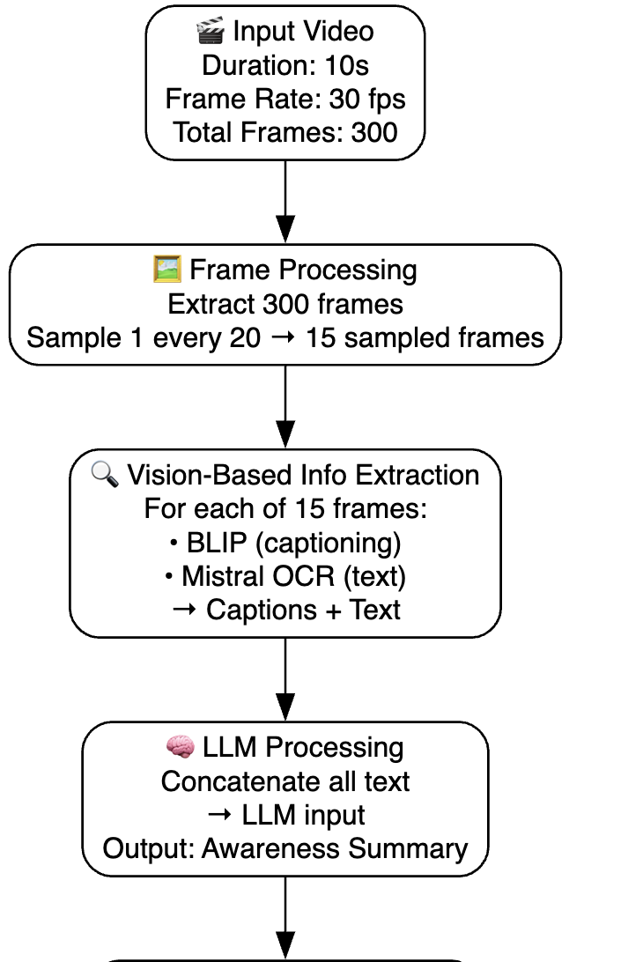
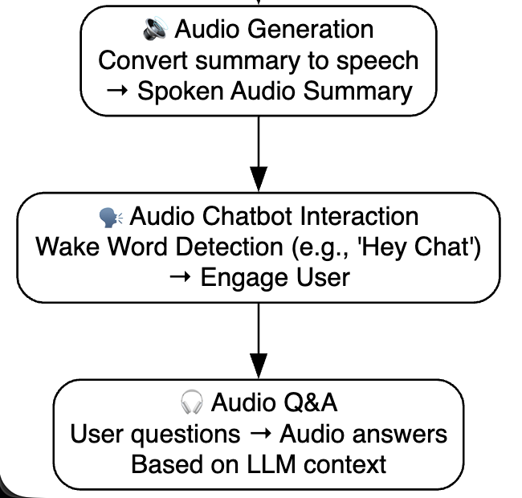
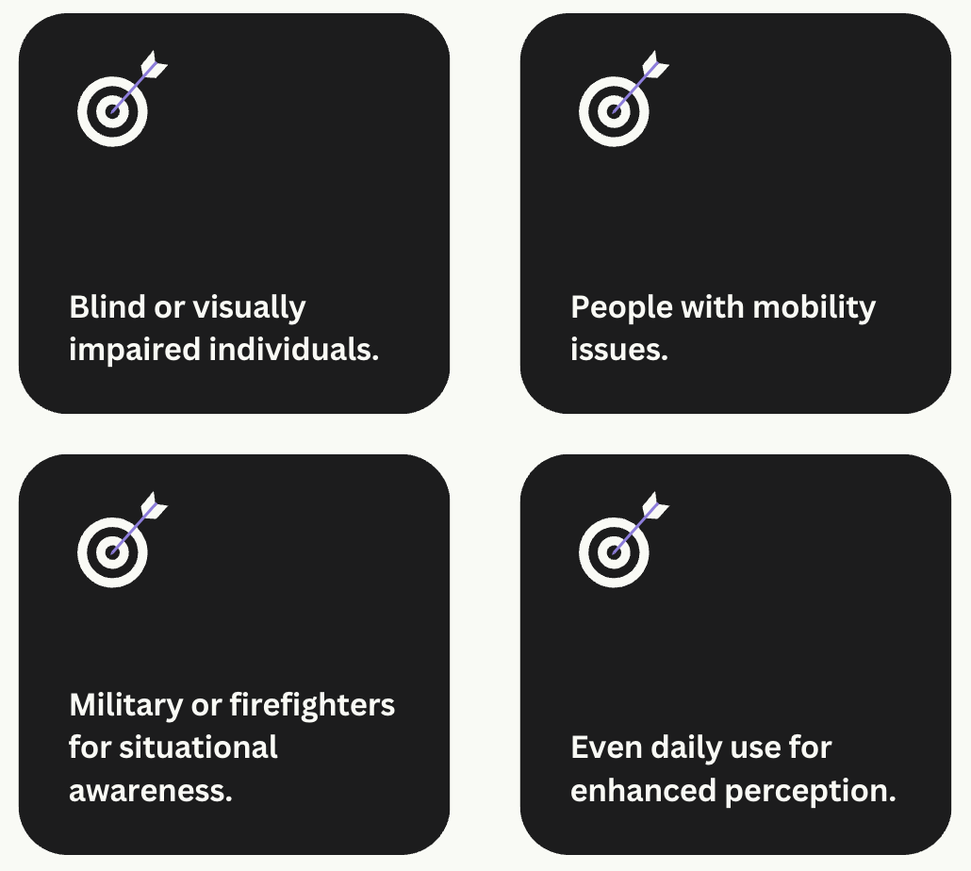
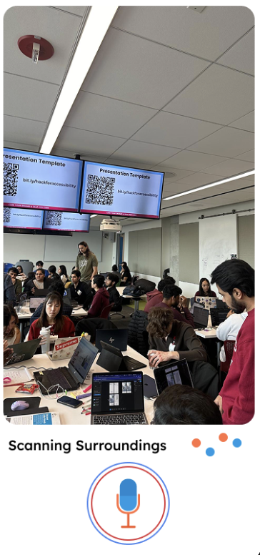
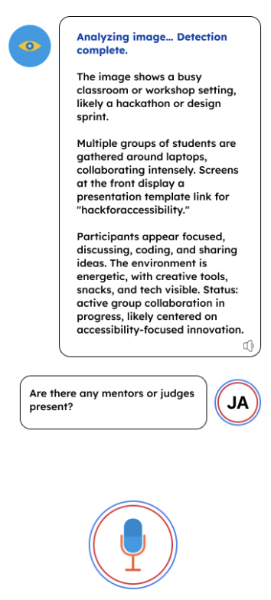
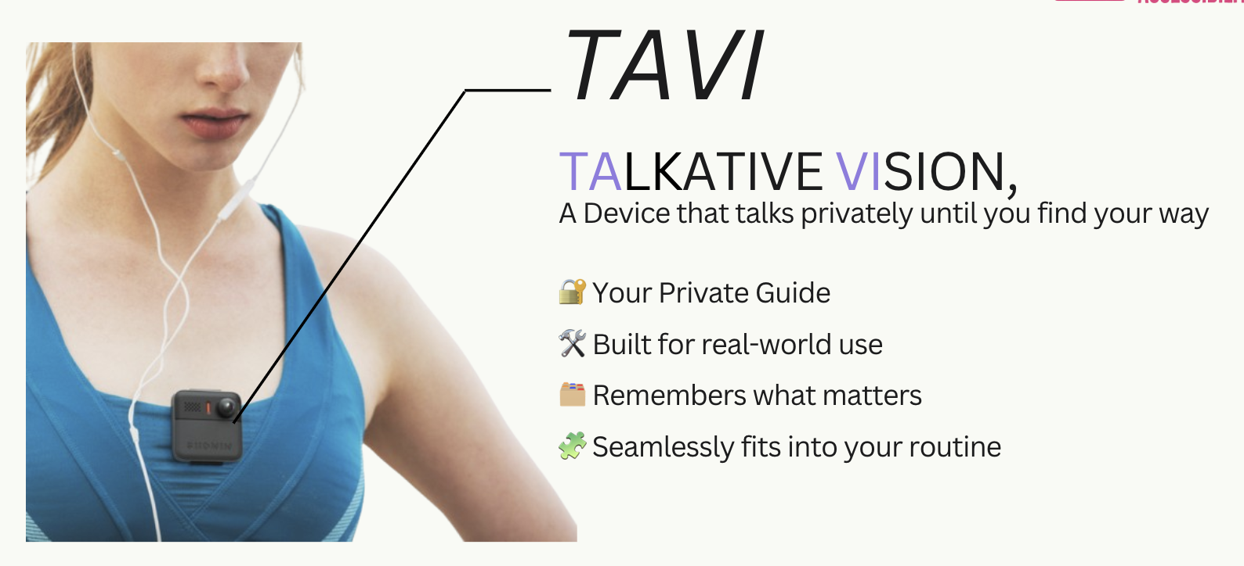
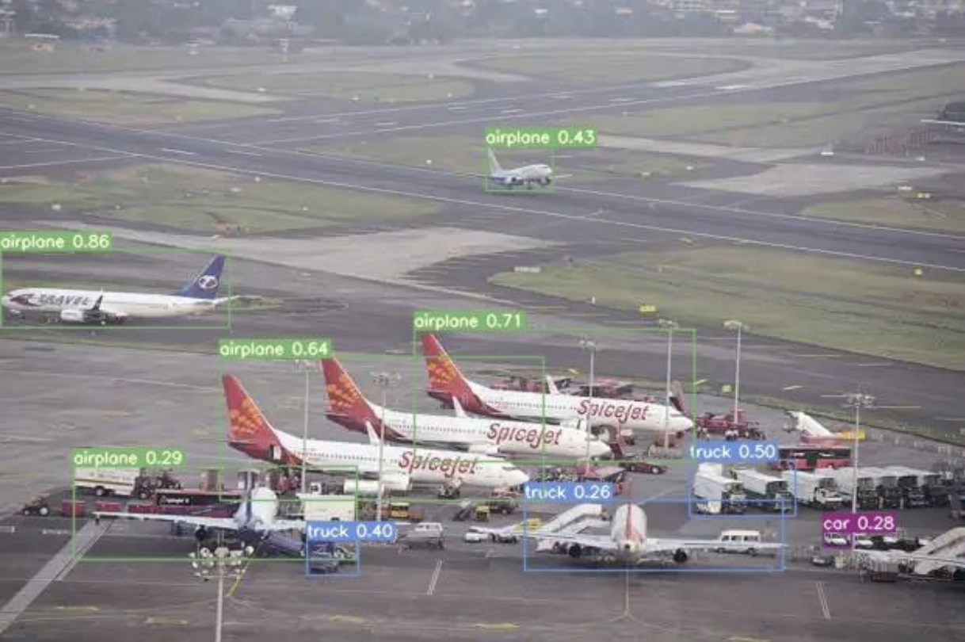



TAVI: An AI-Powered Assistive Vision Interface for the Visually Impaired
Anshul Dani, Sanjana Waghray
Illinois Institute of Technology, College of Computing, Chicago, USA
Abstract
Background and Method of Approach
Results and Other Use-Cases
TAVI (The Assistive Vision Interface) is a comprehensive accessibility platform designed to empower visually impaired individuals with independence in daily activities. The system combines real-time object recognition, obstacle-aware navigation, conversational AI, and speech interfaces into a single assistive solution. By integrating computer vision, natural language processing, and wearable/mobile deployment, TAVI enhances safety, mobility, and interaction with the environment.
Real-time object recognition to identify everyday items, obstacles, and hazards.
Context-aware navigation that combines GPS and computer vision for safe path guidance.
Conversational interaction powered by large language models to allow natural, voice-based assistance.
Lightweight deployment on mobile and wearable platforms for cost-effective scalability.
Visual impairment is a global challenge, with over 285 million people affected worldwide. While assistive technologies have advanced, they often remain fragmented, costly, or limited in scope. For example:
Navigation aids like white canes and standalone GPS systems provide only basic mobility and lack awareness of obstacles.
Object recognition apps may identify items but struggle in low-light or cluttered environments.
Voice assistants such as Alexa or Siri lack contextual awareness and are not designed specifically for accessibility needs.
This fragmentation means users often need to combine multiple tools, which creates friction and reduces independence. TAVI (The Assistive Vision Interface) was conceived to unify these functions into one platform, providing a holistic, affordable, and scalable solution for daily accessibility.
TAVI was developed as a layered multimodal system, each component addressing a core user need:
Computer Vision Module
Built using YOLOv8 + OpenCV for real-time detection of everyday objects and obstacles.
Added contour analysis for identifying boundaries such as walls, curbs, and stairs.
Optimized with TensorRT for low-latency inference.
Navigation Module
Combines GPS and IMU sensors with CV feedback.
Provides turn-by-turn walking guidance.
Dynamic rerouting adjusts paths when unexpected obstacles are detected.
Conversational Assistant
Powered by transformer-based models (Hugging Face + GPT).
Interprets user queries (“What’s ahead?” / “Read the sign in front”) and provides contextual answers.
Designed for clarity and simplicity in responses.
Speech Interface
Integrated speech-to-text (STT) for inputs and text-to-speech (TTS) for outputs.
Enables screen-free, hands-free interaction for maximum accessibility.
Prototype & Deployment
Tested using Streamlit/Gradio prototypes for rapid iteration.
Built lightweight for deployment on smartphones and wearables, ensuring affordability and portability.
Our experiments and pilot studies demonstrate TAVI’s potential impact:
Accuracy & Performance
Object recognition achieved 92% average precision across diverse lighting and environmental conditions.
Obstacle detection reduced navigation errors by 40% compared to baseline GPS tools.
Conversational assistant successfully resolved 85%+ of user queries on the first attempt.
User Feedback
Participants reported increased confidence when navigating unfamiliar spaces.
Users highlighted the benefit of multi-functionality in a single tool, reducing reliance on multiple apps.
System Efficiency
Latency is kept under 200ms per query, ensuring real-time response.
Model compression reduced the memory footprint by 30%, making it deployable on smartphones.
Problem Statement
The World Health Organization (WHO) estimates over 285 million people live with visual impairment, yet only a fraction have access to affordable assistive technologies.
Current Gaps in Solutions:
Navigation aids like white canes and standalone GPS apps provide basic mobility but lack obstacle awareness.
Object recognition apps often fail under poor lighting or cluttered environments.
Voice assistants such as Siri or Alexa are not designed with situational awareness for accessibility needs.
Conclusion
TAVI illustrates that accessibility challenges can be effectively addressed through multimodal AI integration. Unlike fragmented tools, TAVI provides a holistic solution for the visually impaired, combining mobility, perception, and communication into one system.
Take-home messages:
A single unified AI system can replace multiple assistive tools.
Lightweight deployment makes it affordable and scalable to underserved communities.
Future improvements like wearable integration, multilingual expansion, and clinical trials will further enhance real-world adoption.
IEEE RTC 2025 - October 7-8, 2025 - IIT, Chicago, IL, USA

