Slide 1
Computer network monitoring
Network topology graph crud
Baira Spoorthi
Nellore sanjana

Slide 2
Problem statement
Computer networks consist of multiple connected devices
Managing these devices manually is difficult
Need a system to represent network structure efficiently
Perform operations like adding, deleting, updating devices
Store network data permanently for future use

Slide 3
Real-world application
Used in network management systems
Helps monitor routers, switches, and computers
Used in IT infrastructure management
Represents real-world network topology
Useful for learning and simulation purposes

Slide 4
Data structure used
Graph (Adjacency List Representation)
Explanation:
Vertex → Represents a device
Edge → Represents a connection
Structures Used:
struct Vertex → stores device details
struct AdjNode → stores connections

Slide 5
System design
Devices stored in an array
Connections stored as linked lists
Each device maintains its own adjacency list
System Flow:
User Input → Processing → Graph Update → Output Display

Slide 6
algorithm
Add Device → Insert into vertex array
Add Connection → Create adjacency node
Display → Traverse adjacency list
Search → Find device using ID
Update → Modify device name
Delete → Remove device and its connections
Save → Store data in file
Load → Retrieve data from file

Slide 7
implementation
Programming Language: C
Concepts used:
Structures (struct)
Dynamic memory (malloc, free)
File handling
File Used:
network.txt for storing data

Slide 8
features
Add new devices
Connect devices
Delete devices and connections
Update device details
Search devices
Display network topology
Save and load data

Slide 9
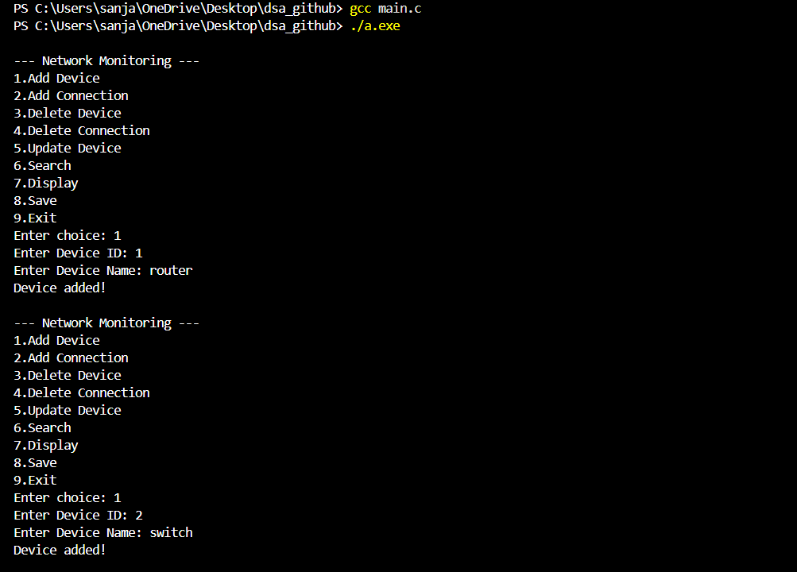
Demo output

Slide 10
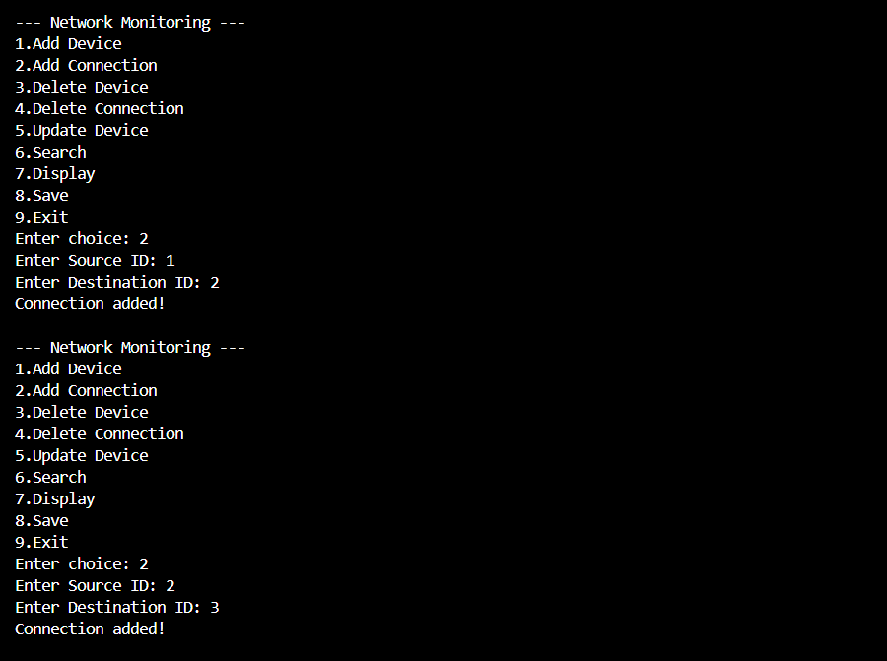

Slide 11
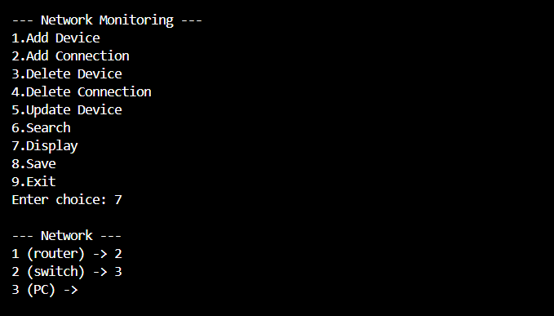
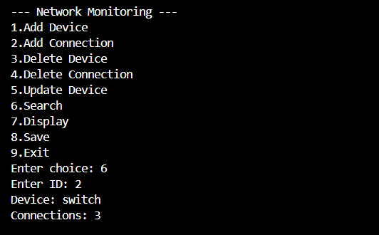

Slide 12



Slide 13

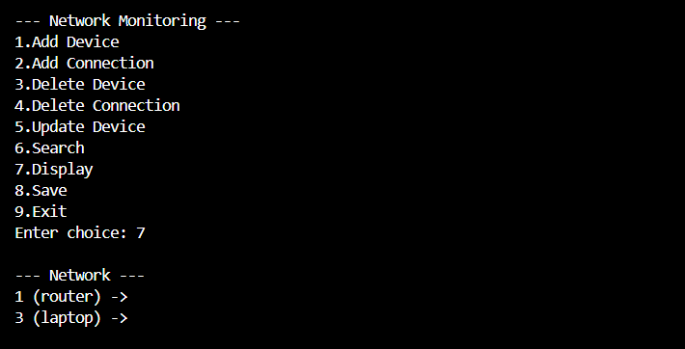

Slide 14

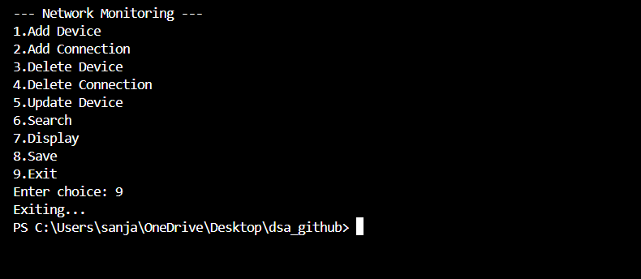

Slide 15
advantages
Efficient representation using graph
Easy to manage network structure
Uses dynamic memory efficiently
Data is stored permanently
Simple and user-friendly interface

Slide 16
Conclusion
Successfully implemented graph using C
Performed all CRUD operations
Stored data using file handling
Simulated real-world network topology
Project meets all requirements

