Slide 1
CS205 Object Oriented Programming in Java
Module 2 - Core Java Fundamentals (Part 1)
1

Slide 2

Topics
Core Java Fundamentals:
Primitive Data types
Integers
Floating Point Types
Characters
Boolean
1

Slide 3
Introduction
Most fundamental elements of Java:
data types
variables
arrays
1

Slide 4
Introduction(contd.)
Java Is a Strongly Typed Language
First, every variable has a type, every expression has a
type, and every type is strictly defined.
Second, all assignments, whether explicit or via parameter passing in method calls, are checked for type compatibility.
No automatic coercions or conversions of conflicting types .
The Java compiler checks all expressions and parameters to ensure that the types are compatible.
Any type mismatches are errors that must be corrected before the compiler will finish compiling the class
1

Slide 5
The Primitive Types
The primitive types are also commonly referred to as
simple types.
The primitive types represent single values—not complex objects
1

Slide 6
The Primitive Types(contd.)
Java defines eight primitive types of data:
byte
short
int
long
float
double
char
boolean
1

Slide 7
The Primitive Types(contd.)
Java defines eight primitive types of data- FOUR GROUPS:
byte
short
int
long
INTEGERS
float
double
FLOATING-POINT NUMBERS
char
CHARACTERS
boolean
BOOLEAN

Slide 8
Primitive Types -four groups
Integers This group includes byte, short, int, and long,
which are for whole-valued signed numbers.
Floating-point numbers This group includes float and
double, which precision. | represent numbers | with | fractional
Characters This | group includes char, | which | represents
symbols in a character set, like letters and numbers.
Boolean This group includes boolean, which is a special type for representing true / false values.

Slide 9
Integers
Java defines four integer types:
byte
short
int
long
Can be signed, positive or negative values.
Java does not support unsigned, positive-only integers.
The width of an integer type is not the amount of storage it consumes, but it is the behavior it defines for variables and expressions of that type

Slide 10
Integers
Name
Width Range
long
64
–9,223,372,036,854,775,808 to
9,223,372,036,854,775,807
int
32
–2,147,483,648 to 2,147,483,647
short
16
–32,768 to 32,767
byte
8
–128 to 127

Slide 11
byte
The smallest integer type is byte.
This is a signed 8-bit type
It has a range from –128 to 127.
Useful when working with a stream of data network or file.
E.g. declares two byte variables called b and c:
byte b, c;
from a

Slide 12
short
short is a signed 16-bit type.
It has a range from –32,768 to 32,767.
It is the least-used Java type.
Examples of short variable declarations: short s;
short t;

Slide 13
int
Variables of type int are commonly employed
to control loops
to index arrays.
When byte and short values are used in an expression
they are promoted to int when the expression is evaluated.
int is often the best choice when an integer is needed.

Slide 14
long
long is a signed 64-bit type and is useful for those occasions where an int type is not large enough to hold the desired value.
The range of a long is quite large.

Slide 15
Floating-Point Types
Floating-point numbers, also known as real numbers.
They are used when evaluating expressions that require fractional precision.
Name | Width in Bits | Approximate Range
double | 64 | 4.9e–324 to 1.8e+308
float | 32 | 1.4e–045 to 3.4e+038

Slide 16
float
The type float specifies a single-precision value that uses
32 bits of storage.
Single precision is faster on some processors and takes half as much space as double precision, but will become imprecise when the values are either very large or very small.
Variables of type float are useful when you need a fractional component, but don’t require a large degree of precision.
Example float variable declarations: float hightemp, lowtemp;

Slide 17
double
Double precision, as denoted by the double keyword, uses 64 bits to store a value.
Double precision is actually faster than single precision on some modern processors.
math functions, such as sin( ), cos( ), and sqrt( ), return
double values.

Slide 18
E.g. double
// Compute the area of a circle. class Area {
public static void main(String args[])
{
double pi, r, a; r = 10.8;
pi = 3.1416;
a = pi * r * r;
System.out.println("Area of circle is " + a);
}
}
OUTPUT
Area of circle is 366.436224

Slide 19
Characters
In Java, the data type used to store characters is char.
char in Java is not the same as char in C or C++.
– In C/C++, char is 8 bits wide.
Java uses Unicode to represent characters.
Unicode defines a fully international characte set that can represent all of the characters found in all human languages.
So it requires 16 bits.
The range of a char is 0 to 65,536.
There are no negative chars
char ch1=‘a’;

Slide 20
// Demonstrate char data type. class CharDemo
{
public static void main(String args[])
{
char ch1, ch2;
ch1 = 88; // code for X ch2 = 'Y';
System.out.print("ch1 and ch2: "); System.out.println(ch1 + " " + ch2);
}
} OUTPUT
ch1 and ch2:X Y

Slide 21
char act as integer type
-arithmetic operations
// char variables behave like integers.
class CharDemo2
{
public static void main(String args[])
{
char ch1; ch1 = 'X';
System.out.println("ch1 contains " + ch1); ch1++; // increment ch1 System.out.println("ch1 is now " + ch1);
}
}
OUTPUT
ch1 contains X ch1 is now Y

Slide 22
Booleans
Java has
values.
a primitive type, called
boolean, for logical
It can have only one of two possible values, true or false.
This is the type returned by all relational operators,
– boolean is also the type required by the conditional expressions that govern the control statements such as if and for.

Slide 23
// Demonstrate boolean values.
class BoolTest
{
public static void main(String args[]) { boolean b;
b = false; System.out.println("b is " + b); b = true; System.out.println("b is " + b);
OUTPUT
b is false
if(b)
System.out.println("This is executed.");
b = false;
if(b)
System.out.println("This is not executed."); System.out.println("10 > 9 is " + (10 > 9));
} }
b is true
This is executed. 10 > 9 is true

Slide 24
Reference
Herbert Schildt, Java: The Complete Reference, 8/e, Tata McGraw Hill, 2011.

Slide 25
CS205 Object Oriented Programming in Java
Module 2 - Core Java Fundamentals (Part 2)

Slide 26

Topics
Literals
Variables
Type Conversion and Casting
Arrays
Strings
Vector class.

Slide 27
Literals
A constant value in Java is created by using a literal
representation.
Integer Literals
Floating-Point Literals
Boolean Literals
Character Literals
String Literals

Slide 28
Integer Literals
Any whole number value is an integer literal.
Examples are 1, 2, 3, and 42
There are three bases which can be used in integer literals
Decimal(base 10)
octal (base 8)
hexadecimal (base 16).

Slide 29
Integer Literals
Normal decimal numbers
cannot have a leading zero.
can use digits from 0 to 9
Octal values
are denoted by a leading zero.
can use digits from 0 to 7
– E.g 012, 0356
Hexadecimal constant
are denoted with a leading zero-x, (0x or 0X).
use digits from 0 to 9 and letters A through F (or a through f ) E.g. 0x234, 0X3B5c

Slide 30
Integer Literals
An integer
variable.
literal can always be assigned to a long
Append an upper- or lowercase L to the literal
9223372036854775807L
integer can also be assigned to a char as long as it is within range.
literal value is assigned to a byte or short variable as
long as it is within range.

Slide 31
Floating-Point Literals
Floating-point numbers represent decimal values fractional component.
with a
Standard notation consists of a whole number component followed by a decimal point followed by a fractional component.
– E.g. 3.14159, 2.0
Scientific notation uses a standard-notation floating-point number plus a suffix (that specifies a power of 10 by which the number is to be multiplied.)
– The exponent is indicated by an E or e followed by a
decimal number, which can be positive or negative
– E.g. 6.022E23, 314159E–05, 2e+100.

Slide 32
Floating-Point Literals
Floating-point literals in Java are double precision by default.
To specify a float literal, we must append an F or f to the constant.
We can also explicitly specify a double literal by appending a D or d.
The default double type consumes 64 bits of storage, while the less-accurate float type requires only 32 bits

Slide 33
Boolean Literals
Boolean literals are simple.
There are only two logical values that a boolean value can have,
– true , false.
The values of true and false do not convert into any numerical representation.
The true literal in Java does not equal 1
The false literal in Java does not equal 0.

Slide 34
Character Literals
Characters in Java are indices into the Unicode character set.
They are 16-bit values that can be converted into integers
and manipulated with the integer operators, such as the addition and subtraction operators.
A literal character is represented inside a pair of single quotes.
All of the visible ASCII characters can be directly entered inside the quotes, such as ‘a’, ‘z’, and ‘@’.

Slide 35
Character Literals
‘\n’ for the newline character.
‘\’’ for the single-quote character
For octal notation, use the backslash followed by the three-digit number.
– For example, ‘141’ is the letter ‘a’.
For hexadecimal, you enter a backslash-u (\u), then
exactly four hexadecimal digits.
– \u0061’

Slide 36
String Literals
String literals in Java are specified like they are in most other languages—by enclosing a sequence of characters between a pair of double quotes
Examples of string literals are
“Hello World”
“two\nlines”
“\”This is in quotes\””

Slide 37
Variables
The variable is the basic unit of storage in a Java program.
A variable is defined by
the combination of an identifier, a type, and an optional
initializer.
All variables have a scope,
which defines their visibility, and a lifetime.

Slide 38
Declaring a Variable
All variables must be declared before they can be used.
The basic form of a variable declaration is :
type identifier [[ = value][, identifier [= value] ... ] ;
The type is one of Java’s atomic types, or the name of a class or interface.
The identifier is the name of the variable.
Square bracket denote that =Value is optional in declaration.

Slide 39
Example- variable declaration
int a, b, c; // declares three int, a, b, and c.
int d = 3, e, f = 5; // declares three int,
// initializes d to 3 and f to 5.
byte z = 22; // initializes z to 22
double pi = 3.14159; // declares an approximation of pi.
char x = 'x'; // the variable x has the value 'x'.

Slide 40
Dynamic Initialization
Java allows variables to be initialized dynamically, using any expression valid at the time the variable is declared.
// Demonstrate dynamic initialization.
class DynInit {
public static void main(String args[]) { double a = 3.0, b = 4.0;
double c = Math.sqrt(a * a + b * b);
// Here c is dynamically initialized
System.out.println("Hypotenuse is " + c);
}
}

Slide 41
The Scope and Lifetime of Variables
All of the variables used have been declared at the start of the main( ) method.
Java allows variables to be declared within any block.
a block begins with an opening curly brace and ended by a closing curly brace.
A block defines a scope.
A block begins with{ and end with }
A scope determines what objects are visible to other parts of your program.
Scope also determines the lifetime of those objects.

Slide 42
The Scope and Lifetime of Variables(contd.)
Two major scopes are
Scope defined by a class
Scope defined by a method.
Variables declared inside a scope are not visible (that is, accessible) to code that is defined outside that scope.
Local variable

Slide 43
The Scope and Lifetime of variables(contd.)
Scopes can be nested.
Each time you create a block of code, we are creating a new, nested scope.
The outer scope encloses the inner scope.
This means that objects declared in the outer scope will be
visible to code within the inner scope.
{//outer
{//inner
{//innermost
}
}
}

Slide 44
class Sample {
public static void main(String args[])
{
int x; x = 10;
if(x == 10)
// known to all code within main function
{ // start new scope
int y = 20; // known only to this block
// x(OUTER SCOPE) and y both known here.
System.out.println("x and y: " + x + " " + y); x = y * 2;
}
// y = 100; // Error! y not known here
// x is still known here.
System.out.println("x is " + x);
}
}

Slide 45
The Scope and Lifetime of variables(contd.)
// This fragment is wrong!
count = 100; // cannot use variable before it is declared!
int count;
Variables are created when their scope is entered, and
destroyed when their scope is left.
– This means that a variable will not hold its value once it has gone out of scope.

Slide 46
// Demonstrate lifetime of a variable.
Variable can be reinitialized each time it enters the block in which it is declared
class LifeTime {
public static void main(String args[]) { int x;
for(x = 0; x < 2; x++)
OUTPUT
y is: -1
y is now: 100 y is: -1
y is now: 100 y is: -1
{
y is now: 100
int y = -1; // y is initialized each time block is entered
System.out.println("y is: " + y); // this always prints -1
y = 100;
System.out.println("y is now: " + y);
}
} }

Slide 47
Although blocks can be nested, you cannot declare a variable to have the same name as one in an outer scope.
// This program will not compile class ScopeErr {
public static void main(String args[])
{ int bar = 1;
{ // creates a new scope
int bar = 2; // Compile-time error
// bar already defined in outer scope!
}
}
}
23

Slide 48
Type Conversion and Casting
If the two types are compatible, then Java will perform the conversion automatically(implicitly).
– it is always possible to assign an int value to a long variable.
The conversion between incompatible types are to be done explicitly.

Slide 49
Java’s Automatic Conversions
When one type of data is assigned to another type of variable, an automatic type conversion will take place if the following two conditions are met:
The two types are compatible.
The destination type is larger than the source type.
Destination = source
(same type or larger)
When these two conditions are met, a widening conversion takes place.

Slide 50
Java’s Automatic Conversions(contd.)
For widening conversions, the numeric types, including integer and floating-point types, are compatible with each other.
– No automatic conversions from the numeric types to char or boolean.
Java also performs an automatic type conversion when a literal integer constant is stored into variables of type byte, short, long, or char.

Slide 51
byte → short →int →long → float → double
WIDENING CONVERSION
SMALL →
LARGE

Slide 52
Casting Incompatible Types
If we want to assign an int value to a byte variable .
– This conversion will not be performed automatically, because a byte is smaller than an int.
byte variable=integer (small) (large)
This is called narrowing conversion.
To create a conversion between two incompatible types,
we must use a cast.

Slide 53
Casting Incompatible Types(contd.)
A cast is simply an explicit type conversion. It has this general form:
(target-type) value
– target-type specifies the desired type to which value is to be converted.
int a; byte b;
b = (byte) a;
//Here integer value in variable a is casted(converted) to byte type
If the integer’s value is larger than the range of a byte, it will be reduced to modulo (the remainder of an integer division) by the byte’s range(256).

Slide 54
Casting Incompatible Types(contd.)
A different type of conversion will occur when a floating- point value is assigned to an integer type: truncation.
If the value 1.23 is assigned to an integer, the resulting value will simply be 1.
int a=1.23; // here variable a stores only 1
// .23 will have been truncated

Slide 55
Casting Incompatible Types(contd.)
If the size of the whole number component is too large to fit into the target integer type, then that value will be reduced modulo the target type’s range.
E.g.
byte b;
int i = 257; b=(byte)i;
Here byte(-128 to 127) is smaller than 257, so the value stored in b is
257 mod 256=1
When the large value is cast into a byte variable, the result is the remainder of the division of value by 256

Slide 56
byte → short →int →long → float → double
WIDENING CONVERSION (AUTOMATIC / IMPLICIT)
SMALL-
→ LARGE
double→ float →long →int → short → byte
NARROWING CONVERSION
LARGE →SMALL
EXPLICIT

Slide 57
Automatic Type Promotion in Expressions
byte a = 40; byte b = 50; byte c = 100;
int d = a * b / c; // conversions may occur in expressions.
Here intermediate term a * b (40*50=2000) exceeds the range of its byte operands(-128 to 127) a and b.
To handle this kind of problem, Java automatically promotes each byte, short, or char operand to int when evaluating an expression.
So no error.
Variable d will contain 20

Slide 58
Automatic promotion
byte b = 50;
b = b * 2; // Error! Cannot assign an int to a byte!
In expression b*2, automatic promotion occurs . i.e. result of b*2 (50*2=100) is promoted to integer.
This result(integer value) is larger than byte type variable b where it is to be stored.
So ERROR is shown.
To solve this issue, result.
byte b = 50;
b = (byte)(b * 2);
NO ERROR
explicit conversion is needed for

Slide 59
The Type Promotion Rules
First, all byte, short, and char values are promoted to
int.
If one operand is a long, the whole expression is promoted to long.
If one operand is a float, the entire expression is promoted to float.
If any of the operands is double, the result is double.

Slide 60
class Promote {
public static void main(String args[]) {
byte b = 42;
f * b , b is promoted to a float (result float)
i / c, c is promoted to int, and the result is of type int.
d * s, the value of s is promoted to double – result double
float plus an int is a float.
float minus the double is promoted to double
char c = 'a';
short s = 1024;
int i = 50000;
RESULT double
float f = 5.67f;
double d = .1234;
double result = (f * b) + (i / c) - (d * s);
}
}
36

Slide 61
Arrays
An array is a group of like-typed(same type) variables
that are referred to by a common name.
Arrays of any type can be created
Arrays may have one or more dimensions.
A specific element in an array is accessed by its index.
Index means position It starts from 0.
Index of first element is 0, second element is 1 etc.

Slide 62
Arrays
One-Dimensional Arrays
create an array variable of the desired type.
Declaration syntax 1
type variablename[ ];
E.g. int a[];
– Declaration syntax 2
type[ ] variablename;
The following two declarations are equivalent:
int a[];
int[]a;
Here this declaration means that a is an array variable, but no array actually exists. No space is allocated for it in memory

Slide 63
Arrays(contd.)
We have to link array with an actual, physical array of integers.
So we must allocate space using new and assign it to array variable .
– new is a special operator that allocates memory.
variable=new type[size];
E.g.
int a[];
a= new int[12];
int a[]=new int[12];
– After this statement executes, variable a will refer to an array of 12 integers

Slide 64
Array
Obtaining an array is a two-step process.
First, we must declare a variable of the desired array type.
Second, we must allocate the memory that will hold the array, using new, and assign it to the array variable
In Java all arrays are dynamically allocated.
It is possible to combine the declaration of the array variable with the allocation.
E.g.
int a= new int[12];
int a[];
a= new int[12];

Slide 65
Store value in array
class Array {
public static void main(String args[])
{
int a[];
a = new int[4];
a[0] = 1;
a[1] = 3;
a[2] = 2;
a[3]=5;
}
}

Slide 66
Array initilization
Arrays can be initialized(give values) when they are declared.
An array initializer is a list of comma-separated expressions surrounded by curly braces.
No need for new operator
class AutoArray {
public static void main(String args[])
{
int a[] = { 1,3,2,5};
}
}

Slide 67
Array(contd.)
If you try to access elements outside the range of the array (negative numbers or numbers greater than the length of the array), it will cause a run-time error.
E.g
int a[]=new int[10];
a[-3]=5;
a[11]=7;
//ERROR
//ERROR
ARRAY INDEX OUT OF BOUNDS

Slide 68
// Average value in an array. class Average {
public static void main(String args[])
{
double nums[] = {10.1, 11.2, 12.3, 13.4, 14.5};
double result = 0; int i;
for(i=0; i<5; i++)
result = result + nums[i]; System.out.println("Average is " + result / 5);
}
}

Slide 69
Array(contd.)
int[] num1, nums2, nums3; // create three arrays
– creates three array variables num1,num2,num3 of type int.
It is the same as writing
int num1[], nums2[], nums3[];

Slide 70
Multidimensional Arrays
Multidimensional arrays are actually arrays of arrays.
To declare a multidimensional array variable, specify each additional index using another set of square brackets.
E.g 2 D array declaration
int b[][]= new int[4][5];
This allocates a 4 by 5 array and assigns it to variable b.
4 rows and 5 columns

Slide 71
Multidimensional Arrays(contd.)
The following declarations are also equivalent: char twod[][] = new char[3][4];
char[][] twod = new char[3][4];

Slide 72
Multidimensional Arrays
When you allocate memory for a multidimensional array, you need only specify the memory for the first (leftmost) dimension.
int a[][] = new int[2][];
int a[][]= new int[2][3];
a[0] = new int[3];
a[1] = new int[3];
– Here a is 2D array with two rows. First row a[0] has 3 columns. Second row a[1] has 3 columns.

Slide 73
class TwoDArray {
public static void main(String args[]) { int a[][]= new int[2][3];
int i, j, k = 0;
for(i=0; i<2; i++)
{
for(j=0; j<3; j++)
{
k++;
}
}
for(i=0; i<2; i++)
{ for(j=0; j<3; j++)
{System.out.print(a[i][j] + " ");} System.out.println();
OUTPUT 0 1 2
3 4 5
}
} }

Slide 74
Array(cont.)
When you allocate dimensions manually, you do not need to allocate the same number of elements for each dimension.
E.g.
int a[][] = new int[2][]; a[0] = new int[1];
a[1] = new int[2];
Here array a has 2 rows.
First row a[0] has 1 column.
Second row a[0] has 1 column.

Slide 75
class TwoDAgain {
public static void main(String args[]) {
int a[][] = new int[2][]; a[0] = new int[1];
a[1] = new int[2]; int i, j, k = 0; for(i=0; i<2; i++)
{
for(j=0; j<i+1; j++)
{a = k; k++;
}
for(i=0; i<4; i++) { for(j=0; j<i+1; j++)
{System.out.print(a[i][j] + " ");}
System.out.println(); }
OUTPUT 0
1 2
} }
51

Slide 76
Multidimensional array initialization
Enclose each dimension’s initializer(values) within its own set of curly braces.
We can use expressions as well as literal values inside of array initializers.
Eg.
int a[][]={ {1,2,3} , {3,4,5}} ;

Slide 77
class Matrix {
public static void main(String args[]) { double m[][] = {
{ 0*0, 1*0, 2*0, 3*0 }, { 0*1, 1*1, 2*1, 3*1 },
{ 0*2, 1*2, 2*2, 3*2 }, { 0*3, 1*3, 2*3, 3*3 }
};
int i, j;
for(i=0; i<4; i++) { for(j=0; j<4; j++)
{System.out.print(m[i][j] + " ");} System.out.println();
}
}
}
OUTPUT
0.0 | 0.0 | 0.0 | 0.0
0.0 | 1.0 | 2.0 | 3.0
0.0 | 2.0 | 4.0 | 6.0
0.0 | 3.0 | 6.0 | 9.0

Slide 78
String class
String is a class.
It can defines an object.
The String type is used to declare string variables
A quoted string constant(E.g. “hello”) can be assigned to a String variable.
A variable of type String can be assigned to another variable of type String.
We can use an object of type String as an argument to println( )
E.g.
_{String str = "this is a test";} Here, str is an object of type String.
It is assigned the string “this is a test”.
System.out.println(str);
This string is displayed by the println( ) statement.
54

Slide 79
String E.g.
class Sample {
public static void main(String args[])
{
String s=“Hello”
OUTPUT
System.out.print(s);
}
Hello
}

Slide 80
String(contd.)
In Java, string is basically an object that represents sequence of char values .
An array of characters works same as Java string.
For example:
char[] ch={‘H’,’e’,’l’,’l’,’o’}; String s=new String(ch);
//This statement converts character array ch to string and store in string object s.
This is same as
String s=“Hello"; //creating string by java string literal

Slide 81
String methods
length()
– The length of a string can be found with the length() method.
class Sample {
public static void main(String args[])
{
String s=“Hello”; System.out.print(“Length=”,s.length());
}
}
OUTPUT
Length=5

Slide 82
String methods(contd.)
toUpperCase() and toLowerCase()
– To convert from lower to upper respectively
class Sample {
public static void main(String args[])
{
String s=“Hello World”; System.out.println(s. toUpperCase()); System.out.println(s. toLowerCase());
}
}
and upper to lower
OUTPUT HELLO WORLD
hello world

Slide 83
String methods(contd.)
indexOf()
– The indexOf() method returns the index (the position) of the first occurrence of a specified text in a string (including whitespace)
class Sample {
public static void main(String args[])
{
String s=“I am fine.I am ok”; System.out.println(s.indexOf(“am”));
}
}
OUTPUT 2
59

Slide 84
String concatenation
Method 1:The + operator can be used between strings to combine them. This is called concatenation
Method 2:We can use concat() method to concatenate two strings.
class Sample {
public static void main(String args[])
{
String s1=“Computer” , s2=“Science” System.out.println(s1+s2);
}
}
OUTPUT
ComputerScience

Slide 85
String concatenation(contd.)
class Sample {
public static void main(String args[])
{
String s1=“Computer ” , s2=“Science”; System.out.println(s1+s2);
}
}
OUTPUT
Computer Science

Slide 86
String concatenation(contd.)
If we add a number and a string, the result will be a string concatenation.
class Sample {
public static void main(String args[])
{
String s1=“10 ” , s2=“12”; int a=13; System.out.println(s1+s2); System.out.println(s1+a);
OUTPUT 1012
1013
}
}
62

Slide 87
Vector class
Vector implements a dynamic array.
it can grow or shrink in size as required.
It is similar to ArrayList class, but with two differences:
Vector is synchronized, and it contains many legacy methods that are not part of the Collections Framework.
Synchronized means if one thread is working on Vector, no other thread can get a hold of it.
Vector can extend AbstractList class and can implement
the List interface.

Slide 88
Vector(contd.)
All vectors start with an initial capacity(size).
After this initial capacity is reached, the next time that you attempt to store an object in the vector, the vector automatically allocates space for that object plus extra room for additional objects.
The amount of extra space allocated during each reallocation is determined by the increment that you specify when you create the vector.
If we don’t specify an increment, the vector’s size is doubled
by each allocation cycle.

Slide 89
Vector(contd.)
Vector is declared like this:
class Vector<E>
Here, E specifies the type of element that will be stored.
Vector constructors are
Vector( )
Vector(int size)
Vector(int size, int incr)
Vector(Collection<? extends E> c)

Slide 90
Vector(contd.)
Vector( ) creates a default vector, which has an initial size of 10.
Vector(int size) creates a vector whose initial capacity is specified by size.
Vector(int size, int incr) creates a vector whose minitial capacity is specified by size and whose increment is specified by incr.
o The increment specifies the number of elements to allocate each time that a vector is resized upward.
Vector(Collection<? extends E> c) creates a vector that contains the elements of collection c.

Slide 91
Vector(contd.)
Vector defines these protected data members:
int capacityIncrement; int elementCount; Object[ ] elementData;
The increment value is stored in capacityIncrement.
The number of elements currently in the vector is stored in elementCount.
The array that holds the vector is stored in elementData.

Slide 92
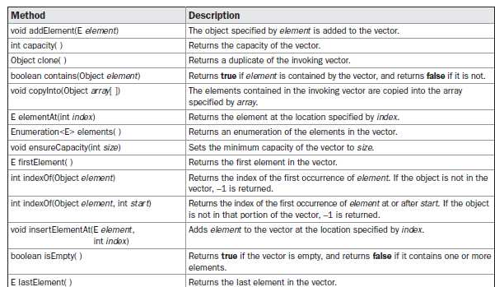
Vector(contd.)
Vector defines several legacy methods

Slide 93
Reference
Herbert Schildt, Java: The Complete Reference, 8/e, Tata McGraw Hill, 2011.

Slide 94
The Scope and Lifetime of Variables(contd.)
The scope defined by a method begins with its opening curly brace. {
– If that method has parameters, they too are included within the method’s scope.

Slide 95
CS205 Object Oriented Programming in Java
Module 2 - Core Java Fundamentals (Part 3)

Slide 96
Topics
Core Java Fundamentals:
Operators –
Arithmetic Operators,
Bitwise Operators,
Relational Operators,
Boolean Logical Operators,
Assignment Operator,
Conditional (Ternary) Operator,
Operator Precedence.

Slide 97
Operators
Operators are used for performing operations.
Arithmetic Operators
+, -, *, /, % ++, +=, -=,*=, /=, %=, - -
Bitwise Operators ~ Bitwise unary NOT
&,| ,^ , >> ,>>> ,<< , &=, |=, ^=, >>=, >>>=
Relational Operators
= =, !=, >, < , <=, >=
Boolean Logical Operators
&, |, ^, ||,&&, &=,| =, ^=, ==, !=, ?:
Assignment Operator
=
Conditional (Ternary) Operator
?:

Slide 98
Assignment Operator
=
Conditional (Ternary) Operator
?:

Slide 99
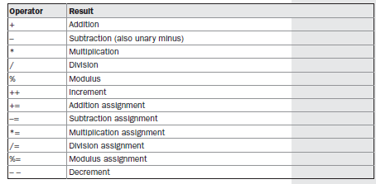
Arithmetic Operators

Slide 100
The Basic Arithmetic Operators
The basic arithmetic operations—addition, subtraction, multiplication, and division works for all numeric types.
– The minus operator also has a unary form that negates its single operand.
– E.g
int a=3; int b=-a;

Slide 101
Modulus Operator
The Modulus Operator
The modulus operator, %, returns the remainder of a division operation. It can be applied to
floating-point types as well as integer following example program demonstrates
the %:
types. The

Slide 102
Arithmetic Compound Assignment Operators
Variable operator = expression; This is same as
Variable =Variable operator expression;
In programming:
a = a + 4; can be written as
a += 4;
E.g.
int a=3;
a+=2; //Now value of a is 3+2=5

Slide 103
// Demonstrate the % operator.
class Modulus {
public static void main(String args[]) { int x = 42;
double y = 42.25;
System.out.println("x mod 10 = " + x % 10); System.out.println("y mod 10 = " + y % 10);
}
}
When you run this program, you will get the following output:
x mod 10 = 2
y mod 10 = 2.25

Slide 104
Pre-Increment Post increment
Pre increment E.g x = 42;
y = ++x;
x 43
y 43
Post increment E.g x = 42;
y = x++;
x 43
y 42

Slide 105
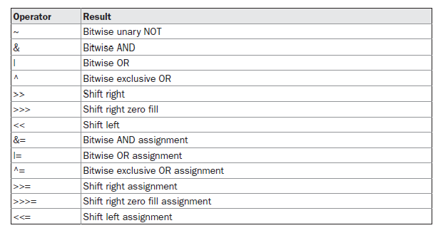
Bitwise operators

Slide 106
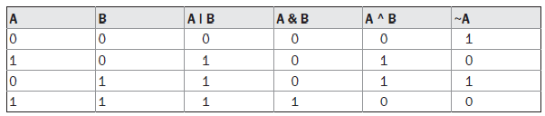
Bitwise logical oprators

Slide 107
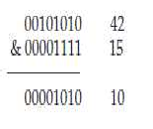



Examples

Slide 108

Right shift
Each time you shift a value to the right, it divides that value by two—and discards any remainder.
When you are shifting right, the top (leftmost) bits exposed by the right shift are filled in with the previous contents of the top bit. This is called sign extension and serves to preserve the sign of negative numbers when you shift them right. For example, –8 >> 1 is –4

Slide 109



Right shift e.g
E.g.
E.g.

Slide 110

Unsigned, shift-right operator, >>>
Shift a zero into the high-order bit(letftmost or top) no matter what its initial value was. This is known as an unsigned shift.
Java’s unsigned, shift-right operator, >>> always shifts zeros into the high-order bit.
E.g a is set to –1, which sets all 32 bits to 1 in binary. This value is then shifted right 24 bits, filling the top 24 bits with zeros, ignoring normal sign extension. This sets a to 255.

Slide 111
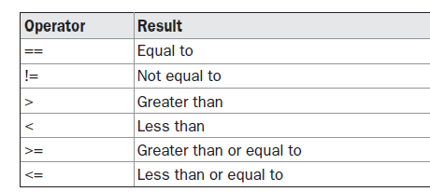
Relational operators

Slide 112
Relational operator(contd.)
int a = 4; int b = 1;
boolean c = a < b; //c contains false. 4 is not less than 1 Here the result of a<b (which is false) is stored in c.
E.g.
int done;
// ...
if(!done) ... // Valid in C/C++
if(done == 0) ... // This is Java-style.
if(done != 0) ... 18
if(done) ... // but not valid in Java.

Slide 113
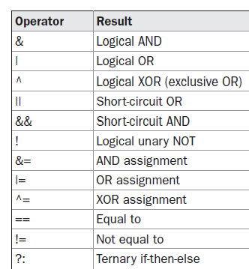
Boolean Logical Operators

Slide 114
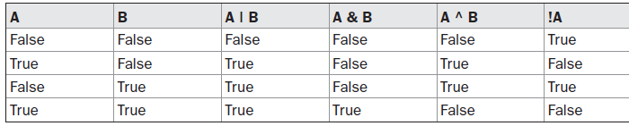
The logical Boolean operators, &, |, and ^, operate on boolean values in the same way that they operate on the bits of an integer.

Slide 115
Short-Circuit Logical Operators
Secondary operators, operators.
versions of the Boolean AND and OR
and are known as short-circuit logical
The OR operator results in true when A is true, no matter what B is. Similarly, the AND operator results in false when A is false, no matter what B is.
If you use the || and && forms, rather than the | and & forms of these operators, Java will not bother to evaluate the right-hand operand when the outcome of the expression can be determined by the left operand alone.

Slide 116
Short-Circuit Logical Operators(E.g)
E.g
if (denom != 0 && num / denom > 10)
Here if denom is 0 the second expression is not validated
– So there is no risk of causing a run-time exception when denom is zero.
If this line of code were written using the single & version of AND, both sides would be evaluated, causing a run-time exception when denom is zero.
ADMIN
2022-10-21 09:10:09
--------------------------------------------
CORRECTION ...! The expression in if() condition should be OR if (denom != 0 || num / denom > 10)

Slide 117
Assignment Operator
var = expression;
Here, the type of var must be compatible with the type of expression.
It allows you to create a chain of assignments int x, y, z;
x = y = z = 100; // set x, y, and z to 100

Slide 118
Ternary (conditional or three-way) operator
The ? Operator has this general form: expression1 ? expression2 : expression3
Here, expression1 can be any expression that evaluates to a boolean value.
If expression1 is true, then expression2 is evaluated; otherwise, expression3 is evaluated.
The result of the ? operation is that of the expression evaluated.
Both expression2 and expression3 are required to return the same type, which can’t be void

Slide 119
E.g.
int ratio = denom == 0 ? 0 : num / denom;
If denom equals zero, then the expression between the question mark and the colon is evaluated and used as the value of the entire ? expression.
Here 0 is stored in ratio
If denom does not equal zero, then the expression after the colon is evaluated and used for the value of the entire ? expression.
i.e num/denom is stored in ratio
The result produced by the ? operator is then assigned to ratio.

Slide 120
int a=3,b=5;
int c=(a>b?a:b);
Here a>b is false so the value of b is stored in c.

Slide 121
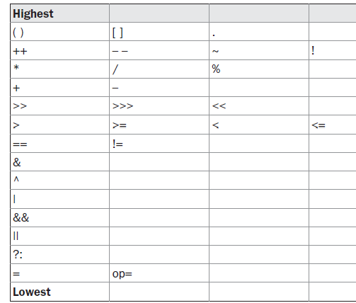
Operator Precedence

Slide 122
Associativity of operators
When an expression has two or more operators with the same precedence, the expression is evaluated according to its associativity.
– It is the order of applying operators

Slide 123
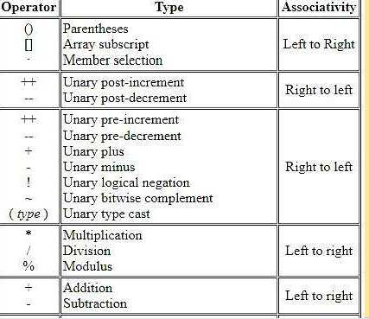
Operator Associativity

Slide 124
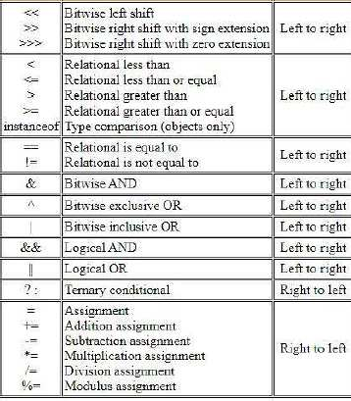

Slide 125
Associativity
Right to Left associative
Unary operators
Assignment operators
Conditional(ternary) operators)
All other operators are Left to Right associative

Slide 126
Reference
Herbert Schildt, Java: The Complete Reference, 8/e, Tata McGraw Hill, 2011.

Slide 127
CS205 Object Oriented Programming in Java
Module 2 - Core Java Fundamentals (Part 4)

Slide 128
Topics
Core Java Fundamentals:
Control Statements
Selection Statements,
Iteration Statements
Jump Statements.

Slide 129
Control statements
A programming language uses control statements to cause the flow of execution to advance and branch based on changes to the state of a program
Categories of control statements
Selection Statements,
Iteration Statements
Jump Statements.

Slide 130
Control statements(contd.)
Selection statements allow the program
to choose different paths of execution based on condition (outcome of an expression or the state of a variable).
Iteration statements enable program execution
to repeat one or more statements (that is, iteration statements form loops).
Jump statements allow your program
to execute in a nonlinear fashion.

Slide 131
Java’s Selection Statements
Also called decision making statements.
Selection statements control the flow of program’s execution based upon conditions known only during run time. It helps to choose different paths of execution based on condition.
Java supports two selection statements:
if
switch

Slide 132
if statement
if statement is Java’s conditional branch statement.
It can be used to route program execution through different paths.
Syntax of simple if statement if (condition)
{
// block of code to be executed if the condition is true
………………
}

Slide 133
Simple if E.g.
class Sample{
public static void main(String args[])
{
if(a>0)
{
System.out.println(" a is a positive number”);
}
}

Slide 134
If-else statement
General form of the if statement:
if (condition) statement1;
else statement2;
Statement may be a single statement or a compound statement enclosed in curly braces (that is, a block).
The condition is any expression that returns a boolean value.
The else clause is optional.

Slide 135
Working of if-else
if (condition) statement1;
else statement2;
If the condition is true, then statement1 is executed.
Otherwise, statement2 (if it exists) is executed.
Both statements will not be executed at the same time.

Slide 136
If-else E.g
class Sample{
public static void main(String args[]) { int a=5, b=3;
if(a < b) a = 0;
OUTPUT
a=5
else b = 0; System.out.println(" a=" + a); System.out.println(" b=" + b);
}
}
b=0

Slide 137
If statement(contd.0
If statement can be controlled using a boolean variable.
E.g.
…
boolean dataAvailable;
// ...
if (dataAvailable) ProcessData();
else
waitForMoreData();
..
//if dataAvailable is true
//call this function
//call this function

Slide 138
If statement(contd.)
Only one statement can appear directly after the if or the else. if(condition)
Statement1; else Statement
If we want to include more statements inside if statement or
else , we have to create a block (start with { and end with}
if(condition)
{
Statement1; Statement1;
…..
}

Slide 139
Nested ifs
A nested if is an if statement that is the inside (target of ) another if or else.
The else statement always refers to the
– nearest if statement that is within the same block as the else and that is not already associated with an else.

Slide 140
Nested if E.g
if(i == 10)
{
if(j < 20) a = b;
if(k > 100) c = d;
// this if is
else a = c; // associated with this else
}
else a = d; // this else refers to if(i == 10)

Slide 141
The if-else-if Ladder
A common programming construct that is
sequence of nested ifs is the if-else-if ladder.
if(condition) statement;
else if(condition) statement;
else if(condition) statement;
...
else
statement;
based upon a

Slide 142
The if-else-if Ladder(contd.)
The if statements are executed from the top down.
As soon as one of the conditions controlling the if is true, the statement associated with that if is executed, and the rest of the ladder is bypassed.
If NONE of the conditions is true, then the final else statement will be executed.
The last else acts as a default condition; that is, if all other conditional tests fail, then the last else statement is performed.

Slide 143
class IfElse {
public static void main(String args[]) { int month = 4; // April
String season;
if(month == 12 || month == 1 || month == 2) season = "Winter";
else if(month == 3 || month == 4 || month == 5) season = "Spring";
else if(month == 6 || month == 7 || month == 8) season = "Summer";
else if(month == 9 || month == 10 || month == 11) season = "Autumn";
else
season = "Bogus Month";
System.out.println("April is in the " + season + ".");}}

Slide 144
class IfElse {
public static void main(String args[]) { int month = 4; // April
String season;
if(month == 12 || month == 1 || month == 2) season = "Winter";
else if(month == 3 || month == 4 || month == 5) season = "Spring";
else if(month == 6 || month == 7 || month == 8) season = "Summer";
else if(month == 9 || month == 10 || month == 11) season = "Autumn";
else
season = "Bogus Month";
System.out.println("April is in the " + season + ".");}}

Slide 145
switch statement
The switch statement is Java’s multiway branch
statement.
It is an better alternative than a large series of if-else-if
statements.

Slide 146
Syntax of switch
switch (expression)
{
case value1:
// statement sequence
break; case value2:
// statement sequence
break;
...
case valueN:
// statement sequence break;
default:
// default statement sequence
}

Slide 147
Switch(contd.)
switch(expression){…..}
The expression inside switch must be of type byte, short, int, or char;
– each of the values specified in the case statements must be of a type compatible with the expression. (An enumeration value can also be used to control a switch statement)

Slide 148
Working of switch
The value of the expression inside switch is compared with each of the literal values in the case statements.
If a match is found, the code sequence following that case statement is executed.
If none of the constants in the case matches the value of the expression, then the default statement is executed.
default statement is optional.
If no case matches and no default is present, then no further action is taken.

Slide 149
Working of switch(cond.)
The break statement is used inside the switch to terminate a statement sequence.
When a break statement is encountered, execution branches to the first line of code after the entire switch statement.
This has the effect of “jumping out” of the switch.

Slide 150
class SampleSwitch {
public static void main(String args[]) { for(int i=0; i<5; i++)
switch(i)
{
case 0:
System.out.println("i is zero."); break;
case 1:
System.out.println("i is one."); break;
case 2:
System.out.println("i is two."); break;
default:
System.out.println("i is greater than 2.");
} } }
OUTPUT
i is zero. i is one. i is two.
i is greater than 2. i is greater than 2.

Slide 151
class Switcheg {
public static void main(String args[]) { for(int i=0; i<4; i++)
switch(i)
{
case 0:
System.out.println("i is zero."); case 1:
System.out.println("i is one."); case 2:
System.out.println("i is two."); break;
default:
System.out.println("i is greater than 2.");
} } }
OUTPUT
i is zero. i is one. i is two. i is one. i is two. i is two.
i is greater than 2.

Slide 152
import java.util.Scanner; class Switchvow {
public static void main(String args[]) { Scanner sc=new Scanner(System.in); System.out.println("Enter a letter:"); char c=sc.next().charAt(0); ; switch(c)
{
case 'a':
case 'e':
case 'i':
case 'o':
case 'u':
case 'A':
case 'E':
case 'I':
case 'O':
case 'U': System.out.println("vowel"); break;
OUTPUT
Enter a letter: A
vowel
default: System.out.println("Not vowel-may be consonent"); } } }

Slide 153
Nested switch Statements
We can use a switch as part of the statement sequence of an outer switch. This is called a nested switch
switch(count) {
case 1:
switch(target) { // nested switch
case 0:
System.out.println("target is zero"); break;
// no conflicts with outer switch System.out.println("target is one"); break;
case 1:
}
break;
case 2: // ... }

Slide 154
Features of the switch statement
The switch differs from the if in that switch can only test for equality, whereas if can evaluate any type of Boolean expression.
switch looks only for a match between the value of the expression inside switch and one of its case constants.
No two case constants in the same switch can have identical values.
But a switch statement and an enclosing outer switch can have case constants in common.
A switch statement is usually more efficient than a set of nested ifs.

Slide 155
Swich(features)
When Java compiler compiles a switch statement, it will inspect each of the case constants and create a “jump table” that it will use for selecting the path of execution depending on the value of the expression.
So a switch statement will run much faster than the equivalent logic coded using a sequence of if-elses.
The compiler can do this because it knows that the case constants are all the same type and simply must be compared for equality with the switch expression.
The compiler has no such knowledge of a long list of if expressions

Slide 156
Iteration Statements
A iteration statements or loop repeatedly executes the same set of instructions until a termination condition is met.
Java’s iteration statements (looping statements) are
for
while
do-while

Slide 157
while
The while loop is Java’s most fundamental loop statement. It is ENTRY CONTROLLED loop.
– The statements inside the body of while is executed only if the condition inside while is true.
It repeats a statement or block while its controlling expression is true.
General form: while(condition)
{
// body of loop
}

Slide 158
Working of while
while(condition)
{
// body of loop
}
The condition can be any Boolean expression.
The body of the loop will be executed as long as the conditional expression is true.
When condition becomes false, control passes to the next line of code immediately after the loop.

Slide 159
While(contd.)
The curly braces are not needed if only a single statement is being repeated.
while(condition)
Statement;

Slide 160
// Demonstrate the while loop. class Whileeg {
public static void main(String args[]) {
int n = 10; while(n > 0) {
System.out.println("tick " + n); n--;
}
}
}
OUTPUT
tick 10
tick 9
tick 8
tick 7
tick 6
tick 5
tick 4
tick 3
tick 2
tick 1

Slide 161
While(contd.)
The body of the while (or any other of Java’s loops) can be empty.
– This is because a null statement (one that consists only of a semicolon) is syntactically valid in Java.
while(condition) ;
Here if condition is true no statement is executed as part of while

Slide 162
class Whileeg {
public static void main(String args[])
OUTPUT
tick 10
tick 10
tick 10
…..
{
int n = 10;
while(n > 0)
{
System.out.println("tick " + n);
}
.
.
INFINITE LOOP
}
}

Slide 163
do-while
The do-while loop always executes its body at least once, because its conditional expression is at the bottom of the loop.
do
{
//statements
}
while(condition);

Slide 164
Working of do-while
do-while is EXIT CONTROLLED loop. do
{
//statements
}
while(condition);
Initially the statements inside the do-while loop is executed
then only the condition inside while is checked.
Then the loop is executed only if that condition is true.
– That is condition is checked only during exit from do-while loop.

Slide 165
class Menu {
public static void main(String args[]) throws java.io.IOException
{
…
char choice = (char) System.in.read();
…
}
Here System.in.read( ) is used here to obtain the value of choice from user. So main() function throws java.io.IOException

Slide 166
class Whileeg {
public static void main(String args[])
OUTPUT
Hello Hello Hello Hello
{
do
{
System.out.println(“Hello”);
}while(true);
….
…
..
}
}
.
INFINITE LOOP

Slide 167
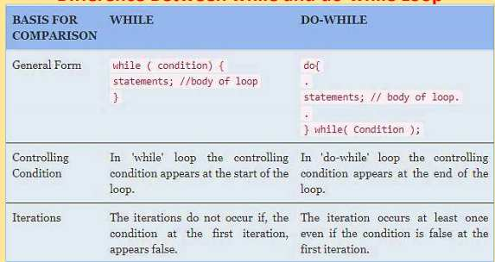
Difference between while and do-while

Slide 168
for
It is an iteration statement(looping)
for(initialization; condition; iteration) {
// body
}

Slide 169
Working of for loop
When the loop first starts, the initialization portion of the loop is executed. It acts as a loop control variable (counter).
the initialization expression is only executed once.
Next, condition is evaluated.(Boolean expression)
It usually tests the loop control variable against a target value.
If this expression is true, then the body of the loop is executed.
If it is false, the loop terminates.
Next, the iteration portion of the loop is executed.
increments or decrements the loop control variable.
Next, condition is evaluated.
And the process continues until condition becomes false

Slide 170
for( ; ; )
{
INFINITE LOOP
// ...
}

Slide 171
The For-Each Version of the for Loop
for(type var : collection) statement-block;
Here, type specifies the type and var specifies the name of an iteration variable that will receive the elements from a collection, one at a time, from beginning to end.
The collection being cycled through is specified by collection

Slide 172
class Foreacheg {
public static void main(String args[])
{
int nums[] = { 1, 2, 3, 4, 5, 6, 7, 8, 9, 10 };
for(int x: nums)
System.out.println(x);
}
OUTPUT
1
2
3
4
5
6
7
8
9
10
During each pass through the loop, x is automatically given a
value equal to the next element in nums.
Thus, on the first iteration, x contains 1;
on the second iteration, x contains 2; and so on.
Not only is the syntax streamlined, but it also prevents
}
boundary errors.

Slide 173
int nums[] = { 1, 2, 3, 4, 5, 6, 7, 8, 9, 10 };
int sum = 0; for(int x: nums)
1
2
3
4
5
6
7
8
System.out.println(x);
9
10
With each pass through the loop, x is automatically given a value equal to the next element in nums.
Thus, on the first iteration, x contains 1;
on the second iteration, x contains 2; and so on.
Not only is the syntax streamlined, but it also prevents
boundary errors.

Slide 174
Nested loops
// Loops may be nested. class Foreg2{
public static void main(String args[]) { int i, j;
for(i=0; i<4; i++) { for(j=0; j<3; j++)
System.out.print("i="+i+" j="+j + "\t\t"); System.out.println();
}
}
}
OUTPUT
i=0 j=0 | i=0 j=1 | i=0 j=2
i=1 j=0 | i=1 j=1 | i=1 j=2
i=2 j=0 | i=2 j=1 | i=2 j=2
i=3 j=0 | i=3 j=1 | i=3 j=2

Slide 175
// Loops may be nested. class Foreg2{
public static void main(String args[]) {
int i, j;
for(i=0; i<4; i++) { for(j=0; j<3; j++) System.out.print(i +"\t\t"); System.out.println();
}
}
}
OUTPUT
0 | 0 | 0
1 | 1 | 1
2 | 2 | 2
3 | 3 | 3

Slide 176
// Loops may be nested. class Foreg2{
public static void main(String args[]) {
int i, j;
for(i=0; i<4; i++) { for(j=0; j<3; j++) System.out.print(j+"\t\t"); System.out.println();
}
}
}
OUTPUT
0 | 1 | 2
0 | 1 | 2
0 | 1 | 2
0 | 1 | 2

Slide 177
Nested loops
// Loops may be nested. class Nested {
public static void main(String args[]) { int i, j;
**
**
**
for(i=0; i<4; i++) { for(j=0; j<2; j++) System.out.print(“*"); System.out.println();
**
.
}
}
}

Slide 178
Nested loops
// Loops may be nested. class Nested {
public static void main(String args[]) { int i, j;
****
***
**
for(i=0; i<4; i++) { for(j=i; j<4; j++) System.out.print(“*"); System.out.println();
*
.
}
}
}

Slide 179
Jump Statements
Java supports three jump statements:
break
continue
return

Slide 180
break statement
Three uses.
First it terminates a statement sequence in a switch statement.
Second, it can be used to exit a loop.
Third, it can be used as a “civilized” form of goto.

Slide 181
break E.g
// Using break to exit a loop. class BreakLoop {
public static void main(String args[]) { for(int i=0; i<6; i++)
{
if(i == 3)
OUTPUT
i: 0
i: 1
i: 2
break; // terminate loop if i is 3
System.out.println("i: " + i);
}
System.out.println("Loop complete.");
}
}
Loop complete.

Slide 182
Using break as a Form of Goto
By using this form of break, you can, for example, break out of one or more blocks of code.
The general form of the labeled break statement is :
break label;

Slide 183
// Using break as a civilized form of goto. class Breakeg {
public static void main(String args[]) { boolean t = true;
first: {
second: {
third: {
System.out.println("Before the break."); if(t) break second; //break of second block System.out.println("This won't execute");
}
System.out.println("This won't execute");
}
System.out.println(“After second block.");
}
OUTPUT
Before the break. After second block..
}
}
57

Slide 184
continue statement
In while and do-while loops, a continue statement causes control to be transferred directly to the conditional expression that controls the loop.
In a for loop, control goes first to the iteration portion of the for statement and then to the conditional expression.
For all three loops, any intermediate code after continue is bypassed(skipped).
58

Slide 185
continue E.g
// Using break to exit a loop. class continueeg{
public static void main(String args[]) { for(int i=0; i<6; i++)
{
if(i == 3)
OUTPUT
i: 0
i: 1
i: 2
i: 4
i: 5
continue; // skip remaining stmts if i is 3
// continue loop.control goes to iteration ^{Loop complete.}
System.out.println("i: " + i);
}
System.out.println("Loop complete.");
}
}

Slide 186
// Demonstrate continue. class Continueeg {
public static void main(String args[]) { for(int i=0; i<10; i++) {
OUTPUT
0 1
2 3
4 5
System.out.print(i + " "); if (i%2 == 0) continue; System.out.println("");
}
}
}
6 7
8 9

Slide 187
return statement
The return statement is used to explicitly return from a method.
The return causes program control to transfer back to the caller of the method.
When return statement is executed the method terminates.
The return causes execution to return to the Java run- time system
Methods that have a return type other than void return a value to the calling method(function)
return value;
Here, value is the value is returned to the calling function

Slide 188
// Demonstrate return. class Return {
public static void main(String args[]) { boolean t = true;
OUTPUT
Before the return
System.out.println("Before the return."); if(t) return;
System.out.println("This won't execute.");
}
}

Slide 189
Reference
Herbert Schildt, Java: The Complete Reference, 8/e, Tata McGraw Hill, 2011.

Slide 190
CS205 Object Oriented Programming in Java
Module 2 - Core Java Fundamentals (Part 5)
1

Slide 191
Topics
Core Java Fundamentals:
Object Oriented Programming in Java
Class Fundamentals
Declaring Objects
Object Reference
Introduction to Methods.
2

Slide 192
Class Fundamentals
The class is the core of Java.
The class forms the basis for object-oriented programming in Java.
A class is a "blueprint" for creating objects
A class is a template for an object.
An object is an instance of a class.
A class defines a new type of data.
A class creates a logical framework that defines the relationship between its members.
3

Slide 193
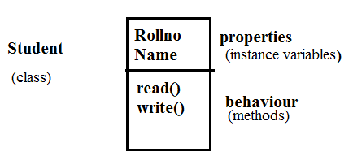

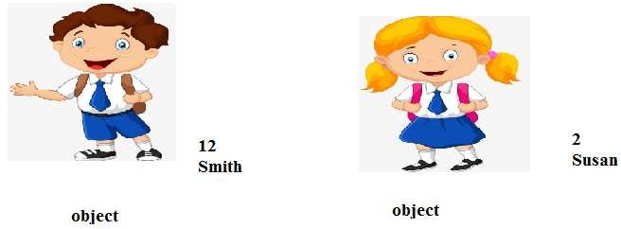
Example
4

Slide 194
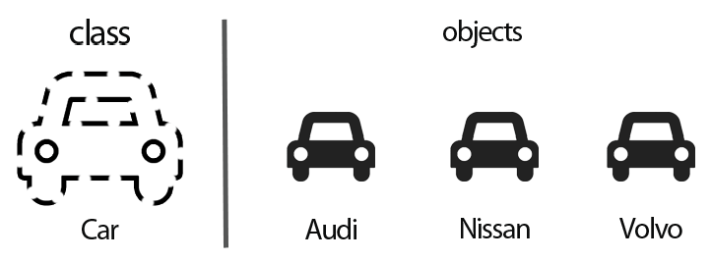
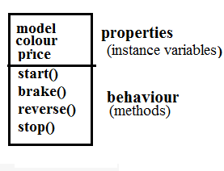
5

Slide 195
Class(continued.)
A class is declared using the keyword class
The data or variables, defined within a class are called
instance variables.
because each instance of the class (that is, each object of the class) contains its own copy of these variables.
the data for each object is separate and unique.
Functions inside class are called methods.
The methods and variables defined within a class are called members of the class.
6

Slide 196
The General Form of a Class
A general form of a class definition is
class classname
{
type instance-variable1; type instance-variableN;
type methodname1(parameter-list)
{
// body of method
}
type methodnameN(parameter-list)
{ // body of method
}
Properties (instance variables)
Behaviour or Method or function
Members
of class
Behaviour or Method or function
}
7

Slide 197
A Simple Class
class Box
{
double width; double height;
Properties (instance variables)
Member of class
double depth;
}
8

Slide 198
A Simple Class
class Box
{
double width; double height; double depth;
Properties
(instance variables)
Members
of class
void volume()
{
//statements
}
Behaviour or Method or Function
}
9

Slide 199
Declaring Objects
When we create a class, we are creating a new data type.
We can use this type to declare objects of that type.
Obtaining objects of a class is a two-step process.
First, we must declare a variable of the class type.
This variable does not define an object.
It is simply a variable that can refer to an object.
Second, we must acquire an actual, physical copy of the object and assign it to that variable (using new operator)

Slide 200
Declaring Objects(contd.)
Classname objectname ; // declare reference to object
objectname = new Classname(); // allocate an object
We can write this in a single statement Classname objectname = new Classname();

Slide 201
class Box
{double Width; double Height; double Depth;
}
Box mybox;
This line declares mybox as a reference to an object of type
Box.
Here mybox contains the value null, which indicates that it does not yet point to an actual object
mybox = new Box();
This line allocates an actual object and assigns a reference to it to mybox.
mybox holds the memory address of the actual Box object.

Slide 202
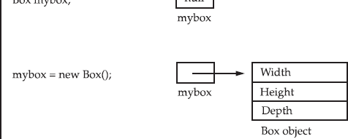
Declaring Objects(contd.)
class Box
{double Width; double Height; double Depth;
}

Slide 203
Declaring Objects(contd.)
The class name followed by parentheses specifies the
constructor for the class.
Box mybox=new Box();
Here Box is the class. Box()is the constructor.
A constructor defines what occurs when an object of a class is created.

Slide 204
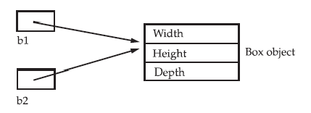
Assigning Object Reference Variables
Object reference variables act differently when an assignment takes place
E.g.
Box b1 = new Box(); Box b2 = b1;
Here b1 and b2 will both refer to the same object.
Any changes made to the object through b2 will affect the object which is referred by b1, because they are the same object.

Slide 205

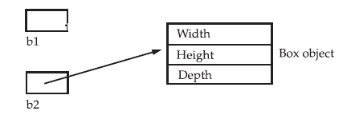
Assigning Object Reference Variables (contd.)
Box b1 = new Box(); Box b2 = b1;
// ...
b1 = null;
b2
Here at the end b1 has been set to null, but b2 still points to the original object.

Slide 206
Class vs object
Class
Template for creating objects
Logical entity
Declared using class
keyword
Class does not get any memory when it is created.
A class is declared only once
Object
Instance of class
Physical entity
Created using new operator.
Object gets memory when it is created using new operator.
Many objects can be created from a class

Slide 207
Introducing Methods
Classes usually consist of two things:
Instance variables
Methods or functions.
The general form of a method:
type name(parameter-list)
{
// body of method
}
The type specifies the type of data returned by the method.
any valid type, including class types, void
The parameter-list or argument list is a sequence of type and identifier pairs separated by commas.

Slide 208
Introducing Methods(contd.)
Methods that have a return type other than void return a value to the calling routine using the following form of the return statement:
return value;
Method of one class can be invoked by functions of other classes through objects of former class.
Objectname.method(parameters);

Slide 209
// EXAMPLE
class Box {
double width; double length; double depth;
Properties
(instance variables)
void volume()
{
System.out.print("Volume is "); System.out.println(width * height * depth);
}
Behaviour or Method or Function
}
class BoxDemo {
public static void main(String args[]) { Box mybox1 = new Box(); mybox1.width = 10;
mybox1. length = 30; mybox1.depth = 15; mybox1.volume();
} }
Box class
Behaviour or Method or Function
MAIN FUNCTION
Object of class Box
BoxDemo class
20

Slide 210
Example
Create a class Box with instance variables length, width and height. Include a method volume to compute the volume of the box,
Create another class BoxDemo with main function that creates an object of class Box named mybox1 and set the values for instance variables(length, width and height). Invoke the function volume in Box to compute the volume of the created object mybox1
21

Slide 211
class Box {
double width; double length; double depth;
void volume()
{
System.out.print("Volume is "); System.out.println(width * length * depth);
}
OUTPUT
Volume is 3000.0
}
class BoxDemo {
public static void main(String args[]) { Box mybox1 = new Box(); mybox1.width = 10;
mybox1. length = 30; mybox1.depth = 15; mybox1.volume();
}
}
22

Slide 212
// program using return statement class Box {
double width; double height; double depth;
void volume()
{
return(width * length * depth);
}
OUTPUT
Volume is 3000.0
}
class BoxDemo {
public static void main(String args[]) { Box mybox1 = new Box(); mybox1.width = 10;
mybox1.height = 20;
mybox1.depth = 15;
int v=mybox1.volume();
System.out.println(”Volume=“+v);
} }
23

Slide 213
Reference
Herbert Schildt, Java: The Complete Reference, 8/e, Tata McGraw Hill, 2011.
24

Slide 214

CS205 Object Oriented Programming in Java
Module 2 - Core Java Fundamentals (Part 6)
1

Slide 215

Topics
Core Java Fundamentals:
Constructors
this Keyword
Method Overloading
Using Objects as Parameters
2

Slide 216
Constructor
A constructor help to initialize an object(give values) immediately upon creation.
Constructor is a special method inside the class.
Constructor has the same name as the class in which it resides.
Once defined, the constructor is automatically called immediately after the object is created, before the new operator completes.
3

Slide 217
Constructor(contd.)
Constructors have no return type, not even void.
This is because the implicit return type of a class’ constructor is the class type itself.
Two types of constructors
Default constructor – has no arguments
Parameterized constructor –has arguments(parameters)
4

Slide 218
Constructor(contd.)
Default constructor has no arguments or parameters.
E.g.
class A
{
Default Constructor of class A
A( )
{
//statements
}
}
5

Slide 219
Default constructor(contd.)
class Box
{
int width ,length,height;
Box()
{
width=10; length=10; height=10;
}}
The following statement creates an object of class Box. Box mybox1 = new Box();
Here new Box( ) is calling the Box( ) constructor.
6

Slide 220
Default constructor(contd.)
class Box
{
int width ,length,height;
Box()
{
width=10; length=10; height=10;
}}
The following statement creates an object of class Box. Box mybox1 = new Box();
Here new Box( ) is calling the Box( ) constructor.
7

Slide 221
Default constructor(contd.)
When we do not explicitly define a constructor for a class, then Java creates a default constructor for the class.
8

Slide 222
class Box {
int width; int length; int height; Box()
{
System.out.println("Constructing Box"); width = 10;
}
9

Slide 223
class BoxDemo {
class Box {
int length; int height; int width; Box()
{
System.out.println(“Constructor");
width = 10;
length = 10;
public static void main(String args[])
{
Box mybox1 = new Box(); Box mybox2 = new Box(); int vol;
vol = mybox1.volume();
System.out.println("Volume is " + vol);
height= 10;
}
int volume()
{
return width * length * height;
}
vol = mybox2.volume();
System.out.println("Volume is " + vol);
}
OUTPUT
}
Constructor Constructor Volume is 1000
Volume is 1000
}
10

Slide 224
Parameterized Constructors
Constructors with arguments are called constructors.
parameterized
11

Slide 225
class Box
{
double width; double height;
double length;
Box(double w, double h, double l)
{
width = w; height = h; length= l;
}
double volume()
{
return width * height * length;
}
Parameterized Constructor of class Box (Box
constructor has arguments-> parameters )
}
12

Slide 226
class Box
class BoxDemo {
public static void main(String args[]) {
{
double width; double height; double length;
Box(double w, double h, double l)
{
width = w; height = h; length = l;
}
double volume()
{
return width * height * length;
}
Box mybox1 = new Box(10, 20, 15); Box mybox2 = new Box(3, 6, 2); double vol;
vol = mybox1.volume(); System.out.println("Volume is " + vol);
vol = mybox2.volume(); System.out.println("Volume is " + vol);
}
}
OUTPUT
Volume is 3000
Volume is 36
}
13

Slide 227
Parameterized constructor(contd.)
Box mybox1 = new Box(10, 20, 15);
Here the values 10, 20, and 15 are passed to the Box( )
constructor when new creates the object mybox1.
The parameterized constructor is
Box(double w, double h, double l)
{
width = w; height = h; length = l;
}
Thus, value of mybox1 object’s width, height, and depth will be set as 10, 20, and 15 respectively.

Slide 228
The this Keyword
The this keyword can be used inside any method to refer to the current object.
this is always a reference to the object on which the method was invoked.
this can be used to refer current class instance variable.
this can be used to invoke current class method (implicitly)
this() can be used to invoke current class constructor.
this can be passed as an argument in the method call.
this can be passed as argument in the constructor call.
static methods cannot refer to this.

Slide 229
this-Example
Box(double w, double h, double l)
{
this.width = w; this.height = h; this.length = l;
}
Here this will always refer to the object invoking the method

Slide 230

class Box
{
double width; double length; double height;
Box(double w, double l, double h)
{
this.width = w; this.length = l; this.height = h;
class BoxDemo {
public static void main(String args[]) {
Box mybox1 = new Box(10, 20, 15);
Box mybox2 = new Box(3, 6, 2);
}
}
}
}
Here in statement
Box mybox1 = new Box(10, 20, 15);
mybox1 object is created by calling parameterized constructor.
Box(double w, double l, double d)
Here this inside constructor refers to object mybox1.
Next when mybox2 object is created, this refers to object mybox2.

Slide 231
Instance variable hiding-using this
We can have local variables, including formal parameters to methods, which has the same name of the class’ instance variables(attributes).
But when a local variable has the same name as an instance variable, the local variable hides the instance variable.
– this helps to solve this. Use this. along with instance variables.

Slide 232
Instance variable hiding-using this (contd.)
// Use this to resolve name-space collisions.
class Box
{
double width
INSTANCE
double length; double height;
Box(double width, double height, double length)
{
this.width = width; this.length = length; this. height; = length;
} }
VARIABLE
CONSTRUCTOR

Slide 233
Instance variable hiding-using this (contd.)
// Use this to resolve name-space collisions.
class Box
{
double width double length; double height
Box(double width, double height, double length)
{
this.width = width;
INSTANCE
Local variable
this.length = length; this. height = length;
} }
VARIABLE

Slide 234
Method Overloading
It is possible to define two or more methods with same name within the same class, but their parameter declarations should be different.
This is called method overloading.
This is a form of polymorphism (many forms)
Overloaded methods must differ in the type and/or number of their parameters. (return types is not significant.)
When an overloaded method is invoked, Java uses the type and/or number of arguments to determine which version of the overloaded method to actually call.

Slide 235
// Demonstrate method overloading.
class Sample {
public static void main(String args[])
{
Over ob = new Over();
class Over
{
void test()
{
System.out.println(“Empty");
}
void test(int a) { System.out.println("a: " + a);
}
void test(int a, int b) { System.out.println(“a=”+a); System.out.println(“b=”+b);
}
ob.test();
ob.test(10);
ob.test(2, 5);
}
}
OUTPUT
Empty a=10
a=2 a=5
}
22

Slide 236
In the example ,test( ) is overloaded three times.
The first version test() takes no parameters,
the second test(int a)takes one integer parameter
the thrd test(int a,int b) takes two integer parameters.

Slide 237
Method Overloading(contd.)
When an overloaded method is called, Java looks for a match between the arguments used to call the method and the method’s parameters
This match need not always be exact.
– In some cases, Java’s automatic type conversions can play a role in overload resolution.

Slide 238
Overloading -through automatic type conversions
class Over{ void test() {
System.out.println(“Empty");
}
void test(double a)
{
System.out.println(“a: " + a);
}
}
class Sample {
public static void main(String args[])
{
Over ob = new Over();
ob.test();
ob.test(10);
ob.test(2.5);
OUTPUT
Empty a=10 a=2.5
}
}

Slide 239
Overloading -through automatic type conversions(contd.)
In this example when test( ) is called with an integer argument inside .
Overload, no matching method is found with int as argument.
However, Java can automatically convert an integer into a double, and this conversion can be used to resolve the call.
Therefore, when test(int) is not found, Java elevates int to double and then calls test(double).

Slide 240
Overloading Constructors
Constructors can be overloaded. Because a class can have any number of constructors
– one default constructor, many parameterized constructors
class A
{
A() { //statements} A(int a) { //statements}
A(int a,float b) { //statements}
}

Slide 241
class Box
{
double width; double length; double height;
Box(double w, double l, double h)
{
width = w; length = l; height = h;
}
Box()
class BoxDemo {
public static void main(String args[]) {
Box mybox1 = new Box();
Box mybox2 = new Box(3, 6, 2); System.out.println("mybox1"); System.out.println(mybox1 .width + " “
+mybox1 .length + " "+ mybox1 .height);
System.out.println("mybox2"); System.out.println(mybox2.width + " “ +
mybox2.length + " " + mybox2 .height);
} }
{
width = 0;
length =0;
height =0;
OUTPUT
mybox1
0.0 0.0 0.0
mybox2
3.0 6.0 2.0
} }
28

Slide 242
class Box
{
double width double length; double height;
Box(double w, double l, double h)
{
this.width = w; this.length = l; this.height = h;
class BoxDemo {
public static void main(String args[]) {
Box mybox1 = new Box(); //ERROR Box mybox2 = new Box(3, 6, 2);
}
}
}
}
ERROR
Here following statement tries to create object mybox1 of class Box ,
Box mybox1 = new Box();
This should call default constructor Box() in class Box.
But Box class has constructor but no default constructor is there.
So ERROR occurs

Slide 243
class Box
{
double width double length; double height;
}
class BoxDemo {
public static void main(String args[]) {
Box mybox1 = new Box();
}
}
NO ERROR in this code
The following statement creates object of Box class mybox1
Box mybox1 = new Box();
Since no constructors are not there, Java provides the default constructor.

Slide 244
Using Objects as Parameters
We can pas objects as arguments(parameters) to function(method).
Objects are passed by reference(call by refernce).

Slide 245
Object as parameters
class Test { int a, b;
Test(int i, int j)
{
a = i; b = j;
}
class PassOb {
public static void main(String args[])
{
Test ob1 = new Test(100, 22); Test ob2 = new Test(100, 22); Test ob3 = new Test(-1, -1);
boolean equals(Test o)
System.out.println(ob1.equals(ob2));
{
if(o.a == a && o.b == b) return true;
else return false;
}
}
System.out.println(ob1.equals(ob3));
}}
OUTPUT
true false

Slide 246
Object as parameters
class Test { int a, b;
Test(int i, int j)
{
a = i; b = j;
}
class PassOb {
public static void main(String args[])
{
Test ob1 = new Test(100, 22); Test ob2 = new Test(100, 22); Test ob3 = new Test(-1, -1);
System.out.println(ob1.equals(ob2));
boolean equals(Test o)
{
System.out.println(ob1.equals(ob3));
}}
if(o.a == this.a && o.b == this.b)
return true; else return false;
}
}
OUTPUT
true false

Slide 247
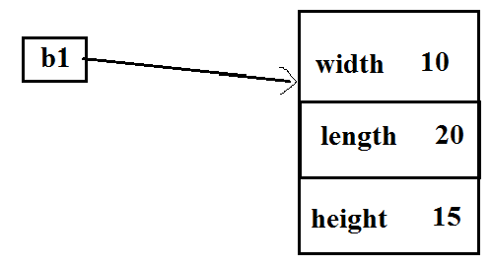
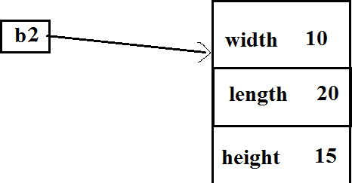
Object to initialize another object
class Box
{
double width double length; double height;
Box(double w, double l, double h)
{
width = w; length = l;
class BoxDemo {
public static void main(String args[])
{
Box b1 = new Box(10, 20, 15);
Box b2 = new Box(b1);
}
}
height = h;
}
}
Here object b2 is a clone of b1. The object b2 is initialized using initial values of object b1

Slide 248
Passing arguments to function
// Primitive types(int,char,double etc.) are passed by value.
// Objects are passed by reference.

Slide 249
class Test { int a; Test(int i)
{
class Obcall {
public static void main(String args[])
{
Test ob = new Test(15); System.out.println("Object parameter"); System.out.println("Before call: " + ob.a ); ob.calc(ob); // //Call by reference System.out.println("After call: " + ob.a );
a = i;
}
void calc(Test o)
{
o.a *= 2;
}
void calc(int a)
{
a*=2;
int a=15;
System.out.println("Integer parameter"); System.out.println("Before call: " + a); ob.calc(a); //Call by value System.out.println("After call: " + a); } }
} OUTPUT
} Object parameter
Before call: 15
After call: 30 Integer parameter Before call: 15
After call: 15
36

Slide 250
Reference
Herbert Schildt, Java: The Complete Reference, 8/e, Tata McGraw Hill, 2011.
37

Slide 251
CS205 Object Oriented Programming in Java
Module 2 - Core Java Fundamentals (Part 7)
Prepared by
Renetha J.B. AP
Dept.of CSE,
Lourdes Matha College of Science and Technology
1

Slide 252
Topics
Core Java Fundamentals:
Returning Objects
Recursion
Access Control
Static Members
2

Slide 253
Returning objects
A method can return any type of data,
Primitive data (int ,float, char, double etc.)
class types(objects) that you create.
etc.
3

Slide 254

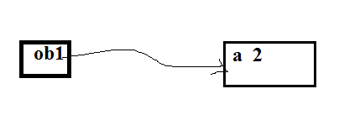

// Returning an object.
class RetOb {
public static void main(String args[]) {
Test ob1 = new Test(2); Test ob2;
ob2 = ob1.increase();
System.out.println("ob1.a: " + ob1.a); System.out.println("ob2.a: " + ob2.a);
class Test { int a; Test(int i)
{
a = i;
}
ob2 = ob2.increase ();
System.out.println(“increase ob2.a: ” +ob2.a);
Test increase()
{
Test temp = new Test(a+10); return temp;
}
}
}
OUTPUT
ob1.a: 2
ob2.a: 12
increase ob2.a: 22
}
4

Slide 255
Recursion
Recursion is the process of defining something in terms of itself.
A method that calls itself is called recursive function.
5

Slide 256
// A simple example of recursion. class Factorial {
int fact(int n)
{
int result; if(n==1)
return 1;
result = n* fact(n-1) ; return result;
}
}
class Recursion {
public static void main(String args[]) { Factorial f = new Factorial();
int s= f.fact(3) System.out.println("Factorial of 3 is " + s);
}
}

Slide 257
Example
class RecTest { int values[]; RecTest(int i) { values = new int[i];
}
void printArray(int i) { if(i==0)
return; else
printArray(i-1);
class Recursion2 {
public static void main(String args[])
{
RecTest ob = new RecTest(5); int i;
for(i=0; i<5; i++) ob.values[i] = i;
ob.printArray(5);
}
}
System.out.println("[" + (i-1) + "] " + values[i-1]);
}
}

Slide 258
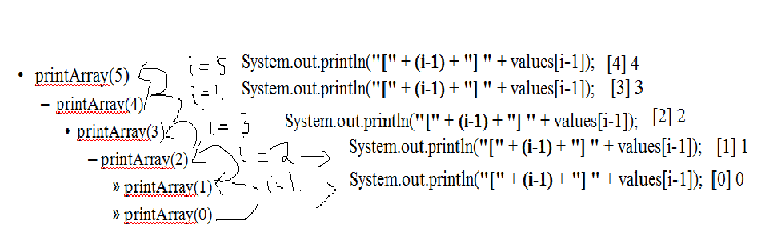
OUTPUT
[0] 0
[1] 1
[2] 2
[3] 3
[4] 4
[5] 5

Slide 259
Access Control
Through encapsulation, we can control what parts of a program can access the members of a class.
– By controlling access, you can prevent misuse.
How a member can be accessed is determined by the
access specifier that modifies its declaration
Java’s access specifiers are
public
private
protected
default

Slide 260
Access Control(contd.)
When a member of a class is modified by the public specifier, then that member can be accessed by any other code. (ACCESSIBLE TO ALL)
public int i;
When a member of a class is specified as private, then that member can only be accessed by any members of the same class.
private int a;

Slide 261
Access Control(contd.)
When a member of a class is specified as protected , then that member can be accessed within the package and by any of its subclasses.
protected char c;
When no access specifier is there, then its access specifier is default.
– It can be accessed within its own package, but cannot be accessed outside of its package
int c;

Slide 262
Access sprcifier-E.g.
class A{
public int i;
private double j;
protected char c;
float f; //default access
public int myMethod(int a, char b)
{ //..
}
//public method
}
12

Slide 263
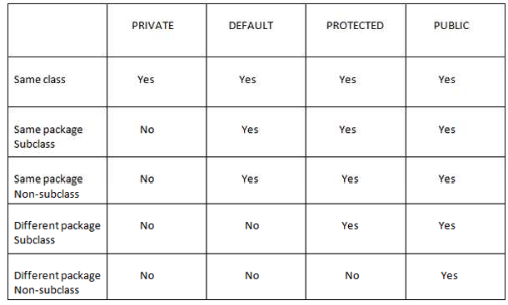
SAME CLASS
SAME PACKAGE, _{SAME PACKAGE}
,
ALL
ANY SUBCLASS
13

Slide 264
class AccessTest {
class Test
{
int a;
public int b; private int c;
public static void main(String args[]) {
Test ob = new Test(); ob.a = 10;
ob.b = 20;
// ob.c = 100; // Error! // PRIVATE
// You must access private variable c
//through its methods
// default access
// public access
// private access
void setc(int i)
{
c = i;
}
//setter
ob.setc(100);
// OK
System.out.println("a=“+ ob.a); System.out.println("b="ob.b”); System.out.println(“c= " + ob.getc() );
}
}
int getc()
{
return c;
} }
//getter
14

Slide 265
static Members
Usually we access the member of another class using object. Syntax is: objectname.member;
If we want to access a member of another class without using object, then we have to make it a make it a static member.
– Static class member is independent of any object of that class. We can make a member static by preceding the member declaration with the keyword static.
static datatype member;

Slide 266
static Members(contd.)
When a member is declared static, it can be accessed before any objects of its class are created, and without reference to any object.
Static member can be accessed using classname.member;

Slide 267
static Members(contd.)
The most common example of a static member is main function.
– main( ) is declared as static because it must be called before any objects is created.
Instance variables declared as static are global variables.
When objects of its class are declared, separate copy of a static variable is NOT made.
All instances(objects) of the class share the same static variable.

Slide 268
static Members(contd.)
Methods declared as static(static methods) have several restrictions:
static methods can only call other static methods.
static methods must only access static data.
static methods cannot refer to this or super.

Slide 269
static Members(contd.)
If we need to do computation to initialize your static variables, we can declare a static block that gets executed exactly once, when the class is first loaded.

Slide 270
// Demonstrate static variables, methods, and blocks.
class UseStatic { static int a = 3; static int b;
static void show(int x) { System.out.println("x = " + x); System.out.println("a = " + a); System.out.println("b = " + b);
OUTPUT
Static block initialized. x = 42
}
static {
System.out.println("Static block initialized."); b = a * 4;
}
public static void main(String args[])
{show(42);
}
a = 3
b = 12
}
20

Slide 271
Working of e.g. code
As soon as the UseStatic class is loaded, all of the static statements are run.
First, static member a is set to 3,
then the static block executes, which prints a message and then initializes b to a * 4 or 12.
Then main( ) is called, which calls show( ), passing 42 to x.
The three println( ) statements in show refer to the two static variables a and b, as well as to the local variable x.

Slide 272
if we want to call a static method from outside its class, we can do so using the following general form:
classname.method( )
Here classname is the name of the class in which the
static method is declared.

Slide 273
Non-static method invocation
class Demo { int a = 42;
int b = 99; void callme()
{
System.out.println("a = " + a);
}
}
class Sample {
public static void main(String args[]) { Demo dm=new Demo (); dm.callme();
System.out.println("b = " + dm.b);
} }

Slide 274
static method invocation
class StaticDemo { static int a = 42; static int b = 99; static void callme()
{
System.out.println("a = " + a);
}
}
class StaticByName {
public static void main(String args[])
{
StaticDemo.callme(); System.out.println("b = " + StaticDemo.b);
} }

Slide 275
Nonnstatic members
static members
class StaticDemo { int a = 42;
static int b = 5;
static void callme()
{
System.out.println("a = " + a);
}
}
class Demo { int a = 42;
int b=5;
void callme()
{
System.out.println("a = " + a);
}
}
class Sample {
public static void main(String args[])
{
Demo dm=new Demo(); dm.callme(); System.out.println("b = " + dm.b);
} }
class StaticByName {
public static void main(String args[])
{
StaticDemo.callme();
System.out.println("b = " + StaticDemo.b);
} }
25

Slide 276
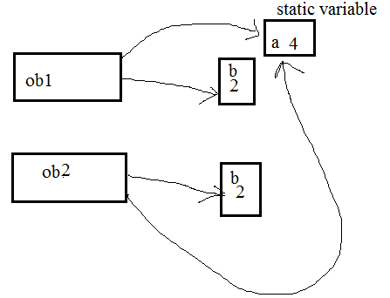
class Samplestat {
public static void main(String args[])
class Sample
{
static int a = 0; int b; Sample()
{
b=0;
{
Sample ob1=new Sample(); System.out.println("ob1"); ob1.callme();
OUTPUT
ob1
static after +2 a = 2
b after +2 = 2 ob2
static after +2 a = 4
b after +2 = 2
}
void callme()
Sample ob2=new Sample(); System.out.println("ob2");
{
ob2.callme();
a=a+2; b=b+2;
System.out.println("static after +2 a = " + a); System.out.println("b after +2 = " + b);
}
}
} }
26

Slide 277
Reference
Herbert Schildt, Java: The Complete Reference, 8/e, Tata McGraw Hill, 2011.
27

Slide 278
CS205 Object Oriented Programming in Java
Module 2 - Core Java Fundamentals (Part 8)
Prepared by
Renetha J.B.
AP
Dept.of CSE,
Lourdes Matha College of Science and Technology
1

Slide 279
Topics
Core Java Fundamentals:
Final Variables
Inner Classes
Command-Line Arguments
Variable Length Arguments
2

Slide 280
Final Variables
A variable can be declared as final by prefixing final keyword.
The contents of final variables cannot be modified.
We must initialize a final variable when it is declared.
E.g.
final int FILE_NEW = 1; final int FILE_OPEN = 2;
It is a convention to choose uppercase identifiers(CAPITAL LETTERS) for final variables. E.g. TOTAL
We can use final variables as if they were constants, without fear that a value has been changed.
Variables declared as final do not occupy memory on a per- instance basis.
3

Slide 281
Nested Classes
It is possible to define a class within another class; such classes are known as nested classes.
The scope of a nested class is bounded by the scope of its enclosing class(outer).
– Thus, if class B is defined within class A, then B does not exist independently of A.
4

Slide 282
Nested Classes(contd.)
A nested class has access to the members, including private members, of the enclosing(outer) class.
The enclosing class does not have access to the members of the nested class.
5

Slide 283
Inner Classes(contd)
A nested class, that is declared directly within its enclosing class scope, is a member of its enclosing class.
class Outer
{
//variables and methods
class Inner
{
//variables and methods
}
}
There are two types of nested classes: static and non- static.
6

Slide 284
Inner Classes(contd)
Static nested class
A static nested class is one that has the static modifier
applied.
It must access the members of its enclosing class through an object.
It cannot refer to members of its enclosing class
directly.
7

Slide 285
// Demonstrate a STATIC inner class.
class Outer
{
int outer_x = 100; void test() {
Nested nested= new Nested (); nested.display();
}
static class Nested { void display() {
Outer obj = new Outer();
System.out.println("display: outer_x = " + obj.outer_x);
}
}
OUTPUT
//static nested class
}
class NestedClassDemo {
public static void main(String args[]) { Outer outer = new Outer(); outer.test();
display: outer_x = 100
} }
8

Slide 286
Inner Class
Non static class
A non-static nested class is called inner class.
An inner class has access to all of the variables and methods of its outer class.
It may refer to members of its enclosing class directly in the same way that other non-static members of the outer class do.
9

Slide 287
// Demonstrate a NONSTATIC inner class.
class Outer
{
int outer_x = 100; void test() {
Inner inner = new Inner(); inner.display();
}
class Inner {
void display() {
System.out.println("display: outer_x = " + outer_x);
}
}
}
OUTPUT
class InnerClassDemo {
public static void main(String args[]) { Outer outer = new Outer(); outer.test();
}
display: outer_x = 100
}
10

Slide 288
In the program, an inner class named Inner is defined
within the scope of class Outer.
Therefore, any code in class Inner can directly access the
variable outer_x in Outer class.
An instance method named display( ) is defined inside Inner.
– This method displays outer_x on the standard output stream.
The main( ) method of InnerClassDemo creates an instance of class Outer and invokes its test( ) method.
That method creates an instance of class Inner and the display() method is called.

Slide 289
Inner class(contd.)
An instance(object) of Inner can be within the scope of class Outer.
created
only
We can create an instance of Inner class outside of Outer class by qualifying its name with Outer classname, as in
Outer.Inner ob=outerobject.new Inner();

Slide 290
Inner class(contd.)
An inner class can access all of the members of its enclosing class, but the reverse is not true.
Members of the inner class are known only within the scope of the inner class and may not be used by the outer class.

Slide 291
We can define a nested class within the block defined by a method or even within the body of a for loop
// Define an inner class within a for loop.
class Outer {
int outer_x = 100; void test() {
for(int i=0; i<5; i++)
{
class Inner { void display() {
System.out.println("display: outer_x = " + outer_x);
}
}
Inner inner = new Inner(); inner.display();
}
OUTPUT
display: outer_x = 100 display: outer_x = 100 display: outer_x = 100 display: outer_x = 100 display: outer_x = 100
} }
class InnerClassDemo {
public static void main(String args[]) { Outer outer = new Outer(); outer.test(); } }

Slide 292
Command-Line Arguments
If we want to pass information into a program when you run it, then you can do this by passing command-line arguments to main( ).
A command-line argument is the information that follows program’s name on the command line when it is executed.
Command-line arguments are stored as strings in a String
array passed to the args parameter of main( ).
The first command-line argument is stored at args[0]
the second at args[1]
so on.

Slide 293
// Display all command-line arguments. class CommandLine {
public static void main(String args[]) { for(int i=0; i<args.length; i++)
System.out.println("args[" + i + "]: " + args[i]);
}
}
Compile this usig javac and execute this program as:- java CommandLine this is a test 100 -1
args[0]: this args[1]: is args[2]: a args[3]: test args[4]: 100
args[5]: -1

Slide 294
Variable length arguments
In Java methods can take a variable number of arguments.
– This feature is called varargs or variable-length arguments.
A method that takes a variable number of arguments is called a variable-arity method, or simply a varargs method.

Slide 295
Variable length arguments(contd.
E.g. A method that opens an Internet connection might take a user name, password, filename, protocol, and so on, but supply defaults if some of this information is not provided. Here it is better to pass only the arguments to which the defaults did not apply.
E.g. printf() method can have any number of arguments.

Slide 296
Handling variable length arguments
If the maximum number of arguments is small and known, then we can create overloaded versions of the method, one for each way the method could be called.
If the maximum number of potential arguments is larger, or unknowable, then the arguments can be put into an array, and then the array can be passed to the method.

Slide 297
class PassArray {
static void test(int v[])
{
System.out.print("Number of args: " + v.length + " Contents: "); for(int x : v)
System.out.print(x + " "); System.out.println();
}
public static void main(String args[])
{
int n1[] = { 10 };
int n2[] = { 1, 2, 3 };
int n3[] = { };
OUTPUT
Number of args: 1 Contents: 10
Number of args: 3 Contents: 1 2 3 Number of args: 0 Contents:
test(n1);
test(n2);
test(n3);
}
// 1 arg
// 3 args
// no args
}
This old method requires that these arguments be manually packaged into an array prior to calling the function test( ).

Slide 298
Handling variable length arguments(contd.)
A variable-length argument is specified by three periods (...).
E.g.
static void test(int ... v) { //statemenst }
This syntax tells the compiler that test( ) can be called with zero or more arguments.

Slide 299
class PassArray { static void test(int ...v)
{
System.out.print("Number of args: " + v.length + " Contents: "); for(int x : v)
System.out.print(x + " "); System.out.println();
}
public static void main(String args[])
{
OUTPUT
Number of args: 1 Contents: 10
Number of args: 3 Contents: 1 2 3 Number of args: 0 Contents:
 | test(10); | // 1 arg
 | test(1,2,3); | // 3 args
 | test(); | // no args
}
}

Slide 300
Handling variable length arguments(contd.)
A method can have “normal” parameters along with a variable-length parameter.
However, the variable-length parameter must be the last parameter declared by the method.
E.g:
int test(int a, int b, double c, int ... vals) { //statements } VALID
E.g.
int test(int a, int b, double c, int ... vals, boolean stopFlag) {
// ERROR!

Slide 301
Overloading Vararg Methods
We can overload a method that takes a variable-length argument.
There can be many functions with same name and having different type of variable length arguments.

Slide 302
// Varargs and overloading.
class VarArgs3
{
static void test(int ... v)
{
System.out.print(“test(int ...): " + "Number of args: " + v.length);
}
static void test(boolean ... v)
{
System.out.print(“test(boolean ...) " +"Number of args: " + v.length);
}
public static void main(String args[])
{
OUTPUT
test(int ...): Number of args: 3 test(boolean ...): Number of args: 2
test(1, 2, 3); test(true, false);
}
}

Slide 303
Varargs and Ambiguity
It is possible to create an ambiguous call to an overloaded varargs method.
class VarArgs3
{
static void test(int ... v)
{
System.out.print(“test(int ...): " + "Number of args: " + v.length);
}
static void test(boolean ... v)
{
System.out.print(“test(boolean ...) " +"Number of args: " + v.length);
}
public static void main(String args[])
{
test(1, 2, 3);
test() can call
test(int ...) or test(boolean ...). Because both these functions have varargs so they can accept zero arguments .
System is confused which one to call
test();
// Error: Ambiguous!
}
}
AMBIGUITY
26

Slide 304
Varargs and Ambiguity(contd.)
Another e.g. of ambiguous functions static void test(int ... v) { // ... }
static void test(int n, int ... v) { // ... }
If a call test(2); comes, then this (ambiguous)
will
create
error

Slide 305
Reference
Herbert Schildt, Java: The Complete Reference, 8/e, Tata McGraw Hill, 2011.

Slide 306
CS205 Object Oriented Programming in Java
Module 2 - Core Java Fundamentals (Part 9)
Prepared by
Renetha J.B.
AP
Dept.of CSE,
Lourdes Matha College of Science and Technology
1

Slide 307
Topics
Core Java Fundamentals:
Inheritance :
Super class
Sub class
keywords super
protected Members
2

Slide 308
Inheritance
Inheritance helps to create hierarchical classifications.
Using inheritance we can create a general class(base or super class) that defines features common to a set of related items.
– This class can then be inherited by other, more specific classes(subclasses).
3

Slide 309
Inheritance(contd.)
A subclass is a specialized version of a superclass.
Subclass inherits all of the instance variables and methods defined by the superclass and adds its own, unique elements.
To inherit a class, we have to use extends keyword along
with subclass definition.
class superclass{ //statements……}
class subclass extends superclass{ //statements……}
4

Slide 310
// A simple example of inheritance.
class A
{
int i, j;
void showij()
{
Here A is the superclass of B
System.out.println("i and j: " + i + " " + j);
}
}
class B extends A { int k;
void showk() {
System.out.println("k: " + k);
}
void sum() {
System.out.println("i+j+k: " + (i+j+k));
}
}
5

Slide 311
class SimpleInheritance
{
public static void main(String args[]) { A superOb = new A();
B subOb = new B(); superOb.i = 10;
superOb.j = 20; System.out.println(“Superobj Contents ");
superOb.showij(); subOb.i = 7;
Superobj Contents 10 20
subOb.j = 8;
subOb.k = 9;
subOb contents 7 8
k: 9
Sum in subOb:24
System.out.println("subOb contents "); subOb.showij();
subOb.showk(); System.out.println("Sum in subOb:");
subOb.sum(); } }
6

Slide 312
Member Access and Inheritance
Subclass cannot access the private members in superclass.
class A {
A class member that has been
int i; // public by default
declared as private will remain private to its class.
It is not accessible by any code outside its class, including subclasses.
private int j; // private to A void setj(int x) { j = x; };
}
class B extends A { int total;
void sum() {
total = i + j; // ERROR, j(private) is not accessible here
}
}
7

Slide 313
A major advantage of inheritance is that once you have created a superclass that defines the attributes common to a set of objects, it can be used to create any number of more specific subclasses.
Each subclass can have its own special features also.
8

Slide 314
A Superclass Variable Can Reference a Subclass Object
A reference variable of a superclass can be assigned a reference to any subclass derived from that superclass.
class A
{
}
Superclassobject=subclassobject
class B extends A
{
}
class Sample
{A oba=new A(); B obb=new B(); oba=obb; }
When a reference to a subclass object is assigned to a superclass reference variable, we will have access only to those parts of the object defined by the superclass..
9

Slide 315
class InhRefsub{
class Sup
{
int a,b; void area()
{
System.out.println(“Product="+ a*b);
}
public static void main(String args[])
{
Sup supob=new Sup();
supob.area();
Sub subob=new Sub(10,20,30);
supob=subob; supob.area();
}
class Sub extends Sup
{
int i;
Sub(int x,int y,int z)
{
a=x; b=y; i=z;
}
//System.out.println(“i="+ supob.i);//ERROR
}
}
OUTPUT
Product=0 Product=200
}
10

Slide 316
Program explanaion
Here the statement Sup supob=new Sup(); creates an object of class Sup named supob using default constructor Sup(). Supob has variables a and b. Since default constructor is not there, compiler provides default constructor by initializing all variables to zero, so a and b are initially 0.
Next supob.area();
Product=0
Sub subob=new Sub(10,20,30); creates object of Sub named subob using parameterized constructed Sub(int x,int y,int z) . Since Sup is the subclass of Sub, so Sub has variables a,b from Sup and i (own variable) and set a=10 b=20 i=30
will call area() in Sup and prints
•
The statement supob=subob; assigns object subob to

Slide 317
Using super
Whenever a subclass needs to refer to its immediate superclass, it can be done using the keyword super.
super has two general forms.
To call the superclass’ constructor.
To access a member of the superclass that has been hidden by a member of a subclass.
The static methods cannot refer to super.

Slide 318
Using super to Call Superclass Constructors
A subclass can call a constructor defined by its superclass by use of the following form of super:
super(arg-list);
Here, arg-list specifies any arguments constructor in the superclass.
needed by the
super( ) must always be the first statement executed inside a subclass’ constructor.

Slide 319
class Supersub{
class Sup
{
Sup()
{
System.out.println("Superclass");
}
}
class Sub extends Sup
{
public static void main(String args[])
{
Sub subob=new Sub();
}
}
Sub()
{
super();
System.out.println("Subclass");
}
OUTPUT
Superclass Subclass
}
14

Slide 320
super keyword to acess member
super always refers to the superclass of the subclass in which it is used.
To access the member in superclass from subclass
super.member
Here member can be either a method or an instance variable.
If subclass contains same variable as superclass, then in subclass, the superclass member will be hidden by corresponding subclass member.
This can be prevented using super keyword
15

Slide 321
class A {
int i;
class UseSuper {
public static void main(String args[])
{
}
class B extends A
{
int i;
B subOb = new B(1, 2); subOb.show();
}
// this i hides the i in A
B(int a, int b) super.i = a;
{
// i in A
i = b;
// i in B
}
}
void show() {
System.out.println("i in superclass: " + super.i); System.out.println("i in subclass: " + i);
}
}
OUTPUT
i in superclass: 1 i in subclass: 2
16

Slide 322
Creating multiple hierarchy
class A
{
int x;
A(int p)
{
System.out.println("Superclass A "); x=p;
}
}
class B extends A
{
int y;
B(int p,int q)
{
super(p);
System.out.println("B Subclass of A"); y=q;
}
Superclass A
class C extends B
{
int z;
C(int p,int q,int r)
{
super(p,q);
System.out.println("C Subclass of A"); z=r;
}
}
class Mulinh{
public static void main(String args[])
{
}
B Subclass of A C Subclass of A x=10
y=20 z=10
17

Slide 323
Protected members
Protected members are declared by prefixing the access specifierc protected.
protected datatype member;
The protected member in a class can be accessed by
any class within the same package.
direct sub-classes in other package also.
18

Slide 324
Protected members(contd;)
If you want to allow an element(member) to be seen outside your current package, but only to classes that subclass your class directly, then declare that element (member) protected.
Eg.
class A
{
protected int c; int a;
private char b; public float f; protected void add()
{ //statements
}
//methods and statements
}
//protected variable
//protected method
19

Slide 325
Reference
Herbert Schildt, Java: The Complete Reference, 8/e, Tata McGraw Hill, 2011.
20

Slide 326
CS205 Object Oriented Programming in Java
Module 2 - Core Java Fundamentals (Part 10)
Prepared by
Renetha J.B.
AP
Dept.of CSE,
Lourdes Matha College of Science and Technology

Slide 327
Topics
Core Java Fundamentals:
Inheritance :
Calling Order of Constructors
Method Overriding
The Object class

Slide 328
Calling Order of Constructors
Constructors are called in the order of derivation, from superclass to subclass
When subclass object is created, it first calls superclass constructor then only it calls subclass constructor.
If super( ) is not used to call superclass constructor, then the default constructor of each superclass will be executed before executing subclass constructors.

Slide 329
class A
{
int i;
A()
{
System.out.println("Constructor of superclass A");
}
}
class B extends A
{
int j; B()
{
System.out.println("Constructor of subclass B");
}
}
class Consorder
{
public static void main(String args[])
{
B obb =new B();
}
}
OUTPUT
Constructor of superclass A Constructor of subclass B

Slide 330
class A
{
class C extends B
{
int j; C()
{
System.out.println("Constructor of subclass C");
}
}
class Consorder{
public static void main(String args[])
{
C obc =new C();
}
OUTPUT
Constructor of superclass A Constructor of subclass B Constructor of subclass C
int i; A()
{
System.out.println("Constructor of superclass A");
}
}
class B extends A
{
int j; B()
{
System.out.println("Constructor of subclass B");
}
}
}

Slide 331
Calling Order of Constructors(contd.)
Superclass has no knowledge of any subclass, any initialization it needs to perform is separate and it should be done as a prerequisite to initialize the subclass object.
Therefore, superclass constructors are executed before executing subclass constructors, when we create subclass object.

Slide 332
Method Overriding
In a class hierarchy, when a method in a subclass has the same name and type signature as a method in its superclass, then the method in the subclass is said to override the method in the superclass.
This is called METHOD OVERRIDING

Slide 333
Method Overriding(contd.)
When an overridden method is called from within a subclass, it will always refer to the method defined by the subclass.
– The version of the method defined by the superclass will be hidden.

Slide 334
// Method overriding.
class A { int i, j;
A(int a, int b) { i = a;
j = b;
}
void show() {
System.out.println(" i : " + i + " j: " + j);
}
}
class B extends A { int k;
B(int a, int b, int c) { super(a, b);
class Override {
public static void main(String args[])
{
B subOb = new B(1, 2, 3); subOb.show(); // this calls show() in B
}
}
OUTPUT
k: 3
k = c;
}
void show() { System.out.println("k: " + k);
}
}
When show( ) is invoked on an object of type B, the version of show( ) defined within B is used.
That is, the version of show( ) inside subclass B overrides the version declared in superclass A.

Slide 335
// No method overriding.
class A { int i, j;
A(int a, int b) { i = a;
j = b;
}
void show() {
System.out.println(" i : " + i + " j: " + j);
}
}
class B extends A { int k;
B(int a, int b, int c) { super(a, b);
class Sample{
public static void main(String args[])
{
B subOb = new B(1, 2, 3); subOb.show(); // this calls show() in A
}
}
OUTPUT
i: 1 j: 2
k = c;
}
void display() { System.out.println("k: " + k);
}
}
Here when show( ) is invoked on an object of type B, since the version of show( ) is not defined within B the version of show() declared in superclass A is called and excuted.

Slide 336
Method Overriding(contd.)
To access the superclass version of an overridden method, we can do using super keyword.

Slide 337
// Method overriding.
class A { int i, j;
A(int a, int b) { i = a;
j = b;
}
void show() {
System.out.println(" i : " + i + " j: " + j);
}
}
class B extends A { int k;
B(int a, int b, int c) { super(a, b);
class Override {
public static void main(String args[])
{
B subOb = new B(1, 2, 3); subOb.show(); // this calls show() in B
OUTPUT
}
}
i:1 j:2 k: 3
k = c;
}
void show() {
super.show(); System.out.println("k: " + k);
}
}
When show( ) is invoked on an object of type B, the version of show( ) defined within B is used..
super.show() calls the show() method in its superclas.

Slide 338
Method Overriding(contd.)
Method overriding occurs only when the names and the type signatures of the methods in subclass and superclass are identical.
If names and the type signatures of the two methods are different, then the two methods are simply overloaded.

Slide 339
class Sample {
public static void main(String args[]) {
class A { int i, j; A() {
i = 0;
j = 0;
}
void show() {
System.out.println(show in A);
}
}
class B extends A {
B subOb = new B(); subOb.show(“k is "); // this calls show() in B
subOb.show(); // this calls show() in A
}
show in subclass B
int k; B() { k = 0;
}
void show(String msg) {
show in A
Here show() Methods have differing type signatures. So they are overloaded – not overridden
System.out.println(“show in subclass B”);
}
}

Slide 340
class Sample {
public static void main(String args[]) {
class A { int i, j;
A(int a, int b) { i = a;
j = b;
}
void show() {
System.out.println("i : " + i + “j: " + j);
}
}
class B extends A { int k;
B(int a, int b, int c) { super(a, b);
k = c;
}
void show(String msg) { System.out.println(msg + k);
}
}
B subOb = new B(1, 2, 3); subOb.show(“k is "); subOb.show();
}
Here show() Methods have differing type signatures. So they are overloaded – not overridden

Slide 341
Object
There is one special class, Object, defined by Java.
All other classes are subclasses of Object.
That is, Object is a superclass of all other classes.
Reference variable of type Object can refer to an object of any other class.

Slide 342
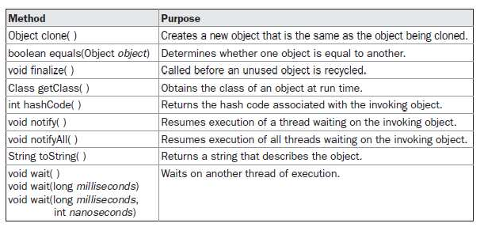
Methods in Object class

Slide 343
Methods in Object class(contd.)
The methods getClass( ), notify( ), notifyAll( ), and wait( ) are declared as final.
The equals( ) method compares the contents of two objects.
It returns true if the objects are equivalent, and false otherwise.
The toString( ) method returns a string that contains a description of the object on which it is called.
This method is automatically called when an object is output using println( ).
Many classes override this method.

Slide 344
Reference
Herbert Schildt, Java: The Complete Reference, 8/e, Tata McGraw Hill, 2011.

Slide 345
CS205 Object Oriented Programming in Java
Module 2 - Core Java Fundamentals (Part 11)
Prepared by
Renetha J.B.
AP
Dept.of CSE,
Lourdes Matha College of Science and Technology
1

Slide 346
Topics
Core Java Fundamentals:
Inheritance :
Abstract Classes and Methods
using final with Inheritance.
2

Slide 347
Abstract Classes and Methods
Sometimes we may want to create a superclass that only defines a generalized form which will be shared by all of its subclasses and leaves the implementation to be filled by each subclass.
– To ensure that a subclass should override all necessary methods(implementations), we have to make them abstract methods in superclass.
For making a method an abstract method we have use
abstract type modifier.
3

Slide 348
Abstract Classes and Methods(contd.)
Abstract methods have no implementation(function body) in the superclass .
so they are also called as subclasser responsibility
the implementation should be there in subclasses by overriding those methods.
To declare an abstract method in superclass, syntax is :
abstract type name(parameter-list);
The semicolon ; after the function header shows that abstract function has no body in superclass.
.
4

Slide 349
Abstract Classes and Methods(contd.)
ABSTRACT CLASS
– Any class that contains one or more abstract methods
must also be declared abstract.
– To declare a class abstract, use the abstract keyword in front of the class keyword at the beginning of the class declaration.
abstract class classname
{
//members.abstract or nonabsract method
}
non abstract methods(concrete
5
– Abstract class can have methods) also.

Slide 350
Abstract Classes and Methods(contd.)
Abstract classes cannot be instantiated using new operator.
i.e. Objects are not created from abstract class.
Such objects would be useless, because an abstract class is not fully defined.
There are no abstract constructors, or no abstract static methods.
Any subclass of an abstract class must either implement all of the abstract methods in the superclass, or it should be declared abstract class.
6

Slide 351
// A Simple demonstration of abstract with abstract and concrete methods.
abstract class A
{
abstract void callme();
class AbstractDemo {
public static void main(String args[])
{
B b = new B(); b.callme(); b.callmetoo();
}
void callmetoo()
{
System.out.println("concrete method.");
}
}
class B extends A { void callme() {
System.out.println("callme in B");
}
}
OUTPUT
callme in B concrete method.
}
7

Slide 352
Abstract Classes(contd.)
Although abstract classes cannot be used to instantiate objects, abstract classes can be used to create object references,
superlassname superclassobjectrefernce ; superclassobjectrefernce =subclassobjectreference;
Java’s run-time polymorphism(dynamic binding) is implemented through the use of superclass references.
8

Slide 353
// DYNAMIC(run-time) BINDING(polymorphism).
class Triangle extends Figure { Triangle(double a, double b)
{ super(a, b);
}
double area()
{ System.out.println("Triangle Area"); return dim1 * dim2 / 2;
} }
class AbstractAreas {
public static void main(String args[]) {
// Figure f = new Figure(10, 10); // illegal Rectangle r = new Rectangle(9, 5); Triangle t = new Triangle(10, 8);
Figure figref; // superclass object reference
//figref refers to object of Rectangle System.out.println("Area is " + figref.area()); figref = t; //figref refers to object of Triangle System.out.println("Area is " + figref.area());
}
abstract class Figure
{ double dim1; double dim2;
Figure(double a, double b)
{ dim1 = a; dim2 = b;
}
abstract double area();
}
class Rectangle extends Figure
{
Rectangle(double a, double b)
{ super(a, b);
}
double area()
{ System.out.println("Rectangle Area"); return dim1 * dim2;
} }
figref = r;
}
9

Slide 354
Dynamic binding(program)contd.
OUTPUT
Rectangle Area Area is 45.0 Triangle Area Area is 40.0
Here all subclasses of abstract class Figure must override abstract method area( ).
Here the statement Figure figref; is notcreating object but creating an object refernce.
The statement figref = r; means that superclass reference figref now points to subclass(Rectangle) object r. So the value of dim1 and dim2 are the values in r. The statement figref.area() will call area() method in that subclass(Rectangle)
The statement figref = t; means that superclass reference figref now points to subclass(Triangle) object t. So the value of dim1 and dim2 are the values in t. The statement figref.area() will call area() method in that subclas(Triangle)

Slide 355
Using final with Inheritance
Use of final keyword
final can be used to create the equivalent of a named constant(final variable). E.g. final int TOTAL=0;
helps to prevent overriding in inheritance
final helps to prevent inheritance.

Slide 356
Using final with Inheritance
Using final to Prevent Overriding
If we don’t want to allow subclass to override a method of supeclasses, we can use final as a modifier at the start of its method declaration in superclass.
Methods declared as final cannot be overridden by subclass.

Slide 357
Using final to Prevent Overriding(contd.)
class A {
final void show()
{ System.out.println("This is a final method.");
}
}
class B extends A {
void show() // ERROR! Can't override.
{ System.out.println("Illegal!");
}
}
Here show() method is declared as final in A. So it cannot be overridden(redefined) in subclass B. If we try to override, COMPILE ERROR will occur in the program.

Slide 358
Using final to Prevent Overriding(contd.)
Methods declared as final can sometimes provide a
performance enhancement:
– The compiler is free call them inline because it “knows” they will not be overridden by a subclass.
When a small final method is called, Java compiler can copy the bytecode for the subroutine directly inline with the compiled code of the calling method, thus eliminating the costly overhead associated with a method call.
Inlining is only an option with final methods.

Slide 359
Using final to Prevent Overriding(contd.)
Normally, Java resolves calls to methods dynamically, at run time. This is called late binding.
However, since final methods cannot be overridden, a call to final method can be resolved at compile time. This is called early binding.

Slide 360
Using final to Prevent Inheritance
To prevent a class from being inherited it can be declared as final.
– We cannot create subclasses from a final class.
Class with final modifier cannot be inherited. It cannot act as superclass.
To make a class a final class, precede the class declaration with the modifier final.
If we declare a class as final, it implicitly declares all of its methods as final.
It is illegal to declare a class as both abstract and final
since an abstract class is incomplete by itself.

Slide 361
Using final to Prevent Inheritance
final class A {
// ...
}
// The following class is illegal.
class B extends A { //ERROR!cannot create a subclass for final class A
// ...
}
It is illegal for B to inherit A since class A is declared as final.

Slide 362
Reference
Herbert Schildt, Java: The Complete Reference, 8/e, Tata McGraw Hill, 2011.

