Slide 1

CS205 Object Oriented Programming in Java
Module 5 - Graphical User Interface and Database support of Java
1

Slide 2



Topics
Swings
Swings fundamentals
Swing Key Features

Slide 3
Swing fundamentals
•
Swing is written entirely in Java (platform-independent).
So swing components are light-weight
Swing components are NOT implemented by platform- specific code.
Swing is a set of classes.
Swing is built on the foundation of the AWT(Abstract Window Toolkit).
Swing provides more powerful and flexible functionalities than standard AWT components.
•
Swing classes are defined in javax.swing package and its subpackages.

Slide 4
Swing Key Features
Two key features of Swing are
Swing components are Lightweight
Swing supports a Pluggable Look and Feel

Slide 5
Swing Key Features-Swing components are
Lightweight
Swing Components are lightweight because
they are written entirely in Java
they do not map directly to platform-specific peers.
Peer classes are written by java API developers to interface with native objects
Lightweight components do not call the native operating system for drawing the graphical user interface(GUI) components
They are rendered using graphics primitives
they can be transparent, which enables nonrectangular shapes.
lightweight components are more efficient and more flexible.

Slide 6
Swing Key Features-Swing components are
Lightweight(contd.)
Lightweight components
do not translate into native peers,
the look and feel of each component is determined by Swing, not by the underlying operating system.
This means that each component will work in a consistent manner across all platforms.

Slide 7
Swing Key Features-Swing Supports a Pluggable Look and Feel
Swing supports a pluggable look and feel (PLAF).
– Because each Swing component is rendered by Java code not by native peers, the look and feel of a component is under the control of Swing.
It is possible to separate the look and feel of a component
from the logic of the component.
Advantage:
It is possible to change the way that a component is rendered without affecting any of its other aspects
it is possible to “plug in” a new look and feel for any given component without creating any side effects in the code that uses that component.

Slide 8
Swing Key Features-Swing Supports a Pluggable Look and Feel
It is possible to define entire sets of look-and-feels that represent different GUI styles
To use a specific style, its look and feel is simply “plugged in.”
Once this is done, all components are automatically rendered using that style.
Pluggable look-and-feels offer several important advantages.
It is possible to define a look and feel that is consistent across all platforms.
it is possible to create a look and feel that acts like a specific platform.
For example, if you know that an application will be running only in a Windows environment, it is possible to specify the Windows look and feel.
It is also possible to design a custom look and feel. Finally, the look and feel can be changed dynamically at run time.

Slide 9
Difference between Swing and AWT
Swing | AWT
Swing components are not platform- dependent. | AWT components are platform- dependent
Swing provides several additional components such as scroll panes, trees etc in addition to other standard components | The AWT defines a basic set of controls, windows, and dialog boxes that support a usable, but limited graphical interface.
Swing is written entirely in Java. So swing components are light-weight | AWT components use native code. So they are heavy weight
Swing supports a pluggable look and feel (PLAF) that can be dynamically changed at run-time depending on environment | In AWT look and feel of each component is fixed and it is difficult to change its look and feel.
Swing follow MVC | AWT does not follow MVC

Slide 10
Swing
Applet
Swing is light weight
Component.
Swing needs main method to execute the program.
Swing follows MVC(Model view Controller).
Swing have its own Layout like most popular Box Layout.
Swing uses for stand alone Applications.
To execute Swing, the browser is not needed.
Applet is heavy weight Component.
Applet does not need main method to execute.
Applet does not follow MVC.
pplet ses W ayouts ik Flowlayout.
Applet need HTML code for Run.
To execute Applet program we
need browsers
like browser
Appletviewer, web etc.
10

Slide 11
Swing
Swing is a set of program components for Java programmers that provide the ability to create graphical user interface ( GUI ) components, such as buttons and scroll bars, that are independent of the windowing system for specific operating system .

Slide 12
Reference
Herbert Schildt, Java: The Complete Reference, 8/e, Tata McGraw Hill, 2011.

Slide 13
CS205 Object Oriented Programming in Java
Module 5 - Graphical User Interface and Database support of Java
(Part 2)
Prepared by
Renetha J.B.
AP
Dept.of CSE,
Lourdes Matha College of Science and Technology
1

Slide 14

Topics
Swings
MVC
Swing Controls
Components and Containers

Slide 15
MVC
A visual aspects:
component is a composite of three distinct
The state information associated with the component
MODEL
The way that the component looks when rendered on the screen VIEW
The way that the component reacts to CONTROLLER
MVC (Model View Controller) architecture is successful because each piece of the design corresponds to an aspect of a component.

Slide 16
MVC(contd.)
In MVC terminology,
the Model corresponds to the state information associated with the component.
For example, in the case of a check box, the model contains a field that indicates if the box is checked or unchecked.
The View determines how the component is displayed on the screen, including any aspects of the view that are affected by the current state of the model.
The Controller determines how the component reacts to the user.
For example, when the user clicks a check box, the controller reacts by changing the model to reflect the user’s choice (checked or unchecked). So view changes.

Slide 17
MVC(contd.)
By separating a component into a model, a view, and a controller, the specific implementation of each can be changed without affecting the other two.
Swing uses a modified version of MVC that combines the view and the controller into a single logical entity called the UI delegate.
– So, Swing’s approach is called either the Model-Delegate architecture or the Separable Model architecture.
Swing’s pluggable look and feel is made possible by its Model-Delegate architecture.
Because the view (look) and controller (feel) are separate from the model, the look and feel can be changed without affecting how the component is used within a program.

Slide 18
MVC(contd.)
To support the Model-Delegate architecture, most Swing components contain two objects.
The first represents the model.
Models are defined by interfaces
The second represents the UI delegate.
UI delegates are classes that inherit ComponentUI.

Slide 19
Swing Controls
Swing controls plays major role in swing applications, every application will have some components and their corresponding event listener.
Swing controls will inherit the properties from following classes.
Component
Container
JComponent.

Slide 20
Swing Controls
Some swing controls are
Container Control(Parent control)
It hold other controls(child controls or components)
JFrame, JPanel
Child Control –These controls are inside container control
They can only exist inside container control. They can be components or containers.
JTextArea,JLabel, JButton
When container control is deleted then its child controls are also deleted.

Slide 21
Components and Containers
A Swing GUI consists of two key items: components and
containers
A container holds a group of components.
– So a container is a special type of component that is designed to hold other components.
To display a component, it must be held within a container.
So all Swing GUIs will have at least one container.
Because containers are components, a container can also hold other containers.

Slide 22
Components
Swing components are derived from the JComponent class.
JComponent provides the functionality that is common to all components.
E.g JComponent supports the pluggable look and feel. JComponent inherits the AWT classes Container and Component..
So, a Swing component is built on and compatible with an AWT component.

Slide 23
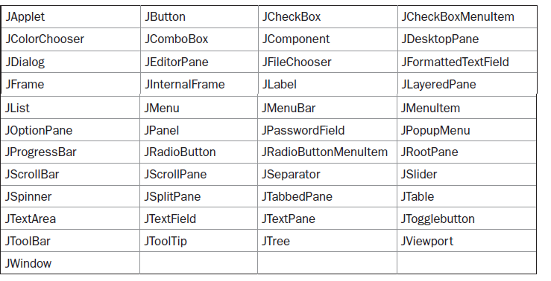
Components(contd.)
All of Swing’s components are represented by classes defined within the package javax.swing.
The class names for Swing components are
* All component classes begin with the letter J.

Slide 24
Containers
Swing defines two types of containers.
The first are top-level containers(heavyweight)
The second type of containers supported by Swing are
lightweight containers.

Slide 25
Containers(contd.)
The first are top-level containers
JFrame, JApplet, JWindow, and JDialog.
These containers do not inherit JComponent
They inherit the AWT classes Component and Container
The top-level containers are heavyweight.
A top-level container must be at the top of a containment hierarchy
A top-level container is not contained within any other container.
Every containment hierarchy must begin with a top-level container.
The one most commonly used for applications is JFrame.
The one used for applets is JApplet.

Slide 26
Containers (contd.)
The second type of containers supported by Swing are
lightweight containers.
Lightweight containers do inherit JComponent.
E.g. JPanel is a general-purpose container.
Lightweight containers are often used to organize and manage groups of related components because a lightweight container can be contained within another container.
We can use lightweight containers such as JPanel to create subgroups of related controls that are contained within an outer container.

Slide 27
Top-level containers
Lightweight containers.
Top level containers do not
inherit Jcomponent.
Heavyweight
A top-level container is not contained within any other container.
E.g. JFrame, JApplet, JWindow, and JDialog
Lightweight containers do inherit JComponent.
Lightweight
A lightweight container can be contained within another container.
E.g. JPanel
15

Slide 28
The Top-Level Container Panes
The Top-Level Container Panes
Each top-level container defines a set of panes.
At the top of the hierarchy is an instance of JRootPane.
JRootPane is a lightweight container whose purpose is to manage the other panes.
It also helps manage the optional menu bar.
The panes that comprise the root pane are called
the glass pane,
the content pane,
the layered pane.

Slide 29
The Top-Level Container Panes
Glass pane :
The glass pane is the top-level pane.
It sits above and completely covers all other panes.
By default, it is a transparent instance of JPanel.
Layered pane :
The layered pane is an instance of JLayeredPane.
The layered pane allows components to be given a depth value.
This value determines which component overlays another.
Content pane:
The pane with which your application will interact the most is the content pane
When we add a component, such as a button, to a top- level container, we will add it to the content pane.
By default, the content pane is an opaque instance of JPanel.

Slide 30
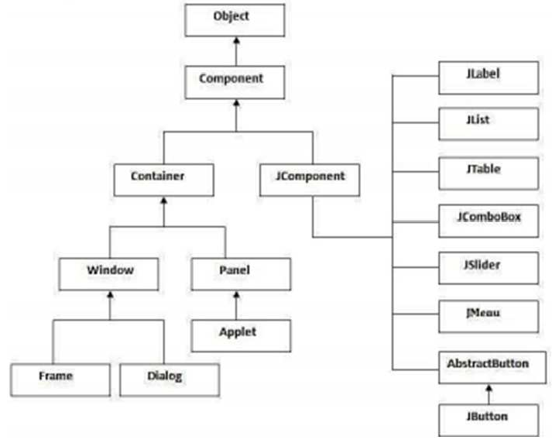

Slide 31
Reference
Herbert Schildt, Java: The Complete Reference, 8/e, Tata McGraw Hill, 2011.

Slide 32
CS205 Object Oriented Programming in Java
Module 5 - Graphical User Interface and Database support of Java
(Part 3)
Prepared by
Renetha J.B.
AP
Dept.of CSE,
Lourdes Matha College of Science and Technology
1

Slide 33
Topics
Swings
Swing Packages
Event Handling in Swings.

Slide 34
Swing Packages
Swing is a very large subsystem and makes use of many packages.
These are the packages used by Swing that are defined by Java SE 6.
The main package is javax.swing.
This package must be imported into any program that uses Swing.
It contains the classes that implement the basic Swing components, such as push buttons, labels, and check boxes.

Slide 35
Swing packages(contd.)
javax.swing | javax.swing.border | javax.swing.colorchooser
javax.swing.event | javax.swing.filechooser | javax.swing.plaf
javax.swing.plaf.basic | javax.swing.plaf.metal | javax.swing.plaf.multi
javax.swing.plaf.synth | javax.swing.table | javax.swing.text
javax.swing.text.html | javax.swing.text.html.par ser | javax.swing.text.rtf
javax.swing.tree | javax.swing.undo

Slide 36
A Simple Swing Application
There are two types of Java programs in which Swing is typically used.
desktop application.
applet

Slide 37
A Simple Swing Application
Q. Write a swing program that uses two Swing components: Jframe and JLabel. The program uses a JFrame container to hold an instance of a JLabel. The label displays a short text message
JFrame is the top-level container that is commonly used for Swing applications. JLabel is the Swing component that
creates a label, which is a component that displays information. The label is
Swing’s simplest component
because it is passive.
– That is, a label does not respond to user input. It just displays output.

Slide 38
import javax.swing.*;
class SwingDemo
{
SwingDemo()
{
// Create a new JFrame container. With title- A Simple Swing
JFrame jfrm = new JFrame("A Simple Swing ");
// Give the frame an initial size. Width=275 height =100
jfrm.setSize(275, 100);
// Terminate the program when the user closes the application.
jfrm.setDefaultCloseOperation(JFrame.EXIT_ON_CLOSE);

Slide 39


JLabel jlab = new JLabel(" Swing is powerful GUI");
// Create a text-based label
// Add the label to the content pane.
jfrm.add(jlab);
// Display the frame.
jfrm.setVisible(true);
Too compile this program, javac SwingDemo.java To run the program,
java SwingDemo
}
public static void main(String args[])
{
// Create the frame on the event dispatching thread.
SwingUtilities.invokeLater( new Runnable()
{
public void run()
{
new SwingDemo();
}
}
);
} }

Slide 40
// A simple Swing application. import javax.swing.*; class SwingDemo { SwingDemo() {
JLabel jlab = new JLabel(" Swing is powerful GUI");
// Add the label to the content pane.
jfrm.add(jlab);
// Display the frame.
jfrm.setVisible(true);
}
public static void main(String args[])
{
// Create the frame on the event dispatching thread.
SwingUtilities.invokeLater(new Runnable() {
public void run() { new SwingDemo();
}
});
}
// Create a new JFrame container.
JFrame jfrm = new JFrame("A Simple Swing ");
// Give the frame an initial size.
jfrm.setSize(275, 100);
// Terminate the program when the user closes the application.
jfrm.setDefaultCloseOperation(JFrame.EXI T_ON_CLOSE);
// Create a text-based label
Prepared by Renetha J.B}.
9

Slide 41
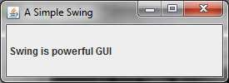
javax.swing defines classes that implement labels, buttons, text controls, and menus.
The constructor is where most of the action of the program occurs. It begins by creating a JFrame, using this line of code:
JFrame jfrm = new JFrame("A Simple Swing ");
This creates a container called jfrm that defines a rectangular window complete with a title bar; close, minimize, maximize, and restore buttons; and a system menu.
Thus, it creates a standard, top-level window.
The title of the window is passed to the constructor
– Here title is A Simple Swing

Slide 42
The window is sized using this statement:
jfrm.setSize(275, 100);
The setSize( ) method (which is inherited by JFrame from the AWT class Component) sets the dimensions of the window, which are specified in pixels. Its general form :
void setSize(in t width, int height)
We want the entire application to terminate when its top- level window is closed. There are a couple of ways to achieve this. The easiest way is to call setDefaultCloseOperation( ),
jfrm.setDefaultCloseOperation(JFrame.EXIT_ON_CLOSE);
After this call executes, closing the window causes the entire application to terminate.

Slide 43
The general form of setDefaultCloseOperation( ) is :
void setDefaultCloseOperation(int what)
– The value passed in what determines what happens when the window is closed.
There are several options :
JFrame.EXIT_ON_CLOSE
JFrame.DISPOSE_ON_CLOSE JFrame.HIDE_ON_CLOSE JFrame.DO_NOTHING_ON_CLOSE

Slide 44
The next line of code creates a Swing JLabel component:
JLabel jlab = new JLabel(" Swing is powerful GUI");
The next line of code adds the label to the content pane of the frame:
jfrm.add(jlab);
Thus, to add a component to a frame, we must add it to the frame’s content pane. This is accomplished by calling add( ) on the JFrame reference (jfrm in this case). The general form of add( ) is:
Component add(Component comp)

Slide 45
The content pane can be obtained by calling getContentPane( ) on a JFrame instance
Container getContentPane( )
The last statement in the SwingDemo constructor causes the window to become visible:
jfrm.setVisible(true);

Slide 46
SwingDemo constructor is invoked using the following lines of code:
SwingUtilities.invokeLater(
new Runnable() {
public void run()
{
new SwingDemo();
}
}
);
This sequence causes a SwingDemo object to be created on the event dispatching thread rather than on the main thread of the application.
Swing programs are event-driven.

Slide 47
To enable the GUI code to be created on the event dispatching thread, we must use one of two methods that are defined by the SwingUtilities class.
These methods are
invokeLater( )
invokeAndWait( ).
static void invokeLater(Runnable obj)
static void invokeAndWait(Runnable obj)
throws InterruptedException, InvocationTargetException
The difference between the two methods is that
invokeLater() returns immediately,
but invokeAndWait( ) waits until obj.run( ) returns

Slide 48
Event Handling in Swings
Delegation event model is the event handling mechanism used by Swing.
Swing uses the same events as does the AWT, and these events are packaged in java.awt.event.
Events specific to Swing are stored in javax.swing.event

Slide 49
Swing-Event handling E.g.
Q. Write a program in swing to create a frame with title “An Event Example ”.
Give FlowLayout to frame and set a width =220 and height=90
Frame has two buttons Ok and Cancel.
Frame has a label that display the message “Push a button”.
When we click the OK button it prints the message “OK pressed” in the label.
When we click the Cancel button it prints the message “Cancel pressed” in the label

Slide 50
import java.awt.*; import java.awt.event.*; import javax.swing.*;
class EventDemo extends JFrame implements ActionListener
{ JLabel jlab;
EventDemo()
{
// Create a new JFrame container.
JFrame jfrm = new JFrame("An Event Example");
// Specify FlowLayout for the layout manager.
jfrm.setLayout(new FlowLayout());
// Give the frame an initial size.
jfrm.setSize(220, 90);
// Terminate the program when the user closes the application.
jfrm.setDefaultCloseOperation(JFrame.EXIT_ON_CLOSE);
// Make two buttons.
JButton jbtnOk = new JButton("OK"); JButton jbtnCancel = new JButton("Cancel");

Slide 51
// Add action listener for Ok button.
jbtnOk.addActionListener(new ActionListener()
{
public void actionPerformed(ActionEvent ae)
{
jlab.setText("OK pressed.");
}
}
);
// Add action listener for Cancel button.
jbtnCancel.addActionListener(new ActionListener()
{
public void actionPerformed(ActionEvent ae)
{
jlab.setText("Cancel pressed.");
}
}
);

Slide 52
// Add the buttons to the content pane. jfrm.add(jbtnOk); jfrm.add(jbtnCancel);
// Create a text-based label.
jlab = new JLabel("Press a button.");
// Add the label to the content pane.
jfrm.add(jlab);
// Display the frame.
jfrm.setVisible(true);
}

Slide 53
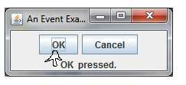
public static void main(String args[])
{
// Create the frame on the event dispatching thread.
SwingUtilities.invokeLater(new Runnable()
{
public void run()
{
new EventDemo();
}
}
);
}
}

Slide 54
The java.awt package is needed because
it contains the FlowLayout class, which supports the standard flow layout manager used to lay out components in a frame
It defines the ActionListener interface and the ActionEvent class.
The EventDemo constructor begins by creating a JFrame called jfrm with title -An Event Example
JFrame jfrm = new JFrame("An Event Example");
It then sets thelayout manager for the content pane of jfrm to FlowLayout.
jfrm.setLayout(new FlowLayout());
By default, the content pane uses BorderLayout as its layout manager.

Slide 55
After setting the size and default close operation,
EventDemo() creates two push buttons, as shown here:
JButton jbtnOk = new JButton(“Ok"); JButton jbtnCancel = new JButton(”Cancel");
– The first button will contain the text “Ok” and the second will contain the text “Cancel”.
When a push button is pressed, it generates an ActionEvent.
Thus, JButton provides the addActionListener( ) method, which is used to add an action listener so that button will respond to events. (JButton also provides removeActionListener( ) to remove a listener)

Slide 56
event listeners for the button’s action events are added by the code shown belo:
// Add action listener for Ok button.
jbtnOK.addActionListener(new ActionListener()
{
public void actionPerformed(ActionEvent ae)
{ jlab.setText(“OKwas pressed.");
}
});
This can also be written as: jbtnOK.addActionListener(this);
…………………………………
}
public void actionPerformed(ActionEvent ae)
{ String s = ae.getActionCommand(); if(s.equalsIgnoreCase("ok"))
//to get the name written in button
//to have case insensitive comparison
jlab.setText("OK pressed.");
}

Slide 57
Simple Program import java.awt.*; import java.awt.event.*; import javax.swing.*;
class EventDemoSwing extends JFrame implements ActionListener
{ JLabel jlab;
EventDemoSwing()
}

Slide 58
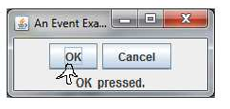
public void actionPerformed(ActionEvent ae)
{ //store the name written in button that is clicked ,in variable s String s = ae.getActionCommand(); if(s.equalsIgnoreCase("ok"))
jlab.setText("OK pressed."); else if(s.equalsIgnoreCase("cancel"))
jlab.setText("Cancel pressed.");
}
public static void main(String args[])
{ SwingUtilities.invokeLater(new Runnable()
{
public void run()
{
new EventDemoSwing();
}
}
);
}

Slide 59
Create a Swing Applet
A Swing applet extends Japplet.
– JApplet is derived from Applet.
Swing applets use the same four lifecycle methods as Applet
init( ),
start( ), stop( ), and destroy( ).
Swing applet will not normally override the paint( ) method

Slide 60
Write a program using SWING APPLET
It should have two buttons Ok and Cancel.
Label to display message “Push a button”.
When we click the OK button it prints the message “OK pressed” in the label.
When we click the Cancel button it prints the message “Cancel pressed” in the label

Slide 61
// A simple Swing-based applet import javax.swing.*;
import java.awt.*; import java.awt.event.*;
/*
This HTML can be used to launch the applet:
<object code="MySwingApplet" width=220 height=90>
</object>
*/
public class MySwingApplet extends JApplet implements ActionListener
{
JButton jbtnOk; JButton jbtnCancel; JLabel jlab;

Slide 62
// Initialize the applet.
public void init() {
try {
SwingUtilities.invokeAndWait(new Runnable ()
{
public void run() {
makeGUI(); // initialize the GUI
}
});
} catch(Exception exc)
{
System.out.println("Can't create because of "+ exc); }
}

Slide 63
private void makeGUI()
{ // Set the applet to use flow layout.
setLayout(new FlowLayout());
// Make two buttons.
jbtnOk = new JButton("Ok"); jbtnCancel = new JButton("Cancel");
// Add action listener for ok.
jbtnOk.addActionListener(this);
// Add action listener for Cancel.
jbtnCancel.addActionListener(this);
// Add the buttons to the content pane.
add(jbtnOk); add(jbtnCancel);
// Create a text-based label.
jlab = new JLabel("Press a button.");
// Add the label to the content pane.
add(jlab);
}

Slide 64
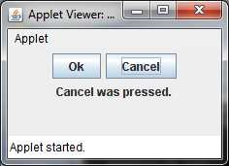
public void actionPerformed(ActionEvent ae)
{
String s = ae.getActionCommand(); if(s.equalsIgnoreCase("Ok"))
jlab.setText("Ok was pressed."); else if(s.equalsIgnoreCase("Cancel"))
jlab.setText("Cancel was pressed.");
}
}
COMPILE
javac MySwingApplet.java
RUN
appletviewer MySwingApplet.java

Slide 65
Reference
Herbert Schildt, Java: The Complete Reference, 8/e, Tata McGraw Hill, 2011.

Slide 66
CS205 Object Oriented Programming in Java
Module 5 - Graphical User Interface and Database support of Java
(Part 4)
Prepared by
Renetha J.B.
AP
Dept.of CSE,
Lourdes Matha College of Science and Technology

Slide 67
Topics
Swings
Swing Layout Managers

Slide 68
Swing Layout Managers
A layout manager automatically arranges our controls within a window by using some type of algorithm.
Each Container object has a layout manager associated with it.
A layout manager is an instance of any class that implements the LayoutManager interface.
The layout manager is set by the setLayout( ) method.
– If no call to setLayout( ) is made, then the default layout
manager is used.
The setLayout( ) method has the following general form:
void setLayout(LayoutManager layoutObj)

Slide 69
Swing Layout Managers(contd.)
The layout manager is notified each time we add a component to a container.
Each layout manager keeps track of a list of components that are stored by their names.
Whenever the container needs to be resized, the layout manager is consulted via its minimumLayoutSize( ) and preferredLayoutSize( ) methods.
– Each component that is being managed by a layout manager contains the getPreferredSize( ) and getMinimumSize( ) methods.

Slide 70
Java has several predefined LayoutManager classes,
FlowLayout
BorderLayout
GridLayout
CardLayout
GridBagLayout

Slide 71
FlowLayout
The direction of the layout is governed by the container’s component orientation property, which, by default, is left to right, top to bottom.
In low Layout
components are laid out line-by-line beginning at the upper- left corner.
When a line is filled, layout advances to the next line.
A small space is left between each component, above and below, as well as left and right.
The constructors for FlowLayout:
FlowLayout( ) FlowLayout(int how)
FlowLayout(int how, int horz, int vert)
6

Slide 72
FlowLayout(contd.)
FlowLayout( ) creates the default layout, which centers components and leaves five pixels of space between each component.
FlowLayout(int how) lets us specify how each line is aligned.
Valid values for how are as follows:
FlowLayout.LEFT
FlowLayout.CENTER
FlowLayout.RIGHT
FlowLayout.LEADING
FlowLayout.TRAILING
– These values specify left, center, right, leading trailing edge alignment, respectively.
FlowLayout(int how, int horz, int vert) allows us to specify the horizontal and vertical space left between components in horz and vert, respectively.
edge, and
7

Slide 73

import java.awt.*; import java.awt.event.*; import javax.swing.*;
class EventDemoSwing extends JFrame implements ActionListener{
JLabel jlab;
JFrame jfrm; JButton jbtnOk; JButton jbtnCancel; EventDemoSwing()
{
jfrm = new JFrame("An Event Eg"); jfrm.setLayout(new FlowLayout()); jfrm.setSize(220, 90);
public void actionPerformed(ActionEvent ae)
{
String s = ae.getActionCommand(); if(s.equalsIgnoreCase("ok"))
jlab.setText("OK pressed."); else if(s.equalsIgnoreCase("cancel"))
jlab.setText("Cancel pressed.");
}
jfrm.setDefaultCloseOperation(JFrame.EXIT_ON_CLOSE);
jbtnOk = new JButton("OK");
JButton jbtnCancel = new JButton("Cancel");
public static void main(String args[])
jbtnOk.setToolTipText("click"); jbtnOk.addActionListener(this); jbtnCancel.addActionListener(this); jfrm.add(jbtnOk); jfrm.add(jbtnCancel);
jlab = new JLabel("Press a button."); jfrm.add(jlab);
{SwingUtilities.invokeLater(new Runnable()
{
public void run()
{ new EventDemoSwing();
}
} );
jfrm.setVisible(true); }
} }
8

Slide 74
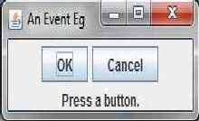

FlowLayout(contd.)
If in code we modify the layout as
jfrm.setLayout(new FlowLayout(FlowLayout.LEFT));
Prepared by Renetha J.B
9

Slide 75
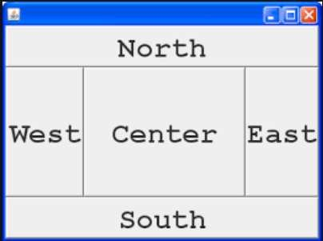
BorderLayout
By default, the content pane associated with a JFrame uses border layout.
The BorderLayout class implements a common layout style for top-level windows.
It has four narrow, fixed-width components at the edges and one large area in the center.
The four sides are referred to as
North,
South
East
West.
The middle area is called
Center

Slide 76
BorderLayout(contd.)
The constructors defined by BorderLayout:
BorderLayout( )
BorderLayout( ) creates a default border layout.
BorderLayout(int horz, int vert) specify the horizontal and vertical space left between components in horz and vert, respectively

Slide 77
BorderLayout(contd.)
BorderLayout defines the following constants
BorderLayout.CENTER
BorderLayout.SOUTH
BorderLayout.EAST
BorderLayout.WEST
BorderLayout.NORTH
When adding components, you will use these constants with the following form ofadd( ), which is defined by Container:
void add(Component compObj, Object region)
– Here, compObj is the component to be added, specifies where the component will be added.
and region

Slide 78
import java.awt.*; import java.awt.event.*; import javax.swing.*;
class EventDemoSwing extends JFrame implements ActionListener{
JLabel jlab;
JFrame jfrm; JButton jbtnOk; JButton jbtnCancel; EventDemoSwing()
{
jfrm = new JFrame("An Event Eg"); jfrm.setLayout(new BorderLayout ()); jfrm.setSize(220, 90);
public void actionPerformed(ActionEvent ae)
{
String s = ae.getActionCommand(); if(s.equalsIgnoreCase("ok"))
jlab.setText("OK pressed."); else if(s.equalsIgnoreCase("cancel"))
jlab.setText("Cancel pressed.");
}
jfrm.setDefaultCloseOperation(JFrame.EXIT_ON_CLOSE);
jbtnOk = new JButton("OK");
JButton jbtnCancel = new JButton("Cancel");
public static void main(String args[])
jbtnOk.setToolTipText("click"); jbtnOk.addActionListener(this); jbtnCancel.addActionListener(this); jfrm.add(jbtnOk,BorderLayout.EAST);
{SwingUtilities.invokeLater(new Runnable()
{
public void run()
jfrm.add(jbtnCancel, BorderLayout.WEST); jlab = new JLabel("Press a button."); jfrm.add(jlab BorderLayout.NORTH);
{ new EventDemoSwing();
}
} );
jfrm.setVisible(true); }
} }

Slide 79

BorderLayout(contd.)

Slide 80
Using Insets
Sometimes we may want to leave a small amount of space between the container that holds the components and the window that contains it.
To do this, override the getInsets( ) method that is defined by
Container.
getInsets( ) method returns an Insets object that contains the top, bottom, left, and right inset to be used when the container is displayed.
These values are used by the layout manager to inset the components when it lays out the window
The constructor for Insets is shown here:
Insets(int top, int left, int bottom, int right)
The values passed in top, left, bottom, and right specify the
amount of space between the container and its enclosing window

Slide 81
Using Insets(contd.)
The getInsets( ) method has this general form:
Insets getInsets( )
– When overriding this method, we must return a new Insets object that contains the inset spacing you desire.

Slide 82
GridLayout
GridLayout lays out components in a two-dimensional grid.
We can define the number of rows and columns.
The constructors supported by GridLayout are GridLayout( )
GridLayout(int numRows, int numColumns)
GridLayolayoutut(int numRows, int numColumns, int horz, int vert)
GridLayout( ) creates a single-column grid
GridLayout(int numRows, int numColumns) creates a grid layout with the specified number of rows and columns.
GridLayolayoutut(int numRows, int numColumns, int horz, int vert) allows us to specify the horizontal and vertical space left between components in horz and vert, respectively. Either numRows or numColumns can be zero. Specifying numRows as zero allows for unlimited-length columns.

Slide 83
import java.awt.*; import java.awt.event.*; import javax.swing.*;
class GridDemo extends JFrame implements ActionListener
{ JLabel jlab; JFrame jfrm; GridDemo()
{ jfrm = new JFrame("An Event Eg");
public void actionPerformed(ActionEvent ae)
{ String s = ae.getActionCommand(); if(s.equalsIgnoreCase("one"))
jlab.setText("One pressed."); else if(s.equalsIgnoreCase("two"))
jfrm.setLayout(new GridLayout (2,2));
jfrm.setSize(220, 90);
jfrm.setDefaultCloseOperation(JFrame.EXIT_ON_CLOSE); jlab.setText("Two pressed.");
JButton jbtnOne = new JButton("One"); JButton jbtnTwo= new JButton("Two"); JButton jbtnThree = new JButton("Three"); JButton jbtnFour = new JButton("Four");
else if(s.equalsIgnoreCase("three")) jlab.setText("Three pressed.");
else if(s.equalsIgnoreCase("four")) jlab.setText("Four pressed.");
jbtnOne.addActionListener(this); jbtnTwo.addActionListener(this); jbtnThree.addActionListener(this); jbtnFour.addActionListener(this); jfrm.add(jbtnOne); jfrm.add(jbtnTwo); jfrm.add(jbtnThree); jfrm.add(jbtnFour); jfrm.setVisible(true);
}
}
public static void main(String args[])
{SwingUtilities.invokeLater(new Runnable()
{ public void run()
{ new GridDemo(); } }
);
}
}

Slide 84

jfrm.setLayout(new GridLayout (2,2));
This set 2 rows and 2 columns
Components are filled in order from first row first column
(0,0)
(1,0)
(0,1)
(1,1)

Slide 85
CardLayout
The CardLayout class is unique among the other layout managers in that it stores several different layouts.
Each layout can be thought of as being on a separate index card in a deck that can be shuffled so that any card is on top at a given time
•
This can be useful for user interfaces with optional
components that can be dynamically enabled and disabled upon user input.
CardLayout provides these two constructors: CardLayout( )
CardLayout(int horz, int vert)
CardLayout( ) creates a default card layout.
CardLayout(int horz, int vert) allows to specify the horizontal and vertical space left between components in horz and vert, respectively.

Slide 86
CardLayout(contd.)
The cards are typically held in an object of type Panel.
This panel must have CardLayout selected as its manager.
layout
The cards that form the deck are also typically objects of type
Panel

Slide 87
CardLayout(contd.)
We must create
a panel that contains the deck and
a panel for each card in the deck.
Next, we add components that form each card to the appropriate panel.
We then add these panels to the panel for which CardLayout is the layout manager.
Finally, we add this panel to the window.
Once these steps are complete, we must provide some way for the user to select between cards.
One common approach is to include one push button for each card in the deck.

Slide 88
CardLayout(contd.)
Use add( ) when adding cards to a panel:
void add(Component panelObj, Object name)
Here, name is a string that specifies the name of the card whose panel is specified by panelObj.
After we have created a deck, our program activates a card by calling one of the following methods defined by CardLayout:
void first(Container deck) void last(Container deck) void next(Container deck)
void previous(Container deck)
void show(Container deck, String cardName)
Here, deck is a reference to the container (usually a panel) that holds the cards, and cardName is the name of a card.
Calling first( ) causes the first card in the deck to be shown. To show the last card, call last( ). To show the next card, call next( ). To show the previous card, call previous( ). Both next( ) and previous( ) automatically cycle back to the top or bottom of the deck, respectively. The show( ) method displays the card whose
name is passed in cardName.

Slide 89
import java.awt.*; import java.awt.event.*; import javax.swing.*;
public class CardLayoutDemo extends JFrame implements ActionListener
{
CardLayout card; JButton b1,b2,b3; Container c;
CardLayoutDemo()
{
c=getContentPane();
card=new CardLayout(40,30);
public void actionPerformed(ActionEvent e)
{
card.next(c);
}
//create CardLayout object with 40 hor space and 30 ver space
c.setLayout(card);
b1=new JButton("Apple"); b2=new JButton("Boy"); b3=new JButton("Cat"); b1.addActionListener(this); b2.addActionListener(this); b3.addActionListener(this);
c.add(b1);c.add(b2);c.add(b3);
}

Slide 90
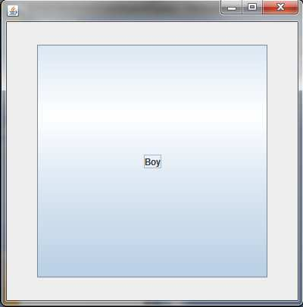

When we click the button it changes to next button like cards

Slide 91
GridBagLayout
We can specify the relative placement of components by specifying their positions within cells inside a grid using GridBagLayout.
The key to the grid bag is that each component can be a different size, and each row in the grid can have a different number of columns.
This is why the layout is called a grid bag.
It’s a collection of small grids joined together.
The location and size of each component in a grid bag are determined by a set of constraints linked to it.
The constraints are contained in an object of type
GridBagConstraints.
Constraints include the height and width of a cell, and the placement of a component, its alignment, and its anchor point within the cell.

Slide 92
GridBagLayout(contd.)
The general procedure for using a grid bag is to
first create a new GridBagLayout object and to make it the current layout manager.
Then, set the constraints that apply to each component that will be added to the grid bag.
Finally, add the components to the layout manager.
GridBagLayout defines only one constructor GridBagLayout( )
GridBagLayout defines several methods, of which many are protected and not for general use.
One method is setConstraints( )
void setConstraints(Component comp, GridBagConstraints cons)

Slide 93
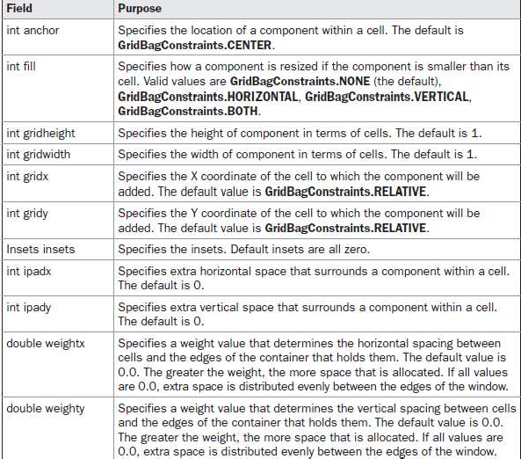
GridBagLayout(contd.)
GridBagConstraints defines several fields that to govern the size, placement, and spacing of a component.

Slide 94
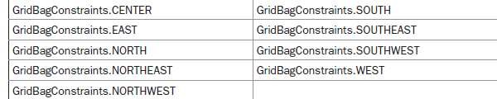
GridBagLayout(contd.)
GridBagConstraints also defines several static fields that contain standard constraint values, such as
GridBagConstraints.CENTER
GridBagConstraints.VERTICAL
When a component is smaller than its cell, you can use the anchor field to specify where within the cell the component’s top-left corner will be locate

Slide 95
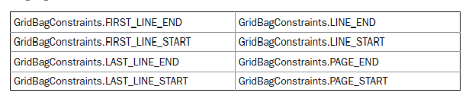
GridBagLayout(contd.)
The second type of values that can be given to anchor is relative, which means the values are relative to the container’s orientation,

Slide 96
import java.awt.*; import java.awt.event.*; import javax.swing.*;
public GridLayoutDemo() {
jfrm = new JFrame("An Event Eg"); GridBagLayout gbag = new GridBagLayout(); GridBagConstraints gbc = new GridBagConstraints();
jfrm.setLayout(gbag); jfrm.setSize(520, 500);
jfrm.setDefaultCloseOperation(JFrame.EXIT_ON_CLOSE); jbtnOk = new JButton("OK");
jbtnCancel = new JButton("Cancel"); jbtnOk.setToolTipText("click"); jbtnOk.addActionListener(this); jbtnCancel.addActionListener(this);
//Define the grid bag. // Use default row weight of 0 for first row.
gbc.weightx = 1.0;
gbc.ipadx = 200;
gbc.insets = new Insets(4, 4, 10, 10);
// use a column weight of 1
// pad by 200 units
// inset slightly from top left
gbc.anchor = GridBagConstraints.NORTH; gbc.gridwidth = GridBagConstraints.RELATIVE; gbag.setConstraints(jbtnOk, gbc);
gbc.gridwidth = GridBagConstraints.REMAINDER;
gbag.setConstraints(jbtnCancel, gbc);
31

Slide 97
jlab = new JLabel("Press a button.");
jfrm.add(jbtnOk); jfrm.add(jbtnCancel); jfrm.add(jlab);
jfrm.setVisible(true);
}
public void actionPerformed(ActionEvent ae)
{
String s = ae.getActionCommand(); if(s.equalsIgnoreCase("ok"))
jlab.setText("OK pressed."); else if(s.equalsIgnoreCase("cancel"))
jlab.setText("Cancel pressed.");
}
}

Slide 98
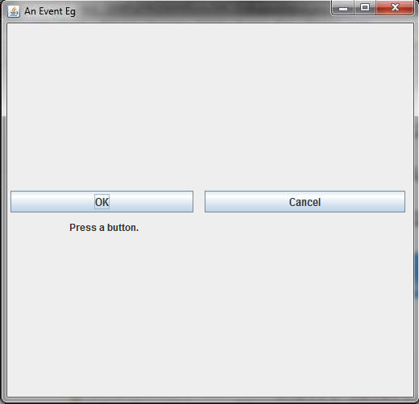

Slide 99
Reference
Herbert Schildt, Java: The Complete Reference, 8/e, Tata McGraw Hill, 2011.

Slide 100
CS205 Object Oriented Programming in Java
Module 5 - Graphical User Interface and Database support of Java
(Part 5)
Prepared by
Renetha J.B.
AP
Dept.of CSE,
Lourdes Matha College of Science and Technology

Slide 101


Topics
Swings
Exploring Swings
JFrame
Jlabel
The Swing Buttons
JTextField

Slide 102
Some of the swing components are:
– JButton
JCheckBox
JComboBox
JLabel
JList
These components are all lightweight. They are all derived from JComponent.
JRadioButton
JScrollPane
JTabbedPane
JTable
JTextField
JToggleButton
JTree

Slide 103
JFrame
JFrame is a top level container that is commonly used for Swing applications.
JFrame do not inherit JComponent.
JFrame inherit the AWT classes Component and Container.
The top-level containers are heavyweight.
Every containment container.
hierarchy must begin with a top-level

Slide 104
JFrame(contd.)
JFrame jfrm = new JFrame(“Swing Example);
This creates a container called jfrm that
defines a rectangular window complete with a title bar; close, minimize, maximize, and restore buttons; and a system menu.
Thus, it creates a standard, top-level window.
The title of the window is passed to the constructor.
Here it is Swing Example

Slide 105
JFrame(contd.)
The setSize( ) method (which is inherited by JFrame from the AWT class Component) sets the dimensions of the window, which are specified in pixels.
Its general form is :
void setSize(int width, int height)
E.g.
jfrm.setSize(275, 100);

Slide 106
JFrame(contd.)
If we want the entire application to terminate when its top- level window is closed the easiest way is to call setDefaultCloseOperation( )
E.g.
jfrm.setDefaultCloseOperation(JFrame.EXIT_ON_CLOSE);
After this call executes, closing the window causes the entire application to terminate.
The general form of setDefaultCloseOperation( ) is :
void setDefaultCloseOperation(int what)
what can be
JFrame.EXIT_ON_CLOSE
JFrame.DISPOSE_ON_CLOSE
JFrame.HIDE_ON_CLOSE
JFrame.DO_NOTHING_ON_CLOSE

Slide 107
JFrame(contd.)
The content pane can be obtained by calling getContentPane( )
on a JFrame instance.
The getContentPane( ) method is :
Container getContentPane( )
The setVisible( ) method is inherited from the AWT Component class.
If its argument is true, the window will be displayed. Otherwise, it will be hidden.
By default, a JFrame is invisible, so setVisible(true) must be called to show it.
E.g.
jfrm.setVisible(true);

Slide 108
JLabel
JLabel is Swing’s easiest-to-use component.
It creates a label.
JLabel can be used to display text and/or an icon.
It is a passive component because it does not respond to user input.
JLabel defines several constructors:
JLabel(Icon icon)
JLabel(String str)
JLabel(String str, Icon icon, int align)
The align argument specifies the horizontal alignment of the text and/or icon within the dimensions of the label.
It must be one of the following values: LEFT, RIGHT, CENTER, LEADING, or TRAILING

Slide 109
JLabel(contd.)
The easiest way to obtain an icon is to use the ImageIcon class.
ImageIcon implements Icon and encapsulates an image.
The following ImageIcon constructor obtains the image in the file named filename. the Icon parameter of JLabel’s constructor
ImageIcon(String filename)
The icon and text associated with the label can be obtained by the following methods:
Icon getIcon( ) String getText( )
The icon and text associated with a label can be set by these methods:
void setIcon(Icon icon)
void setText(String str)

Slide 110
The Swing Buttons
Swing defines four types of buttons:
JButton
JToggleButton JCheckBox JRadioButton
All are subclasses of the AbstractButton class (which extends JComponent)

Slide 111
The Swing Buttons(contd.)
AbstractButton contains many methods that allow you to control the behavior of buttons.
E.g. We can define different icons that are displayed for the button when it is disabled, pressed, or selected. Another icon can be used as a rollover icon, which is displayed when the mouse is positioned over a button.
void setDisabledIcon(Icon di) void setPressedIcon(Icon pi) void setSelectedIcon(Icon si) void setRolloverIcon(Icon ri)
– Here, di, pi, si, and ri are the icons for specific purpose

Slide 112
The Swing Buttons (contd.)
We can get the text associated with a button using:
String getText( )
We can modify the text associated with a button using:
void setText(String str)
The model used by all buttons is defined by the
ButtonModel interface.

Slide 113
JButton
The JButton button.
class provides the
functionality of a push
JButton allows an icon, a string, or both to be associated with the push button.
Three of its constructors are shown here: JButton(Icon icon)
JButton(String str)
JButton(String str, Icon icon)
When the button is pressed, an ActionEvent is generated.

Slide 114
JButton(contd.)
Using the ActionEvent object passed to the actionPerformed( ) method of the registered ActionListener, we can obtain the action command string associated with the button.
We can set the action command by calling
setActionCommand( ) on the button.
We can obtain the
getActionCommand( )
String getActionCommand( )
action command by calling
The action command helps to identify the button.
– Thus, when using two or more buttons within the same application, the action command gives you an easy way to determine which button was pressed.

Slide 115
import javax.swing.*; import java.awt.*; import java.awt.event.*;
ImageIcon imgok= new ImageIcon("C:\\RJB\\image1.jpg");
jbok = new JButton(imgok); jbok.setActionCommand("OK"); jfrm.add(jbok);
ImageIcon imgcancel= new ImageIcon("C:\\RJB\\image2.jpg");
jbcancel = new JButton(imgcancel); jbcancel.setActionCommand("Cancel"); jbok.addActionListener(this); jbcancel.addActionListener(this);
jfrm.add(jbcancel);
jlab = new JLabel(“Waiting button press "); jfrm.add(jlab);
jfrm.setVisible(true);
}
class SwingButton extends JFrame implements ActionListener
{ JFrame jfrm;
JButton jbok , jbcancel; JLabel jlab; SwingButton()
{
jfrm = new JFrame("Simple Swing ");
jfrm.setSize(500, 400); jfrm.setLayout(new
FlowLayout());
jfrm.setDefaultCloseOperation(J Frame.EXIT_ON_CLOSE);

Slide 116
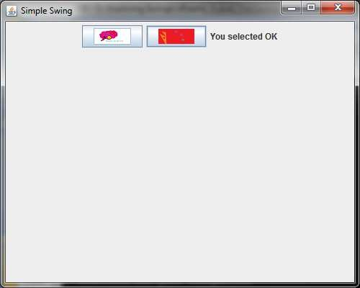
public void actionPerformed(ActionEvent ae)
{
jlab.setText("You selected " + ae.getActionCommand());
}
public static void main(String args[])
{ SwingUtilities.invokeLater(new Runnable()
{
public void run()
{
new SwingButton ();
}
}
);
}
}

Slide 117
JToggleButton
A toggle button looks just like a push button,
It acts differently from push button because it has two states:
Pushed
Released
When we press a toggle button, it stays pressed.
It does not pop back up as a regular push button.
When we press the toggle button a second time, it releases (pops up).
Each time a toggle button is pushed, it toggles between its two states
Toggle buttons are objects of the JToggleButton class.

Slide 118
JToggleButton(contd.)
JToggleButton implements AbstractButton.
JToggleButton is a superclass for JCheckBox and
JRadioButton
JToggleButton defines several constructors. JToggleButton(String str)
This creates a toggle button that contains the text passed in str.
By default, the button is in the off position.
JToggleButton uses a model defined by a nested class called JToggleButton .ToggleButtonModel.
JToggleButton generates an action event each time pressed.
When a JToggleButton is pressed in, it is selected.
When it is popped out, it is deselected.
it is

Slide 119
JToggleButton(contd.)
To handle item events, we must implement the ItemListener
interface.
Each time an item event is generated, it is passed to the
itemStateChanged( ) method defined by ItemListener.
Inside itemStateChanged( ), the getItem( ) method can be called on the ItemEvent object to obtain a reference to the JToggleButton instance that generated the event.
Object getItem( )
The easiest way to determine a toggle button’s state is by calling the isSelected( ) method.
boolean isSelected( )
– It returns true if the button is selected and false otherwise.

Slide 120
import javax.swing.*; import java.awt.*; import java.awt.event.*;
jtbn=new JToggleButton("On/Off"); jtbn.addItemListener(this); jfrm.add(jtbn);
jlab = new JLabel("Button is OFF"); jfrm.add(jlab);
jfrm.setVisible(true);
}
public void itemStateChanged(ItemEvent ie)
class SwingToggleButton extends JFrame implements ItemListener
{ JFrame jfrm; JToggleButton jtbn; JLabel jlab;
SwingToggleButton()
{
jfrm = new JFrame("Simple Swing "); jfrm.setSize(500, 400); jfrm.setLayout(new FlowLayout()); jfrm.setDefaultCloseOperation(JFrame
.EXIT_ON_CLOSE);
{
if(jtbn.isSelected()) jlab.setText("Button is on.");
else
jlab.setText("Button is off.");
}

Slide 121
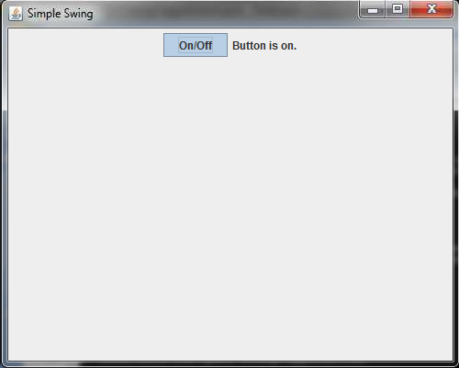
public static void main(String args[])
{ SwingUtilities.invokeLater(new Runnable()
{
public void run()
{
new SwingToggleButton ();
}
}
);
}
}

Slide 122
JCheckBox
JCheckBox class provides the functionality of a check box.
Its immediate superclass is JToggleButton,
JCheckBox defines several constructors. JCheckBox(String str)
When the user selects or deselects a check box, an ItemEvent is generated.
Inside the itemStateChanged( ) method, getItem( ) is called on ItemEvent object to obtain a reference to the JCheckBox object that generated the event
To determine the selected state of a check box is to call
isSelected( ) on the JCheckBox instance.

Slide 123
import javax.swing.*; import java.awt.*; import java.awt.event.*;
JCheckBox cb = new JCheckBox("C"); cb.addItemListener(this);
jfrm.add(cb);
cb = new JCheckBox("Java"); cb.addItemListener(this); jfrm.add(cb);
cb = new JCheckBox("Python"); cb.addItemListener(this);
class SwingJCheckBox extends JFrame implements ItemListener
{ JFrame jfrm; JCheckBox cb; JLabel jlab;
SwingJCheckBox()
{
jfrm = new JFrame("Simple Swing "); jfrm.setSize(500, 400); jfrm.setLayout(new FlowLayout()); jfrm.setDefaultCloseOperation(JFrame
.EXIT_ON_CLOSE);
jfrm.add(cb);
jlab = new JLabel("Select language"); jfrm.setVisible(true);
}

Slide 124
public void itemStateChanged(ItemEvent ie)
{ JCheckBox cb = (JCheckBox)ie.getItem(); if(cb.isSelected())
jlab.setText(cb.getText() + " is selected now");
else
jlab.setText(cb.getText() + " is cleared now");
}
public static void main(String args[])
SwingUtilities.invokeLater(new Runnable()
{
public void run()
{
new SwingJCheckbox();
}
});
{
} }

Slide 125
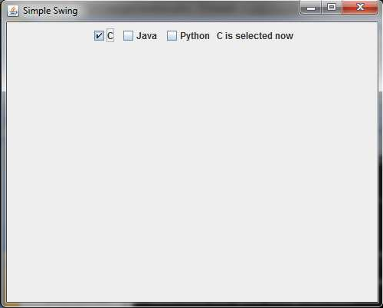

Slide 126
JRadioButton
Radio buttons are a group of mutually exclusive buttons, in which only one button can be selected at any one time.
They are supported by the JRadioButton class, which extends JToggleButton.
JRadioButton provides several constructors JRadioButton(String str)
A button group is created by the ButtonGroup class.
Its default constructor is invoked for this purpose.
Elements are then added to the button group via the following method:
void add(AbstractButton ab)
– Here, ab is a reference to the button to be added to the group.
A JRadioButton generates action events, item events, and
change

Slide 127
JRadioButton(contd.)
We will normally implement the ActionListener interface
with method actionPerformed( ).
Inside this method we can check its action command by calling getActionCommand( ).
By default, the action command is the same as the button label, but we can set the action command to something else by calling setActionCommand( ) on the radio button.
We can call getSource( ) on the ActionEvent object and check that reference against the buttons.
We can simply check each radio button to find out which one is currently selected by calling isSelected( ) on each button.

Slide 128
import javax.swing.*; import java.awt.*; import java.awt.event.*;
JRadioButton b1 = new JRadioButton("A"); b1.addActionListener(this);
class SwingJRadioButton extends
JFrame implements ActionListener
jfrm.add(b1);
{ JFrame jfrm; JLabel jlab;
JRadioButton b2 = new JRadioButton("B"); b2.addActionListener(this); jfrm.add(b2);
JRadioButton b3 = new JRadioButton("C"); b3.addActionListener(this);
SwingJRadioButton()
{
jfrm = new JFrame("Simple Swing "); jfrm.setSize(220, 100); jfrm.setLayout(new FlowLayout()); jfrm.setDefaultCloseOperation(JFrame
.EXIT_ON_CLOSE);
jfrm.add(b3);
ButtonGroup bg = new ButtonGroup(); bg.add(b1);
bg.add(b2);
bg.add(b3);
jlab = new JLabel("Select language"); jfrm.setVisible(true);
}

Slide 129
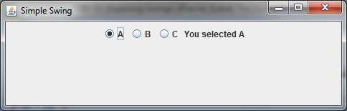
public void actionPerformed(ActionEvent ae)
{
jlab.setText("You selected " + ae.getActionCommand());
}
public static void main(String args[])
SwingUtilities.invokeLater(new Runnable()
{
public void run()
{
new SwingJRadioButton ();
}
});
{
} }

Slide 130
JTextField.
JTextField is the simplest Swing text component.
JTextField allows you to edit one line of text.
It is derived from JTextComponent, which provides the basic functionality common to Swing text components.
Three of JTextField’s constructors are :
JTextField(int cols) JTextField(String str, int cols) JTextField(String str)
Here, str is the string to be initially presented, and cols is the number of columns in the text field. If no string is specified, the text field is initially empty.
If the number of columns is not specified, the text field is sized to fit the specified string

Slide 131
JTextField(contd.)
JTextField generates events in response to user interaction.
For example, an ActionEvent is fired when the user presses ENTER.
A CaretEvent is fired each time the caret (i.e., the cursor) changes position.
CaretEvent is packaged in javax.swing.event
To obtain the text currently in the text field, call getText( )

Slide 132
JTextField(contd.)
// A simple Swing application. import javax.swing.*;
import java.awt.*; import java.awt.event.*;
/* <object code="SwingText" width=220 height=90>
</object>
*/
public class SwingText extends JApplet implements ActionListener
{ JLabel jlab; JTextField jtf;

Slide 133
private void makeGUI()
{ setLayout(new FlowLayout());
jlab = new JLabel(" Swing is powerful GUI"); add(jlab);
jtf = new JTextField(15); jtf.addActionListener(this); add(jtf);
}
public void actionPerformed(ActionEvent ae)
{
showStatus(jtf.getText());
}

Slide 134
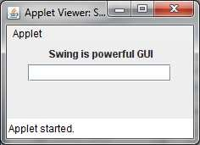
public void init()
{ try {
SwingUtilities.invokeAndWait(new Runnable ()
{
public void run()
{
makeGUI(); }
});
} catch(Exception exc)
{ System.out.println("Can't create because of "+ exc); }
}
}
COMPILE USING
javac SwingText.java RUN
appletviewer SwingText.java

Slide 135
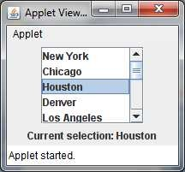
JList
In Swing, the basic list class is called JList.
JList provides several constructors
JList(Object[ ] items)
A JList generates a ListSelectionEvent when the user makes or changes a selection or deselects an item. It is handled by implementing ListSelectionListener
ListSelectionListener interface specifies only one method, called valueChanged(),
void valueChanged(ListSelectionEvent le)

Slide 136
JList(contd.)
We can change this behavior by calling setSelectionMode( ),
void setSelectionMode(int mode)
Here mode can be SINGLE_SELECTION SINGLE_INTERVAL_SELECTION
MULTIPLE_INTERVAL_SELECTION
We can obtain the index of the item selected from list by calling getSelectedIndex( ) :
int getSelectedIndex( )
– Indexing begins at zero. So, if the first item is selected, this method will return 0. If no item is selected, –1 is returned.
We can obtain the value associated with
the selection by calling getSelectedValue( ):
Object getSelectedValue( )

Slide 137
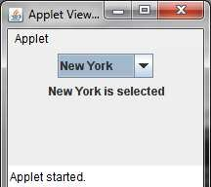
JComboBox
Swing provides a combo box (a combination of a text field and a drop-down list) through the JComboBox class.
JComboBox constructor is: JComboBox(Object[ ] items)
Items can also be dynamically added to the list of choices via the addItem( ) method:
void addItem(Object obj)
To obtain
the item selected in the list is to call
getSelectedItem( ) on the combo box.
Object getSelectedItem( )

Slide 138
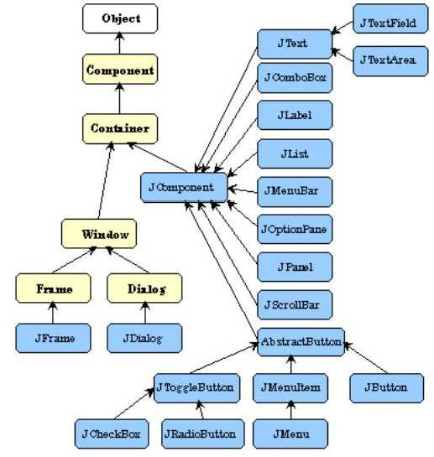
Class hierarchy of swing components

Slide 139
Reference
Herbert Schildt, Java: The Complete Reference, 8/e, Tata McGraw Hill, 2011.

Slide 140
CS205 Object Oriented Programming in Java
Module 5 - Graphical User Interface and Database support of Java
(Part 6)
Prepared by
Renetha J.B.
AP
Dept.of CSE,
Lourdes Matha College of Science and Technology

Slide 141
Topics
JDBC overview
Creating and Executing Queries
create table
delete
Insert
select

Slide 142
Introduction
Programming Language -Java
– for coding, developing interfaces(front application )
Database – MySQL , Oracle , PostgreSQL
– For storing data- (back end of an application)
end of an
Different types- relational database, object based database etc.
Relational database
Tabular structure
E.g. - Oracle, Microsoft Access, MySQL, PostgreSQL, MongoDB etc
SQL- Structured Query Language
– SQL statements are used to perform operations on a database. We can insert , delete, update and retrieve data in database using SQL statements.

Slide 143
JDBC overview
JDBC stands for “Java DataBase Connectivity”.
JDBC API (Application Programming Interface) is a Java API that can access any kind of tabular data, especially data stored in a Relational database.
JDBC is used for executing SQL statements from Java program.
With the help of JDBC API, we can insert, update, delete and fetch data from the database.

Slide 144
Why JDBC?
Before JDBC, ODBC(Open DataBase Connectivity) API was the database API to connect and execute the query with the database.
But, ODBC API uses ODBC driver which is written in C language (i.e. platform dependent and unsecure).
That is why, Java has defined its own API (JDBC API) that uses JDBC drivers (written in Java language).
If our application is using JDBC API to interact with the database, then we need not change much in our code even if we change the database of our application.

Slide 145
Advantage of JDBC
JDBC standardizes how to do many of the operations like
connect to the database,
query the database,
update the database, and
call stored procedures.

Slide 146
JDBC architecture
JDBC architecture can be classified categories:-
in 2 broad
JDBC API
JDBC Drivers

Slide 147
Java-JDBC API -JDBC Driver- Database
Java – programming language – coding- Front end
The JDBC API defines a set of interfaces and classes that all major database providers follow, so that using JDBC API, Java developers can connect to many Relational Database Management Systems (RDBMS).
– JDBC API uses JDBC drivers to connect with the database.
A JDBC driver is a software component that enables a Java application to interact with specific database.
Database – store data – Back end

Slide 148
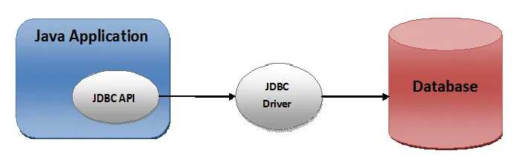

Slide 149
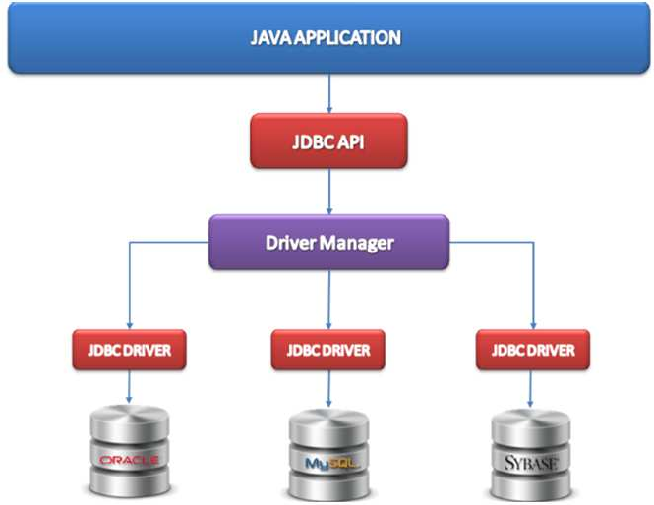

Slide 150
JDBC API
The Java Database Connectivity (JDBC) API provides universal data access from the Java programming language
Using the JDBC API, we can access virtually any data source like relational databases , spreadsheets etc. from Java.
The JDBC API is comprised of two packages:
java.sql javax.sql
These packages contains classes and interfaces for JDBC API.

Slide 151
JDBC API
Some classes and interfaces in java.sql package which support connectivity between Java and database are:
DriverManager :-"DriverManager class" manages all the Drivers found in JDBC environment, load the most appropriate driver for connectivity.
Connection: Connection interface objects which represents connection and it's object also helps in creating object of Statement, PreparedStatement etc.
Statement : :-Statement interface object is used to execute query and also store it's value to "ResultSet" object.

Slide 152
JDBC API(contd.)
PreparedStatement:- represents a precompiled SQL statement .
Callable Statement:-Callable statement support stored procedure .
ResultSet: it is used to store the result of SQL query. Java application get the result of database from this ResultSet.
SQLException:- SQLException class is used to represent error or warning during access from database or during connectivity.

Slide 153
JDBC Drivers
JDBC API uses JDBC drivers to connect with the database.
JDBC drivers .All major vendors provide their own JDBC drivers .
A JDBC driver is a software component that enables a Java application to interact with a database.
JDBC drivers contain a set of java classes that enables to connect to that particular database.

Slide 154
JDBC Drivers
Types Of JDBC Drivers:
JDBC drivers are divided into four types or levels.
Type 1:
JDBC-ODBC Bridge driver (Bridge)
Type 2:
Native- API/partly Java driver (Native)
Type 3:
All Java/Net- protocol driver (Middleware)
Type 4:
All Java/Native- protocol driver
/Thin Driver
(Pure)

Slide 155
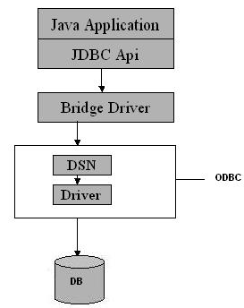
Type 1 JDBC Driver
The Type 1(JDBC-ODBC Bridge driver) driver translates all JDBC calls into ODBC calls and sends them to the ODBC driver
Advantage
– The JDBC-ODBC Bridge allows access to almost any database, since the datab are already available.
ase's ODBC drivers

Slide 156
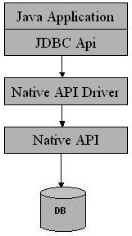
Type 2 JDBC Driver
Type 2 drivers(Native-API/partly Java driver) JDBC calls into database-specific calls.
convert

Slide 157
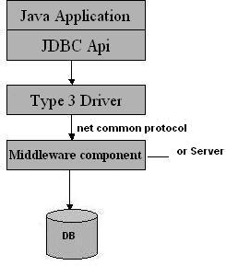
Type 3 JDBC Driver
Type 3 database driver(All Java/Net-protocol driver) requests are passed through the network to the middle-tier server.
The middle-tier then translates the request to the database.
Advantage
This driver is fully written in Java
and hence portable.
It is suitable for the web.

Slide 158
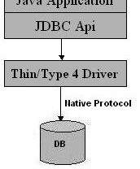
Type 4 JDBC Driver
Type 4 drivers(Native-protocol/all-Java driver) uses java networking libraries to communicate directly with the database server.
Advantage
They are completely written in Java-platform independent.
It is most suitable for the web.

Slide 159
Java-Database connectivity
Basic Steps fo connecting Java and database
Before we can create a java JDBC connection to the database, we must first import the java.sql package using:-
import java.sql.*;
Steps for connecting Java and database are:
Load and register a database driver Establish(create) a connection to the database Create Statement object
Execute the SQL Statements Process the result
Close the connection and Statement
epared by Renetha J.B.
20

Slide 160
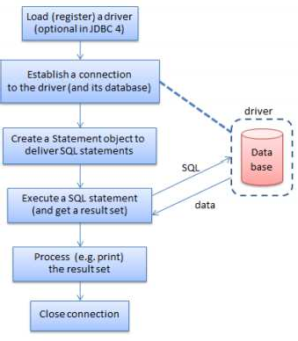

Slide 161
Steps to develop JDBC application:
Load and Register Driver
Establish the connection between java application and database
Creation of statement object
Send and execute SQL query
Process Result from ResultSet
Close the connection and statement.

Slide 162
Java Database Connectivity steps
Load or register a database driver
We can load /register a driver in Java in one of two ways:
Class.forName(String driver)
DriverManager.registerDriver(new constructor of
the driver )
We can load the driver class by calling Class.forName() with the Driver class name as an argument or DriverManager.registerDriver() with constructor of the driver class as argument
Once loaded, the Driver class creates an instance of itself.
JDBC-ODBC Bridge driver is commonly used.
Each database has its own driver.
The JDBC Driver class for MySQL database are
com.mysql.jdbc.Driver
com.mysql.cj.jdbc.Driver

Slide 163
Java Database Connectivity
The code for loading MySQL database driver from Java Class.forName("com.mysql.cj.jdbc.Driver");
or
DriverManager.registerDriver(new com.mysql.cj.jdbc.Driver());
Class.forName("com.mysql.jdbc.Driver");
Or
DriverManager.registerDriver(new com.mysql.jdbc.Driver());

Slide 164
Java Database Connectivity(contd.)
2. Establish the connection between Java application and database
– The getConnection() method of DriverManager class is used to establish connection with the database.
public static Connection getConnection(String url ,String name, String password) throws SQLException
Connection con=DriverManager.getConnection ( "jdbc:mysql://localhost:3306/ABC" ,
"root"
, "root123" );
JDBC url
username
password

Slide 165
Java Database Connectivity(contd.)
A JDBC URL provides a way of identifying a database so that the appropriate driver will recognize it and establish a connection with it.
The standard syntax for JDBC URLs is: jdbc:<subprotocol>:<subname>
A JDBC URL has three parts, which are separated by colons:
jdbc is the protocol.
<subprotocol> is usually the driver or the database connectivity mechanism, which may be supported by one or more drivers.
<subname> is the database.
For example, to access a MySQL database through a JDBC- ODBC bridge, one might use a URL such as the following:
jdbc:mysql://localhost:3306/ABC

Slide 166
Java Database Connectivity(contd.)

Slide 167
Java Database Connectivity(contd.)
Creating a Statement object
Once a connection is established, we can interact with the database.
To execute SQL statements, we need to create a Statement object from the Connection object by using the createStatement() method.
A Statement object is used to send and execute SQL statements to a database.
Statement object= connectionobject. createStatement();
E.g.
Connection con=DriverManager.getConnection( "jdbc:mysql://localhost:3306/ABC" , "root" , "root123" );
Statement st = con.createStatement();
Statement object st is used to send and execute SQL statements to
a database.

Slide 168
Java Database Connectivity(contd.)
4. Execute the SQL Statements
To execute a SQL statement we use executeQuery() or
executeUpdate() method on Statement object.
The executeUpdate() method executes the CREATE, INSERT, DELETE and UPDATE statements.
E.g.:
st.executeUpdate("CREATE TABLE stud1(roll int, name varchar(15))");
st.executeUpdate(“INSERT INTO student values(1, ’Anu’) ”);
The executeQuery() method executes a SELECT query
it takes an SQL SELECT query string as an argument and returns the result(output) as a ResultSet object.
E.g.:
ResultSet rs=st.executeQuery(“SELECT rollno, name from student”);

Slide 169
Java Database Connectivity(contd.)
Process the Result (in the case of SELECT query only -To Retrieve the Result)
The result of SELECT query (retrieves data from database) is stored in ResultSet object.
To retrieve the data from the ResultSet object, we have to use ResultSet’s getxxx() method (where xxx is the data type. )
public int getxxx(int columnIndex):
public int getxxx(Stringt columnIndex):
getInt() to retrieve a integer value.
getString() method can be used to retrieve a string value.
getFloat() method can be used to retrieve a floating point value.

Slide 170
Java Database Connectivity(contd.)
Eg:
ResultSet rs=st.executeQuery(“SELECT rollno, name
from while(rs.next())
{
student”);
System.out.println(rs.getInt(1)); System.out.println(rs.getString(2));
Here rs contains all rollno and name rows in studenttable
ResultSet cursor is initially positioned before the first row;
the first call to the method next() (rs.next()) moves the cursor forward and makes the first row the current row)
the second call to next() moves the cursor forward and makes the second row as the current row, and so on.

Slide 171
Java Database Connectivity(contd.)
rs.getInt(1) will retrieve the value of first attribute in the current row(getInt() is used because first attribute is rollno which is integer)
rs.getString(2) will retrieve the value of second attribute in the current row(getString() is used because second attribute is name which is character string)

Slide 172
Java Database Connectivity(contd.)
ResultSet rs=st.executeQuery(“SELECT rollno, name from while(rs.next())
{
System.out.println(rs.getInt(1)); System.out.println(rs.getString(2));
}
Working:
student”);
Here rollno and name in all rows in student table are retrieved.
ResultSet object rs maintains a cursor that is initially positioned
before the first row.
When while(rs.next()) is first executed the cursor moves forward to first row of result and prints the value of first attribute (rollno) and second attribute(name)in first row in the result
Next time while loop is executed, if second row is there, then rs.nex() moves cursor to second row and prints the values in thar row.
This continues until there is no more row in the result.

Slide 173
Java Database Connectivity(contd.)
6. Close the connection and Statement
Finally open connections need to be closed using close()
method as:
con.close() st. close()

Slide 174
MySQL
MySQL is an open source database software.
– We can create databases, tables etc for storing data and we can perform various database operations.
Take mysqlshell and type:
\sql
\connect root@localhost
Enter password root123
(password given during installation)
Create database
CREATE DATABASE ABC;
Use the database for creating tables
USE ABC;
Now you can do database operations in MySQL

Slide 175
SQL Commands- CREATE TABLE
CREATE TABLE tablename (atribute1 type, attribute2 type, attribute3 type Primary Key,….. atributen type,constraints);
– Type can be int char(size)
varchar(size) real
date
E.g. CREATE TABLE int);
person(name varchar(15) , age

Slide 176
SQL Commands- INSERT
Insert rows(values of attribute) into table.
INSERT INTO
tablename (attribute,attribute..)
VALUES( value1,value2,….);
If type of attribute is varchar or char its value should be enclose in single quotes.
E.g. Insert the following details into Person table
Name is Anu Age 20, Name is Smith Age 10 , Name is Roy Age 70
INSERT INTO Person(name,age) VALUES(‘Anu’, 20);
INSERT INTO Person(name,age) VALUES(‘Smith’, 10); INSERT INTO Person(name,age) VALUES(‘Roy’, 70);

Slide 177
SQL Commands- DELETE
Delete from table.
DELETE FROM tablename WHERE condition;
Condition can be of the form:
Attribute=value Attribute<value Attribute>value Attribute<=value Attribute>=value Attribute!=value Attribute BETWEEN value 1AND value2
– If more than one condition is there, then they can be combined using AND , OR as required.
E.g. . Remove details of persons having age 20
DELETE FROM Person WHERE age=20;
Remove details of persons having name Smith or age more than 60
DELETE FROM Person where age>60 OR name=‘Smith’;

Slide 178
SQL Commands - UPDATE
To update or modify the contents in table.
UPDATE tablename SET
attribute=value WHERE condition;
Condition can be of the form:
attribute=value ,
Attribute=value Attribute<value Attribute>value
Attribute BETWEEN value 1AND value2
– If more than one condition is there, then they combined using AND , OR as required.
E.g. Change the age of Roy to 25
UPDATE Person SET age=25 WHERE name=‘Roy’;
can be

Slide 179
SQL Commands - SELECT
To select or retrieve content from table.
SELECT attribute1, attribute2,….. tablename WHERE condition;
Condition can be of the form:
attributen
FROM
Attribute=value Attribute<value Attribute>value
Attribute BETWEEN value 1AND value2
– If more than one condition is there, then they combined using AND , OR as required.
can be
E.g. Display name and age of persons with age more than 10.
SELECT name, age FROM Person WHERE age>10;

Slide 180
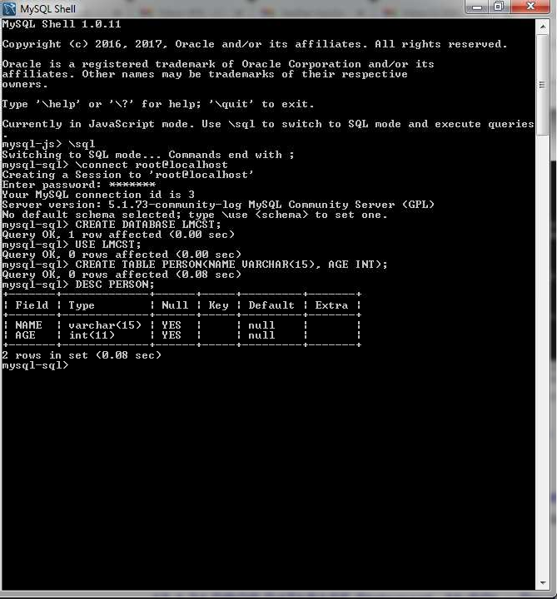

Slide 181
Creating and Executing Queries
CREATE TABLE
DELETE
INSERT
SELECT.

Slide 182
CREATE TABLE in MySQL from Java
Write a Java program to create a table named Student
with fields rollno and name in the database ABC
Attribute | Domain type
rollno | int
name | Varchar(15)

Slide 183
Create table from Java
import java.sql.*;
public class CreateTableEg
{ public static void main(String args[]) throws ClassNotFoundException
{
try {
// Register JDBC driver
Class.forName("com.mysql.jdbc.Driver");
//Open a connection
Connection con=DriverManager.getConnection( "jdbc:mysql://localhost:3306/ABC" , "root","root123");
//Create a statement object
Statement st=con.createStatement();
st.executeUpdate("CREATE TABLE Student (rollno int, name varchar(15))"); System.out.println("Table created");
con.close();
}catch(SQLException e) {
}

Slide 184
INSERT row using Java
Write a Java program to insert the following row into Student table with fields rollno and name in the database ABC
1
Anu

Slide 185
INSERT row using Java
import java.sql.*;
public class InsertEg
{ public static void main(String args[]) throws ClassNotFoundException
{
try {
// Register JDBC driver
Class.forName("com.mysql.jdbc.Driver");
//Open a connection
Connection con=DriverManager.getConnection( "jdbc:mysql://localhost:3306/ABC" , "root","root123");
//Create a statement object
Statement st=con.createStatement();
st.executeUpdate("INSERT INTO Student(rollno,name) VALUES (1,'Anu')"); System.out.println(“Data inserted successfully");
con.close();
}catch(SQLException e) {
}
}

Slide 186
To access value of java variable inside the SQL command use : SinglequoteDoublequote+varaiable+DoublequoteSinglequote
E.g.
int roll=2;
String nam=“Anu”;
st.executeUpdate("INSERT INTO Student(rollno,name)
VALUES('"+ roll +"' , '"+ nam +"' )");

Slide 187
INSERT row using Java
Write a Java program to insert details about n students into Student table with fields rollno and name in the database ABC

Slide 188
INSERT n rows from Java
import java.sql.*;
import java.util.*;
public class CreateTableEg
{ public static void main(String args[]) throws ClassNotFoundException
{ try {
Scanner sc=new Scanner(System.in); int roll,n,i;
String nam;
Class.forName("com.mysql.jdbc.Driver"); Connection con=DriverManager.getConnection(
"jdbc:mysql://localhost:3306/ABC" , "root","root123"); Statement st=con.createStatement();
System.out.println("Enter how many students detail to be inserted"); n=sc.nextInt();
con.close();
}
for(i=0;i<n;i++)
{ System.out.println("Enter the rollno"); roll=sc.nextInt(); System.out.println("Enter the name"); sc.nextLine();
nam=sc.nextLine();
catch(SQLException e)
{
System.out.println(e);
}
}
}
st.executeUpdate("INSERT INTO Student(rollno,name)
values('"+ roll +"' , '"+ nam +"' )");
} System.out.println(“Data inserted successfully");

Slide 189
DELETE rows using Java
Write a Java program to delete details about students into Student table with given roll number.

Slide 190
DELETE rows using Java
import java.sql.*; import java.util.*;
public class InsertEg
{ public static void main(String args[]) throws ClassNotFoundException
{
int roll;
Scanner sc=new Scanner(System.in);
try { Class.forName("com.mysql.jdbc.Driver"); Connection con=DriverManager.getConnection(
"jdbc:mysql://localhost:3306/ABC" , "root","root123");
Statement = .createStatement();
System.out.println("Enter the rollno of student to be deleted"); roll=sc.nextInt();
st.executeUpdate("DELETE FROM Student WHERE rollno='"+ roll +"' "); System.out.println("Data deleted succesfully.");
con.close();
}catch(SQLException e) { System.out.println("Error is " +e); }
}
}

Slide 191
UPDATE rows using Java
Write a Java program to update the name of roll number 1 to John in Student table

Slide 192
UPDATE rows using Java
import java.util.*;
import java.sql.*;
public classUpdateEg
{ public static void main(String args[]) throws ClassNotFoundException
{ Scanner sc=new Scanner(System.in);
int roll;
try {
String nam;
Class.forName("com.mysql.jdbc.Driver");
Connection con=DriverManager.getConnection( "jdbc:mysql://localhost:3306/ABC" , "root","root123");
Statement st=con.createStatement(); System.out.println("Enter the rollno of student "); roll=sc.nextInt(); sc.nextLine();
System.out.println("Enter the name of new student "); nam=sc.nextLine();
st.executeUpdate("UPDATE Student SET name='"+ nam +"' WHERE
rollno='"+ roll +"' ");
con.close();
}catch(SQLException e) { System.out.println("Error is " +e); }
}
}

Slide 193
SELECT rows using Java
Write a Java program to list all names and roll numbers in
Student table

Slide 194
SELECT rows Using Java
import java.sql.*;
public class InsertEg
Import classes and interfaces from java.sql package
{ public static void main(String args[]) throws ClassNotFoundException
{
try {
Load the Driver for MySQL
Class.forName("com.mysql.jdbc.Driver"); Connection con=DriverManager.getConnection(
Establish connection
"jdbc:mysql://localhost:3306/ABC" , "root","root123");
Statement st=con.createStatement();
Create statement
ResultSet rs=st.executeQuery("SELECT rollno,name FROM student");
while(rs.next())
{
}
con.close();
Execute Query and represent result as result set
System.out.println(rs.getInt(1)+" "+rs.getString(2));
First column
Second column
Close the connection
}catch(SQLException e) { System.out.println("Error is " +e); }
Load the Driver for MySQL
}
}

Slide 195
SELECT rowsUsing Java
import java.sql.*;
public class InsertEg
{ public static void main(String args[]) throws ClassNotFoundException
{
try {
Class.forName("com.mysql.jdbc.Driver"); Connection con=DriverManager.getConnection(
"jdbc:mysql://localhost:3306/ABC" , "root","root123");
Statement st=con.createStatement();
ResultSet rs=st.executeQuery("select rollno,name from student"); while(rs.next())
{
}
con.close();
System.out.println(rs.getInt(1)+" "+rs.getString(2));
}catch(SQLException e) {
System.out.println("Error is " +e); }
}
}

Slide 196
WORKING
In this example we used MySQL as the database.
Class.forName() is used for loading the Driver class
Driver class: The driver class is com.mysql.jdbc.Driver.
DriverManager.getConnection() connection
for the mysql database
helps to establish the
Connection URL: The connection URL for the mysql database is jdbc:mysql://localhost:3306/ABC where jdbc is the API, mysql is the database, localhost is the server name on which mysql is running, we may also use IP address, 3306 is the port number and ABCis the database name. We may use any database in MySQL here.
Username: The default username for the mysql database is root.
Password: It is the password given by the user at the time of installing the mysql database.

Slide 197
WORKING(contd.)
Connection con=DriverManager.getConnection(
"jdbc:mysql://localhost:3306/ABC" ,
The JDBC url used is
jdbc:mysql://localhost:3306/ABC
"root"
, "root123" );
Here jdbc is the API,
mysql is the database,
localhost is the server name on which mysql is running(we can also give IP address here)
3306 is the port number
ABC is the database name created in MySQL (give your database name here)
root is the username of MySQL(root is the default username . Other MySQL username we can give here).
root123 is the password of MySQL given during installation(give password you gave during installation)

Slide 198
WORKING(contd.)
Statement st=con.createStatement();
// con is the Connection object
– Statement object st is created from the Connection object con using the method createStatement(). st can be used to send and execute SQL statements to a database.
To execute a SQL statement SELECT we use executeQuery()
method on Statement object .
(Note:To execute a SQL commands CREATE TABLE, INSERT, DELETE , UPDATE we use executeUpdate() method on Statement object. )
ResultSet rs=st.executeQuery("SELECT rollno, name FROM Student");
executeQuery() method on

Slide 199
WORKING(contd.)
ResultSet rs=st.executeQuery(“SELECT rollno, name FROM
while(rs.next())
{
System.out.println(rs.getInt(1)); System.out.println(rs.getString(2));
}
student”);
ResultSet object rs maintains a cursor that is initially positioned
before the first row in the result.
When while(rs.next()) is first executed the cursor moves forward to first row of result
System.out.println(rs.getInt(1)); prints the value of first attribute (rollno)
System.out.println(rs.getString(2)); prints the value of second attribute (name) in the result
Next time while loop is executed, if second row is there, then rs.nex() moves cursor to second row and prints the values in that row.
This continues until there is no more row in the result.
con.close(); closes the connection

Slide 200
WORKING(contd.)
ResultSet rs=st.executeQuery(“SELECT rollno, name FROM
while(rs.next())
{
System.out.println(rs.getInt(1)); System.out.println(rs.getString(2));
}
Working:
student”);
Here rollno and name in all rows in student table are retrieved.
ResultSet object rs maintains a cursor that is initially positioned
before the first row in the result.
When while(rs.next()) is first executed the cursor moves forward to first row of result and prints the value of first attribute (rollno) and second attribute(name)in first row in the result
Next time while loop is executed, if second row is there, then rs.nex() moves cursor to second row and prints the values in that row.
This continues until there is no more row in the result.
con.close(); closes the connection

Slide 201
WORKING(contd.)
ClassNotFoundException , SQLException and exceptions may occur during these steps.
ClassNotFoundException is thrown from main function
other
public static void main(String args[]) throws ClassNotFoundException
Using try catch other exceptions like SQLException can be handled
try{
}catch(SQLException se)
{ }
catch(Exception e)
{ }

Slide 202
SELECT rows based on conditionusing Java
Write a Java program to list name of the student in
Student table having given roll number

Slide 203
SELECT row based on condition Using Java import java.sql.*;
import java.util.*
public class InsertEg
{ public static void main(String args[]) throws ClassNotFoundException
{ try { int roll;
Scanner sc=new Scanner(System.in); Class.forName("com.mysql.jdbc.Driver"); Connection con=DriverManager.getConnection(
"jdbc:mysql://localhost:3306/ABC" , "root","root123"); Statement st=con.createStatement();
System.out.println("Enter the rollno of student "); roll=sc.nextInt();
ResultSet rs=st.executeQuery("SELECT rollno='"+ roll +"' ");
System.out.println("Name of student is “+rs.getString(1));
name FROM student WHERE
con.close();
}catch(SQLException e) {
}
}

Slide 204
Summary
Programming Language -Java
for coding, developing interfaces(front end of an application )
Database – MySQL , Oracle , PostgreSQL
For storing data- (back end of an application)
Relational database -Tabular structure
E.g. - Oracle, Microsoft Access, MySQL, PostgreSQL, MongoDB etc
SQL- Structured Query Language
SQL statements are used to perform operations on a database. CREATE TABLE, INSERT, DELETE, UPDATE, SELECT

Slide 205
Com.jd bc.mys ql.Drive r

