Slide 1
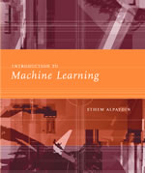
INTRODUCTION TO
Machine Learning
Lecture Slides for
ETHEM ALPAYDIN
© The MIT Press, 2004
alpaydin@boun.edu.tr
http://www.cmpe.boun.edu.tr/~ethem/i2ml

Slide 2
CHAPTER 1:
Introduction

Slide 3
Why “Learn” ?
Machine learning is programming computers to optimize a performance criterion using example data or past experience.
There is no need to “learn” to calculate payroll
Learning is used when:
  Human expertise does not exist (navigating on Mars),
  Humans are unable to explain their expertise (speech recognition)
  Solution changes in time (routing on a computer network)
  Solution needs to be adapted to particular cases (user biometrics)
Lecture Notes for E Alpaydın 2004 Introduction to Machine Learning © The MIT Press (V1.1)

Slide 4
What We Talk About When We Talk About“Learning”
Learning general models from a data of particular examples
Data is cheap and abundant (data warehouses, data marts); knowledge is expensive and scarce.
Example in retail: Customer transactions to consumer behavior:
  People who bought “Da Vinci Code” also bought “The Five People You Meet in Heaven” (www.amazon.com)
Build a model that is a good and useful approximation to the data.
Lecture Notes for E Alpaydın 2004 Introduction to Machine Learning © The MIT Press (V1.1)

Slide 5
Data Mining
Retail: Market basket analysis, Customer relationship management (CRM)
Finance: Credit scoring, fraud detection
Manufacturing: Optimization, troubleshooting
Medicine: Medical diagnosis
Telecommunications: Quality of service optimization
Bioinformatics: Motifs, alignment
Web mining: Search engines
...
Lecture Notes for E Alpaydın 2004 Introduction to Machine Learning © The MIT Press (V1.1)

Slide 6
What is Machine Learning?
Optimize a performance criterion using example data or past experience.
Role of Statistics: Inference from a sample
Role of Computer science: Efficient algorithms to
  Solve the optimization problem
  Representing and evaluating the model for inference
Lecture Notes for E Alpaydın 2004 Introduction to Machine Learning © The MIT Press (V1.1)

Slide 7
Applications
Association
Supervised Learning
  Classification
  Regression
Unsupervised Learning
Reinforcement Learning
Lecture Notes for E Alpaydın 2004 Introduction to Machine Learning © The MIT Press (V1.1)

Slide 8
Learning Associations
Basket analysis:
P (Y | X ) probability that somebody who buys X also buys Y where X and Y are products/services.
Example: P ( chips | beer ) = 0.7
Lecture Notes for E Alpaydın 2004 Introduction to Machine Learning © The MIT Press (V1.1)

Slide 9
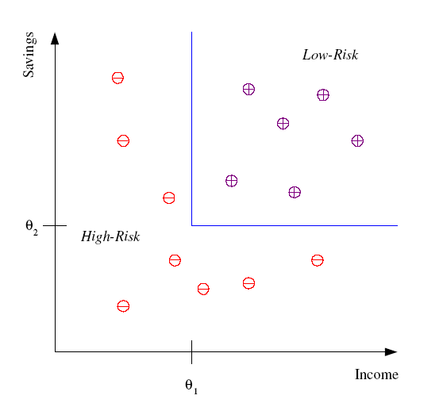
Classification
Example: Credit scoring
Differentiating between low-risk and high-risk customers from their income and savings
Discriminant: IF income > θ₁ AND savings > θ₂
THEN low-risk ELSE high-risk
Lecture Notes for E Alpaydın 2004 Introduction to Machine Learning © The MIT Press (V1.1)

Slide 10
Classification: Applications
Aka Pattern recognition
Face recognition: Pose, lighting, occlusion (glasses, beard), make-up, hair style
Character recognition: Different handwriting styles.
Speech recognition: Temporal dependency.
  Use of a dictionary or the syntax of the language.
  Sensor fusion: Combine multiple modalities; eg, visual (lip image) and acoustic for speech
Medical diagnosis: From symptoms to illnesses
...
Lecture Notes for E Alpaydın 2004 Introduction to Machine Learning © The MIT Press (V1.1)

Slide 11








Face Recognition
Training examples of a person
Test images
AT&T Laboratories, Cambridge UK
http://www.uk.research.att.com/facedatabase.html
Lecture Notes for E Alpaydın 2004 Introduction to Machine Learning © The MIT Press (V1.1)

Slide 12
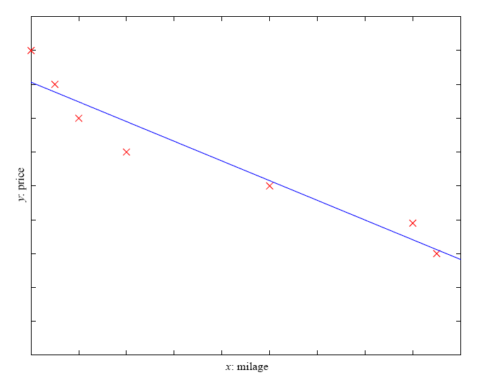
Regression
Example: Price of a used car
x : car attributes
y : price
y = g (x | θ )
g ( ) model,
θ parameters
y = wx+w₀
Lecture Notes for E Alpaydın 2004 Introduction to Machine Learning © The MIT Press (V1.1)

Slide 13
Regression Applications
Navigating a car: Angle of the steering wheel (CMU NavLab)
Kinematics of a robot arm
(x,y)
α₁= g₁(x,y)
α₂= g₂(x,y)
α₂
α₁
Response surface design
Lecture Notes for E Alpaydın 2004 Introduction to Machine Learning © The MIT Press (V1.1)

Slide 14
Supervised Learning: Uses
Prediction of future cases: Use the rule to predict the output for future inputs
Knowledge extraction: The rule is easy to understand
Compression: The rule is simpler than the data it explains
Outlier detection: Exceptions that are not covered by the rule, e.g., fraud
Lecture Notes for E Alpaydın 2004 Introduction to Machine Learning © The MIT Press (V1.1)

Slide 15
Unsupervised Learning
Learning “what normally happens”
No output
Clustering: Grouping similar instances
Example applications
  Customer segmentation in CRM
  Image compression: Color quantization
  Bioinformatics: Learning motifs
Lecture Notes for E Alpaydın 2004 Introduction to Machine Learning © The MIT Press (V1.1)

Slide 16
Reinforcement Learning
Learning a policy: A sequence of outputs
No supervised output but delayed reward
Credit assignment problem
Game playing
Robot in a maze
Multiple agents, partial observability, ...
Lecture Notes for E Alpaydın 2004 Introduction to Machine Learning © The MIT Press (V1.1)

Slide 17
Resources: Datasets
UCI Repository: http://www.ics.uci.edu/~mlearn/MLRepository.html
UCI KDD Archive: http://kdd.ics.uci.edu/summary.data.application.html
Statlib: http://lib.stat.cmu.edu/
Delve: http://www.cs.utoronto.ca/~delve/
Lecture Notes for E Alpaydın 2004 Introduction to Machine Learning © The MIT Press (V1.1)

Slide 18
Resources: Journals
Journal of Machine Learning Research www.jmlr.org
Machine Learning
Neural Computation
Neural Networks
IEEE Transactions on Neural Networks
IEEE Transactions on Pattern Analysis and Machine Intelligence
Annals of Statistics
Journal of the American Statistical Association
...
Lecture Notes for E Alpaydın 2004 Introduction to Machine Learning © The MIT Press (V1.1)

Slide 19
Resources: Conferences
International Conference on Machine Learning (ICML)
  ICML05: http://icml.ais.fraunhofer.de/
European Conference on Machine Learning (ECML)
  ECML05: http://ecmlpkdd05.liacc.up.pt/
Neural Information Processing Systems (NIPS)
  NIPS05: http://nips.cc/
Uncertainty in Artificial Intelligence (UAI)
  UAI05: http://www.cs.toronto.edu/uai2005/
Computational Learning Theory (COLT)
  COLT05: http://learningtheory.org/colt2005/
International Joint Conference on Artificial Intelligence (IJCAI)
  IJCAI05: http://ijcai05.csd.abdn.ac.uk/
International Conference on Neural Networks (Europe)
  ICANN05: http://www.ibspan.waw.pl/ICANN-2005/
...
Lecture Notes for E Alpaydın 2004 Introduction to Machine Learning © The MIT Press (V1.1)

