Slide 1

INTRODUCTION TO
Machine Learning
Lecture Slides for
ETHEM ALPAYDIN
© The MIT Press, 2004
alpaydin@boun.edu.tr
http://www.cmpe.boun.edu.tr/~ethem/i2ml

Slide 2
CHAPTER 2:
Supervised Learning

Slide 3
Learning a Class from Examples
Class C of a “family car”
  Prediction: Is car x a family car?
  Knowledge extraction: What do people expect from a family car?
Output:
  Positive (+) and negative (–) examples
Input representation:
x₁: price, x₂ : engine power
Lecture Notes for E Alpaydın 2004 Introduction to Machine Learning © The MIT Press (V1.1)

Slide 4
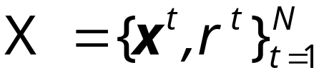
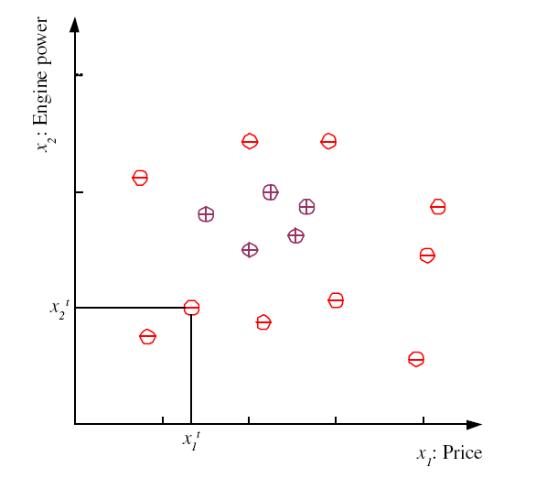
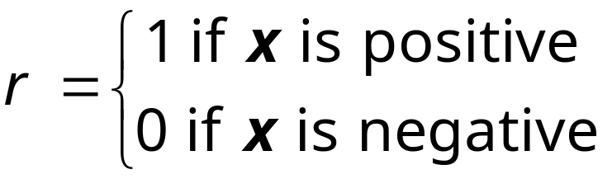
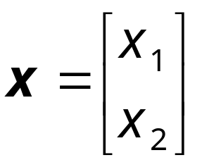
Training set X
Lecture Notes for E Alpaydın 2004 Introduction to Machine Learning © The MIT Press (V1.1)

Slide 5
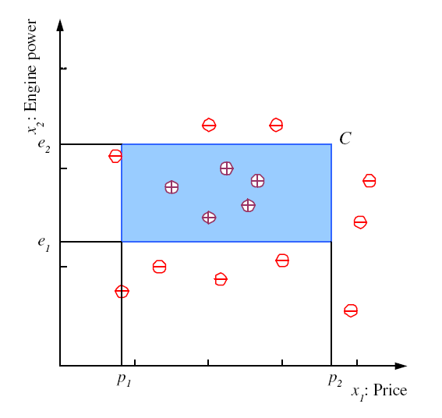
Class C
Lecture Notes for E Alpaydın 2004 Introduction to Machine Learning © The MIT Press (V1.1)

Slide 6
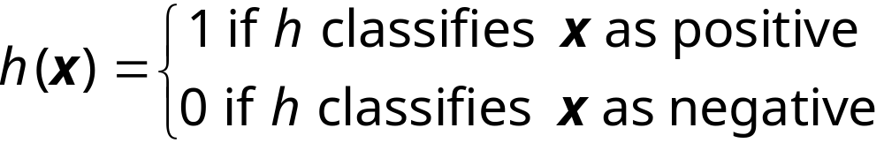
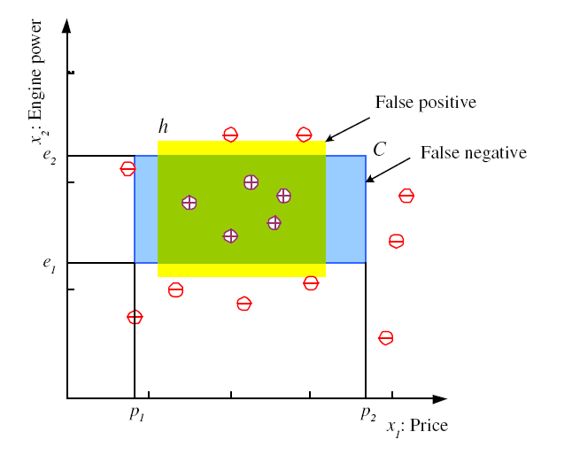
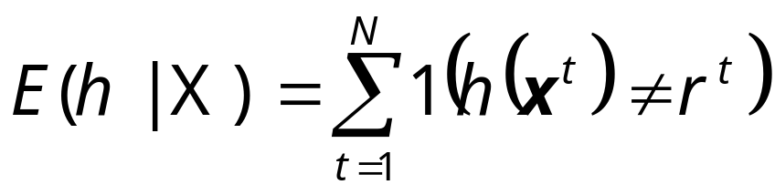
Hypothesis class H
Error of h on H
Lecture Notes for E Alpaydın 2004 Introduction to Machine Learning © The MIT Press (V1.1)

Slide 7
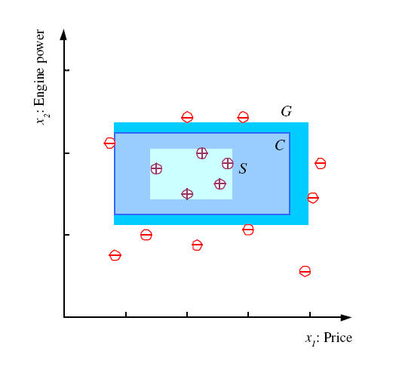
S, G, and the Version Space
most specific hypothesis, S
most general hypothesis, G
h ∈ H, between S and G is
consistent
and make up the
version space
(Mitchell, 1997)
Lecture Notes for E Alpaydın 2004 Introduction to Machine Learning © The MIT Press (V1.1)

Slide 8
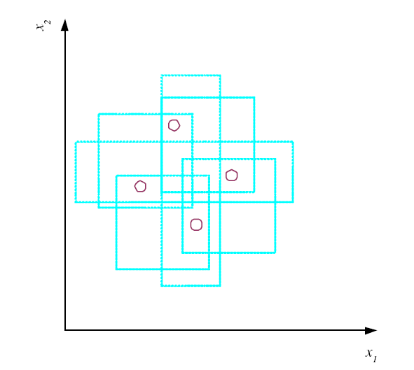
VC Dimension
N points can be labeled in 2^{N} ways as +/–
H shatters N if there
exists h ∈ H consistent
for any of these:
VC(H ) = N
An axis-aligned rectangle shatters 4 points only !
Lecture Notes for E Alpaydın 2004 Introduction to Machine Learning © The MIT Press (V1.1)

Slide 9
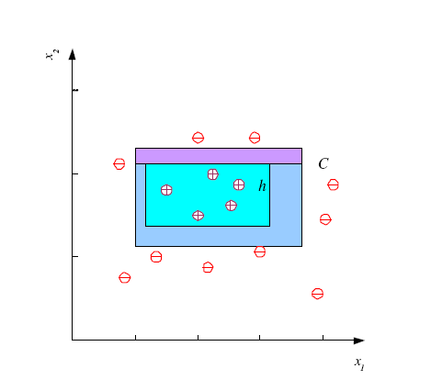
Probably Approximately Correct (PAC) Learning
How many training examples N should we have, such that with probability at least 1 ‒ δ, h has error at most ε ?
(Blumer et al., 1989)
Each strip is at most ε/4
Pr that we miss a strip 1‒ ε/4
Pr that N instances miss a strip (1 ‒ ε/4)^{N}
Pr that N instances miss 4 strips 4(1 ‒ ε/4)^{N}
4(1 ‒ ε/4)^{N} ≤ δ and (1 ‒ x)≤exp( ‒ x)
4exp(‒ εN/4) ≤ δ and N ≥ (4/ε)log(4/δ)
Lecture Notes for E Alpaydın 2004 Introduction to Machine Learning © The MIT Press (V1.1)

Slide 10
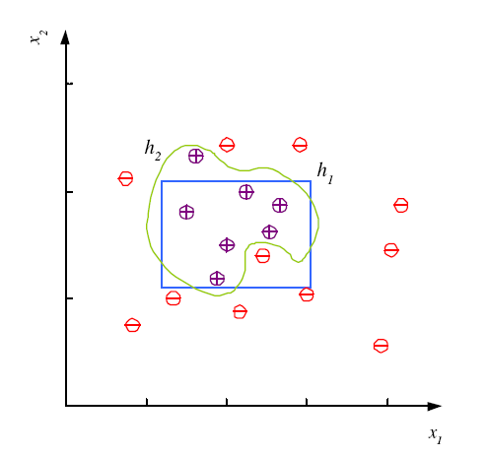
Noise and Model Complexity
Use the simpler one because
Simpler to use
(lower computational
complexity)
Easier to train (lower
space complexity)
Easier to explain
(more interpretable)
Generalizes better (lower
variance - Occam’s razor)
Lecture Notes for E Alpaydın 2004 Introduction to Machine Learning © The MIT Press (V1.1)

Slide 11
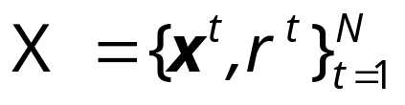
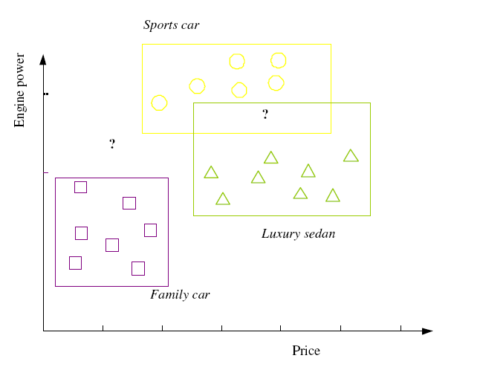
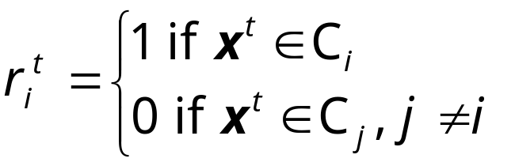

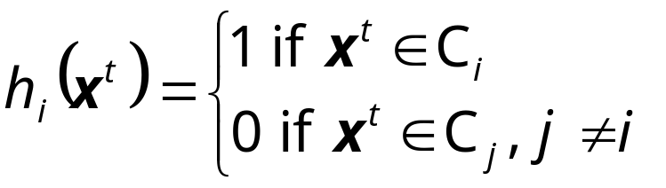
Multiple Classes, C_{i} i=1,...,K
Train hypotheses
h_{i}(x), i =1,...,K:
Lecture Notes for E Alpaydın 2004 Introduction to Machine Learning © The MIT Press (V1.1)

Slide 12
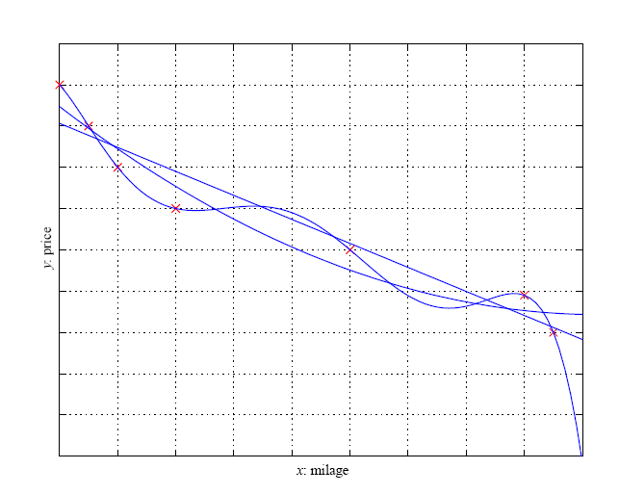
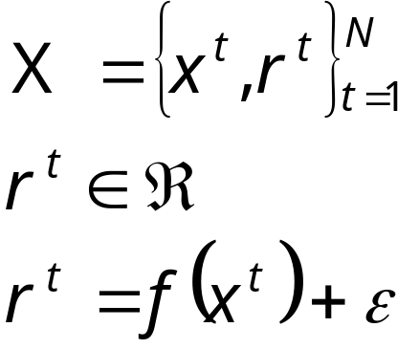
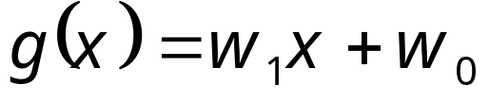
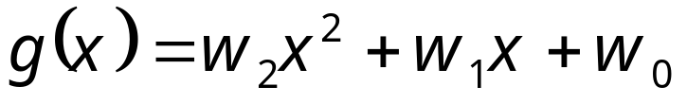
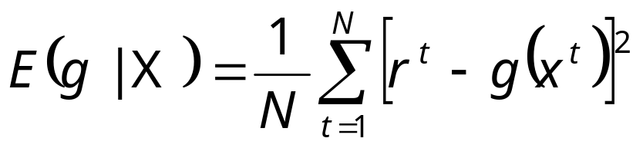
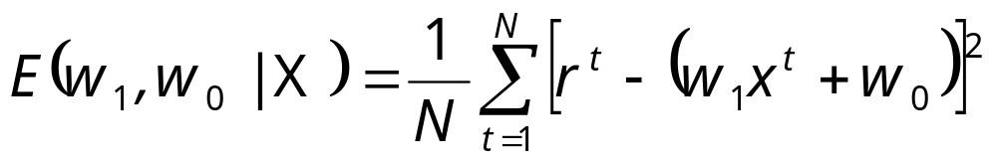
Regression
Lecture Notes for E Alpaydın 2004 Introduction to Machine Learning © The MIT Press (V1.1)

Slide 13
Model Selection & Generalization
Learning is an ill-posed problem; data is not sufficient to find a unique solution
The need for inductive bias, assumptions about H
Generalization: How well a model performs on new data
Overfitting: H more complex than C or f
Underfitting: H less complex than C or f
Lecture Notes for E Alpaydın 2004 Introduction to Machine Learning © The MIT Press (V1.1)

Slide 14
Triple Trade-Off
There is a trade-off between three factors (Dietterich, 2003):
  Complexity of H, c (H),
  Training set size, N,
  Generalization error, E, on new data
As N↑, E↓
As c (H)↑, first E↓ and then E↑
Lecture Notes for E Alpaydın 2004 Introduction to Machine Learning © The MIT Press (V1.1)

Slide 15
Cross-Validation
To estimate generalization error, we need data unseen during training. We split the data as
  Training set (50%)
  Validation set (25%)
  Test (publication) set (25%)
Resampling when there is few data
Lecture Notes for E Alpaydın 2004 Introduction to Machine Learning © The MIT Press (V1.1)

Slide 16

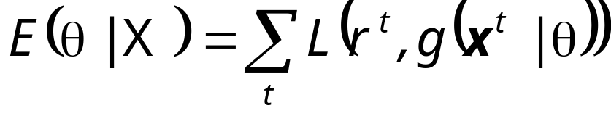
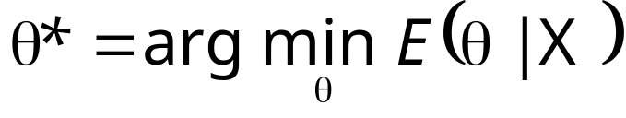
Dimensions of a Supervised Learner
Model :
Loss function:
Optimization procedure:

Lecture Notes for E Alpaydın 2004 Introduction to Machine Learning © The MIT Press (V1.1)

