Slide 1
DBMS
Data Models and Schema

Slide 2
Data Models
How logical structure of DB is modelled
Fundamental entities to introduce Abstraction in System
How data is connected to each other, and how they are processed & stores.
Most data models also include a set of basic operations
  Insert, Delete, Modify
Also province Dynamic Aspect or behaviour
  User defined operation
“Collection of concepts that can be used to describe the structure of database – provide means to achieve abstraction”
Structure – Data type, Relation, constraints

Slide 3
Catogories of Data Model
Many data models have been proposed, which we can categorize according to the types of concepts they use to describe the database structure.
High-level or conceptual data models
  Provide concepts similar to user perceive data
Low-level or physical data models
  Provide concepts how data is stored
Representational (or implementation) data models
  Provide concepts in between High level & low level
  Understood by end user, but not too far from data storage organization.

Slide 4
High-level or conceptual data models
provide concepts that are close to the way many users perceive data
use concepts such as entities, attributes, and relationships
  An entity represents a real-world object or concept
  An attribute represents some property of interest that further describes an entity,
  A relationship among two or more entities represents an interaction among the entities

Slide 5
Low-level or physical data models
Provide concepts that describe the details of how data is stored in the computer.
Concepts provided by low-level data models are generally meant for computer specialists, not for typical end users.
Describe how data is stored in the computer by representing information such as record formats, record orderings, and access paths.
An access path is a structure that makes the search for particular database records efficient.

Slide 6
Representational (or implementation) data models
Which provide concepts that may be understood by end users but that are not too far removed from the way data is organized within the computer.
It hides some details of data storage but can be implemented on a computer system in a direct way.
used most frequently in traditional commercial DBMSs, and they include the widely-used relational data model
  SQL Standard
the network and hierarchical models sometimes called record-based data models

Slide 7
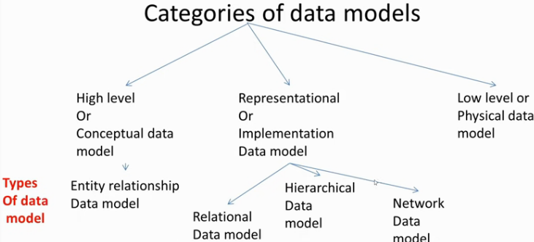

Slide 8
Relational Data model
data is organized in two-dimensional tables and the relationship is maintained by storing a common field.
This model was introduced by E.F Codd in 1970, and since then it has been the most widely used database model, infact, we can say the only database model used around the world.
The basic structure of data in the relational model is tables. All the information related to a particular type is stored in rows of that table.

Slide 9
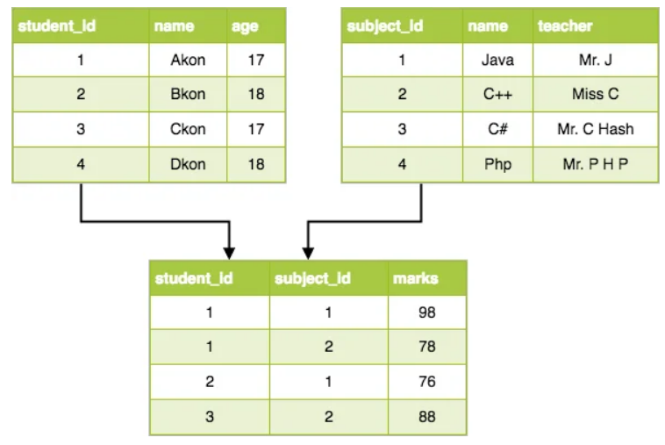
Relational

Slide 10
Hierarchical Data model
This database model organizes data into a tree-like-structure, with a single root, to which all the other data is linked. The hierarchy starts from the Root data, and expands like a tree, adding child nodes to the parent nodes..
one one-to-many relationship between two different types of data, for example, one department can have many courses, many professors and of-course many students.

Slide 11
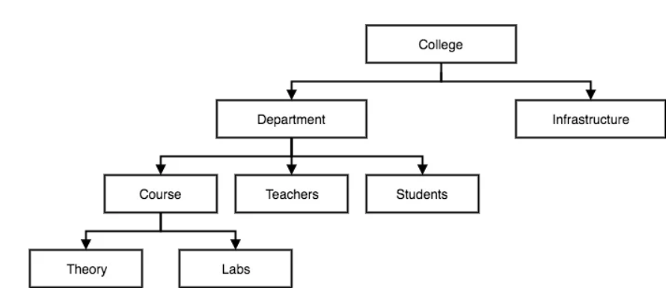
Hierarchical

Slide 12
Network Data model
This is an extension of the Hierarchical model. In this model data is organized more like a graph, and are allowed to have more than one parent node
This is an extension of the Hierarchical model. In this model data is organised more like a graph, and are allowed to have more than one parent node
was the most widely used database model, before Relational Model was introduced

Slide 13
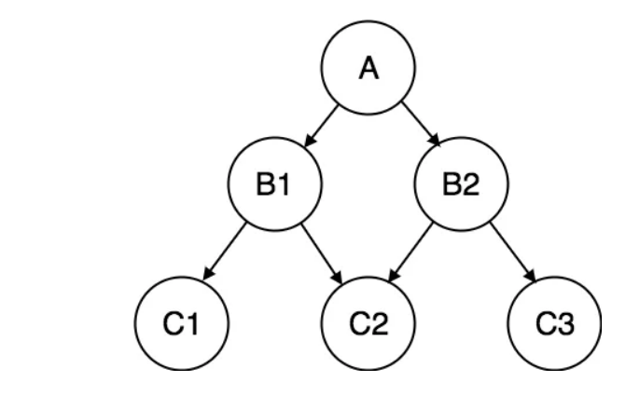
Network

Slide 14
Entity-Relationship Model
In this database model, relationships are created by dividing object of interest into entity and its characteristics into attributes.
Different entities are related using relationships.
This model is good to design a database, which can then be turned into tables in relational model
School Database, then Student will be an entity with attributes name, age, address.
As Address is generally complex, it can be another entity with attributes street name, pincode, city etc, and there will be a relationship between them

Slide 15
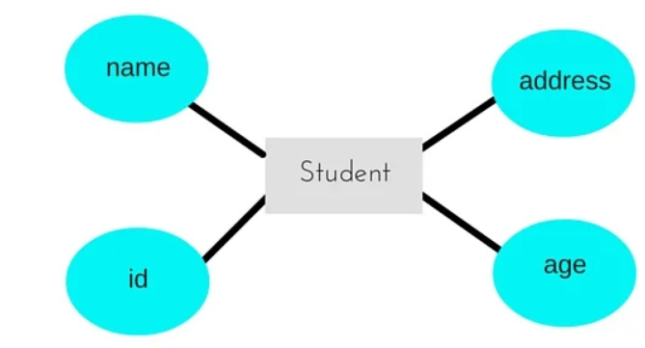
Entity Relationship

Slide 16
Object Oriented Data Model
New family of Higher level data model
Close to higher level / Conceptual data model
Proposed by Object Data Model Group (ODMG)
both the data and relationship are present in a single structure known as an object.
Objects are connected through Link
Link relate one object to other object

Slide 17
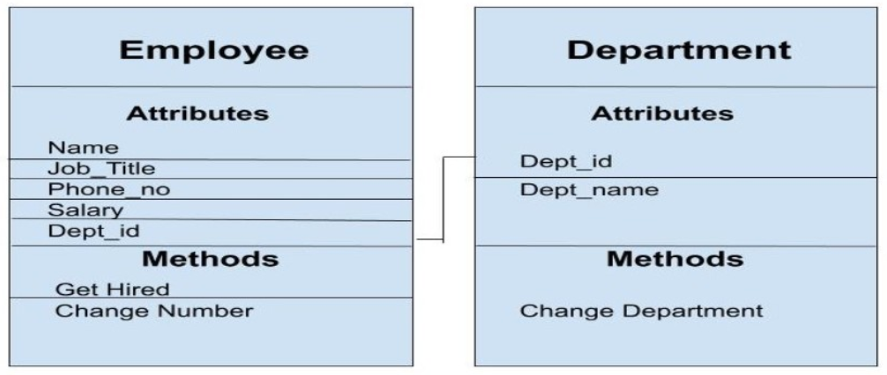
Object Oriented Data Model

Slide 18
Scheme, Instances, State
Schema- Description of the database
  Specified during DB Design
  Schema is not changed frequently
  Can represent in Schema diagram
  Schema construct : Each object in diagram
  “A database schema is the skeleton structure that represents the logical view of the entire database. It defines how the data is organized and how the relations among them are associated”

Slide 19
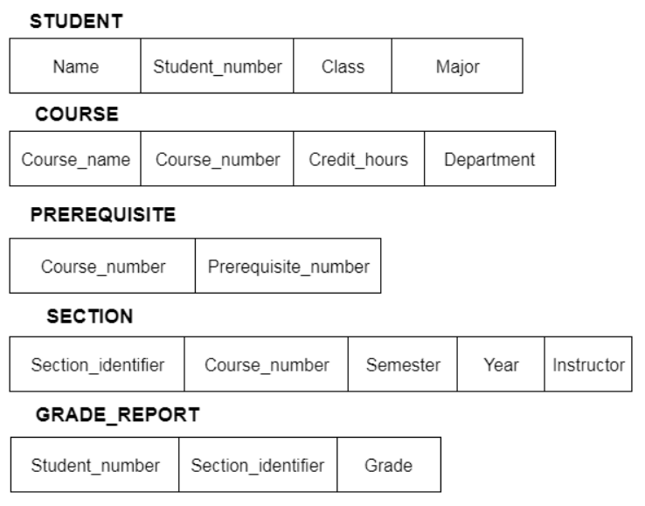
Scheme, Instances, State

Slide 20
Instances, State
Actual data is expected to change frequently
State – Data in a database at a particular moment
  Its also called Snapshot, Instance, or Current set of occurrences
  Each schema construct has its own state
  Empty state – when define a database, that is when specify schema
  Initial state – when database is first populated/loaded with initial data.
  Current state – state at any instance after initial state is reached.
  Valid state – state that satisfies exact structure and constraints as specified by schema

Slide 21
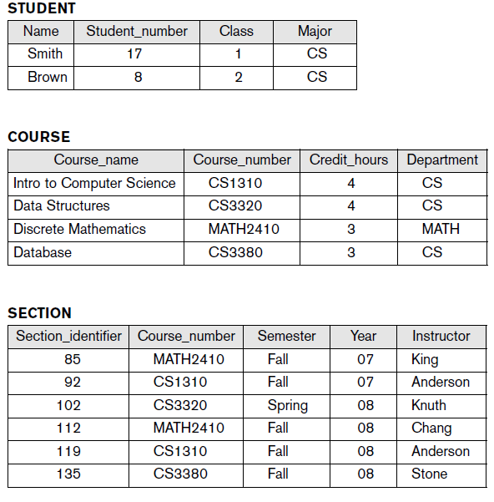
Instances, State

Slide 22
Schema, State
Schema evolution-
  Schema is not supposed to change frequently.
  But if requirement changes, schema will be modified
  Another term for schema is – extension
  Another term for State is - intension

Slide 23
Three Schema Architecture and
Data Independence

Slide 24
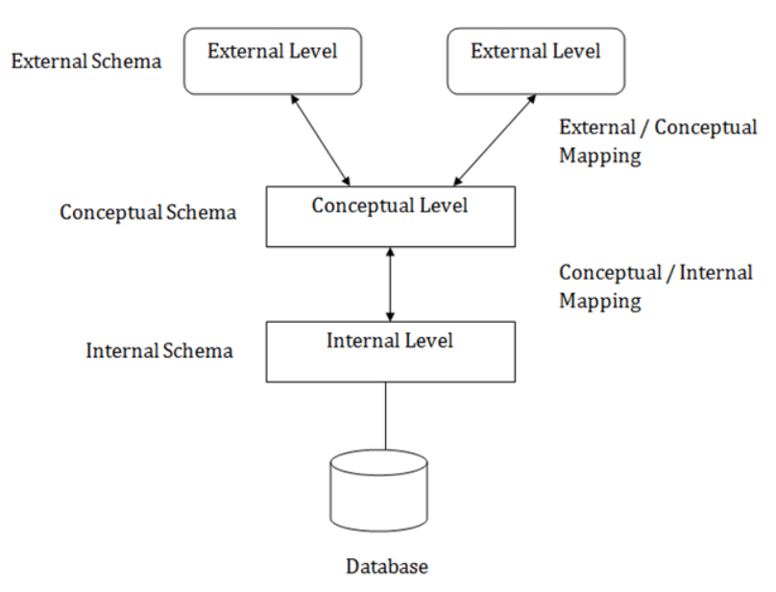
Three-schema architecture

Slide 25
Three Schema
The three schema architecture is also called ANSI/SPARC architecture or three-level architecture.
User can visualize Schema levels in a databse
The three schema architecture is also used to separate the user applications and physical database.
The three schema architecture contains three-levels. It breaks the database down into three different categories.
Mapping is used to transform the request and response between various database levels of architecture
In External / Conceptual mapping, it is necessary to transform the request from external level to conceptual schema.
In Conceptual / Internal mapping, DBMS transform the request from the conceptual to internal level.

Slide 26
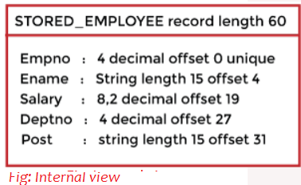
Internal Schema / Level
The internal schema is the lowest level of data abstraction
Describe physical storage structure of database
It contains multiple occurrences of multiple types of internal record/stored record
Use a physical data model
  Describe compete details of data storage & access path
  Define how data is stored in a block
Concerned with below tasks
  Storage space allocation, B-tree, hashing
  Access path, Specification of primary and secondary keys, indexes, pointers and sequencing,
  Data compression & encryption

Slide 27
Conceptual Schema / Level
The conceptual schema describes the design of a database at the conceptual level. Conceptual level is also known as logical level.
Describes the structure of the whole database for a community of users.
The conceptual schema hides the details of physical storage structures and concentrates on
The conceptual level describes what data are to be stored in the database and also describes what relationship exists among those data.
A high-level data model or an implementation data model can be used at this level.
Programmers and database administrators work at this level.

Slide 28
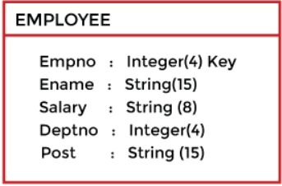
Conceptual Schema / Level
Hide details of physical storage.
Focus on describing entities, data types, relations, and constraints.
Only one instance

Slide 29
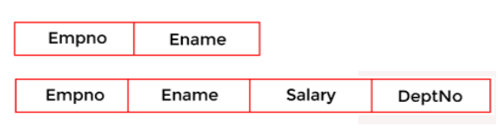
External Schema / User View
The external or view level includes a number of external schemas or user views, some times call sub-schema, or view- schema
The view-schema is used to describe the different view of the database
Each view schema describes the database part that a particular user group is interested and hides the remaining database from that user group.
A high-level data model can be used at this level.

Slide 30
Mapping between Views
Mapping
  DBMS must transform a request on an external schema into a request against conceptual schema and then to a request on the internal schema for processing over a stored database
  If request is database retrieval, The data from storage must be reformatted in the reverse order
Two types of mapping in the database architecture
  Conceptual/ Internal Mapping
    Its role is to define the correspondence between the records and fields of the conceptual level and files and data structures of the internal level.
  External / Conceptual Mapping
    define the correspondence between a particular external and the conceptual view.
    Tells the DBMS which objects on the conceptual level correspond to the objects requested on a particular user’s external view
    If changes are made to either an external view or conceptual view, then mapping must be changed accordingly

Slide 31
Data Independence
main purpose of the three levels of data abstraction is to achieve data independence
The capacity to change the schema at one level of a database system without having to change the schema at the next higher level.
the changes in one level should not affect the data at other levels of the database
Only mapping changes, schema of layers remain unchanged.
Types
  Physical Data Independence
  Logical Data Independence

Slide 32
Data Independence
Physical Data Independence.
  changing the physical level without affecting the logical level or conceptual level
  After changing, if data remain same, no logical schema change needed
Example
  A new storage device like magnetic tape, hard disk, etc.
  A new data structure for storage.
  A different data access method
  Changing the location of the database.

Slide 33
Data Independence
Logical Data Independence.
  capacity to change the conceptual schema without having to change external schemas or application programs.
  Harder to achieve
    Can have structural and constraint changes.
Example
  Adding, deleting, or updating any new attribute, entity or relationship in the database.
“Codd’s Rule of Logical Data Independence says that users should be able to manipulate the Logical View of data without any information of its physical storage.”

