Slide 1
DATABASE
MANAGEMENT SYSTEMS

Slide 2
OUTLINE
Types of Databases and Database Applications
Basic Definitions
Typical DBMS Functionality
Example of a Database (UNIVERSITY)
Main Characteristics of the Database Approach
Types of Database Users
Advantages of Using the Database Approach
Slide 1- <number>

Slide 3
Basic Definitions
Data: Known facts that can be recorded and have an implicit meaning.
Database: : a highly organized, interrelated, and structured set of data about a particular enterprise
Controlled by a database management system (DBMS).
Database Management System (DBMS):
A collection of programs that enables users to create and maintain a database.
Database System: The DBMS software together with the data itself. Sometimes, the applications are also included.

Slide 4
1.2 Database Management System
“A database management system (DBMS) is a computerized system that enables users to create and maintain a database. The DBMS is a general-purpose software system that facilitates the processes of defining, constructing, manipulating, and sharing databases among various users and applications”.

Slide 5
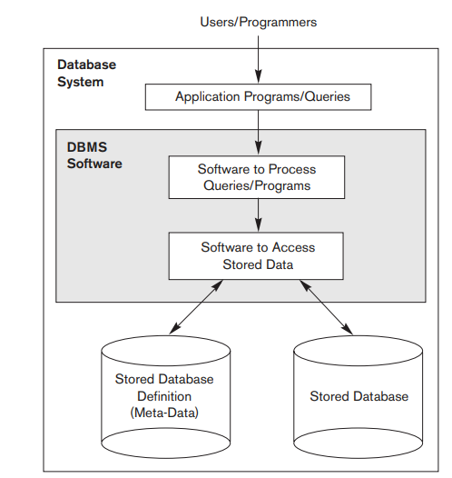
1.3 Simple Database System Environment
Application program accesses the database by sending queries or requests for data to the DBMS
Key Features
System protection against hardware or software malfunction and security protection against unauthorized or malicious access.
Must be able to maintain the database system by allowing the system to evolve as requirements change over time.

Slide 6
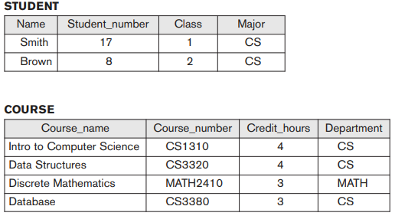
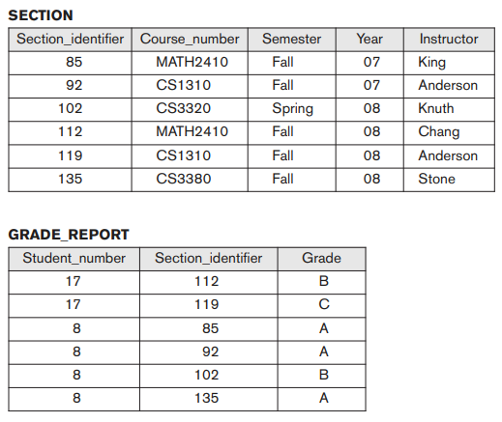
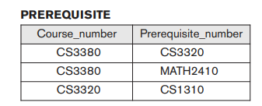
1.4 Example-University DB

Slide 7
1.5 Examples for DB Manipulation
Retrieve the transcript—a list of all courses and grades of ‘Smith’
List the names of students who took the section of the ‘Database’ course offered in fall 2008 and their grades in that section
List the prerequisites of the ‘Database’ course

Slide 8
1.5 Examples for DB Updation
Change the class of ‘Smith’ to sophomore
Create a new section for the ‘Database’ course for this semester
Enter a grade of ‘A’ for ‘Smith’ in the ‘Database’ section of last semester

Slide 9
Types of Databases and Database Applications
Traditional applications:
  Numeric and textual databases
More recent applications:
  Multimedia databases
  Geographic Information Systems (GIS)
  Biological and genome databases
  Data warehouses
  Mobile databases
  Real-time and active databases
Slide 1- <number>

Slide 10
Recent Developments (1)
Social Networks started capturing a lot of information about people and about communications among people-posts, tweets, photos, videos in systems such as:
  - Facebook
  - Twitter
  Linked-In
  New technologies are emerging like BigData, No SQL to manage vast amounts of data generated on the web
Slide 1- <number>

Slide 11
Typical DBMS Functionality
Define a database : in terms of data types, structures and constraints
Construct or Load the Database on a secondary storage medium
Manipulating the database : querying, generating reports, insertions, deletions and modifications to its content
Concurrent Processing and Sharing by a set of users and programs – yet, keeping all data valid and consistent

Slide 12
Example of a Database
(with a Conceptual Data Model)
Some mini-world relationships:
  SECTIONs are of specific COURSEs
  STUDENTs take SECTIONs
  COURSEs have prerequisite COURSEs
  INSTRUCTORs teach SECTIONs
  COURSEs are offered by DEPARTMENTs
  STUDENTs major in DEPARTMENTs
Note: The above entities and relationships are typically expressed in a conceptual data model, such as the entity-relationship (ER) data or UML class model (see Chapters 3, 4)
Slide 1- <number>

Slide 13

Example of a Simple Database
Slide 1- <number>

Slide 14
Characteristics of Database Approach
Reading Material - Click Here

Slide 15
Main Characteristics of the Database Approach
Self-describing nature of a database system:
  A DBMS catalog stores the description of a particular database (e.g. data structures, types, and constraints)
  The description is called meta-data*.(fig 1.3)
  This allows the DBMS software to work with different database applications.
Insulation between programs and data:
  Called program-data independence.
  Allows changing data structures and storage organization without having to change the DBMS access programs
Slide 1- <number>

Slide 16

Example of a Simplified Database Catalog
Slide 1- <number>

Slide 17
Main Characteristics of the Database Approach (continued)
Data abstraction:
  A data model is used to hide storage details and present the users with a conceptual view of the database.
  Programs refer to the data model constructs rather than data storage details
Slide 1- <number>

Slide 18
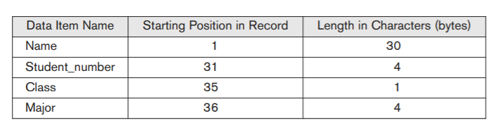
Data Abstraction
Database user is not concerned with the location of each data item within a record or its length; rather, the user is concerned that when a reference is made to Name of STUDENT, the correct value is returned

Slide 19
Multiple Views
Each user may require a different perspective or view of the database.
A view may be a subset of the database or it may contain virtual data that is derived from the database files but is not explicitly stored.

Slide 20
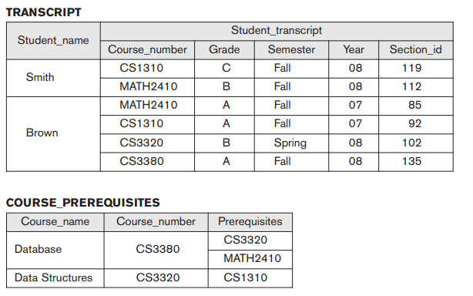
Multiple Views

Slide 21
Main Characteristics of the Database Approach (continued)
Sharing of data and multi-user transaction processing:
  Allowing a set of concurrent users to retrieve from and to update the database.
  Concurrency control within the DBMS guarantees that each transaction is correctly executed or aborted
  Recovery subsystem ensures each completed transaction has its effect permanently recorded in the database
  OLTP (Online Transaction Processing) is a major part of database applications; allows hundreds of concurrent transactions to execute per second.
Slide 1- <number>

Slide 22
Database Users
Users may be divided into those who actually use and control the content (called “Actors on the Scene”) and those who enable the database to be developed and the DBMS software to be designed and implemented (called “Workers Behind the Scene”).

Slide 23
3. Actors on the Scene!
Database Administrator
Database Designers

Slide 24
3. Actors on the Scene!
Database Administrator
Database Designers
Responsible for authorizing access to the database.
Coordinates & monitors its use.
Acquire software & Hardware resources when required.
Accountable for Security Breach, poor response time etc.

Slide 25
3. Actors on the Scene!
Database Administrator
Database Designers
Identifies the data to be stored in the database.
Choose appropriate structure to store this data.
Communicates with end users to create the proper database design.

Slide 26
3. Actors on the Scene!
Casual
Naive
End Users
Sophisticated
Stand-Alone

Slide 27
3. Actors on the Scene!
Casual
Occasionally Uses the DB.
They may need different information each time.
Use a sophisticated database query interface to specify their requests
Naive
End Users
Sophisticated
Stand-Alone

Slide 28
3. Actors on the Scene!
Casual
They constantly query and update the database, using standard types of queries and updates called canned transactions
Naive
End Users
Sophisticated
Clerical Staff in a Bank, Reservation Agents, Social Media Users etc.
Stand-Alone

Slide 29
3. Actors on the Scene!
Casual
Are familiarized with the facilities of the DBMS in order to implement their own applications to meet their complex requirements.
Naive
End Users
Sophisticated
Stand-Alone

Slide 30
3. Actors on the Scene!
Casual
Maintain personal databases by using ready-made program packages that shall provide easy-to-use menu-based or graphics-based interfaces.
Naive
End Users
Sophisticated
Stand-Alone

Slide 31
3. Workers Behind the Scene!
DBMS System Designers & Implementers
Tool Developers
Operators & Maintenance Personnel

Slide 32
3. Workers Behind the Scene!
DBMS System Designers & Implementers
Design and implement the DBMS modules and interfaces as a software package.
Handles the Different Modules - Design , Implementation
Ensures interfacing with OS and various programming languages.

Slide 33
3. Workers Behind the Scene!
Tool Developers
Tools - optional packages that are often purchased separately. Includes packages for database design, performance monitoring, natural language or graphical interfaces, prototyping, simulation, and test data generation.
Tool Developers design & implement the tools.

Slide 34
3. Workers Behind the Scene!
Operators & Maintenance Personnel
Responsible for the actual running and maintenance of the hardware and software environment for the database system.

Slide 35
Advantages of DBMS Approach
Providing Storage Structures and Search Techniques for Efficient Query Processing
Controlling Redundancy
Restricting Unauthorized Access
Providing Backup and Recovery
Providing Persistent Storage for Program Objects
Enforcing Integrity Constraints

Slide 36
Advantages of DBMS Approach
Permitting Inferencing and Actions Using Rules and Triggers
Additional Implications of Using the Database Approach This section discusses a few additional impl
Providing Multiple User Interfaces
Representing Complex Relationships among Data

Slide 37
Structured, Semi Structured and Unstructured Data
Three characterizations:
  Structured Data
  Semi-Structured Data
  Unstructured Data
Structured Data:
  Information stored in databases is known as structured data because it is represented in a strict format.
  The DBMS then checks to ensure that all data follows the structures and constraints specified in the schema.
Slide 27- <number>

Slide 38
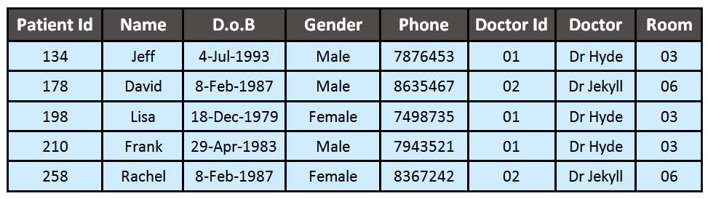
Structured Data- Example
Source: Google

Slide 39
Structured, Semi Structured and Unstructured Data (contd.)
Semi-Structured Data:
  In some applications, data is collected in an ad-hoc manner before it is known how it will be stored and managed.
  This data may have a certain structure, but not all the information collected will have identical structure. This type of data is known as semi-structured data.
  In semi-structured data, the schema information is mixed in with the data values, since each data object can have different attributes that are not known in advance. Hence, this type of data is sometimes referred to as self-describing data.
  A typical example would be a text document that contains information embedded within It. Example: HTML, XML
Slide 27- <number>

Slide 40
Structured, Semi Structured and Unstructured Data (contd.)
Semi-structured data may be
displayed as a directed graph...
  The labels or tags on the directed edges represent the schema names—the names of attributes, object types (or entity types or classes), and relationships.
  The internal nodes represent individual objects or composite attributes.
  The leaf nodes represent actual data values of simple (atomic) attributes.
Slide 27- <number>

Slide 41
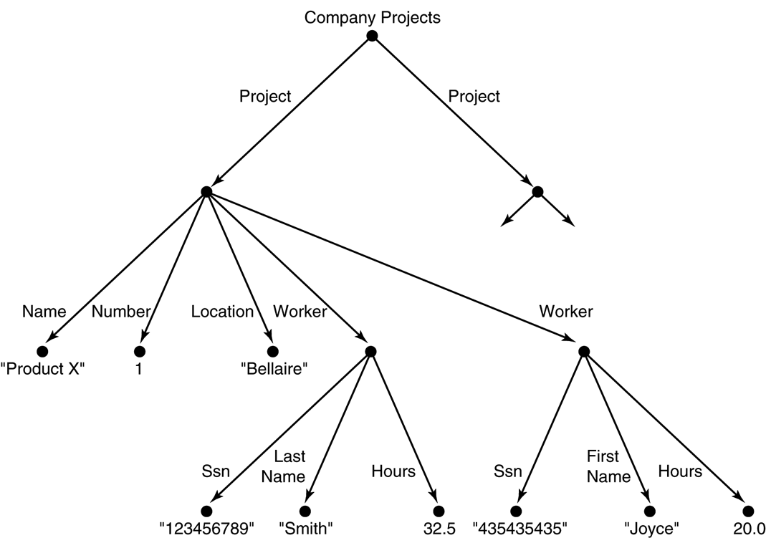
FIGURE 27.1 Representing semistructured data as a graph.
Slide 27- <number>

Slide 42
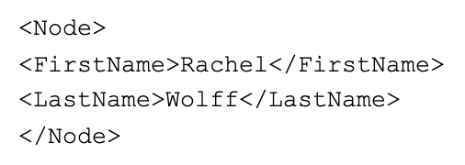
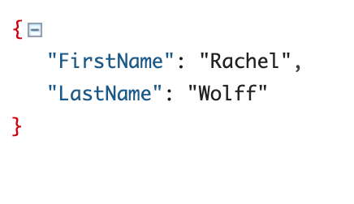
Semi structured Data

Slide 43
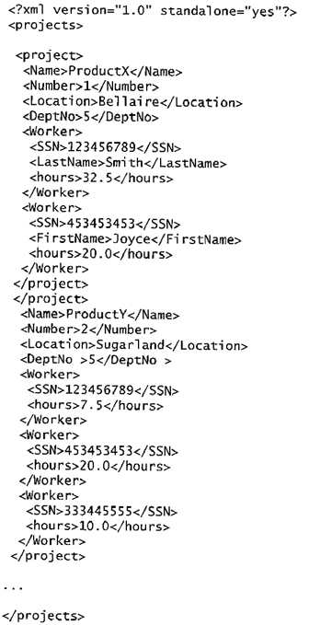
FIGURE 27.3
A complex XML element called <projects>
[no need to study the code]
Slide 27- <number>

Slide 44
Structured, Semi Structured and Unstructured Data (contd.)
Unstructured Data:
  A third category is known as unstructured data, because there is very limited indication of the type of data.
  Just think of all the text, chat, video and audio content that is generated every day around the world!
  Unstructured data is typically easy to consume for humans (e.g. images, videos and PDF-documents). But due to the lack of organization in the data, it is less machine-readable.
Slide 27- <number>

Slide 45

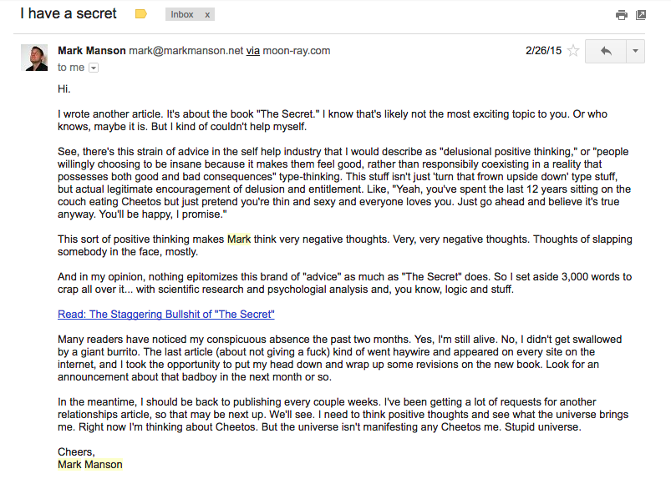
Unstructured Data
Source : Google

Slide 46
Three-Schema Architecture
Proposed to support DBMS characteristics of:
  Program-data independence.
  Support of multiple views of the data.

Slide 47
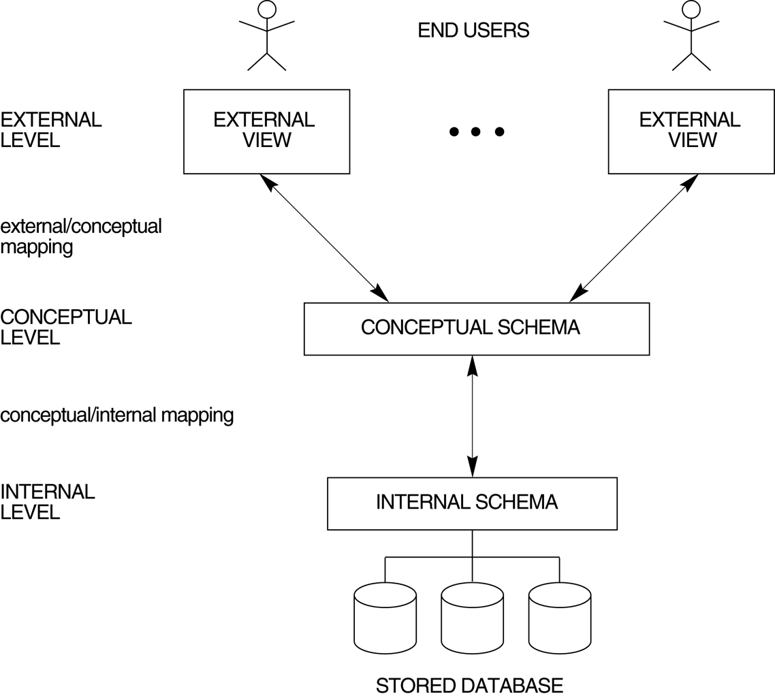
The three-schema architecture.

Slide 48
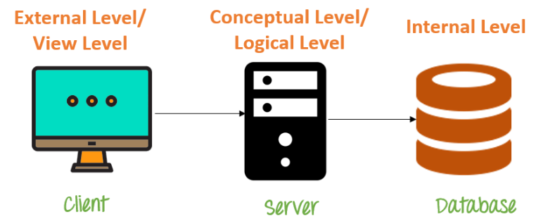

Slide 49
Three-Schema Architecture
Defines DBMS schemas at three levels:
  Internal schema at the internal level to describe physical storage structures and access paths. Typically uses a physical data model.
  Conceptual schema at the conceptual level to describe the structure and constraints for the whole database for a community of users. Uses a conceptual or an implementation data model.
  External schemas at the external level to describe the various user views. Usually uses the same data model as the conceptual level.
Notes:
Conceptual example: STUDENT database contains STUDENT and COURSE tables which will be visible to users but unaware abt their storage
External- specifies a view of the data in terms of conceptual level tables eg.STUDENTS are interested in looking details related to academics, accounts, courses etc.

Slide 50
Three-Schema Architecture
The process of transforming requests and results between schema levels are called Mappings.
Programs refer to an external schema, and are mapped by the DBMS to the internal schema for execution.

Slide 51
Data Independence
The capacity to change the schema at one level of a database system without having to change the schema at the next higher level.

Slide 52
Data Independence
Logical Data Independence: The capacity to change the conceptual schema without having to change the external schemas and their application programs.(eg: Merging two records into one)
Physical Data Independence: The capacity to change the internal schema without having to change the conceptual schema.( eg Using a new storage device like Hard Drive , Switching to different data structures)

Slide 53
DBMS Component Modules
A DBMS is a complex software system
The figure showed in next slide is divide into two halves.
The top half refers to the various users of the database system
The lower half shows the internals of the DBMS responsible for storage of data and processing of transactions

Slide 54


Slide 55
Database Architectures

Slide 56
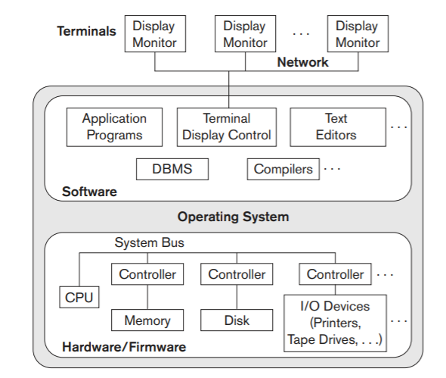
Centralized DBMS Architecture
All DBMS functionality, application program execution, and user interface processing are carried out on one machine.

Slide 57
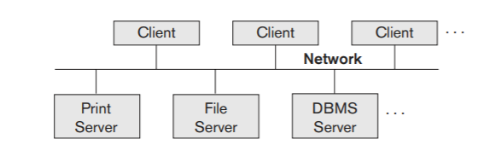
Basic Client Server Architecture
Specific Functionalities
CSA was developed to deal with computing environments in which a large number of PCs, workstations, file servers, printers, database servers, Web servers, e-mail servers, and other software and equipment are connected via a network

Slide 58
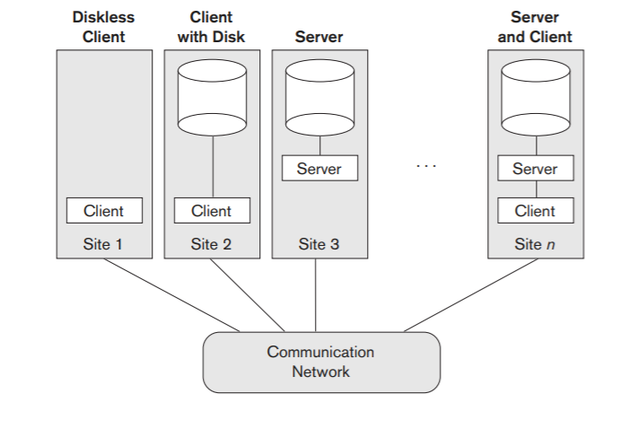
Physical 2-Tier C-S Architecture
The user interface programs and application programs run on the client side.
When DBMS access is required, the program establishes a connection to the DBMS (server side);
Query and transaction functionality related to SQL processing remains on the server side.

Slide 59
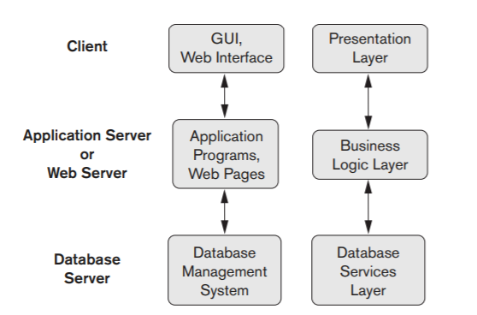
Three Tier Architecture- for Web Applications
The intermediate server accepts requests from the client, processes the request and sends database queries and commands to the database server,
Data may be processed further and filtered to be presented to the users.

Slide 60
Reading Material-Click Here

Slide 61
Database Languages
Types of
DBMS Languages
DDL
DML
DCL
TCL

Slide 62
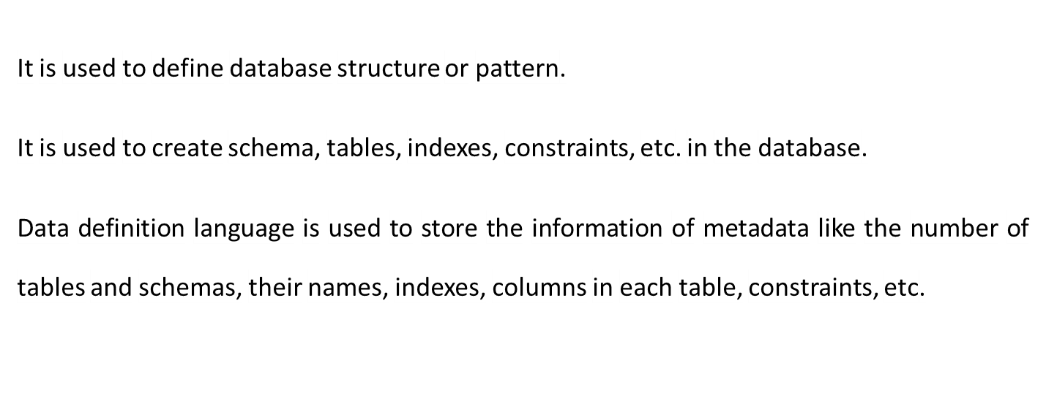
Data Definition Language(DDL)

Slide 63
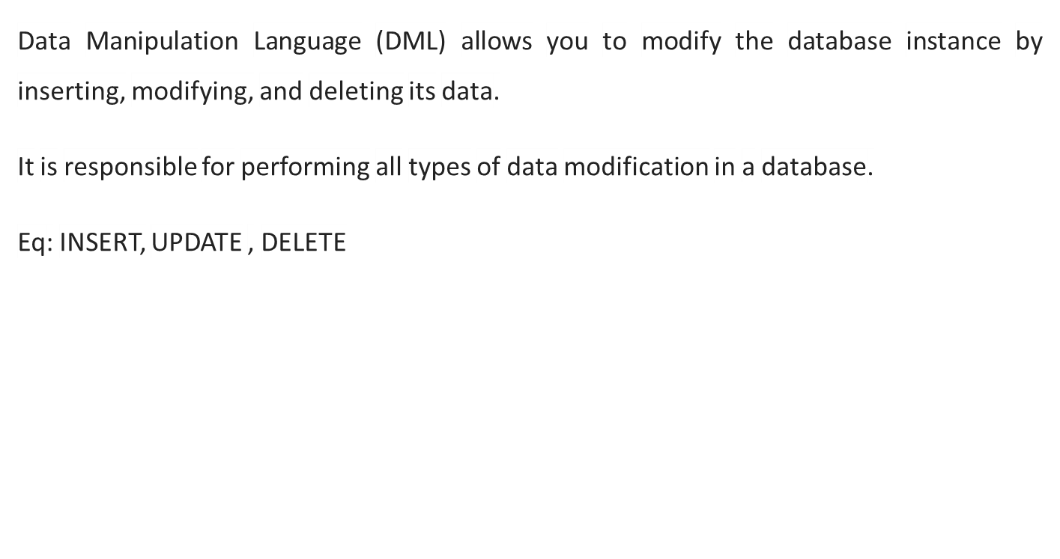
Data Manipulation Language(DML)

Slide 64
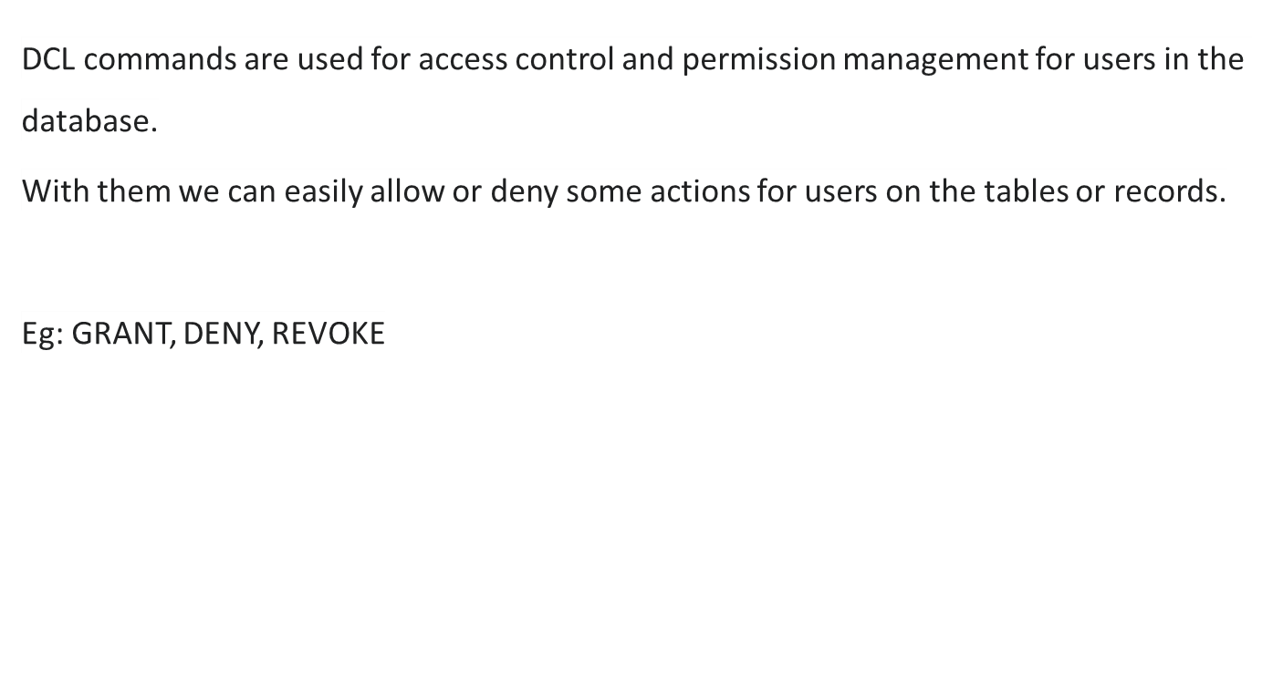
Data Control Language

Slide 65
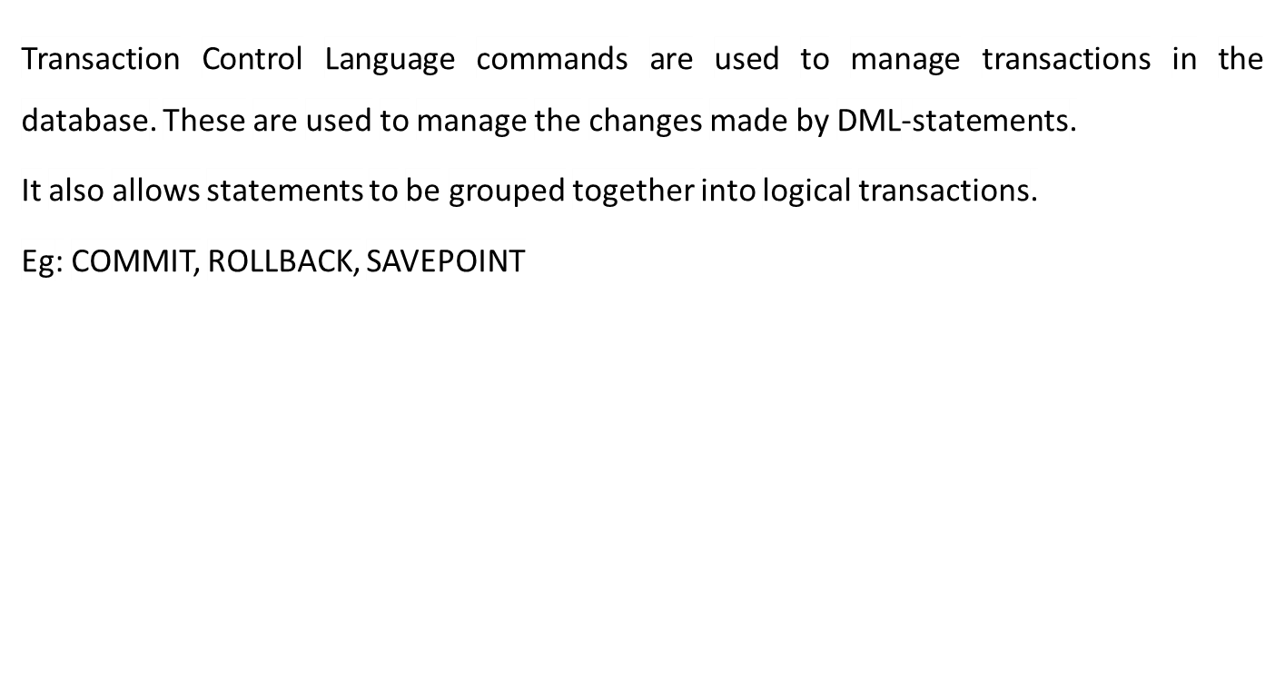
Transaction Control Language

Slide 66
STRUCTURED QUERY LANGUAGE (SQL)
• SQL is used to interact with a database to manage and retrieve data.
• The DBMS processes the SQL request, retrieves the requested data from the Database, and returns it.
• This process of requesting data from a Database and receiving back the results is called a Database Query and hence the name Structured Query Language.

Slide 67
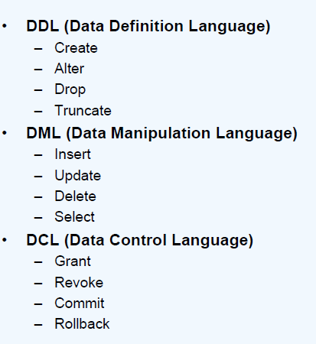
SQL STATEMENTS

Slide 68
Data Models
Data Model: A collection of concepts that can be used to describe the structure of a database.

Slide 69
Categories of data models
Conceptual (high-level, semantic) data models: Provide concepts that are close to the way many users perceive data. (Also called entity-based or object-based data models.)
Physical (low-level, internal) data models: Provide concepts that describe details of how data is stored in the computer.
Implementation (representational) data models: Provide concepts that fall between the above two, balancing user views with some computer storage details.

Slide 70
Data Models
Object Based Logical Model
Example: E-R model
Record Based Logical model
Example: Hierarchical model ,network model, relational model

Slide 71
Entity Relationship Model(E-R model)
Entity Relationship Model (ER Modeling) is a graphical approach to database design. Popular high level conceptual model
Basic object in the ER model is an entity
Entity means which is a thing or object in the real world with an independent existence
Eg: employee , car, person etc.
Attributes : are properties used to describe an entity.
Eg: employee entity may be described by the employees name, address,age, salary.

Slide 72
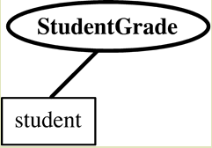
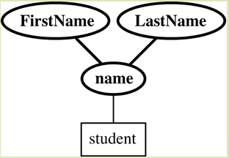
Types of attributes
Simple or atomic attributes
attributes that are not divisible are called simple or atomic.
Eg: studentgrade, id
Composite attributes
can be divided into smaller subparts, which represents more basic attributes with independent meanings.
Eg: name(address( firstname,lastname)

Slide 73
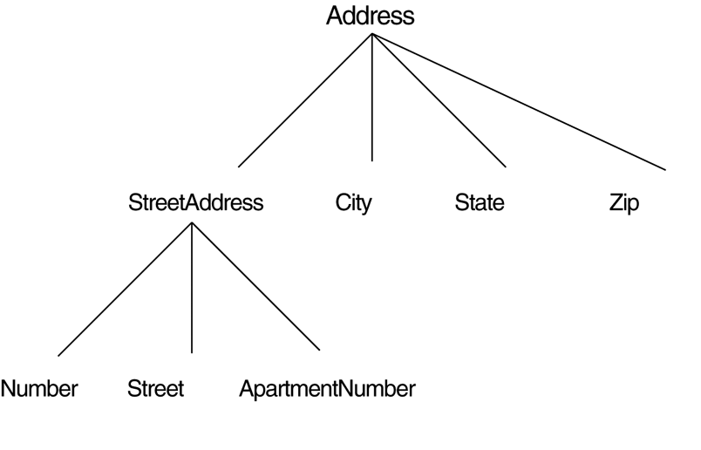
Composition may form a hierarchy where some components are themselves composite.

Slide 74
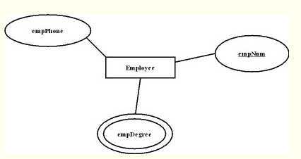
Single-valued attribute
Multivalued attributes
Attributes that have a single value for a particular entity
Eg: empNum(ellipse)
An attribute can have a set of values for the same entity.(double ellipse)
Eg: empDegree

Slide 75
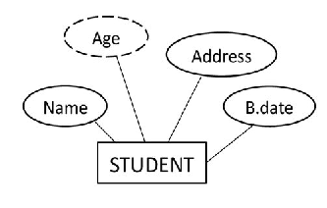
Stored versus derived attribute
In some cases two (or more )attributes values are related.
Eg: age and birth date
Here age : derived attribute
Birth date(B.date): stored attribute

Slide 76
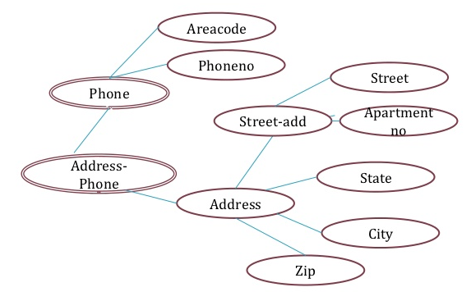
Complex attribute
Combination of composite and multivalued attributes
Eg:
{address_phone
({phone(areacode,phno)},address(streetaddress(no,street,apt_no),city,state,zip))}

Slide 77
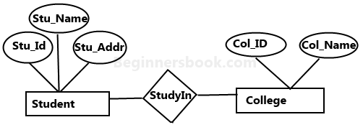
Relationship
It is a natural association that exist between one or more entities. Represented by a diamond shape
Eg: Student StudyIn college

Slide 78
Entity Types
An entity type defines a collection(or set) of entities that have the same attributes
Each entity type in the database is described by its name and attributes.
Eg: employee,company
Entity set
The collection of all entities of a particular entity type in the database at any point in time is called an entity set.

Slide 79
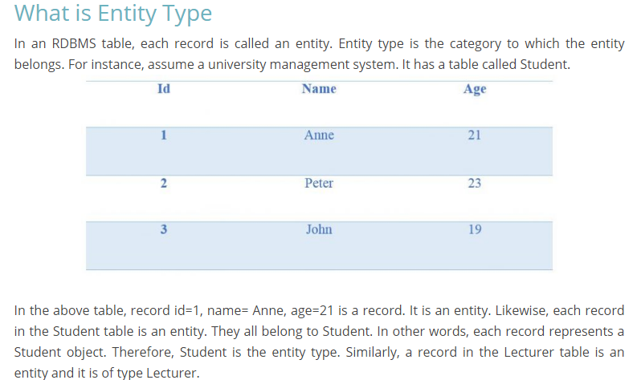
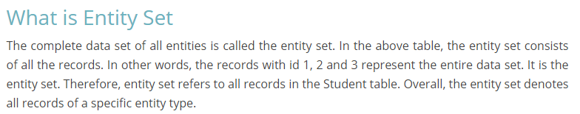

Slide 80
Key attributes of an entity
An attribute of an entity type for which each entity must have a unique value is called a key attribute of the entity type.
Eg: ssn of employee
name attribute of a company
In some cases the combination of the attribute values must be distinct for each entity.
Some entity types have more than one key attribute.
Weak entity: An entity type may have no key value .

Slide 81
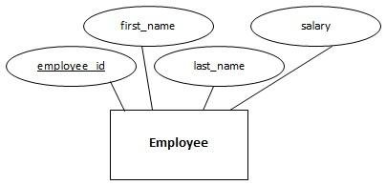
Types of Entities
Strong Entity- an entity set which has a key is called a strong entity. It is represented by rectangle
Eg: employee

Slide 82
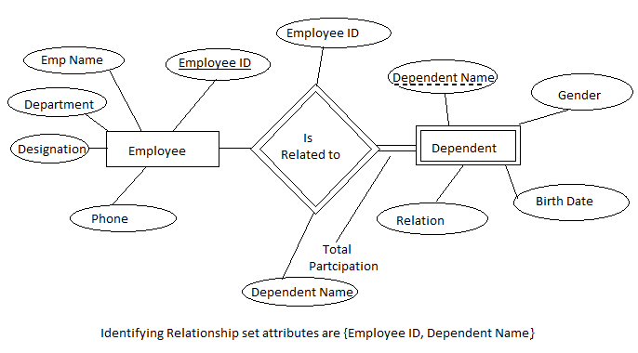
Weak Entity set- An entity set which does not have a key attribute is called a weak entity set. Here dependent is a weak entity

Slide 83
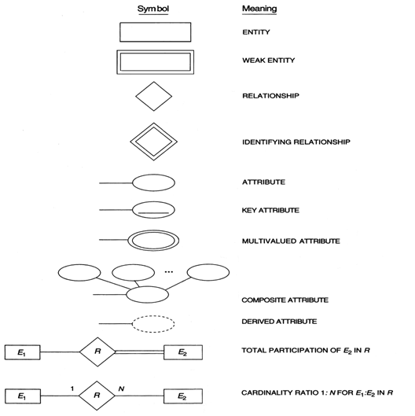

Slide 84
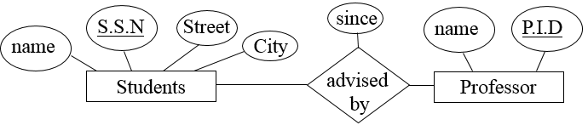
An example of 2 entities student and Professor

Slide 85
Value sets(domain of attribute)
Value set specifies the set of values that may be assigned to that attribute for each individual entity
Each simple attribute of an entity type is associated with a value set.
Eg: age attribute of employee to be the set of integers between 16 and 55

Slide 86
Cardinality of a relationship
It defines the type of relationship between two participating entities.
There are four types of cardinality relationship:
One to one (1-1)
One to many(1:M)
Many to one(M:1)
Many to many(M:N)

Slide 87








One-to-one(1-1) Relationships
: An entity in A is associated with at most one entity in B, and an entity in B is associated with at most one entity in A.
A man may be married to at most one women, and woman may be married to at most one man (both men and women can be unmarried)
since
name
name
Is
Married
to
Men
Women
Is Married to
This diagram is not a part of the ER model! It is just an intuitive picture to explain a concept

Slide 88




One-to-many
One-to-many: An entity in A is associated with any number in B. An entity in B is associated with at most one entity in A.
A women may be the mother of many (or no) children. A person may have at most one mother.
name
Born on
name
Is
Mother
of
Women's Club
Low I.Q. Club
Is mother of
Note that this example is not saying that Moe does not have a mother, since we know as a biological fact that everyone has a mother.
It is simply the case that Moes mom is not a member of the Women’s club.

Slide 89





Many-to-one
Many-to-one: An entity in A is associated with at most one entity in B. An entity in B is associated with any number in A.
Many people can be born in any county, but any individual is born in at most one country.
year
name
Capital
Was
Born
in
Bowling Club
Country
Was born in
Note that we are not saying that the Sea Captain was not born in some country, he almost certainly was, we just don’t know which country, or it is not in our Country entity set.
Also note that we are not saying that no one was born in Ireland, it is just that no one in the Bowling Club was.

Slide 90





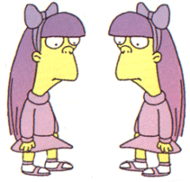

Many-to-many
Many-to-many: Entities in A and B are associated with any number from each other.
Since
name
name
Is
Classmate
of
Girls
Boys
Is Classmate of

Slide 91

Answer this

Slide 92
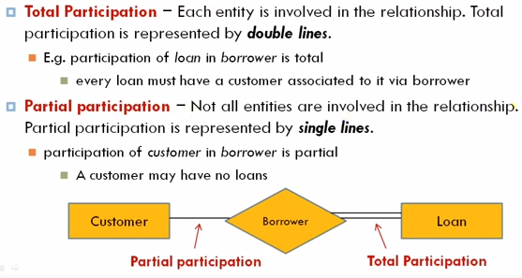
Participation Constraints

Slide 93
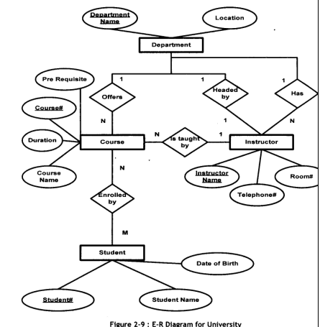

Slide 94
Here we do not expect every employee to manage a dept., so the participation of Employee in Manages relationship type is partial.
That is some or part of the set of employee entities are related to some department entities via manages.

Slide 95
ER DIAGRAM – Entity Types are:
EMPLOYEE, DEPARTMENT, PROJECT, DEPENDENT
name
number
location
fname
lname
1
minit
works for
N
department
address
salary
name
sex
1
number of
employees
startdate
1
ssn
employee
manages
controls
bdate
1
supervisor
N
hours
N
degree
supervisee
supervision
1
works on
M
project
dependents of
name
number
location
N
dependent
name
sex
birthdate
relationship
Notes:
Degree of supervision relation is 2 ie binary relationship. Here supervisor and supervisee are called “Role names”

Slide 96
Relationships of Higher Degree
Degree
The degree of a relationship is the number of entity types that participate in the relationship. The three most common relationships in ER models are Binary, Unary and Ternary
Relationship types of degree 2 are called binary
Relationship types of degree 3 are called ternary and of degree n are called n-ary
Constraints are harder to specify for higher-degree relationships (n > 2) than for binary relationships

Slide 97
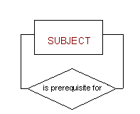

Type of relationship contin..
A unary relationship is when both participants in the relationship are the same entity.
A binary relationship is when two entities participate and is the most common relationship degree.

Slide 98
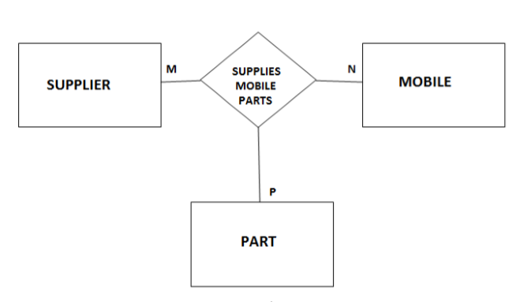
Example of ternary relationship
Fig: Mobile manufacture company.

Slide 99

Example of a ternary relationship
Slide 3- <number>

Slide 100

Another example of a ternary relationship
Slide 3- <number>

Slide 101
Enhanced ER model
Three new concepts were added to the existing ER Model, they were:
Generalization
Specialization
Aggregration
Generalization
Generalization is a bottom-up approach in which two lower level entities combine to form a higher level entity. In generalization, the higher level entity can also combine with other lower level entities to make further higher level entity
Slide 1- <number>

Slide 102
Specialization
Specialization is opposite to Generalization. It is a top-down approach in which one higher level entity can be broken down into two lower level entity.
Slide 1- <number>

Slide 103
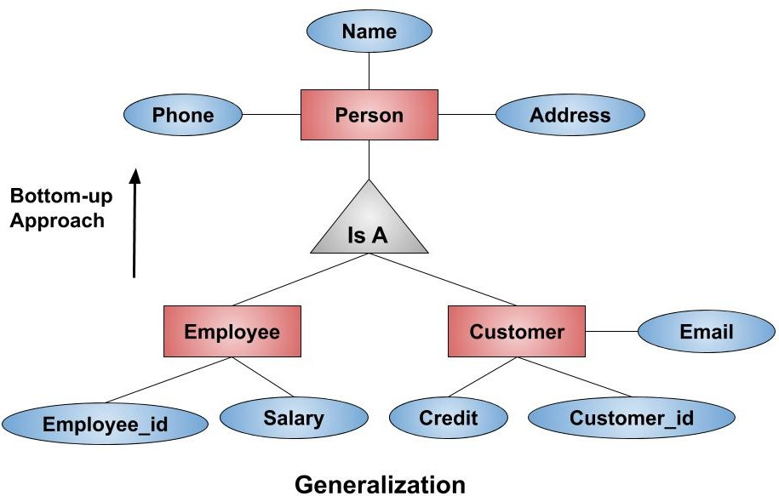

Slide 1- <number>

Slide 104
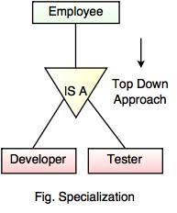
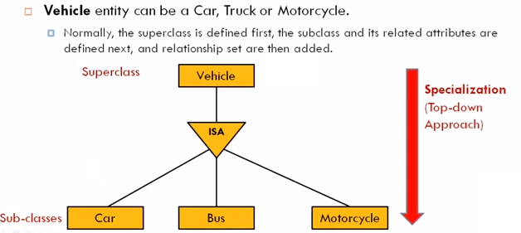
Example 1
Example 2
Slide 1- <number>

Slide 105
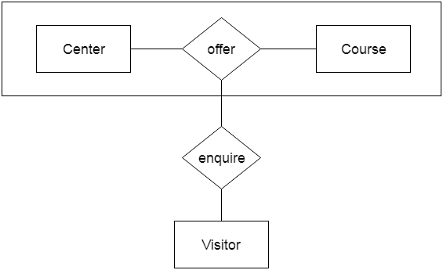
Aggregration
Aggregration is a process when relation between two entities is treated as a single entity.
Center entity offers the Course entity act as a single entity in the relationship which is in a relationship with another entity visitor
Slide 1- <number>
Notes:
Now in real world, if a Visitor or a Student visits a Coaching Center, he/she will never enquire about the center only or just about the course, rather he/she will ask enquire about both.

