Slide 1
String
StringBuffer
StringBuilder

Slide 2
Strings
Strings in Java are objects used to represent a sequence of character.
They can be either created using the String Literal or by using the NEW keyword.
Strings are immutable in Java are represented in the UTF-16 format.
When a new String is created, it looks for the String with the same value in the JVM string pool. If it finds a same value, then it returns the reference else it created a String object and places that object in the String pool.

Slide 3
Strings
String Pool
To decrease the number of String objects created in the JVM, the String class keeps a pool of strings.
Each time a string literal is created, the JVM checks the string literal pool first.
If the string already exists in the string pool, a reference to the pooled instance returns.
If the string does not exist in the pool, a new String object initializes and is placed in the pool.

Slide 4
Strings
String Pool
String str = “ASIET”
This will be added to String Pool
String str1 = “ASIET”
string already exists in the string pool, a reference to the pooled instance returns.
String str2 = new String(str1)
This will go to JVM Heap, --- not in JVM String Pool
Can explicitely set in String Pool by str.intern() call.

Slide 5
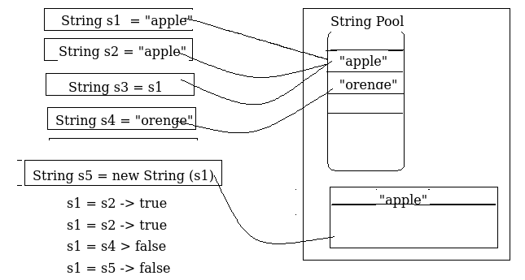
Strings

Slide 6
String
Since Strings are immutable in Java, whenever String manipulations are performed, automatically a new String would be generated by discarding the older one.
Well, to avoid garbage in heap, Java came up with StringBuffer and StringBuilder.

Slide 7
StringBuffer/ StringBuilder
StringBuffer and StringBuilder are classes used for String manipulation.
These are mutable objects, which provide methods such as substring(), insert(), append(), delete() for String manipulation.
Well, to avoid garbage in heap, Java came up with StringBuffer and StringBuilder.

Slide 8
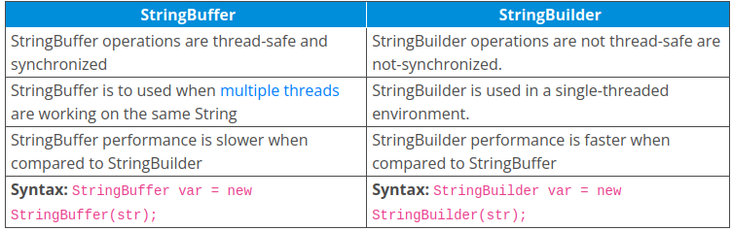
StringBuffer/ StringBuilder

Slide 9
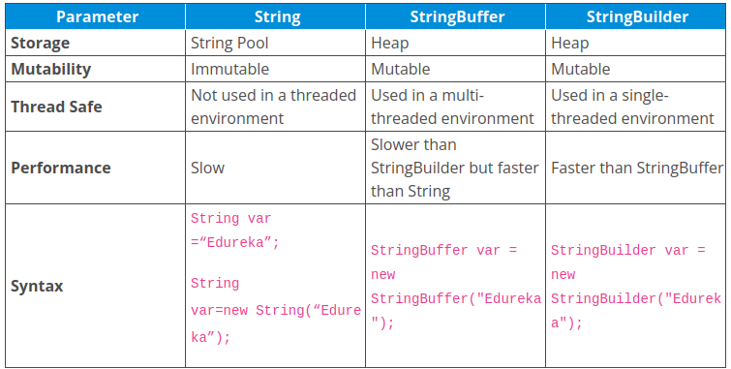
String/StringBuffer/ StringBuilder

Slide 10
HashCode

Slide 11
Hashcode()
public int hashCode()
Defined in Object class (java.lang.Object)
Returns a hash code value for the object
Same for an object till application exits
Need not be same in multiple program execution
If equal() = true, then hashcode must be same
If two objects are unequal according to equals() method, their hash code are not required to be different. Their hash code value may or may-not be equal.
“Object is the superclass of all class”

Slide 12
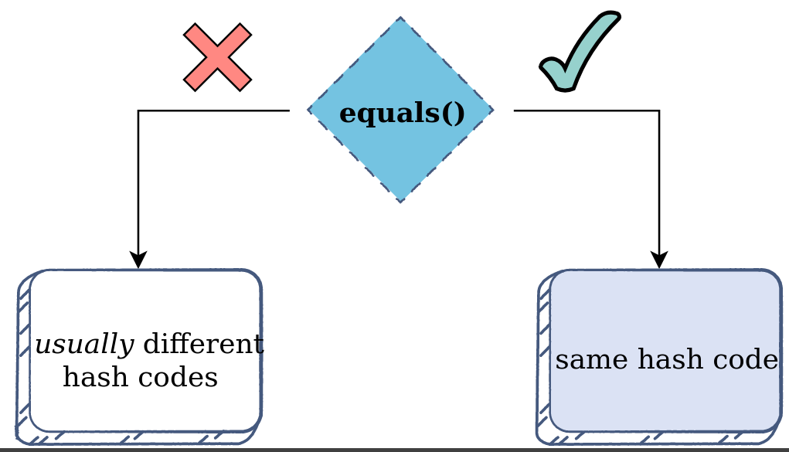

Slide 13
Hashcode will be different
String str = "123";
System.out.println(str.hashCode());
str = "1234";
System.out.println(str.hashCode());

