Slide 1
Object Oriented Programming Using Java Module 5

Slide 2
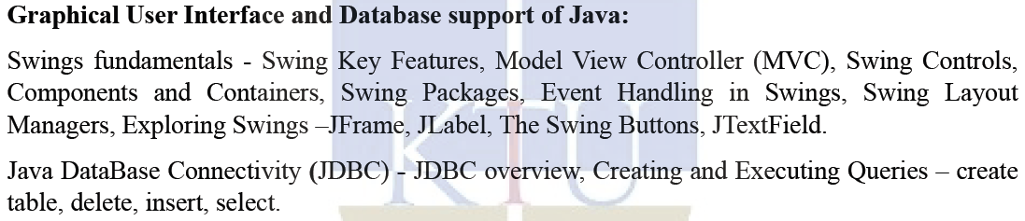
SYLLABUS – MODULE 5

Slide 3
SWING

Slide 4
SWING
Swing API is a set of extensible GUI Components - to ease the developer's life to create JAVA based GUI Applications.
It is a replacement for AWT (Abstract Window Toolkit) API, since it has almost every control corresponding to AWT controls.
Swing provides richer and easier to use user interface than does AWT.
Swing classes are defined in javax.swing package and its sub-packages.
The javax.swing package provides classes for java swing API such as JButton, JTextField, JTextArea, JRadioButton, JCheckbox, JMenu, JColorChooser etc.

Slide 5
SWING
Swing Framework contains a set of classes that provides more powerful and flexible GUI components than those of AWT.
Swing provides the look and feel of modern Java GUI.
Swing library is an official Java GUI tool kit released by Sun Microsystems.
It is used to create graphical user interface with Java.
Java Swing is a part of Java Foundation Classes (JFC) - set of GUI components which simplify the development of desktop applications.
Unlike AWT, Java Swing provides platform-independent and lightweight components.

Slide 6
FEATURES OF SWING TOOLKIT
Lightweight
Rich Controls
Highly Customizable
Pluggable Look and Feel

Slide 7
FEATURES OF SWING TOOLKIT
Lightweight :
Swing components are lightweight as they are written entirely in Java and do not depend on native Operating System's API.
Rather, they use simple drawing primitives to render themselves on the screen.
The look and the feel of the component is not controlled by the underlying operating system but by Swing itself.
Thus, they are not restricted to platform-specific appearance like, rectangular or opaque shape.
Most of the components are lightweight but not all.

Slide 8
FEATURES OF SWING TOOLKIT
Rich Controls :
Swing provides a rich set of advanced controls like Tree, TabbedPane, slider, colorpicker, and table controls.
Highly Customizable :
Swing controls can be customized in a very easy way as visual appearance is independent of internal representation.

Slide 9
FEATURES OF SWING TOOLKIT
Pluggable Look and Feel :
SWING based GUI Application look and feel can be changed at run-time, based on available values.
As the look and feel of components is controlled by Swing rather than by operating system, the feel of components can also be changed.
Thus, it is possible to "plug in" a new look and feel for any given component without affecting the rest of the code.

Slide 10
MODEL-VIEW-CONTROLLER ARCHITECTURE

Slide 11
MVC ARCHITECTURE
It is a way to organize the code.
A visual component is a composite of three distinct aspects:
The way that the component looks when rendered on the screen.
The way that the component reacts to the user.
The state information associated with the component.
By separating a component into a model, a view, and a controller, the specific implementation of each can be changed without affecting the other two.

Slide 12
SWING API ARCHITECTURE
Swing API architecture follows loosely based MVC architecture in the following manner.
Model represents component's data.
View represents visual representation of the component's data.
Controller takes the input from the user on the view and reflects the changes in Component's data.
Swing component has Model as a separate element, while the View and Controller part are clubbed in the User Interface elements.
Swing uses a modified version of MVC that combines the view and the controller into a single logical entity called the UI delegate.
Swing’s approach is called either the Model-Delegate architecture or the Separable Model architecture.

Slide 13
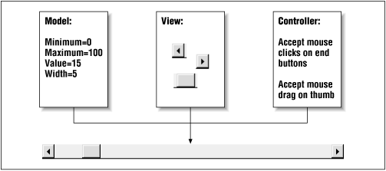

Slide 14
MVC ARCHITECTURE
The model
Corresponds to the state information associated with the component.
For example, in the case of a check box, the model contains a field that indicates if the box is checked or unchecked.
The view
Determines how the component is displayed on the screen.
The controller
Determines how the component reacts to the user.
For example, when the user clicks a check box, the controller reacts by changing the model to reflect the user’s choice (checked or unchecked). This then results in the view being updated.

Slide 15

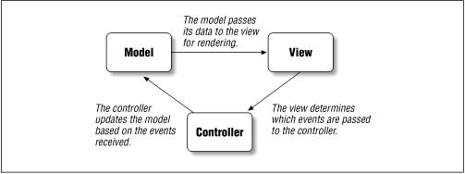

Slide 16
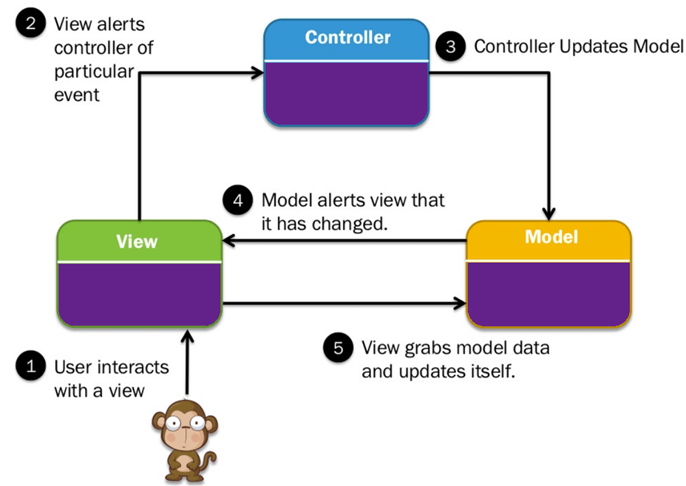

Slide 17
SWING CONTROLS

Slide 18
Swing controls
A Swing GUI consists of two key items: components and containers.
A component is an independent visual control. Eg: button.
A container holds a group of components. Eg: Frame
All containers are also components.
All Swing GUIs will have at least one container.
Most of the controls throw HeadlessException.

Slide 19
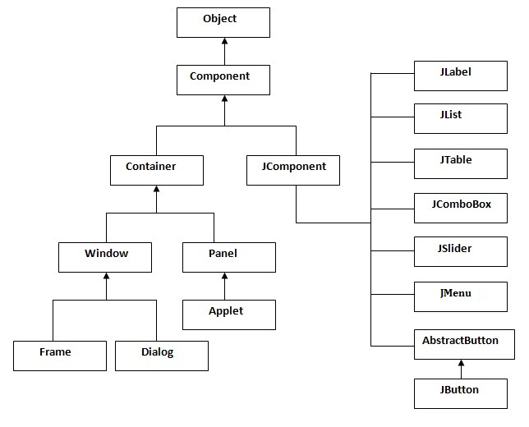
Hierarchy of Java Swing classes (Containment Hierarchy)

Slide 20
Components and Containers
A Swing GUI consists of two key items: components and containers.
A component is an independent visual control, such as a push button or slider.
A container holds a group of components.
All containers are also components

Slide 21
Thus, a container is a special type of component that is designed to hold other components.
Furthermore, in order for a component to be displayed, it must be held within a container.
Thus, all Swing GUIs will have at least one container. Because containers are components, a container can also hold other containers.
This enables Swing to define what is called a containment hierarchy, at the top of which must be a top-level container.

Slide 22
Components
Swing components are derived from the JComponent class.
JComponent provides the functionality that is common to all components.
For example, JComponent supports the pluggable look and feel.
JComponent inherits the AWT classes Container and Component.
Thus, a Swing component is built on and compatible with an AWT component.
All of Swing’s components are represented by classes defined within the package javax.swing.

Slide 23
Containers
Swing defines two types of containers.
The first are top-level containers: JFrame, JApplet, JWindow, and JDialog.
These containers do not inherit JComponent.
They do inherit the AWT classes Component and Container. Unlike Swing’s other components,which are lightweight, the top-level containers are heavyweight.
This makes the top-level containers a special case in the Swing component library.

Slide 24
Containers
The second type of containers supported by Swing are lightweight containers.
Lightweight containers do inherit JComponent.
An example of a lightweight container is JPanel, which is a general-purpose container.
Lightweight containers are often used to organize and manage groups of related components because a lightweight container can be contained within another container.

Slide 25
Components
Swing components are derived from the JComponent class.
All component classes begin with the letter J.
Few swing component classes are listed below:
COMPONENT | DESCRIPTION
JLabel | An area where uneditable text or icons can be displayed.
JTextField | An area in which the user inputs data from the keyboard. The area can also display information.
JButton | An area that triggers an event when clicked.
JCheckBox | A GUI component that is either selected or not selected.
JRadioButton | To create a radio button

Slide 26
Components
COMPONENT | DESCRIPTION
JComboBox | A drop-down list of items from which the user can make a selection by clicking an item in the list or by typing into the box.
JList | An area where a list of items is displayed from which the user can make a selection by clicking once on any element in the list. Double-clicking an element in the list generates an action event. Multiple elements can be selected.
JFrame | A container in which components can be placed.
JColorChooser | We can create our own color palette.

Slide 27
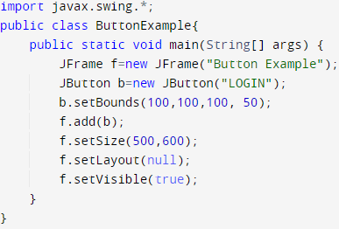
Java Swing Example

Slide 28
Component class methods
Component add(Component c)
public void setTitle(String s)
public void setSize(int width, int height)
public void setVisible(boolean b)
public void setLayout(LayoutManager l)
public void setBounds(int x, int y, int width, int height)
public void setDefaultCloseOperation(JFrame.EXIT_ON_CLOSE)

Slide 29
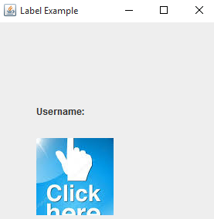
JLabel Class
JLabel can be used to display text and/or an icon.
It is a passive component in that it does not respond to user input.
Constructors:
JLabel()
JLabel(String s), JLabel(String s, int horizontalAlignment)
JLabel(Icon i), JLabel(Icon i, int horizontalAlignment)
Egs:
JLabel l1 = new JLabel();
JLabel l2 = new JLabel(“Username:”);
Icon i1 = new ImageIcon(“click.jpg”);
JLabel l3 = new JLabel(i1);

Slide 30
JLabel Class
Methods:
String getText()
void setText(String text)
void setHorizontalAlignment(int alignment)
It sets the alignment of the label's contents along the X axis.
l2.setHorizontalAlignment(JLabel.CENTER);//RIGHT, LEFT
int getHorizontalAlignment()
Icon getIcon()

Slide 31
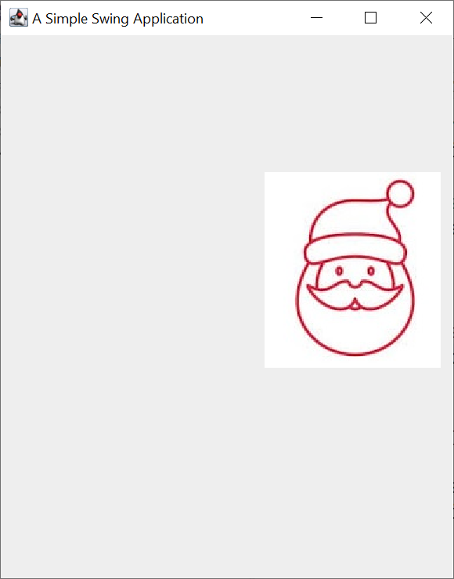
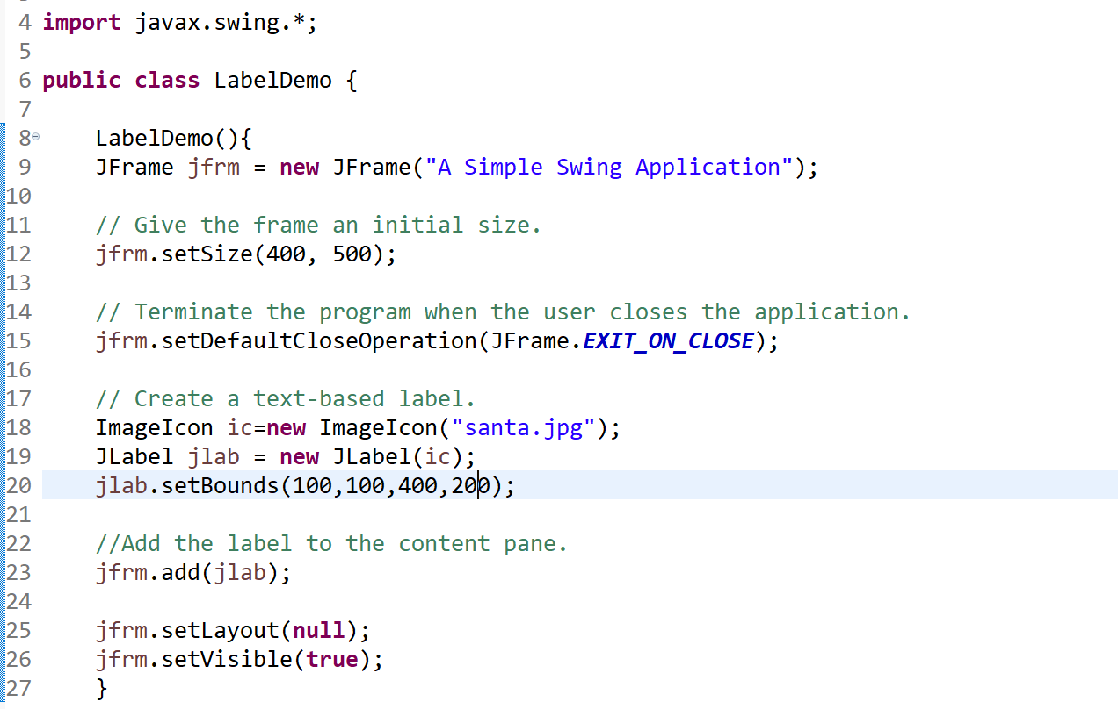
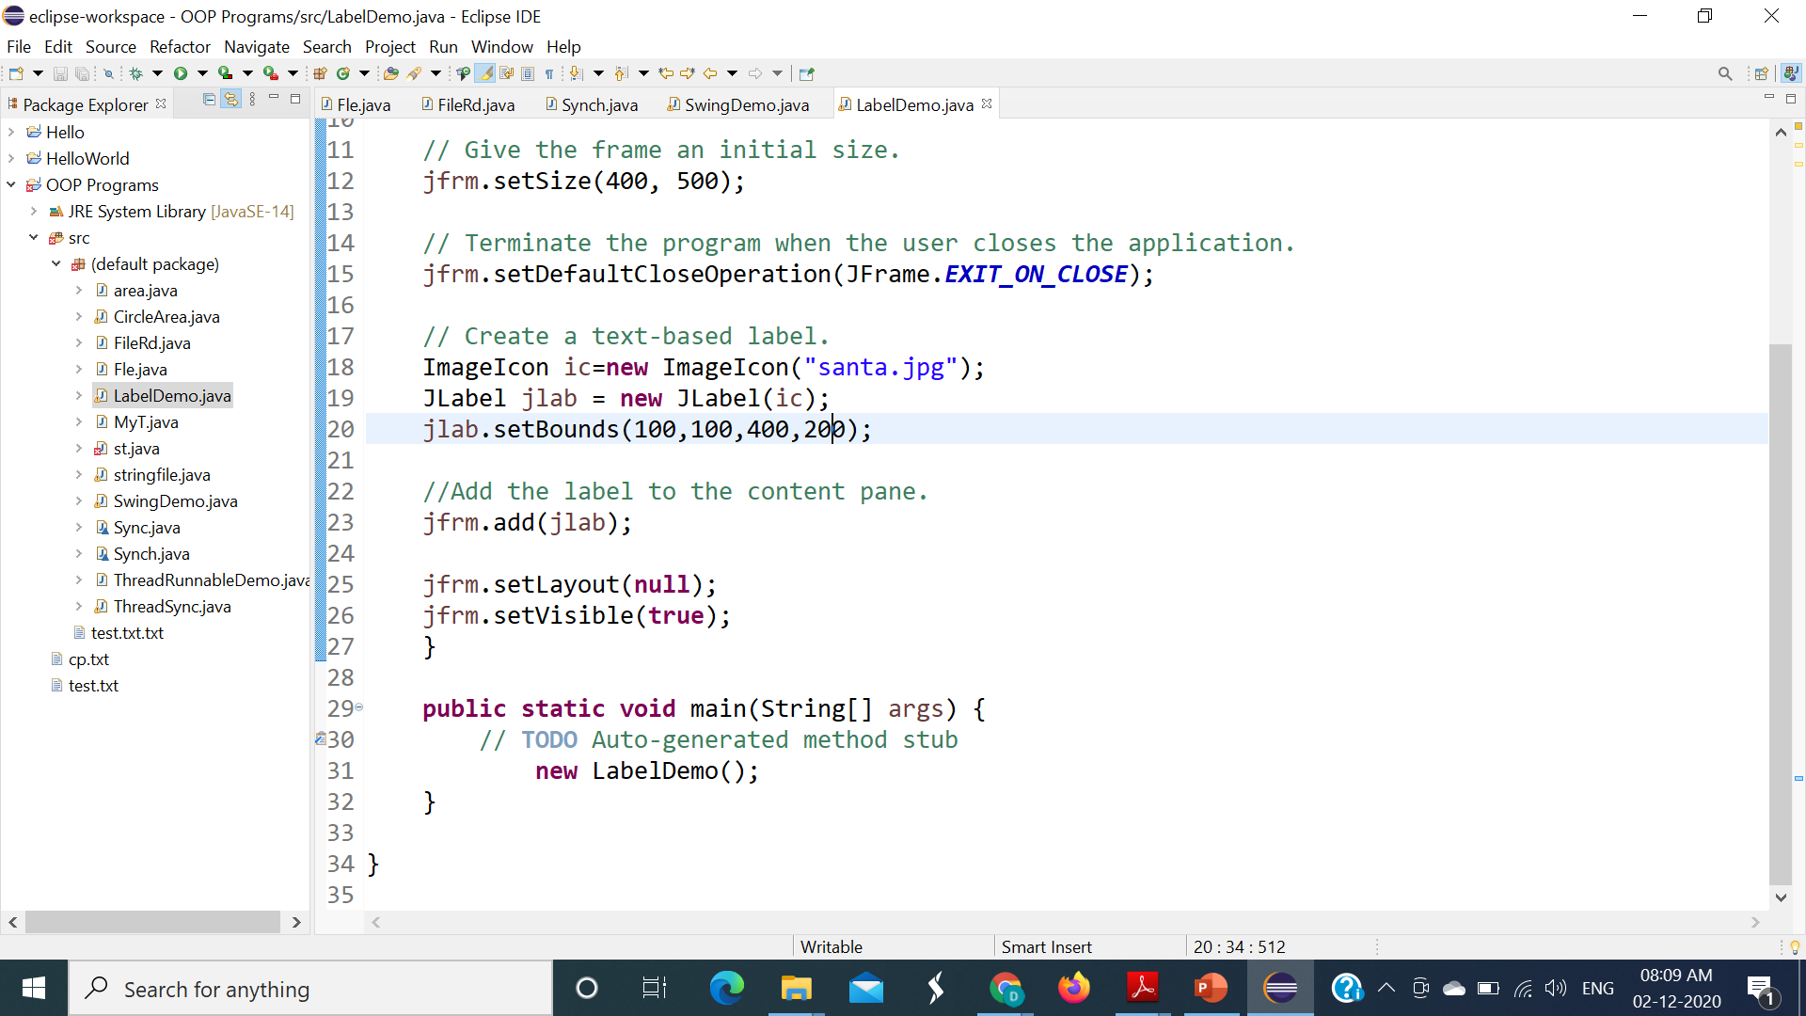
JLabel Class

Slide 32
JButton
Constructors:
JButton()
JButton(String s)
JButton(Icon i)
Egs:
JButton b1 = new JButton();
JButton b2 = new JButton(“LOGIN”);
Icon i1 = new ImageIcon(“click.jpg”);
JButton b3 = new JButton(i1);

Slide 33
JButton
Methods:
void setText(String s)
String getText()
void setEnabled(boolean b)
It is used to enable or disable the button.
void setIcon(Icon b)
Icon getIcon()

Slide 34
Jbutton Example Program
import javax.swing.*;
public class ButtonExample {
public static void main(String[] args) {
JFrame f=new JFrame("Button Example");
JButton b=new JButton("Click Here");
b.setBounds(50,100,95,30);
f.add(b);
f.setSize(400,400);
f.setLayout(null);
f.setVisible(true);
}
}

Slide 35
Java JButton Example with ActionListener
import java.awt.*;
import java.awt.event.*;
class AEvent extends Frame implements ActionListener{
TextField tf;
AEvent(){
//create components
tf=new TextField();
tf.setBounds(60,50,170,20);
Button b=new Button("click me");
b.setBounds(100,120,80,30);
//register listener
b.addActionListener(this);//passing current instance
//add components and set size, layout and visibility

Slide 36
add(b);add(tf);
setSize(300,300);
setLayout(null);
setVisible(true);
}
public void actionPerformed(ActionEvent e){
tf.setText("Welcome");
}
public static void main(String args[]){
new AEvent();
}
}

Slide 37
JTextField
JTextField is the simplest Swing text component
JTextField allows you to edit one line of text.
Constructors:
JTextField ()
JTextField (String s)
JTextField (String s, int columns)
JTextField (int columns)
Egs:
JTextField t1 = new JTextField();

Slide 38
JTextField
Methods:
void setText(String s)
String getText()
void setEditable(boolean canEdit)
It is used to enable or disable the button.
boolean isEditable()
setColumns(int n), getColumns(), setFont(Font f)
Font fo = new Font("Serif", Font.BOLD, 20);
Font(String fontName, int fontStyle, int pointSize)
• fontName – name of the desired font.
• fontStyle – Font.PLAIN, Font.BOLD, Font.ITALIC
• pointSize – size of the font

Slide 39
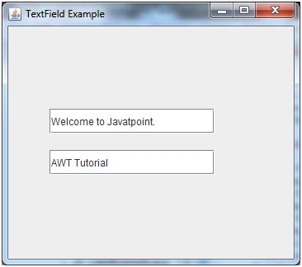
Jtextfield Example
import javax.swing.*;
class TextFieldExample
{
public static void main(String args[])
{
JFrame f= new JFrame("TextField Example");
JTextField t1,t2;
t1=new JTextField("Welcome to Javatpoint.");
t1.setBounds(50,100, 200,30);
t2=new JTextField("AWT Tutorial");
t2.setBounds(50,150, 200,30);
f.add(t1); f.add(t2);
f.setSize(400,400);
f.setLayout(null);
f.setVisible(true);
}
}

Slide 40

JPasswordField
Constructors:
JPasswordField ()
JPasswordField(String s)
JPasswordField(String s, int columns)
JPasswordField(int columns)
Egs:
JPasswordField t1 = new JPasswordField();

Slide 41
JPasswordField
Methods:
void setEchoChar(char c)
char getEchoChar()
String getPassword()/ getText()

Slide 42
JTextArea
Constructors:
JTextArea()
JTextArea(String s)
JTextArea(int rows, int columns)
JTextArea(String s, int rows, int columns)
Egs:
JTextArea t1 = new JTextArea();

Slide 43
JTextArea
Methods:
void setRows(int rows)
void setColumns(int cols)
void setFont(Font f)
void insert(String s, int position)
void append(String s)

Slide 44

JCheckBox
Constructors:
JCheckBox()
Creates an initially unselected check box button with no text, no icon.
JCheckBox(String s)
Creates an initially unselected check box with text.
JCheckBox(String text, boolean selected)
Creates a check box with text and specifies whether or not it is initially selected.

Slide 45
JCheckBox
Methods:
boolean getState()
void setState(boolean b)
String getLabel()
void setLabel(String s)

Slide 46
JRadioButton
Constructors:
JRadioButton()
Creates an unselected radio button with no text.
JRadioButton(String s)
Creates an unselected radio button with specified text.
JRadioButton(String s, boolean selected)
Creates a radio button with the specified text and selected status.
It should be added in ButtonGroup to select one radio button only.

Slide 47

JRadioButton
ButtonGroup bg = new ButtonGroup();
JRadioButton r1 = new JRadioButton(“A)Male”);
JRadioButton r2 = new JRadioButton(“B)Female”);
bg.add(r1);
bg.add(r2);
f.add(r1);
f.add(r2);

Slide 48
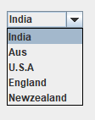
JComboBox
Constructors:
JComboBox()
Creates a JComboBox with a default data model.
JComboBox(Object[] items)
Creates a JComboBox that contains the elements in the specified array.
JComboBox(Vector<?> items)
Creates a JComboBox that contains the elements in the specified Vector.

Slide 49
JComboBox
Methods:
void addItem(Object anObject)
It is used to add an item to the item list.
void removeItem(Object anObject)
It is used to delete an item to the item list.
void removeAllItems()
It is used to remove all the items from the list.
void setEditable(boolean b)
It is used to determine whether the JComboBox is editable.

Slide 50
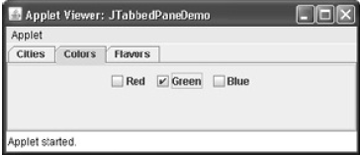
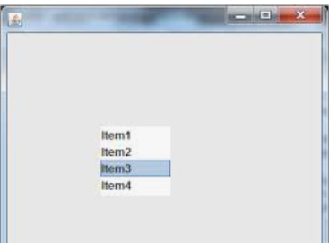
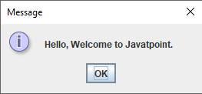

Other controls…
JTabbedPane
JOptionPane
JScrollBar
JTable
JList
JMenu, etc…

Slide 51
EVENT HANDLING IN SWINGS

Slide 52
Example Program
Write a swing program to create 2 buttons – ‘Yes’ and ‘No’. On click on that button, display the message “You pressed Yes”/ “You pressed No”.
public void actionPerformed(ActionEvent ae){
msg=“”;
String str = ae.getActionCommand();
if str.equals(“Yes”) {
msg = “You pressed Yes”;}
else {
msg = “You pressed No:;}

Slide 53
To be continued…

