Slide 1

CST 205 OOP :OBJECT ORIENTED CONCEPTS

Slide 2
OBJECTIVES
INTRODUCTION TO SWING
AWT VS SWING
FEATURES OF SWING
SWING ARCHITECTURE
SIMPLE SWING GUI PROGRAM
EVENT HANDLING
SWING CONTROLS

Slide 3
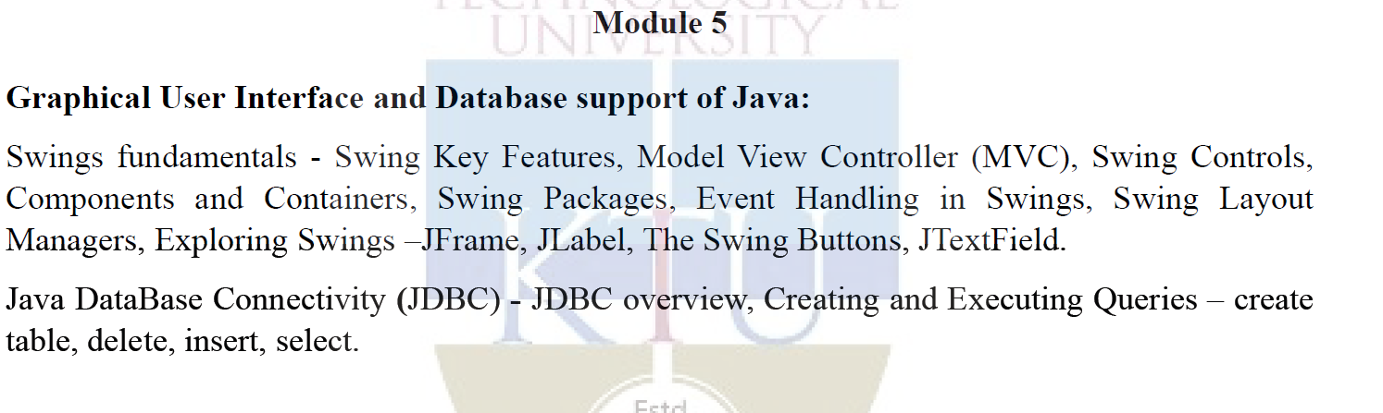
Syllabus

Slide 4
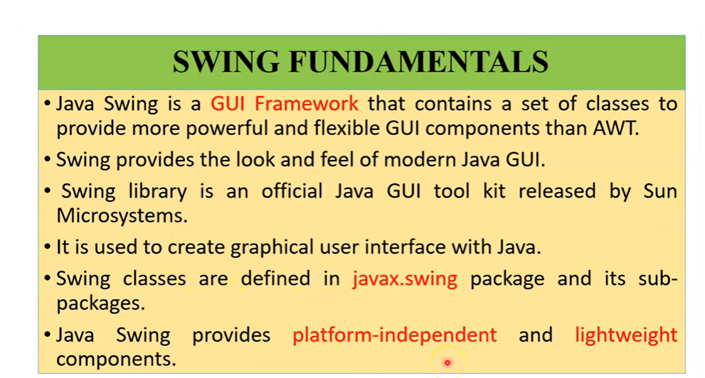

Slide 5
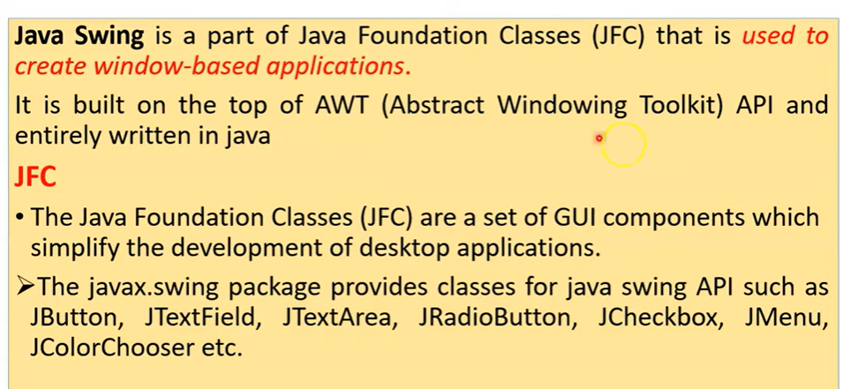

Slide 6
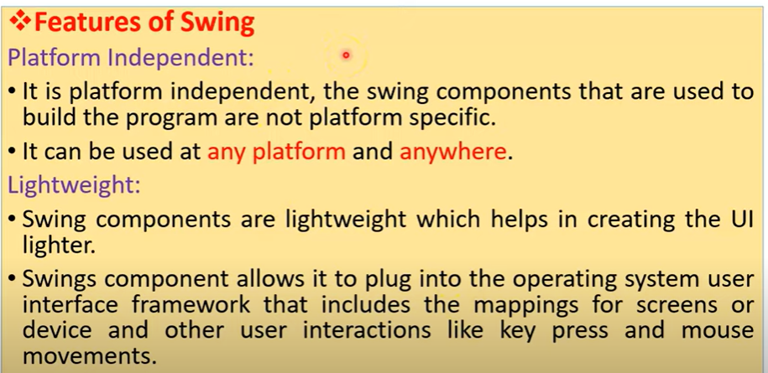

Slide 7
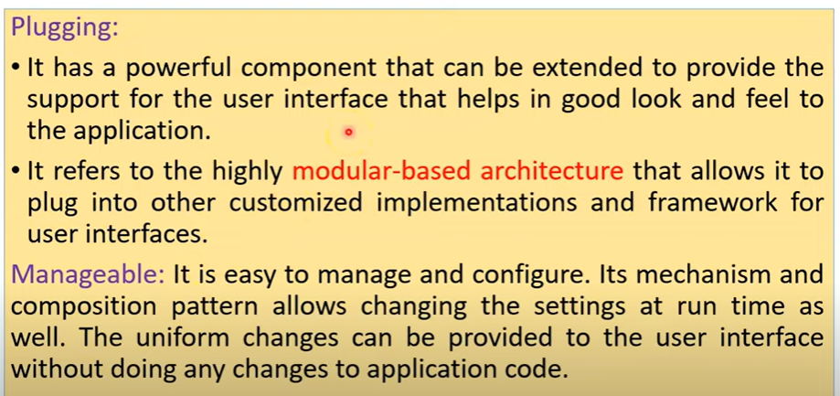

Slide 8
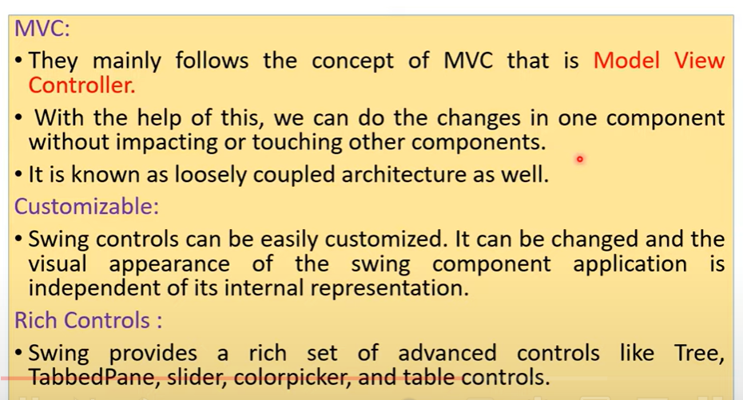

Slide 9
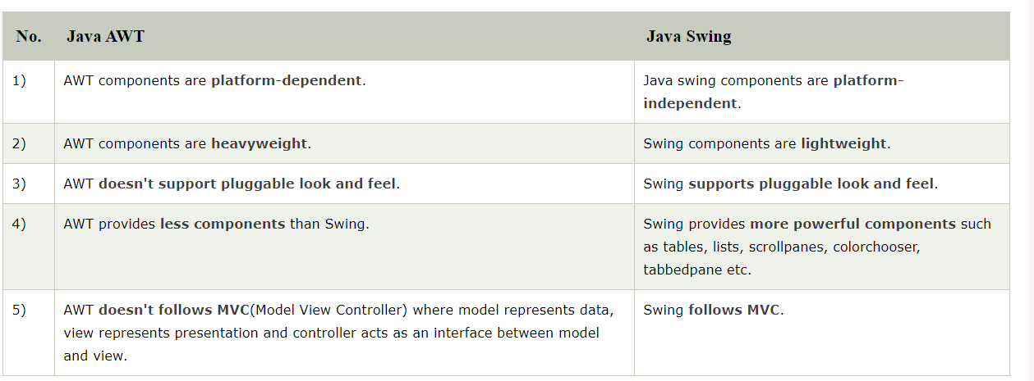

Slide 10
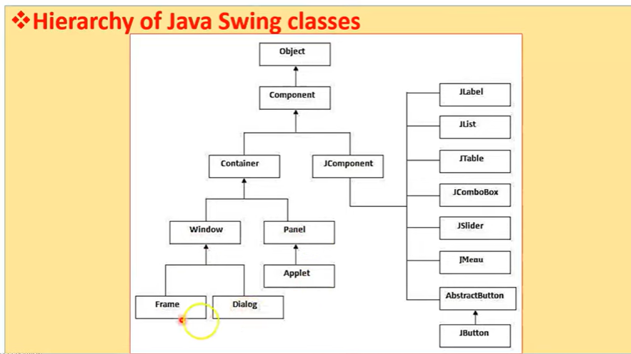

Slide 11
