Slide 1

CST 205 OOP :OBJECT ORIENTED CONCEPTS

Slide 2
OBJECTIVES
INTRODUCTION TO SWING
AWT VS SWING
FEATURES OF SWING
SWING ARCHITECTURE
SIMPLE SWING GUI PROGRAM
EVENT HANDLING
SWING CONTROLS

Slide 3
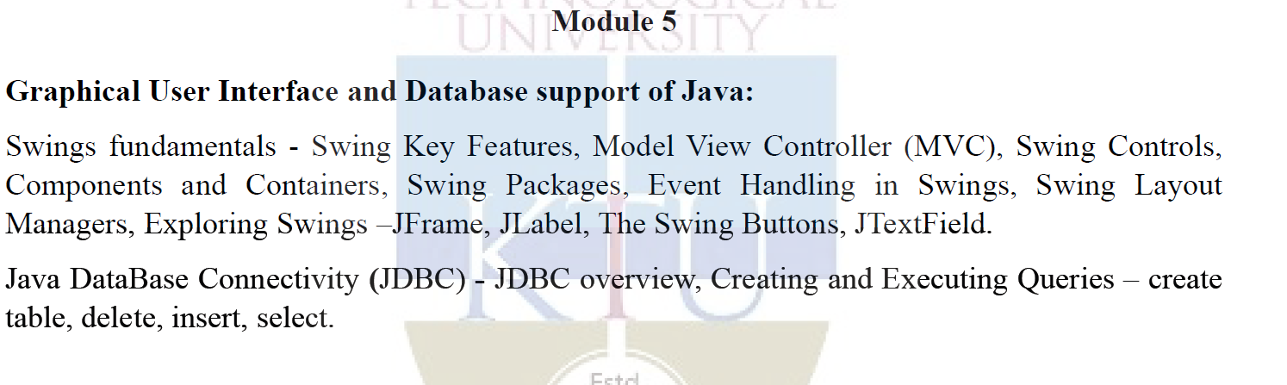
Syllabus

Slide 4
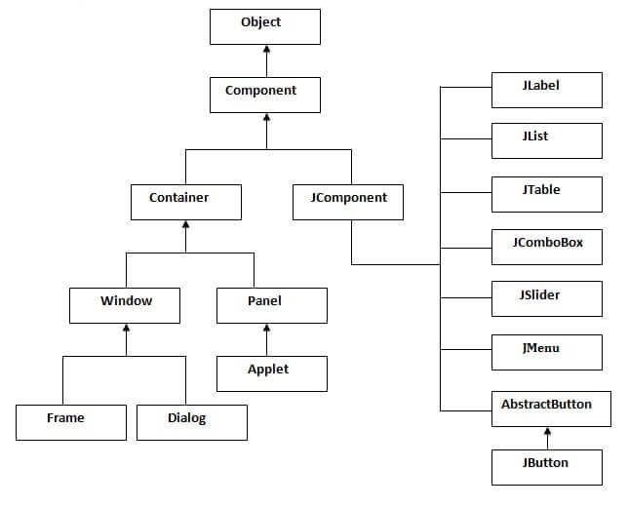
Hierarchy of Java Swing classes

Slide 5
Components and Containers
A Swing GUI consists of two key items: components and containers.
A component is an independent visual control, such as a push button or slider.
A container holds a group of components.
All containers are also components

Slide 6
Thus, a container is a special type of component that is designed to hold other components.
Furthermore, in order for a component to be displayed, it must be held within a container.
Thus, all Swing GUIs will have at least one container. Because containers are components, a container can also hold other containers.
This enables Swing to define what is called a containment hierarchy, at the top of which must be a top-level container.

Slide 7
Components
Swing components are derived from the JComponent class.
JComponent provides the functionality that is common to all components.
For example, JComponent supports the pluggable look and feel.
JComponent inherits the AWT classes Container and Component.
Thus, a Swing component is built on and compatible with an AWT component.
All of Swing’s components are represented by classes defined within the package javax.swing.

Slide 8
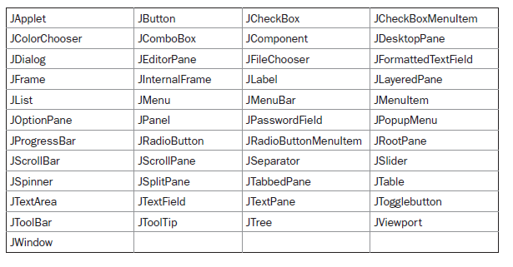
Class names for Swing components

Slide 9
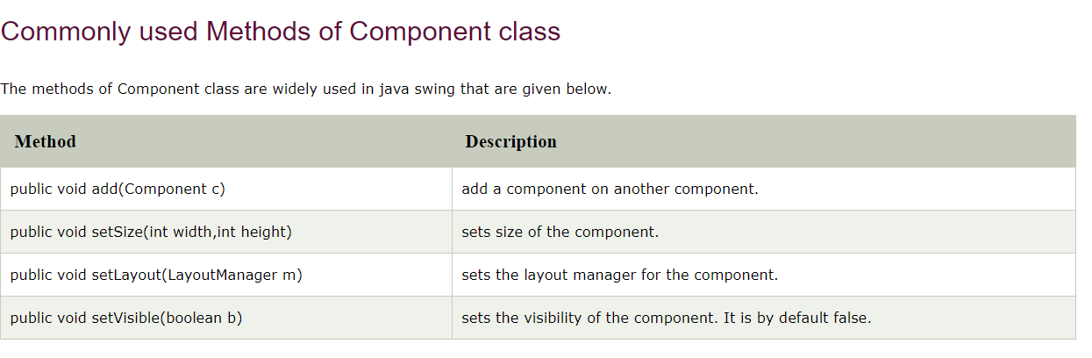
Component class

Slide 10
Containers
Swing defines two types of containers.
The first are top-level containers: JFrame, JApplet, JWindow, and JDialog.
These containers do not inherit JComponent.
They do inherit the AWT classes Component and Container. Unlike Swing’s other components,which are lightweight, the top-level containers are heavyweight.
This makes the top-level containers a special case in the Swing component library.

Slide 11
Containers
The second type of containers supported by Swing are lightweight containers.
Lightweight containers do inherit JComponent.
An example of a lightweight container is JPanel, which is a general-purpose container.
Lightweight containers are often used to organize and manage groups of related components because a lightweight container can be contained within another container.

Slide 12
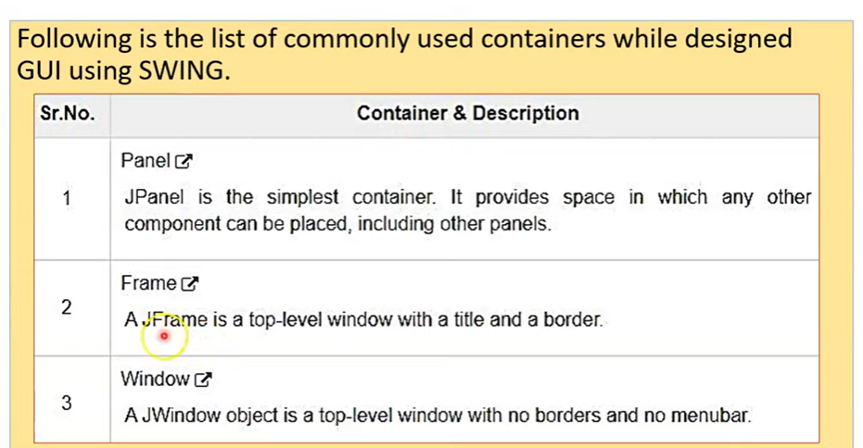

Slide 13
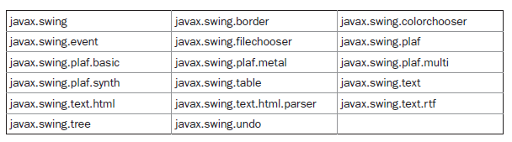
The Swing Packages

Slide 14
A Simple Swing Application
It uses two Swing components:
JFrame and JLabel.
JFrame is the top-level container that is commonly used for Swing applications.
JLabel is the Swing component that creates a label, which is a component that displays information.
The label is Swing’s simplest component because it is passive.
That is,a label does not respond to user input. It just displays output. The program uses a Jframe container to hold an instance of a JLabel.
The label displays a short text message.

Slide 15
A Simple Swing Application
import javax.swing.*;
class SwingDemo {
SwingDemo() {
// Create a new JFrame container.
JFrame jfrm = new JFrame("A Simple Swing Application");
// Give the frame an initial size.
jfrm.setSize(275, 100);
// Terminate the program when the user closes the application.
jfrm.setDefaultCloseOperation(JFrame.EXIT_ON_CLOSE);
// Create a text-based label.
JLabel jlab = new JLabel(" Swing means powerful GUIs.");

Slide 16
A Simple Swing Application
// Add the label to the content pane.
jfrm.add(jlab);
// Display the frame.
jfrm.setVisible(true);
}
public static void main(String args[]) {
// Create the frame on the event dispatching thread.
SwingUtilities.invokeLater(new Runnable() {
public void run() {
new SwingDemo();
}
});
}}

Slide 17

A Simple Swing Application

Slide 18
A Simple Swing Application
JFrame jfrm = new JFrame("A Simple Swing Application");
This creates a container called jfrm that defines a rectangular window complete with a title bar; close, minimize, maximize, and restore buttons; and a system menu.
setDefaultCloseOperation( ):
By default, when a top-level window is closed ,the window is removed from the screen, but the application is not terminated.
jfrm.setDefaultCloseOperation(JFrame. EXIT_ON_CLOSE);
After this call executes, closing the window causes the entire application to terminate.

Slide 19
A Simple Swing Application
The general form of setDefaultCloseOperation( ) is shown here:
void setDefaultCloseOperation(int what)
The value passed in what determines what happens when the window is closed. There are several other options in addition to JFrame.EXIT_ON_CLOSE.
They are shown here:
JFrame.DISPOSE_ON_CLOSE
JFrame.HIDE_ON_CLOSE
JFrame.DO_NOTHING_ON_CLOSE
Their names reflect their actions. These constants are declared inWindowConstants, which is an interface declared in javax.swing that is implemented by JFrame.

Slide 20
A Simple Swing Application
All your GUI manipulations are done from the event dispatch thread.
Every GUI application has an event dispatch thread: it is the thread that waits for events to occur and then dispatches those events to the appropriate event handlers.
All of your event listener methods are invoked by the event dispatch thread, so any GUI manipulations you perform from an event listener are safe.
Swing provides two utility methods that allow you ask the event dispatch thread to run arbitrary code.
The methods are SwingUtilities.invokeLater() and SwingUtilities.invokeAndWait().
You pass a Runnable object to each method, and the run() method of this object is invoked from the event thread.

Slide 21
A Simple Swing Application
invokeLater() returns right away, regardless of when the run() method is invoked, while invokeAndWait() does not return until the run() method has completed.
Each method encapsulates the Runnable object within a special event object and places the event on the event queue.
Then, when all pending events have been handled, the Runnable object is extracted from the event queue and the event dispatch thread calls its run() method.

Slide 22
A Simple Swing Application
SwingDemo object to be created on the event dispatching thread rather than on the main thread of the application.
Swing programs are event-driven.
The handler is executed on the event dispatching thread provided by Swing and not on the main thread of the application.
Thus, although event handlers are defined by your program, they are called on a thread that was not created by your program.

Slide 23
Anonymous Inner Class
It is an inner class without a name and for which only a single object is created. An anonymous inner class can be useful when making an instance of an object with certain “extras” such as overriding methods of a class or interface, without having to actually subclass a class.
Tip: Anonymous inner classes are useful in writing implementation classes for listener interfaces in graphics programming.

Slide 24
The Difference Between Regular Class(normal Classes) And Anonymous Inner Class
A normal class can implement any number of interfaces but the anonymous inner class can implement only one interface at a time.
A regular class can extend a class and implement any number of interfaces simultaneously. But anonymous Inner class can extend a class or can implement an interface but not both at a time.
For regular/normal class, we can write any number of constructors but we can’t write any constructor for anonymous Inner class because the anonymous class does not have any name and while defining constructor class name and constructor name must be same.

Slide 25
/ *Java program to demonstrate Need for Anonymous Inner class*/
// Interface
interface Age { // Defining variables and methods
int x = 21;
void getAge();
}
// Class 1
// Helper class implementing methods of Age Interface
class MyClass implements Age {
// Overriding getAge() method
@Override public void getAge()
{
// Print statement
System.out.print("Age is " + x);
}}
// Class 2
// Main class
// AnonymousDemo
class GFG {
// Main driver method
public static void main(String[] args)
{
// Class 1 is implementation class of Age interface
MyClass obj = new MyClass();
// calling getage() method implemented at Class1
// inside main() method
obj.getAge();
}
}

Slide 26
// Java Program to Demonstrate Anonymous inner class
// Interface
interface Age {
int x = 21;
void getAge();
}
// Main class
class AnonymousDemo {
// Main driver method
public static void main(String[] args)
{
// Myclass is hidden inner class of Age interface
// whose name is not written but an object to it
// is created.
Age oj1 = new Age() {
@Override public void getAge()
{
// printing age
System.out.print("Age is " + x);
}
};
oj1.getAge();
}
}

Slide 27
// Java program to illustrate defining a thread Using Anonymous Inner class that define inside argument
// Main class
class MyThread {
// Main driver method
public static void main(String[] args)
{
// Using Anonymous Inner class that define inside
// argument
// Here constructor argument
Thread t = new Thread(new Runnable() {
public void run()
{
System.out.println("Child Thread");
}
});
t.start();
System.out.println("Main Thread");
}}

Slide 28
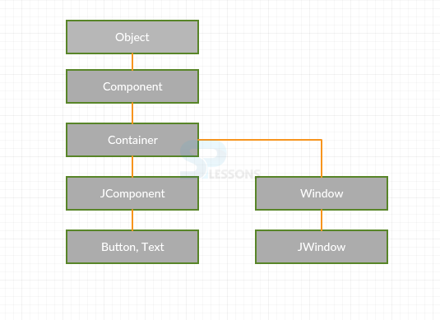
The Swing Controls
Swing controls will inherit the properties from following classes.
Component
Container
JComponent.

Slide 29
The Swing Controls
JLabel
JCheckBox
JComboBox
JProgressBar
JToggleButton
JSlider

Slide 30
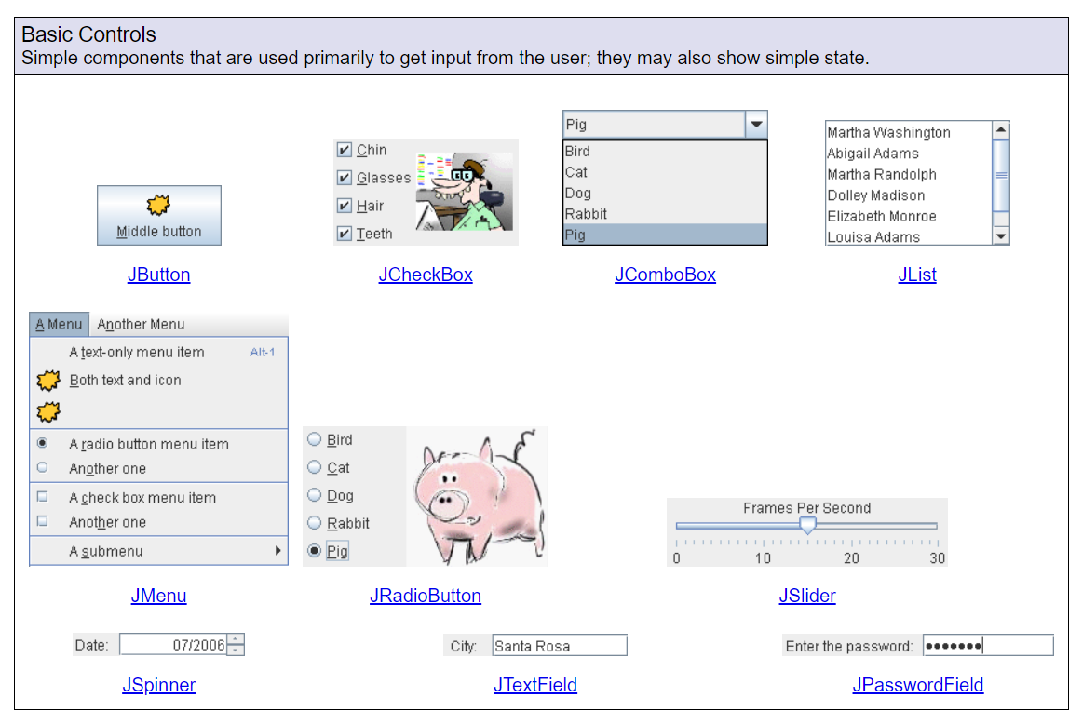
The Swing Controls

Slide 31
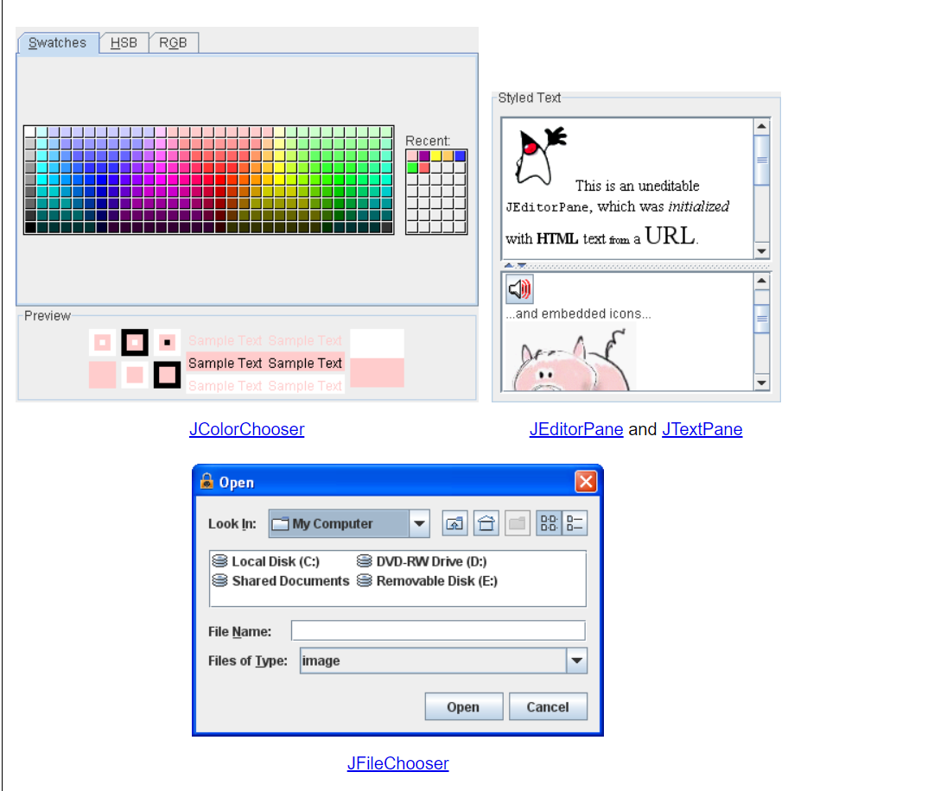
The Swing Controls

Slide 32
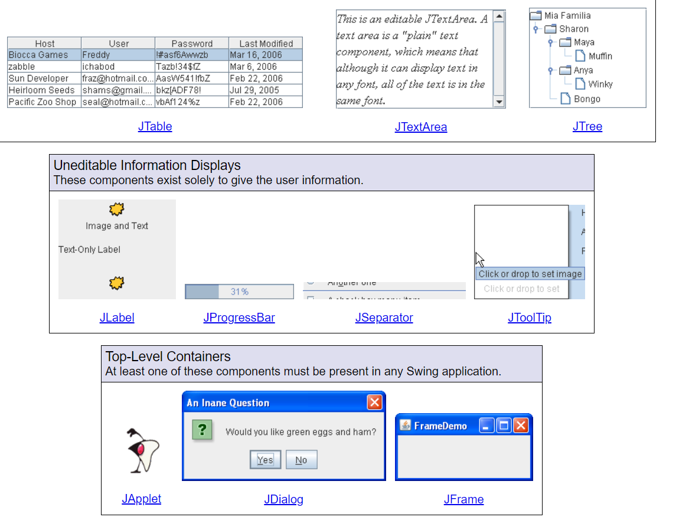
The Swing Controls

Slide 33
Event Handling
The event handling mechanism used by Swing is the same as that used by the AWT ie the delegation event model.
Swing uses the same events as does the AWT, and these events are packaged in
java.awt.event.
Events specific to Swing are stored in javax.swing.event

Slide 34
Event Handling
import java.awt.*;
import java.awt.event.*;
import javax.swing.*;
class EventDemo {
JLabel jlab;
EventDemo() {
// Create a new JFrame container.
JFrame jfrm = new JFrame("An Event Example");
// Specify FlowLayout for the layout manager.
jfrm.setLayout(new FlowLayout());
// Give the frame an initial size.
jfrm.setSize(220, 90);

Slide 35
Event Handling
// Terminate the program when the user closes the application.
jfrm.setDefaultCloseOperation(JFrame.EXIT_ON_CLOSE);
// Make two buttons.
JButton jbtnAlpha = new JButton("Alpha");
JButton jbtnBeta = new JButton("Beta");
// Add action listener for Alpha.
jbtnAlpha.addActionListener(new ActionListener() {
public void actionPerformed(ActionEvent ae) {
jlab.setText("Alpha was pressed.");
}
});

Slide 36
Event Handling
// Add action listener for Beta.
jbtnBeta.addActionListener(new ActionListener() {
public void actionPerformed(ActionEvent ae) {
jlab.setText("Beta was pressed.");
}
});
// Add the buttons to the content pane.
jfrm.add(jbtnAlpha);
jfrm.add(jbtnBeta);
// Create a text-based label.
jlab = new JLabel("Press a button.");
// Add the label to the content pane.
jfrm.add(jlab);
// Display the frame.

Slide 37
Event Handling
jfrm.setVisible(true);
}
public static void main(String args[]) {
// Create the frame on the event dispatching thread.
SwingUtilities.invokeLater(new Runnable() {
public void run() {
new EventDemo();
}
});
}
}

Slide 38

Event Handling

Slide 39
Create a Swing Applet
A Swing applet extends JApplet rather than Applet. JApplet is derived from Applet.
Thus, JApplet includes all of the functionality found in Applet and adds support for Swing.
JApplet is a top-level Swing container, which means that it is not derived from JComponent.
Swing applets use the same four lifecycle methods init( ),start( ), stop( ), and destroy( ).
Painting is accomplished differently in Swing than it is in the AWT,and a Swing applet will not normally override the paint( ) method. (Painting in Swing is described later in this chapter.)

Slide 40
Demonstrate JTextField
// A simple Swing-based applet import javax.swing.*; import java.awt.*; import java.awt.event.*; /* <applet code="MySwingApplet" width=220 height=90> </applet> */ public class MySwingApplet extends JApplet { JButton jbtnAlpha; JButton jbtnBeta; JLabel jlab; | // Initialize the applet. public void init() { try { SwingUtilities.invokeAndWait(new Runnable () { public void run() { makeGUI(); // initialize the GUI } }); } catch(Exception exc) { System.out.println("Can't create because of "+ exc); } }

Slide 41
Demonstrate JTextField
private void makeGUI() { // Set the applet to use flow layout. setLayout(new FlowLayout()); // Make two buttons. jbtnAlpha = new JButton("Alpha"); jbtnBeta = new JButton("Beta"); // Add action listener for Alpha. jbtnAlpha.addActionListener(new ActionListener() { public void actionPerformed(ActionEvent le) { jlab.setText("Alpha was pressed."); } }); | // Add action listener for Beta. jbtnBeta.addActionListener(new ActionListener() { public void actionPerformed(ActionEvent le) { jlab.setText("Beta was pressed."); } }); // Add the buttons to the content pane. add(jbtnAlpha); add(jbtnBeta); // Create a text-based label. jlab = new JLabel("Press a button."); // Add the label to the content pane. add(jlab); } }

Slide 42
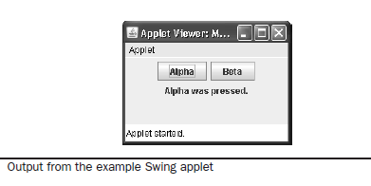
EXPLORING SWING

Slide 43
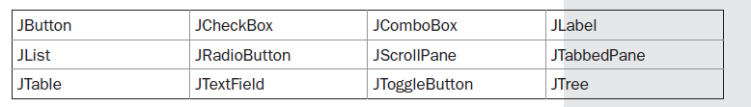
EXPLORING SWING

Slide 44
JLabel and ImageIcon
JLabel and ImageIcon
JLabel(Icon icon)
JLabel(String str)
JLabel(String str, Icon icon, int align)
The easiest way to obtain an icon is to use the ImageIcon class.
ImageIcon implements Icon and encapsulates an image.
Thus, an object of type ImageIcon can be passed as an argument to the Icon parameter of JLabel’s constructor.

Slide 45
JLabel and ImageIcon
There are several ways to provide the image, including reading it from a file or downloading it from a URL.
Here is the ImageIcon constructor used by the example in this section:
ImageIcon(String filename)
It obtains the image in the file named filename.
The icon and text associated with the label can be obtained by the following methods:
Icon getIcon( )
String getText( )
The icon and text associated with a label can be set by these methods:
void setIcon(Icon icon)
void setText(String str)

Slide 46
Demonstrate JTextField
// Demonstrate JLabel and ImageIcon. import java.awt.*; import javax.swing.*; /* <applet code="JLabelDemo" width=250 height=150> </applet> */ public class JLabelDemo extends JApplet { public void init() { try { SwingUtilities.invokeAndWait( new Runnable() { public void run() { makeGUI(); } } | ); } catch (Exception exc) { System.out.println("Can't create because of " + exc); } } private void makeGUI() { // Create an icon. ImageIcon ii = new ImageIcon("france.gif"); // Create a label. JLabel jl = new JLabel("France", ii, JLabel.CENTER); // Add the label to the content pane. add(jl); } }

Slide 47
EXPLORING SWING

Slide 48
JTextField
TextField is the simplest Swing text component. It is also probably its most widely used text component.
JTextField allows you to edit one line of text. It is derived from JTextComponent,which provides the basic functionality common to Swing text components.
Three of JTextField’s constructors are shown here:
JTextField(int cols)
JTextField(String str, int cols)
JTextField(String str)

Slide 49
JTextField
JTextField generates events in response to user interaction. For example, an ActionEvent is fired when the user presses ENTER.
A CaretEvent is fired each time the caret (i.e., the cursor) changes position. (CaretEvent is packaged in javax.swing.event.)
To obtain the text currently in the text field, call getText( ).

Slide 50
Demonstrate JTextField
// Demonstrate JTextField. import java.awt.*; import java.awt.event.*; import javax.swing.*; /* <applet code="JTextFieldDemo" width=300 height=50> </applet> */ public class JTextFieldDemo extends JApplet { JTextField jtf; public void init() { try { SwingUtilities.invokeAndWait( new Runnable() { public void run() { makeGUI(); } } ); } catch (Exception exc) {System.out.println("Can't create because of " + exc); }}

Slide 51
Demonstrate JTextField
private void makeGUI() { // Change to flow layout. setLayout(new FlowLayout()); // Add text field to content pane. jtf = new JTextField(15); add(jtf); jtf.addActionListener(new ActionListener() { public void actionPerformed(ActionEvent ae) { // Show text when user presses ENTER. showStatus(jtf.getText()); } }); } }

Slide 52
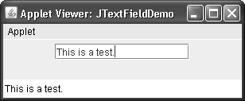
Demonstrate JTextField

Slide 53
Demonstrate The Swing Buttons
Swing defines four types of buttons: JButton, JToggleButton, JCheckBox, and JRadioButton.
All are subclasses of the AbstractButton class, which extends JComponent. Thus, all buttons share a set of common traits.
AbstractButton contains many methods that allow you to control the behavior of buttons.
For example, you can define different icons that are displayed for the button when it is disabled, pressed, or selected.
Another icon can be used as a rollover icon, which is displayed when the mouse is positioned over a button.
Button generates an action event when it is pressed

Slide 54
Demonstrate The Swing Buttons
The following methods set these icons
void setDisabledIcon(Icon di)
void setPressedIcon(Icon pi)
void setSelectedIcon(Icon si)
void setRolloverIcon(Icon ri)
Here, di, pi, si, and ri are the icons to be used for the indicated purpose.
The text associated with a button can be read and written via the following methods:
String getText( )
void setText(String str)
Here, str is the text to be associated with the button.

Slide 55
Demonstrate The Swing Buttons
1.JButton
The JButton class provides the functionality of a push button. You have already seen a simple form of it in the preceding chapter. JButton allows an icon, a string, or both to be associated with the push button.
Three of its constructors are shown here:
JButton(Icon icon)
JButton(String str)
JButton(String str, Icon icon)
Here, str and icon are the string and icon used for the button.

Slide 56
Demonstrate The Swing Buttons
When the button is pressed, an ActionEvent is generated. Using the ActionEvent object passed to the actionPerformed( ) method of the registered ActionListener, you can obtain the action command string associated with the button.
By default, this is the string displayed inside the button. However, you can set the action command by calling setActionCommand( ) on the button. You can obtain the action command by calling getActionCommand( ) on the event object.
It is declared like this:
String getActionCommand( )
The action command identifies the button

Slide 57
Demonstrate JButton
// Demonstrate an icon-based JButton. import java.awt.*; import java.awt.event.*; import javax.swing.*; /* <applet code="JButtonDemo" width=250 height=450> </applet> */ public class JButtonDemo extends JApplet implements ActionListener { JLabel jlab; public void init() { try { SwingUtilities.invokeAndWait( new Runnable() { } | public void run() { makeGUI(); } } ); } catch (Exception exc) { System.out.println("Can't create because of " + exc); } private void makeGUI() { // Change to flow layout. setLayout(new FlowLayout()); // Add buttons to content pane. ImageIcon france = new ImageIcon("france.gif"); JButton jb = new JButton(france); jb.setActionCommand("France"); jb.addActionListener(this); add(jb);

Slide 58
Demonstrate JTextField
ImageIcon germany = new ImageIcon("germany.gif"); jb = new JButton(germany); jb.setActionCommand("Germany"); jb.addActionListener(this); add(jb); ImageIcon italy = new ImageIcon("italy.gif"); jb = new JButton(italy); jb.setActionCommand("Italy"); | jb.addActionListener(this); add(jb); ImageIcon japan = new ImageIcon("japan.gif"); jb = new JButton(japan); jb.setActionCommand("Japan"); jb.addActionListener(this); add(jb); // Create and add the label to content pane. jlab = new JLabel("Choose a Flag"); add(jlab); } // Handle button events. public void actionPerformed(ActionEvent ae) { jlab.setText("You selected " + ae.getActionCommand()); } }

Slide 59
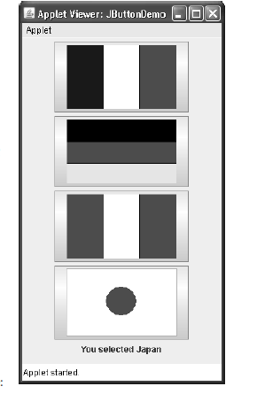
Demonstrate JTextField

Slide 60
JToggleButton
A useful variation on the push button is called a toggle button. A toggle button looks just like a push button, but it acts differently because it has two states: pushed and released.
That is, when you press a toggle button, it stays pressed rather than popping back up as a regular push button does.
When you press the toggle button a second time, it releases (pops up). Therefore, each time a toggle button is pushed, it toggles between its two states.
Toggle buttons are objects of the JToggleButton class. JToggleButton implements AbstractButton. In addition to creating standard toggle buttons, JToggleButton is a superclass for two other Swing components that also represent two-state controls.

Slide 61
JToggleButton
These are JCheckBox and JRadioButton, which are described later in this chapter. Thus, JToggleButton defines the basic functionality of all two-state components.
JToggleButton defines several constructors. The one used by the example in this section is shown here:
JToggleButton(String str)
Like JButton, JToggleButton generates an action event each time it is pressed. Unlike
JButton, however, JToggleButton also generates an item event.
This event is used by those
components that support the concept of selection.
When a JToggleButton is pressed in, it is selected. When it is popped out, it is deselected.

Slide 62
JToggleButton
To handle item events, you must implement the ItemListener interface.
each time an item event is generated, it is passed to the itemStateChanged( )
method defined by ItemListener.
Inside itemStateChanged( ), the getItem( ) method can be called on the ItemEvent object to obtain a reference to the JToggleButton instance that generated the event. It is shown here:
Object getItem( ) :Areference to the button is returned.
The easiest way to determine a toggle button’s state is by calling the isSelected( ) method (inherited from AbstractButton) on the button that generated the event. It is shown here:
boolean isSelected( )

Slide 63
Demonstrate JToggleButton
import java.awt.*; import java.awt.event.*; import javax.swing.*; /* <applet code="JToggleButtonDemo" width=200 height=80> </applet> */ public class JToggleButtonDemo extends JApplet { JLabel jlab; JToggleButton jtbn; public void init() { try { SwingUtilities.invokeAndWait( new Runnable() { public void run() { | makeGUI(); } } ); } catch (Exception exc) { System.out.println("Can't create because of " + exc); } } private void makeGUI() { // Change to flow layout. setLayout(new FlowLayout()); // Create a label. jlab = new JLabel("Button is off."); // Make a toggle button. jtbn = new JToggleButton("On/Off");

Slide 64
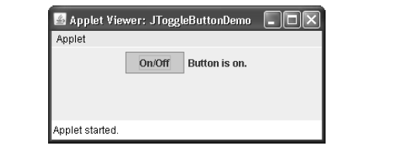
Demonstrate JToggleButton
// Add an item listener for the toggle button. jtbn.addItemListener(new ItemListener() { public void itemStateChanged(ItemEvent ie) { if(jtbn.isSelected()) jlab.setText("Button is on."); else jlab.setText("Button is off."); } }); // Add the toggle button and label to the content pane. add(jtbn); add(jlab); } }

Slide 65
Check Boxes
The JCheckBox class provides the functionality of a check box. Its immediate superclass is JToggleButton, which provides support for two-state buttons, as just described.
JCheckBox defines several constructors. The one used here is
JCheckBox(String str)
It creates a check box that has the text specified by str as a label. Other constructors let you specify the initial selection state of the button and specify an icon.
When the user selects or deselects a check box, an ItemEvent is generated. You can obtain a reference to the JCheckBox that generated the event by calling getItem( ) on the ItemEvent passed to the itemStateChanged( ) method defined by ItemListener. The easiest way to determine the selected state of a check box is to call isSelected( ) on the JCheckBox instance.

Slide 66
Demonstrate Check Boxes
// Demonstrate JCheckbox. import java.awt.*; import java.awt.event.*; import javax.swing.*; /* <applet code="JCheckBoxDemo" width=270 height=50> </applet> */ public class JCheckBoxDemo extends JApplet implements ItemListener { JLabel jlab; public void init() { try { SwingUtilities.invokeAndWait( new Runnable() { public void run() { | makeGUI(); } } ); } catch (Exception exc) { System.out.println("Can't create because of " + exc); } } private void makeGUI() { // Change to flow layout. setLayout(new FlowLayout()); // Add check boxes to the content pane. JCheckBox cb = new JCheckBox("C"); cb.addItemListener(this); add(cb); cb = new JCheckBox("C++");

Slide 67
Demonstrate Check Boxes
cb.addItemListener(this); add(cb); cb = new JCheckBox("Java"); cb.addItemListener(this); add(cb); cb = new JCheckBox("Perl"); cb.addItemListener(this); add(cb); // Create the label and add it to the content pane. jlab = new JLabel("Select languages"); add(jlab); } // Handle item events for the check boxes. public void itemStateChanged(ItemEvent ie) { JCheckBox cb = (JCheckBox)ie.getItem(); if(cb.isSelected()) jlab.setText(cb.getText() + " is selected"); else jlab.setText(cb.getText() + " is cleared"); } }

Slide 68
Radio Buttons
Radio buttons are a group of mutually exclusive buttons, in which only one button can be selected at any one time. They are supported by the JRadioButton class, which extends JToggleButton.
JRadioButton provides several constructors. The one used in the example is shown here:
JRadioButton(String str)
Here, str is the label for the button. Other constructors let you specify the initial selection state of the button and specify an icon.
A button group is created by the ButtonGroup class. Its default constructor is invoked for this purpose. Elements are then added to the button group via the following method:
void add(AbstractButton ab)
Here, ab is a reference to the button to be added to the group.

Slide 69
Radio Buttons
A JRadioButton generates action events, item events, and change events each time the button selection changes implement the ActionListener interface.
Recall that the only method defined by ActionListener is actionPerformed( ).
Inside this method, you can use a number of different ways to determine which button was selected. First, you can check its action command by calling getActionCommand( ).
By default, the action command is the same as the button label, but you can set the action command to something else by calling setActionCommand( ) on the radio button. Second, you can call getSource( ) on the ActionEvent object and check that reference against the buttons.
Finally, you can simply check each radio button to find out which one is currently selected by calling isSelected( ) on each button

Slide 70
Demonstrate RadioButton
import java.awt.*; import java.awt.event.*; import javax.swing.*; /* <applet code="JRadioButtonDemo" width=300 height=50> </applet> */ public class JRadioButtonDemo extends JApplet implements ActionListener { JLabel jlab; public void init() { try { SwingUtilities.invokeAndWait( new Runnable() { public void run() { makeGUI(); } } ); } | catch (Exception exc) { System.out.println("Can't create because of " + exc); } } private void makeGUI() { // Change to flow layout. setLayout(new FlowLayout()); // Create radio buttons and add them to content pane. JRadioButton b1 = new JRadioButton("A"); b1.addActionListener(this); add(b1); JRadioButton b2 = new JRadioButton("B"); b2.addActionListener(this); add(b2); JRadioButton b3 = new JRadioButton("C"); b3.addActionListener(this); add(b3);

Slide 71
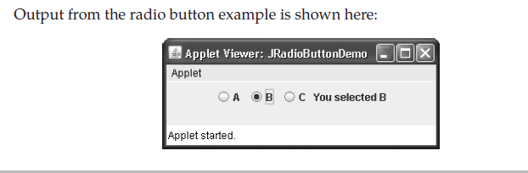
Demonstrate Check Boxes
// Define a button group. ButtonGroup bg = new ButtonGroup(); bg.add(b1); bg.add(b2); bg.add(b3); // Create a label and add it to the content pane. jlab = new JLabel("Select One"); add(jlab); } // Handle button selection. public void actionPerformed(ActionEvent ae) { jlab.setText("You selected " + ae.getActionCommand()); } }

Slide 72
Thanks!
Any questions?

