Slide 1
CST 205 - Object Oriented Programming
Using Java
Introduction
Notes:
T

Slide 2
Object-Oriented Programming
Object-oriented programming is a method of implementation in which programs are organized as cooperative collections of objects, each of which represents an instance of some class, and whose classes are all members of a hierarchy of classes united via inheritance relationships.
There are three important parts to this definition:
  (1) Object-oriented programming uses objects, not algorithms/functions, as its fundamental logical building blocks
  (2) each object is an instance of some class
  (3) classes may be related to one another via inheritance relationships
Notes:
User - > Database

Slide 3
Advantages of OOPS
Modularity and Code Reusability
Encapsulation
Abstraction
Inheritance
Polymorphism
Security
Scalability and Extensibility

Slide 4
Categories of Analysis and Design Methods
A method: is a disciplined procedure for generating a set of models that describe various aspects of a software system under development, using some well-defined notation.
Methods are important for several reasons. Foremost, they instill a discipline into the development of complex software systems. Eg ERD
A methodology: is a collection of methods applied across the software development lifecycle and unified by process, practices, and some general, philosophical approach.
most methods can be categorized as one of three kinds
  ■ Top-down structured design
  ■ Data-driven design
  ■ Object-oriented design

Slide 5
Complexity of Software
There are five attributes common to all complex systems.
Hierarchic Structure: composed of interrelated subsystems
Relative Primitives: The choice of what components in a system are primitive is relatively arbitrary and is largely up to the discretion of the observer of the system
Separation of Concerns: involving interaction among components
Common Patterns: complex systems have common patterns. These patterns may involve the reuse of small components
Stable Intermediate Forms: A complex system designed from scratch never works and cannot be patched up to make it work. You have to start over, beginning with a working simple system.

Slide 6
The Role of Decomposition
When designing a complex software system, it is essential to decompose it into smaller and smaller parts, each of which we may then refine independently.
  Algorithmic Decomposition
  Object Oriented Decomposition.
Algorithmic/Functional Decomposition
  Most of us have been formally trained in the dogma of top-down dstructured design, and so we approach decomposition as a simple matter of algorithmic decomposition, wherein each module in the system denotes a major step in some overall process

Slide 7
The Role of Decomposition
Object Oriented Decomposition.
  Decompose the system according to the key abstractions in the problem domain.
  Rather than decomposing the problem into steps of Functions or Algorithms, we have identified certain Objects
  Key abstractions refer to high-level concepts or entities in the problem domain that are essential to understanding and solving a particular problem.
  These abstractions may or may not correspond directly to classes or objects in the software design.

Slide 8
Function-oriented Design
Salient features of the function-oriented design approach
1. Top-down decomposition
  A system, to start with, is viewed as a black box that provides certain services (also known as high-level functions) to the users of the system.
  Application of divide and conquer principle. Through this each high-level function is independently decomposed into detailed functions.
  Graphical representation of the analysis results using data flow diagrams.(DFD)[hierarchical graphical model of a system]
  During structured design phase the results of the structured analysis (that is, the DFD model) is converted into a structure chart.

Slide 9
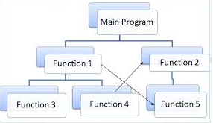
Algorithmic Decomposition updates the content of a master file
Function Oriented Desingn
Notes:
Test123

Slide 10
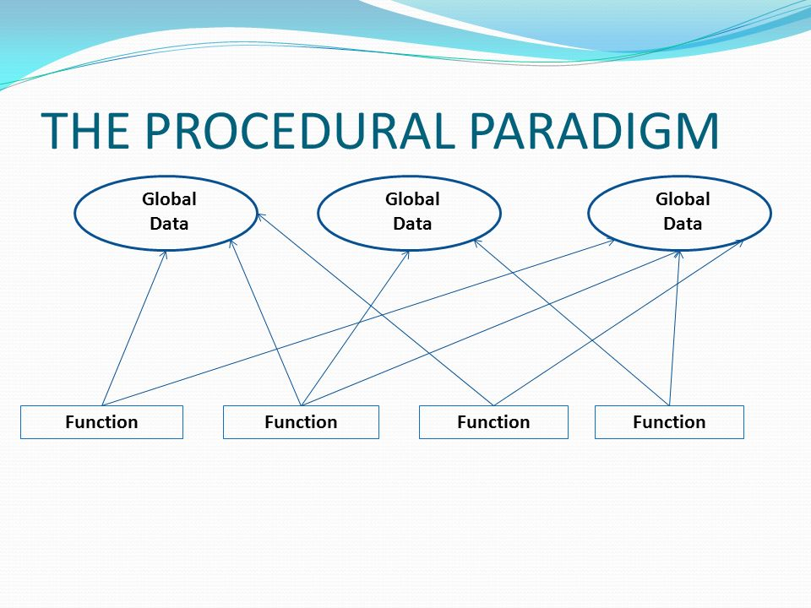
Algorithmic Decomposition updates the content of a master file
Function Oriented Desingn
Notes:
Test123

Slide 11
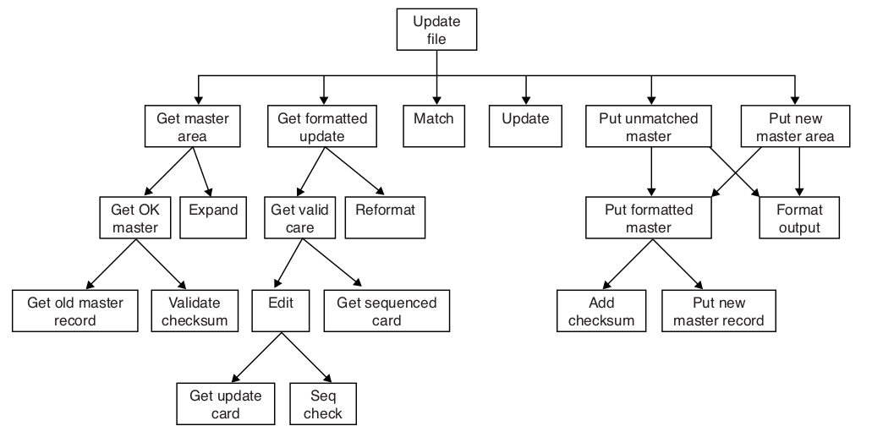
Algorithmic Decomposition
Updates the content of a Master file
Notes:
Test123

Slide 12
Object Oriented Decomposition updates the content of a master file
Rather than decomposing the problem into algorithma/functions such as Get_formatted, Update and Add_checksum, we have identified objects such as Master_File and Checksum, which derive directly from the vocabulary of the problem domain.
  Objects- Master_File, Cheksome etc
  No components like Get_formatted(), Update() or Add_checksome().
Notes:
Test123

Slide 13
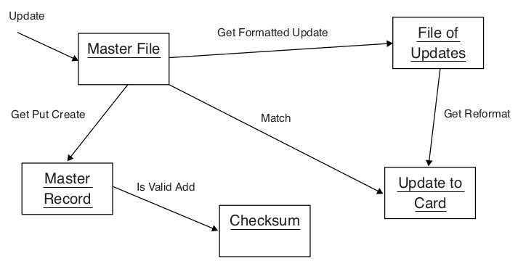
Object Oriented Decomposition updates the content of a master file
Notes:
Test123

Slide 14
Object Oriented Decomposition updates the content of a master file
Both designs solve the same problem, they do so in quite different ways.
In this second decomposition, we view the world as a set of autonomous agents that collaborate to perform some higher-level behavior.
Get Formatted Update thus does not exist as an independent algorithm; rather, it is an operation associated with the object File of Updates.
Calling this operation creates another object, Update to Card. In this manner, each object in our solution embodies its own unique behavior, and each one models some object in the real world.
From this perspective, an object is simply a tangible entity that exhibits some well-defined behavior.
Objects do things, and we ask them to perform what they do by sending them messages. Because our decomposition is based on objects and not algorithms, we call this an object-oriented decomposition.

Slide 15
Object Oriented Decomposition updates the content of a master file
Algorithmic view highlights the ordering of functions/algorithms,
Object-oriented view emphasizes the agents/objects that either cause action or are the subjects on which these operations act.
  Let Car is the Object/agent
    Start will cause action that change the state from engine Off->On
    Accelarate which opeate on car to change its Speed.

Slide 16
Objects
Object-oriented technology is built on a sound engineering foundation called Object Model
When we use Object-oriented methods to analyze or design a complex software system, our basic building blocks are classes and objects
Infromal Definition
“Object as a tangible entity that exhibits some well-defined behavior”

Slide 17
Objects
Formal Definition Of Object
  An object is an entity that has state, behavior, and identity. The structure and behavior of similar objects are defined in their common class.
  The terms instance and object are interchangeable.

Slide 18
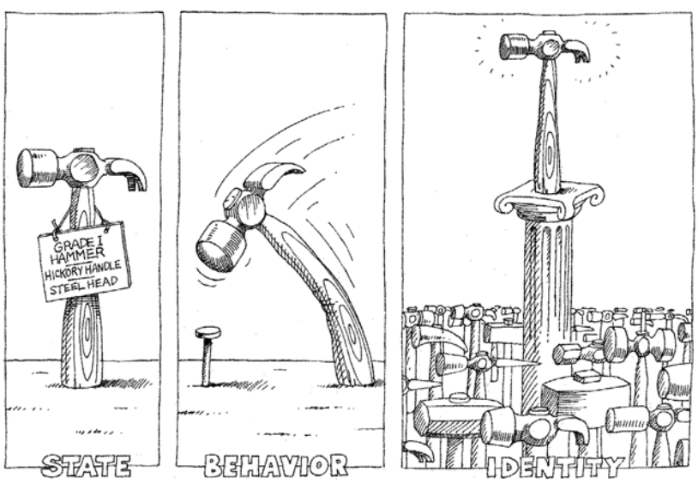
Objects
An object has state, exhibits some well-defined behavior, and has a unique identity.

Slide 19
Objects
State: The state of an object refers to the data or attributes that describe its current condition or properties. These attributes can be represented as variables or fields within the object
  Material: e.g., steel or wood
  Weight: e.g., 16 ounces or 32 ounces
  Color: The color of the hammer.
  Condition: e.g., new, used, or damaged
Attributes are non-tangible

Slide 20
Objects
Behavior:
The behavior of an object defines the actions or operations that the object can perform. These actions are typically implemented as methods or functions associated with the object.
Strike: A hammer can be used to strike or hit objects, such as nails, to drive them into surfaces.
Pull: In some cases, a hammer might have a claw on the opposite end, allowing it to be used for pulling nails out of surfaces.

Slide 21
Objects
Identity:
Each object in a program has a unique identity. This identity distinguishes one object from another, even if they have the same state and behavior.
In most programming languages, this identity is typically represented by a unique memory address or some other internal identifie
This uniqueness can be based on factors like its serial number, manufacturing details.

Slide 22
Class
The concepts of a class and an object are tightly interwoven, for we cannot talk about an object without regard for its class.
However, there are important differences between these two terms.
Whereas an object is a concrete entity that exists in time and space, a class represents only an abstraction, the “essence” of an object, as it were.
Thus, we may speak of the class Mammal, which represents the characteristics common to all mammals. To identify a particular mammal in this class, we must speak of Instance/Object of Mammal, for eg, Dolphin is an instance of Class Mammal.

Slide 23
Class
Formal Definition of Class
A class is a set of objects that share a common structure, common behavior, and common semantics.
Alternate Definition
A class is a blueprint or a prototype or a template for creating objects. It defines the attributes (data) and methods (functions) that the objects of that class will have.

Slide 24
Class
What isn’t a class?
An object is not a class. Objects that share no common structure and behavior cannot be grouped in a class because, by definition, they are unrelated except by their general nature as objects.

Slide 25
Object Oriented Language
By this definition, some languages are object-oriented, and some are not.
Language is object-oriented if and only if it satisfies the following requirements:
  It supports objects that are data abstractions with an interface of named operations and a hidden local state.
  Objects have an associated type.
  Types [classes] may inherit attributes from supertypes [superclasses].

Slide 26
Object-Oriented Analysis ...(2)
Object-oriented analysis is a method of analysis that examines requirements from the perspective of the classes and objects found in the vocabulary of the problem domain.
Library Management System
  Identify Object – Books, Members, Librararian, Transaction
  Define Object Attributes/Properties:
    Book attributes: Title, Author, ISBN, Availability, Genre, etc.
    Library Member attributes: Name, ID, Contact Information, etc.
    Transaction attributes: Date, Due Date, Fine Amount, etc
  Identify Object Behaviors (Methods/Functions):
    Book behaviors: Enter, Remove, Reserve, Update Information, etc.
    Library Member behaviors: Borrow Book, Return Book, Place Reservation, Pay Late Fees, etc.
  Determine Object Relationships:
    A Library Member can borrow multiple books.
    A Book can be borrowed by multiple Library Members.
    Librarians manage books and transactions.
    Books belong to specific Library Sections, etc.

Slide 27
Object-Oriented Analysis
Object-oriented analysis is a method of analysis that examines requirements from the perspective of the classes and objects found in the vocabulary of the problem domain.
  Understand the requirements - This is the initial phase where you identify and understand the requirements of the system.
  Problem Domain Modeling- Focus on modeling the problem domain,which means representing real-world entities, their attributes, behaviors, and relationships.
  Identifying Objects- These objects become the building blocks of the design. They define the structure and functionality of the system
The goal is to gain a clear understanding of what the software should do and how it should interact with the real world.

Slide 28
Object-Oriented Design
Object-oriented design is a method of design encompassing the process of object-oriented decomposition and a notation for depicting both logical and physical aswell as static and dynamic models of the system under design.
There are two important parts to this definition: object-oriented design.
  (1) leads to an object-oriented decomposition and
  (2) uses different notations to express different models of the logical (class and object structure) and physical (module and process architecture, implementation, tables etc) design of a system, in addition to the static and dynamic aspects of the system

Slide 29
How OOA, OOD, and OOP related
Object-Oriented Analysis (OOA):
Objective: OOA focuses on understanding the problem domain and defining the requirements of a software system.
Activities: During OOA, software engineers identify and define the objects, their attributes, their relationships, and the behaviors or methods associated with these objects. This phase is primarily concerned with understanding and modeling the problem, often using techniques like use case diagrams, class diagrams, and interaction diagrams.
Output: The output of OOA is a detailed and clear understanding of what the system needs to do, without specifying how it will be implemented.

Slide 30
How OOA, OOD, and OOP related
Object-Oriented Design (OOD):
Objective: OOD follows OOA and focuses on transforming the requirements and analysis models into a design that can be implemented in code.
Activities: During OOD, software engineers take the conceptual models created during OOA and refine them into more concrete designs. This includes defining class hierarchies, designing the system's architecture, specifying interfaces, and detailing the implementation of methods.
Output: The output of OOD is a detailed design specification that serves as a blueprint for coding. It includes class diagrams, sequence diagrams, and other design artifacts.

Slide 31
How OOA, OOD, and OOP related
Object-Oriented Programming (OOP):
Objective: OOP is the actual implementation phase where the software is written in a programming language following the design specifications created during OOD.
Activities: During OOP, developers write code using an object-oriented programming language (such as Java, C++, or Python) to create classes and objects based on the OOD specifications. They implement the methods, encapsulate data, and manage object interactions.
Output: The output of OOP is executable code or software that can be run on a computer. It directly represents the realization of the design.

Slide 32
Object-Oriented Analysis and Design (OOAD):
Focus: OOAD is an integrated approach that combines OOA and OOD into a unified and iterative process.
Activities: The process involves analyzing and designing your system from an object-oriented point of view. It ensures that the results of the analysis phase are effectively translated into a practical, implementable design.
Output: The output of OOAD includes a design model that directly reflects the conceptual model created during analysis. It also addresses issues related to system architecture, modularity, and reusability..
Goal: The goal of OOAD is to bridge the gap between understanding the problem domain (OOA) and creating a structured, object-oriented solution (OOD). It ensures that the analysis model and the design model are closely aligned.

Slide 33
Object-Oriented Analysis and Design (OOAD):
Focus: OOAD is an integrated approach that combines OOA and OOD into a unified and iterative process.
Activities: The process involves analyzing and designing your system from an object-oriented point of view. It ensures that the results of the analysis phase are effectively translated into a practical, implementable design.
Output: The output of OOAD includes a design model that directly reflects the conceptual model created during analysis. It also addresses issues related to system architecture, modularity, and reusability..
Goal: The goal of OOAD is to bridge the gap between understanding the problem domain (OOA) and creating a structured, object-oriented solution (OOD). It ensures that the analysis model and the design model are closely aligned.

Slide 34
OOAD and UML
UML is an integral part of OOAD, serving as a visual language for modeling, designing, and documenting object-oriented software systems.
It enhances communication, improves understanding, and supports various aspects of the software development process, from analyzing requirements to designing the system's structure and behavior.
UML diagrams are used as powerful tools throughout the OOAD lifecycle to create a shared understanding of the software system's architecture and design.
  Visual Representation of Concepts
  Analysis and Design Artifacts
  Communication and Collaboration
  Design Documentation
  Code Generation

Slide 35
The Role of Classes and Objects in Analysis and Design
During analysis and the early stages of design, the developer has two primary tasks:
1. Identify the classes that form the vocabulary of the problem domain
2. Invent the structures whereby sets of objects work together to provide the behaviors that satisfy the requirements of the problem
Collectively, we call such classes and objects the key abstractions of the problem,and we call these cooperative structures the mechanisms of the implementation.

Slide 36
The Role of Classes and Objects in Analysis and Design
1. Identify the classes that form the vocabulary of the problem domain
  Gather Requirements
  Domain Analysis: Analyze the problem domain to identify key entities, concepts, and relationships that are relevant to the problem
  Class Definition: Define the attributes (properties or data) and methods (functions or behaviors) that each class should have.
  UML Diagrams: Create Unified Modeling Language (UML) diagrams, such as class diagrams, to visually represent the identified classes and their relationships. This helps in visualizing the structure of the software.

Slide 37
The Role of Classes and Objects in Analysis and Design
2. Invent the structures whereby sets of objects work together to provide the behaviors that satisfy the requirements of the problem
  System Architecture: Define the high-level architecture of the software system. Determine the major components and their responsibilities. These components often correspond to sets of related classes
  Class Relationships: Specify how classes are related to each other. Common relationships include association (how classes are connected), inheritance (subclasses inheriting from superclasses), and composition (classes containing instances of other classes).
  UML Diagrams : Sequence Diagram, etc

