Slide 1
Data reduction

Slide 2
Data reduction
Reduced representation of the data set that is much smaller in volume
Maintains the integrity of the original data.
Mining on the reduced data set should be more efficient yet produce the same (or almost the same) analytical results

Slide 3
Strategies for data reduction
Data cube aggregation
Attribute subset selection
Dimensionality reduction
Numerosity reduction
Discretization and concept hierarchy generation

Slide 4
Strategies for data reduction
1. Data cube aggregation, where aggregation operations are applied to the data in the construction of a data cube.
2. Attribute subset selection, where irrelevant, weakly relevant, or redundant attributes or dimensions may be detected and removed.
3. Dimensionality reduction, where encoding mechanisms are used to reduce the data set size.

Slide 5
Strategies for data reduction
4. Numerosity reduction,where the data are replaced or estimated by alternative, smaller data representations such as parametric models or nonparametric methods such as clustering, sampling, and the use of histograms.
5. Discretization and concept hierarchy generation,where raw data values for attributes are replaced by ranges or higher conceptual levels.

Slide 6
Data cube aggregation
A data cube allows data to be modelled and viewed in multiple dimensions.
Data cubes store multidimensional aggregated information

Slide 7
A Multidimensional Data Model
Data warehouses and OLAP tools are based on a multidimensional data model.
This model views data in the form of a data cube.
an n-Dimensional base cube is called a base cuboid
The top most 0-D cuboid, which holds the highest-level of summarization, is called the apex cuboid
The lattice of cuboids forms a data cube

Slide 8
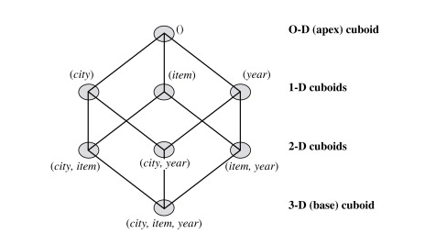
Cube: A Lattice of Cuboids

Slide 9
Cube: A Lattice of Cuboids
all
0-D(apex) cuboid
time
item
location
supplier
1-D cuboids
time,location
item,location
location,supplier
time,item
2-D cuboids
time,supplier
item,supplier
time,location,supplier
3-D cuboids
time,item,location
time,item,supplier
item,location,supplier
4-D(base) cuboid
time, item, location, supplier

Slide 10
Data cube aggregation
Aggregation operations are applied to the data in the construction of a data cube.
Types are
basecuboid.
apex cuboid.
lattice of cuboids

Slide 11
basecuboid.
Imagine that we have collected the data for analysis.
These data consist of the AllElectronics sales per quarter, for the years 2002 to 2004.
But we are, interested in the annual sales (total per year), rather than the total per quarter.
Thus the data can be aggregated so that the resulting data summarize the total sales per year instead of per quarter.
The resulting data set is smaller in volume, without loss of information necessary for the analysis task.

Slide 12
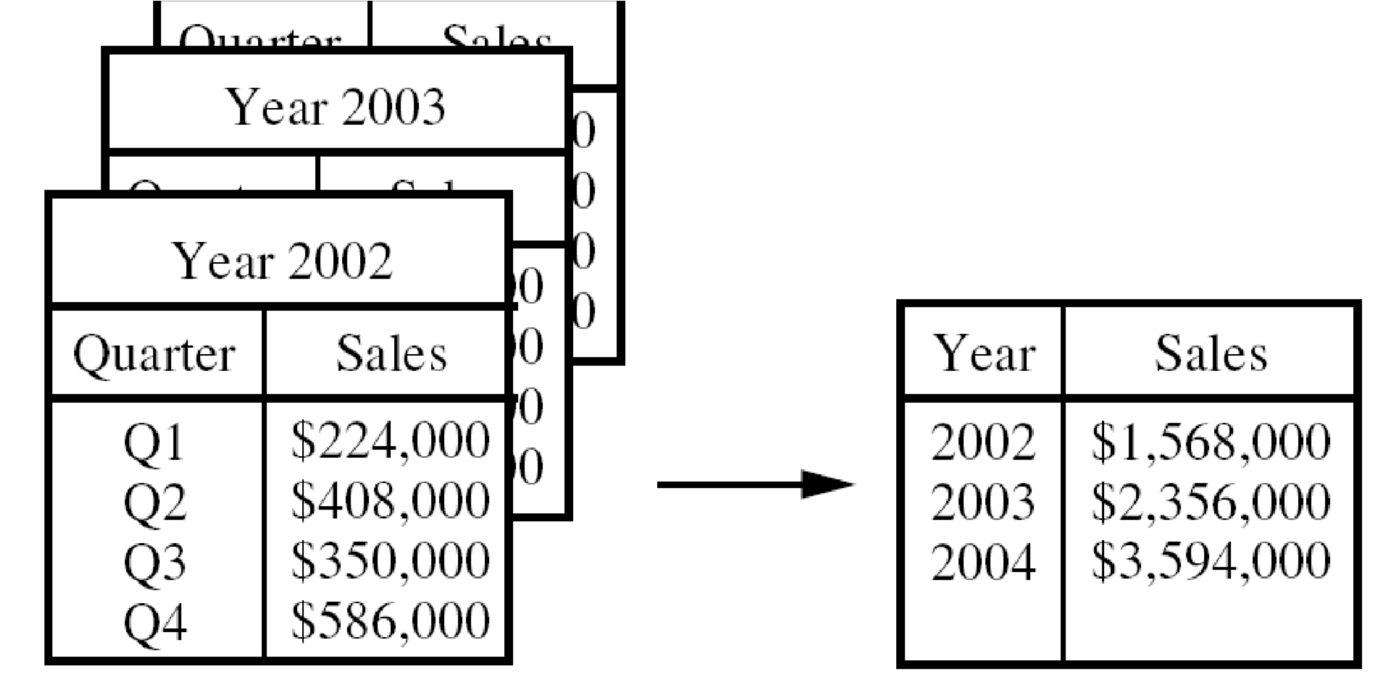
Data CUBE Aggregation
On the left, the sales are shown per quarter. On the right, the data are aggregated to provide the annual sales

Slide 13
Basecuboid & apex cuboid
Data cubes provide fast access to precomputed, summarized data, thereby benefiting on-line analytical processing as well as data mining.
The cube created at the lowest level of abstraction is referred to as the basecuboid.
The base cuboid should correspond to total sales for any combination of the all dimensions.
A cube at the highest level of abstraction is the apex cuboid.
For the sales data of above Figure , the apex cuboid would give one total—the total sales for all three years, for all item types, and for all branches.

Slide 14
Attribute subset selection
irrelevant, weakly relevant, or redundant attributes or dimensions may be detected and removed.
Stepwise forward selection:
Stepwise backward elimination
Combination of forward selection and backward elimination
Decision tree induction

Slide 15
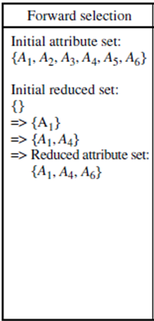
Stepwise forward selection:
The procedure starts with an empty set of attributes as the reduced set.
The best of the original attributes is determined and added to the reduced set

Slide 16
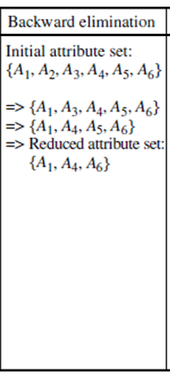
Stepwise backward elimination:
The procedure starts with the full set of attributes.
At each step, it removes the worst attribute remaining in the set.

Slide 17
Combination of forward selection and backward elimination :
At each step, the procedure selects the best attribute and removes the worst from among the remaining attributes

Slide 18
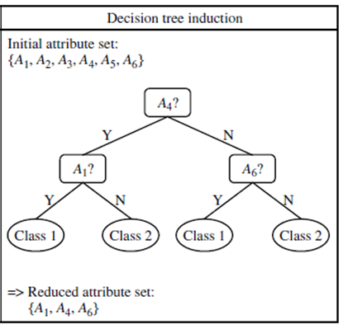
Decision tree induction
A tree is constructed from the given data.
All attributes that do not appear in the tree are assumed to be irrelevant.
The set of attributes appearing in the tree form the reduced subset of attributes.

Slide 19
Dimensionality reduction
The number of input variables or features for a dataset is referred to as its dimensionality.
Dimensionality reduction refers to techniques that reduce the number of input variables in a dataset.
More input features often make a predictive modeling task more challenging to model, more generally referred to as the curse of dimensionality.
High-dimensionality statistics and dimensionality reduction techniques are often used for data visualization.

Slide 20
Curse of Dimensionality
Dimensions are also known as features or attributes
As the number of features increases, the classifier’s performance increases as well until we reach the optimal number of features.
Adding more features based on the same size as the training set will then degrade the classifier’s performance.
Hughes phenomenon
To get rid of the curse of dimensionality, a process called dimensionality reduction was introduced.
Dimensionality reduction techniques can be used to filter only a limited number of significant features needed for training

Slide 21
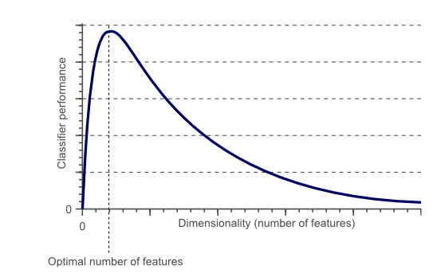
Curse of Dimensionality

Slide 22
Dimensionality reduction
In statistical and machine learning, dimensionality reduction or dimension reduction is the process of reducing the number of variables under consideration by obtaining a smaller set of principal variables.

Slide 23
Why is Dimensionality Reduction required?
Here are some of the benefits of applying dimensionality reduction to a dataset:
Space required to store the data is reduced as the number of dimensions comes down
Less dimensions lead to less computation/training time
It takes care of multicollinearity by removing redundant features.
It helps in visualizing data.
it is very difficult to visualize data in higher dimensions so reducing our space to 2D or 3D may allow us to plot and observe patterns more clearly

Slide 24
Dimensionality reduction,
Data encoding or transformations are applied so as to obtain a reduced or “compressed” representation of the original data.
Two types of reduction
lossless.
Lossy.
If the original data can be reconstructed from the compressed data without any loss of information, the data reduction is called lossless.

Slide 25
Dimensionality reduction,
If, instead, we can reconstruct only an approximation of the original data, then the data reduction is called lossy.
Types are
Wavelet Transforms
Principal Components Analysis

Slide 26
PCA
Principal components analysis (PCA) is a technique that can be used to simplify a dataset
It is a linear transformation that chooses a new coordinate system for the data set such that
greatest variance by any projection of the data set comes to lie on the first axis (then called the first principal component),
the second greatest variance on the second axis, and so on.
PCA can be used for reducing dimensionality by eliminating the later principal components.

Slide 27
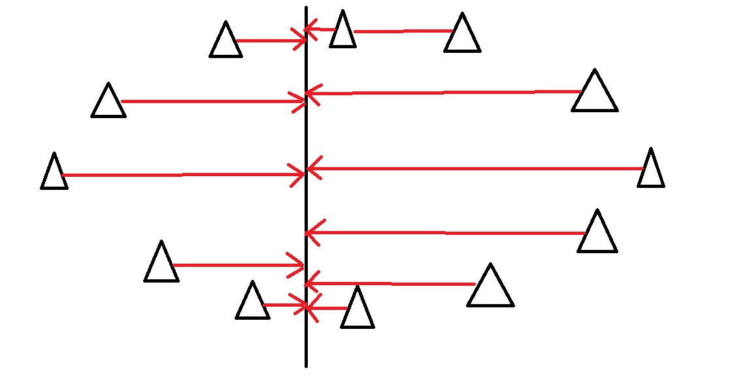
To find the direction where there is most variance, find the straight line where the data is most spread out when projected onto it. A vertical straight line with the points projected on to it will look like this:

Slide 28
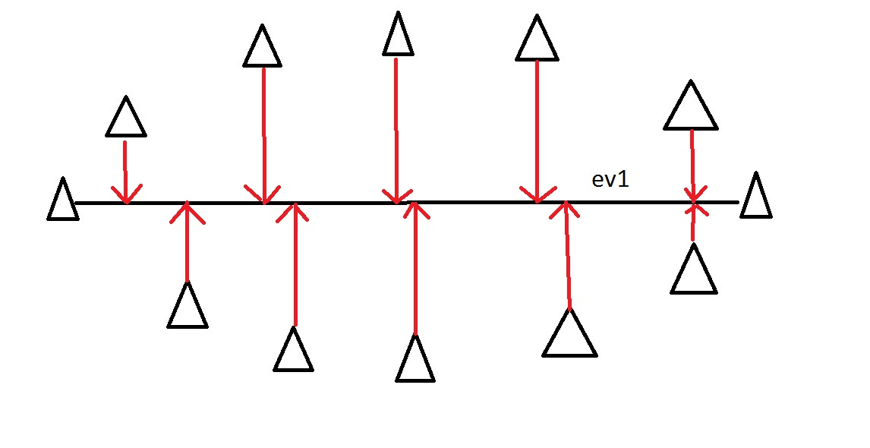
On this line the data is way more spread out, it has a large variance. In fact there isn’t a straight line you can draw that has a larger variance than a horizontal one. A horizontal line is therefore the principal component in this example.

Slide 29
Step By Step Computation Of PCA
The below steps need to be followed to perform dimensionality reduction using PCA:
Standardization of the data
Computing the covariance matrix
Calculating the eigen values and normalized eigen vectors of covariance matrix
Computing the Principal Components
Reducing the dimensions of the data set

Slide 30
Wavelet Transforms
The Discrete Wavelet Transform (DWT) is a linear signal processing technique.
When applied to a data vector D, transforms it into a numerically different vector, D’, of wavelets coefficients .
All wavelet coefficients larger than some user defined threshold can be retained .
The remaining coefficients set to zero.

Slide 31
Numerosity Reduction
Reduce the data volume by choosing alternative, ‘smaller’ forms of data representation.
These techniques may be
parametric
nonparametric.

Slide 32
Parametric methods,
Used to estimate the data, so that typically only the data parameters need to be stored, instead of the actual data.
Eg:
Regression
Log-linear models

Slide 33
Regression and Log-Linear Models
In linear regression, the data are modeled to fit a straight line
For example, a random variable, y (called a response variable), can be modeled as a linear function of another random variable, x (called a predictor variable), with the equation
Y = α+βx
x and y are numerical database attributes.
The coefficients, α and β (called regression coefficients), specify the Y-intercept and slope of the line respectively.
These coefficients can be solved for by the method of least squares

Slide 34
Regression and Log-Linear Models
Multiple linear regression is an extension of (simple) linear regression,
which allows a response variable, y, to be modelled as a linear function of two or more predictor variables.
Log-linear models is a technique used in statistics to examine the relationship between more than two categorical variables.

Slide 35
Nonparametric methods
reduced representations of the data include
histograms
clustering
sampling.

Slide 36
Histograms
Histograms use binning to approximate data distributions and are a popular form of data reduction.
A histogram for an attribute, A, partitions the data distribution of A into disjoint subsets, or buckets.
If each bucket represents only a single attribute-value/frequency pair, the buckets are called singleton buckets.

Slide 37
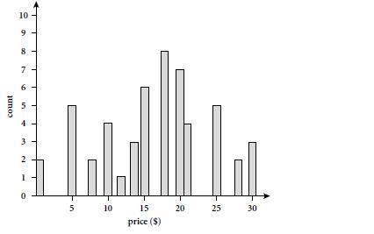
Example Histograms
. The following data are a list of prices of commonly sold items at AllElec-tronics (rounded to the nearest dollar). The numbers have been sorted: 1, 1, 5, 5, 5, 5, 5, 8, 8, 10, 10, 10, 10, 12, 14, 14, 14, 15, 15, 15, 15, 15, 15, 18, 18, 18, 18, 18, 18, 18, 18, 20, 20, 20, 20, 20, 20, 20, 21, 21, 21, 21, 25, 25, 25, 25, 25, 28, 28, 30, 30, 30.

Slide 39
Clustering
Clustering techniques consider data tuples as objects.
They partition the objects into groups or clusters, so that objects within a cluster are “similar” to one another and “dissimilar” to objects in other clusters.
Similarity is commonly defined in terms of how “close” the objects are in space, based on a distance function.
In data reduction, the cluster representations of the data are used to replace the actual data.
The effectiveness of this technique depends on the nature of the data.

Slide 40
Sampling
Sampling can be used as a data reduction technique because it allows a large data set to be represented by a much smaller random sample (or subset) of the data.
common ways that we could sample data set for for data reduction,
Simple random sample without replacement (SRSWOR) of size s:
Simple random sample with replacement (SRSWR) of size s:
Cluster sample:
Stratified sample:

Slide 41
Data Discretization and Concept Hierarchy Generation
Data discretization techniques can be used to reduce the number of values for a given continuous attribute by dividing the range of the attribute into intervals.
Interval labels can then be used to replace actual data values.
This will reduces and simplifies the original data.
This leads to a concise, easy-to-use,knowledge-level representation of mining results.

Slide 42
Category of discretization techniques
top-down vs bottom-up
supervised discretization vs unsupervised.

Slide 43
Category of discretization techniques
If the discretization process uses class information, then we say it is supervised discretization.
Otherwise, it is unsupervised.
If the process starts by first finding one or a few points (called split points or cut points) to split the entire attribute range, and then repeats this recursively on the resulting intervals, it is called top-down discretization or splitting.
This contrasts with bottom-up discretization or merging, which starts by considering all of the continuous values as potential split-points, removes some by merging neighborhood values to form intervals, and then recursively applies this process to the resulting intervals.

Slide 44
Data Discretization and Concept Hierarchy Generation
A concept hierarchy for a given numerical attribute defines a discretization of the attribute.
Concept hierarchies can be used to reduce the data by collecting and replacing low-level concepts (such as numerical values for the attribute age) with higher-level concepts (such as youth, middle-aged, or senior).

Slide 45
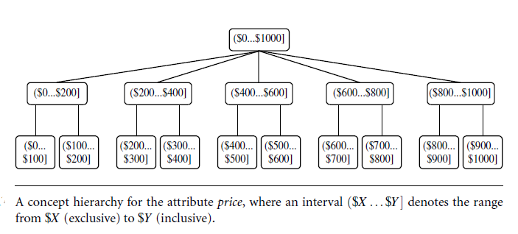

Slide 46
Methods of discretization
Binning,
Histogram analysis
3. Entropy-based discretization
4. Interval Merging by χ 2 Analysis
5. Cluster analysis
6. Discretization by intuitive partitioning
In general, each method assumes that the values to be discretized are sorted in ascending order.

Slide 47
Binning
Binning is a top-down splitting technique based on a specified number of bins.
Binning methods can be used for data smoothing.
These methods are also used as discretization methods for numerosity reduction and concept hierarchy generation.
For example, attribute values can be discretized by applying equal-width or equal-frequency binning, and then replacing each bin value by the bin mean or median, as in smoothing by bin means or smoothing by bin medians, respectively.

Slide 48
Simple Discretization Methods: Binning
Equal-width (distance) partitioning:
It divides the range into N intervals of equal size: uniform grid
if A and B are the lowest and highest values of the attribute, the width of intervals will be: W = (B-A)/N.
Equal-depth (frequency) partitioning:
It divides the range into N intervals, each containing approximately same number of samples
Good data scaling

Slide 49
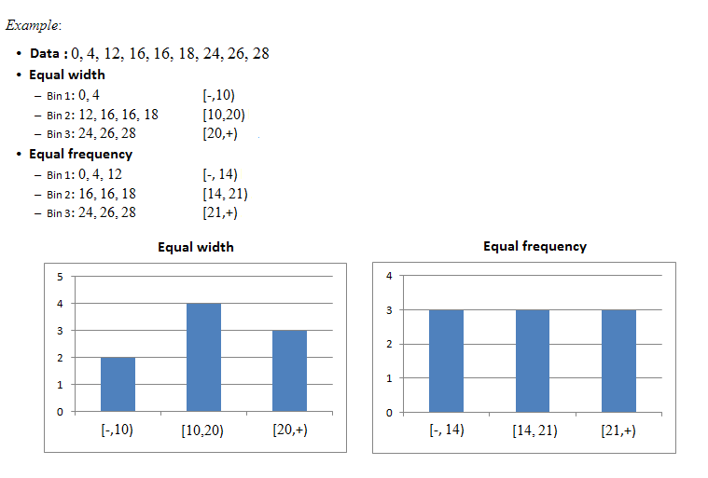

Slide 50
Binning does not use class information and is therefore an unsupervised discretization technique.
It is sensitive to the user-specified number of bins, as well as the presence of outliers

Slide 51
Histogram Analysis
Like binning, histogram analysis is an unsupervised discretization technique because it does not use class information
Histograms partition the values for an attribute, A, into disjoint ranges called buckets.
In an equal-width histogram, for example, the values are partitioned into equal-sized partitions or ranges
With an equal frequency histogram, the values are partitioned so that, ideally, each partition contains the same number of data tuples.

Slide 52
Entropy-Based Discretization
Entropy is one of the most commonly used discretization measures
Entropy-based discretization is a supervised, top-down splitting technique.
Entropy measures the amount of information in a random variable
Using Entropy-based measure for attribute selection
Ex. Decision tree construction

Slide 53
Interval Merge by χ² Analysis
ChiMerge is χ² -based discretization method.
Employs a bottom-up approach
finds the best neighboring intervals and then merging these to form larger intervals, recursively.
The method is supervised in that it uses class information.
ChiMerge proceeds as follows.
Initially, each distinct value of a numerical attribute A is considered to be one interval.
χ² tests are performed for every pair of adjacent intervals.
Adjacent intervals with the least χ² values are merged together, because low χ² values for a pair indicate similar class distributions.
This merging process proceeds recursively until a predefined stopping criterion is met.

Slide 54
Cluster Analysis
Cluster analysis is a popular data discretization method.
A clustering algorithm can be applied to discretize a numerical attribute, A, by partitioning the values of A into clusters or groups.
Clustering takes the distribution of A into consideration, as well as the closeness of data points, and therefore is able to produce high-quality discretization results.
Clustering can be used to generate a concept hierarchy for A by following either a topdown splitting strategy or a bottom-up merging strategy, where each cluster forms a node of the concept hierarchy.
In the former, each initial cluster or partition may be further
decomposed into several subclusters, forming a lower level of the hierarchy.

Slide 55
Discretization by intuitive partitioning
3-4-5 rule can be used to segment numeric data into
relatively uniform, “natural” intervals.
* If an interval covers 3, 6, 7 or 9 distinct values at the most significant digit, partition the range into 3 equi-width intervals
* If it covers 2, 4, or 8 distinct values at the most significant digit, partition the range into 4 intervals
* If it covers 1, 5, or 10 distinct values at the most significant digit, partition the range into 5 intervals

Slide 56
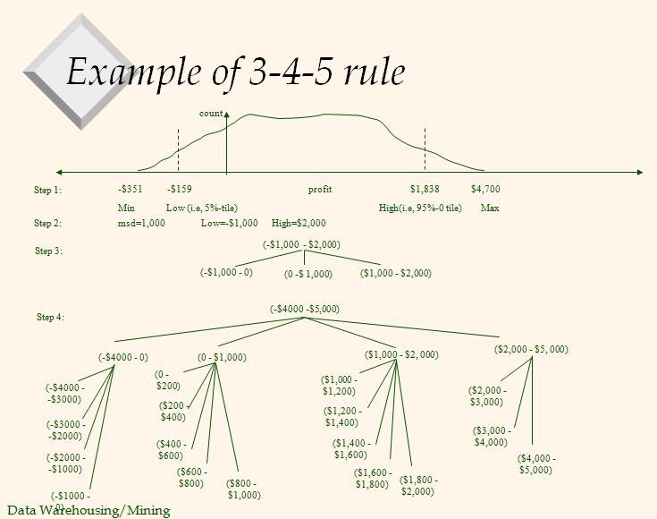

Slide 57
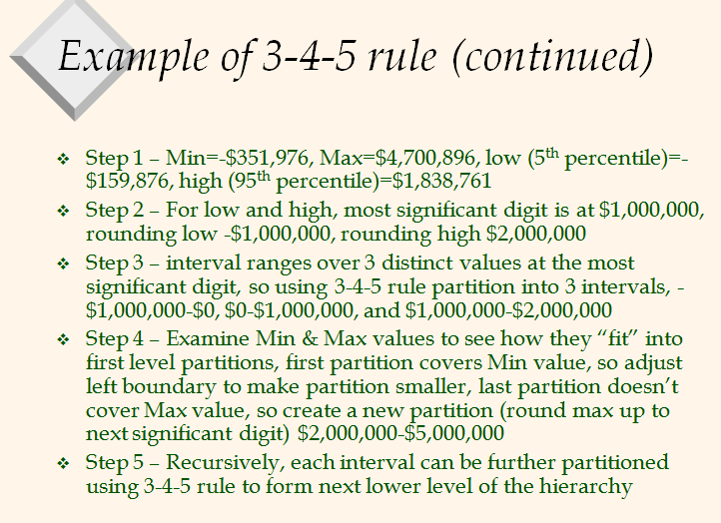

Slide 58
Example:
Suppose that profit data values for year 2017 for a company range from -3,51,976 to +4,70,00,896.
For practical purpose of avoiding noise, extremely high or extremely low values are not considered. So first we need to smooth out our data. Let’s discard bottom 5% and top 5% values.
Suppose after discarding above data new values for LOW = -159876 and HIGH = 1838761.
Most Significant Digit or MSD is at million position, see highlighted digit : –159876 and 1838761.
Next step is to round down LOW and round up HIGH to MSD that million position. So LOW = -1000000 and HIGH = 2000000. -1000000 is nearest down million to -159876 and 2000000 is nearest up million to 1838761.
Now let’s identify range of this interval. Range = HIGH – LOW that is 2000000 – (-1000000) = 3000000. We consider only MSD here which is 3.

Slide 59
Now that we know range MSD = 3, we can apply rule #1.
Rule #1 says that we can divide this interval into three equal size intervals:
Interval 1 : -1000000 to 0
Interval 2 : 0 to 1000000
Interval 3 : 1000000 to 2000000
You should be thinking how 0 can be part of multiple intervals? You’re right! We should represent it as follows:
Interval 1 : (-1000000 … 0]
Interval 2 : (0 … 1000000]
Interval 3 : (1000000 … 2000000]
Here (a … b] denotes range that excludes a but includes b. ( , ] is notation for half-open interval.

Slide 60
Suppose that profits at different branches of All Electronics for the year 2004 cover a wide
range, from $-351 to $4,700.
The data within the 5th percentile and 95th
percentile are between $-159 and $1,838. Partition the above data range,ie
$-351 to $4,700 using 3-4-5 rule

