Slide 1
Data Transformation

Slide 2
Data Transformation
In data transformation, the data are transformed or consolidated into forms appropriate for mining.

Slide 3
Data transformation can involve the following:
Smoothing
Aggregation
Generalization
Normalization
min-max normalization
z-score nor malization
normalization by decimal scaling
Attribute construction

Slide 4
Smoothing,
which works to remove noise from the data. Such techniques include
binning
Regression
clustering.

Slide 5
Aggregation,
where summary or aggregation operations are applied to the data.
For example, the daily sales data may be aggregated so as to compute monthly and annual total amounts

Slide 6
Generalization
low-level or “primitive” (raw) data are replaced by higher-level concepts through the use of concept hierarchies.
For example, categorical attributes, like street, can be generalized to higher-level concepts, like city or country.
Age may be mapped to higher-level concepts, like youth, middle-aged, and senior

Slide 8
Normalization
An attribute is normalized by scaling its values so that they fall within a small specified range, such as 0.0 to 1.0.
There are many methods for data normalization.
They are
min-max normalization
z-score normalization
normalization by decimal scaling.

Slide 9
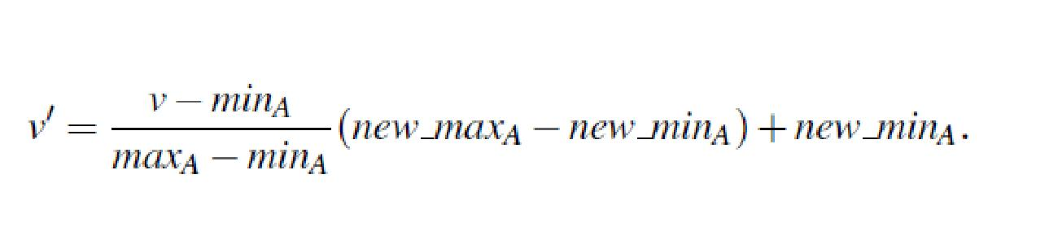
min-max normalization
Min-max normalization performs a linear transformation on the original data.
Suppose that minA and maxA are the minimum and maximum values of an attribute,A.
Min-max normalization maps a value, v, of A to v¹ in the range [new minA;new maxA] by computing
Min-max normalization preserves the relationships among the original data values.

Slide 10

Min-max normalization Example :
Suppose that the minimum and maximum values for the attribute income are $12,000 and $98,000, respectively.
We would like to map income to the range [0.0;1.0].
By min-max normalization, a value of $73,600 for income is transformed to

Slide 11
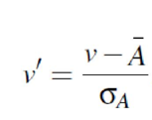
z-score normalization
The values for attribute A, are normalized based on the mean and standard deviation of A.
A value v of A is normalized to v¹ by computing
where A and σ_{A} are the mean and standard deviation, respectively, of attribute A.
This method of normalization is useful when the actual minimum and maximum of attribute A are unknown

Slide 12

z-score normalization Example
Suppose that the mean and standard deviation of the values for the attribute income are $54,000 and $16,000, respectively.
With z-score normalization, a value of $73,600 for income is transformed to

Slide 13

Normalization by decimal scaling
normalizes by moving the decimal point of values of attribute A.
The number of decimal points moved depends on the maximum absolute value of A.
A value, v, of A is normalized to v¹ by computing
where j is the smallest integer such that Max(|v||)< 1.

Slide 14
Example Decimal scaling.
Suppose that the recorded values of A range from -986 to 917. The maximum absolute value of A is 986.
To normalize by decimal scaling, we therefore divide each value by 1,000 (i.e., j = 3) so that 986 normalizes to - 0.986 and 917 normalizes to 0.917.

Slide 15
University question
Use the two methods below to normalize the following group of data: 100,200,300,500,900
min-max normalization by setting min=0 and max=1
z-score normalization

Slide 16
Solution
Use the two methods below to normalize the following group of data: 100,200,300,500,900
min-max normalization by setting min=0 and max=1
Ans: 0, 0.125, 0.25, 0.5, 1
z-score normalization
-1.0607,-0.7071, -0.3536, 0.3536, 1.7678

Slide 17
calculate Z-Score of the following data?
marks
8
10
15
20

Slide 18
calculate Z-Score of the following data?- Solution
Mean = 13.25
Standard deviation = 4.65
marks | marks after z-score normalization
8 | -1.12
10 | -0.69
15 | 0.37
20 | 1.45

Slide 19
calculate Min Max normalization of the following data?
newMax: 1
newMin: 0
marks
8
10
15
20

Slide 20
calculate Min Max normalization of the following data? - Solution
marks | marks after Min-Max normalization
8 | 0
10 | 0.16
15 | 0.58
20 | 1

Slide 21
Use the two methods below to normalize the following group of data:
200, 300, 400, 600, 1000
(a) min-max normalization by setting min = 0 and max = 1
(b) z-score normalization

Slide 22
Attribute construction (or feature construction),
where new attributes are constructed and added from the given set of attributes to help the mining process.

