Slide 1

CAPGEMINI
ChaloSamundar
Team Members
• Aditya Bhardwaj
• Anjali
• Ishaan Bansal
• Gurnoor Oberoi
• Sanjana Singh
• Upkaar Malik
Academic Project | Capgemini Training Program | 2026

Slide 2
Table of Contents
01
Project Overview
02
System Architecture
03
Microservices Breakdown
Goals, scope, and platform summary
Gateway-fronted microservices pattern
Six core services explained
04
Tech Stack
05
Key Highlights
06
User Journey & Data Flow
Technologies and frameworks used
Design principles and achievements
Step-by-step booking flow
07
Challenges & Solutions
08
Future Scope
09
Conclusion
Problems faced and how we solved them
Enhancements and next phases
Outcomes and future scope

Slide 3
Project Overview
6
6
1
Microservices
Databases
API Gateway
About ChaloSamundar
🔐
Secure Auth
🚢 Full-stack cruise booking platform on .NET microservices
JWT-based login and token management
🗺️ Browse trips, plan itineraries & select cabin types
🚢
Trip Catalog
💳 Secure booking flow with integrated payment processing
Browse and filter cruise schedules
🔐 JWT-secured gateway with role-based access control
💳
Payments
⚙️ Operators manage trip catalogs & cabin inventory
Integrated payment processing flow

Slide 4
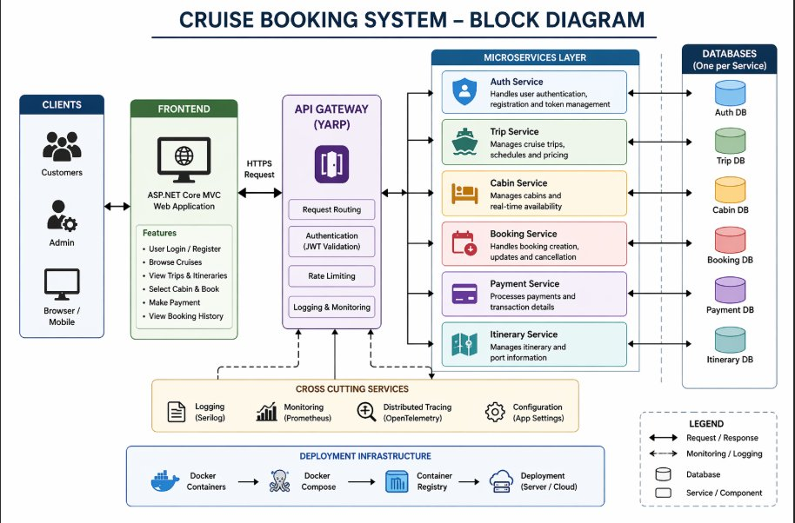
System Architecture

Slide 5



Microservices Breakdown
(1 of 2)
AuthService
Security
User registration & login
EF Core migrations
Handles user registration, login, and JWT token issuance. Uses SQL Express with Entity Framework Core migrations for user data persistence.
JWT Bearer token issuance
SQL Express storage
TripService
Catalog
Trip catalog management
Layered architecture
Manages the full catalog of cruise trips, schedules, and pricing. Implements a strict layered architecture: Controllers → Services → Repositories.
Pricing & schedules
SQL Express storage
ItineraryService
Planning
Multi-stop itinerary planning
Isolated SQL Express DB
Lets customers plan multi-stop itineraries tied to a specific trip. Each itinerary entry is persisted in its own isolated SQL Express database.
Trip-linked itineraries
CRUD operations

Slide 6



Microservices Breakdown
(2 of 2)
BookingService
Bookings
Booking records
Customer details
Stores and manages all booking records — customer details, selected trip, chosen cabin, booking status, and timestamps for each transaction.
Status tracking
Timestamps
CabinService
Inventory
Cabin type catalog
Real-time availability
Maintains the complete cabin catalog: cabin types (standard, deluxe, suite), occupancy limits, and real-time seat availability to prevent overbooking.
Occupancy limits
Overbooking prevention
PaymentService
Payments
Payment processing
Exception handling
Processes payments for confirmed bookings. Uses a repository pattern with dedicated exception handling and SQL Express persistence for reliable financial records.
Repository pattern
SQL Express persistence

Slide 7



Technology Stack
Backend & API
Data Storage
DevOps & Docs
🌐
ASP.NET Core MVC
🗄️
Entity Framework Core
🐳
Docker (containers)
⚡
ASP.NET Web API
💾
SQL Express (per-service)
📄
Swagger / OpenAPI
🔀
YARP Reverse Proxy
🍃
MongoDB (client-side)
🚀
Per-service deployment
🔑
JWT Bearer Auth
🔄
EF Core Migrations
📊
Health monitoring

Slide 8
Key Design Highlights
01
🔐 Centralized Authentication
02
🗄️ Database-per-Service
All services are protected by a single YARP API Gateway that validates JWT tokens before routing requests to downstream microservices. No auth logic is duplicated.
Every microservice owns its dedicated SQL Express database. This isolation ensures independent deployability, prevents tight coupling, and enables each service to evolve its schema independently.
03
🏗️ Layered Architecture
04
🐳 Containerized Deployment
Inside each service, a clean separation of Controllers → Services → Repositories is enforced. This maintains single responsibility and makes each layer independently testable.
Every service is Dockerized and independently deployable. This enables individual scaling of hot services (e.g., BookingService during peak times) without affecting others.

Slide 9
User Journey & Data Flow
1
👤 Register / Login
2
🚢 Browse Trips
3
🗺️ Plan Itinerary
User signs up or logs in via AuthService. JWT token is issued and stored.
Customer browses cruise catalog served by TripService with schedules & pricing.
Multi-stop itinerary is created and linked to the selected trip via ItineraryService.
4
🛏️ Select Cabin
5
📋 Book Ticket
6
💳 Make Payment
CabinService checks real-time availability and reserves the chosen cabin type.
BookingService creates a booking record with customer, trip, cabin and status info.
PaymentService processes the transaction and updates booking status to confirmed.

Slide 10
Challenges & Solutions
⚠️ Challenge
✅ Solution
Inter-service communication without tight coupling
→
YARP gateway acts as a single entry point; services communicate only via well-defined HTTP API contracts
Preventing cabin overbooking across concurrent requests
→
CabinService manages real-time seat availability with atomic updates to ensure consistency
Securing all microservices without duplicating auth logic
→
Centralized JWT validation at the gateway layer — downstream services trust the forwarded token
Managing separate databases per service during development
→
EF Core migrations per service with SQL Express — lightweight, file-based, easy to reset and version

Slide 11
Future Scope & Enhancements
📱
Mobile Application
🔔
Real-Time Notifications
Build a cross-platform mobile app (iOS & Android) using React Native or .NET MAUI, connecting to the same microservices via the existing API gateway.
Integrate SignalR or a message broker (RabbitMQ / Azure Service Bus) to push booking confirmations, payment receipts, and itinerary updates in real time.
Phase 1
Phase 2
🤖
AI-Powered Recommendations
☁️
Cloud & Kubernetes Deployment
Use machine learning to suggest cruise trips and cabin types based on customer booking history, preferences, and seasonal trends.
Migrate from Docker Compose to Kubernetes (AKS / EKS) with auto-scaling, load balancing, and CI/CD pipelines via GitHub Actions or Azure DevOps.
Phase 3
Phase 4
📊
Analytics Dashboard
💬
Customer Support Chat
Operator-facing dashboard with real-time booking analytics, revenue tracking, cabin occupancy rates, and trip popularity metrics using Power BI or Grafana.
Embed an AI chatbot (powered by OpenAI / Azure Bot Service) to handle booking queries, cancellations, and FAQs without human intervention.
Phase 5
Phase 6

Slide 12

CONCLUSION
Project Summary
The Cruise Booking System demonstrates a production-grade microservices approach to building scalable travel platforms. Each service is independently owned, deployable, and testable — delivering both technical excellence and business value.
6 independent microservices
Docker containerization
JWT-secured gateway
Swagger API documentation
Database-per-service isolation
Layered internal architecture
ChaloSamundar· Capgemini ·

