Slide 1
END-TO-END DATA ANALYTICS PROJECT
Global Superstore Analysis
📊Excel | 🗄️MySQL | 📈Power BI
Transforming Raw Data into Actionable Business Insights
Prepared By Sanjana Sharma

Slide 2
PROJECT OVERVIEW
🎯 Objective
Build an end-to-end BI solution that transforms retail sales data into actionable business insights.
📂 Dataset
Global Superstore (Kaggle)
Orders
Returns
People
📈 Project Outcome
Cleaned & Prepared Data
SQL Business Analysis
Interactive Dashboards
Business Recommendations
🛠️ Tools Used
📊 Excel 🗄MySQL 📈 Power BI📐DAX
Raw Data → Analysis → Visualization → Business Insights

Slide 3
DATASET UNDERSTANDING Global Superstore Dataset (Kaggle)
📊 Global Superstore Dataset
Source: Kaggle
Industry: Retail / E-commerce
Purpose: Sales & Business Performance Analysis
📑 Tables Orders (Transaction Data) Returns (Return Status) People (Regional Managers)
🔑 Key Data Fields
Customer
Product
Sales
Profit
Discount
Quantity
Order Date
Ship Date
Region
Market
⭐ Relational Dataset (Star Schema)

Slide 4
END-TO-END ANALYTICS WORKFLOW
Raw Dataset Orders Returns People
Excel Cleaning Feature Engineering Validation
SQL 30 Queries KPIs Analysis
Power BI DAX Modelling Dashboards
Insights Sales Customers Products
Recommendation Profit Returns Operations

Slide 5
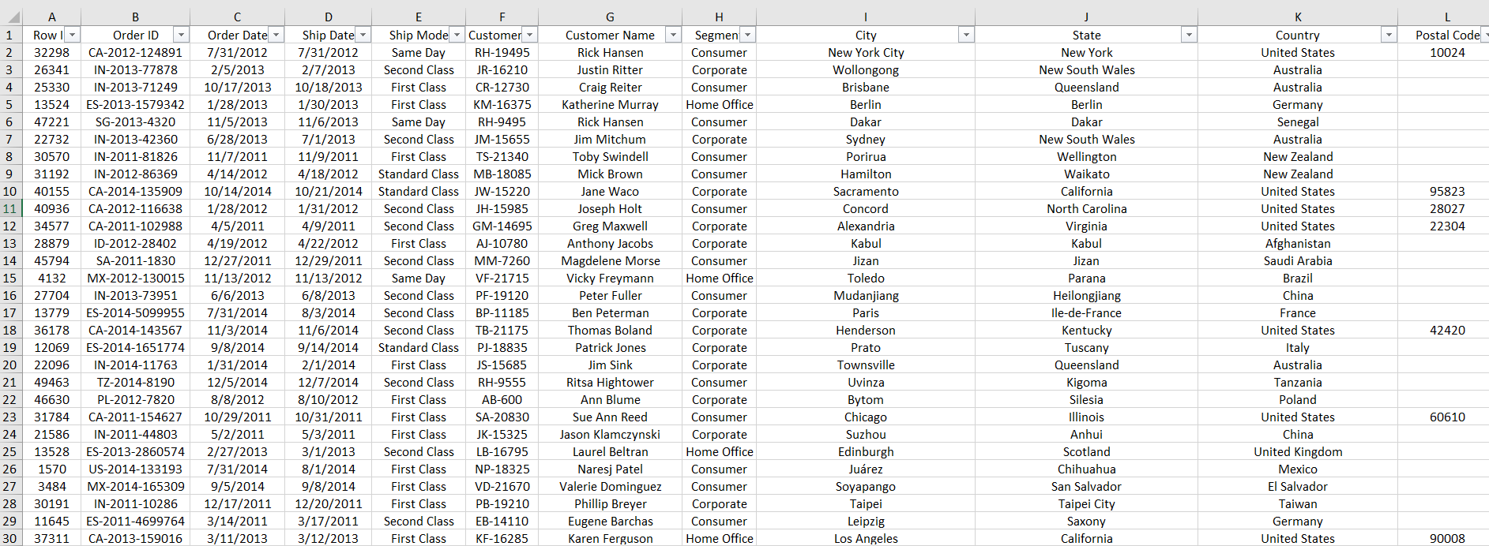
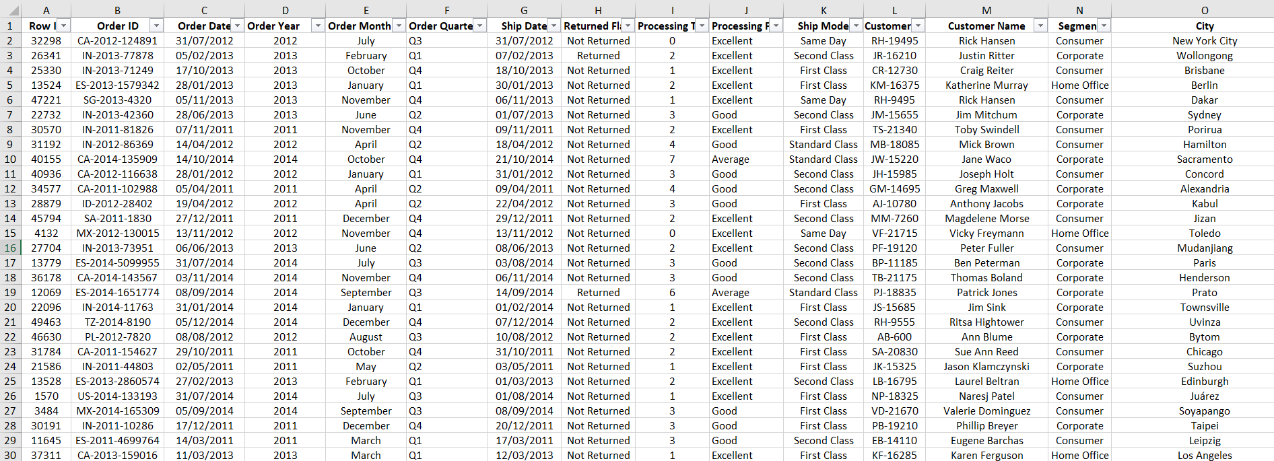
DATA CLEANING & FEATURE ENGINEERING
🔴 Raw Dataset
🟢 Cleaned Dataset

Slide 6
🧹 Data Cleaning
Fixed date formats
Removed inconsistencies
Validated data
⚙️ Feature Engineering
Processing Time
Profit Margin %
Profit Status
Order Year & Quarter
🔗 Data Integration
VLOOKUP (Returns)
VLOOKUP (People)
✅ Data Quality
28% Postal Codes Missing
Flagged for analysis
City/Region used instead

Slide 7
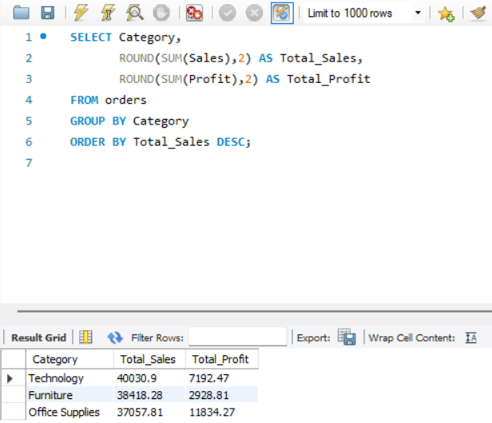
🗄 SQL Business Analysis Transforming data into actionable business insights
Business Analysis 📈 Sales Analysis
💰 Profit Analysis
🌍 Regional Analysis
📦 Product Analysis
👥 Customer Analysis
🚚 Operational Analysis
30 SQL Queries | 6 Business Domains | KPI Analysis

Slide 8
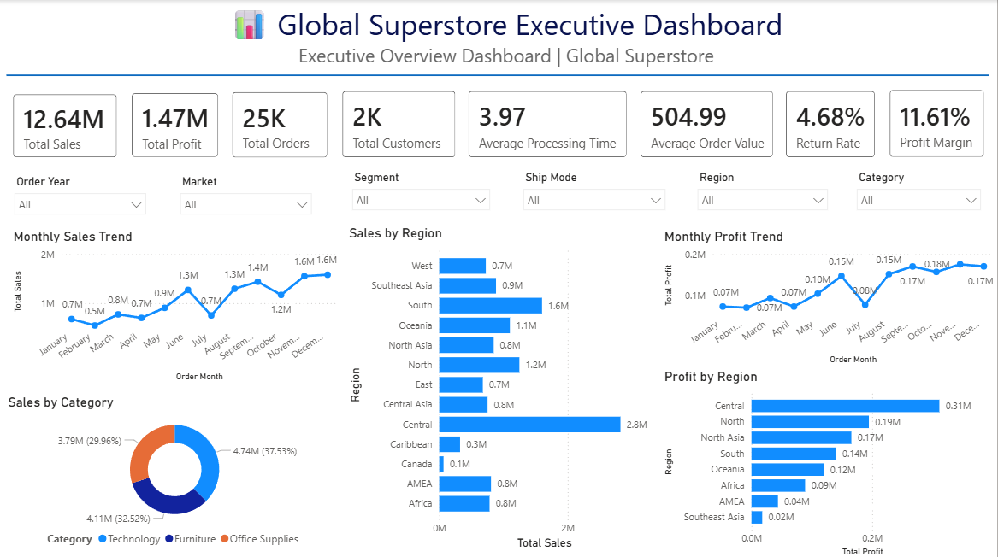
EXECUTIVE DASHBOARD Business Performance Overview
Provides a high-level overview of business performance through interactive KPIs, sales trends, and regional analysis. Enables executives to monitor key metrics and make data-driven decisions using dynamic filters.

Slide 9
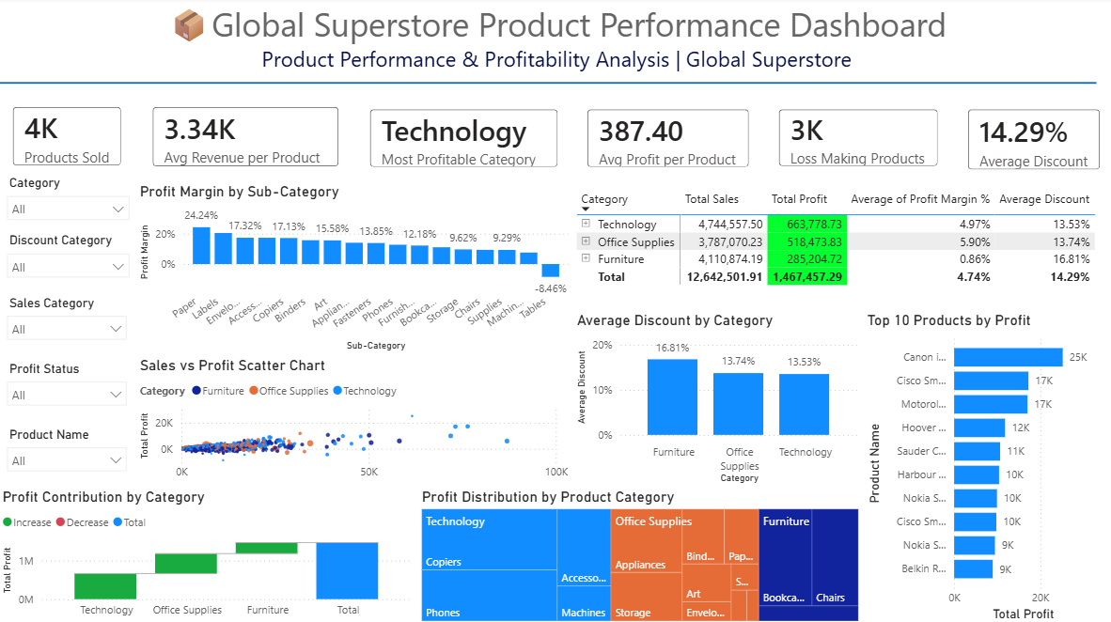
Product Performance Dashboard
Analyzing Product Performance & Profitability
Provides a comprehensive analysis of product sales, profitability, discounts, and category-wise performance through interactive visualizations.
Helps identify top-performing products, loss-making items, and opportunities to improve product profitability.

Slide 10
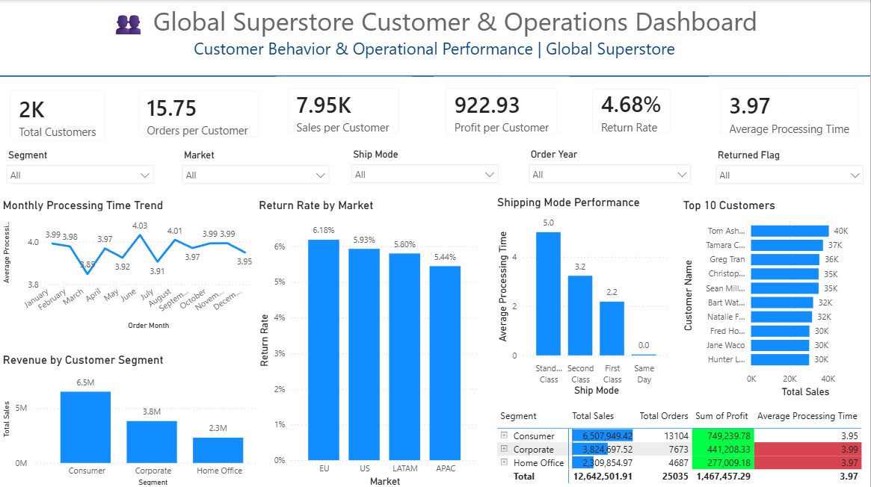
Customer & Operations Dashboard Customer Behavior & Operational Performance
Analyzes customer behavior, operational efficiency, return rates, and shipping performance through interactive business metrics.
Helps optimize customer experience, improve operational processes, and support data-driven business decisions.

Slide 11
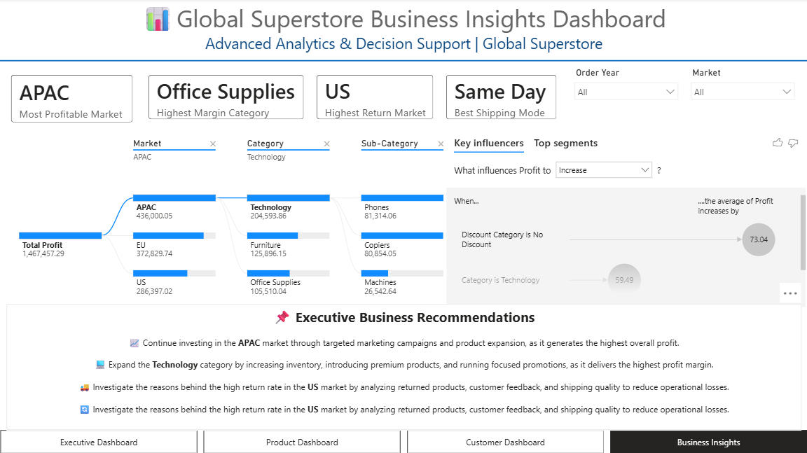
Business Insights Dashboard Advanced Analytics & Decision Support
Delivers advanced business insights using Decomposition Tree, Key Influencers, and interactive analytics to uncover performance drivers.
Supports strategic decision-making by identifying profitable markets, high-margin categories, return trends, and actionable business recommendations.

Slide 12
THANK YOU End-to-End Analytics Project
💻 Tools & Technologies
Excel
MySQL
Power BI
DAX
📚 Skills Demonstrated Data Cleaning SQL Analysis Dashboard Development Data Storytelling
📩 Connect With Me Sanjana Sharma Email : sssanjana35@gmail.com LinkedIn : https://www.linkedin.com/in/sanjanasharmaba/ GitHub : https://github.com/sanjana02041902

