Slide 1
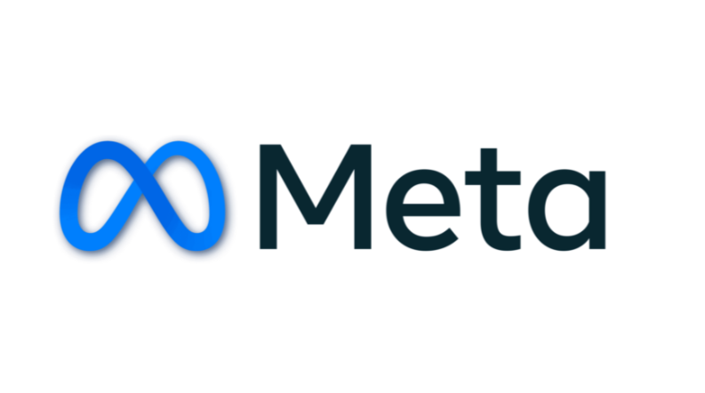
Social Media Analysis

Slide 2
INTRODUCTION
Formerly Facebook, Inc., rebranded as Meta Platforms, Inc. in 2021 to reflect its vision of building the metaverse.
Founded: 2004 by Mark Zuckerberg and co-founders at Harvard University.
Headquarters: Menlo Park, California, USA.
Operates leading platforms: Facebook, Instagram, WhatsApp, Messenger, and Horizon Worlds.
Mission: “Give people the power to build community and bring the world closer together.”
Investing heavily in Virtual Reality (VR) and Augmented Reality (AR) technologies to shape the next generation of digital interaction.

Slide 3
PROblem Statement
Identifying User Behavior Patterns How can Instagram analyze key user activities—such as photo uploads, engagement (likes, comments, shares), and feature usage—to uncover patterns that drive higher engagement and optimize personalization?
Differentiating Retained vs. Churned Users What factors distinguish active, retained users from churned users, and how can interventions like personalization, incentives, or notifications be applied to reduce churn and boost retention?

Slide 4
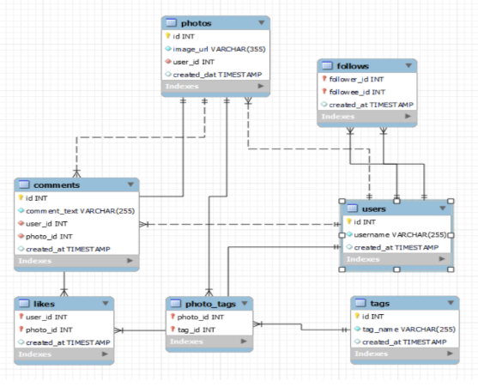
Database schema
.

Slide 5
Data description
comments_id : unique identifier for each comment
comment_text : text content of a given comment
user_id : unique identifier for each user
photo_id : unique identifier for each photo
created_at : date of interaction in the form like, photos, tags
follower_id : user_id of the follower for a certain user
followee_id : user_id of followee for a certain user
tag_id : unique identifier for each tag
image_url : link to the image posted on the platform
username : username chosen by the user

Slide 6
AGENDA
Problem Statement
Data Description
Objective Key Metrics and Visualizations
Subjective Question for Insights

Slide 7
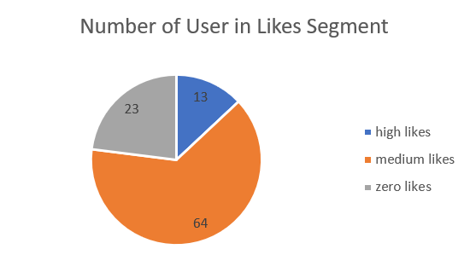
Likes Segment
* Majority of users (64) fall into the medium likes category, showing moderate engagement on their posts.
* 23 users received zero likes, indicating inactive accounts, low visibility, or weak content performance.
* Only 13 users achieved high likes, suggesting a small but highly engaging group with strong influence potential.
* The distribution highlights that most users engage at a medium level, while very few generate high engagement.
* Zero-like users may represent an opportunity for re-engagement strategies, while high-like users could be leveraged as influencers or brand advocates.

Slide 8
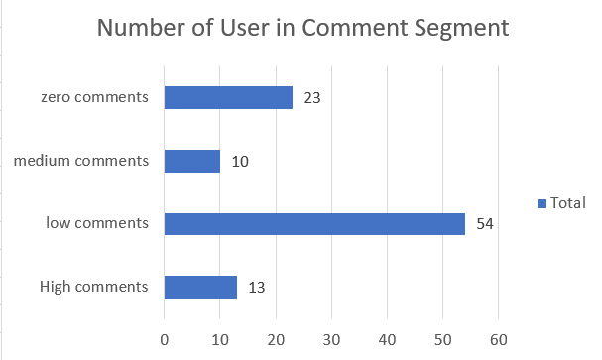
Comment Segment
* Low comments dominate: A majority of users (54) fall into the low comments category, indicating limited but present interaction.
* Zero comments: 23 users have not received any comments, reflecting inactive or less engaging content.
* High comments: Only 13 users attract a high volume of comments, representing the most engaging and influential group.
* Medium comments: A small group (10 users) falls into the medium category, showing moderate engagement.

Slide 9
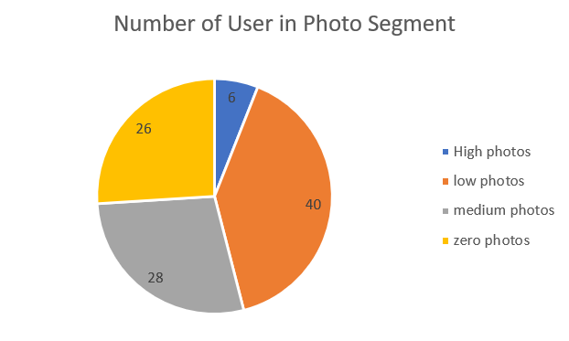
Photo segment
Low photo activity dominates: The largest group of users (40) falls in the low photo segment, meaning they upload photos occasionally but not actively.
Medium photo activity: 28 users share photos at a moderate level, indicating consistent but not very frequent activity.
Zero photo uploads: A significant number (26 users) have not uploaded any photos, showing inactivity in content creation.
High photo uploads: Only 6 users are highly active in sharing photos, representing the most engaged content creators.

Slide 10
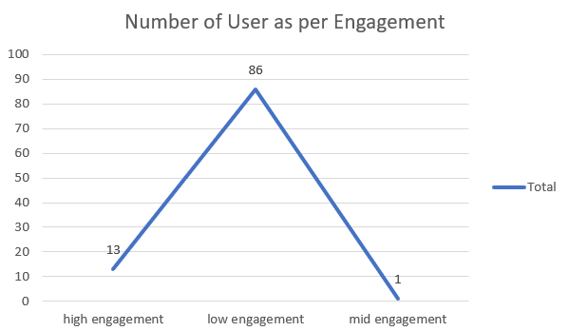
User and their engagement
86 users show low engagement, indicating limited interaction.
Only 13 users are in the high engagement category, driving most activity.
Just 1 user falls in mid engagement, showing a polarized distribution.
Leverage high-engagers for visibility, promotions, or ambassador roles.
Activate low-engagers using gamification, campaigns, or relatable content.
Foster community activities to bridge the engagement gap.

Slide 11
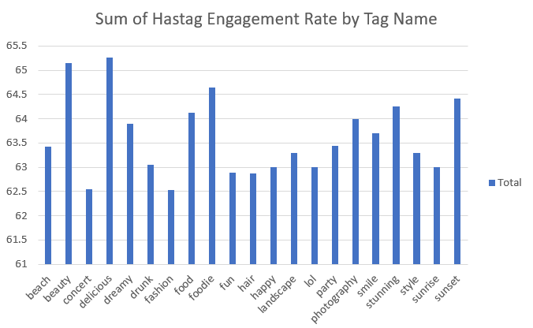
Hashtag Engagement Rate
Consistent range: Overall engagement rates across all hashtags fall in a narrow band (61.5–65.5), meaning no extreme highs or lows.
Content insight: Posts with aesthetic/lifestyle hashtags (dreamy, beauty, foodie) resonate more strongly than event-specific tags (concert, drunk).
Opportunity: To maximize reach, creators can focus on mixing high-engagement hashtags (dreamy, foodie, beauty) with trending ones for better visibility.

Slide 12
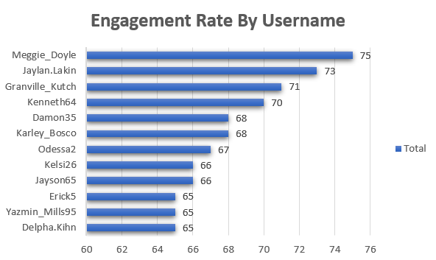
top users with the highest engagement rates
Meggie_Doyle (75), Jaylan.Lakin (73), and Granville_Kutch (71) lead in engagement.
Kenneth64 (70) and Damon35/Karley_Bosco (68) form the mid-tier.
Odessa2 (67), Kelsi26/Jayson65 (66) show moderate engagement.
Erick5, Yazmin_Mills95, Delpha.Kihn (65) are lowest but consistent.
A 10-point gap exists between top and bottom users.
Leverage top users’ strategies to boost mid/low-tier performers.

Slide 13
Strategic recommendation
* Gamification of Engagement
Introduce leaderboards, streak rewards, and challenges to motivate consistent user activity.
Create seasonal contests (e.g., photo challenges, story themes) with digital or tangible rewards.
* Community-Building Initiatives
Launch interest-based groups (e.g., travel, food, fitness) to foster micro-communities.
Host virtual events like Q&A sessions, live discussions, or collaborative content creation.
* Data-Driven Insights for Users
Provide creators with personalized analytics dashboards (best-performing posts, audience trends, engagement heatmaps).
Suggest tailored growth strategies based on individual posting habits.
* Monetization Opportunities
Allow top creators to earn through exclusive content subscriptions or brand collaborations.
Introduce a tipping or gifting feature for followers to directly support creators.
* Cross-Platform Integration
Enable easy sharing of content across other platforms (YouTube Shorts, TikTok, Twitter/X) to increase visibility.
Partner with complementary apps (music, shopping, fitness) for integrated experiences.

Slide 14
THANK YOU

