Slide 1

Analyzing Customer Behavior, Churn Patterns, and Retention Opportunities Using Power BI
-Sanjana Sharma

Slide 2
Agenda
1. Introduction to CRM 2. Problem Statement 3. Database Schema 4. Dataset Features 5. Project Objectives 6. Methodology 7. Analytical Approach 8. Key Insights & Findings 9. Dashboards 10. Conclusion&Recommendations 11. Reference

Slide 3

Introduction to CRM
• CRM helps organizations manage customer relationships and improve business performance. • This banking CRM project uses SQL and Power BI to analyze customer data and generate business insights. • The analysis focuses on customer demographics, transaction patterns, active customers, and churn behavior. • The objective is to identify churn drivers, understand customer behavior, and support customer retention through data-driven recommendations.

Slide 4

Problem Statement
• The project analyzes banking customer data to understand customer behavior and identify factors contributing to customer churn. • Data includes customer demographics, transaction details, churn information, and active customer profiles. • Power BI is used to create interactive dashboards and generate actionable business insights. • The goal is to support customer retention, improve engagement, and enable data-driven decision-making.

Slide 5
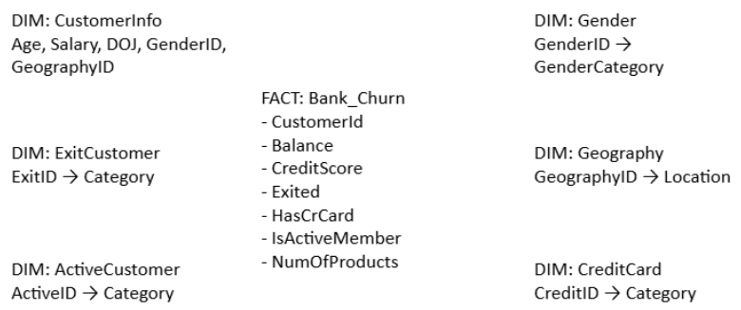
Database Schema

Slide 6

Dataset Features
CustomerId : Unique identifier assigned to each customer. CreditScore : Measures customer creditworthiness and financial reliability. GeographyID : Represents the customer's geographic location or region. GenderID : Encoded variable indicating customer gender. Age : Age of the customer in years. Tenure : Number of years the customer has been associated with the bank. Balance : Current account balance maintained by the customer. NumOfProducts : Total number of banking products or services used by the customer. Credit Score Categories : Excellent: 800–850, Very Good: 740–799, Good: 670–739, Fair: 580–669, Poor: 300–579

Slide 7

Project Objectives
• Analyze customer demographics, financial behavior, and account activity to identify key factors influencing customer churn and retention. • Develop an interactive Power BI CRM dashboard to transform raw data into meaningful visual insights and support data-driven decision-making. • Identify customer segments based on demographic, credit, and behavioral characteristics to enable targeted marketing and personalized services. • Provide actionable insights to improve customer engagement, satisfaction, and long-term loyalty. • Support business stakeholders in optimizing retention strategies, risk management, and overall customer relationship management performance.

Slide 8
Methodology
• Problem Understanding & Exploration: Reviewed the dataset to understand customer attributes and churn factors. • Data Cleaning & Preparation: Resolved data quality issues and prepared data for analysis. • SQL Analysis: Used SQL queries, joins, aggregations, and window functions to perform exploratory analysis. • Power BI Modeling: Created table relationships, DAX measures, and calculated columns for KPI analysis. • Dashboard Development: Built interactive dashboards using charts, KPIs, slicers, and filters. • Insight Generation: Identified churn drivers and customer behavior trends to support business decisions.

Slide 9
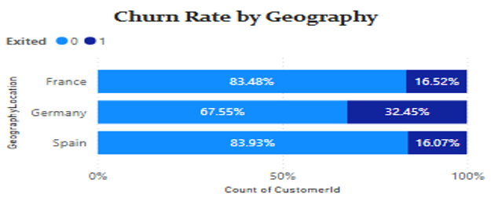
Churn Rate by Geography
• Germany has the highest churn rate at 32.45%, significantly higher than France and Spain. • France (16.52%) and Spain (16.07%) demonstrate stronger customer retention and lower churn levels.
• The churn rate in Germany is nearly twice that of the other two regions, indicating a notable retention challenge.
Key Insight: Germany should be the primary focus for customer retention efforts, while France and Spain provide opportunities to strengthen customer engagement and drive business growth.

Slide 10
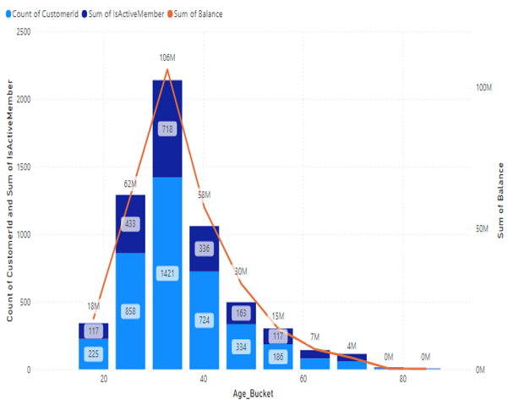
Risk Management by Age Group
• Customers aged 20–40 form the largest customer segment and hold the highest account balances. • A significant portion of customers in this age range are inactive, increasing potential retention risk. • Customer count and total balances decline noticeably beyond the age of 40.
• The 30–40 age group combines high balances with high inactivity levels, making it a critical segment for analysis.
Key Insight: The 30–40 age group presents both the highest risk and opportunity, requiring targeted engagement and retention strategies to reduce churn and protect high-value customers.

Slide 11
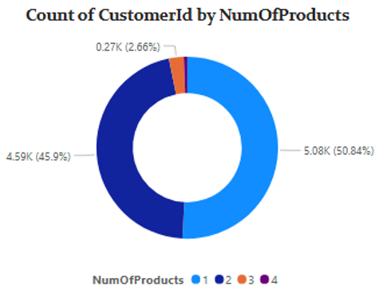
Customer Segmentation by Number of Products
• Customer Segmentation by Number of Products Most customers hold either 1 or 2 products, accounting for over 96% of the customer base. • 50.84% of customers use 2 products, while 45.9% use only 1 product. • Less than 4% of customers hold 3 or more products. Insight : The low adoption of multiple products highlights a significant cross-selling opportunity. Encouraging customers with 1–2 products to adopt additional services can increase customer value, engagement, and retention.

Slide 12
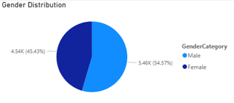
Gender Distribution Analysis
The customer base is relatively balanced across genders, with Male customers accounting for 54.57% (5.46K) and Female customers accounting for 45.43% (4.54K).
Male customers represent a slightly larger share of the overall customer population.
The distribution indicates that the bank serves a diverse customer base without a significant gender imbalance.
Insight : Both genders contribute significantly to the customer base, highlighting the need for balanced customer engagement and retention strategies. Further analysis of churn, product usage, and account balances by gender can help identify targeted growth opportunities..

Slide 13
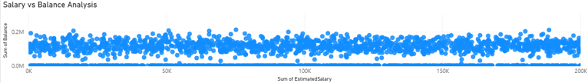
Salary vs Balance Analysis
• The scatter plot compares customer account balances against their estimated salaries. • Customer balances are distributed across all salary levels, with no clear upward or downward trend. • High-balance customers are present in both lower and higher salary groups. • The spread of data points suggests that account balance is not strongly influenced by salary alone. Insight: Salary shows a weak correlation with account balance, suggesting that factors such as customer tenure, product usage, and account activity have a greater influence on customer value and financial behavior.

Slide 14
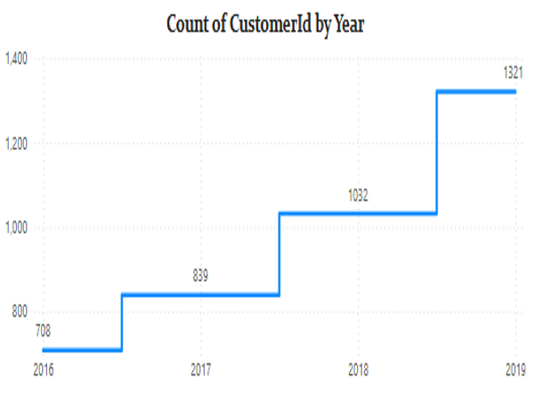
Customer Acquisition Over the Years
• Customer acquisition increased steadily from 708 customers in 2016 to 1,321 customers in 2019, reflecting consistent business growth. • The largest increase occurred between 2018 and 2019, with 289 new customers added. • The upward trend suggests effective customer acquisition and engagement strategies during this period. • Growing customer numbers indicate increased trust in the bank's products and services. Insight: The bank experienced strong customer growth, particularly in 2019, indicating successful customer acquisition efforts. Maintaining this growth will require a balanced focus on both customer acquisition and retention to maximize long-term customer value.

Slide 15
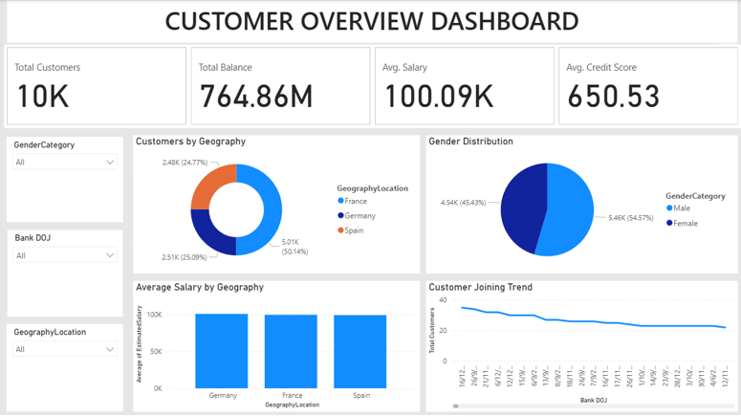
Customer Overview Dashboard

Slide 16
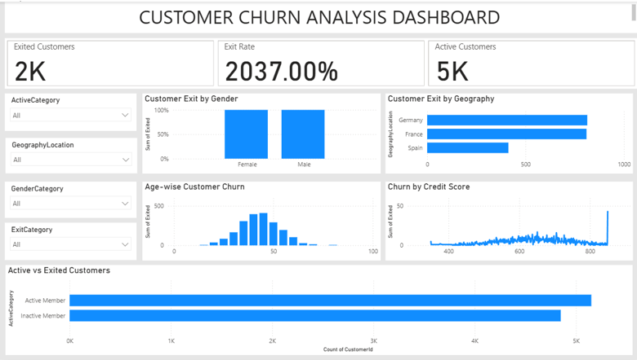
Customer Churn Analysis Dashboard

Slide 17
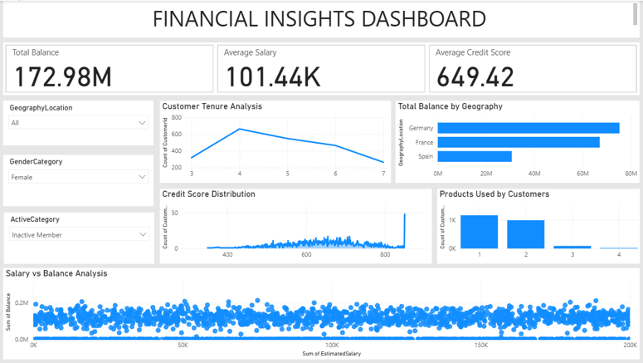
Financial Insights Dashboard

Slide 18

Conclusion & Recommendations
Key Findings :
Higher churn is concentrated in Germany, inactive customers, and customers with lower tenure.
Customers aged 20–40 hold the highest balances, presenting both growth opportunities and churn risks.
Most customers use only 1–2 products, indicating potential for cross-selling.
Recommendations :
Increase engagement through personalized offers and product bundling.
Regularly monitor churn trends by geography, age, and customer activity to support data-driven decisions.
Business Impact : These initiatives can help reduce churn, improve customer loyalty, and increase revenue growth.

Slide 19

References & Tools Used
Data Source :
Customer Churn Dataset provided by Newton School
Tools & Technologies
MySQL – Data cleaning, querying, and analysis
Power BI – Data modeling, visualization, and dashboard development
MS Word – Project documentation
MS PowerPoint – Presentation design and reporting Skills Applied :
SQL Queries (JOINs, Aggregations, Window Functions)
Data Cleaning & Transformation
DAX Measures & Calculated Columns
Data Visualization & Dashboard Design
Business Insight Generation

Slide 20


