Slide 1

EMBRACE Enrollment Platform
A seamless, user-centric enrollment experience
Presented By: Your Name / Team
Simplifying enrollment for users and administrators

Slide 2

Addressing Core Challenges in Enrollment
Complicated Processes
Users often face confusing and overly complex enrollment journeys, leading to frustration and drop-offs.
Manual Errors
Reliance on manual data handling introduces errors, delays, and inefficiencies for administrators.
Lack of Visibility
Users lack real-time updates on their application status, creating anxiety and increasing support queries.
Poor User Experience
Inconsistent experiences across devices deter engagement and reflect poorly on the institution.

Slide 3

Our Solution: Streamlined Enrollment Excellence
EMBRACE offers a modern, intuitive platform designed to revolutionise the enrollment process.
Intuitive Design
A user-friendly interface that simplifies every step of enrollment.
Cross-Device Accessibility
Seamless experience across mobile and web platforms, catering to all users.
Automated Workflows
Reduces manual effort and minimises errors through intelligent automation.
Real-Time Tracking
Keeps users informed with instant updates on their application progress.
Key Features:
User Registration & Onboarding Dynamic & Intelligent Forms Comprehensive Dashboard & Analytics Automated Notifications & Confirmations

Slide 4
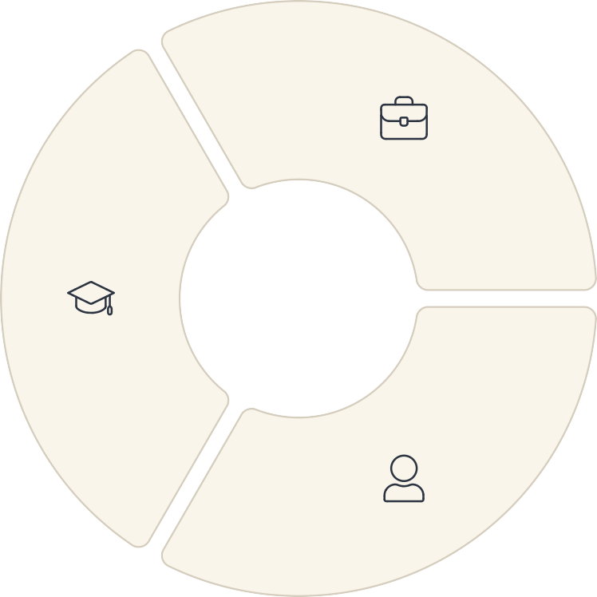


Who We Serve: Our Valued Users
EMBRACE is crafted to meet the diverse needs of everyone involved in the enrollment journey.
Administrators
Enrollment Officers, Coordinators requiring efficient dashboards and status tracking.
Primary Users
Students, Candidates, Learners seeking a fast, clear enrollment flow.
Stakeholders
Training Providers, Managers overseeing enrollment processes and data.
Persona: Student Sam
Persona: Admin Alex
Sam needs a quick, hassle-free way to apply and track his enrollment. He values clarity and mobile accessibility.
Alex requires an intuitive dashboard to manage applications, track statuses, and generate reports efficiently.

Slide 5



Market Insights & Growth Opportunities
The market is ripe for an advanced enrollment platform, driven by evolving trends in digital education.
Digital Enrollment Growth
Significant trends in online education and digital adoption are fuelling demand for streamlined solutions.
Remote Onboarding Needs
The increasing shift to remote learning and work necessitates robust, digital onboarding tools.
Expanding SaaS Market
A growing market for education and administration SaaS tools presents substantial revenue potential.
EMBRACE is strategically positioned to capture a significant share of this expanding market.

Slide 6
Competitive Landscape: EMBRACE vs. The Rest
We stand out by prioritising user experience, real-time data, and comprehensive features.
Ease of Use | { { { { | { {
Real-Time Status | 7 | 7 | o
Mobile Ready | 7 | o | 7
Admin Dashboard | 7 | o
Our focus on a superior, comprehensive user experience gives us a distinct advantage.

Slide 7




Core Features: The Heart of EMBRACE
EMBRACE is built with powerful modules designed for efficiency and transparency.
User Onboarding
Guided registration and profile creation for a smooth start.
Dynamic Enrollment Forms
Intelligent forms that adapt to user input, reducing errors and complexity.
Profile & Progress Tracking
Users can monitor their application status and update profiles easily.
Alerts & Notifications
Automated reminders and updates keep users informed at every stage.
Admin Dashboard
Centralised control panel for administrators to manage applications and users.
Data Export & Reports
Robust reporting tools for insights and easy data integration.

Slide 8


Technology Powering EMBRACE
Our platform is built on a modern, scalable, and secure technology stack.
Frontend / UI
Built with React and styled with Tailwind CSS, leveraging Lovable AI for rapid development.
Backend / Database
Utilising Supabase for robust database management and secure authentication.
Integrations
Seamless connections for email/SMS notifications, advanced analytics, and scalable cloud hosting.
Design Tools
UI/UX crafted meticulously in Figma, ensuring an exceptional user experience.
Explore Lovable AI: lovable.dev

Slide 9


Business Model & Monetisation Strategy
EMBRACE offers flexible revenue models designed for sustainable growth and broad market appeal.
Custom Integrations
Tailored services and dedicated support for unique institutional requirements.
Licensing for Institutions
Enterprise-level agreements for schools, universities, and training providers.
Subscription Plans
Tiered offerings: Free (basic), Pro (advanced), and Enterprise (fully customisable).
Our diversified approach ensures accessibility for various client types and maximises revenue potential.

Slide 10

Roadmap & Future Horizons
Our journey continues with exciting milestones planned for enhancing EMBRACE.
Beta Release &
Testing
Launch to early adopters,
gathering crucial feedback for refinement.
1
2
Feedback & Iteration
Continuous improvement cycles based on user and administrator insights.
Mobile App Launch
Dedicated native mobile applications for iOS and Android, expanding
accessibility.
3
4
Marketing & Partnerships
Strategic campaigns and collaborations to expand our reach and user base.
We are committed to evolving EMBRACE into the leading enrollment platform.

