Slide 1
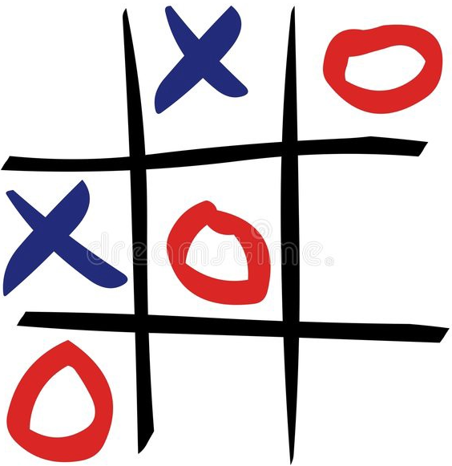
OOPS MINI PROJECT
TIC-TAC-TOE
BY,
SANJANA.C.S
KRITHIKA.S
MADHUMITHA.P
IRFAN.N

Slide 2
TIC-TAC-TOE
Tic-tac-toe, noughts and crosses, or Xs and Os is a paper-and-pencil game for two players who take turns marking the spaces in a three-by-three grid with X or O. The player who succeeds in placing three of their marks in a horizontal, vertical, or diagonal row is the winner.

Slide 3

PROGRAM
IMPORTING THE REQUIRED PACKAGES

Slide 4
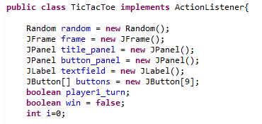
PROGRAM
CREATING OBJECTS FOR REQUIRED CLASSES

Slide 5
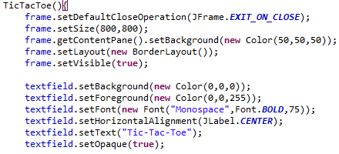
PROGRAM
CREATING A CONSTRUCTOR AND SETTING THE LAYOUTS

Slide 6
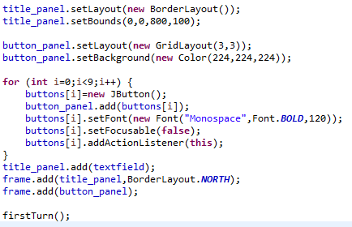
PROGRAM
CREATING TITLE PANEL AND BUTTONS

Slide 7
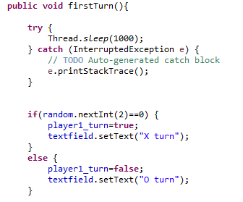
PROGRAM
CALLING A METHOD TO KNOW WHOSE TURN IS 1ST

Slide 8
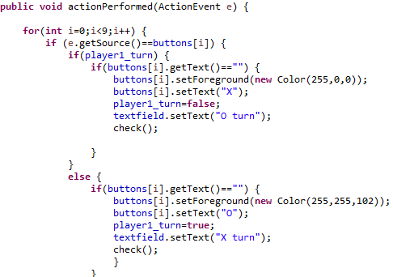
PROGRAM
ACTION EVENT OF THE GAME

Slide 9
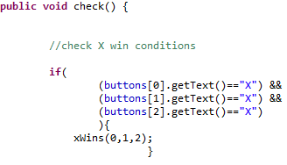
PROGRAM
CALLING CHECK() METHOD
USING IF CONDITIONS

Slide 10
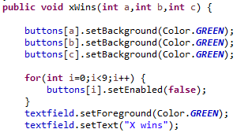
PROGRAM
IF X WIN CONDITION SATISFIES ,xWINS() METHOD IS CALLED

Slide 11
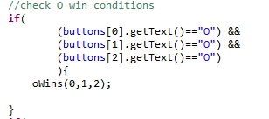
PROGRAM
CONDITION FOR O WINS

Slide 12
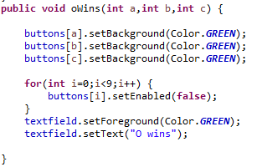
PPROGRAM
IF O WIN CONDITION SATISFIES ,oWINS() METHOD IS CALLED

Slide 13
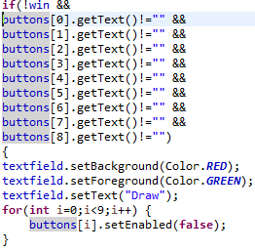
PROGRAM
IF NEITHER X NOR O WINS, THE MATCH IS A DRAW

Slide 14
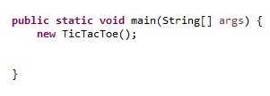
PROGRAM
IN OUR MAIN METHOD WE ARE INVOKING THE CONSTRUCTOR

Slide 15
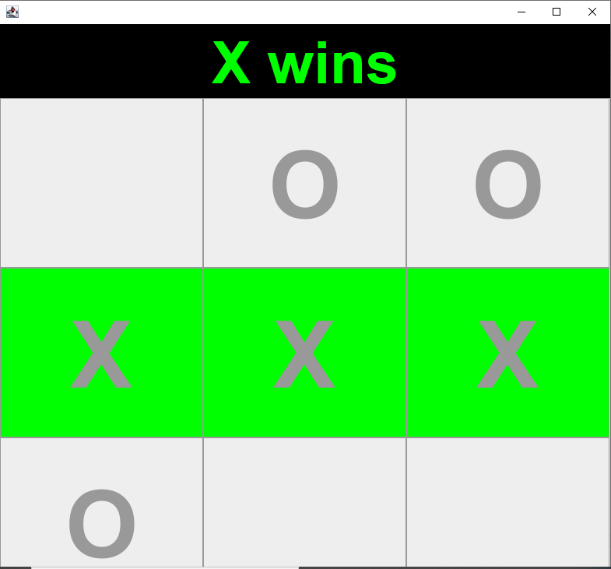
OUTPUT

Slide 16
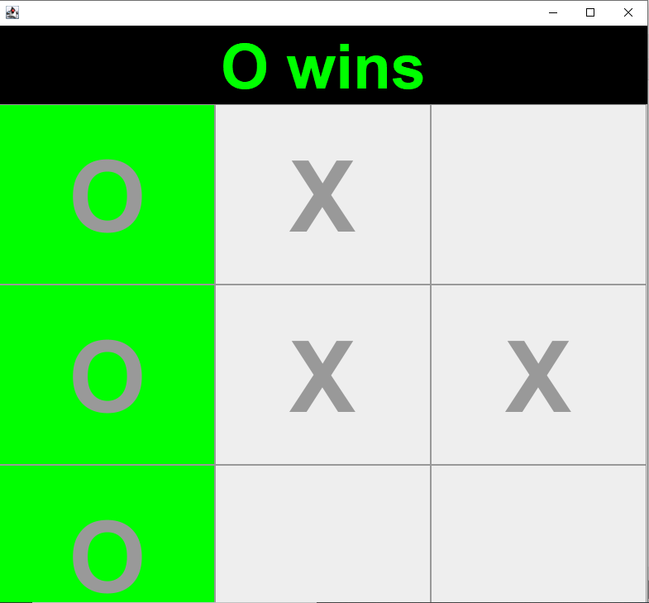
OUTPUT

Slide 17
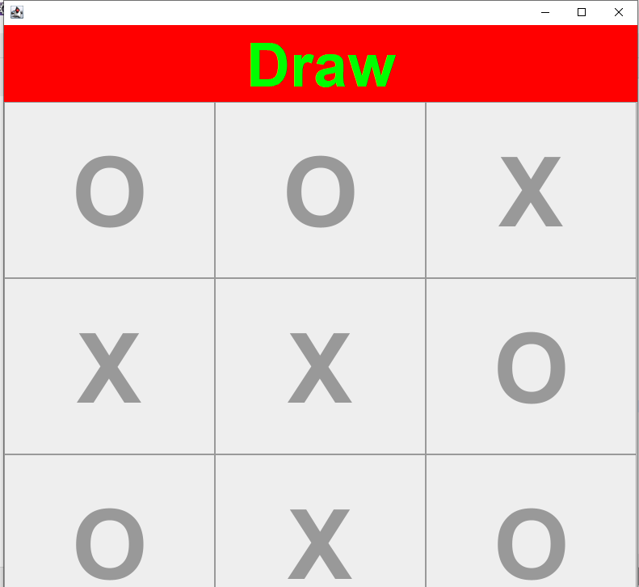
OUTPUT

Slide 18
THANK YOU

