Slide 1
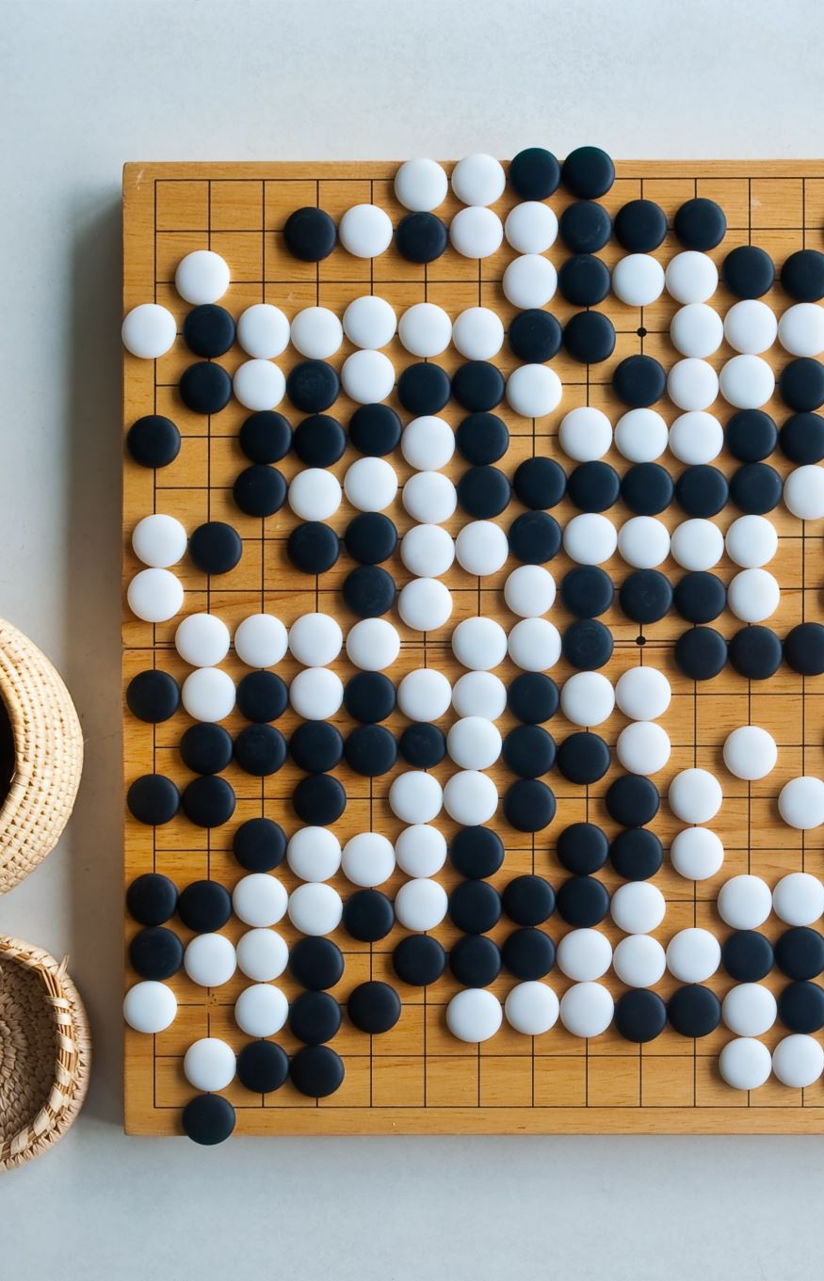
Tic-Tac-Toe Game using Python
By: Sanjana

Slide 2
Introduction: Building a Tic-Tac-Toe Game in Python
Welcome to our Python project—a fun and interactive Tic-Tac-Toe game! This project serves as an introduction to Python programming, showcasing the simplicity and enjoyment of coding with Python.

Slide 3
Project Purpose:
Interactive Python Program: Our project is an interactive Python program that allows users to play the classic game of Tic-Tac-Toe in a text-based environment.
Educational Tool: It serves as an educational tool for those learning Python, highlighting the language's readability and beginner-friendly nature.
Programming Enjoyment: Above all, our project aims to bring the joy of programming to learners by providing a hands-on experience in creating and playing a familiar game.

Slide 4
Let's dive into the world of Python and Tic-Tac-Toe!

Slide 5
How Does It Work?
Game Initialization:
The game starts by initializing an empty 3x3 game board.
Player Turns:
Players, represented as "X" and "O," take turns to make moves on the board.
"X" typically goes first, followed by "O," and they continue to alternate.
Winning Combinations:
After each move, the game checks for winning combinations.
Winning combinations can occur horizontally, vertically, or diagonally when a player occupies three consecutive spaces on the board with their symbol (X or O).
Detecting Draws:
If neither player achieves a winning combination, the game checks if the board is full.
When all nine spaces on the board are occupied, and no player has won, the game declares a draw.
User Interface:
The game employs a simple text-based user interface (UI) to display the current state of the board.
Players make moves by entering a number corresponding to their desired position on the board.
With these mechanics in place, our Python Tic-Tac-Toe game provides an interactive and engaging experience for players to enjoy.

Slide 6
Practical Uses
1. Educational Tool for Learning Python:
Our project serves as an effective educational tool for those learning Python programming.
It offers hands-on experience with Python syntax and logic, making it an ideal choice for beginners.
Learners can grasp fundamental concepts while having fun playing the game.
2. Fun and Interactive Coding Practice:
Coding becomes an enjoyable experience through the creation and execution of the Tic-Tac-Toe game.
It encourages coding practice in a playful context, helping learners become more proficient in Python.
The satisfaction of building and playing the game enhances the learning process.
3. Base for More Complex Projects:
Our Tic-Tac-Toe project can serve as a foundation for building more complex games or applications.
Learners can expand upon this project to create custom games, add graphical interfaces, or develop AI opponents.
It fosters creativity and innovation in programming by providing a starting point for future projects.

Slide 7
Advantages
1. Simplicity and Ease of Understanding:
The project's code is designed with simplicity in mind, making it easy for beginners to comprehend.
It serves as a practical example of writing clear and readable Python code.
2. Demonstrates Basic Game Logic:
The project effectively demonstrates fundamental game logic, such as player turns, win conditions, and draw detection.
It provides a solid foundation for understanding more complex game development concepts.
3. Ideal for Beginners in Programming:
Our Tic-Tac-Toe project is tailor-made for programming newcomers.
It offers a gentle introduction to Python, helping beginners build confidence in their coding skills.

Slide 8
Disadvantages
1. Basic Text-Based User Interface:
The user interface is limited to a simple text-based format.
It lacks the visual appeal and interactivity of graphical user interfaces (GUIs), which might be preferred in modern applications.
2. Limited to Two Players (No AI Opponent):
The project currently supports only two human players, limiting the scope for solo play.
It doesn't include an AI opponent for single-player mode, which could add more complexity and challenge to the game.
While our Tic-Tac-Toe project offers numerous advantages, including ease of understanding and suitability for beginners, it's essential to acknowledge its limitations for a comprehensive assessment.

Slide 9
Future Scope
1. Implementing a Graphical User Interface (GUI):
Enhance the user experience by transitioning from a text-based interface to a graphical user interface (GUI).
GUIs can make the game more visually appealing and user-friendly, attracting a broader audience.
2. Adding AI Opponents with Varying Difficulty Levels:
Elevate the game's challenge by incorporating AI opponents with different difficulty levels.
Players can choose from easy to advanced AI opponents, creating a dynamic and engaging gaming experience.
3. Multiplayer Functionality Over a Network:
Expand the project's reach by enabling multiplayer functionality over a network.
Players can compete with friends or users from around the world, fostering a sense of community and competition.
These potential enhancements demonstrate the project's versatility and the opportunity to transform it into a more sophisticated and captivating gaming experience. The future holds exciting possibilities for our Python Tic-Tac-Toe project.

