Slide 1

Data Gathering in Wireless Sensor Network
Presented By :
Sanjana Singh - 1507011
Anurag - 1507040
Shubham Mishra - 1507047
Nisha Singhania - 1507048
Computer Science and Engineering Department, NIT Patna
Under the supervision of Dr. Dinesh Dash

Slide 2
Motivation :
Title : Delay-Tolerant Data Gathering in Energy Harvesting Sensor Network With a Mobile Sink. (2012)
Authors : Xiaojiang Ren, Weifa Liang

Slide 3
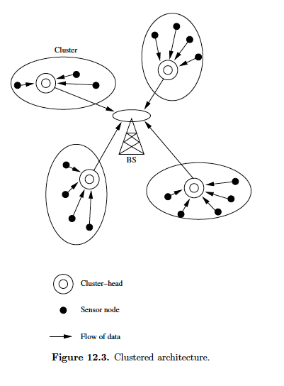
Problem Statement
Given a energy harvesting sensor network G(V u S, E) with the sensor set V and a set of potential sojourn locations S for a mobile sink, the throughput maximization problem in G is to find an optimal close trajectory for the mobile sink consisting of sojourn locations in S and time scheduling at each sojourn locations such that the network throughput is maximized subject to a given tolerant delay T.
Assumptions:
Mobile Sink collects data from single hop.
Mobile sink stops at each sojourn location chosen.
Each sensor has a definite energy capacity C(v) and a maximum communication range as R.
For each sensor : Energy consuming rate >> Energy harvesting rate.

Slide 4
Mobile Sink Trajectory
V = { v1, v2, v3, . . . . . . , vn} /* set of stationary sensor nodes */
S = { s0, s1, s2, . . . . , si, sj, . . . . . . . . , sm} /* set of potential sojourn locations */
Returns to starting point
S2
Si
Feasible sojourn time
S0
Non-feasible sojourn time
S1
S3
Condition : ( T0,i + t`i,j + tj + t`j,0 ) ≤ T

Slide 5
V = { v1, v2, v3, . . . . . . , vn}
S = { s0, s1, s2, . . . . , si, sj, . . . . . . . . , sm}
S2
Si
S0
Too far
Too close
S3
S1
Too far :- More time incorporated in travelling and while travelling no data is collected.
Too close :- Mostly nearby sensors have transmitted their data and are low in energy for survival.
PROBLEM !!!

Slide 6
Trade-offs :
There is a non-trivial trade-off between the travel distance (or the time spent in travelling), the number of sensor nodes, and the amount of sojourn time when we choose the next location for the stoppage of mobile sink.
Problem Approach :
Condition : ( T0,i + ti,j + t`j + t`j,0 ) ≤ T
With the help of this condition, a set F of feasible sojourn locations is generated. Then, for each location sj ∈ F following process is done.

Slide 7
At each feasible location sj ∈ F :
1. Declare a set
N(sj) : set of neighbouring sensors
2. Sort the sensors [ N(sj) ] by their survival time in non-increasing order .
V1 V2 V3 V4 V5 V6 . . . . . . . . . . . . . V|N(sj)|
Short of required energy
. . . . . . . .
Energy Levels of sensors

Slide 8
✸
V1 V2 V3 V4 V5 V6 . . . . . . . . . . . . . V|N(sj)|
Short of required energy
. . . . . . . .
Energy Levels of sensors
Data = max{ ( t₁.1.r_{g}) , ( t₂.2.r_{g}) , . . , ( t₃.3.r_{g}) , . . . , ( t_{k}.k.r_{g}) , . . . . , ( t|N(sj)|.|N(sj)|.r_{g}) }
Maximum value (suppose)
i.e k = 3

Slide 9
✸
V1 V2 V3 V4 V5 V6 . . . . . . . . . . . . . V|N(sj)|
. . . . . . . . .
Energy Levels of sensors
For all i , 1 <= i <= k (assumed as 3)
E(Vi) = E(Vi) - E(V3)
Repeated for all the feasible locations sj ∈ F and then the location with largest value of Data is chosen as the next sojourn location.

Slide 10
Throughput Maximisation by maximizing data :
Begin
S ← { S0 }
Max_data ← 0 ;
/* next_soj_location with the maximum volume of data collected . */
Repeat
For each feasible location sj ∈ F do
Sort in survival time sequence in decreasing order
Find the max term from the Data sequence
Data = { ( t₁.1.r_{g}) , ( t₂.2.r_{g}) , . . . . . , ( t_{k}.k.r_{g}) , . . . . . , ( t|N(sj)|.|N(sj)|.r_{g}) }
D(s_{j}) ← ( t_{k}.k.r_{g}) ; /*assumed maximum*/
If Max_data < D(s_{j})
Next_soj_location ← s_{j} ;
Next_soj_time ← t_{k} ;
Max_data = D(s_{j}) ;
S ← S U { Next_soj_location } ;
Max_data ← 0 ;
Update the energy of sensors ;
Until there is no more feasible sojourn location ;
End
Time Complexity :
n . logn . |S| . T

Slide 11
Rationale :
Time Cost factor associated with data collection from new location is included.
Gain(Sj) = Max_Data(Sj)
Δt(Sj)
Where , Δt(s_{j}) ← Tj + ti,j + tj,0 - ti,0
Repeated for all the feasible locations sj ∈ F and then the location with largest value of Data Gain metric is chosen as the next sojourn location.

Slide 12
Throughput Maximisation by maximizing gain:
Begin
S ← { S0 }
Max_data ← 0 ;
/* next_soj_location with the maximum volume of data collected . */
Repeat
For each feasible location sj ∈ F do
Sort in survival time sequence in non-increasing order
Find the max term from the Data sequence
Data = { ( t₁.1.r_{g}) , ( t₂.2.r_{g}) , . . . . . , ( t_{k}.k.r_{g}) , . . . . . , ( t|N(sj)|.|N(sj)|.r_{g}) }
D(s_{j}) ← ( t_{k}.k.r_{g}) ; /*assumed maximum*/
Δt(s_{j}) ← Tj + ti,j + ti,0 - tj,0 /*time cost factor*/
G(s_{j}) ← D(s_{j}) ÷ Δt(s_{j})
If Max_Gain < G(s_{j}) /*Choosing location with maximum data gain per time-unit*/
Next_soj_location ← s_{j} ;
Next_soj_time ← t_{k} ;
Data = D(s_{j}) ;
S ← S U { Next_soj_location } ;
Max_Gain ← 0 ;
Update the energy of sensors ;
Until there is no more feasible sojourn location ;
End
Time Complexity :
n . logn . |S| . T

Slide 13
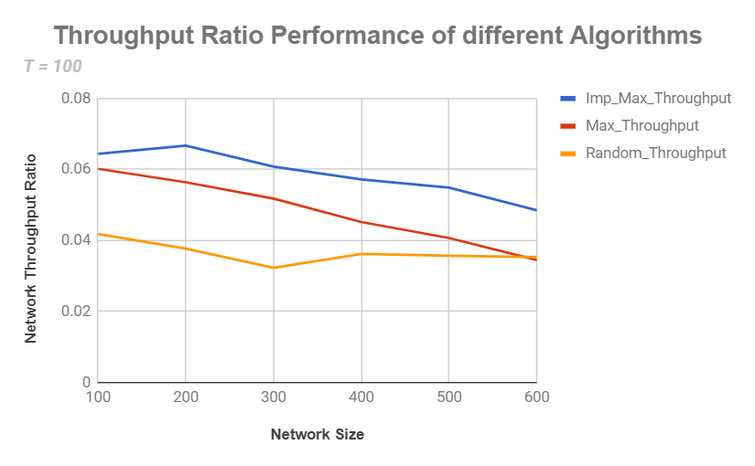
Network Size
Network Throughput Ratio
Imp_Max | Max_Thr | Rnd_Thr
100 | 0.0644 | 0.0602 | 0.0418
200 | 0.0667 | 0.0564 | 0.0377
300 | 0.0608 | 0.0518 | 0.0323
400 | 0.0572 | 0.0452 | 0.0362
500 | 0.0549 | 0.0407 | 0.0357
600 | 0.0485 | 0.0345 | 0.0353

Slide 14
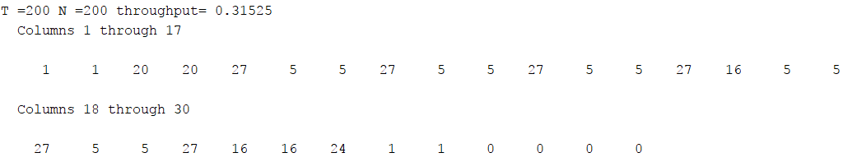
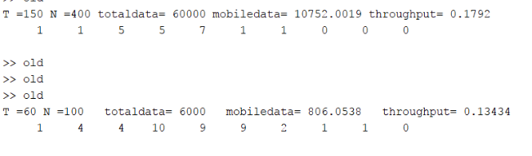
Some Examples of Results:

Slide 15
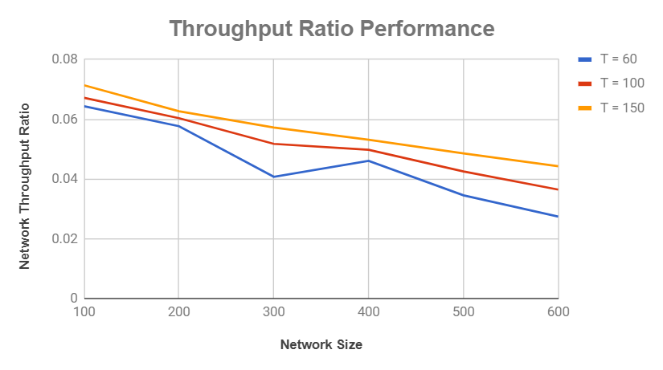
Network Size
Network Throughput Ratio
T = 60 | T = 100 | T =150
100 | 0.0644 | 0.0672 | 0.0714
200 | 0.0577 | 0.0604 | 0.0627
300 | 0.0408 | 0.0518 | 0.0573
400 | 0.0461 | 0.0498 | 0.0532
500 | 0.0346 | 0.0426 | 0.0486
600 | 0.0275 | 0.0365 | 0.0443

Slide 16
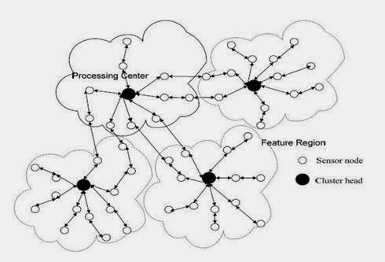
Current Work :
Given a set of stationary sensor nodes V forming a network G(V,E) spread randomly over an area with each sensor powered by a rechargeable battery with a
definite capacity.
The optimization problem in G is to minimize the total tour length to completely collect the data in the network.
Source:http://jpinfotech.blogspot.in/2014/08/secure-and-efficient-data-transmission.html

Slide 17
Network Model:
We consider a wireless sensor network G = (V u E), where V is set of n homogeneous sensors randomly deployed in a region ( 600 units X 600 units (For testing purpose)) and E being the edges between the sensors if they fall in communication range R.
Each sensor is associated with Energy (e_{i} ) and Data ( d_{i} ). Data transmission rate is T_{r.} The amount of energy spent while transmitting the data is proportional. It will require the same number units of energy required to transmit data as the number of units of data.
Speed of Mobile Sink is given by S_{ms.} It is constant.

Slide 18
Assumptions:
Multi-hop data transfer is allowed in the network.
Time has to be minimized to gather all the data presented by the network.
Cluster heads are characterized as pickup points for mobile sink to collect data.
No data gathering is performed while travelling.

Slide 19
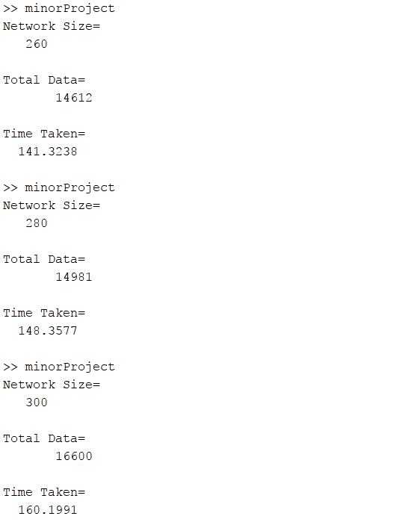
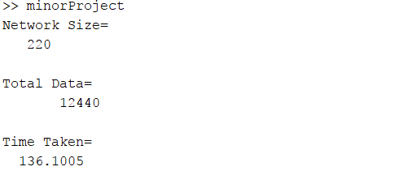
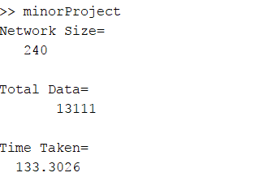
Some sample results:

Slide 20
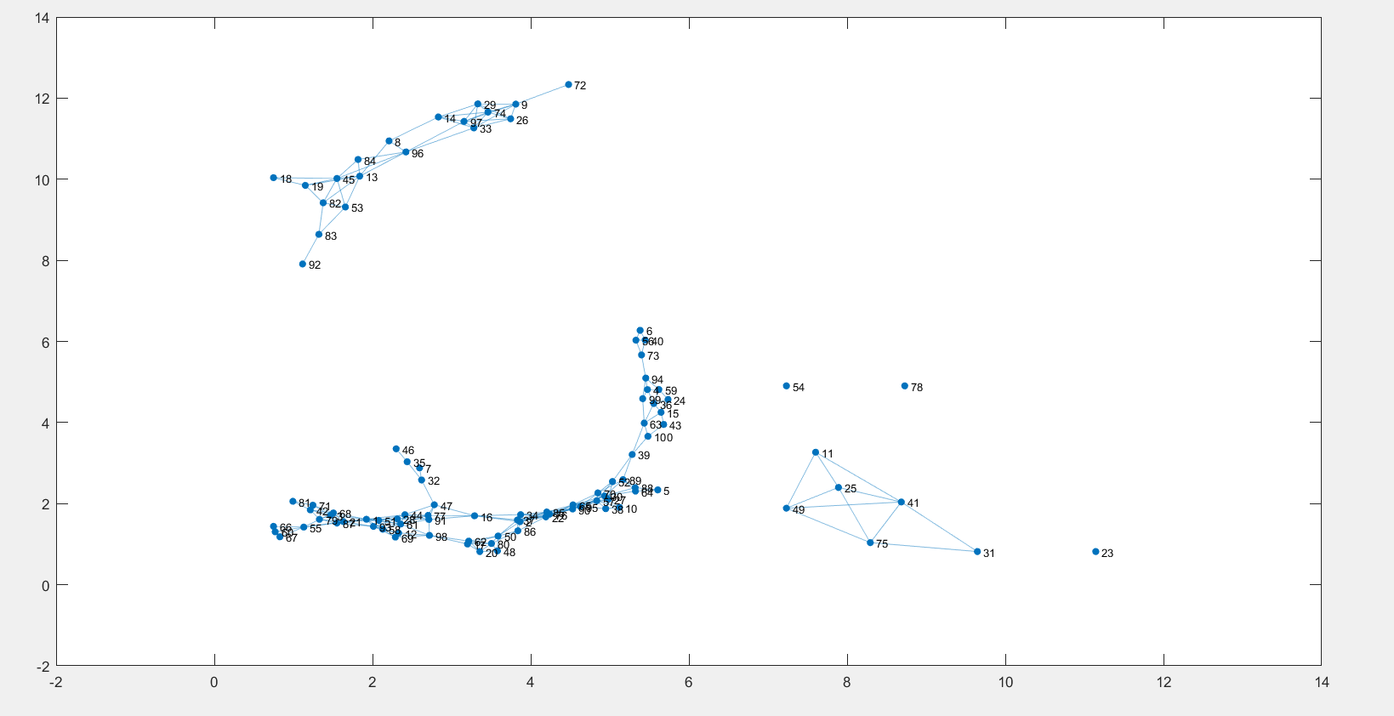

Slide 21
Approach for forming Clusters:
· Calculated the ratio of Energy/Data ( e_{i} / d_{i} ) for each sensor node to form a Ratio array.
· Sorted the array in descending order.
· Picked up the first element and then checked energy condition
e_{i} – d_{i} >= 0
If it satisfies this condition add it to a new path.
· Picked the neighbour of the first element and then checked it energy condition. The parent element should be able to transfer data from all its children so for any parent element in a path i.e.
E_{parent} – D_{children} – D_{parent} >= 0
Also for current child node
E_{child} – D_{child} >= 0
· The basic idea of this algorithm comes from Depth First Search (DFS).

Slide 22
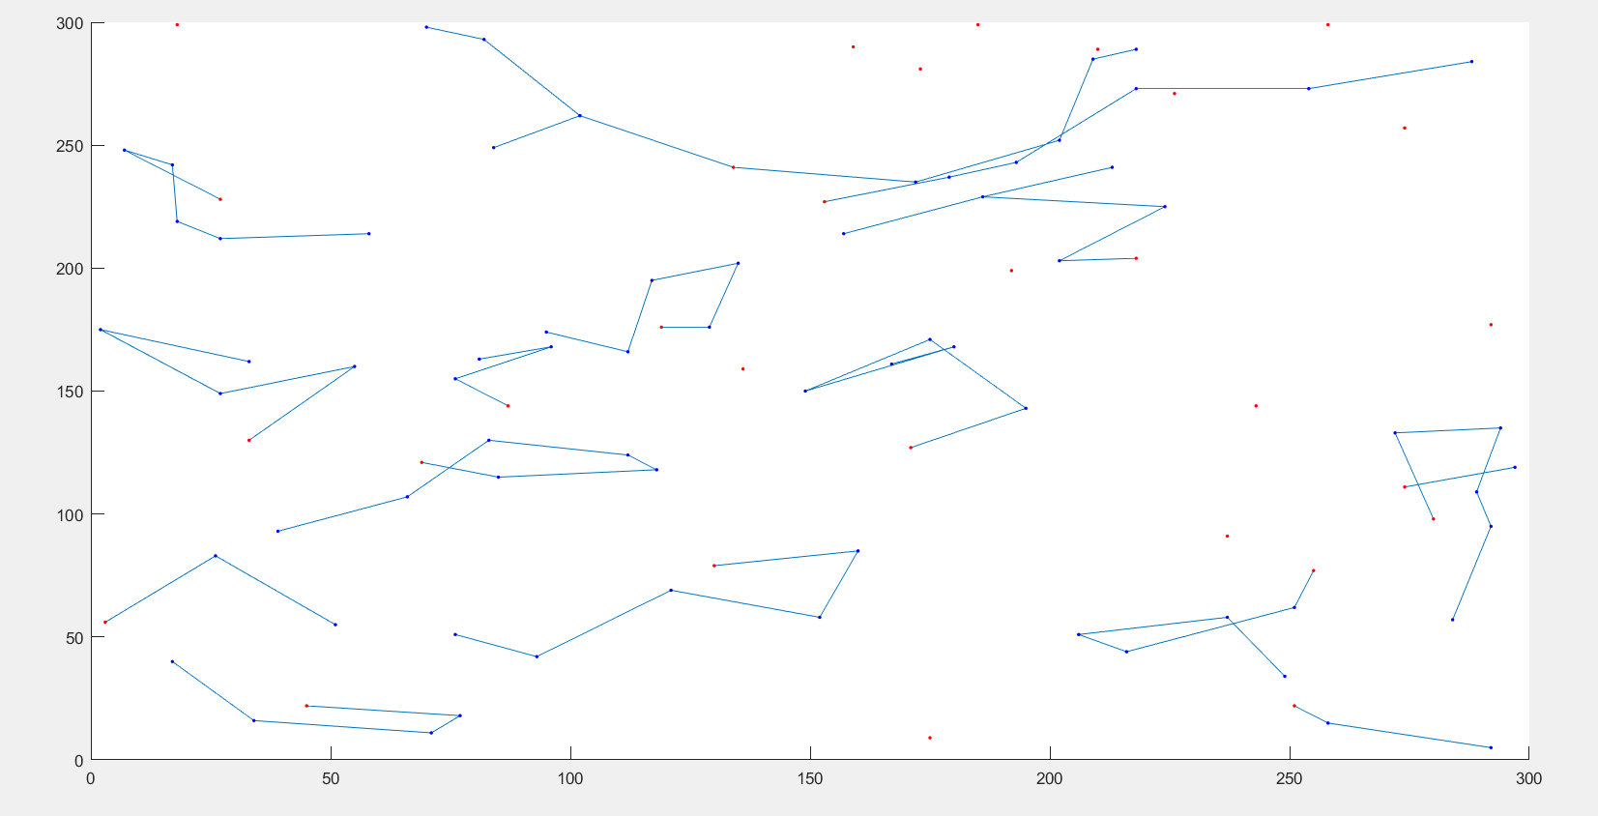
Cluster Graph : After reducing the graph into cluster of nodes with each cluster head shown as a red dot and children of cluster head as blue dots.

Slide 23
Existing work Vs Proposed work:
Single hop
Time sensitive network
No data gathering while travelling
Aim: Maximize data collection offered by network
Locations are explicitly defined
Applications: Forest fires, Crisis management.
Multi hop allowed
Data Gathering network with no time boundation
Data gathering possible while travelling
Aim: Minimize tour length to collect entire sensed data from all sensors..
Cluster heads are characterized as locations
Applications: Habitat monitoring, Weather Forecasting

Slide 24


