Slide 1
Submitted by:
Sanjana Goel
Computer Science & Engineering
IGDTUW- New Delhi
Summer Intern Project Presentation
Submitted to:
Prof Vineet Chaitanya

Slide 2
1.1 Objective: To automate the Collins ENG-HINDI Dictionary using Selenium WebDriver as the automation tool and web scraper for Google Chrome.
TOOLS & UTILITIES:
Selenium WebDriver, Python
THEORY:
Selenium WebDriver is a web automation framework that allows you to execute your tests against different browsers, not just Firefox, Chrome (unlike Selenium IDE) but also browsers like Safari, Opera browser, Internet Explorer. It also enables you to use a programming language in creating your test scripts (not possible in Selenium IDE). Useable languages: JAVA, Python, Perl, .NET, PHP, Ruby.

Slide 3
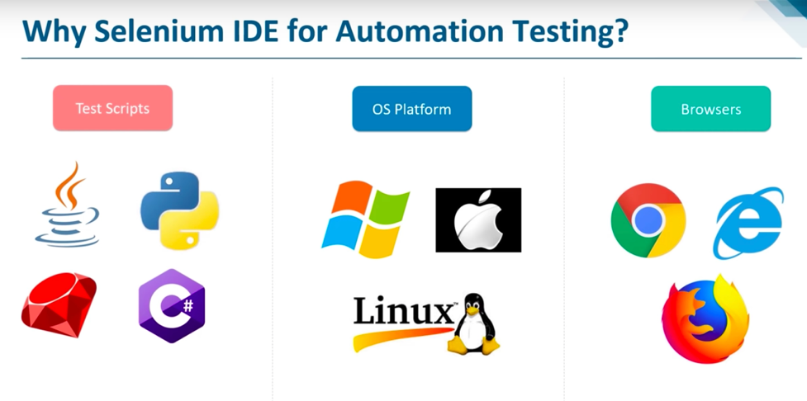
• – The tests can then be run against most modern web browsers.
• – Selenium deploys on Windows, Linux, and Macintosh platforms.
• – It allows recording, editing, and debugging tests.
• – Recorded tests can be exported in most language e.g. html, Java, .net, perl, ruby etc.
• – Selenium is an open source tool with Corporate backing.

Slide 4
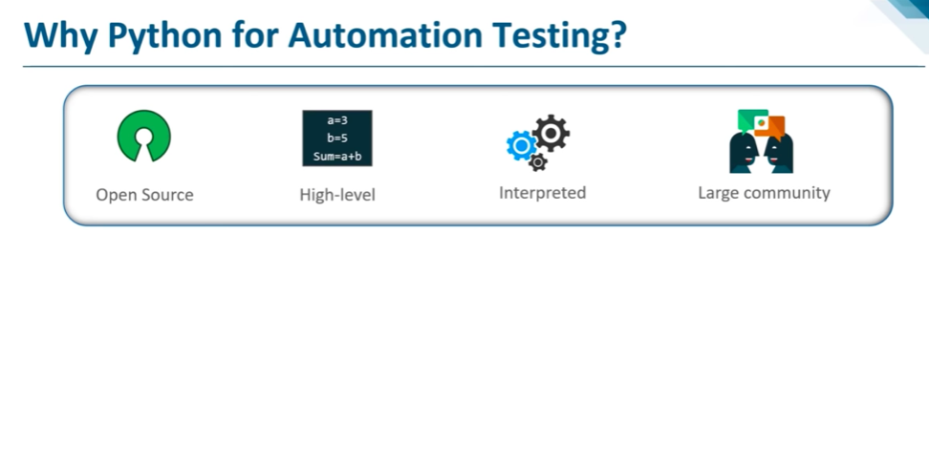
• – It is free and open-source
• – It is high-level, interpreted and blessed with a large community.
• – It has many built-in testing frameworks that cover debugging and fastest workflows.
• – It also supports testing with cross platform and cross browser.

Slide 5
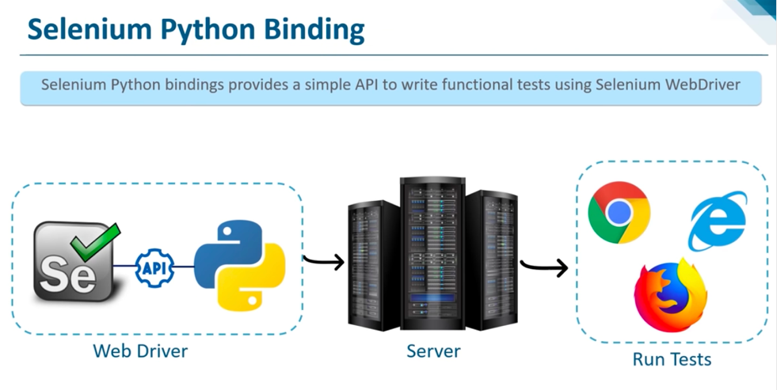

Slide 6
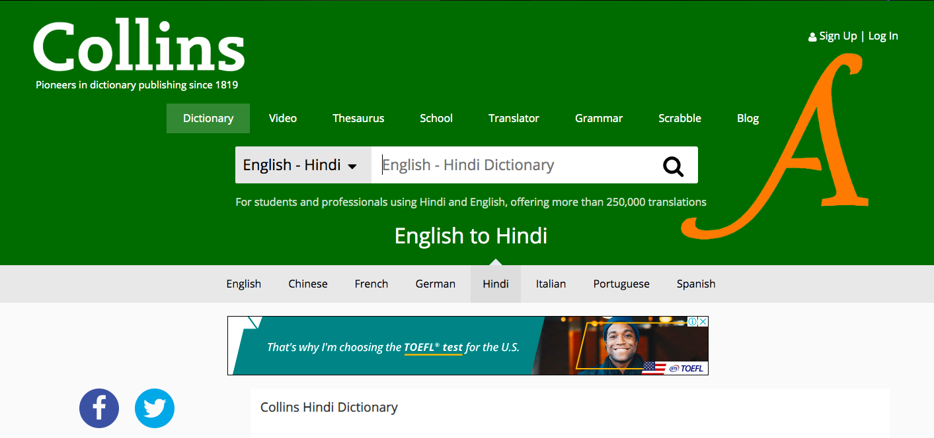
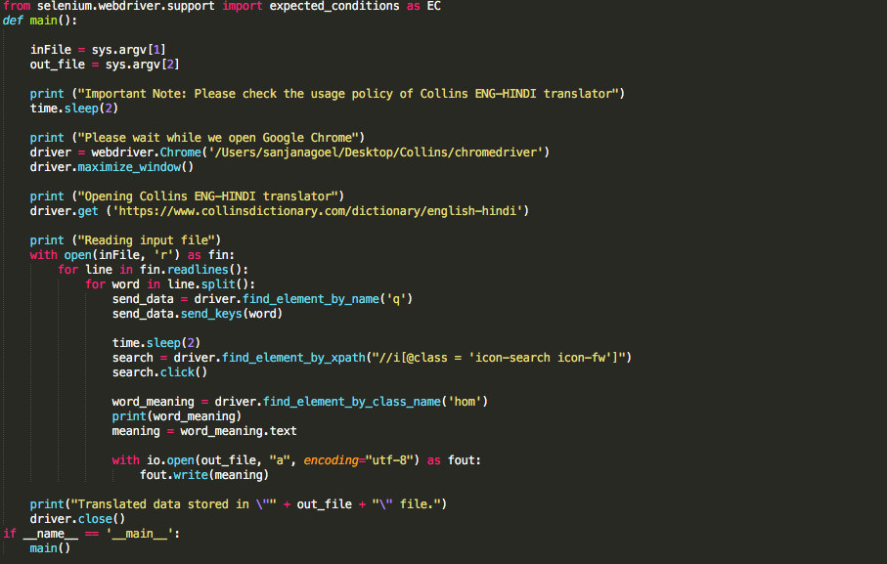

Slide 7
Result/Conclusion:
ENG-HINDI word translation is automated with simultaneous data collection.
On an average, manual search on Collins Web Dictionary takes about 35 seconds per word. However, by automating the search process using Selenium, the search time is reduced to approximately 5 seconds per word.
Thus, enhancing the quality and productivity of web search.

Slide 8
1.2 Objective:
To observe and tabulate the word-alignment outputs produced by Anusaaraka.

Slide 9
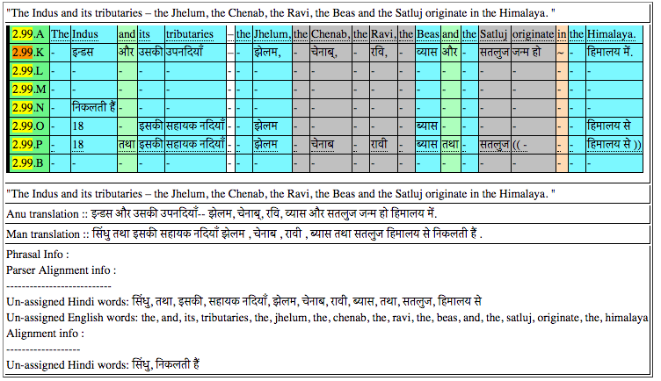
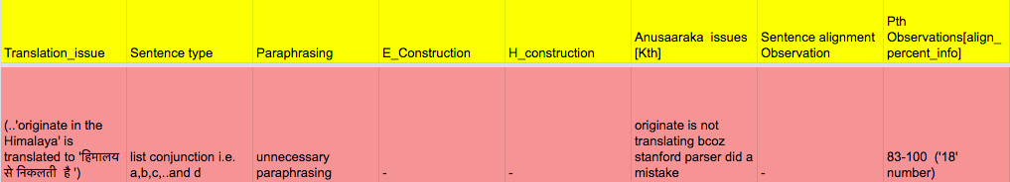
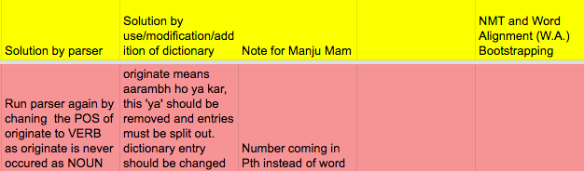

Slide 10
1.3 Objective: To draw a systematic comparison of the context predictive models with the classic context counting based distributional semantics model.
Distributional Semantics is a research area that develops and studies theories and methods for quantifying and categorising semantic similarities between linguistic items based on their distributional properties in large samples of language data. Basically, it is a subfield of Natural Language Processing that learns meaning from word usages.
Count models: It employs the development of probabilistic models that are able to predict the next word in the sequence given the words that precede it.We extracted count vectors from symmetric context windows of two and five words to either side of target. We considered two weighting schemes: Point-wise Mutual Information and Local Mutual Information which was obtained by applying the Singular Value Decomposition.
Predictive models: Associate each word in the vocabulary with a distributed word feature vector. It makes use of word embedding algorithms: word2vec and Glove.

Slide 11
Thank You :)

