Slide 1

Airbnb's Recovery Strategy: New York City Market Analysis
Airbnb aims to revitalize its business post-COVID-19. This analysis focuses on New York City listings to guide strategic decisions. We'll examine neighborhood trends, pricing patterns, and customer preferences to optimize Airbnb's market position.
Presented by :
Sanjana Dadlani
Sarika Pande

Slide 2
Market Background
1
Revenue Decline
Airbnb experienced significant revenue loss during the pandemic due to travel restrictions.
2
Travel Resurgence
As restrictions lift, travel demand is increasing, presenting opportunities for Airbnb's recovery.
3
Strategic Analysis
Airbnb conducted an in-depth analysis of New York City listings to inform recovery strategies.

Slide 3




Data Preparation Process
Data Cleaning
Column Refinement
Outlier Identification
Removed missing values and duplicates to ensure data accuracy and reliability.
Dropped insignificant columns to focus on relevant data for meaningful analysis.
Detected and addressed outliers to prevent skewed results and improve analysis quality.

Slide 4
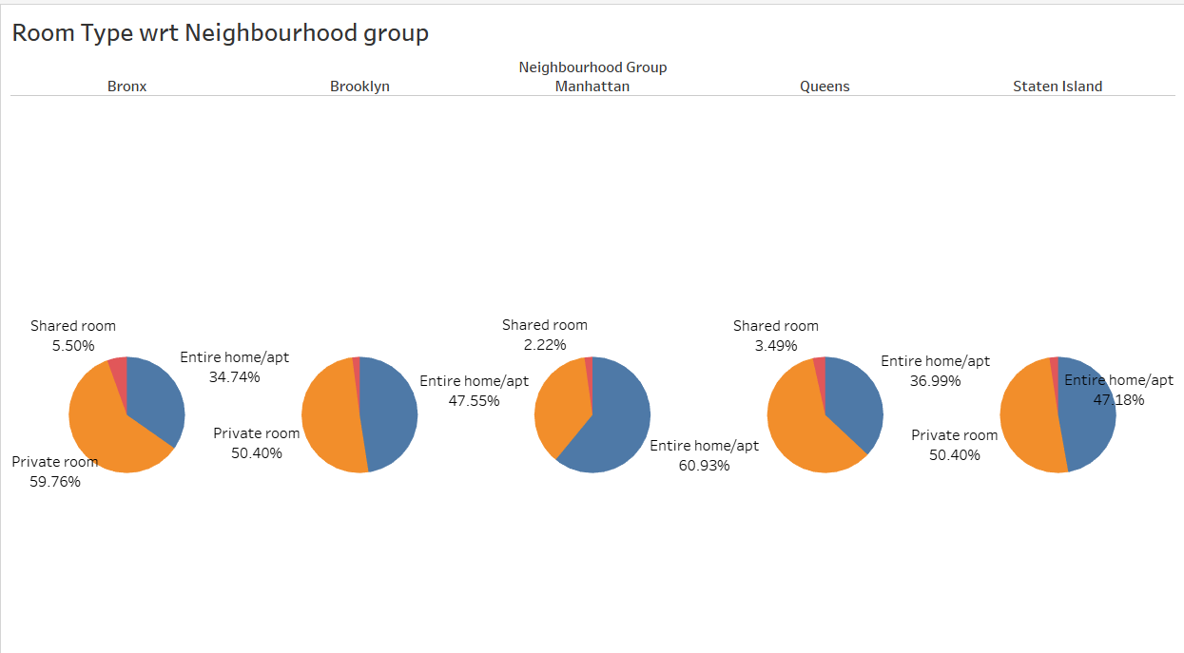
Room Types Across Neighborhoods
Manhattan Dominance
Brooklyn's Variety
Bronx's Niche
Manhattan leads with 60.93% of entire home/apartment listings, catering to luxury seekers.
Brooklyn offers a mix of entire homes and private rooms, appealing to diverse travelers.
Bronx specializes in private rooms, with 59.76% of listings, attracting budget-conscious guests.

Slide 5
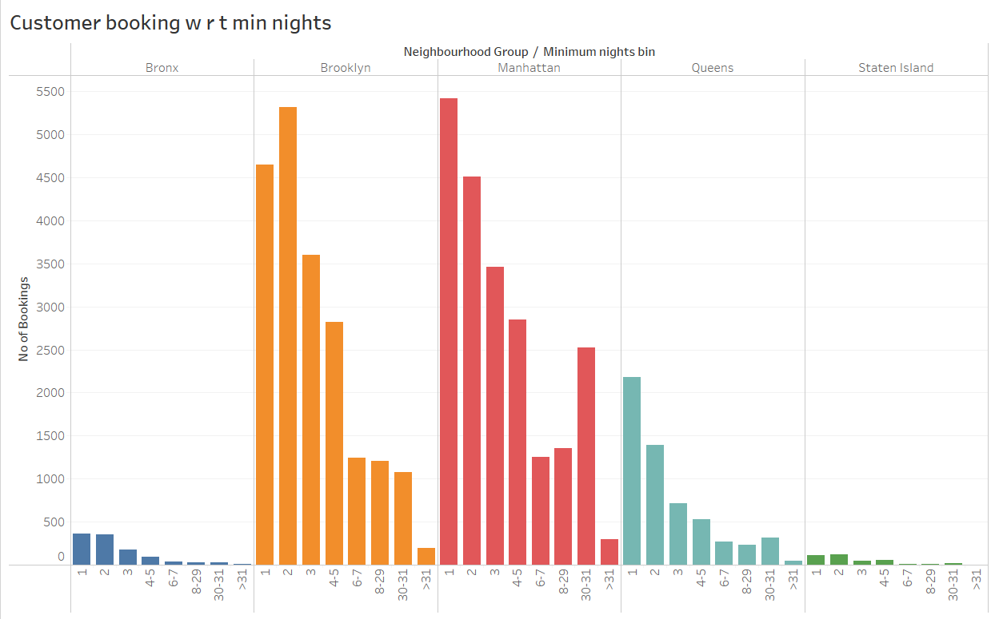
Booking Patterns and Minimum Nights
1
Short Stays Dominate
2
Monthly Rentals Trend
Listings with 1-5 minimum nights are most popular, catering to weekend getaways.
30-day bookings spike, especially in Manhattan and Queens, attracting long-term visitors.
3
Business Travel Impact
Extended stays in prime areas suggest a mix of tourists and business travelers.

Slide 6
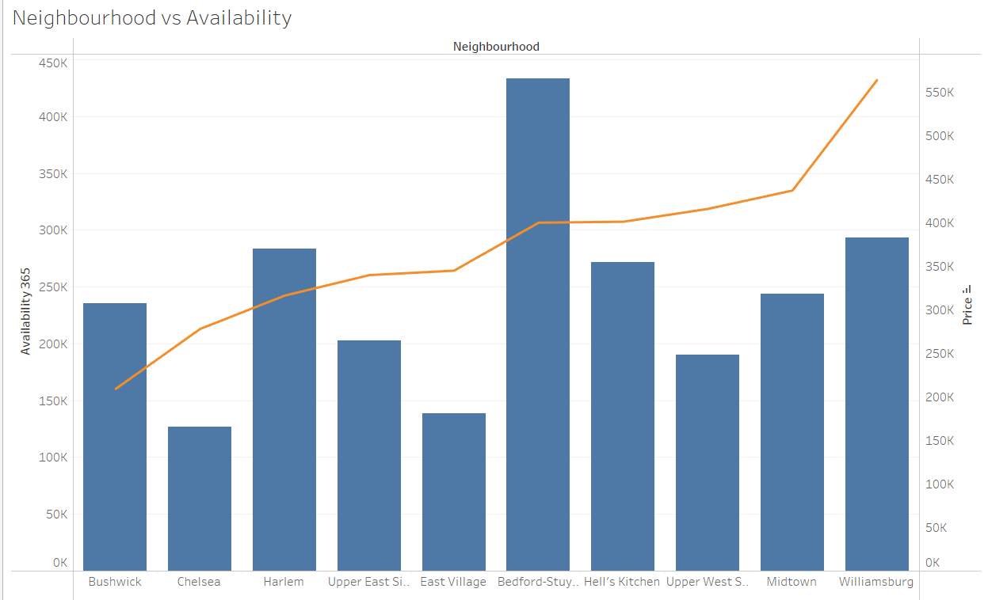
Neighborhood Availability and Pricing
Neighborhood
Availability
Price
Recommendation
Bedford
High
Low
Great value for guests
Harlem
High
Moderate
Good balance
Chelsea
Low
High
Premium, exclusive option
Williamsburg
Medium
High
Trendy, sought-after area

Slide 7
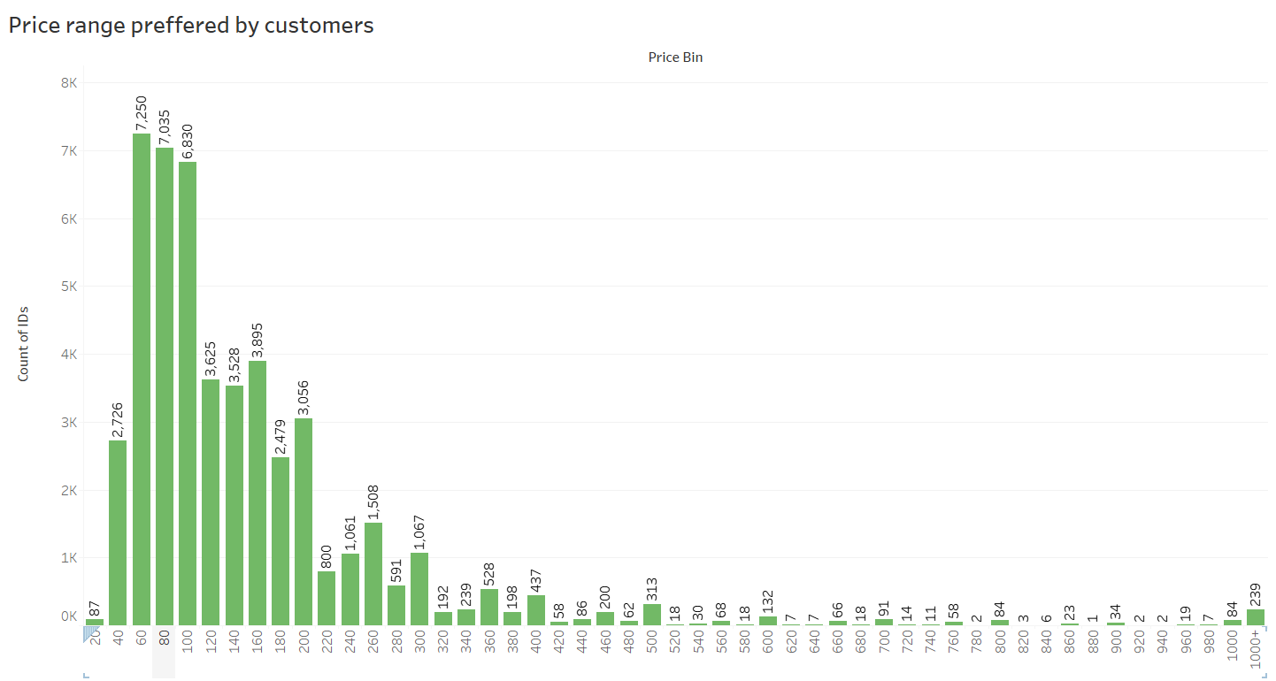
Customer Price Preferences
Optimal Price Range
Budget Segment
Luxury Market
$60 - $200 is the sweet spot for most bookings, balancing affordability and quality.
Listings under $60 attract price-sensitive travelers but have lower booking volumes.
Properties over $200 cater to high-end guests, representing a smaller but lucrative segment.

Slide 8
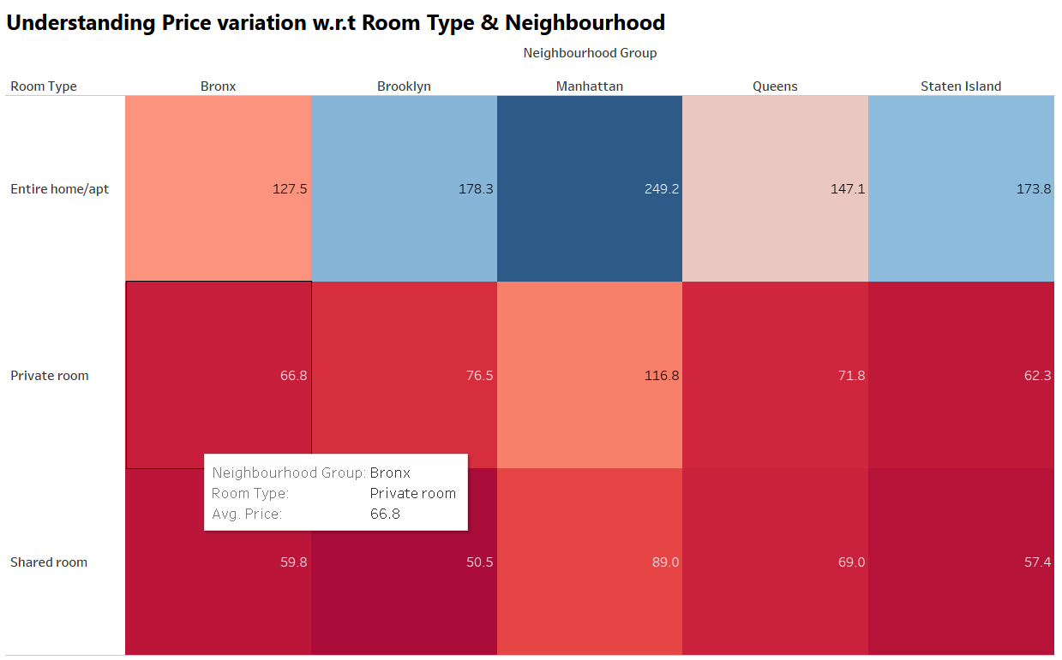



Price Variation by Room Type and Neighborhood
Luxury Homes
Manhattan's entire homes average $250, targeting affluent travelers seeking
premium experiences.
Private Rooms
Manhattan and Brooklyn lead in private room pricing, ideal for solo travelers.
Budget Options
Brooklyn's shared rooms at $50.5 attract budget-conscious guests and backpackers.

Slide 9
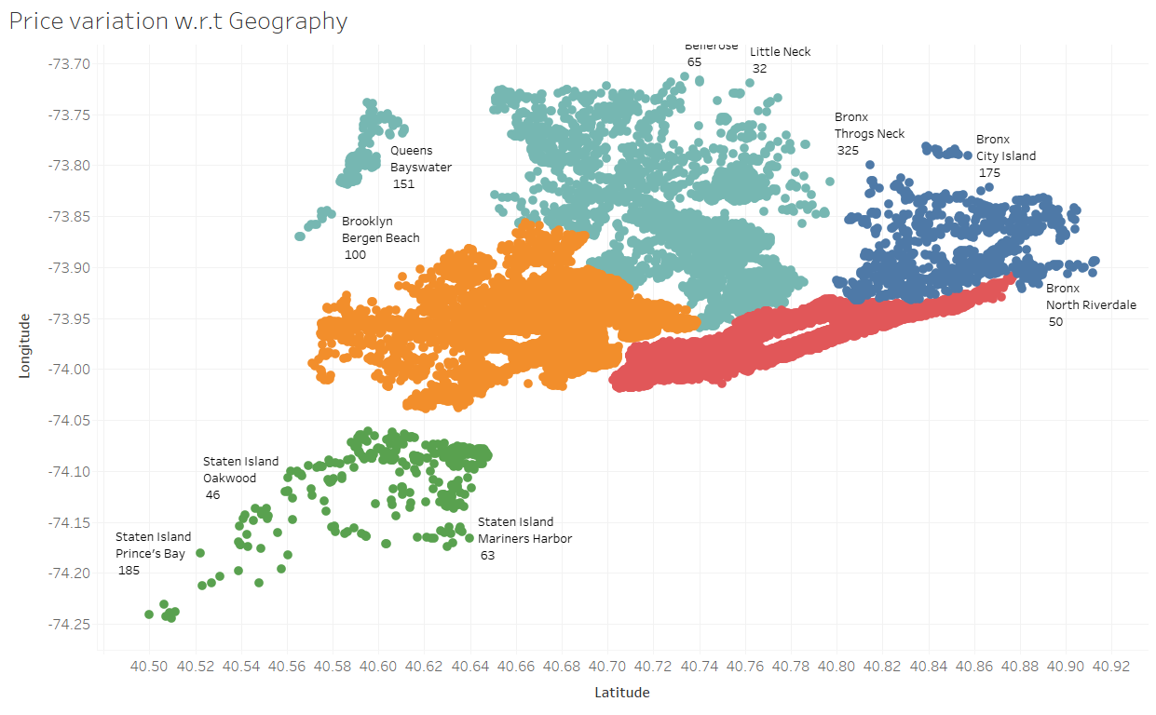




Geographical Price Distribution
Manhattan
Highest concentration of listings, reflecting its status as NYC's prime tourist destination.
Brooklyn
Strong presence with diverse offerings, appealing to trendy and value-seeking travelers.
Queens
Growing market with potential for expansion, offering more affordable options.
Staten Island
Limited listings due to lower tourism appeal, potential for niche market development.

Slide 10
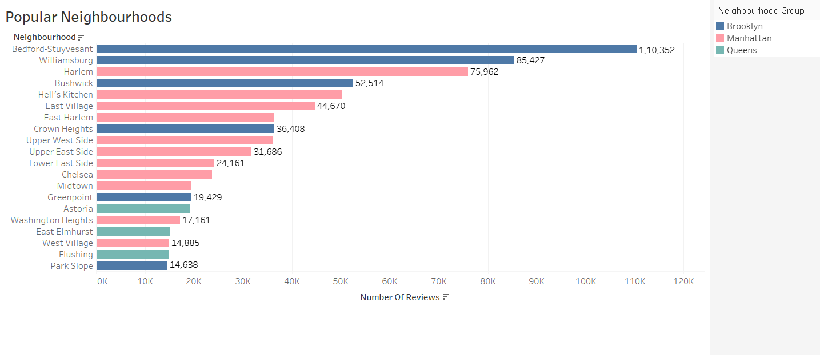
Top-Rated Neighborhoods
1
Bedford-Stuyvesant
Brooklyn's gem with 110,352 reviews, known for its brownstones and cultural diversity.
2
Williamsburg
Trendy Brooklyn neighborhood popular among young professionals and artists.
3
Harlem
Manhattan's cultural hotspot, offering rich history and vibrant community experiences.
4
Hell's Kitchen
Centrally located Manhattan neighborhood with diverse dining and entertainment options.

