Slide 1
Utility Analytics
Session 2

Slide 2
AGENDA
Yesterday
Today
Utility analytics overview
Applying analytics
Analytics – lifecycle
Data visualization best practices
Data preparation
Mapping business problems to analytics solutions
Hands-on with SQL
Copyright 2021, the Board of Regents of the University of Oklahoma.

Slide 3
DATA ANALYTICS LIFECYCLE
Discovery
1
Operationalize
6
Data Preparation
2
Communicate Results
Model Planning
5
3
Model Building
4
Source: Services, 2015, pp. 26-30

Slide 4
PHASE 2: DATA PREPARATION
Collect
Non-production environment
All kinds of data
Gap analysis
Exploration
Gain context
Data quality
Data access/gaps
Condition
Cleaning, transforming, and normalizing data
Notes:
The second phase of the analytics lifecycle involves data preparation, which includes the steps to explore, preprocess, and condition the data prior to modeling and analysis.
Common steps
Create a robust non-production environment in which to explore the data.
ETLT the data from where it’s housed into the sandbox environment.
Learn about the data and become familiar with it: data understanding.
This usually includes data visualization: trends, outliers, and relationships among data variables.
Decide how to transform and preprocess the data to format it for subsequent analysis.
It is common for this phase to be the most time-consuming part of the analytics lifecycle. It may take 50%+ of time/effort on a given project.
========
Collect data into sandbox/workspace.
The purpose is to have the data in a non-production environment so it can be manipulated and analyzed.
Collect all kinds of data here, including summary-level data, raw data feeds, unstructured text data, depending on type of analysis your team is performing.
This includes ETLT (Extract-Transform-Load-Transform).
Gap analysis: compare the data the team currently has access to with what is ultimately needed to complete the analysis.
A critical aspect of a data analytics project is becoming familiar with the data itself.
Gain context about what constitutes a reasonable value vs. what is a surprising outcome.
Identify data quality problems
Allows you to gain clarity about the data access you have vs the data you still need to obtain.
Some of the activities in this step may overlap with the initial investigation in the previous step.
Conditioning the data
Refers to the process of cleaning, transforming and normalizing your datasets.

Slide 5
ADD SLIDE: DATA TYPES

Slide 6
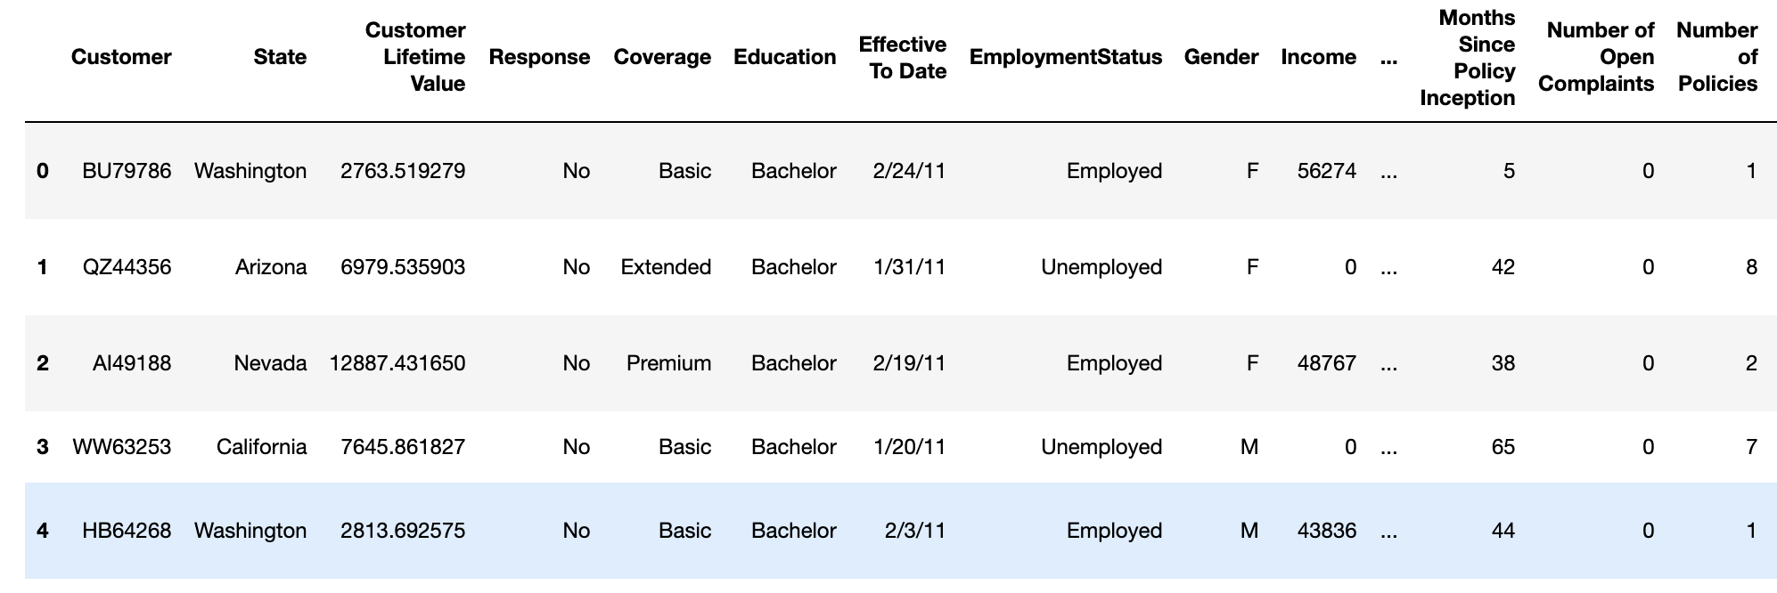
DATA TYPES
Categorical
Continuous
Ordinal
Binary
Discrete
Numeric: can be measured and aggregated
  Continuous: can take on any value in an interval.
  Discrete: can take on only integer data (counts)
Categorical: takes a value from a limited and usually fixed number of possible values
  Binary: Two possible values
  Ordinal: Values have inherent order. The intervals between values are arbitrary
Copyright 2021, the Board of Regents of the University of Oklahoma.
Notes:
In our example table we see a mix of numeric data and categorical data. These are generally the two types of structured data that we work with.
Numeric or quantitative: types of numbers that allow you to perform calculations on those numbers. Numeric data comes in two forms.
Continuous: those that can take any value within an interval. Customer Lifetime Value
Discrete: those which can only be an integer, like a count. Months Since Policy Inception
Categorical, which takes a fixed set of values. These values are qualitative (vs quant) and discrete.
State is an example here, which can take a value from one of several possible qualitative values.
Some more terminology:
Variables containing categorical data are factors;
A factor’s different categories are called levels.
The number of possible values in a categorical attribute (or factor) is called the cardinality of the attribute
There are two special cases of categorical data:
Binary: categorical, but with only two possible values. Gender, Response
Ordinal: categorical data with some inherent order or rank. Education. Likert scale data is another example of ordinal data.
Ordinal variables are not numeric (even if represented with numbers) because the intervals between the categories are ambiguous.

Slide 7
DATA EXPLORATION
Search for Answers
Refine Questions
Generate Questions
Goal: develop an understanding of your data.
  Compare your data with your expectations
  Investigate the quality of your data
Variation is the tendency of a variable (feature) to change from measurement to measurement.
Covariation is the tendency for two or more variables (features) to vary together in a related way.
Missing data refers to the situation in which specific measurements were not collected.
Copyright 2021, the Board of Regents of the University of Oklahoma.
Notes:
Goal: develop an understanding of our data.
Exploratory data analysis is an iterative process in which we…
Generate questions about your data.
Search for answers, often by visualizing, transforming, and modelling
Use what you learn to refine your questions and generate new questions
Quantity of questions lead to quality questions
During the initial phases of EDA you should feel free to investigate every idea that occurs to you.
Some of these ideas will pan out, others won’t.
As your exploration continues, you will home in on a few particularly productive areas that you’ll eventually write up and communicate to others.
There are two general types of questions to ask:
What type of variation occurs within my variables? Variation is the tendency of the values of a variable to change from measurement to measurement.
What type of covariation occurs between my variables? Covariation is the tendency for the values of two or more variables to vary together in a related way.
If variation describes the behavior within a variable, covariation describes the behavior between variables.
Missing data refers to the situation in which specific measurements were not collected.

Slide 8
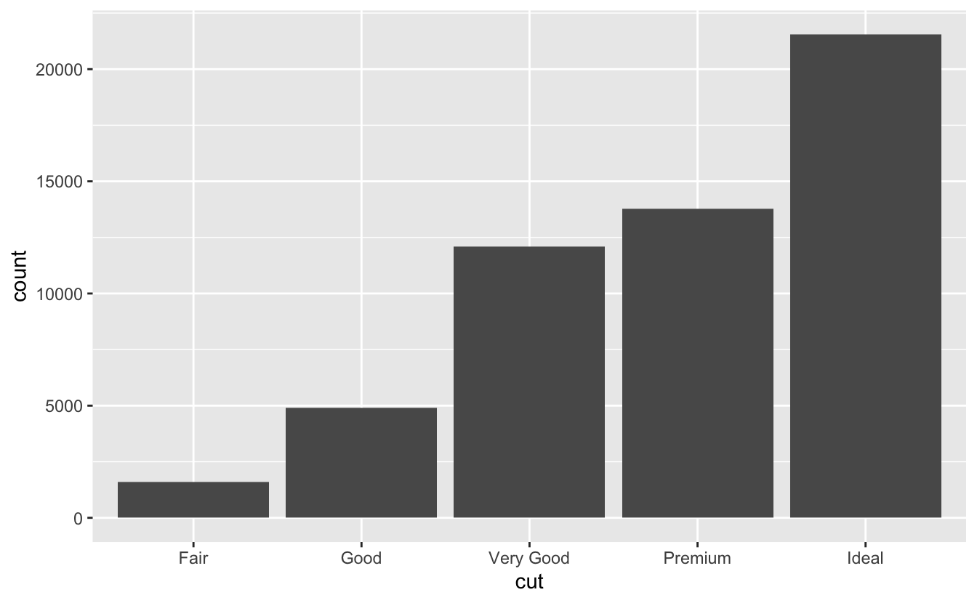
DATA EXPLORATION
Visualizing Distributions
  Categorical variable: bar chart
Variation
  Typical values
Copyright 2021, the Board of Regents of the University of Oklahoma.
Notes:
Variation is the tendency of a variable (feature) to change from measurement to measurement.
Every variable has its own pattern of variation, which can reveal interesting information.
The best way to understand that pattern is to visualise the distribution of the variable’s values.
Bar charts: The height of the bars displays how many observations occurred with each x value.
Histograms: A histogram divides the x-axis into equally spaced bins and then uses the height of a bar to display the number of observations that fall in each bin.
Bin width: You should always explore a variety of bin widths when working with histograms, as different bin widths can reveal different patterns.
Summary statistics
Look at the basic statistics of each column.
Tukey suggests using a five-number summary, which includes the minimum and maximum, the median and quartiles
The data in the table is from an open body measurement data set
Why is the median age is 584? Going back to the data, we learn that age is measured in months, meaning the median is 48.67 years.
Arm and leg length seem to have about the same median, but leg length has much greater variability.
For categorical fields, like occupation, the analogous summary would be a report on how many different label types appear in the column, and what the three most popular categories are, with associated frequencies.

Slide 9
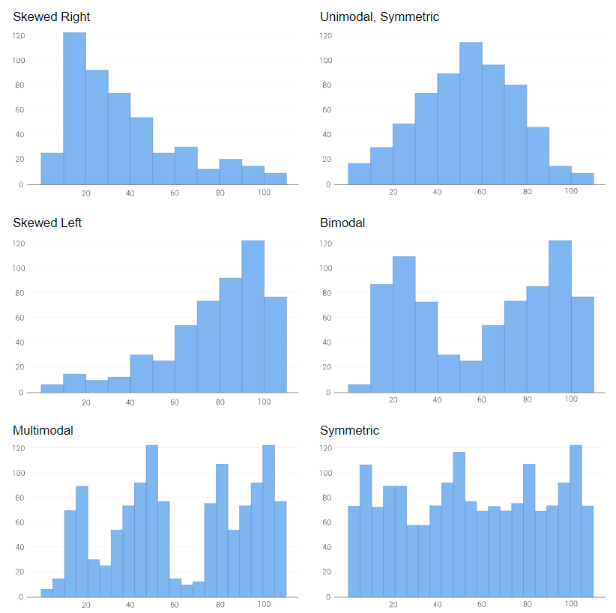
DATA EXPLORATION
Visualizing Distributions
  Categorical variable: bar chart
  Continuous variable: histogram
Variation
  Typical values
Copyright 2021, the Board of Regents of the University of Oklahoma.
Notes:
Variation is the tendency of a variable (feature) to change from measurement to measurement.
Every variable has its own pattern of variation, which can reveal interesting information.
The best way to understand that pattern is to visualise the distribution of the variable’s values.
Bar charts: The height of the bars displays how many observations occurred with each x value.
Histograms: A histogram divides the x-axis into equally spaced bins and then uses the height of a bar to display the number of observations that fall in each bin.
Bin width: You should always explore a variety of bin widths when working with histograms, as different bin widths can reveal different patterns.
Summary statistics
Look at the basic statistics of each column.
Tukey suggests using a five-number summary, which includes the minimum and maximum, the median and quartiles
The data in the table is from an open body measurement data set
Why is the median age is 584? Going back to the data, we learn that age is measured in months, meaning the median is 48.67 years.
Arm and leg length seem to have about the same median, but leg length has much greater variability.
For categorical fields, like occupation, the analogous summary would be a report on how many different label types appear in the column, and what the three most popular categories are, with associated frequencies.

Slide 10
DATA EXPLORATION
Visualizing Distributions
  Categorical variable: bar chart
  Continuous variable: histogram
Questions
  Which values are most common (why)?
  Which values are rare (why)?
  Are there unusual patterns? What might explain them?
Summary statistics
  Descriptive statistics for each feature.
  Five-number summary: minimum, maximum, median, quartiles.
  For categorical features: cardinality (levels), most frequently occurring values.
Variation
  Typical values
Copyright 2021, the Board of Regents of the University of Oklahoma.
Notes:
Variation is the tendency of a variable (feature) to change from measurement to measurement.
Every variable has its own pattern of variation, which can reveal interesting information.
The best way to understand that pattern is to visualise the distribution of the variable’s values.
Bar charts: The height of the bars displays how many observations occurred with each x value.
Histograms: A histogram divides the x-axis into equally spaced bins and then uses the height of a bar to display the number of observations that fall in each bin.
Bin width: You should always explore a variety of bin widths when working with histograms, as different bin widths can reveal different patterns.
Summary statistics
Look at the basic statistics of each column.
Tukey suggests using a five-number summary, which includes the minimum and maximum, the median and quartiles
The data in the table is from an open body measurement data set
Why is the median age is 584? Going back to the data, we learn that age is measured in months, meaning the median is 48.67 years.
Arm and leg length seem to have about the same median, but leg length has much greater variability.
For categorical fields, like occupation, the analogous summary would be a report on how many different label types appear in the column, and what the three most popular categories are, with associated frequencies.

Slide 11
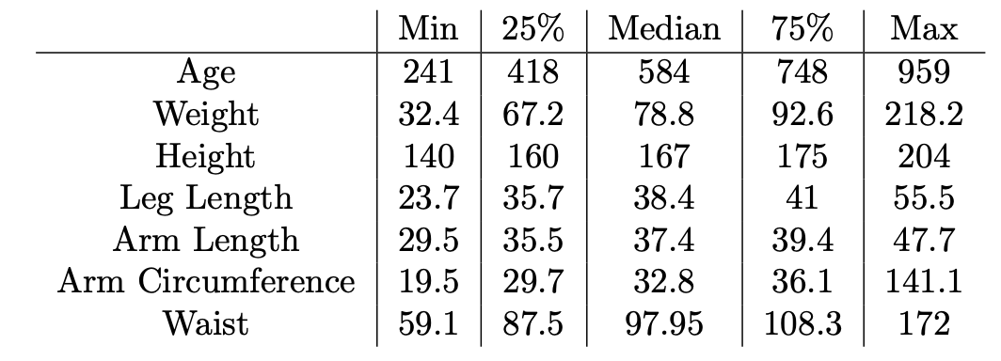
DATA EXPLORATION
Visualizing Distributions
  Categorical variable: bar chart
  Continuous variable: histogram
Questions
  Which values are most common (why)?
  Which values are rare (why)?
  Are there unusual patterns? What might explain them?
Summary statistics
Variation
  Typical values
Copyright 2021, the Board of Regents of the University of Oklahoma.
Notes:
Variation is the tendency of a variable (feature) to change from measurement to measurement.
Every variable has its own pattern of variation, which can reveal interesting information.
The best way to understand that pattern is to visualise the distribution of the variable’s values.
Bar charts: The height of the bars displays how many observations occurred with each x value.
Histograms: A histogram divides the x-axis into equally spaced bins and then uses the height of a bar to display the number of observations that fall in each bin.
Bin width: You should always explore a variety of bin widths when working with histograms, as different bin widths can reveal different patterns.
Summary statistics
Look at the basic statistics of each column.
Tukey suggests using a five-number summary, which includes the minimum and maximum, the median and quartiles
The data in the table is from an open body measurement data set
Why is the median age is 584? Going back to the data, we learn that age is measured in months, meaning the median is 48.67 years.
Arm and leg length seem to have about the same median, but leg length has much greater variability.
For categorical fields, like occupation, the analogous summary would be a report on how many different label types appear in the column, and what the three most popular categories are, with associated frequencies.

Slide 12
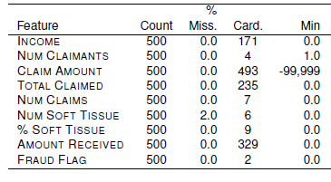
CARDINALITY
Feature cardinality is the number of distinct values within a feature.
  Cardinality of 1 check for errors in the data
  Does cardinality match expectations?
  Do the values themselves meet your expectations?
Copyright 2021, the Board of Regents of the University of Oklahoma.

Slide 13
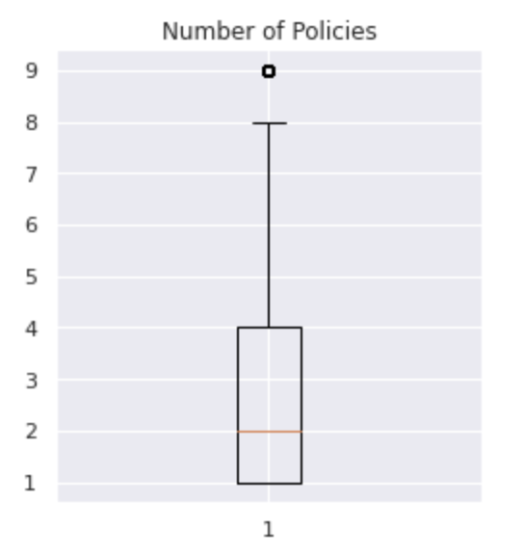
DATA EXPLORATION
Outliers are observations that are unusual or extreme.
  Causes: bad data? something interesting or exceptional?
  Detection: feature min / max; visualization (histogram, boxplots, scatterplots)
  Treatment: drop observations, treat as missing, use robust methods
Variation
  Typical values
  Unusual values
Outlier
Copyright 2021, the Board of Regents of the University of Oklahoma.
Notes:
Outliers are observations that are unusual or extreme. They are very different from the “typical” example.
Causes: Bad data? Something interesting or exceptional (outliers may be the focus of the analysis)
Some sources advise repeating analysis with and without outliers.
If minimal impact on the analysis (and you can’t determine why they are present), you might convert them to missing variables.
Otherwise, you need to determine what caused them and disclose that you removed them in your write-up.

Slide 14
DATA EXPLORATION
Real data sets often contain missing values.
  Explicit: flagged as missing (e.g., NaN)
  Implicit: not present in the data
Causes
  Irrelevant feature for the object (year of death for a living person)
  Broken sensor
  Refusal to answer a survey question
Treating missing values:
  Remove examples with missing data
  Drop features with missing data
  Use a data imputation technique:
    mean/median value
    nearest neighbor
    interpolation
Variation
  Typical values
  Unusual values
Missing values
Copyright 2021, the Board of Regents of the University of Oklahoma.
Notes:
Missing data refers to the situation in which specific measurements were not collected (or are not present in the dataset).
A value can be missing in two ways:
Explicit: the value is flagged as missing (NA, nonsensical value).
Implicit: not present in the data.
Hadley Wickham: “An explicit missing value is the presence of an absence; an implicit missing value is the absence of a presence.”
Many causes
Irrelevant feature
Broken sensor
Refusal to answer a survey question
Sometimes the data is not coded as missing.
==========
Treatment
Drop the example or the feature
Imputation
Mean value
Nearest neighbor: identify the closest example, and use that value to impute
Interpolation: use the missing value as the target for a regression problem (use complete examples as input).
If data is missing at prediction time, you’ll want to use the same technique to impute the unseen example.

Slide 15
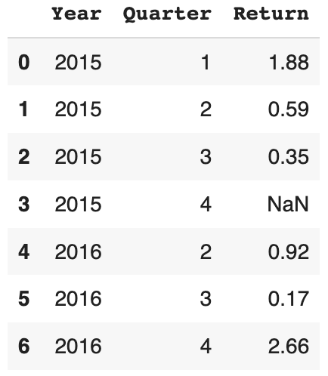
DATA EXPLORATION
Real data sets often contain missing values.
  Explicit: flagged as missing (e.g., NaN)
  Implicit: not present in the data
Variation
  Typical values
  Unusual values
Missing values
Explicit
Implicit
Copyright 2021, the Board of Regents of the University of Oklahoma.
Notes:
Missing data refers to the situation in which specific measurements were not collected (or are not present in the dataset).
A value can be missing in two ways:
Explicit: the value is flagged as missing (NA, nonsensical value).
Implicit: not present in the data.
Hadley Wickham: “An explicit missing value is the presence of an absence; an implicit missing value is the absence of a presence.”
Many causes
Irrelevant feature
Broken sensor
Refusal to answer a survey question
Sometimes the data is not coded as missing.
==========
Treatment
Drop the example or the feature
Imputation
Mean value
Nearest neighbor: identify the closest example, and use that value to impute
Interpolation: use the missing value as the target for a regression problem (use complete examples as input).
If data is missing at prediction time, you’ll want to use the same technique to impute the unseen example.

Slide 16
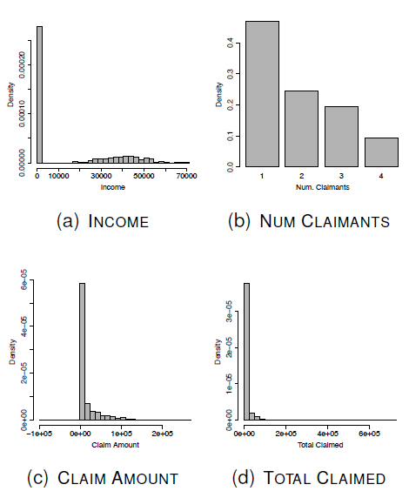
DISTRIBUTIONS
Copyright 2021, the Board of Regents of the University of Oklahoma.
Notes:
Some things to investigate further:
Are there missing values that are not coded as missing?
Are there outliers at the end of the distribution?

Slide 17
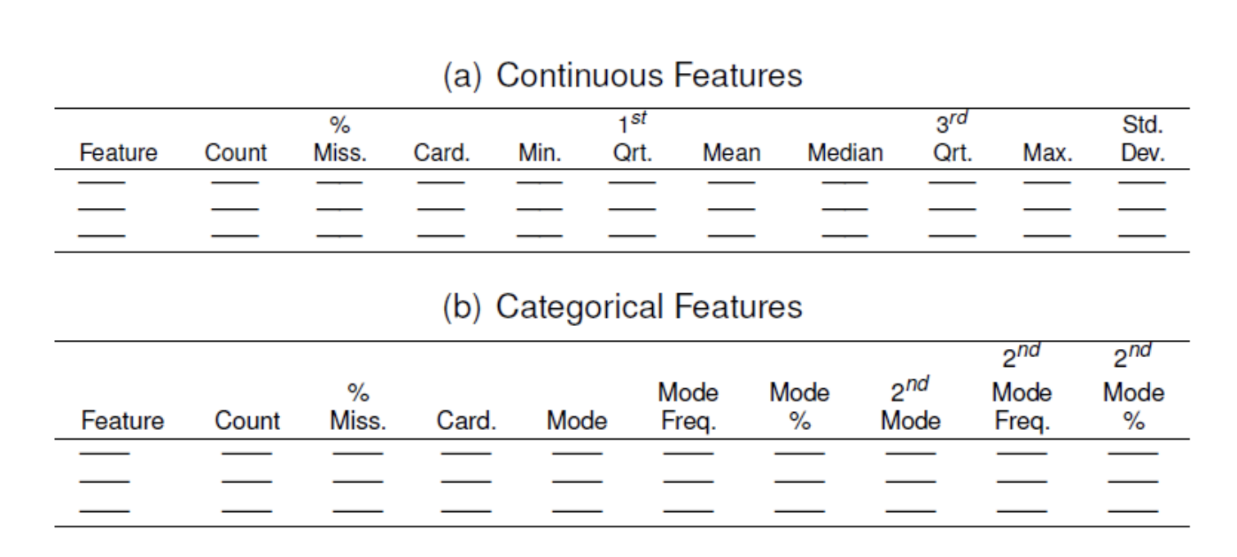
DATA QUALITY REPORT
The data quality report is a table that provides the descriptive characteristics of the data.
Copyright 2021, the Board of Regents of the University of Oklahoma.

Slide 18
DATA EXPLORATION
Tendency for two or more variables (features) to vary together in a related way.
Identify by visualizing the relationship between two or more variables.
  Categorical and continuous variables: boxplot
Variation
  Typical values
  Unusual values
Missing values
Covariation
Copyright 2021, the Board of Regents of the University of Oklahoma.
Notes:
Covariation is the tendency for two or more variables (features) to vary together in a related way.
If variation describes the behavior within a variable, covariation describes the behavior between variables.
Visualization is again a great way to see covariation. The type of variables involved determines the type of plots to use.
Categorical and continuous variables:

Slide 19
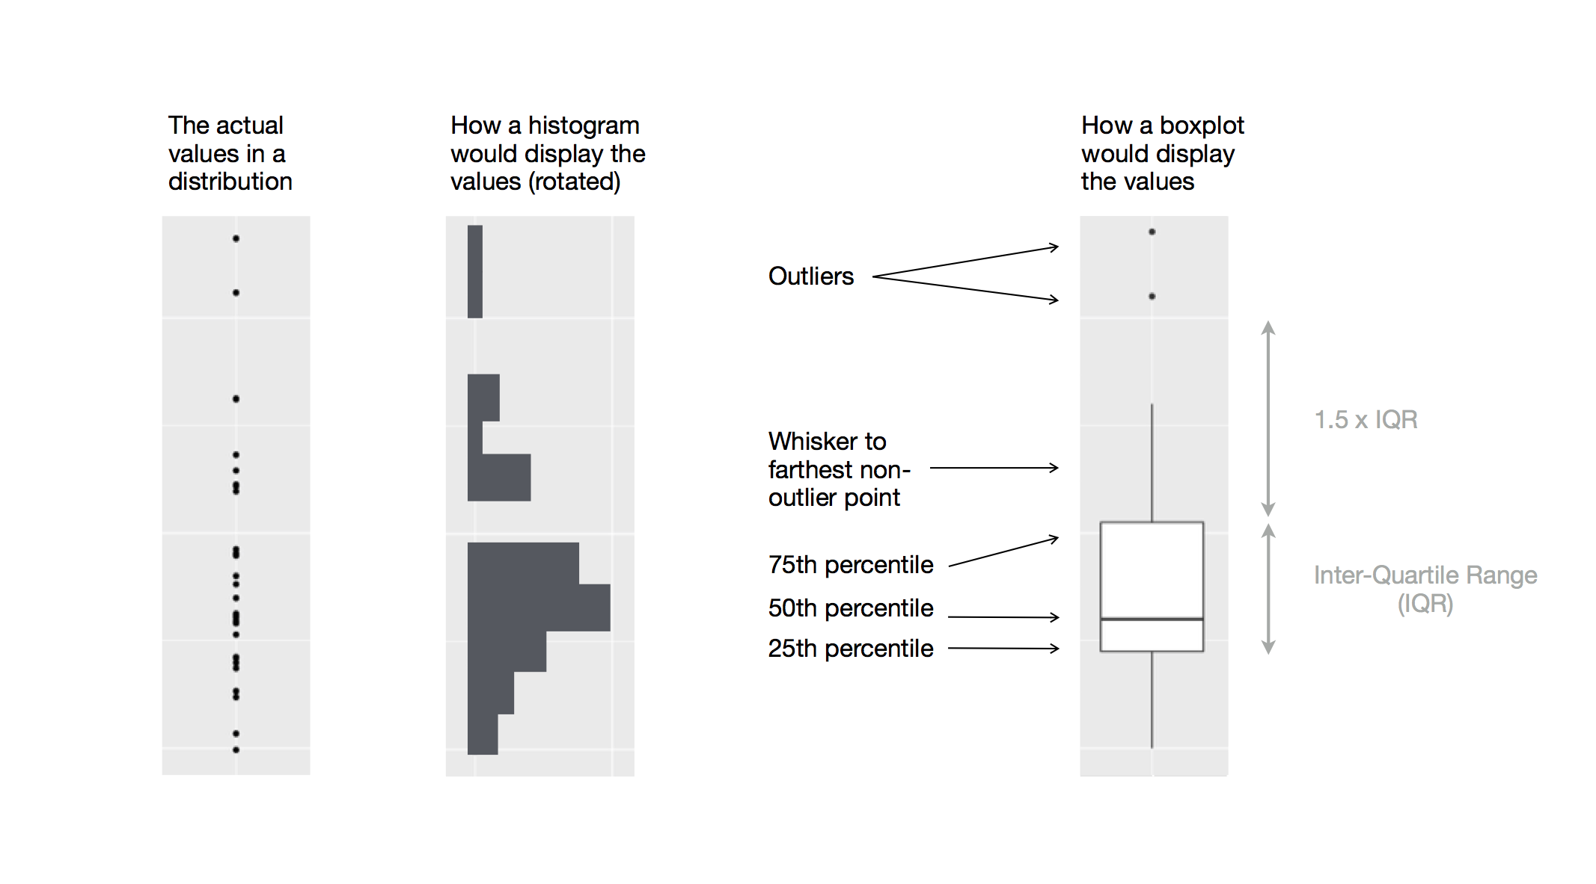
Copyright 2021, the Board of Regents of the University of Oklahoma.

Slide 20
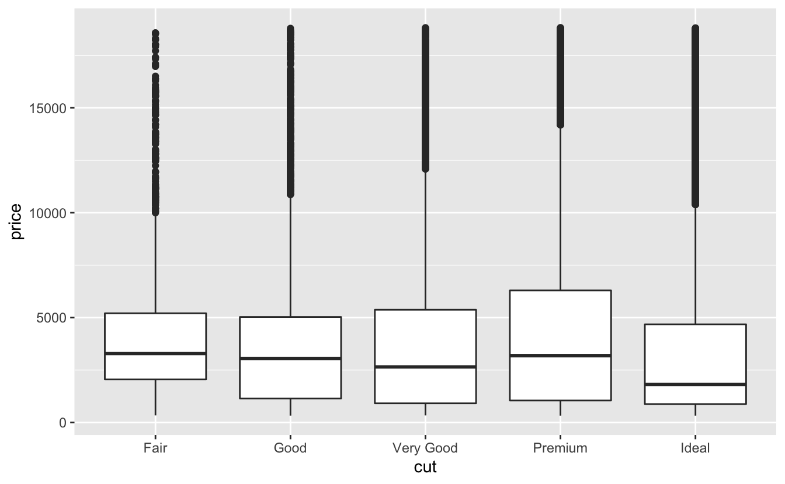
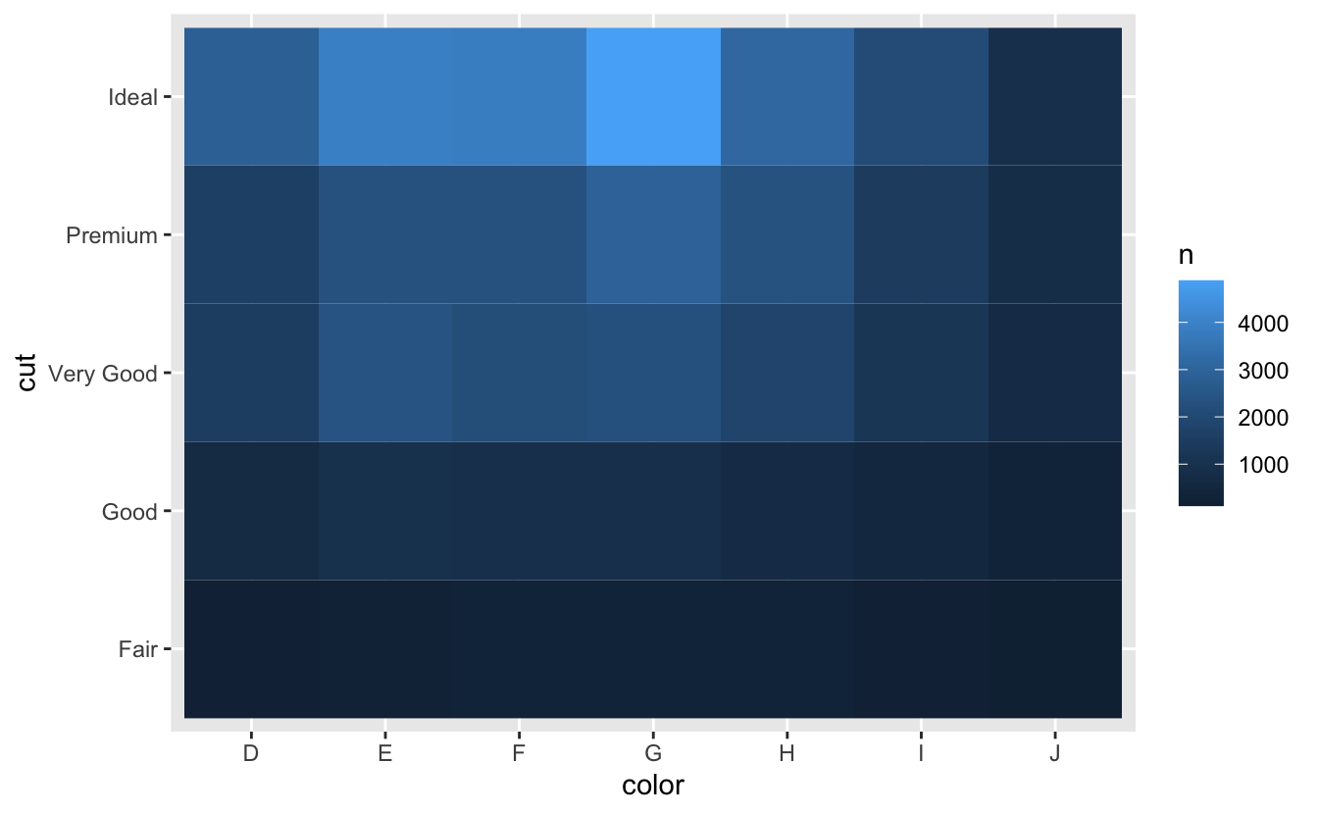
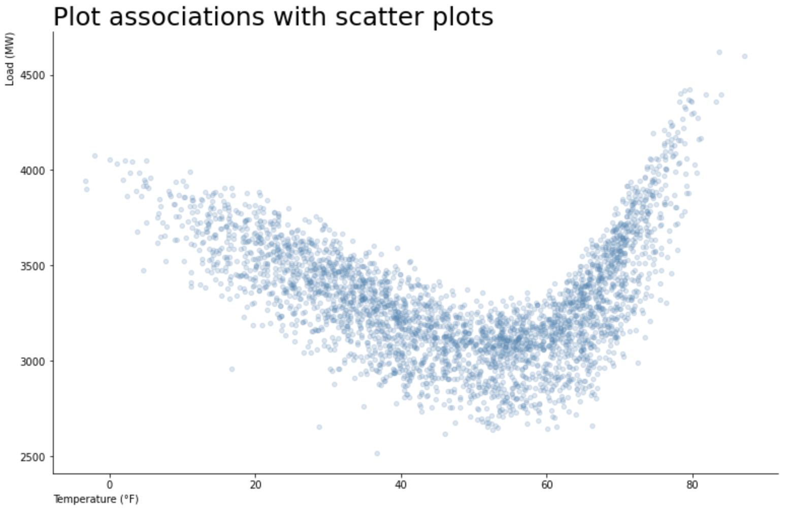
DATA EXPLORATION
Tendency for two or more variables (features) to vary together in a related way.
Identify by visualizing the relationship between two or more variables.
  Categorical and continuous variables: boxplot
  Two categorical variables: heatmap
  Two continuous variables: scatterplot
Variation
  Typical values
  Unusual values
Missing values
Covariation
Copyright 2021, the Board of Regents of the University of Oklahoma.
Notes:
Covariation is the tendency for two or more variables (features) to vary together in a related way.
If variation describes the behavior within a variable, covariation describes the behavior between variables.
Visualization is again a great way to see covariation. The type of variables involved determines the type of plots to use.
Categorical and continuous variables: boxplots (examples from R for Data Science)
Two categorical variables: grouped bar or stacked bar, heatmaps (examples from R for Data Science)
Two continuous variables

Slide 21
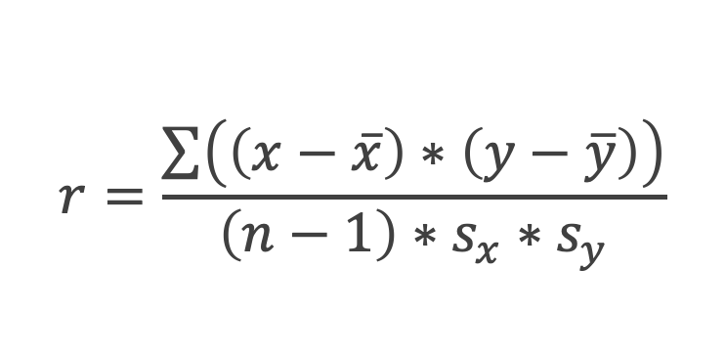
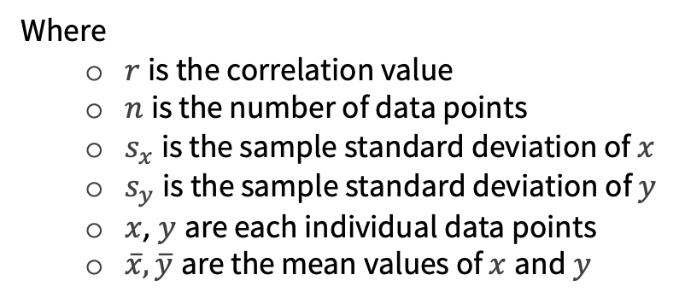
DATA EXPLORATION
Correlation is a measure of how closely two variables move together.
  Pearson’s correlation coefficient is a common measure of correlation.
$$r=\frac{\sum{\left(\left(x−\overline{x}\right)∗\left(y−\overline{y}\right)\right)}}{\left(n−1\right)∗s_{x}∗s_{y}}$$
Where
  $r$ is the correlation value
  $n$ is the number of data points
  $s_{x}$ is the sample standard deviation of $x$
  $s_{y}$ is the sample standard deviation of $y$
  $x$, $y$ are each individual data points
  $\overline{x},\overline{y}$ are the mean values of $x$ and $y$
Correlation coefficient (+/-) | What it could mean
0 | No relationship
0.01 - 0.29 | Weak relationship
0.3 – 0.59 | Moderate relationship
0.6 – 0.99 | Strong relationship
1 | Perfect relationship
Copyright 2021, the Board of Regents of the University of Oklahoma.
Notes:
Correlation
When we do exploratory data analysis, which we’ll look closer at momentarily, we often want to understand the relationships between variables, and one such measure of relationships is correlation. Correlation measures the degree to which two variables are related to one another.
Variables X and Y are said to be positively correlated if high values of X go with high values of Y, and low values of X go with low values of Y.
The most common one is the Pearson Correlation Coefficient (denoted as r) which is a measure for quantifying the strength of a linear relationship between two variables. It shows the extent to which an increase or decrease in one variable is correlated to a change in another variable. Values fall between -1 and 1, with values at 1 and -1 indicating perfect correlation and values at 0 indicating no correlation. Positive r values indicate a direct relationship; negative values indicated an inverse relationship.
Variables can have an association that is not linear, in which case the correlation coefficient may not be a useful metric.
Like the mean and standard deviation, the correlation coefficient is sensitive to outliers in the data
One crucial point that you’ve probably heard before is that correlation does not imply causation. The amount of ice cream consumed and number of shark bites might be correlated, but there is not a causal relationship.

Slide 22
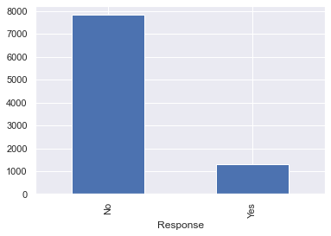
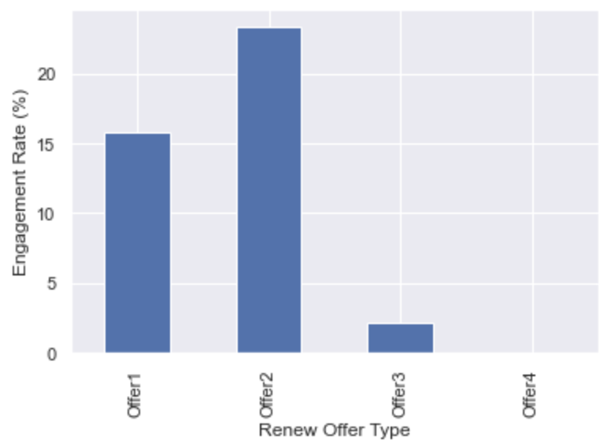
DATA EXPLORATION
Drill down: does splitting frequency by class change the distributions? View the class breakdowns.
Copyright 2021, the Board of Regents of the University of Oklahoma.
Notes:
View class breakdowns
Are there interesting ways to break things down by major categorical variables?
Put another way, when you look at the numerical distributions split by a category, does your view of the variable change?
E.g.: If we plotted the duck plot (data was from California) with data from different regions, do we see different patterns?
***Would like an example here.***
Plot the distributions
Here we are looking for general shapes of each distribution and outliers.
General shape: Normal-looking distribution? Uniform? Multimodal?
To what extent does the data need to be processed and transformed prior to further analysis or modeling?

Slide 23
SUMMARY
The goal of data understanding is to become more familiar with our dataset.
  Assess data quality
  Identify first insights: variation and covariation
After thorough exploratory analysis, you can prepare your data for further analysis or communication.
Copyright 2021, the Board of Regents of the University of Oklahoma.

