Slide 1
Utility Analytics
Session 2

Slide 2
Intro to SQL Databases
High-level Overview
Purpose of SQL
Setting up the Environment
Copyright 2021, the Board of Regents of the University of Oklahoma.

Slide 3
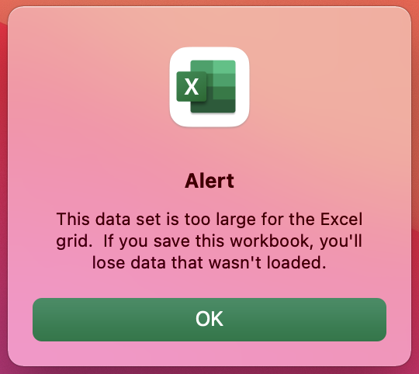
Why Learn SQL?
Utilities are generating and collecting data at exponential rates.
Other tools can become impractical with large volumes of data.
SQL allows the user to access and manipulate data in meaningful ways to provide business insights.
Copyright 2021, the Board of Regents of the University of Oklahoma.
Notes:
We have seen how businesses of all industries, including the utilities, are gathering data at exponential rates.
The data is likely to be stored in a database.
Often, for a variety of reasons, the type of database used is a relational database.
The language that relational databases speak is SQL.
Knowing SQL allows you to access, modify, explore and summarize data right where it lives.
(Large volumes of data can make using tools like Excel and Access impractical; using another programming languages like Python has some benefits, but requires additional overhead.)
I think it’s worth underscoring how important the skill of SQL is to own.
According to the 2021 StackOverflow Developer Survey (https://insights.stackoverflow.com/survey/2021#overview), SQL is the fourth most used programming language (practically tied with Python for third place).
Only Javascript and the HTML/CSS stack are ranked higher.
One misperception about SQL is that it is strictly an IT skill and therefore only applicable to technology (not business) professionals. In today’s data environment, business people, managers, IT professionals, analysts and engineers can all benefit from adding SQL to their tool kit.

Slide 4
What is a Database?
Broadly: anything that collects and organizes data.
Examples:
Spreadsheets
Text files
File cabinet with organized documents
When referenced professionally, a database is often a Relational Database Management System (RDBMS) or a NoSQL database.
Copyright 2021, the Board of Regents of the University of Oklahoma.
Notes:
Broadly speaking a database is anything that collects and organizes data. Examples include
Spreadsheets
Text files
File cabinets with organized documents
Usually when someone in the workplace references a database they are referring to a virtual database, including a relational database or a NoSQL database. We will be spending most of our time on relational databases in this training.
NoSQL is an umbrella term that includes the following type of databases:
Document databases
Key-value stores
Column oriented databases
Graph databases

Slide 5
Relational databases
Collection of two-dimensional tables (relations) made up of rows (tuples) and columns (attributes).
Data are separated into different tables so that data is not needlessly replicated.
Attribute
Tuple
Relation
Fundamental idea: tables may have attributes that point to information in other tables.
Copyright 2021, the Board of Regents of the University of Oklahoma.
Notes:
A Relational Database Management System (RDBMS) is simply a type of database that holds one or more tables that may have relationships.
Tables store data in columns and rows, much like a spreadsheet.
Databases usually hold multiple tables, which helps eliminate duplicate data, makes database maintenance easier.
There is another fundamental concept to note and that is that tables usually have attributes that reference other tables. That connection helps define the relationship between those tables.

Slide 6
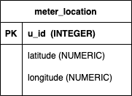
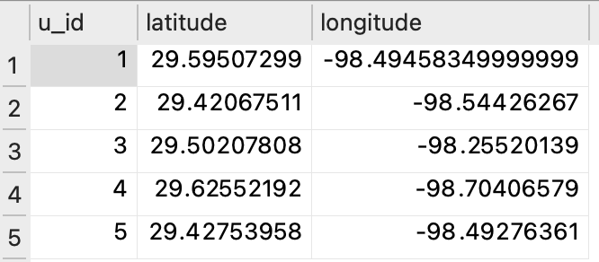
Tables
A table is a set of rows and columns that stores data.
In any single data row, each column contains only one value.
The data placed in a column are taken from the column’s domain, i.e. the permissible values for the column.
Copyright 2021, the Board of Regents of the University of Oklahoma.
Notes:
The main structure in the relational database is the table, which is a set of rows and columns that stores data.
Some important qualities
For any single row, each column contains only one value
The data placed in each column are take from the column’s domain – that is from the set of permissible values in the column.
The domain is defined when the table is created.

Slide 7
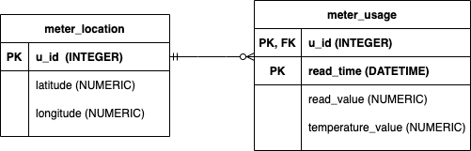
Primary and Foreign Keys
A primary key is a column or set of columns which uniquely identifies each row in the table.
Values are unique, never NULL.
Multiple columns used together as a key is a composite key.
A foreign key is a column (or set) that references a primary key in another table.
Copyright 2021, the Board of Regents of the University of Oklahoma.
Notes:
The concept of keys is another defining characteristic of relational databases.
A primary key is a column or set of columns which uniquely identifies each row in the table.
Values must be unique, and cannot be null NULL
The primary key in the table on the slide called meter_location is the column, u_id.
Referencing the meter_usage table, the primary key is made up of two columns: u_id and read_time.
This is an example of a composite key.
A foreign key is a column that points to related data in another table. It also enforces a constraint that values entered must already exist in the table it references.
So the key concept allows us to split data into multiple tables without the risk of ending up with rows in one table that have no relation to rows in another table, which is orphaned data.
The diagram here is a high-level conceptual data model diagram that helps when creating a database; it helps with organization and design by:
Demonstrating how tables and fields are related.
Allowing the designer/DBA to to communicate the logical structure of the database to users.

Slide 8
What makes it relational?
Individual tables can reference other tables based on relationships between columns in the tables.
A logical relationship exists between two tables when a table contains a column (foreign key) that is the same as the primary key in another table.
Copyright 2021, the Board of Regents of the University of Oklahoma.
Notes:
The relational part of relational databases today is commonly understood as being the fact that individual tables can reference other tables based on logical relationships between columns in the tables.
Let’s take the image on the right as an example.
The diagram gives two tables: meter_location and meter_usage.
If you look at the table meter_location, you’ll notice that it has three columns or attributes called u_id, latitude, and longitude with their associated data types or domains.
Also notice that u_id has a primary key indicator. Again, the primary key is a column or set of columns that acts as a unique identifier for each row.
Relationships between tables are expressed by indicating matching columns between the them: this is the primary and foreign key relationship (logical relationship).
So if you look at the meter_usage table, you’ll see that it has a composite primary key consisting of the columns u_id and read_time; those two columns together are the unique identifier.
Also notice the u_id in this table has a foreign key indicator.
u_id in meter_usage references u_id in meter location.

Slide 9
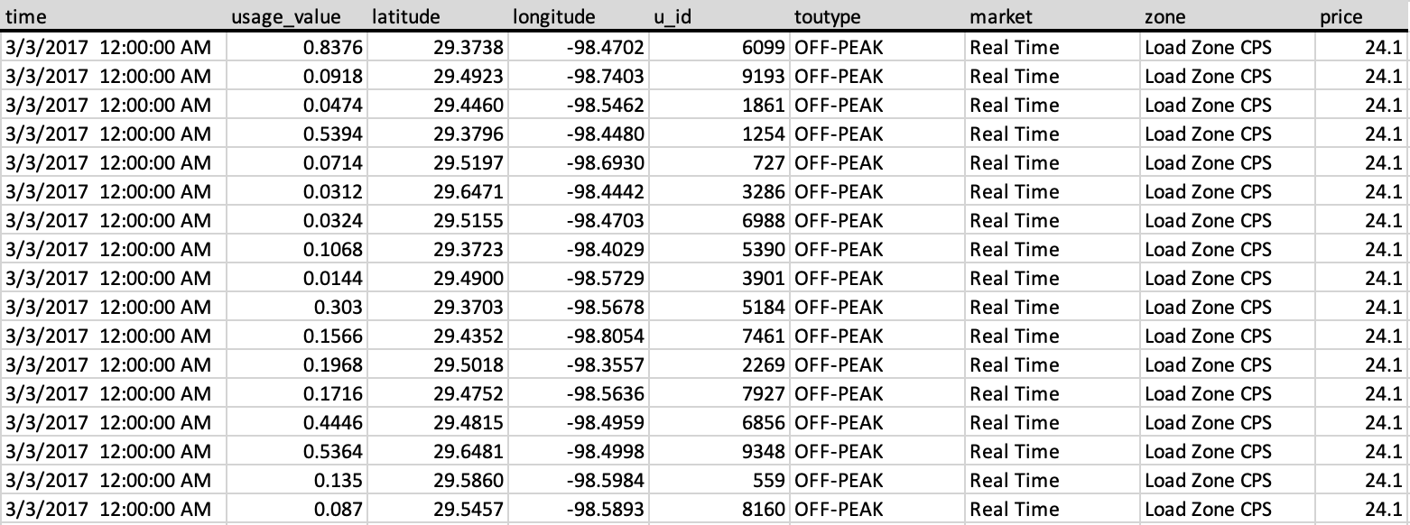
Why Not One Big Table?
Splitting large tables into smaller, related tables reduces data redundancy.
Non-normalized databases can be difficult to maintain.
Copyright 2021, the Board of Regents of the University of Oklahoma.
Notes:
During analysis, we usually need to consolidate data from several locations to make up our data set of interest. So that raises the question, why not simply store all of our data in a single big table?
Splitting data into multiple tables, or normalizing the database based on formal rules, helps reduce redundancy and ensure data integrity.
Makes database maintenance easier.

Slide 10
Copyright 2021, the Board of Regents of the University of Oklahoma.
Notes:
Let’s look at an example. The table here has columns for time, usage value, location, a unique meter ID, type, market, zone and price…
Does anyone see any problems?
Redundancy:
In this subset, we see that several columns are dependent on the timestamp (toutype, market, zone, and price). Those values are repeated for each timestamp and meter, where they really only need to be recorded for each time interval.
Another example that may be harder to notice is that location data for each meter is going to be repeated at each timestamp.

Slide 11
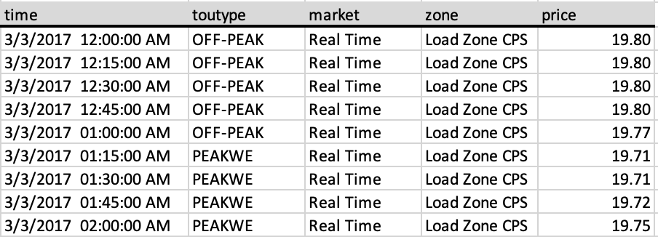
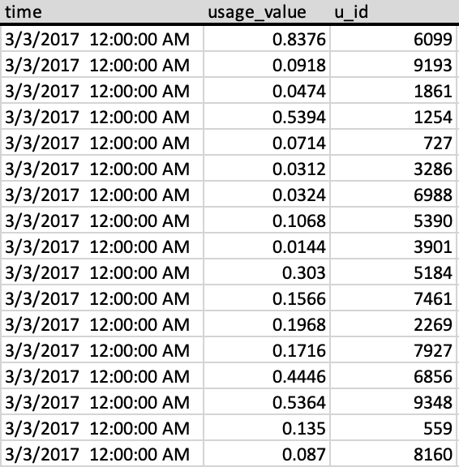
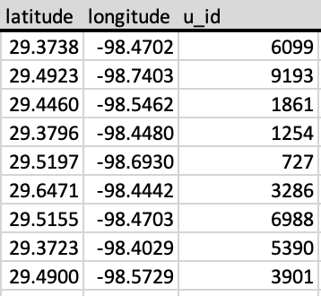
Copyright 2021, the Board of Regents of the University of Oklahoma.

Slide 12
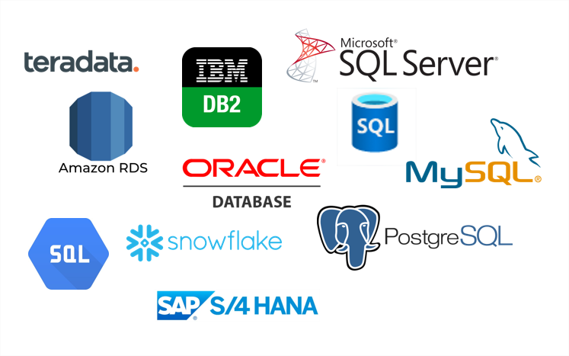
Relational Databases
Many different relational database systems (e.g. MySQL, SQL Server, PostgreSQL, …)
SQL is the standard language for storing, manipulating, and retrieving data in relational DBs.
Copyright 2021, the Board of Regents of the University of Oklahoma.
Notes:
There are many different database systems to choose from, including both proprietary and open-source options.
Microsoft SQL Server is an example of a proprietary system, whereas MySQL is an example of an open-source option.
Another distinction is that between lightweight databases and centralized databases.
Centralized databases are used to support a high volume of users and applications.
Typical client-server setup
Some of these solutions can be installed on a single computer, which is then used as the serve
Connect users’ computers (clients) to the server so they can access the data
Larger traffic volumes require more specialized computers (server computers), which are optimized for this task
The experience between the centralized DB and the lightweight DB is similar
Examples: MySQL, Microsoft SQL Server, Oracle, PostgreSQL, MariaDB
Lightweight databases are good if a simple solution for one or a few users is needed
Little to no overhead (no servers, nimble)
Databases typically stored in a file you can share with others
However, these options are not meant to support concurrent use.
Examples: SQLite
A commonality between these systems is the use of SQL to interact with the database.
-------------------------
Across all database solutions, you use SQL to interact with tables in a relatively uniform way, and even the SQL editor tools are somewhat similar.
However, each implementation or system may use its own dialect of SQL, which extends standard SQL.
An example is that Postgres (centralized solutions) offers a wide variety of statistical functionality that is not part of the SQL standard.
I’ll try to stick to universal functionality when I can and point out when I am using system-specific functionality.

Slide 13
SQL
SQL is the standard interface for interacting with relational databases.
Used to:
Add, update or delete rows of data.
Retrieve subsets of data for transaction processing and analytics applications.
Manage all aspects of the database.
Database implementations may have unique features.
Copyright 2021, the Board of Regents of the University of Oklahoma.
Notes:
The standard interface for interacting with relational databases.
Uses include:
Includes adding/updating/deleting rows and columns of data
Subsetting the data
Managing the database: setting up and maintaining the DB structure, managing users and groups, and interacting with the data
Relatively mature and standard across platforms.
Most implementations have their own quirks and features – get to know the implementation that you use the most.

Slide 14


NoSQL Databases
NoSQL (“not only SQL”) is an umbrella term for databases that are typically used for big data applications (e.g. large volume, unstructured or semi-structured, etc.).
Examples:
Document
Key-value
Wide column
Graph
Copyright 2021, the Board of Regents of the University of Oklahoma.
Notes:
Another popular category of database is the NoSQL database. We won’t spend a ton of time here, but it is worth knowing this exists.
NoSQL stands for “not only SQL” and is often used to describe “Big Data” platforms that may leverage SQL but are not relational.
These platforms store massive amounts of data in a variety of raw, unstructured formats (e.g. documents, key-value).
Most are distributed across multiple machines.
-----------------
MongoDB and Couchbase have many things in common. Both are NoSQL distributed databases, use the JSON model, have high-level query languages with support for select-join-project operations, have secondary indexes, have an optimizer that chooses the query plan automatically, and support intra-cluster and inter-cluster replication.
Couchbase is designed to be distributed from the get-go. For example, the data container Bucket is always distributed — nothing to share. Simply add new nodes and the system will automatically distribute. Intra cluster replication requires no new servers - simply set the number of replicas and you're all set. From the developer interaction perspective, the big difference is the query language itself - MongoDB has a proprietary query language and Couchbase has N1QL - SQL for JSON. MongoDB uses its B-Tree-based index for search as well and recently released $searchbeta for the Atlas service using Apache Lucene; Couchbase has a built-in Full-Text Search.

Slide 15
SQL vs NoSQL
Feature | SQL | NoSQL | Winner
Integrity/Consistency | Data is enforced with logical relationships, minimized redundancy, and “up-to-date” consistency. | Simple key-value and document storage does not enforce any rules or structure. Redundancy and write latency is common. | SQL
Design changes | Easy to “add” to database, but harder to modify. | NoSQL can quickly and arbitrarily change what data it stores. | NoSQL
Analysis | SQL is a universal language that makes accessing and analyzing data simple. | SQL support is sparse, and proprietary languages are esoteric and hardly universal. | SQL
Programming | Programmers of Java, Python, and .NET have to map entities to tables, which can be tedious. But data integrity is given. | Programming against NoSQL database is quick and simple, but onus is on programmer to validate data. | Draw
Performance | Relational databases can store data for most use cases, but struggle with true “big data” cases. Integrity constraints also slow down performance. | NoSQL is capable of storing vast amounts of data with horizontal scaling. It also performs quickly due to horizontal scaling and no integrity constraints. | NoSQL
Reference: Nield, T. Getting Started with SQL. O’Reilly Media, 2016.
Copyright 2021, the Board of Regents of the University of Oklahoma.
Notes:
Reference: Nield, T. Getting Started with SQL. O’Reilly Media, 2016.
In short…
SQL = integrity and accuracy
NoSQL = speed and scalability
General advice is to learn SQL prior to moving to NoSQL and big data.
We are going to explore SQL databases further because they are more common, and understanding how SQL databases work makes transitioning to other types of databases easier.
--------
ETL vs. ELT
As a data engineer you'll extract raw data from a structured or unstructured data pool and migrate it to a staging data repository. Because the data source might have a different structure than the target destination, you'll transform the data from the source schema to the destination schema. This process is called transformation. You'll then load the transformed data into the data warehouse. Together, these steps form a process called extract, transform, and load (ETL).
A disadvantage of the ETL approach is that the transformation stage can take a long time. This stage can potentially tie up source system resources.
An alternative approach is extract, load, and transform (ELT). In ELT, the data is immediately extracted and loaded into a large data repository such as Azure Cosmos DB or Azure Data Lake Storage. This change in process reduces the resource contention on source systems. Data engineers can begin transforming the data as soon as the load is complete.
ELT also has more architectural flexibility to support multiple transformations. For example, how the marketing department needs to transform the data can be different than how the operations department needs to transform that same data.

Slide 16
SQLite
SQLite is a C-language library that implements full-featured SQL database engine.
Small
Fast
Self-contained
Most-used database engine.
Not a replacement for large SQL database engines, e.g., SQL Server
Copyright 2021, the Board of Regents of the University of Oklahoma.
Notes:
SQLite is a C-language library that implements a small, fast, self-contained, high-reliability, full-featured, SQL database engine.
Small: small program, small database (storing data takes less disk space than individual files).
Fast: when reading / writing files compared to the same operation to individual files on disk.
Self-contained: in the sense that it has very few dependencies and can run on any OS
SQLite is the most used database engine..
SQLite is built into all mobile phones and most computers and comes bundled inside countless other applications that people use every day.
SQLite is found in:
Every Android device
Every iPhone and iOS device
Every Mac
Every Windows10 machine
Every Firefox, Chrome, and Safari web browser
Every instance of Skype
Every instance of iTunes
Every Dropbox client
Every TurboTax and QuickBooks
PHP and Python
Most television sets and set-top cable boxes
Most automotive multimedia systems
Since SQLite is used extensively in every smartphone, and there are more than 4.0 billion (4.0e9) smartphones in active use, each holding hundreds of SQLite database files, it is seems likely that there are over one trillion (1e12) SQLite databases in active use.
Not meant to replace or compete with large SQL database engines like SQL Server, MySQL, Postgres, etc.
Serverless: most DB engines are implemented as a separate server process (to access the DB, communicate with some kind of interprocess communication to send requests to the server and receive back results). With SQLite, the process that accesses the DB reads and writes directly from the database files. (There is no intermediary server process).
Advantage: zero-configuration database (requires no administrative support for setting up the DB).
Disadvantage: it fails in environments where multiple people or processes can write to file simultaneously.
It works for us because
It doesn’t require installation or configuration.
It uses standard SQL.
There are many SQL editors you can use to work with a SQLite database. SQLiteStudio is a good option and the editor I recommended you install prior to this training. Other options:
DB browser
SQLite Online
--------
Quirks: https://www.sqlite.org/quirks.html
Flexible typing
Does not automatically enforce some constraints like

Slide 17
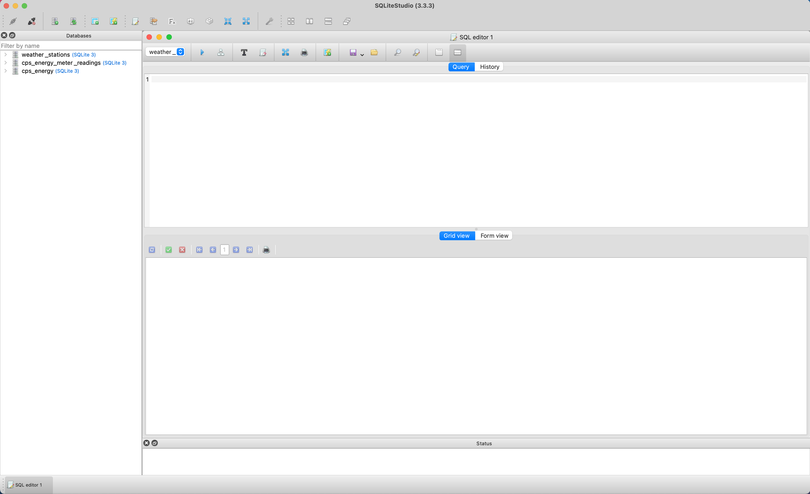
Using SQLiteStudio
Databases
Query Window
Output
Copyright 2021, the Board of Regents of the University of Oklahoma.
Notes:
At this time, switch to the editor:
Familiarize the audience with the environment. Note the following:
The Databases pane on the left shows the available SQLite database.
View tables and associated information by clicking the arrow.
Open SQL Editor: View > Open SQL editor
Import a database: Database > Add a database
Import the database: cps_energy
Download from GitHub
Add the database and connect

Slide 18
SELECT
SQL has one command for retrieving data: SELECT
A basic query has the following general structure:
SELECT column1, column2, …
FROM table1…
The SELECT statement consists of clauses. The most important are:
WITH
SELECT
FROM
WHERE
GROUP BY
HAVING
ORDER BY
Retrieve all columns
Choose specific columns
Calculating expressions
Concatenating text
Copyright 2021, the Board of Regents of the University of Oklahoma.
Notes:
We will most frequently query the database to retrieve specific subsets of data. We query the database with the SELECT statement.
The basic syntax of the SELECT statement has the following structure: SELECT – FROM – WHERE
The SELECT clause specifies the columns you want to see. The specify the tables used in the query in the FROM clause. The optional WHERE clause can contain a wide variety of criteria that identify which rows you want to retrieve.
Just so you know where we’re going, these are the most important clauses to understand. We’ll discuss each of them in this training.

Slide 19
Retrieve Columns with SELECT
Retrieve all columns:
SELECT *
FROM table1;
Returns every row and column in table1
Retrieve selected columns:
SELECT some_column, another_column, …
FROM table1;
This query returns some_column and another_column from table1 in the order specified
Copyright 2021, the Board of Regents of the University of Oklahoma.
Notes:
When you retrieve all columns using an asterisk (*), columns are returned in the order they were defined when the table was created.
The asterisk is a wildcard. In this case it is a stand-in for “select all columns”.
The semicolon at the tend of the statement indicates the end of the query statement.
<< click >>
Most of the time, you will want to specify exactly which column or columns you want to retrieve.

Slide 20
Expressions in SELECT Statements
Perform calculations using the SELECT statement.
Scalar values
Two or more columns
Allows us to keep stored data simple.
SELECT price, price * 1.08 AS taxed_price
FROM product;
Copyright 2021, the Board of Regents of the University of Oklahoma.
Notes:
Sometimes you’ll want to perform calculations on numeric data in your database. SQL allows us to perform calculations directly in the SELECT statement.
The ability to perform calculations dynamically is a powerful feature, which allows us to keep the stored data simple and use queries to layer calculations on top of it.

Slide 21
Math Operators
Operator | Description
+ | Addition
- | Subtraction
* | Multiplication
/ | Division (returns the quotient only)
% | Modulo (divides and returns just the remainder)
^ | Exponentiation
|/ | Square root
||/ | Cube root
! | Factorial
^ | Exponentiation
|/ | Square root
||/ | Cube root
! | Factorial
Copyright 2021, the Board of Regents of the University of Oklahoma.
Notes:
If your data includes any of the number data types we discussed earlier – integer, decimals, or floating points – then your analysis will include some calculations at some point. SQL handles calculations ranging from basic arithmetic through advanced statistics.
Note that some of these operators - exponentiation, square root, cube root, and factorial operator - are not available across all platforms or distributions (and are not available in SQLite, actually); again, remember that some database distributions offer additional functions and may have different implementations.
The order of operations follows the math standard.
-------
The data types returned follow this pattern:
Two integers return an integer
A numeric on either side of the operator returns a numeric
Anything with a floating-point number returns a double precision
Exponentiation, root and factorial functions floating-point types
Show examples from Practical SQL pgs 60-4.

Slide 22
Text Concatenation
Merges two or more text columns.
Uses the double-pipe (‘||’) operator or the CONCAT() function.
SELECT
name,
city || ‘, ’ || state AS location
FROM customer;
Copyright 2021, the Board of Regents of the University of Oklahoma.

Slide 23
WHERE
The WHERE clause contains a logical expression against which each row in the table is evaluated
If it meets the criteria, it becomes part of the result table
If not, it is omitted
SELECT column1, column2, …
FROM table1
WHERE column2 = some_value;
Filtering Records Filtering
NULL values
Using AND / OR
Copyright 2021, the Board of Regents of the University of Oklahoma.
Notes:
Sometimes you will want to limit the rows a query returns to only those in which one or more columns meet certain criteria. For this, use the WHERE clause.
The WHERE keyword allows you to find rows that match a specific value, range of values, or multiple values based on criteria supplied via an operator.
The WHERE clause contains a logical expression against which each row in the table is evaluated. If a row meets the criteria in the expression, then it becomes a part of the result table.

Slide 24
Common Comparison and Matching Operators
Operator | Meaning | Examples
= | Equal to | col1 = 25
< | Less than | col1 < col2
<= | Less than or equal to | col1 <= 25
> | Greater than | col1 > col2
>= | Greater than or equal to | col1 >= 25
!= or <> | Not equal to | col1 <> col2
BETWEEN | Within a range | col1 BETWEEN x AND y
IN | Match one of a set of values | col1 IN (‘val1’, ‘val2’, ‘val3’)
LIKE | Match a pattern (case sensitive) | col1 LIKE ‘My_value%’
NOT | Negate a condition | col1 NOT LIKE ‘My_value%’
Copyright 2021, the Board of Regents of the University of Oklahoma.
Notes:
These operators are fairly straightforward. Where the criteria evaluate to TRUE, the row is included in the result table. Conversely, where the criteria evaluates to FALSE, the row is excluded from the result table.
Take the first row – the ”equal to” operator as an example. If the value in col1 for a given row is equal to 25, then the row meets the criteria and is INCLUDED in the result table.
Let’s take a closer look at a few of these.

Slide 25
NULL values
Nullability: whether a column may contain NULL values
NULL indicates an empty or unknown value
Comparison operators return FALSE when NULL is included as an operand
Use IS NULL and IS NOT NULL instead.
SELECT *
FROM table1
WHERE col1 != NULL;
SELECT *
FROM table1
WHERE col1 IS NOT NULL;
Copyright 2021, the Board of Regents of the University of Oklahoma.
Notes:
NULL is a special value that indicates missing or unknown.
Comparison operators return FALSE when NULL is included in the statement. Think about it like this: Is a real value in a column equal to an unknown value? We don’t know. So FALSE is always returned in this case.
In the query listed, 0 is returned since no values meet the condition.
To determine if a value is NULL, use the special operators IS NULL and IS NOT NULL.
NULL values solve an important problem, which is how to represent missing or unknown values. Consider alternatives to this solution:
Using a non-sensical value like -999 or 0 -> the DB treats these as regular values, so calculations (summations, averages, etc.) are incorrect.
Use of flags indicating whether or not a value is NULL -> simple calculations require cumbersome queries, e.g. (CASE WHEN a_flag = 1 AND b_flag = 1 THEN A + B END) instead of simply A + B

Slide 26
AND and OR
Use AND and OR to combine logical operators.
SELECT *
FROM station_data
WHERE rain = 1 AND temperature < 32;
Copyright 2021, the Board of Regents of the University of Oklahoma.
Notes:
To specify more than one condition in a WHERE clause, use the AND and OR operators.
SELECT * FROM station_data WHERE rain = 1 AND temperature <= 32 OR snow_depth > 0;

Slide 27
Grouping Conditional Operators
SELECT *
FROM station_data
WHERE rain = 1 AND temperature < 32 OR snow_depth > 0;
What conditions belong to the AND, and what conditions belong to the OR?
Remove ambiguity by explicitly grouping conditions.
SELECT *
FROM station_data
WHERE (rain = 1 AND temperature < 32)
OR snow_depth > 0;
Copyright 2021, the Board of Regents of the University of Oklahoma.
Notes:
When specifying more than two conditions in the WHERE clause, it is good practice to group conditions that work together…take a look at the example on the slide.
The SQL interpreter could derail quickly and incorrectly interpret that we are looking for rain AND another condition where either the temperature is below 32 OR the snow depth is greater than 0. The semantics are not clear, and in more complicated SQL this could confuse not only people but also the machine.
This is why it is better to explicitly group conditions in parentheses:
SELECT * FROM station_data WHERE (rain = 1 AND temperature <= 32) OR snow_depth > 0

Slide 28
Working with Dates and Times
Date and Time functionality varies between distributions.
Date Functions:
Standard format: YYYY-MM-DD
Enables chronological tasks like date comparison: SELECT ‘2019-05-14’ > ‘2020-10-19’
Get today’s date: SELECT DATE(‘now’)
Pass modifier arguments to the DATE() function: SELECT DATE(‘now’, -1 day)
Copyright 2021, the Board of Regents of the University of Oklahoma.
Notes:
Functionality for dates and times in SQL varies greatly between database platforms. You will need to learn the date/time syntax for your specific database platform. We’ll cover some common date and time tasks as implemented by SQLite.
When working with dates, it is simplest to store them in the string format YYYYMM-DD as most database platforms inherently understand this format (technically called the ISO8601 format). A four-digit year comes first, following by a two-digit month, and a two-digit day, each separated by a dash (e.g., 2015-06-17). Formatting your date strings like this allows you avoid performing explicit conversions.
When running a query, any string in the 'YYYY-MM-DD' date format will be interpreted as a date. This means you can do chronological tasks like comparing one date to another date:

Slide 29
Working with Dates and Times
Time Functions:
Standard format: HH:MM:SS
Compare one time value with another: SELECT ‘12:31’ < ‘17:31’
Get current time: SELECT TIME(‘now’)
Perform transformations with the TIME function: SELECT TIME(‘16:00’, ‘+1 minute’)
Date/Time Functions:
Standard format: YYYY-MM-DD HH:MM:SS
The DATETIME() function works like the DATE() and TIME functions
Copyright 2021, the Board of Regents of the University of Oklahoma.
Notes:
Time also has a typical format, which is HH:MM:SS (this also is ISO8601 standard). HH is a two-digit military format of hours, MM is a two-digit format of minutes, and SS is a two-digit format of seconds . The separator is a colon. If you format times likethis, the strings will always be interpreted as time values.
The 'now' string also works with the TIME() function to get the current time. Note that the time returned should be in Universal Coordinated Time (UTC).
You can have a date that also has a time value. Reasonably, the standard string format is the date and time formats concatenated together, separated by a space: ‘YYYYMM-DD HH:MM:SS’. SQLite will recognize a string in this format to be a date/time value.
All the rules from the DATE() and TIME() functions can apply to the DATETIME() function. You can use 'now', transformations, and any other chronological operations we have learned. For instance, you can subtract a day from a date/time value and add three hours: SELECT DATETIME('2015-12-13 16:04:11','-1 day','+3 hour') There are several other functions and features for working with dates and time in SQLite, including converting dates into alternative formats and compensating for times zones. There is also support for Unix time and the Julian day number system.
Visit the docs for comprehensive functionality.

Slide 30
GROUP BY & ORDER BY
Aggregating data (i.e., rolling up, summarizing, or grouping data) is creating a total from multiple records.
SUM, MIN, MAX, COUNT, and AVG.
Grouping on specified columns allows the user to control the scope of these aggregations.
Counting records, GROUP BY, and ORDER BY
COUNT, SUM, MIN, MAX, and AVG
Filtering aggregate values with HAVING
SELECT <function_name>(<column(s)>)
FROM <table_name>
GROUP BY <column(s)>;
Copyright 2021, the Board of Regents of the University of Oklahoma.
Notes:
What are functions?
Sub-program with a name
Takes some input (columns, scalar values)
Performs some action
Returns an output
Aggregate functions combine values from multiple rows and return a single result based on an operation on those values. For example, you might return the average of values with the AVG() function, which is one of many aggregate functions in SQL. Common examples include count, min, max, and sum.
The general form is at the bottom of the slide.

Slide 31
Counting Rows and Values
The COUNT() function will return the number of rows and perform other counting tasks.
To count present values in a column, specify the column name as input.
Add the DISTINCT keyword to count unique values.
SELECT COUNT(*)
FROM myTable;
SELECT COUNT(source)
FROM myTable;
SELECT COUNT(DISTINCT source)
FROM myTable;
Copyright 2021, the Board of Regents of the University of Oklahoma.
Notes:
Tthe simplest aggregation: count the number of records in a table. The COUNT(*) means to count the records. We can also use this in combination with other SQL operations, like WHERE.
The query on the right shows SQL syntax with the count function. Here we supply an asterisk or wildcard as input, which returns the number of table rows regardless of whether they include NULLs.
To return the number of rows in a specific column that contain values, we supply the name of the column as input rather than the wildcard.
If we want to see the cardinality within a column – that is the number of distinct values – add the keyword DISTINCT.

Slide 32
Aggregate Functions
MIN() returns the smallest value in the given column.
MAX() returns the largest value in the given column.
These aggregates only consider non-null values.
SELECT MIN(price),
MAX(price)
FROM myTable;
SELECT month,
AVG(temp) as avg_temp
FROM station_data
WHERE year >= 2000
GROUP BY month;
Copyright 2021, the Board of Regents of the University of Oklahoma.
Notes:
We already used the COUNT(*) function to count records. But there are other aggrega‐ tion functions, including SUM(), MIN(), MAX(), and AVG(). We can use aggregation functions on a specific column to perform some sort of calculation on it.
Knowing the largest and smallest values within a column is useful for a couple reasons. First, it helps us get a sense of the scope of the values reported for a particular variable. Second, it allows us to check for data quality issues and unexpected values.
The min and max functions work as expected: MIN() returns the smallest value in the given column; MAX() returns the largest value in the given column. The syntax is similar to that of the count operation.
Average and Sum work in a similar way, and we will look at some examples of those later on.

Slide 33
Using GROUP BY
Group results according to the values in one or more columns with GROUP BY.
Must use GROUP BY when individual columns are included with aggregate functions in the SELECT clause.
SELECT source, COUNT(*)
FROM myTable
GROUP BY source;
Copyright 2021, the Board of Regents of the University of Oklahoma.
Notes:
The query given on the right asks for the values in the source column, and a count for each distinct value.
When individual columns are included with aggregate functions in the SELECT clause, we must include those columns in the GROUP BY clause. We can’t group values by aggregating and have ungrouped column values in the same query.
GROUP BY follows the FROM clause and includes the column name to group.

Slide 34
HAVING
The WHERE clause filters at the row level – it does not work at the aggregate level.
To filter results of an aggregate value, use the HAVING clause.
SELECT year,
SUM(precipitation) as total_precipitation
FROM station_data
WHERE total_precipitation > 30
GROUP BY year;
SELECT year,
SUM(precipitation) as total_precipitation
FROM station_data
GROUP BY year
HAVING total_precipitation > 30;
Copyright 2021, the Board of Regents of the University of Oklahoma.
Notes:
From time to time, we’ll want to filter the results of a query to get a smaller result set. You’re familiar with the WHERE clause for filtering. WHERE cannot be used with aggregate functions because they operate at the row level, and aggregate functions work across rows. The HAVING clause places conditions on group created by the aggregation.
The way aggregation works is that the software processes record by record, finding which ones it wants to keep based on the WHERE condition. After that, it crunches the records down on the GROUP BY and per‐ forms any aggregate functions, such as SUM(). If we wanted to filter on the SUM() value, we would need the filter to take place after it is calculated. This is where HAVING can be applied.
--> After this slide do some more work in SQL.

Slide 35
DISTINCT
Use DISTINCT to remove duplicates from a result table:
SELECT DISTINCT column1, column2, …
FROM table1;
Copyright 2021, the Board of Regents of the University of Oklahoma.
Notes:
Unique primary keys ensure relations have no duplicate rows. However, when you view only a portion of the columns in a table, you may end up with duplicates.
To remove duplicates from a result table, insert the keyword DISTINCT following SELECT. The result is a table without duplicate rows.
Another way to think about this is viewing distinct values in a column.
When multiple columns are selected, we can ask, “for each x in the table, what are all the y values?”

Slide 36
ORDER BY
Record order is not an inherent property of an RDBMS.
No guarantees that your data will return in a specific (or consistent) order.
Specify the order in which records are returned using the ORDER BY clause.
Will return in ascending order.
Use DESC to return in descending order.
SELECT *
FROM table1
ORDER BY column_name1;
SELECT *
FROM table1
ORDER BY column_name1 DESC;
Copyright 2021, the Board of Regents of the University of Oklahoma.
Notes:
ORDER BY specifies the order in which tables are returned
The keywords ORDER BY are followed by the column or columns on which you want to sort the result table.
When you include more than one column, the first column represents the outer sort, and the next column a sort within it.

Slide 37
CASE Expressions
The CASE statement is a conditional expression.
Syntax:
Example:
CASE WHEN condition THEN result
WHEN another_condition THEN result
ELSE result
END
Use CASE Expressions
CASE Expressions with GROUP BY
The Zero/Null Case Trick
SELECT max_temp,
CASE WHEN max_temp >= 90 THEN ‘Hot’
WHEN max_temp BETWEEN 70 AND 89 THEN ‘Warm’
WHEN max_temp BETWEEN 50 AND 69 THEN ‘Pleasant’
WHEN max_temp BETWEEN 33 AND 49 THEN ‘Cold’
WHEN max_temp BETWEEN 20 AND 32 THEN ‘Freezing’
ELSE ‘Inhumane’
END AS temperature_group
FROM temperature_readings;
Copyright 2021, the Board of Regents of the University of Oklahoma.
Notes:
The case statement is a conditional expression, meaning it allows you to add ”IF – THEN” logic to a query. The general syntax is given.
One pertinent use is to reclassify values into categories.

Slide 38
Zero/NULL Case Trick
Apply filters for different values within the SELECT clause.
Copyright 2021, the Board of Regents of the University of Oklahoma.
Notes:
Say you wanted to aggregate precipitation into two sums, tornado_precipitation and non_tornado_precipitation, and GROUP BY year and month. The logic is primarily dependent on two fields: precipitation and tornado. But how exactly do you code this? If you give it some thought, you will realize you cannot do this with a WHERE statement unless you do two separate queries.
But it is possible to do this in a single query using a CASE statement. You can move the tornado conditions from the WHERE to a CASE, and make the value 0 if the condition is false. Then you can SUM those CASE statements: SELECT year, month, SUM(CASE WHEN tornado = 1 THEN precipitation ELSE 0 END) as tornado_precipitation, SUM(CASE WHEN tornado = 0 THEN precipitation ELSE 0 END) as non_tornado_precipitation FROM station_data GROUP BY year, month

Slide 39
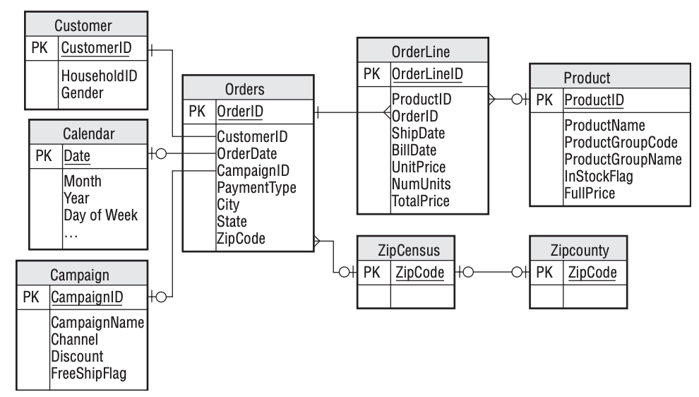
Joins
A JOIN clause is used to combine rows in one table to rows in other tables
To connect tables in a query, use a JOIN…ON statement (or a variation)
SELECT *
FROM table_a JOIN table_b
ON table_a.key_column = table_b.key_column;
Entity-Relationship (ER) Diagram
Joining Tables
Join Types
Cardinality
This entity-relationship diagram shows the relationship among entities in a purchase dataset. Each entity corresponds to one table.
Source: Data Analysis Using SQL and Excel
Copyright 2021, the Board of Regents of the University of Oklahoma.
Notes:
We have discussed how rows and columns in a relational database are organized within distinct tables. The structure of a database might look something like this ER diagram.
We will often need to query data that lives in more than one table. We can merge data from different tables with the JOIN operation.
The join operation creates one result table from two or more source tables by pasting a row from one source table onto the end of a row from the other source table. A DBMS uses a relationship between data in two source tables to determine which rows should be combined.
Matching based on equality between values is the most common use of the ON clause.

Slide 40
Primary and Foreign Keys
Entity-Relationship (ER) Diagram
Primary key -> uniquely identify each row in the table
No two rows have the same value
NULL not allowed
Composite primary key
Foreign key -> field (column) that refers to the primary key in another table
This entity-relationship diagram shows the relationship among entities in a purchase dataset. Each entity corresponds to one table.
Source: Data Analysis Using SQL and Excel
Copyright 2021, the Board of Regents of the University of Oklahoma.
Notes:
Composite primary key consists of multiple columns.
When a foreign key value matches a primary key value, we know there is a logical relationship between the database objects represented by matching rows.
ER Diagram
What? A high-level conceptual data model diagram that helps the person implementing a DB produce a well-designed DB.
Why?
Demonstrates how tables and fields are related.
Helps describe entities and relationships
Allows you to communicate the logical structure of the database to users
Make note of:
Tables/table names
Primary key/foreign key
Cardinality

Slide 41
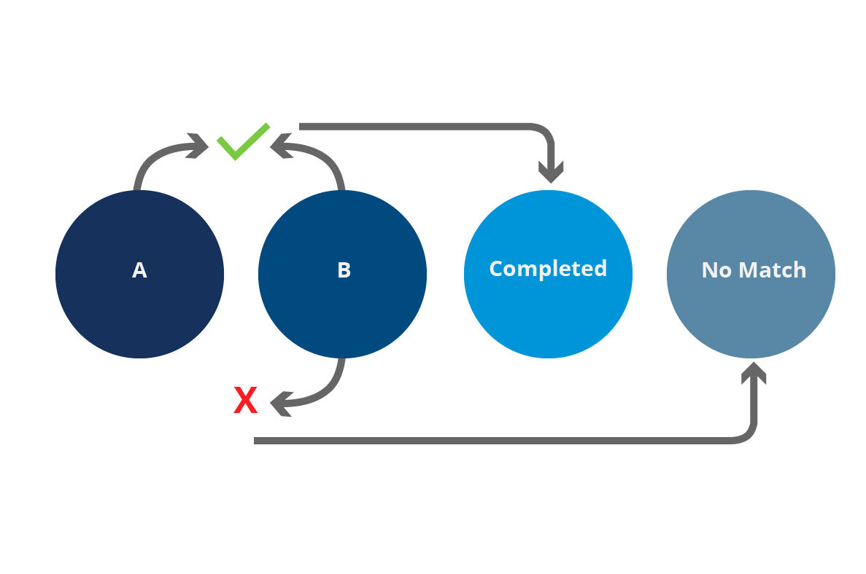
Joining Tables
A JOIN clause is used to combine rows in one table to rows in other tables
Copyright 2021, the Board of Regents of the University of Oklahoma.
Notes:
We discussed and viewed the entity-relationship diagram earlier, and we also discussed primary and foreign keys. Since there is no permanent connections between tables stored in a database, the DBMS must provide some way for users to match primary and foreign key values when needed. This capability is provided by the join operations. The join operation creates one result table from two source tables by pasting a row from one source table onto the end of a row from the other source table. A DBMS uses a relationship between data in two source tables to determine which rows should be combined.
To understand how joins work, consider an example (which has nothing to do with SQL). Assume you are part of an assembly line, and your job is to connect two individual parts. Parts are either A parts or B parts. There are many different kinds of A and B parts. Each B is to be matched to the A part with the same number and vice versa.
This process requires four bins. One contains A parts, one contains B parts, and one holds the completed assemblies (after individual A and B parts have been connected). The fourth bin holds parts with no match.
You start by taking a part from the B bin, and noting its number. Then you search the A bin to find a part with a matching number. If you find a match, you connect the two pieces and toss them into the “Completed” bin. If you cannot find a match, you toss the unmatched B part into the “No Match” bin. You repeat the process until the B bin is empty.
As you might guess, the A parts and B parts are analogous to tables with primary and foreign key relationships. The matching of part numbers is like the matching of data that occurs when you perform a join. The “Completed” bin corresponds to the result table of the operation.
Matching based on equality between values is the most common use of the ON clause, but you can use any expression that evaluates to the Boolean true or false.

Slide 42
As a data analyst, you are tasked with generating a report that gives organizational payroll by department. Two tables in the organization’s database stand out: employees and departments.
employees
empl_id name_first name_last salary dept_id
------- ---------- --------- ------ -------
1 Jeff Winger 62500 1
2 Britta Perry 59300 1
3 Troy Barnes 83000 2
4 Annie Edison 95000 2
5 Pierce Hawthorne 75000 3
6 Shirley Bennett 78000 3
SELECT *
FROM employees JOIN departments
ON empoyees.dept_id = departments.dept_id;
departments
dept_id dept city
------- ---- ----
1 Acct Atlanta
2 IT Boston
3 HR Denver
empl_id name_first name_last salary dept_id dept_id dept city
------- ---------- --------- ------ ------- ------- ---- ----
1 Jeff Winger 62500 1 1 Acct Atlanta
2 Britta Perry 59300 1 1 Acct Atlanta
3 Troy Barnes 83000 2 2 IT Boston
4 Annie Edison 95000 2 2 IT Boston
5 Pierce Hawthorne 75000 3 3 HR Denver
6 Shirley Bennett 78000 3 3 HR Denver
Copyright 2021, the Board of Regents of the University of Oklahoma.
Notes:
Here is an example: you are a data analyst tasked with generating a report that gives organizational payroll by department. Among the many tables in the organization’s DB, two stand out: departments and employees.
The department table includes department ID, department name, and city. The employees table includes the employee ID, first and last name, salary, and department ID.
Recall:
a primary key is a column (or collection of columns) that uniquely identifies each row and has no missing values.
a foreign key is a column that refers to the primary key in another table.
The primary keys in our two columns are dept_id and empl_id. Again, the values these columns are unique for each row, and contain no NULLs.
Dept_id in the employees table is a foreign key, and refers to dept_id in the departments table.
When you join the tables in a query, the database connects rows in both tables where the columns you specified for the join have matching values. The query results then include columns from both tables if you requested them as part of the query.

Slide 43
To select specific columns, specify the table followed by a dot and the column: table_name.column_name
employees
empl_id name_first name_last salary dept_id
------- ---------- --------- ------ -------
1 Jeff Winger 62500 1
2 Britta Perry 59300 1
3 Troy Barnes 83000 2
4 Annie Edison 95000 2
5 Pierce Hawthorne 75000 3
6 Shirley Bennett 78000 3
SELECT employees.empl_id,
employees.salary,
departments.dept
FROM employees JOIN departments
ON empoyees.dept_id = departments.dept_id;
departments
dept_id dept city
------- ---- ----
1 Acct Atlanta
2 IT Boston
3 HR Denver
empl_id salary dept
------- ------ ----
1 62500 Acct
2 59300 Acct
3 83000 IT
4 95000 IT
5 75000 HR
6 78000 HR
Copyright 2021, the Board of Regents of the University of Oklahoma.

Slide 44
Use table aliases to simplify join syntax
employees
empl_id name_first name_last salary dept_id
------- ---------- --------- ------ -------
1 Jeff Winger 62500 1
2 Britta Perry 59300 1
3 Troy Barnes 83000 2
4 Annie Edison 95000 2
5 Pierce Hawthorne 75000 3
6 Shirley Bennett 78000 3
SELECT e.empl_id,
e.salary,
d.dept
FROM employees AS e JOIN departments AS d
ON e.dept_id = d.dept_id;
departments
dept_id dept city
------- ---- ----
1 Acct Atlanta
2 IT Boston
3 HR Denver
empl_id salary dept
------- ------ ----
1 62500 Acct
2 59300 Acct
3 83000 IT
4 95000 IT
5 75000 HR
6 78000 HR
Copyright 2021, the Board of Regents of the University of Oklahoma.

Slide 45
JOIN Types
JOIN Type | Description
JOIN | Returns rows from both tables where matching values are found in the the joined columns of both tables. Alternate syntax is INNER JOIN.
LEFT JOIN | Returns every row from the left table plus rows that values in the joined column from the right table.
RIGHT JOIN | Returns every row from the right table plus rows that values in the joined column from the left table.
FULL OUTER JOIN | Returns every row from both tables and matches rows; then joins the row where values in the joined columns match. If there is no match for a value in either the left or right table, the query result contains an empty row for the other table.
CROSS JOIN | Returns every possible combination of rows from both tables.
Copyright 2021, the Board of Regents of the University of Oklahoma.
Notes:
There is more than one way to join tables in SQL, and the type of join you’ll use depends on how you want to retrieve data. This list describes the different types of joins.

Slide 46
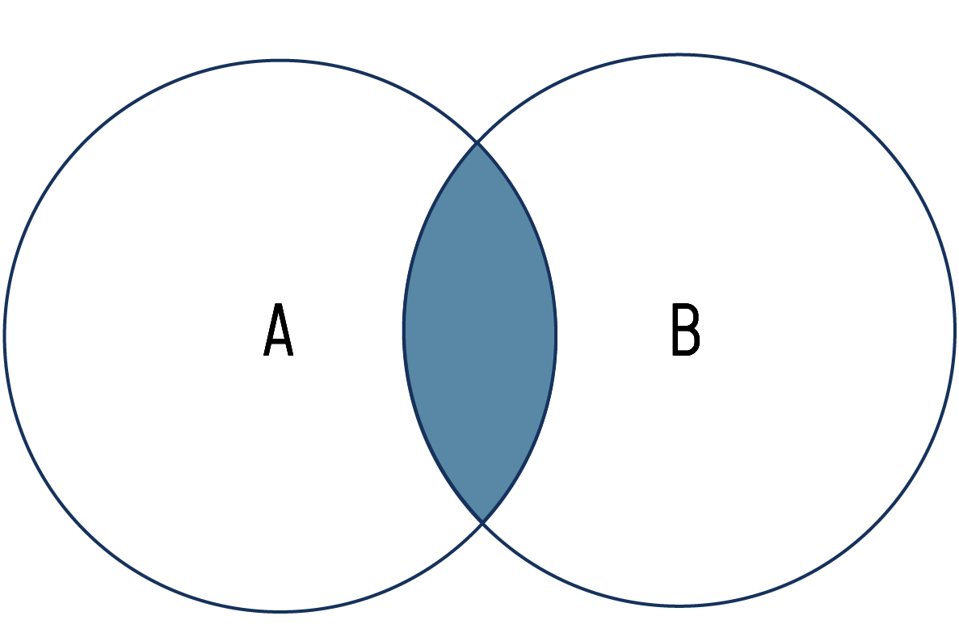
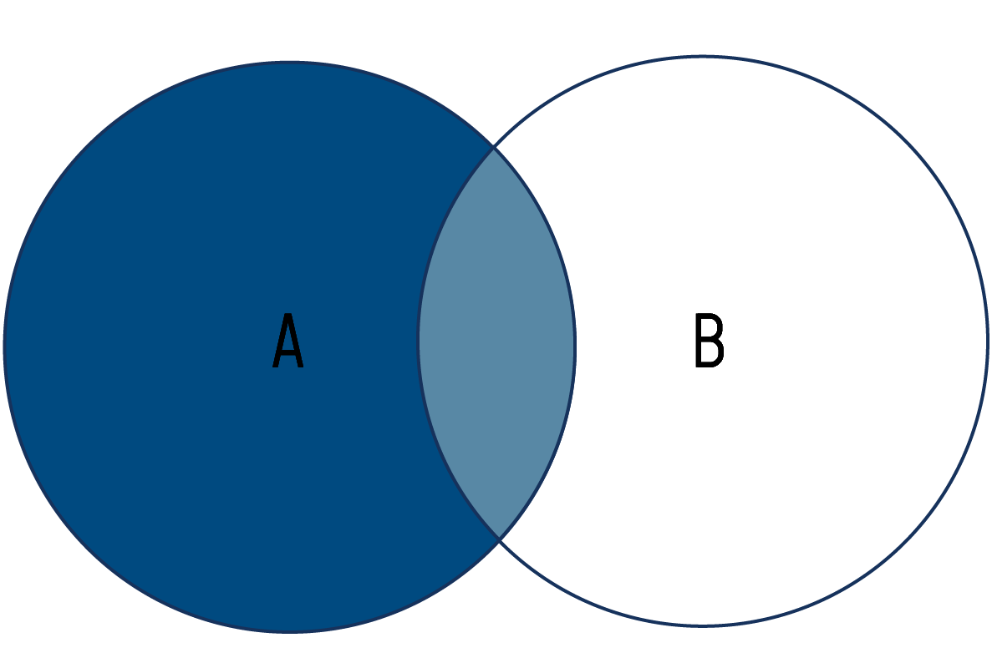
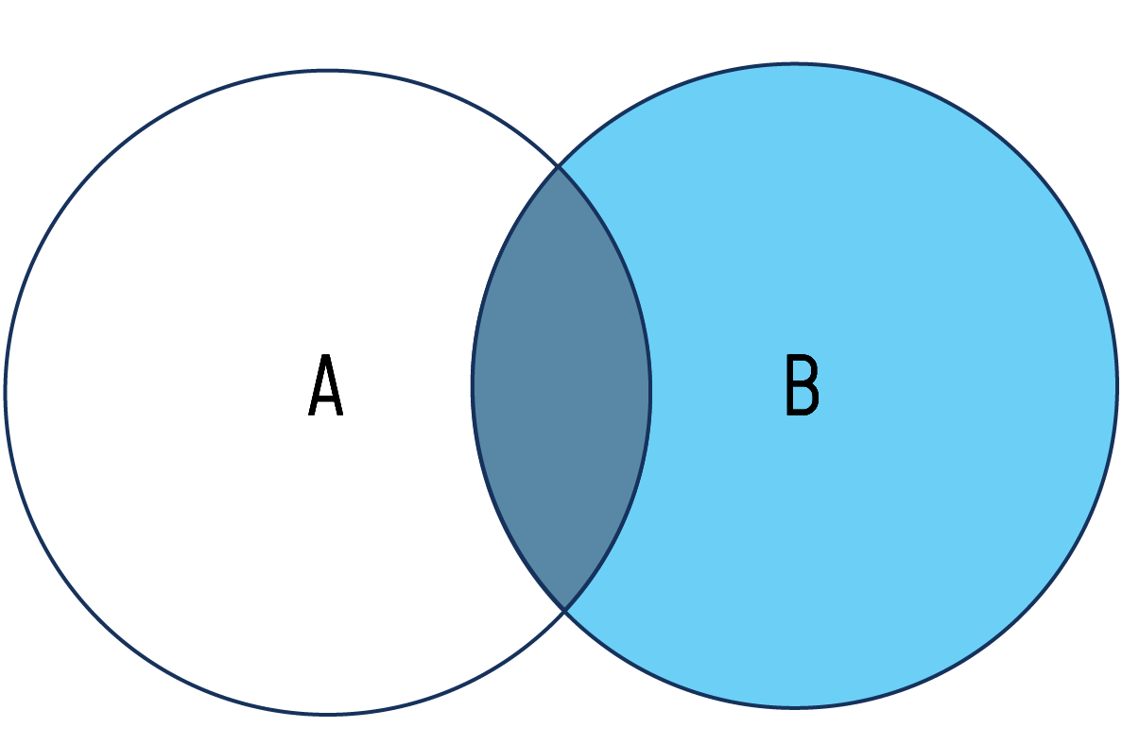
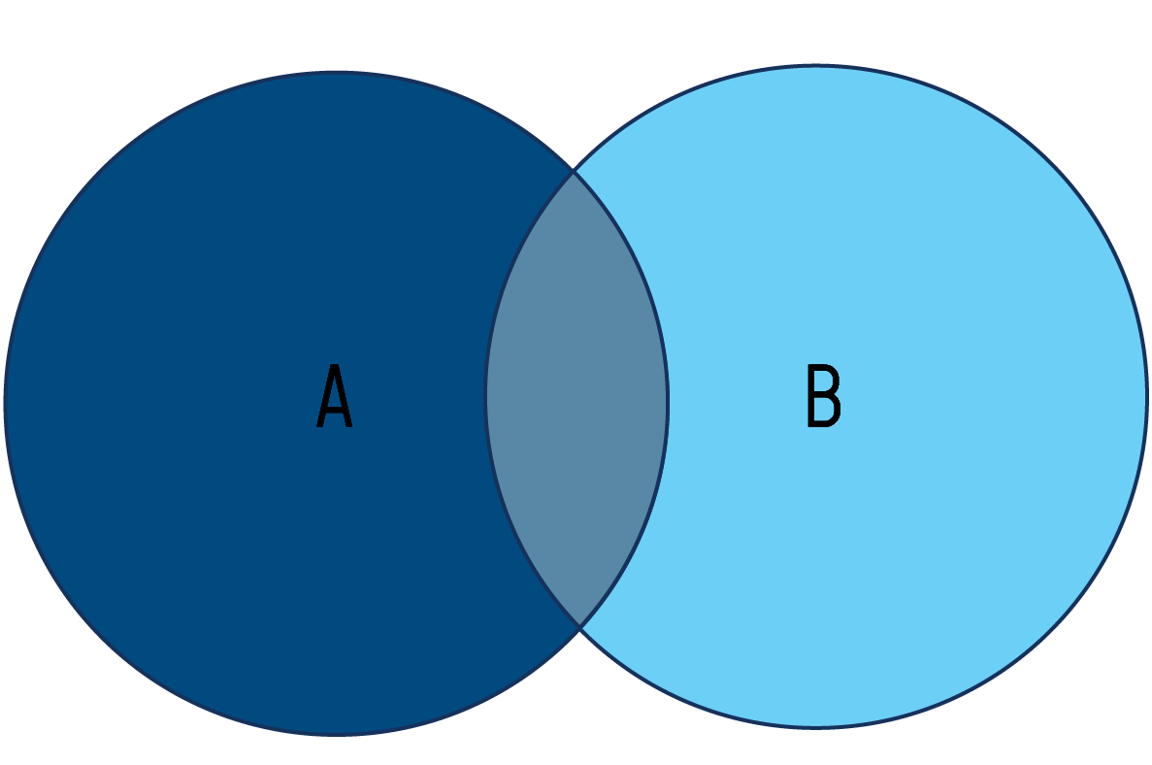
JOIN / INNER JOIN
LEFT JOIN
RIGHT JOIN
FULL OUTER JOIN
SELECT <fields>
FROM tableA A
INNER JOIN tableB B
ON A.key = B.key;
SELECT <fields>
FROM tableA A
LEFT JOIN tableB B
ON A.key = B.key;
SELECT <fields>
FROM tableA A
RIGHT JOIN tableB B
ON A.key = B.key;
SELECT <fields>
FROM tableA A
FULL OUTER JOIN tableB B
ON A.key = B.key;
Return rows that have a match in the columns used for the join
Typically used with well-structured and maintained datasets
Return all rows from one table and display blank rows from the other table if no matching values are found in the joined columns.
Used in a few circumstances:
When the query must contain all rows from one of the tables
To search for missing values in one of the tables
When it is known in advance that some rows in a joined table will not have a match
Return all rows from both tables regardless of whether a match exists
Used to:
Merge two data sources that partially overlap
Visualize the degree to which the tables share matching values
Copyright 2021, the Board of Regents of the University of Oklahoma.
Notes:
There is more than one way to join tables in SQL, and the type of join you’ll use depends on how you want to retrieve data. This list describes the different types of joins.

Slide 47
Cardinality
One-to-One: tables are associated with each other based on only one matching row
One-to-Many: a row in one table can have multiple matching rows in another table
Many-to-Many: multiple rows in one table are related to multiple rows in another table
Entity-Relationship (ER) Diagram
This entity-relationship diagram shows the relationship among entities in a purchase dataset. Each entity corresponds to one table.
Source: Data Analysis Using SQL and Excel
Copyright 2021, the Board of Regents of the University of Oklahoma.
Notes:
Understanding the database’s relational model – that is, how the tables relate to each other – is helpful when joining tables. Cardinality, in the data modeling sense, refers to the relationship one table has with another. The three types of table relationships are one to one, one to many, and many to many…
One-to-one
Example: state-by-state census data. One table might contain household income data; a second table might contain educational attainment data. Both tables have 51 rows, and if we want to join them on a key like state name or abbreviation, we would would have one match for each key value in each table.
One-to-many
Example: auto database. One table has data on manufacturers (Ford, Honda, Kia, and so on) and another has model names. If we joined these tables, there are several models for each manufacturer.
Many-to-many
Example: baseball players and field positions. Each player can be assigned to multiple positions, and each position can be played by multiple people.
Let's take a look at the ER diagram on the right to see some examples. The relationship between Orders and ZipCensus is a zero/one-to-many relationship. This specifies that every row in Orders has at most one zip code; and, every zip code has 0 or more orders. There is a many-to-many relationship between Orders and Products, represented by the OrderLine entity which has a zero/one-to-many relationship with each of those. This means that each order can have many products, and each product can be associated with many orders.
Understanding these relationships is essential because it helps us discern whether the results of queries accurately reflect the structure of the database.

Slide 48
Creating Tables
Create a new table in a database with the CREATE TABLE statement.
CREATE TABLE <table name> (
<col1> <type> <constraint>,
<col2> <type> <constraint>,
…
);
The type is the domain or data type for the column.
Constraints ensure data entered into the columns conforms to rules we specify.
Primary key (can use AUTOINCREMENT)
Foreign key
Unique
Not NULL
Default
Copyright 2021, the Board of Regents of the University of Oklahoma.
Notes:
There may be a time when you need to create new tables and views. To create a table, use the CREATE TABLE statement. The general syntax is provided on the slide.

Slide 49
Common Column Types
Type | Description
INTEGER | A simple, whole number
DOUBLE/DECIMAL | Supports none-whole, decimal numbers
BOOLEAN | A true/false value represented by a 1 or 0 (resp.)
CHAR | A fixed number of text characters
VARCHAR | Any number of text characters, with an optional max.
DATE | A calendar date value
TIME | A time value
DATETIME | A data and time value
TEXT | A longer piece of text (e.g. memos, articles, etc.)
Copyright 2021, the Board of Regents of the University of Oklahoma.
Notes:
Different relational database platforms support different data types.

Slide 50
Numbers
Hold various types of numbers and allow you to perform calculations on those numbers.
Two general types: integers and decimal (fixed point and floating point).
Three guidelines to consider:
Use integers when possible.
If you are working with decimal data, and need calculations to be exact (e.g. dealing with money), choose numeric or decimal. Use floating-point types only when exactness is not important.
Choose a big enough number type.
Copyright 2021, the Board of Regents of the University of Oklahoma.
Notes:
The important part: numeric types allow the user to perform calculations.
2 general type:
Integers: positive and negative whole numbers
Fixed-point and floating point
Integers
Positive and negative whole numbers, including 0.
SQL standard includes smallint, integer, and bigint; the difference between them is the maximum size the numbers can hold.
Generally, bigint is useful working with numbers larger than about 2.1B
Inserting outside of the allowable range will result in a out of range error.
Decimal numbers: represent a whole number plus a fraction of a whole number. SQL uses two types: fixed-point and floating-point.
Fixed-point (a.k.a. arbitrary precision): you specify the total digits stored (precision) and the number of digits to the right of the decimal (scale).
Floating-point: two types are real and double precision.
A.K.A. variable precision
Note that the way floating-point numbers are stored can lead to unexpected mathematical errors. This is why they are referred to as inexact. Be careful when using floating-point numbers.

Slide 51
Text
Characters: general purpose type suitable for any combination of text, numbers, and symbols.
char(n): fixed-length space to hold a string of characters of size (n).
varchar(n): variable-length space to hold a string of characters of maximum size (n).
text: variable length column of unlimited length. Not part of the SQL standard.
CREATE TABLE char_data_types (
varchar_column varchar(10),
char_column char(10),
text_column text
);
Copyright 2021, the Board of Regents of the University of Oklahoma.
Notes:
Tells the DB how to store values. This is critical because storing data in the appropriate format is fundamental to building usable databases and performing accurate analysis.
It may be important to know they type to reduce or eliminate unexpected outcomes.
Characters
Char
Varchar
Text: not part of the SQL standard, but similar implementations are found among Postgres, MySQL, and SQL Server.
Integer: storage size is 4 bytes.
Float stores an approximate value and decimal stores an exact value. Float generally uses less storage than decimal.

Slide 52
More Data Types
Additional data types that may or may not be supported by your implementation:
Geometric types: points, lines, line segments, …
Universally Unique Identifier (UUID) type
XML and JSON data types that store information in those structured formats
Copyright 2021, the Board of Regents of the University of Oklahoma.
Notes:
There are many defined data types, and they can vary somewhat based on implementation. Some of interest include:
Boolean type: stores true and false
Geometric types: points, lines, line segments, …
Universal Unique Identifier (UUID) type
XML and JSON data types that store information in those structured formats

Slide 53
Setting the Foreign Key
Recall: the foreign key in a child table is associated with the primary key of a parent table.
Set the foreign key when creating a table by adding a line:
CREATE TABLE <table name> (
<col1> <type> <constraint>,
<col2> <type> <constraint>,
…,
FOREIGN KEY (<col>) REFERENCES <table>(<reference_col>)
);
Alternatively, add a foreign key constraint after the table has been created with the ALTER TABLE command.
Copyright 2021, the Board of Regents of the University of Oklahoma.
Notes:
There is one last task remaining to make our tables airtight. We have defined the primary keys but not the foreign keys. Remember that the foreign key in a child table is tied to the primary key of a parent table. Logically, we should never have a foreign key value that does not have a corresponding primary key value.

Slide 54
Creating Views
A view is a query saved in a database.
Query from a view just like a table, but often cannot modify the data.
Syntax:
CREATE VIEW <view name> AS
SELECT <col1>,
<col2>,
…
FROM …;
Copyright 2021, the Board of Regents of the University of Oklahoma.
Notes:
It is not uncommon to store frequently used SELECT queries in a database. When you save a query in a database, it is called a view. A view behaves much like a table. You can run SELECT statements against it and join it to other views and tables. But the data is completely derived from a SELECT query you specify, so in many cases you cannot modify the data (nor would it make sense to).

Slide 55
Statistical Functions
Correlation: CORR(Y, X)
Regression analysis:
REGR_SLOPE(Y, X)
REGR_INTERCEPT(Y, X)
Rankings:
RANK()
DENSE_RANK()
Copyright 2021, the Board of Regents of the University of Oklahoma.
Notes:
A SQL database is not usually the first tool you’d think of when performing statistical analysis that requires more than SUMS and AVG. Typically, programming languages or full-featured statistics software would be the first choice. Perhaps even Excel if the dataset is small enough. However, SQL offers a handful of powerful stats functions that can reveal a lot about your data without have to export your data set to another program.
Correlation
Researcher often want to understand the relationships between variables and one such measure of relationships is correlation.
Recall: The Pearson Correlation Coefficient (denoted as r) is a measure for quantifying the strength of a linear relationship between two variables. It shows the extent to which an increase or decrease in one variable correlated to a change in another variable. Values fall between -1 and 1, with values at 1 and -1 indicating perfect correlation and values at 0 indicate no correlation. Positive r values indicate a direct relationship; negative values indicated an inverse relationship.
CORR(Y, X) is a binary aggregate function, meaning it takes two inputs.
Y is the dependent variable whose variation depends on another variable.
X is the independent variable.
In practice, correlation calculations do not distinguish between dependent and independent - switching the order of inputs produces the same result.

Slide 56
Statistical Functions
Correlation: CORR(Y, X)
Regression analysis:
REGR_SLOPE(Y, X)
REGR_INTERCEPT(Y, X)
Rankings:
RANK()
DENSE_RANK()
SELECT CORR(col1, col2)
FROM table1;
Copyright 2021, the Board of Regents of the University of Oklahoma.
Notes:
A SQL database is not usually the first tool you’d think of when performing statistical analysis that requires more than SUMS and AVG. Typically, programming languages or full-featured statistics software would be the first choice. Perhaps even Excel if the dataset is small enough. However, SQL offers a handful of powerful stats functions that can reveal a lot about your data without have to export your data set to another program.
Correlation
Researchers often want to understand the relationships between variables and one such measure of relationships is correlation.
Recall: The Pearson Correlation Coefficient (denoted as r) is a measure for quantifying the strength of a linear relationship between two variables. It shows the extent to which an increase or decrease in one variable correlated to a change in another variable. Values fall between -1 and 1, with values at 1 and -1 indicating perfect correlation and values at 0 indicate no correlation. Positive r values indicate a direct relationship; negative values indicated an inverse relationship.
CORR(Y, X) is a binary aggregate function, meaning it takes two inputs.
Y is the dependent variable whose variation depends on another variable.
X is the independent variable.
In practice, correlation calculations do not distinguish between dependent and independent - switching the order of inputs produces the same result.

Slide 57
Statistical Functions
Correlation: CORR(Y, X)
Regression analysis:
REGR_SLOPE(Y, X)
REGR_INTERCEPT(Y, X)
Rankings:
RANK()
DENSE_RANK()
SELECT REGR_SLOPE(col1, col2),
REGR_INTERCEPT(col1, col2)
FROM table1;
SELECT REGR_R2(col1, col2)
FROM table1;
Copyright 2021, the Board of Regents of the University of Oklahoma.
Notes:
A SQL database is not usually the first tool you’d think of when performing statistical analysis that requires more than SUMS and AVG. Typically, programming languages or full-featured statistics software would be the first choice. Perhaps even Excel if the dataset is small enough. However, SQL offers a handful of powerful stats functions that can reveal a lot about your data without have to export your data set to another program.
Regression Analysis
Researchers not only want to understand the relationships between variables; they also want to predict values using available data. We can often do so with linear regression.
The regression method finds the best linear equation (or straight line) that describes the relationship between an independent variable and a dependent variable.
Use the REGR_SLOPE and REGR_INTERCEPT functions to calculate the slope and intercept, respectively.
The resulting slope value shows that for every one unit increase in the X variable, we can expect the Y variable to change by the resulting value.
A moment ago, we discussed the correlation coefficient, r, to determine the direction and strength of the relationship between two variables. We can also calculate the extent that the variation in the independent variable, X, explains the variation in the dependent variable (Y). This value is called r-squared or the coefficient of determination.
An r-squared value is between 0 - 1, and indicates the percentage of the variation that is explained by the independent variable.
RECALL: correlation does not equal causality. Many variables correlate well but have no meaning.
Statisticians usually perform significance testing on results to make sure values are not the result of randomness. That is outside the scope of this training.
We’re also not testing assumptions of linear regression here.
So we can say that SQL’s statistics functions are useful as a preliminary survey of the data before doing more rigorous analysis. A full study on performing regression is outside the scope of this training, but may be worth your time in the future.

Slide 58
Statistical Functions
Correlation: CORR(Y, X)
Regression analysis:
REGR_SLOPE(Y, X)
REGR_INTERCEPT(Y, X)
Rankings:
RANK()
DENSE_RANK()
SELECT col1,
col2,
RANK() OVER ([PARTITION BY] | [ORDER BY])
FROM table1;
Copyright 2021, the Board of Regents of the University of Oklahoma.
Notes:
A SQL database is not usually the first tool you’d think of when performing statistical analysis that requires more than SUMS and AVG. Typically, programming languages or full-featured statistics software would be the first choice. Perhaps even Excel if the dataset is small enough. However, SQL offers a handful of powerful stats functions that can reveal a lot about your data without have to export your data set to another program.
Rankings
Rankings are relatively common; you might see them around box office charts and sports standings, among other places.
We already know how to order query results based on values in a column, but SQL lets you go further and create numbered rankings.
Rankings are useful for data analysis in several ways, including tracking changes over time and as its own measure.
There are several ranking functions in SQL, but we’ll look at RANK and DENSE RANK.
Both are window functions, which perform calculations across set of rows we specify using the OVER clause.
Unlike aggregate functions, window functions present results for each row in the table.
The difference between rank and dense rank is how the next rank is handled in case of a tie: rank includes a gap in the rank order, but dense rank does not.
Notice in the query that we use RANK followed by and OVER clause. The expression in parentheses specifies the window of rows the function should operate on.
Sometimes you’ll want to produce rankings within groups of rows in a table. To do so use the PARTITION BY clause, which divides table rows according to values in a column we specify.

Slide 59
Calculating Rates
Rates often provide more meaningful information when comparing between two categories
Calculate rates in SQL by using the arithmetic in the SELECT statement
SELECT city,
population,
property_crime,
ROUND((property_crime::numeric / population) * 1000, 1) AS pc_1000
FROM fbi_crime_data_2015
WHERE population >= 500000
ORDER BY(property_crime::numeric / population) DESC;
Copyright 2021, the Board of Regents of the University of Oklahoma.
Notes:
Rankings and raw counts can be helpful and interesting, but they can also be misleading without context.
For example, in 2015 the FBI reporting about 130,000 property crimes in NYC about 80,000 property crimes in Chicago.
Are property crimes more common in NYC?
Now consider that during the same year, NYC had over 8 million residents, while Chicago had about 2.7 million. Given that context, comparing the total property crimes doesn’t provide much insight.
A better way to compare numbers like this is to transform them into rates.

Slide 60
Writing Data
INSERT records
UPDATE records
DELETE records
Transactions
Indexes
Copyright 2021, the Board of Regents of the University of Oklahoma.

Slide 61
Additional Query Techniques
Subqueries: A subquery is a complete SELECT statement embedded within another SELECT.
SELECT column(s)
FROM table
WHERE operator (SELECT column(s)
FROM table
WHERE …);
Subqueries
Common Table Expressions (CTEs)
Notes:
A subquery must be enclosed in parentheses.
A subquery must be placed on the right side of the comparison operator.
Copyright 2021, the Board of Regents of the University of Oklahoma.
Notes:
A subquery is nothing more than a query inside another query. The outside query is known as the containing query, or the outer query. The query on the inside is the inner query, or the subquery.
The general syntax is given on the slide.
Notice the parentheses surrounding the subquery.
The subquery can be used in the SELECT, FROM or the WHERE clauses…
-------------
Use a subquery when…
You want to use the result of a query to restrict the result of another query.
--------------
Let’s take a look at some more advanced query techniques. Sometimes data analysis requires advanced SQL techniques that go beyond a table join or basic SELECT query. For example, you might need to write a query that uses that uses the results of other queries as inputs. Or, you might need to reclassify numerical values into categories before counting them. SQL provides a collection of functions and options essential for solving more complex problems.
A subquery is a query nested inside another query.
The syntax is not unusual: enclose the subquery in parentheses and use it where needed. For example, we might write a subquery that returns multiple rows and treat the results as a table in the FROM cluse of the main query.
There are two general types of subqueries. An uncorrelated subquery has no reference to objects in the main query. This allows the processor to process the inner query before the outer.
Correlated subqueries depend on a value or table from the main query. For example, if you refer to a table from the outer query in the subquery, this would be a correlated subquery. Correlated subqueries usually require the select to be completed more than once and can therefore execute relatively slowly.
Another concept to know about is the derived table. If the subquery contains rows and columns, you can use subquery in the FROM clause as a table. You can even join subqueries that are derived tables as you would tables.
A few notes about subqueries:
A subquery must be enclosed in parentheses.
A subquery must be placed on the right side of the comparison operator.
Use single-row operators with single-row subqueries.
If a subquery (inner query) returns a null value to the outer query, the outer query will not return any rows when using certain comparison operators in a WHERE clause.

Slide 62
Common Table Expressions (CTEs)
Define one or more tables with subqueries; query the result table as often as needed in a main query that follows
WITH expression_name[(column_name [,...])]
AS
(CTE_definition)
SQL_statement;
WITH large_counties (geo_name, st, population)
AS
(
SELECT geo_name, state_abbrev, population
FROM us_counties_2010
WHERE population >= 100000
)
SELECT st, COUNT(*)
FROM large_counties
GROUP BY st
ORDER BY COUNT(*) DESC;
Copyright 2021, the Board of Regents of the University of Oklahoma.
Notes:
A second approach to creating temporary tables for querying use the Common Table Expression (CTE).
Informally called the WITH clause.
Allows you to create one or more tables with subqueries, and use the result table(s) as often as needed in the main query that follows.
Note that you can define more than one CTE per query. Simply separate the subqueries including parentheses with a comma.
You can see the general syntax here:
First, specify the expression name (expression_name) to which you can refer later in a query.
Next, specify a list of comma-separated columns after the expression_name. The number of columns must be the same as the number of columns defined in the CTE_definition.
Then, use the AS keyword after the expression name or column list if the column list is specified.
After, define a SELECT statement whose result set populates the common table expression.
Finally, refer to the common table expression in a query (SQL_statement) such as SELECT, INSERT, UPDATE, DELETE, or MERGE.
A benefit of CTEs over subqueries is that they are more readable. When you nest queries, they can become difficult to read. However, with CTEs, it’s easier to follow the logic. It also eliminates having to duplicate SELECT statments multiple times when you need to use a subquery more than once in the main query.

Slide 63
Notes About DB Performance
Add indexes to columns to increase query speed
SELECT specific fields instead of selecting all fields ( * )
Avoid SELECT DISTINCT whenever possible
Create joins with INNER JOIN (instead of a WHERE clause)
Use wildcards at the end of the phrase only
Use LIMIT to sample query results
Query during off-peak hours
Copyright 2021, the Board of Regents of the University of Oklahoma.
Notes:
Uncorrelated subqueries can replace join syntax to produce faster performance.
An index is a data structure that provides a fast access path to rows in a table based on the values in one or more columns (the index key). Because an index stores key values in order, the DBMS can use a fast search technique to find the values rather than being forced to search each row in an unordered table sequentially. The index itself contains an ordered list of keys along with the locations of the associated rows in an associated table. When you create a primary key for a table, the DBMS automatically creates an index for that table using the primary key column or columns as the index key. In addition to primary keys, you can create indexes to provide fast access to any column or combination of columns. Lke just about anything, there are some trade offs to consider, including:
Indexes take up space in the database. Since space is relatively inexpensive today, this usually isn’t a problem
When data is inserted, modified, or deleted, the DBMS must also update the indexes. This may slow modification operations.
So while it is unnecessary to add indexes to every column in a table, adding them to foreign keys and columns that are frequently used in WHERE clauses can be helpful.
SELECT specific fields instead of selecting all fields ( * )
It is common to want to see an entire table during exploratory analysis. However, selecting all columns of a table with many rows is taxing to the database.
Avoid SELECT DISTINCT whenever possible
SELECT DISTINCT is a handy way to remove duplicates from a query. SELECT DISTINCT works by GROUPing all fields in the query to create distinct results. To accomplish this goal however, a large amount of processing power is required. Additionally, data may be grouped to the point of being inaccurate. To avoid using SELECT DISTINCT, select more fields to create unique results.
Create joins with INNER JOIN (instead of a WHERE clause)
Joining within a WHERE clause creates the cartesian product, which is the combination of all rows within the table, before filtering for the rows that match the query. This is unnecessary. Use inner join as a more efficient alternative.
Use wildcards at the end of the phrase only
We didn’t discuss text analysis in this class, but we did discuss character matching using the % sign. You can match the beginning or end (or both) of a phrase using the wildcard. However, using it only at the end of the phrase reduces the search space compared to using the wildcard at the beginning of the phrase.
Use LIMIT to sample query results
Another keyword we didn’t discuss is LIMIT. LIMIT limit number of rows returned to a specified number. So in situations when a truncated result will do, use LIMIT to return few rows than the enter table.
Off-peak Hours
In order to minimize the impact of your analytical queries on the production database, talk to a DBA about scheduling the query to run at an off-peak time. The query should run when concurrent users are at their lowest number, which is typically the middle of the night (3 – 5 a.m.). The more of the following criteria your query has, the more likely of a candidate it should be to run at night:
Selecting from large tables (>1,000,000 records)
Cartesian Joins or CROSS JOINs
Looping statements
SELECT DISTINCT statements
Nested subqueries
Wildcard searches in long text or memo fields
Multiple schema queries

Slide 64
Wrap-Up
Today
Tomorrow
Data visualization with Excel
Relational DBs and SQL
Hands-on with SQLite
Communicating with Data
Identifying an insight and focusing on your audience
Big Idea and storyboarding
Telling a story & making a point
Putting it all together
Python / COLAB
Meter Data
Copyright 2021, the Board of Regents of the University of Oklahoma.

Slide 65

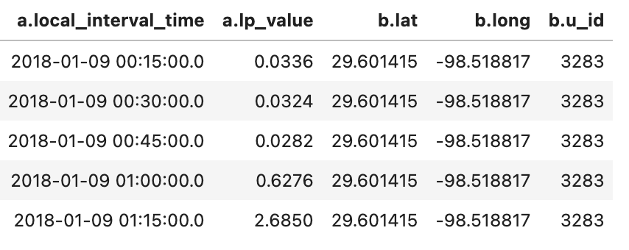
Training Data
AMI 10K Meter Data
12 months of 15-minute meter data for 10k customers
Approximate lat/long location of the 10k customers
Copyright 2021, the Board of Regents of the University of Oklahoma.
Notes:
https://www.cpsenergy.com/en.html
https://sites.google.com/geekdom.com/2021-smartsa-datathon-data-cat/home
https://www.civtech-sa.com/datathon/

