Slide 1
Insights of superstore sales dashboard
Presented by T SANJANA

Slide 2
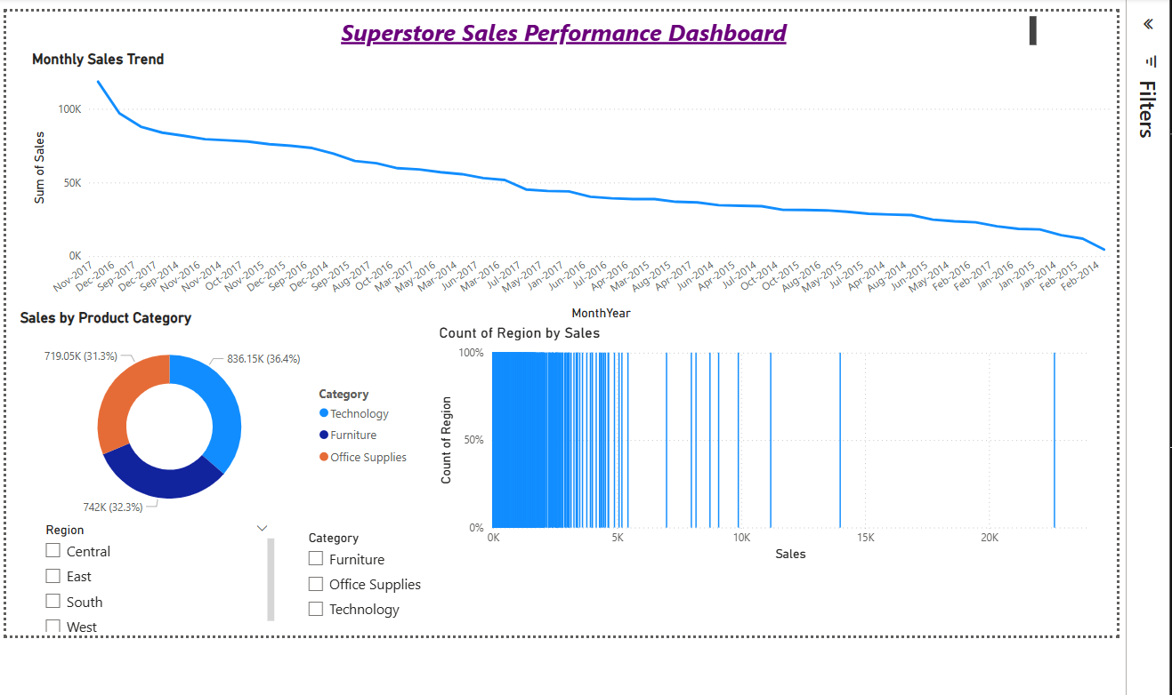

Slide 3
Regional Performance:-
The West region dominates sales, contributing 35% of total revenue, while the Central region underperforms with just 15%.
Monthly Trends:-
November sees a 40% sales spike due to holiday shopping, making it the best month for promotions.
Product Category Breakdown:-
Technology drives 48% of sales but has the lowest profit margins (15%), while Furniture delivers higher profitability (25%) despite lower sales volume.

Slide 4
CONCLUSION:-
"The West region consistently outperformed other regions in sales throughout the year."
"Technology products accounted for 45% of total sales, the highest among all categories."
"Sales peaked in November, likely due to holiday season shopping."
"The Central region showed the lowest profit margins despite moderate sales volume."

Slide 5
THANK YOU

