Slide 1


Slide 2




Contents
Managing I/O console
C++ Stream Classes
Formatted and Unformatted Console I/O
Usage of Manipulators

Slide 3

Managing I/O console
C++ supports a rich set of I/O operations.
functions and
It uses the concept of stream and stream classes to implement its I/O operations with the console and disk files.

Slide 4

C++ Streams
The I/O system supplies an interface to the programmer that is independent of the actual device being accessed.
This interface is known as stream.
A stream is a sequence of bytes.
The source stream that provides data to the program is called the input stream.
The destination stream that receives output from the program is called the output stream.

Slide 5

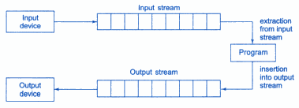
C++ Streams

Slide 6

C++ Stream Classes
The C++ I/O system contains a hierarchy of classes that are used to define various streams to deal with both the console and disk files.
These classes are called stream classes.
These classes are declared in the header file iostream.

Slide 7

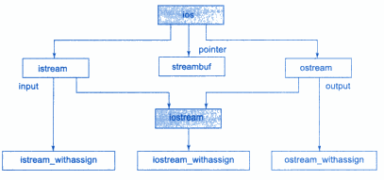
C++ Stream Classes

Slide 8

C++ Stream Classes
The class ios provides the basic support for formatted and unformatted I/O operations.
The class istream provides the facilities for formatted and unformatted input while the class ostream provides the facilities for formatted output.
The class iostream provides the facilities for handling both input and output streams.
Three classes istream_withassign, ostream_withassign and iostream_withassign add assignment opreators to these classes.

Slide 9

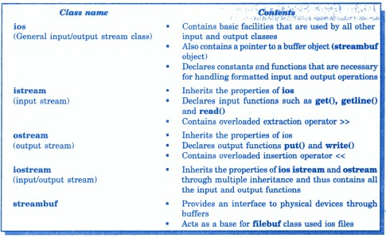
Stream classes for console operations

Slide 10
Unformatted I/O Operations
Overloaded Operators >> and <<
put() and get() functions
getline() and write() functions

Slide 11

Overloaded Operators >> and <<
The objects cin and cout are used for the input and output of data of various types by overloading >> and << operators.
The >> operator is overloaded in the istream class and << is overloaded in the ostream class.
The general format for reading data from keyboard is:
cin >> variable1 >> variable2 >> ....... >> variableN
The input data are separated by white spaces and should match
the type of variable in the cin list.

Slide 12
Overloaded Operators >> and <<
The operator reads the data character by character and assigns it to the indicated location.
The reading for a variable will be terminated at the encounter of a whitespace or a character that does not match the destination type.
Eg:
int code;
cin >> 4258D
The operator will read the characters upto 8 and the value 4258 is assigned to code.

Slide 13
Overloaded Operators >> and <<
The general form for displaying data on screen is:
cout << item1 << item2 << ..... << itemN
The items item1 through itemN may be the variables or constants of any basic type.

Slide 14

put () and get () Functions
The classes istream and ostream define two member functions get() and put() to handle the single character input and output operations.
There are two types of get() functions : get (char *) and get (void).
get(char *) version assigns the input character argument.
get(void) version returns the input character.
to its

Slide 15

put () and get () Functions
The function put() is used to output a line of text character by character.
cout.put(‘x’); -
cout.put(ch); -
DisplayWs thhaet chhaaprpaecnteifrtxhis statement is executed ?
Displays the value of variable ch.
The variable ch must contain a character value.
cout.put(68);
The statement will convert
68 to char value and display
character D.

Slide 16
getline() and write () Functions
The getline() function reads a whole line of text that ends with a newline character.
This function can be invoked by using the object cin.
cin.getline (line, size);
The function getline() which reads character input into the variable line.
The reading is terminated as soon as either the newline character is read or size-1 characters are read.

Slide 17

getline() and write () Functions
The write() function displays an entire line.
cout.write(line, size);
The first argument line represents the name of the string to be displayed and the second argument size indicates the number of characters to display.

Slide 18

Formatted I/O Operations
C++ supports a number of features that could be used for formatting the output.
ios class functions and flags
Manipulators
User-defined output functions.

Slide 19
ios class functions and flags
Functions | Task
Width() | To specify the required field size for displaying an output value.
Precision() | To specify the number of digits to be displayed after the decimal point of a float value.
Fill() | To specify a character that is used to fill the unused portion of a field.
Setf() | To specify format flags that can control the form of output display.
Unsetf() | To clear the flags specified

Slide 20

Defining Field Width: width()
The width() function to define the width of a field necessary for the output of an item.
cout.width(w);
Where w is the field width. The output will be printed in a field
of w characters wide at the right end of the field.
Eg: cout.width(5);
cout<< 543; cout.width(5); cout << 12;

Slide 21
Setting Precision: precision()
We can specify the number of digits to be displayed after the decimal point while printing the floating point numbers.
cout.precision(d);
Where d is the number of digits to the right of the decimal
point.
Eg: cout.precision(3);
- 1.141
- 3.142
cout<< sqrt(2) << “\n”;
cout << 3.14159;

Slide 22

Filling and Padding: fill()
The unused positions of the field are filled with white spaces.
However, the fill() function can be used to fill the unused positions by any desired character.
cout.fill(ch);
Where ch represents the character which is used for filling the
unused positions.
Eg: cout.fill(‘*’);
cout.width(10); cout << 5250 ;

Slide 23

Formatting Flags, Bit-fields and setf()
The setf() member function of the ios class is used for various types of formatting.
Syntax:
cout.setf(arg1, arg2)
The arg1 is one of the formatting flags, specifying the action
required for the output.
The arg2 known as bit field specifies the group to which the formatting flag belongs.
There are three bit fields and each has a group of format flags.

Slide 24

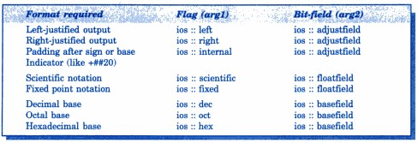
Formatting Flags, Bit-fields and setf()

Slide 25
#include <iostream> using namespace std; int main(void){ cout << true << " " << false << endl; cout.setf(ios_base::boolalpha); cout << true << " " << false << endl; cout << 192.168 << " "; cout.setf(ios_base::scientific, ios_base::floatfield); cout << 192.168 << endl;

Slide 26
cout.width(30); cout << "Saluton, Mundo!" << endl; cout.setf(ios_base::left, ios_base::adjustfield); cout.width(30); cout << "Saluton, Mundo!" << endl; return 0; }

Slide 27

Formatting Flags, Bit-fields and setf()
Consider the following segment of code:
cout.fill(‘*’);
cout.setf(ios::left, ios::adjustfield); cout.width(15);
cout<< “TABLE 1” << “\n”;
Will produce the following output:

Slide 28
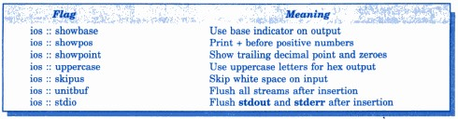
Displaying trailing zeros and Plus sign
The setf() can be used with a single argument for achieving various format of output.
Their are some flags that do not have bit fields.

Slide 29
Managing Output with Manipulators
The header file iomanip provides a set of functions called manipulators which can be used to manipulate the output formats.
They provide the same features as that if the ios member functions and flags.
Manipulators can be used as a chain in one statement as:
cout << manip1 << manip2 << mainp3 << item; cout << mainp1 << item1 << manip2 << item2;

Slide 30
Manipulators and their meaning
Manipulator | Meaning | Equivalent
setw ( int w ) | Set the field width to w. | width()
setprecision ( int d) | Set the floating point precision to d. | precision()
setfill ( int c) | Set the fill character to c. | fill()
setiosflags ( long f ) | Set the format flag f. | setf()
resetiosflags ( long f) | Clear the flag specified by f. | unsetf()
endl | Insert new line and flush stream. | “\n”

Slide 31

Managing Output with Manipulators
Examples:
cout << setw(10) << 12345;
Prints the value 12345 right justified in a field width 10.
cout << setw(10) <<setprecision(4) << sqrt(2);
Prints the value of sqrt(2) with 4 decimal places in the field width 10.
cout << endl;
Inserts a new line.

Slide 32

User-defined output functions
The programmer can also define his own manipulator according to the requirement of the program.
Syntax:
ostream & m_name (ostream & o)
{
statement 1;
statement 2;
return 0;
}
The m_name is the name of the manipulator.

Slide 33
User-defined output functions
ostream & tab (ostream & o)
{
o << “\t”;
return o;
}
void main()
{
clrscr();
cout << 1 << tab << 2 << tab << 3 ;
}

Slide 34

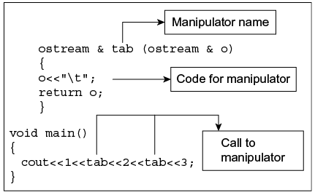
Working of tab manipulator

Slide 35

Summary
is a sequence of bytes and serves as a source or
destination for an I/O data.
The source stream that provides data to the program is called
stream and the destination stream that receives output
from the program is called stream.
The istream and ostream classes define two member functions
and to handle the single character I/O operations.
The >> operator is overloaded in the class and an
extraction operator << is overloaded in the class.
The functions width(), precision(), fill(), setf() for formatting the
output are present in class.
provides a set of manipulators functions to manipulate output formats.

Slide 36

Short Answer Questions
Discuss the various forms of get() functions supported by the input stream. How are they used?
There are two types of get() functions : get (char *) and get (void).
get(char *) version assigns the input character to its argument.
get(void) version returns the input character.

Slide 37
Short Answer Questions
How do the following two statements differ in operation?
cin >> c;
cin.get(c);
The first statement using the overloaded >> operator will skip
the white spaces and newline character.
The second statement will fetch a character including the blank space, tab and newline character.

Slide 38

Short Answer Questions
What does the following statement do?
cout.write(s1,m).write(s2,n);
The above statement is used to concatenate two strings using the write() function.
What is the difference between put() and write() ?
The put() is used to output a line of test character by character.
The write() is used to display an entire line.

Slide 39
Short Answer Questions
What will be the output of following statements: cout.setf(ios :: showpoint);
cout.setf(ios :: showpos); cout.precision(3);
cout.setf(ios :: fixed, ios :: floatfield);
cout.setf(ios :: internal, ios :: adjustfield); cout.width(10);
cout << 275.5 << “\n”;

Slide 40
Short Answer Questions
What is the basic difference between manipulators and ios member functions in implementation? Give examples.
Manipulators are more convenient to use than compare to ios member functions.
The manipulators cab ne used as a chain in one statement as:
cout << manip1 << manip2 << manip3 << item;

Slide 42
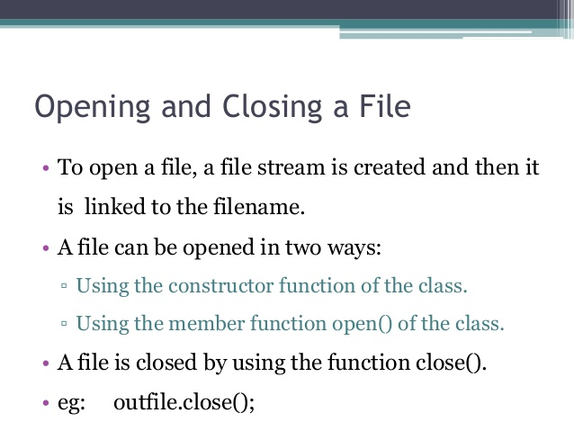

Slide 44

References
Object Oriented Programming with C++ by E. Balagurusamy.

Slide 45


