Slide 1
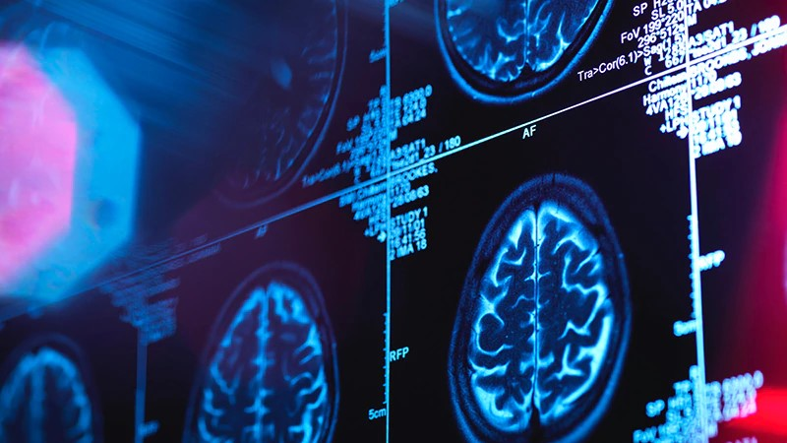
Brain Tumor Detection
Team 17

Slide 2
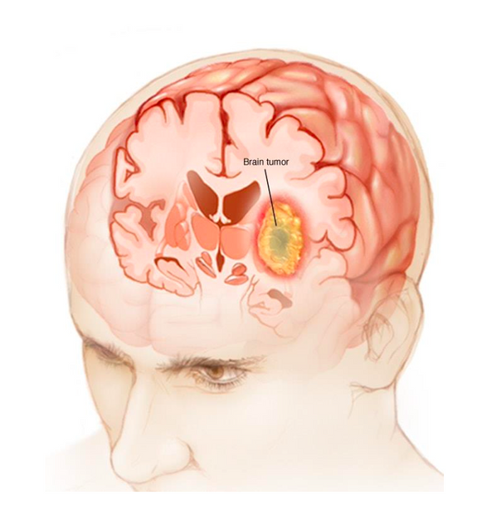
AGENDA
1.Introduction
2.Objective
3.Literature survey
4.Problem statement
5. Proposed solution
6.Inference
7.References

Slide 3
INTRODUCTION
Brain tumors refer to abnormal growths of cells within the brain or surrounding tissues. They can be either benign (non-cancerous) or malignant (cancerous).
Common symptoms include headaches, seizures, cognitive changes, and neurological deficits.
Diagnosis typically involves imaging tests like MRI or CT scans, followed by biopsy for confirmation.
Treatment options include surgery, radiation therapy, and chemotherapy, depending on the tumor type, location, and patient's overall health.

Slide 4
OBJECTIVE
The objective of this project is to develop an accurate and efficient brain tumor detection system using advanced imaging techniques and machine learning algorithms, with the goal of improving early detection rates, facilitating timely interventions, and enhancing patient outcomes.
The project aims to achieve higher accuracy in tumor identification, reduce false positives and false negatives, and provide a reliable tool for healthcare professionals to aid in the diagnosis and treatment planning of brain tumors

Slide 5
LITERATURE SURVEY

Slide 6
Source Information | Praveen Kumar; Anjana Pandey; Mahesh Kumar (2021) | Mukul Aggarwal; Amod Kumar Tiwari; M Partha Sarathi; Anchit Bijalwan (2023) | Khadija Elaissaoui; Mohammed Ridouani (2023)
Research topic/question | Tumor detection in an MRI brain image using optimization techniques and CNN. | An early detection and segmentation of Brain Tumor using Deep Neural Network | Application of Deep Learning in Healthcare: A Survey on Brain Tumor Detection.
Methodology | Preprocessing Segmentation Feature Extraction Whale Optimization Algorithm CNN (Activation Function: ReLU-element-wise) | Tumor segmentation based on the Residual Network (ResNet). | Preprocessing Feature Extraction Segmentation U-Net Architecture
Findings | DBN classifiers provided 94.11% accuracy while this model provides 98.9% accuracy. | The accuracy is 82.5% to 87.9% by improving the model accordingly. Decreases the computational time. | Including small layers of preprocessing increases the accuracy from 86.87% to 88.44%
Limitations | The preprocessing and feature extraction increases the computational time. | In spite of reducing the preprocessing, the accuracy decreases. | The accuracy increases but not much as comparison to the previous CNN model.
Areas for future research | Time complexity can be reduced and architectures can be added. | Hybrid model can be implemented. | Data Augmentation and Transfer Learning must be added.

Slide 7
Models
VGG 19
Inception V3
Image Preprocessing
Data Augmentation
Epochs=30
Accuracy=98
Data Augmentation
Epochs=25
Accuracy=91

Slide 8
Problem Statement
The problem of low accuracy in brain tumor detection necessitates the development of a hybrid model that combines multiple techniques to improve detection rates.
The manual interpretation of brain tumor images is time-consuming and requires specialized skills, motivating the need for an efficient hybrid model that automates the detection process.
By integrating deep learning methods with traditional approaches, the hybrid model can leverage the strengths of both to accurately identify brain tumors based on structural and texture-based features

Slide 9
Solution
Imaging: Conduct MRI or CT scans to capture detailed brain images.
Segmentation: Use image processing techniques to segment and isolate tumor regions.
Feature Extraction: Extract relevant features from the segmented tumor regions.
Classification: Utilize machine learning algorithms to classify tumors as benign or malignant.
Validation: Validate the model's performance using evaluation metrics and compare against ground truth data for accuracy

Slide 10
Code
Trial 1
Normal Concatenation of two models
Accuracy=51%

Slide 11
Code
Trial 2
Addition of Preprocessed Images
Accuracy=62.5%

Slide 12
Code
Final Model
Preprocessed Images
Transfer learning:
-Early Stopping
-Data Augmentation
-Decreasing learning Rate

Slide 13
Inference
The development of a hybrid model for brain tumor detection addresses the limitations of existing methods, improving accuracy and reducing the risk of misdiagnosis.
By automating the detection process and leveraging complementary techniques, the hybrid model enables faster and more efficient diagnosis, potentially saving patients' lives.
The integration of clinical information enhances the comprehensive analysis, leading to more accurate tumor detection and improved

Slide 14
THANK YOU
Sanjana Mitra
SCOPE
21BCE8418

