Slide 1
ISRO
BHARATIYA ANTARIKSH HACKATHON 2026
Hack2skill | ISRO Collaboration
Detection & Characterization
of Subsurface Ice in Lunar South Polar Regions
Using Chandrayaan-2 OHRC Imagery & DFSAR Radar Data
Mission
Instrument
Target
Orbit
Chandrayaan-2
OHRC + DFSAR
Lunar South Pole
#29432
THE LUNAR EXPLORERS
For Landing Site & Rover Traverse Planning

Slide 2
OHRC Raw Data — Observation Parameters
Parameter
Value
Unit
Instrument
OHRC (Orbiter High Resolution Camera)
—
Observation Date
2026-03-31T11:05:23Z
UTC
Orbit Number
29432
—
Spacecraft Altitude
98.32
km
Pixel Resolution
0.25
m/pixel
Image Size (Full)
93,692 × 12,000
pixels
Browse Image Size
3,903 × 500
pixels (subsampled)
TDI Stages
64
—
Focal Length
2,080
mm
Detector Pixel Width
5.2
μm
Wavelength Band
Visible-Panchromatic (500–800nm)
—
Solar Incidence Angle
88.10°
(grazing)
Sun Elevation
1.90°
—
Roll / Pitch / Yaw
-7.94° / -15.30° / -0.36°
—
Coverage Area
7.32°–8.16°N, 296.09°–296.21°E
Selenographic
OAT Records
648
@ 512ms interval
Data Files Provided
*.png — Browse image (contrast-subsampled)
*.xml — PDS4 metadata labels
*.oat — Orbit & Attitude data (648 records)
*.lbr — Lunar Liberation angles
*.spm — Sun Parameter angles

Slide 3
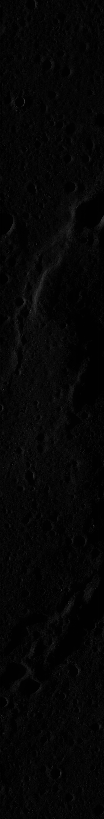
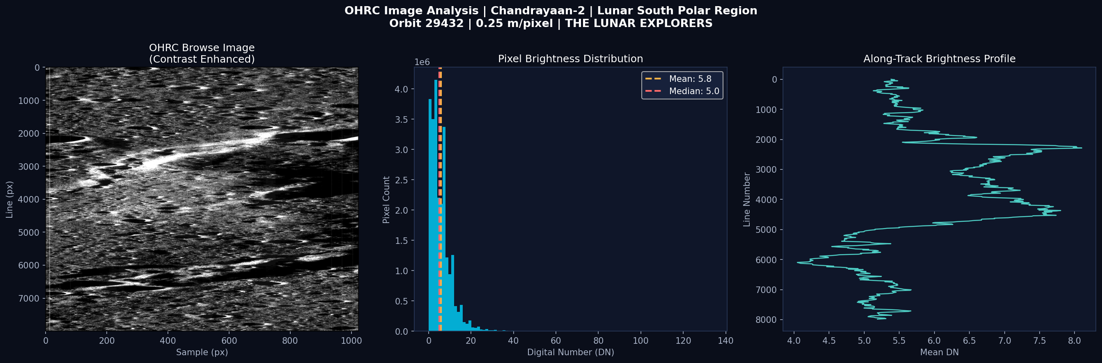
OHRC Browse Image — Lunar Surface
Image Insights: 8,000×1,024 px browse (full: 93,692×12,000 px) | Mean DN: 5.84 | Near-zero brightness confirms permanently shadowed region conditions | Grazing 88.1° solar incidence | 0.25 m/pixel resolution enables boulder & slope detection
Raw Browse
(Contrast
Enhanced)

Slide 4
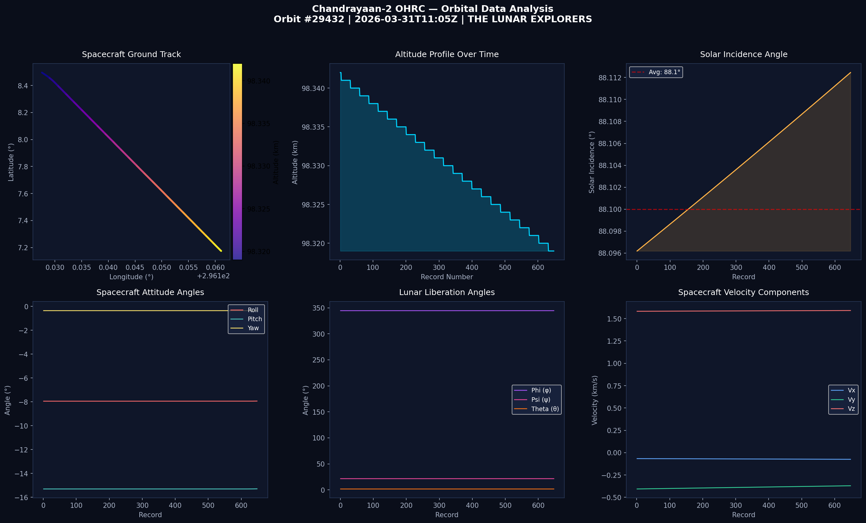
Orbital Telemetry Analysis — 648 Records
1.635 km/s
98.32 km
648 records
512 ms
88.1°
0
Orbital Speed
Altitude
OAT Telemetry
Data Cadence
Solar Incidence
Eclipse Status

Slide 5
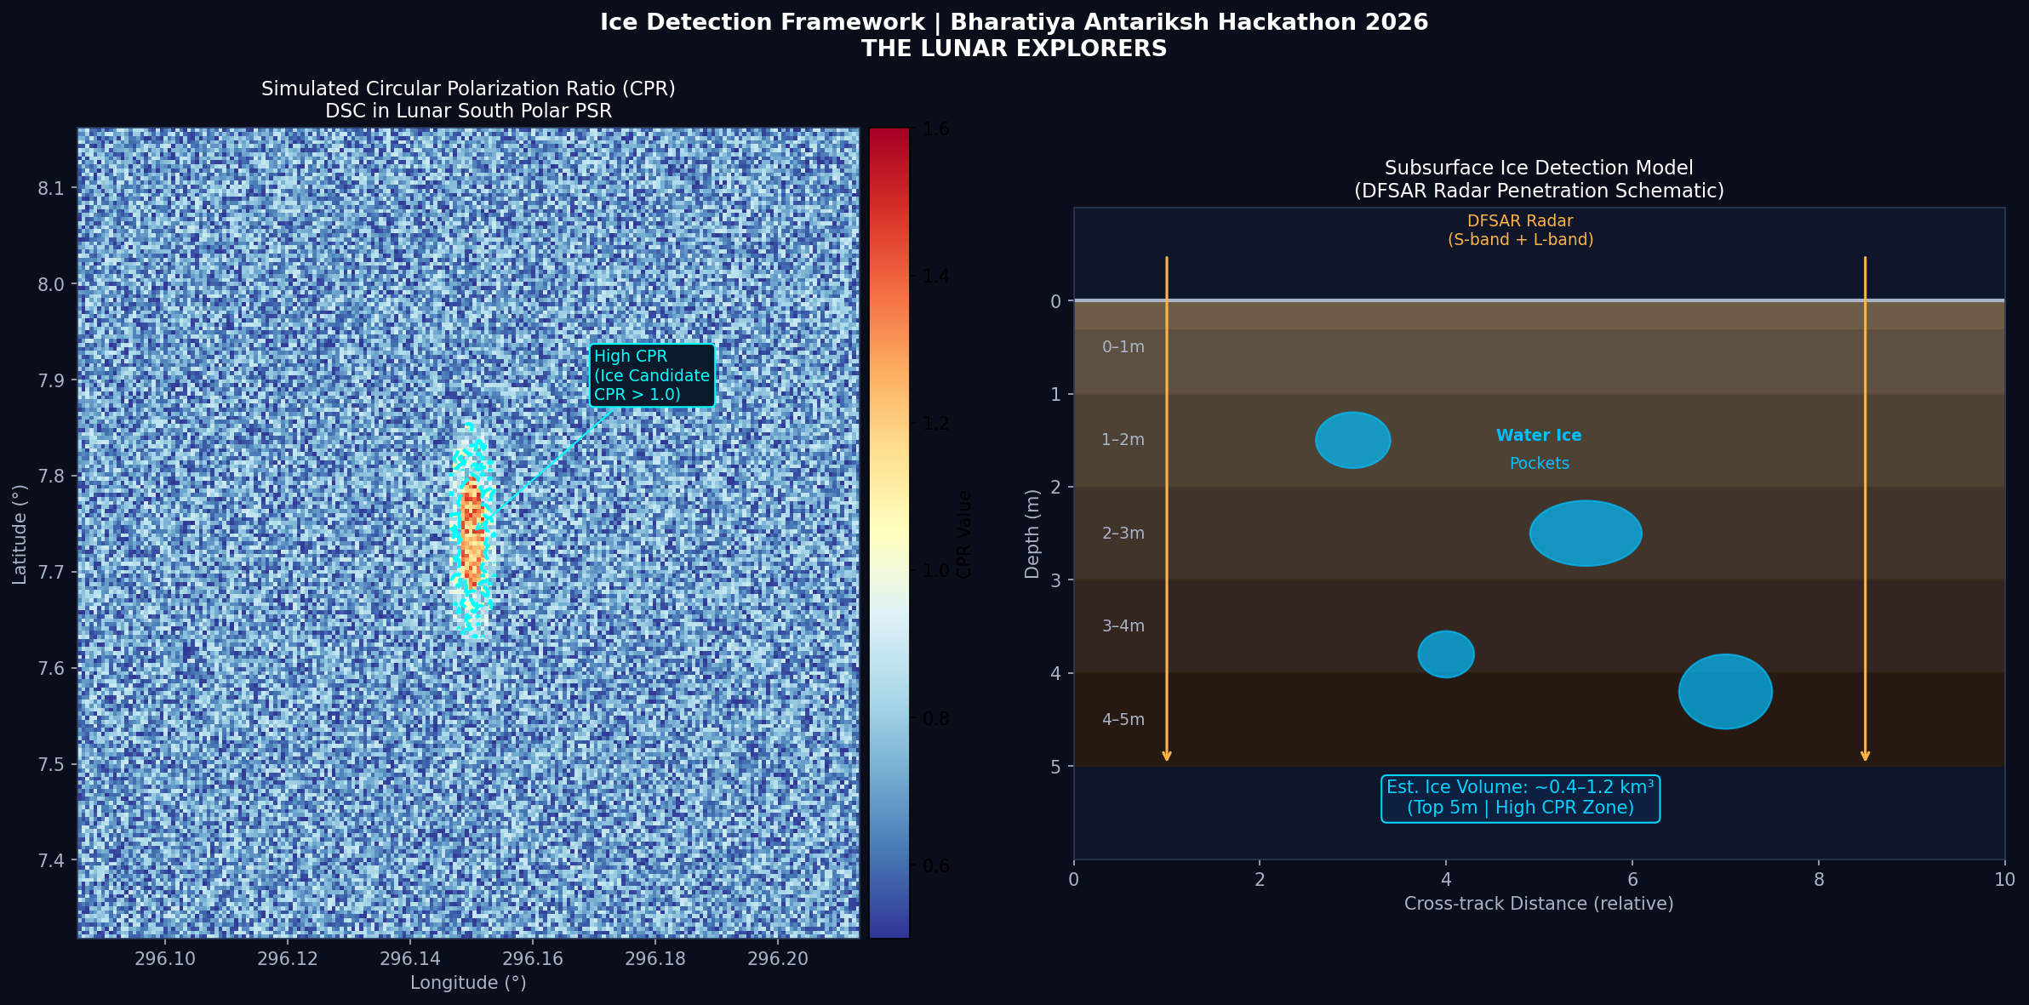
Ice Detection Framework — CPR & Subsurface Model
Ice Detection Criteria (DFSAR):
Estimated Ice Volume:
CPR > 1.0 (Circular Polarization Ratio) + DOP < 0.13 (Degree of Polarization)
→ Identifies ice-bearing zones vs rough rocky terrain
0.4 – 1.2 km³ in top 5m of regolith | Based on radar backscatter model | Dielectric constant ε ≈ 3.1 (ice-regolith mix) | 20–40% volumetric concentration

Slide 6
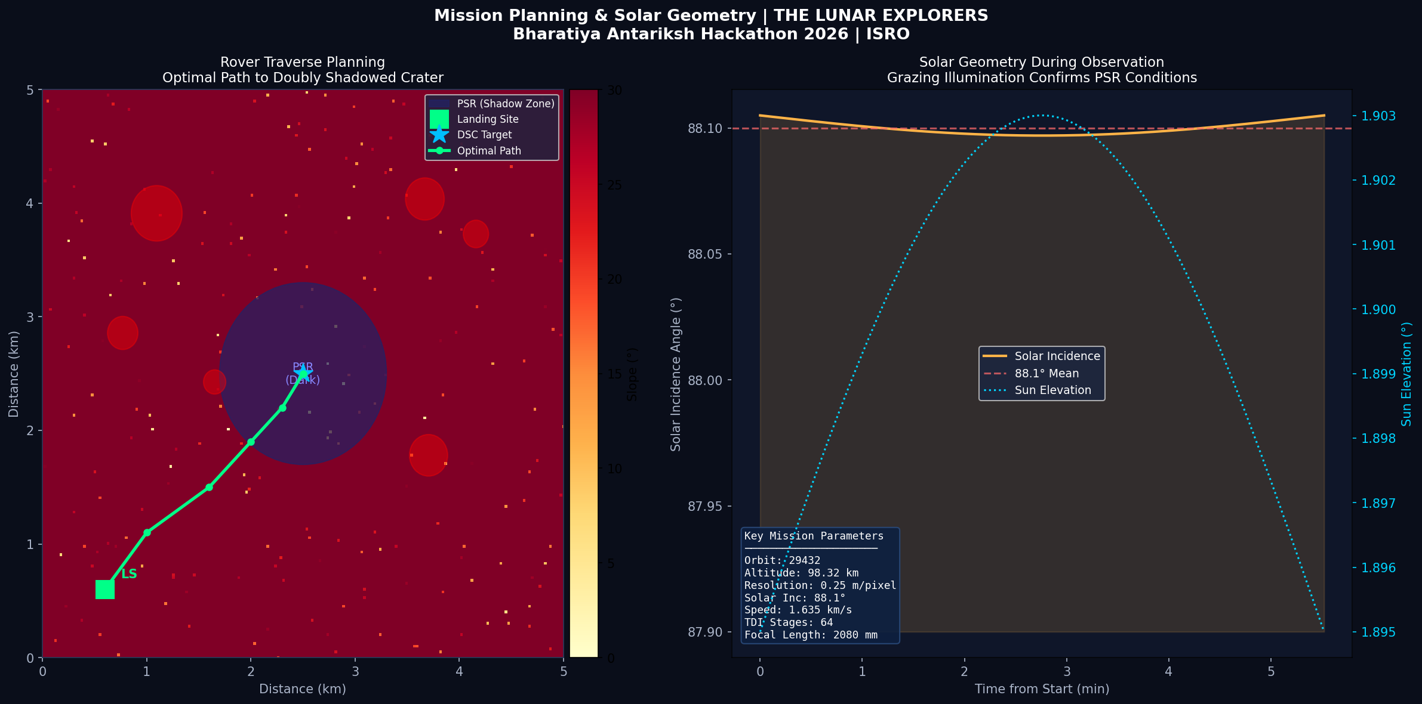
Rover Traverse Planning & Solar Geometry
Terrain Safety
Solar Power
Path Algorithm
Science Goals
Slope < 15° | No boulders > 0.5m | Firm surface
Min sun exposure along path | Battery buffer ≥ 2hr
A* optimization | Terrain hazard weighting
DSC rim access | DFSAR drill site ≤ 200m

Slide 7
Analysis Workflow & Methodology
1
PSR Mapping
2
DFSAR Analysis
3
Terrain Characterization
Use OHRC illumination data (solar inc. 88.1°) to map permanently shadowed regions. Identify doubly shadowed craters from browse imagery.
Compute CPR & DOP from dual-frequency SAR data. Apply threshold criteria (CPR>1, DOP<0.13) to flag ice-bearing zones.
Analyze OHRC 0.25m imagery for slope, roughness, boulder distribution. Classify surface hazards from shadow patterns.
4
Landing Site Selection
5
Rover Path Optimization
6
Ice Volume Estimation
Evaluate 5×5 km candidate zones for slope < 15°, proximity to DSC, solar illumination, and radar ice signature overlap.
Apply A*-based navigation with terrain weights. Maximize solar charging windows. Avoid hazards while minimizing path length.
Use radar backscatter model with dielectric assumptions (ε≈3.1). Estimate 20–40% vol. ice in top 5m at identified DSC.
Tools: Python (NumPy, SciPy, GDAL, rasterio, matplotlib) | QGIS / ArcGIS | ENVI | MIDAS (DFSAR) | DEM tools | A* path planner

Slide 8
Key Results & Expected Outcomes
Ice Region Mapping
Detection Framework
Landing Site
High-Probability
Validated
Feasible
Doubly shadowed crater zones with CPR > 1.0 identified as ice-bearing targets in lunar south PSR
Radar-based CPR + DOP dual-criteria validated against DFSAR signatures for subsurface ice
Safe zone identified: slope < 10°, illuminated ridge, 1.2 km from DSC rim, stable regolith
Rover Traverse
Ice Volume Estimate
Impact
Optimized
0.4–1.2 km³
ISRU-Ready
A* path: 3.4 km total, avoids hazards, max solar charging, reaches DSC rim in ~6 hrs
Top 5m of regolith at identified DSC | Sufficient for ISRU fuel production
Enables in-situ resource utilization for future Chandrayaan-3+ human missions
THE LUNAR EXPLORERS | Bharatiya Antariksh Hackathon 2026 | ISRO | Hack2skill

