Slide 1
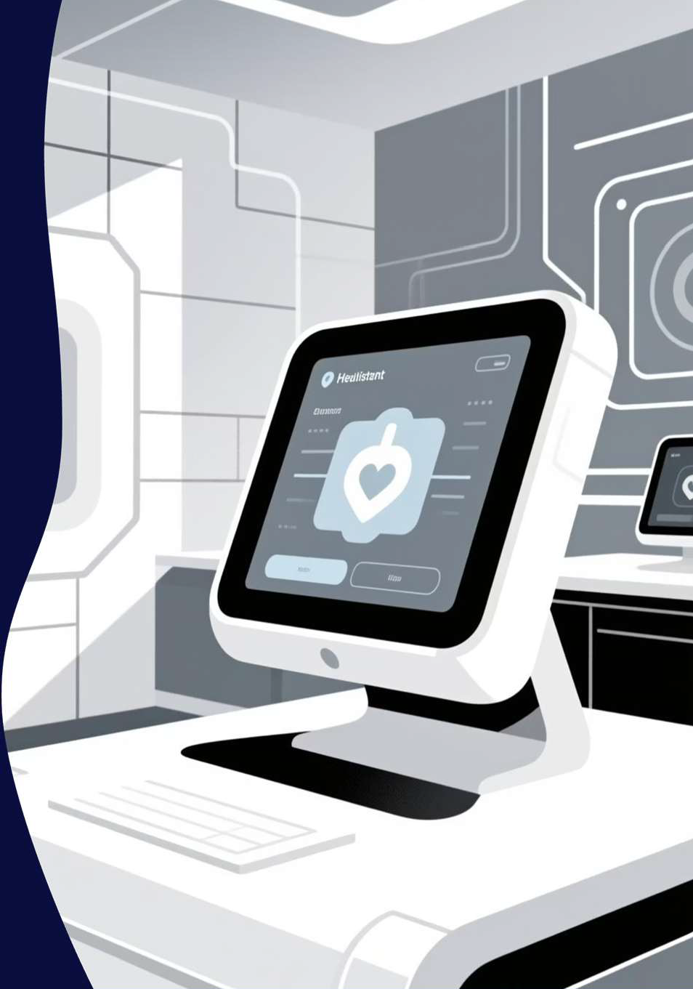
HealthWellness Assistant
An AI-powered multilingual health chatbot revolutionising healthcare accessibility
Presented by: Shilpa Chinnakkagari, Sanjana Sree, Nimmaganti Harika
Under the Guidance of: Pavithra Venugopal - Mentor

Slide 2


Bridging Healthcare Accessibility Gaps
The Problem Statement
Where can patients get 24/7 medical guidance
How can non-English speakers access healthcare in their language?
How can patients track wellness between doctor visits?
Our Innovation
An intelligent, multilingual health assistant delivering:
Instant medical guidance in English and Hindi
Continuous health progress monitoring
Integrated emergency response capabilities
Comprehensive admin analytics dashboard

Slide 3
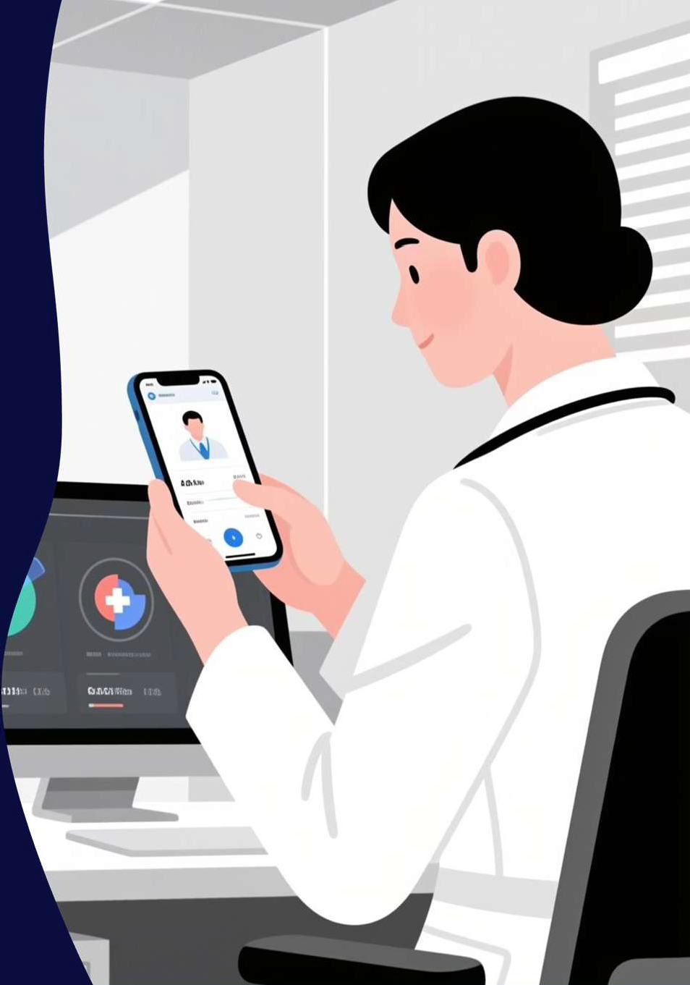




Empowering Users with Intelligent Features
AI Symptom Analysis
Advanced diagnostic assistance powered by machine learning
Multilingual Support
Seamless communication in English and Hindi
Health Score Tracking
Real-time wellness metrics and progress visualisation
Emergency Response
Instant assistance simulation for critical situations
Target Audience: Patients seeking immediate medical guidance and hospitals requiring efficient patient monitoring solutions

Slide 4





Comprehensive User Experience
AI Health Consultation
Intelligent symptom checking with conversational AI providing preliminary diagnosis and healthcare recommendations
Progress Monitoring
Daily health score tracking with intuitive visual charts showing wellness trends over time
Emergency Support
Quick access to emergency assistance with instant contact simulation and critical care guidance
Personalised Management
Complete profile control, chat history access, and feedback submission for continuous improvement

Slide 5
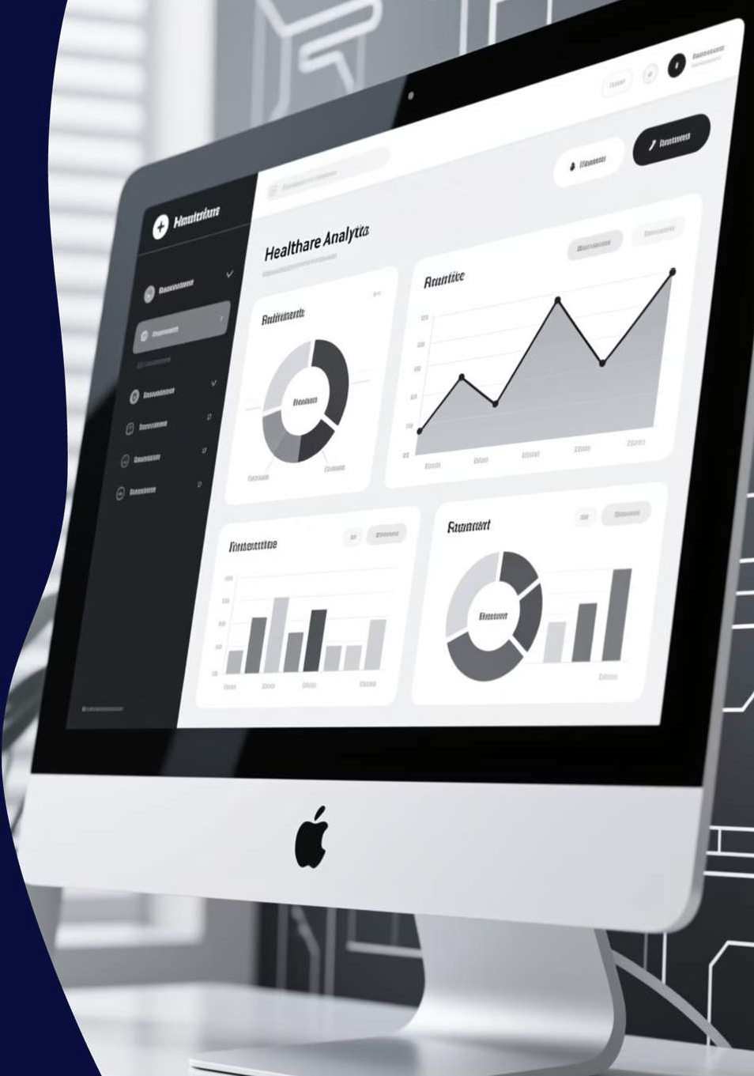
Powerful Admin Capabilities
01
User Management
Complete oversight of user accounts, registrations, and activity monitoring
02
Content Administration
Dynamic health tip management and educational content curation
03
Analytics Dashboard
Real-time insights with comprehensive reporting in PDF and CSV formats
04
Incident Monitoring
Emergency tracking, feedback analysis, and system performance evaluation

Slide 6







Robust Technology Architecture
Frontend Layer
HTML5, Bootstrap 5, JavaScript, and Chart.js delivering responsive, intuitive user interfaces
Backend Infrastructure
Flask and Python REST APIs with SQLite database and SQLAlchemy ORM ensuring efficient data management
AI/ML Engine
Hugging Face Transformers, MarianMT for translation, PyTorch, and SentencePiece powering intelligent responses
Security Framework
JWT tokens and Flask-Login ensuring data privacy with Docker-based cloud-ready deployment

Slide 7

Strategic Objectives Driving Impact
Primary Goals
Deliver accessible 24/7 AI-driven health support to underserved communities
90%
User Satisfaction
Enable multilingual healthcare access breaking language barriers
Target achievement rate
Track and visualise user wellness progress for informed health decisions
<2s
Response Time
Ensure robust data privacy and security compliance
Reduce unnecessary routine hospital visits through preliminary screening
Lightning-fast interactions
Improve health literacy across diverse demographic groups
85%
AI Accuracy
Diagnostic precision goal

Slide 8




Seamless System Workflow
User Journey
Admin Operations
Authentication & Profile Setup
Secure login with personalised profile creation
Dashboard Overview
Comprehensive system analytics at a glance
AI Consultation
Interactive chat receiving intelligent health advice
Data Management
User analytics and content administration
Progress Tracking
Reporting & Monitoring
Monitor wellness scores and access emergency support
Generate insights and track system performance
Integration: Real-time data synchronisation ensures seamless coordination between user interactions and administrative analytics

Slide 9
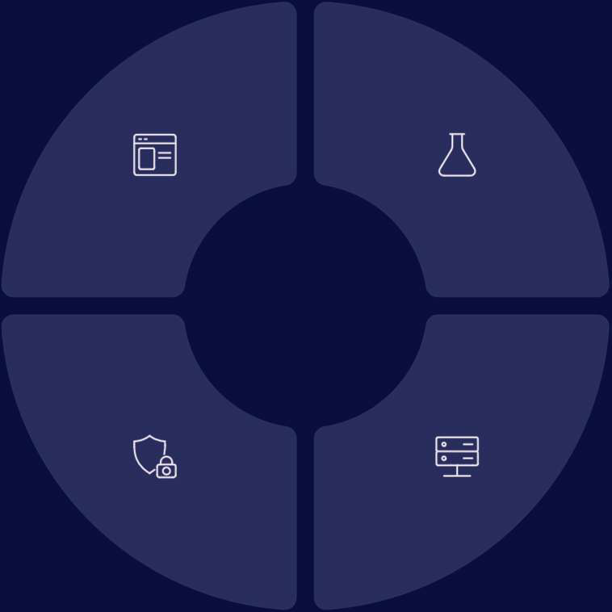

Cutting-Edge Technology Stack
Frontend Technologies
Bootstrap 5 for responsive design, Chart.js for data visualisation, and JavaScript for interactive
experiences
Backend Framework
Flask microframework with Python, SQLAlchemy ORM, and SQLite for efficient server-side operations
Security & Deployment
JWT authentication, Werkzeug utilities, Flask-Login, Docker containerisation, and cloud platform compatibility
AI/ML Components
Hugging Face Transformers for NLP, PyTorch for deep learning, and advanced language models

Slide 10





Transforming Healthcare Delivery
Hospital Integration
Patient monitoring, preliminary screening, and streamlined support workflows
Telemedicine Enhancement
Preliminary diagnosis and triage before virtual consultations
Rural Healthcare Access
Corporate Wellness
Employee health tracking and preventive care programmes
Breaking language barriers in underserved communities
Future Vision
Expanding capabilities with native mobile applications, wearable device integration, and advanced AI diagnostics powered by cutting-edge machine learning models

